Slide 1

Drawing Actionable Insights from an Analysis of Unstructured Data: The case of Text Analytics
Dr. Sridhar Panchapakesan Nerur
Professor, Information Systems & Operations Management

Slide 2

Outline of Presentation
Introduction
Overview of Text Analytics
Research Examples
Tools for Text Analysis
Text Analysis with Python

Slide 3
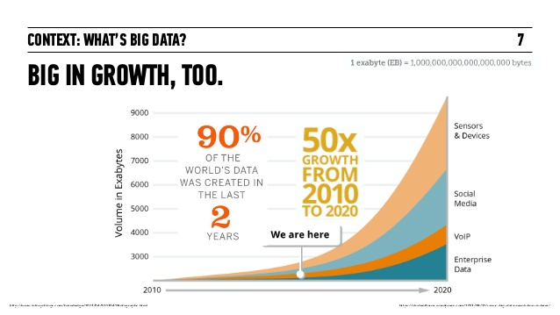
INTRODUCTION

Slide 4
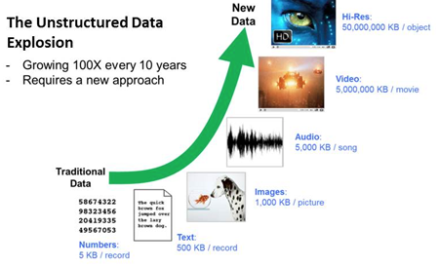

Slide 5
Overview of Text Analytics
Unstructured text data is being generated all the time
Text analytics / Text Mining involves techniques and algorithms for analyzing text
Traditional data mining techniques may be used if text is converted to numerical vectors

Slide 6
Why text analytics?
Classification – spam/no spam, does a document belong to a particular class?
Clustering - grouping together documents/reviews/customer complaints, etc.
Assessing similarity of documents
Identifying authors of a document/text
Predictions – can customer reviews predict sales?

Slide 7
Some more reasons…..
Sentiment Analysis
Positive and Negative Emotions
Assessing opinion polls
Psychological Insights (agreeableness, conscientiousness, introversion, extraversion, emotional range, …..)
Modeling topics

Slide 8
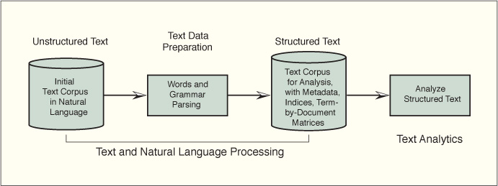
From Text Processing to Text Analytics
Source: Modeling Techniques in Predictive Analytics with Python and R: A Guide to Data Science by Thomas W. Miller (0133892069) Copyright © 2015 Pearson Education, Inc. All rights reserved.

Slide 9
EXAMPLES FROM RESEARCH

Slide 10
BACKGROUND
It is apparent that statistics plays a key role in research – our interest is in business research
Can this be affirmed through an analysis of secondary data?
Specifically, how are statistics journals related to business journals in terms of lexical structure?

Slide 11
Research Methodology
Two basic approaches to assessing influence:
Bibliometric analysis (e.g., citations)
Text Analysis
Whiteside, Eakin & Nerur (Joint Statistical Meeting, 2015) used citation patterns to assess the extent of conceptual interaction between business and statistics journals

Slide 12
Why Text Analysis?
Among other things, citations disregard context
Text Analysis allows us to examine lexical similarity between journals
Citation and text analyses together can offer more insights than either one alone

Slide 13
METHODOLOGY
36 journals – 19 business and 17 statistics – were used in our analysis
To assess the changing influence of statistics journals on business, we analyzed data from 2000, 2005, 2010 and 2015
Abstracts from each of the journals were downloaded from the Web of Science

Slide 14
STEPS USED
Abstracts were preprocessed
converted to lowercase, removed stopwords, removed punctuation and digits
generated document-term matrix
For each time period, the cleansed data were used to:
generate a word cloud
perform hierarchical and K-Means cluster analysis and multidimensional scaling
extract topics using Latent Dirichlet Allocation (LDA)

Slide 15
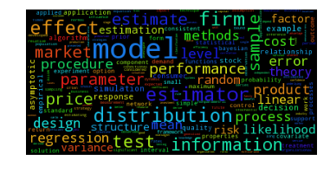
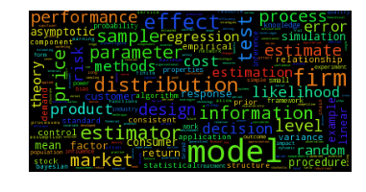
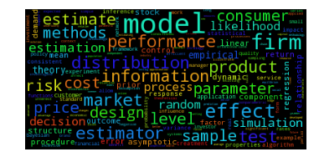
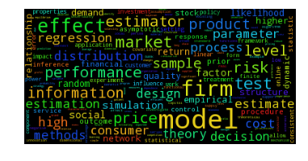
WORD CLOUD
2000
2005
2010
2015

Slide 16
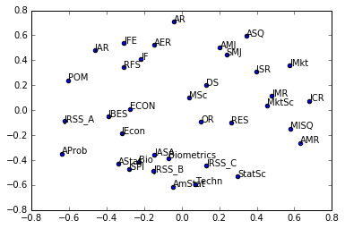
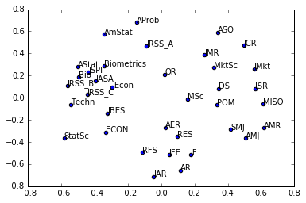
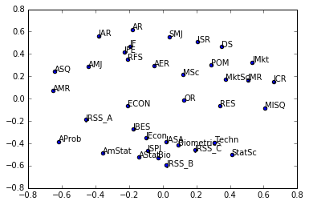
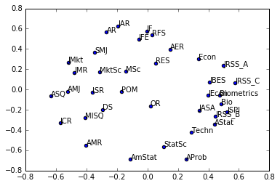
2000
2005
2010
2015

Slide 17
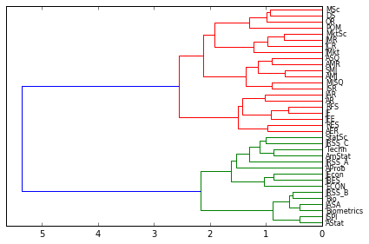
Cluster Analysis - 2000

Slide 18
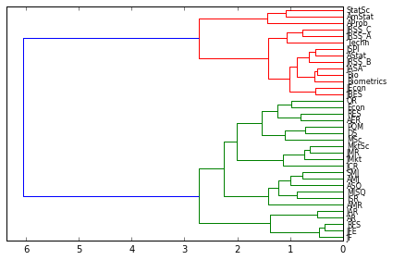
Cluster Analysis - 2015

Slide 19
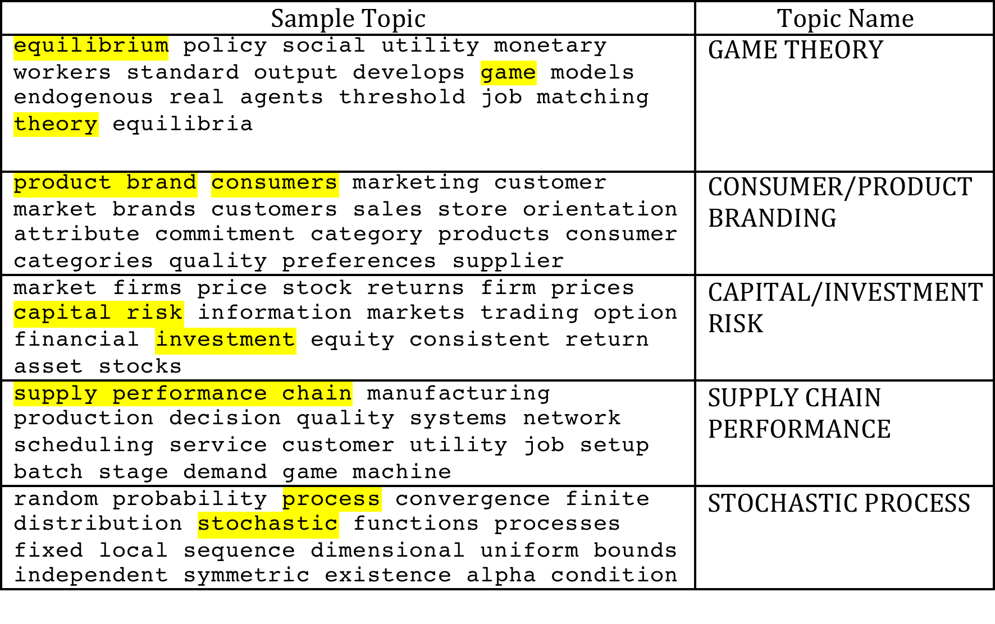
SAMPLE TOPICS IN 2000

Slide 20
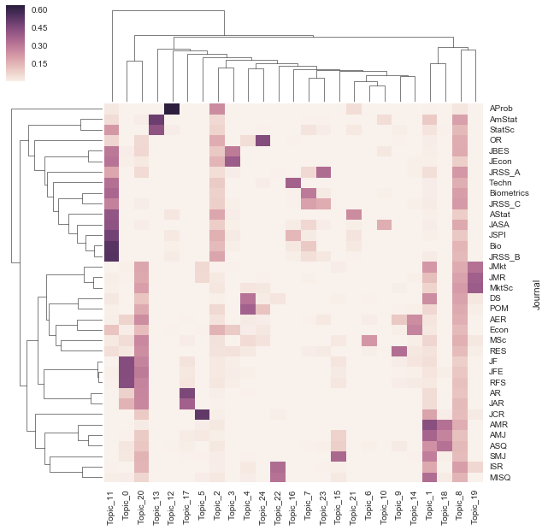

Slide 21
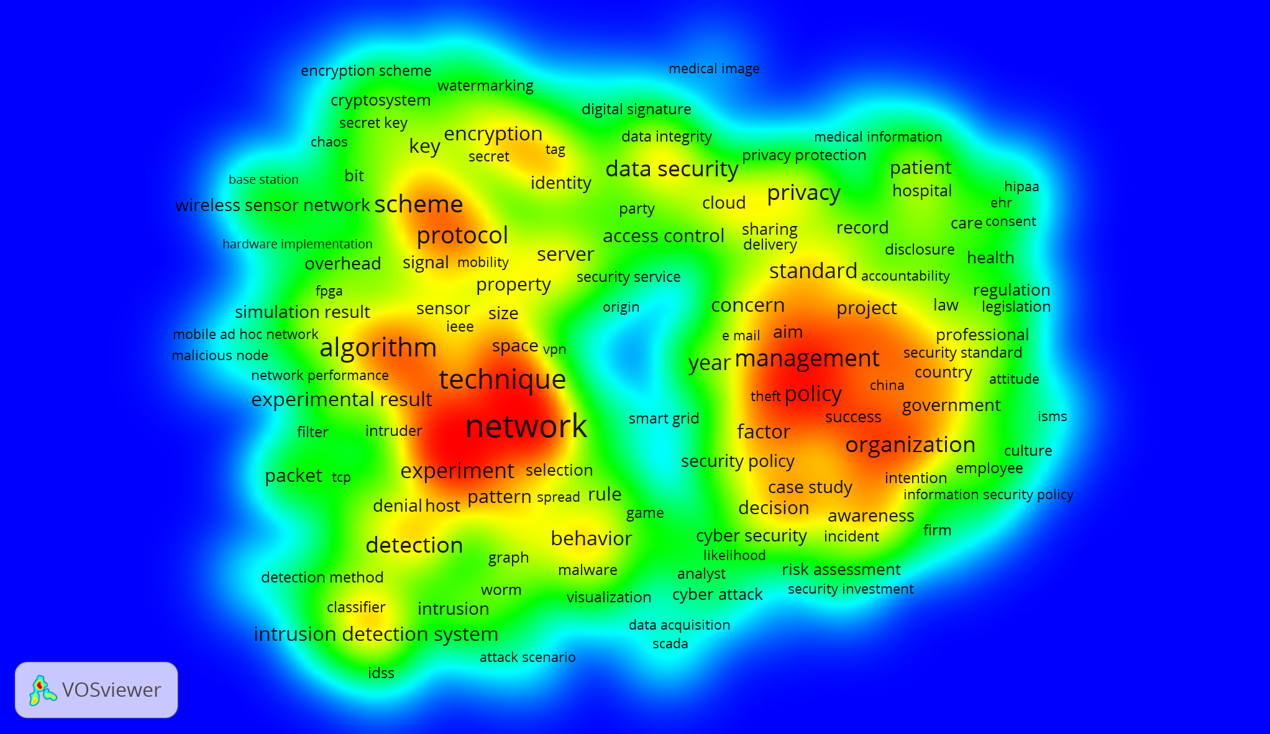
TOP WORDS RELATED TO CYBERSECURITY

Slide 22
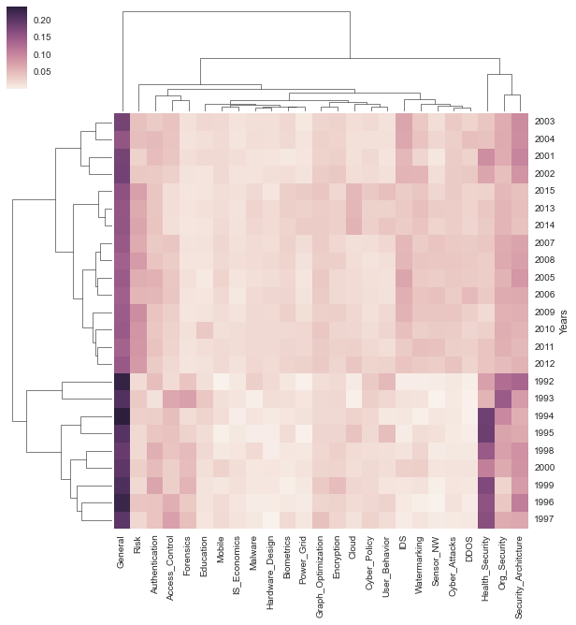

Slide 23
Knowledge Sharing Behaviors in a Co-opetitive Environment
Kaggle – a crowdsourcing platform
Why do participants share knowledge on Kaggle?
IBM Watson’s Alchemy API was used to get social tones (Big Five personality model)
Agreeableness, openness, and conscientiousness were found to be positively associated with knowledge sharing behavior

Slide 24
Other Projects
Tracking Student Discussions of What Counts as Healthy: Focus Group Data of the Language of Pre-Diabetic Populations (With Stvan Laurel & Rebecca Garner)
Changes in Vernacular Perspectives on Health: Medieval to Modern Texts Highlighting Food and Health (With Stvan Laurel & Jacqueline Fay)

Slide 25
Other Projects
CEO Narcissism – analysis of CEO letters as well as images of CEOs
The relationship between readability of Annual Reports/10k statements and firm performance
Influence of language on problem understanding/problem solving

Slide 26
Readability Measures
Flesch Reading ease: 52.53
Smog Index: 8.8
Flesch Kincaid Grade: 12.6
Coleman Liau Index: 11.61
Automated Readability Index: 15.5
Dale Chall Readability Score: 7.86
Difficult Words: 15
Linsear Write Formula: 15.0
Gunning Fog: 12.8

Slide 27
Tools for Text Analysis
Python, R, PySpark, Scala
APIs
Google Cloud Platform’s NLP
IBM Watson’s Alchemy API
Remedies for taming Text (www.rxnlp.com)
LIWC

Slide 28
IBM Personality Insights
Five Factor Model of Personality
Values
Needs
Consumption Preferences
https://www.ibm.com/watson/services/personality-insights/

Slide 29
IBM Tone Analyzer
Emotion Tones
Social Tones
Language Tones
https://www.ibm.com/watson/services/tone-analyzer/

Slide 30
Text Analytics
Unstructured text data is being generated all the time
Text analytics / Text Mining involves techniques and algorithms for analyzing text
Traditional data mining techniques may be used if text is converted to numerical vectors

Slide 31
Why text analytics?
Classification – spam/no spam, does a document belong to a particular class?
Clustering - grouping together documents/reviews/customer complaints, etc.
Assessing similarity of documents
Identifying authors of a document/text
Predictions – can customer reviews predict sales?

Slide 32
Some more reasons…..
Sentiment Analysis
Positive and Negative Emotions
Assessing opinion polls
Being able to detect anger, neuroticism, agreeableness, and other emotional states

Slide 33
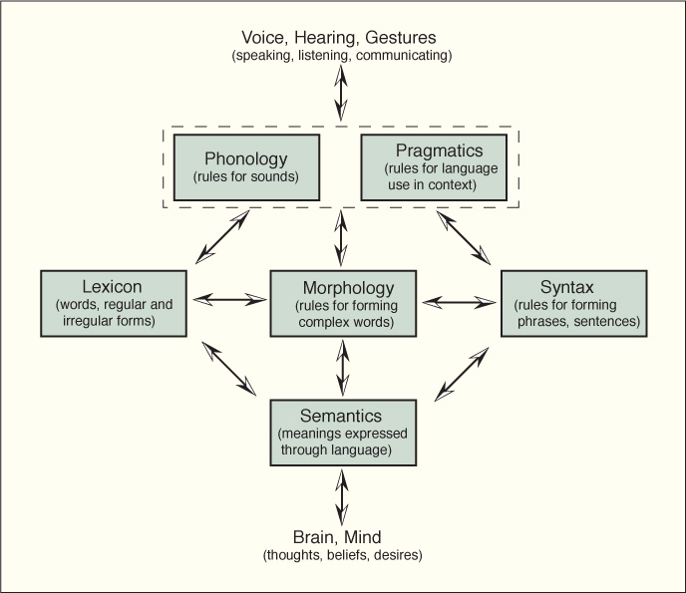
Figure 7.8. Linguistic Foundations of Text Analytics
From Modeling Techniques in Predictive Analytics with Python and R: A Guide to Data Science by Thomas W. Miller (0133892069) Copyright © 2015 Pearson Education, Inc. All rights reserved.

Slide 34
Figure 7.7. From Text Processing to Text Analytics
From Modeling Techniques in Predictive Analytics with Python and R: A Guide to Data Science by Thomas W. Miller (0133892069) Copyright © 2015 Pearson Education, Inc. All rights reserved.

Slide 35
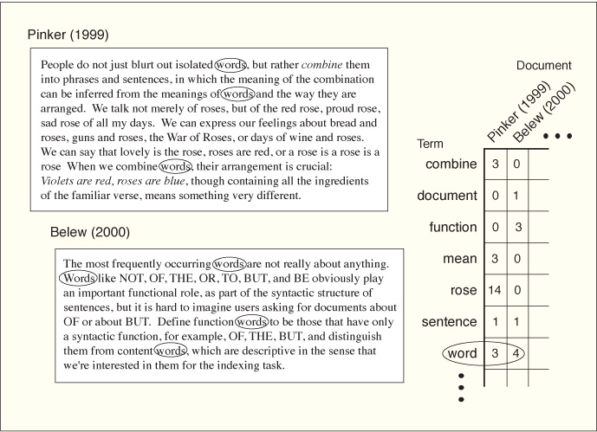
Figure 7.9. Creating a Terms-by-Documents Matrix
From Modeling Techniques in Predictive Analytics with Python and R: A Guide to Data Science by Thomas W. Miller (0133892069) Copyright © 2015 Pearson Education, Inc. All rights reserved.

Slide 36
Removing punctuation and digits
>>> s = "Hello!! 1984 is great, isn't it? So is 2015!!!"
>>> import string
>>> p = string.punctuation
>>> p
'!"#$%&\'()*+,-./:;<=>?@[\\]^_`{|}~'
>>> d = string.digits
>>> d
'0123456789'
>>> table = str.maketrans(p, len(p) * " ")
>>> s.translate(table)
'Hello 1984 is great isn t it So is 2015 '
>>> table = str.maketrans(d, len(d) * " ")
>>> s.translate(table)
"Hello!! is great, isn't it? So is !!!"
>>>

Slide 37
Stemming
import nltk
stemmer= nltk.PorterStemmer()
lst = ['force', 'forces', 'forcing']
stemmed_lst = [stemmer.stem(word) for word in lst]
stemmed_lst
Out[13]: [u'forc', u'forc', u'forc']

Slide 38
Useful Module - nltk
import nltk
#read some file in
f = open(“reviews.txt”)
#tokenize it using nltk
words = nltk.word_tokenize(f.read())
#pass words to nltk.FreqDist
freq = nltk.FreqDist(words)
#plot the top 25 words
freq.plot(25)

Slide 39
Removing Stopwords
import nltk
s = "this is to demonstrate how stopwords can be removed“
words = s.split()
stopwords = nltk.corpus.stopwords.words("english")
words = [w for w in words if w not in stopwords]

Slide 40
Using TextBlob
from textblob import TextBlob
s = """It is all a checkerboard of nights and days; Destiny with men for pieces plays""“
text = TextBlob(s)
In [67]: text.words
Out[67]: WordList(['It', 'is', 'all', 'a', 'checkerboard', 'of', 'nights', 'and', 'days', 'Destiny', 'with', 'men', 'for', 'pieces', 'plays'])
In [68]: text.sentences
Out[68]: [Sentence("It is all a checkerboard of nights and days; Destiny with men for pieces plays")]

Slide 41
Getting POS Tags and Noun Phrases in TextBlob
In[69]:text.tags
Out[69]:
[('It', 'PRP'),
('is', 'VBZ'),
('all', 'PDT'),
('a', 'DT'),…….
In[70]:text.noun_phrases
Out[70]: WordList(['destiny', 'pieces plays'])

Slide 42
Determining sentiments using TextBlob
s = 'this is a great class'
text = TextBlob(s)
In[76]:text.sentiment
Out[76]: Sentiment(polarity=0.8, subjectivity=0.75)
s = 'this is not a great class‘
In[79]:text.sentiment
Out[79]: Sentiment(polarity=-0.4, subjectivity=0.75)

Slide 43
Preprocess Text
Convert text to common case – lower or upper
Remove digits/punctuation, ‘\n’,’\r’, … (regular expressions can be useful in this regard)
Remove stopwords
Stem/lemmatize

Slide 44
Understanding Vectorizers
Vectorizers are used to transform words into numbers
Some use a CountVectorizer – just raw counts of each word in each document
I generally use TfidVectorizer, which weights words by importance, not just by frequency

Slide 45
Count Vectorizer
from sklearn.feature_extraction.text import CountVectorizer
#mock data for demo purposes
doc1 = "the moving finger writes and having writ moves on"
doc2 = "gold finger or golden finger; the question is moot"
doc3 = "he is a finger spinner and can write with it too"
doc4 = "the valiant never taste of death but once, or so they say"
doc5 = "knights are valiant and never afraid of death"
docs = [doc1, doc2, doc3, doc4, doc5]
vectorizer = CountVectorizer()
matrix = vectorizer.fit_transform(docs)
print(vectorizer.get_feature_names())
print(matrix.toarray())

Slide 46
OUTPUT
['afraid', 'and', 'are', 'but', 'can', 'death', 'finger', 'gold', 'golden', 'having', 'he', 'is', 'it', 'knights', 'moot', 'moves', 'moving', 'never', 'of', 'on', 'once', 'or', 'question', 'say', 'so', 'spinner', 'taste', 'the', 'they', 'too', 'valiant', 'with', 'writ', 'write', 'writes']
[[0 1 0 0 0 0 1 0 0 1 0 0 0 0 0 1 1 0 0 1 0 0 0 0 0 0 0 1 0 0 0 0 1 0 1]
[0 0 0 0 0 0 2 1 1 0 0 1 0 0 1 0 0 0 0 0 0 1 1 0 0 0 0 1 0 0 0 0 0 0 0]
[0 1 0 0 1 0 1 0 0 0 1 1 1 0 0 0 0 0 0 0 0 0 0 0 0 1 0 0 0 1 0 1 0 1 0]
[0 0 0 1 0 1 0 0 0 0 0 0 0 0 0 0 0 1 1 0 1 1 0 1 1 0 1 1 1 0 1 0 0 0 0]
[1 1 1 0 0 1 0 0 0 0 0 0 0 1 0 0 0 1 1 0 0 0 0 0 0 0 0 0 0 0 1 0 0 0 0]]

Slide 47
TfidVectorizer
Term Frequency
Inverse Document Frequency
Source: Pandu Nayak and Prabhakar Raghavan – Course on Information Retrieval, Stanford University

Slide 48
TfidfVectorizer Example
from sklearn.feature_extraction.text import TfidfVectorizer
#mock data for demo purposes
doc1 = "the moving finger writes and having writ moves on"
doc2 = "gold finger or golden finger; the question is moot"
doc3 = "he is a finger spinner and can write with it too"
doc4 = "the valiant never taste of death but once, or so they say"
doc5 = "knights are valiant and never afraid of death"
docs = [doc1, doc2, doc3, doc4, doc5]
vectorizer = TfidfVectorizer()
matrix = vectorizer.fit_transform(docs)
print(vectorizer.get_feature_names())
print(matrix.toarray())

Slide 49
OUTPUT
NOTE: Only one vector is shown
['afraid', 'and', 'are', 'but', 'can', 'death', 'finger', 'gold', 'golden', 'having', 'he', 'is', 'it', 'knights', 'moot', 'moves', 'moving', 'never', 'of', 'on', 'once', 'or', 'question', 'say', 'so', 'spinner', 'taste', 'the', 'they', 'too', 'valiant', 'with', 'writ', 'write', 'writes']
[[ 0. 0.24710183 0. 0. 0. 0.
0.24710183 0. 0. 0.36896749 0. 0. 0.
0. 0. 0.36896749 0.36896749 0. 0.
0.36896749 0. 0. 0. 0. 0. 0.
0. 0.24710183 0. 0. 0. 0.
0.36896749 0. 0.36896749]

Slide 50
Converting to Dense Format
vectorizer = TfidfVectorizer()
sparse_matrix = vectorizer.fit_transform(docs)
#convert sparse matrix to dense
dense_matrix = sparse_matrix.todense()
#transpose to get term-to-document matrix
tdm = dense_matrix.transpose()
print(tdm)

Slide 51
Getting Distances – Example Using Cosine Distances
from sklearn.metrics.pairwise import cosine_similarity
vectorizer = TfidfVectorizer(stop_words = 'english', min_df = 2)
dtm = vectorizer.fit_transform(corpus)
#cosine similarity
similarity = cosine_similarity(dtm)
#convert to distance
cos_distance = 1 - similarity
What do we do with this?

Slide 52
Multidimensional Scaling (MDS)
from sklearn.manifold import MDS
import matplotlib.pyplot as plt
mds = MDS(n_components = 2, dissimilarity='precomputed', random_state=1)
pos = mds.fit_transform(cos_distance)
xs, ys = pos[:,0], pos[:,1]
for x, y, name in zip(xs, ys, names):
plt.scatter(x, y)
plt.text(x, y, name)
plt.show()
Note: names is a list of feature names

Slide 53
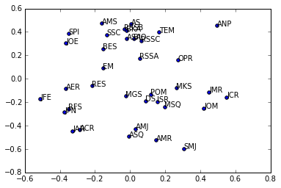
Multidimensional Scaling Map of Business & Statistics Journals

Slide 54
Hierarchical Clustering (Dendrogram)
from scipy.cluster.hierarchy import ward, dendrogram
linkage_matrix = ward(cos_distance)
dendrogram(linkage_matrix, orientation='left', labels=names)
plt.tight_layout()
plt.show()

Slide 55
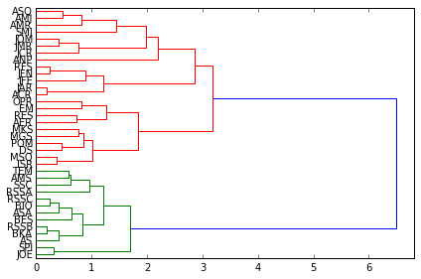
Results of cluster analysis

Slide 56
Plotting Top 50 words &K-Means Clustering
from sklearn.cluster import Kmeans
import pandas as pd
import nltk
nltk.download()
freq = nltk.FreqDist(list_of_words)
#plot top 50
freq.plot(50)

Slide 57
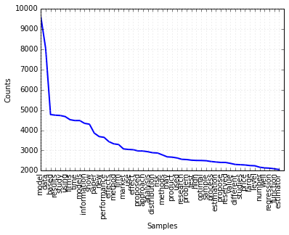

Slide 58
Kmeans…….
#converting to Dense Format
vectorizer = TfidfVectorizer()
dtm = vectorizer.fit_transform(corpus)
km = KMeans(n_clusters=5, random_state=999)
cluster_solution = km.fit(dtm)
cluster_membership = km.predict(dtm)
doc_distance_to_center = km.transform(dtm)

Slide 59
labels = [name[:name.index(".")] for name in files]
clusters = zip(cluster_membership, labels)
for a, b in clusters:
print(a,":", b)
top_docs = {'docs': labels, 'cluster': cluster_membership,\
'doc_to_0':doc_distance_to_center[0:,0],\
'doc_to_1':doc_distance_to_center[0:,1],\
'doc_to_2':doc_distance_to_center[0:,2],\
'doc_to_3':doc_distance_to_center[0:,3],\
'doc_to_4':doc_distance_to_center[0:,4],
}
df = pd.DataFrame(top_docs)
df.to_excel("clusters.xlsx", "Sheet1")

Slide 60
Output
cluster | doc_to_0 | doc_to_1 | doc_to_2 | doc_to_3 | doc_to_4 | docs
0 | 0.538201 | 1.091023 | 0.919317 | 0.89296 | 1.053719 | ACR
3 | 0.911954 | 0.968107 | 0.969983 | 0.717726 | 1.009623 | AER
2 | 0.95387 | 1.04001 | 0.49969 | 0.860661 | 0.959539 | AMJ
2 | 1.111193 | 1.077888 | 0.624073 | 0.964298 | 1.038785 | AMR
1 | 1.153649 | 0.678864 | 1.036929 | 0.967994 | 1.099106 | AMS
1 | 1.225864 | 0.947439 | 1.140942 | 1.094697 | 1.211694 | ANP
1 | 1.146997 | 0.512815 | 1.061299 | 0.938632 | 1.123105 | AS
1 | 1.116369 | 0.387697 | 1.009341 | 0.883046 | 1.059495 | ASA
2 | 0.986648 | 1.060535 | 0.600101 | 0.912453 | 1.010871 | ASQ

Slide 61
Reading Tweets
from twython import Twython
api_key = “user’s key"
api_secret = “users secret”
access_token = “user’s access token”
token_secret = “user’s token secret”
api = Twython(api_key, api_secret, access_token, token_secret)

Slide 62
Completing the program…
def get_tweets(twython_object, query, n):
count = 0
result_generator = twython_object.cursor(twython_object.search, q = query)
return result_generator
rg = get_tweets(api, '#BigData', 1000 )
MAX_LIMIT = 1000 #limit tweets to 1000
tweets = []
count = 0
for r in rg:
tweets.append(r)
count += 1
if count == MAX_LIMIT:
break

Slide 63
Extracting Useful Information from Tweets
Understand what keys are available to you
Key values may be dictionaries
You may have to get values and look at their keys to extract useful information

Slide 64
Useful Links
https://dev.twitter.com/rest/reference/get/search/tweets
https://dev.twitter.com/rest/reference/get/search/tweets

Slide 65
Explore the tweets
In 3: x = tweets[0]
In 4: type(x)
Out[4]: dict
In 5: x.keys()
Out[5]: dict_keys(['metadata', 'lang', 'entities', 'source', 'possibly_sensitive', 'text', 'retweeted_status', 'place', 'in_reply_to_user_id_str', 'in_reply_to_status_id_str', 'geo', 'created_at', 'in_reply_to_status_id', 'in_reply_to_screen_name', 'retweet_count', 'is_quote_status', 'retweeted', 'contributors', 'id_str', 'user', 'favorite_count', 'coordinates', 'favorited', 'truncated', 'id', 'in_reply_to_user_id'])

Slide 66
Continued…..
In 9: x['text']
Out[9]: 'RT @KirkDBorne: Smarticle! &gt;&gt; Apache Spark #MachineLearning Tutorial: https://t.co/wwu91MrEDA #BigData #DataScience by @MapR https://t.co/7…'
In [10]: x['user']
Out[10]:
{'contributors_enabled': False,
'created_at': 'Mon Dec 28 06:59:47 +0000 2009',
'default_profile': True,
'default_profile_image': False,
'description': '',
'entities': {'description': {'urls': []}},
'favourites_count': 0,
'follow_request_sent': False,
'followers_count': 47,
'following': False,
'friends_count': 144,
……….

Slide 67
My Current Research Using Tweets
CFO tweets
Sentiments by day
A lot of preprocessing – hashtags, references, abbreviations, emojis, misspelled words
Extracting useful variables – retweets, followers, lexical diversity, readability of text

Slide 68
Sentiment Analysis
Text may reflect sentiments
Common practice is to use a dictionary of words that have been assigned positive or negative scores
You may use TextBlob or NLTK (or other tools) to determine sentiment

Slide 69
Examples of Sentiment Scores (from AFINN)
abhorred -3 abhorrent -3 abhors -3 abilities 2 ability 2 aboard 1 absentee -1 absentees -1
Hu & Liu’s lexicon is quite popular (https://www.cs.uic.edu/~liub/FBS/sentiment-analysis.html)

Slide 70
Better options for sentiment analysis
Google API https://cloud.google.com/natural-language/docs/sentiment-tutorial
IBM’s Alchemy API
https://www.ibm.com/watson/alchemy-api.html
Sentistrength
http://sentistrength.wlv.ac.uk/

Slide 71
NLTK FOR SENTIMENT ANALYSIS
import nltkfrom nltk.sentiment.vader
import SentimentIntensityAnalyzer
nltk.download('vader_lexicon’)
s = “This is a great class. It is a lot of fun!”
sid = SentimentIntensityAnalyzer()
sid.polarity_scores(s) results in:
{'compound': 0.8268, 'neg': 0.0, 'neu': 0.476, 'pos': 0.524}
Notes:
Give a brief overview of the presentation. Describe the major focus of the presentation and why it is important.
Introduce each of the major topics.
To provide a road map for the audience, you can repeat this Overview slide throughout the presentation, highlighting the particular topic you will discuss next.

Slide 72
Using TextBlob To Get Sentiment Score
In 22: s = "The ambience is good"
In 23: txt = TextBlob(s)
In 24: txt.sentiment
Out[24]: Sentiment(polarity=0.7, subjectivity=0.6000000000000001)
In 25: s = "The ambience is not good“
In 26: txt = TextBlob(s)
In 27: txt.sentiment
Out[27]: Sentiment(polarity=-0.35, subjectivity=0.6000000000000001)
Note that polarity is negative when the words ‘not good’ are used.
You may also look up: 1) The anew module and b) Sentisearch

Slide 73
Stemming vs Lemmatization
import spacy
import nltk
# load spacy's English language models
en_nlp = spacy.load('en')
# instantiate NLTK's Porter stemmer
stemmer = nltk.stem.PorterStemmer()
# define function to compare lemmatization in spacy with stemming in NLKT
def compare_normalization(doc):
# tokenize document in spacy:
doc_spacy = en_nlp(doc)
# print lemmas found by spacy
print("Lemmatization:")
print([token.lemma_ for token in doc_spacy])
# print tokens found by Porter stemmer
print("Stemming:")
print([stemmer.stem(token.norm_.lower()) for token in doc_spacy])

Slide 74
Output
compare_normalization(u"Our meeting today was worse than yesterday, "
"I'm scared of meeting the clients tomorrow.")
Lemmatization:
['our', 'meeting', 'today', 'be', 'bad', 'than', 'yesterday', ',', 'i', 'be', 'scared', 'of', 'meet', 'the', 'client', 'tomorrow', '.']
Stemming:
['our', 'meet', 'today', 'wa', 'wors', 'than', 'yesterday', ',', 'i', "'m", 'scare', 'of', 'meet', 'the', 'client', 'tomorrow', '.']

Slide 75
Topic Modeling
Discover topics in a corpus
Gensim module in Python is very popular
Techniques include:
Non-negative matrix factorization
Latent Dirichlet Allocation (LDA)
Topic Mapping (http://amaral-lab.org/resources/software/topic-mapping)

Slide 76
NMF Example
import numpy as np # a conventional alias
from sklearn.feature_extraction.text import CountVectorizer, TfidfVectorizer
import glob
import os
from sklearn import decomposition #for NMF
os.chdir("c:/1014/files") #This is where my files are stored
files = glob.glob("*.txt") #get text file names
def parse_text(txt): #I made it very simple – you should use this for preprocessing
txt = txt.lower()
return txt
corpus = []

Slide 77
for f in files:
f_input = open(f)
txt = parse_text(f_input.read())
#txt = [w.strip() for w in txt.split()]
corpus.append(txt)
vectorizer = TfidfVectorizer(stop_words = 'english', min_df = 2)
dtm = vectorizer.fit_transform(corpus)
vocab = vectorizer.get_feature_names() #gets features/words
names = [fn[:-4] for fn in files] #get file names without .txt
num_topics = 10
num_top_words = 20
clf = decomposition.NMF(n_components = num_topics, random_state=1)
doctopic = clf.fit_transform(dtm)
topic_words = []
for topic in clf.components_:
word_idx = np.argsort(topic)[::-1][0:num_top_words]
topic_words.append([vocab[i] for i in word_idx])

Slide 78
for t in range(len(topic_words)):
print("Topic {}: {}".format(t, ' '.join(topic_words[t][:15])))
Topic 0: model data estimator models estimators method asymptotic estimation regression proposed based methods likelihood linear propose
Topic 1: organizational research organizations social theory firms work study performance identity employees team ceos new information
Topic 2: firms earnings firm investors information market financial risk managers tax returns audit performance stock equity
Topic 3: consumers authors brand marketing product consumer advertising research effect customer products brands effects customers self
Topic 4: reserved paper asymptotic estimators test returns distribution estimator market model volatility sample tests models risk
Topic 5: model firm product demand supply information optimal inventory retailer cost problem supplier market price service
Topic 6: jel model paper using data market firms risk effects price prices income effect equilibrium evidence
Topic 7: random process prove bar time infinity probab alpha brownian xi stochastic results ann distribution lambda
Topic 8: wiley sons john copyright firms firm performance ceo strategic capabilities study industry knowledge innovation results
Topic 9: data model article statistical methods models used using statistics analysis approach supplementary bayesian based online

Slide 79
LDA in Scikit-Learn
from sklearn.decomposition import LatentDirichletAllocation
#read in corpus, preprocess, etc. – NOT SHOWN
vectorizer = CountVectorizer(max_df=0.95, min_df=2, max_features=10000, stop_words='english')
num_topics = 10 #arbitrary
dtm = vectorizer.fit_transform(corpus)
lda = LatentDirichletAllocation(n_components=num_topics, learning_method="batch”, max_iter=2000, random_state=0)
document_topics = lda.fit_transform(dtm)
feature_names = vectorizer.get_feature_names()

Slide 80
def display_topics(model, feature_names, n_top_words):
for idx, topic in enumerate(model.components_):
print("Topic %d:" % (idx))
print(" ".join([feature_names[i]
for i in topic.argsort()[:-n_top_words - 1:-1]]))
display_topics(lda, feature_names, 10)

Slide 81
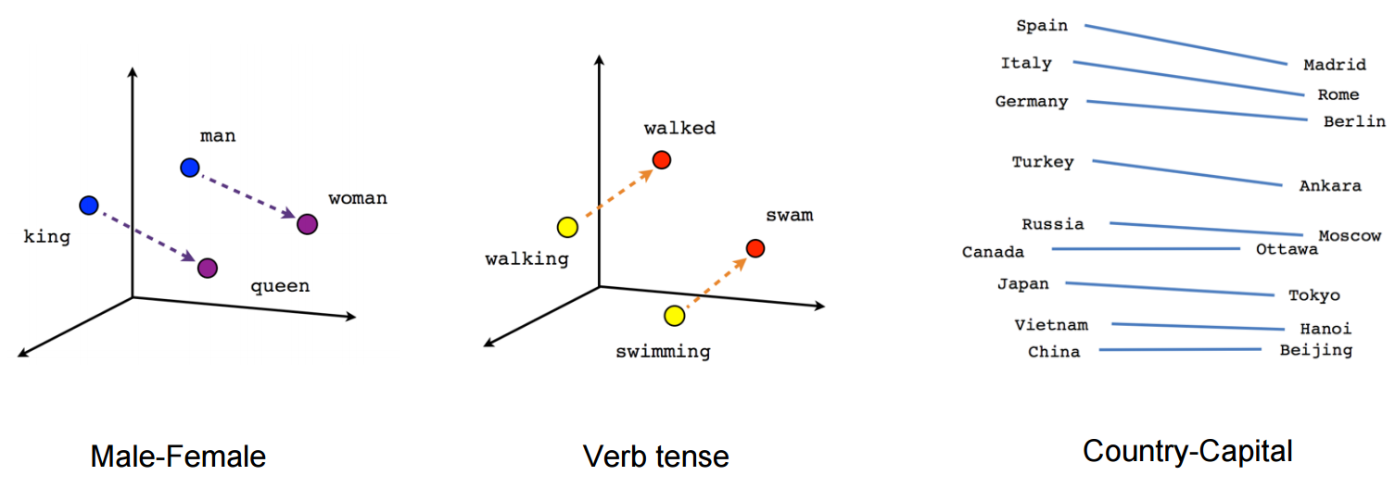
Word2Vec and Doc2Vec
Uses a Vector Space Model – words in vector space

Slide 82
Famous example ……
result = model.most_similar(positive=['king', 'woman'], negative=['man'])
for word, conf in result:
print(word, conf)
queen 0.71181923151
monarch 0.618967413902
princess 0.59024310112
crown_prince 0.549946069717
prince 0.537732183933
kings 0.523684442043
Queen_Consort 0.523594617844
queens 0.518113434315
sultan 0.509859323502
monarchy 0.508741259575

Slide 83
Naïve Bayes Classifiers for text classification
Use the sklearn.naive_bayes module
GaussianNB – normal distribution
MultinomialNB – uses probabilities based on feature counts
BernoulliNB – good for binary counts; penalizes absence of a feature

Slide 84
Example
Check out the following URL for a description of the exercise
http://openclassroom.stanford.edu/MainFolder/DocumentPage.php?course=MachineLearning&doc=exercises/ex6/ex6.html
Download the data – four directories:
Spam-train, spam-test, nonspam-train and nonspam-test
Read in the data and set up the training and test data sets

Slide 85
I am leaving this as an exercise for you. You have to get the following:
train_docs = [] #list of documents - spam and non-spam used for training
train_Y = [] #0s and 1s for nonspam/spam
test_docs = [] #list of test documents from spam and nonspam folders
test_Y = [] #0s and 1s for nonspam/spam
The remainder of the code is………
#create a Multinomial Naive Bayes classifier
#alpha = 0.01 to ensure we don't get 0 probabilities
#for very rare words
classifier = MultinomialNB(alpha=0.01)
#since the training and test sets may have differences in their features
#use the hashing trick to accommodate unseen words
import sklearn.feature_extraction.text as txt
hash_vectorizer = txt.HashingVectorizer(stop_words='english', binary=False,
norm=None, non_negative=True)
classifier.fit(hash_vectorizer.transform(train_docs), train_Y)
#now that the model is trained, let us predict the test set
predicted = classifier.predict(hash_vectorizer.transform(test_docs))

Slide 86
Displaying the results
import sklearn.metrics as metrics
print("Accuracy: ", metrics.accuracy_score(test_Y, predicted))
#let us look at some more metrics ... get probabilities first
probabilities = classifier.predict_proba(hash_vectorizer.transform(test_docs))
from sklearn.metrics import precision_recall_curve, auc, classification_report
print("\nClassification Report: ")
print(classification_report(test_Y, predicted, target_names=['Non-Spam', 'Spam']))
precision, recall, prob_threholds = precision_recall_curve(test_Y, probabilities[:, 1])

Slide 87
#let us plot the area under the curve
import matplotlib.pyplot as pl
area = auc(recall, precision)
print("\nArea Under Curve: %0.2f" % area)
#print(prob_thresholds)
pl.clf()
pl.plot(recall, precision, label='Precision-Recall curve')
pl.xlabel('Recall')
pl.ylabel('Precision')
pl.ylim([0.0, 1.05])
pl.xlim([0.0, 1.0])
pl.title('Precision-Recall example: AUC=%0.2f' % area)
pl.legend(loc="lower left")
pl.show()

Slide 88
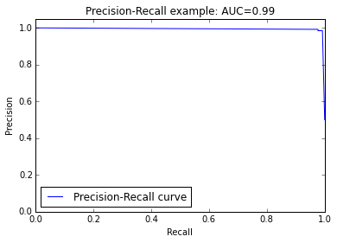
Accuracy: 0.984615384615
Classification Report:
precision recall f1-score support
Non-Spam 0.98 0.99 0.98 130
Spam 0.99 0.98 0.98 130
avg / total 0.98 0.98 0.98 260
Area Under Curve: 0.99

