Slide 1

Preprocessing Data
Dr. Sridhar Nerur
Goolsby-Virginia and Paul Dorman Endowed Chair in Leadership
Professor, Information Systems & Operations Management

Slide 2
What is preprocessing?
Getting data ready for analysis
Deal with missing values (i.e., imputation)
Convert categorical to numbers (dummies?)
Deal with data imbalance (will be covered later)
Scaling data
Dimensionality reduction (will be covered later)

Slide 3
Preprocessing
Consider the following data:
Gender Age Score
0 Female 28 97.5
1 Female 25 92.8
2 Male 23 76.0
3 Female 22 NaN
4 Male NaN 100.0
5 Male 27 NaN
6 Female 25 84.0
7 Female 27 82.0

Slide 4
Replacing Missing Values
Replace missing scores with mean value
mean_score = df.Score.dropna().mean()
df.Score = df.Score.fillna(mean_score)
Result:
Gender Age Score
0 Female 28 97.500000
1 Female 25 92.800000
2 Male 23 76.000000
3 Female 22 88.716667
4 Male NaN 100.000000
5 Male 27 88.716667
6 Female 25 84.000000
7 Female 27 82.000000

Slide 5
Replacing with median values
Replace age with median value
median_age = df.Age.dropna().median()
df.Age = df.Age.fillna(median_age)
Results:
Gender Age Score
0 Female 28 97.5
1 Female 25 92.8
2 Male 23 76.0
3 Female 22 NaN
4 Male 25 100.0
5 Male 27 NaN
6 Female 25 84.0
7 Female 27 82.0

Slide 6
Replacing with mode
mode_age = df.Age.dropna().mode()
df.Age = df.Age.fillna(mode_age[0])
Result:
Gender Age Score
0 Female 28 97.5
1 Female 27 92.8
2 Male 23 76.0
3 Female 22 NaN
4 Male 27 100.0
5 Male 27 NaN
6 Female 25 84.0
7 Female 27 82.0

Slide 7
Consider the following dataframe
StudentID | Age | Gender | Major | Exam_1 | Exam_2
1 | 22 | M | INSY | 90 | 86
2 | 28 | M | INSY | 82 | 88
3 | 21 | NaN | MKT | 94 | 84
4 | NaN | F | ECON | 80 | 87
5 | 18 | M | MKT | 86 | 86
6 | NaN | M | ECON | 92 | 82
7 | 26 | F | INSY | 88 | 76
8 | 24 | F | INSY | 78 | 81
9 | 18 |  | MKT | 79 | 80
10 | 20 | M | MKT | 89 | 81

Slide 8
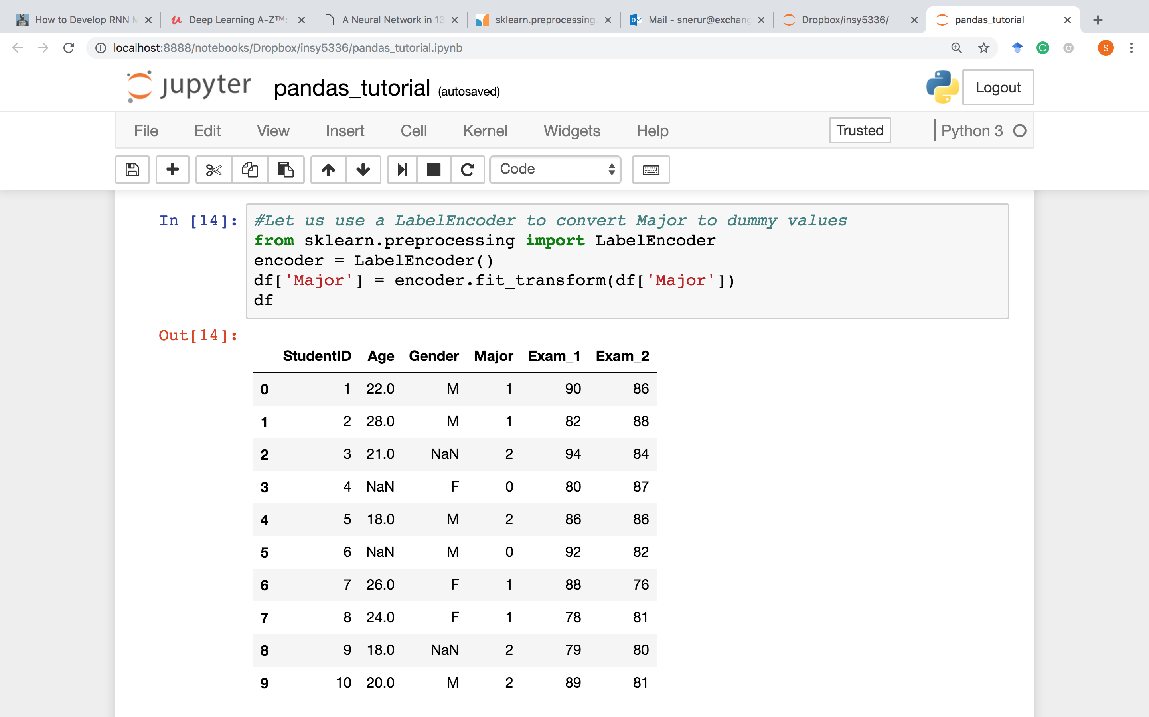

Slide 9
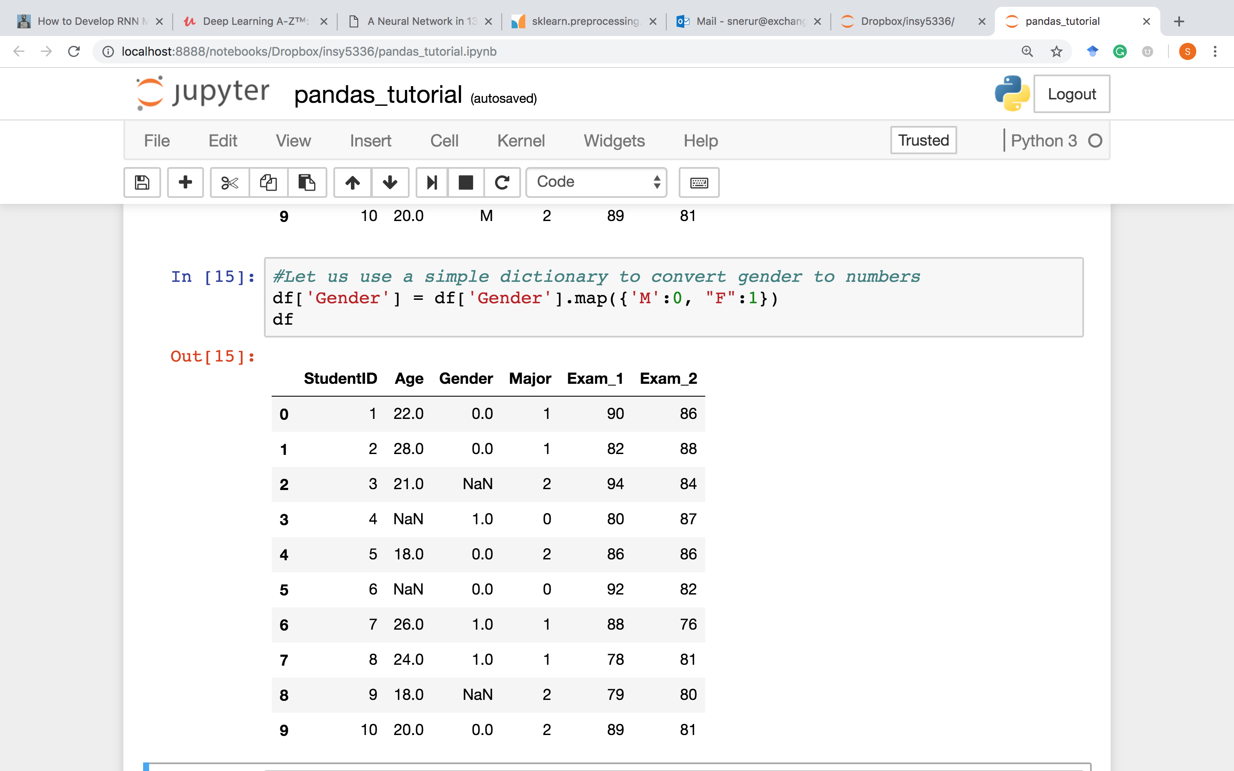

Slide 10
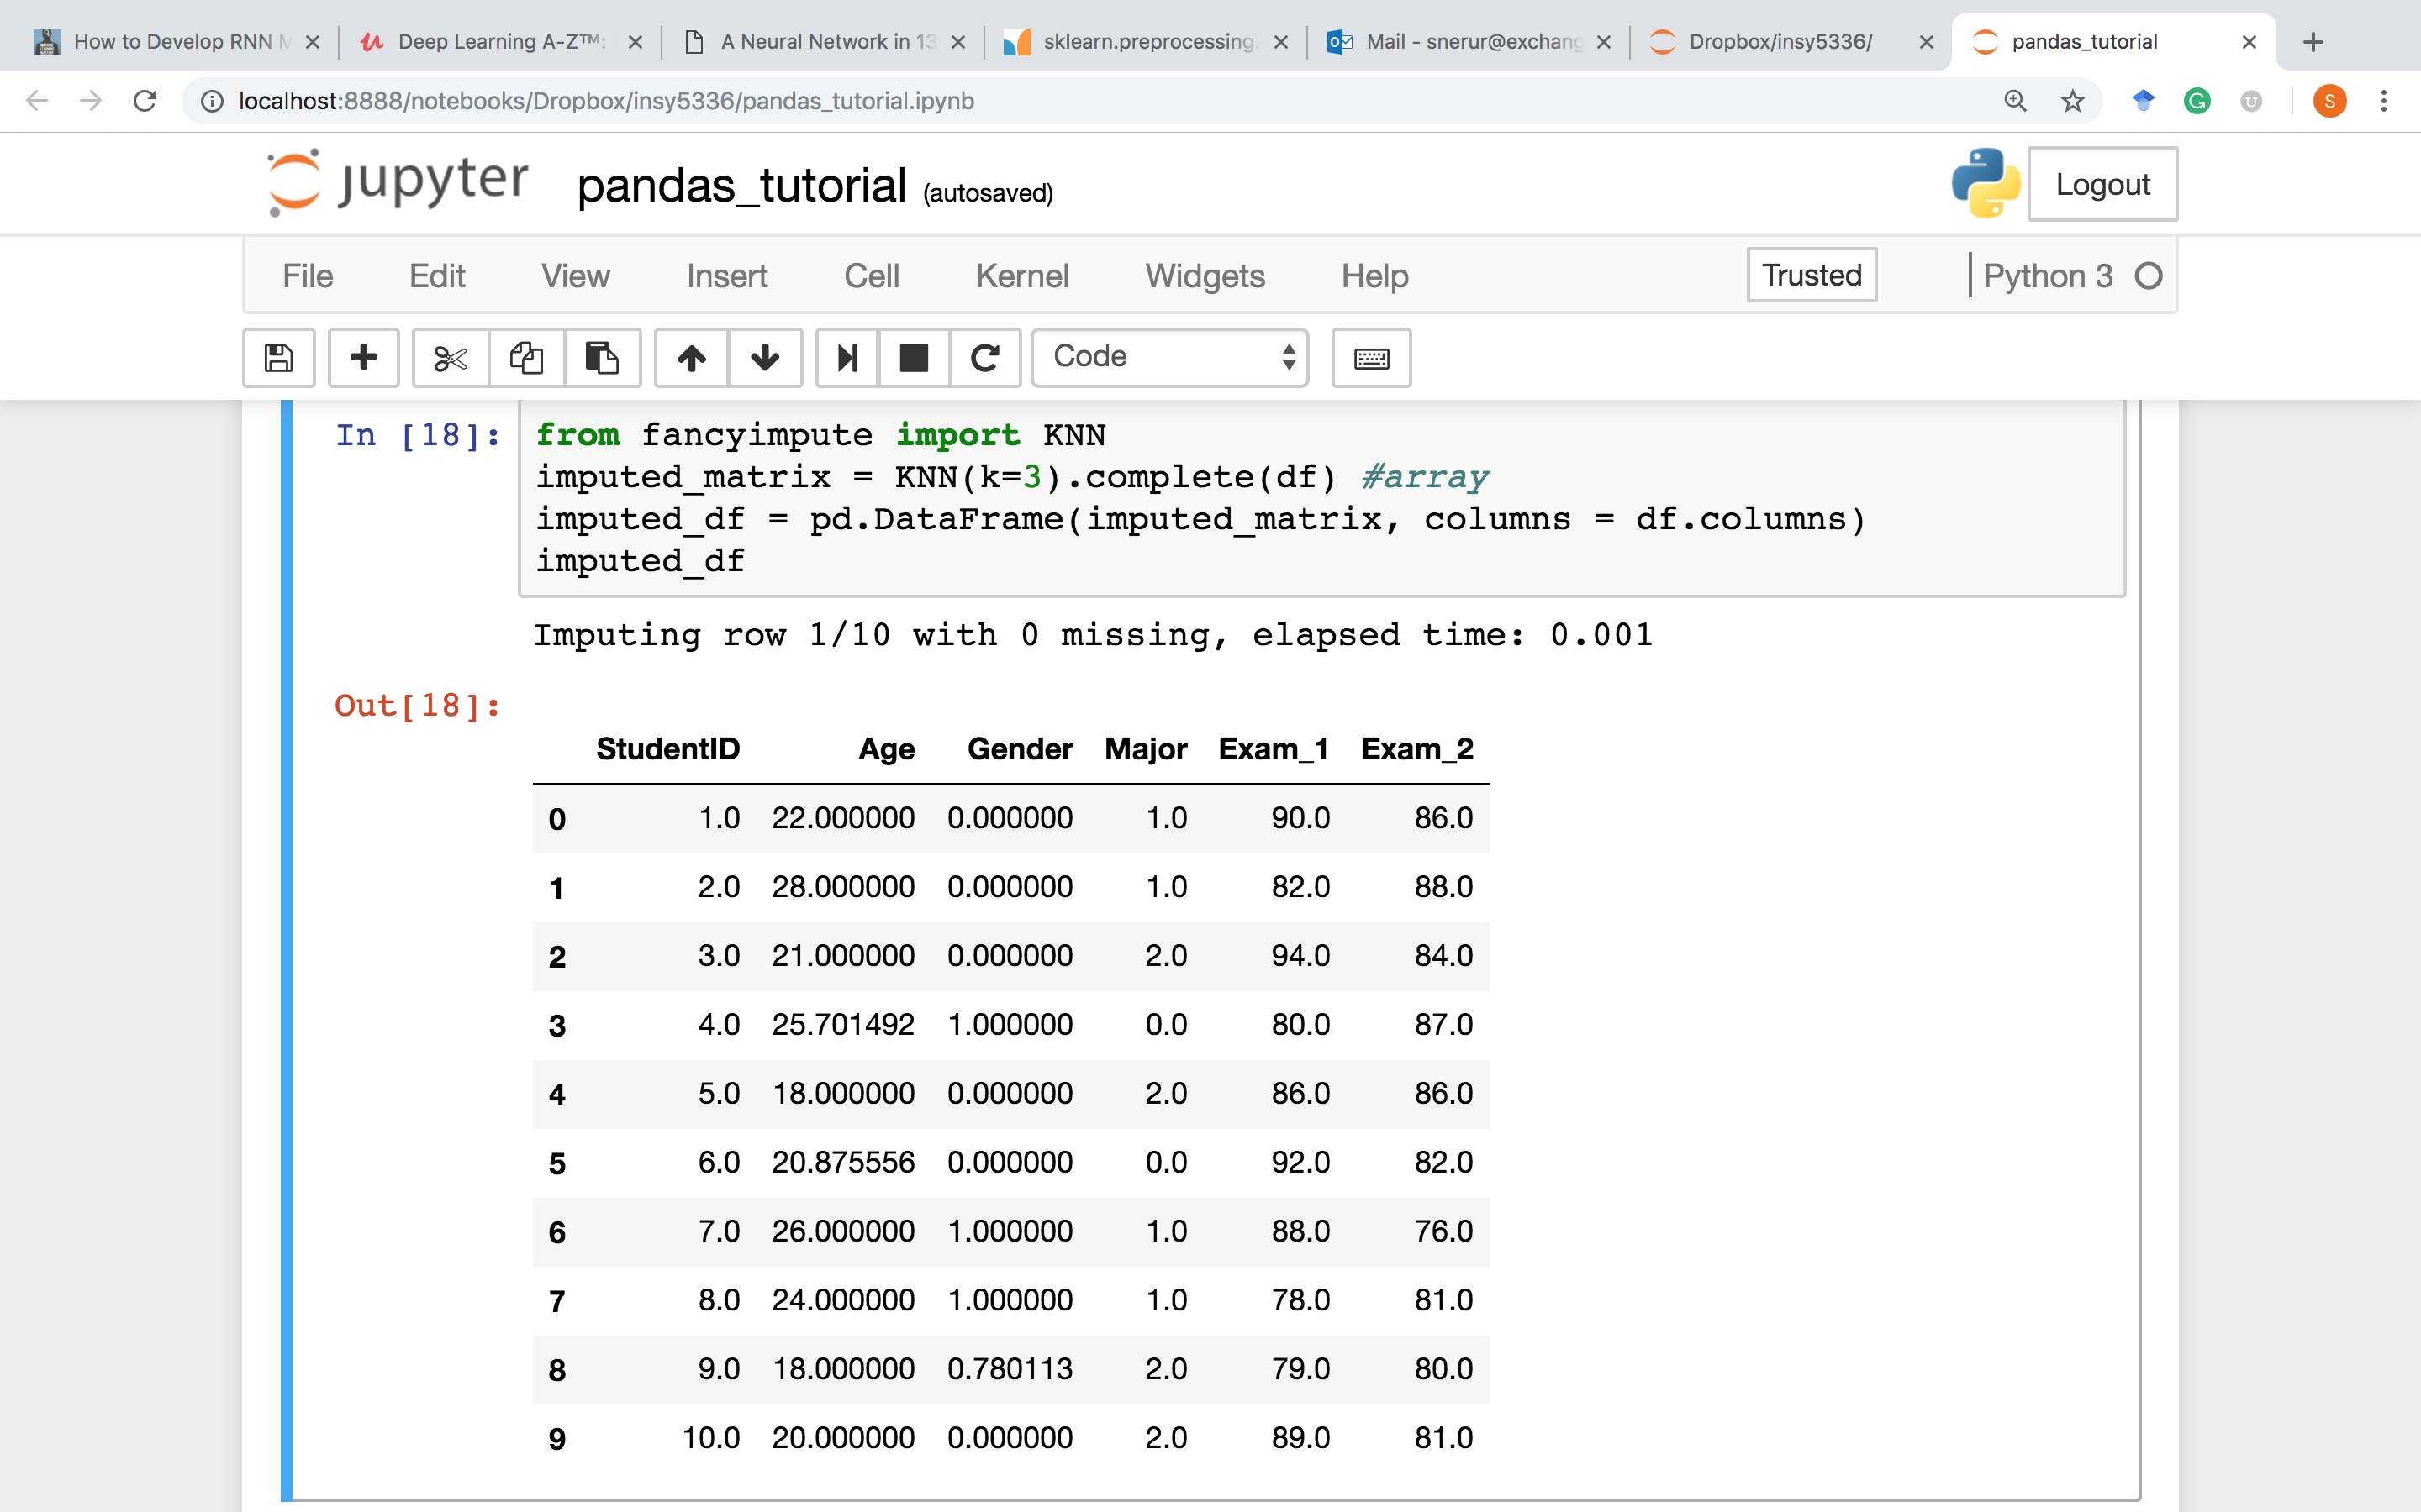

Slide 11
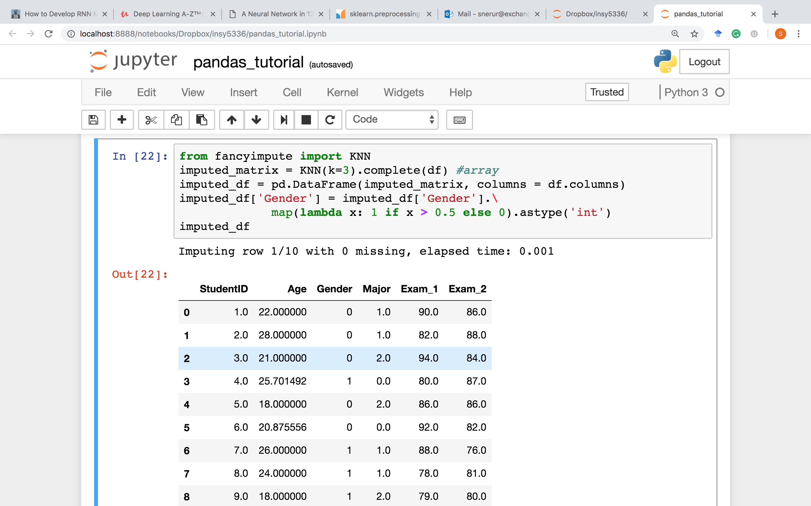

Slide 12
StudentID | Age | Gender | Major | Exam_1 | Exam_2
1 | 22 | M | INSY | 90 | 86
2 | 28 | M | INSY | 82 | 88
3 | 21 | F | MKT | 94 | 84
4 | 22 | F | ECON | 80 | 87
5 | 18 | M | MKT | 86 | 86
6 | 30 | M | ECON | 92 | 82
7 | 26 | F | INSY | 88 | 76
8 | 24 | F | INSY | 78 | 81
9 | 18 | M | MKT | 79 | 80
10 | 20 | M | MKT | 89 | 81
Is there an easier way to convert to dummies?

Slide 13
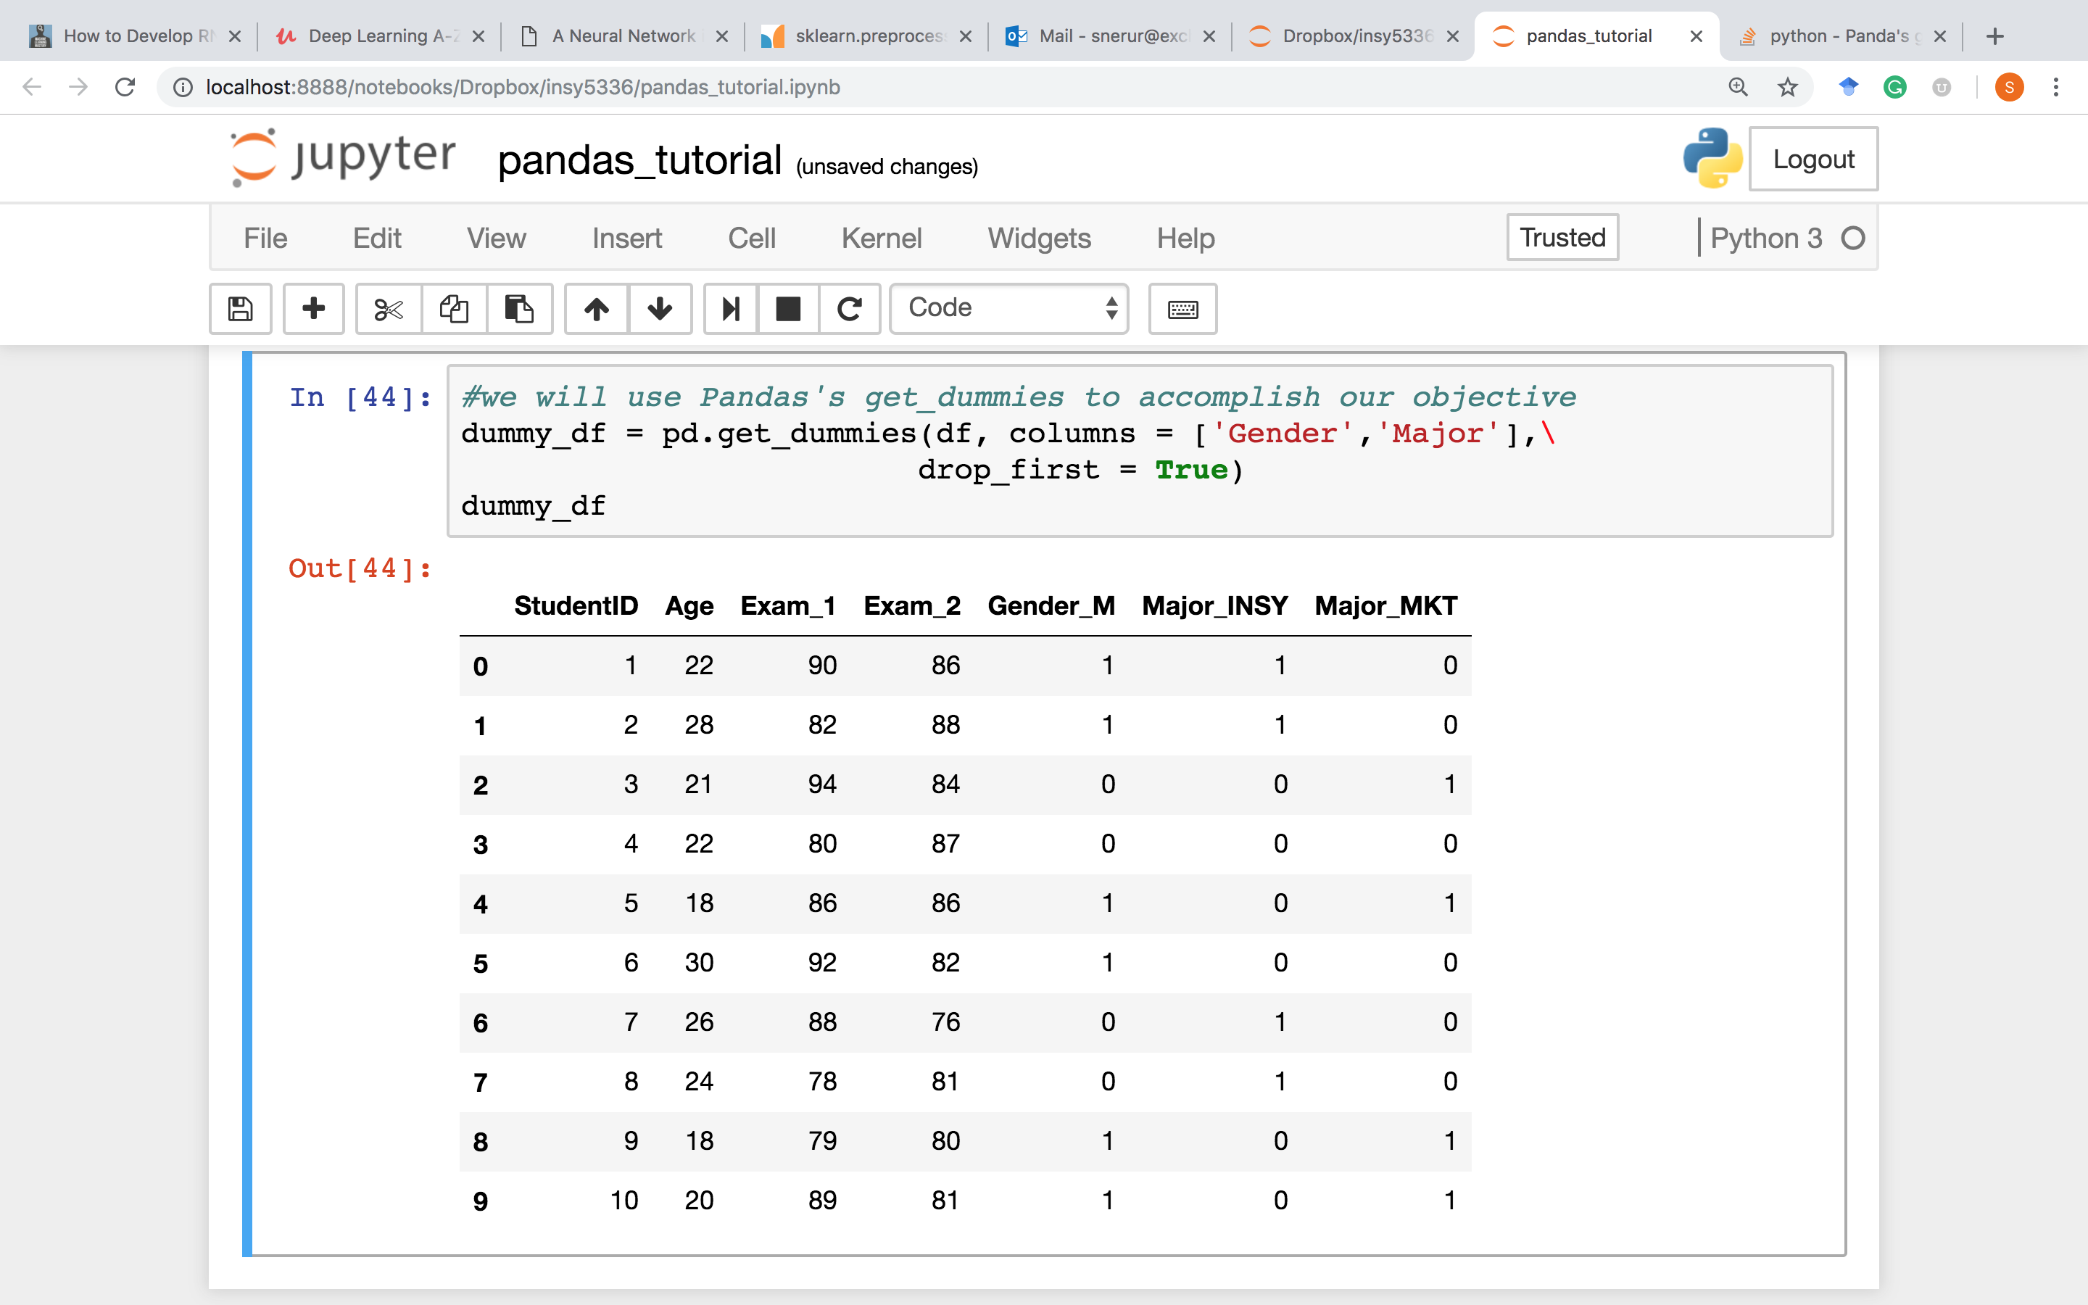

Slide 14
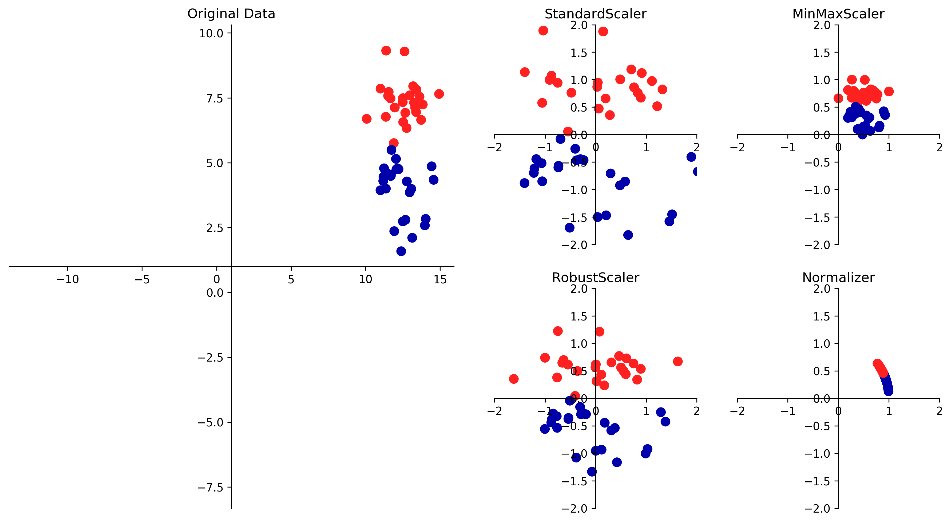
StandardScaler and RobustScaler ensure statistical properties
MinMaxScaler results in values between 0 and 1
Normalizer results in a Euclidean length of 1 (used when direction matters)

Slide 15
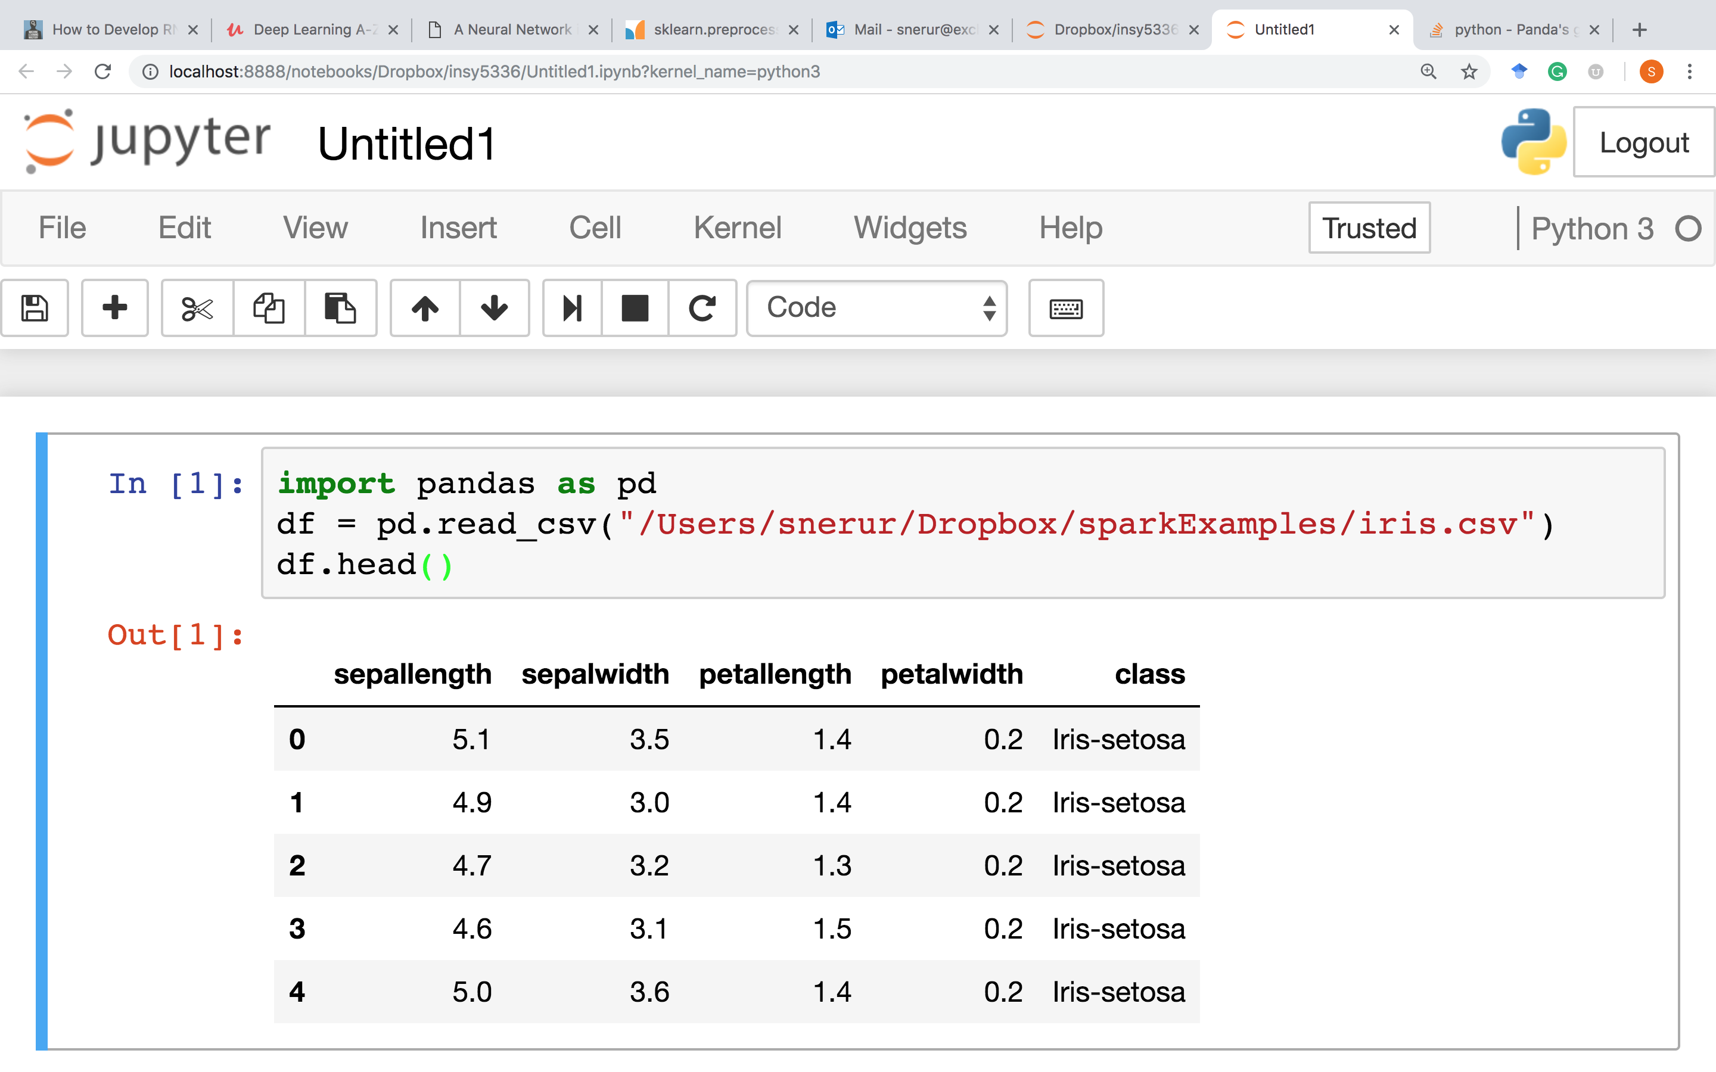

Slide 16
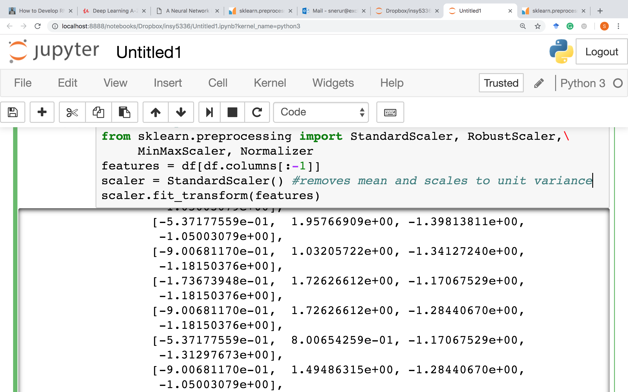

Slide 17
Now that you get the idea, try the following
scaler = RobustScaler() #removes median and uses interquartile range
scaler.fit_transform(features) #good for outliers
scaler = MinMaxScaler()
scaler.fit_transform(features)
MinMaxScaler uses the following to transform the data:
X_std = (X - X.min(axis=0)) / (X.max(axis=0) - X.min(axis=0))
X_scaled = X_std * (max - min) + min
scaler = Normalizer() #normalizes samples to unit norm
scaler.fit_transform(features)

Slide 18
Oversampling/Undersampling
Use SMOTE (Synthetic Minority Over-sampling Technique)
SMOTE() is used for oversampling
NearMiss is an undersampling technique
You will need the following module for this:
!pip install imblearn
from imblearn.over_sampling import SMOTE
from imblearn.under_sampling import NearMiss
Source: https://medium.com/@saeedAR/smote-and-near-miss-in-python-machine-learning-in-imbalanced-datasets-b7976d9a7a79

