Slide 1
RateMyProfessorHAU
A professor review app for HAU students
Students can look up professors, read peer feedback, and prepare a review across eight categories.
Final project presentation
Lester Manapul • Holy Angel University
Flutter • Dart

Slide 2
The problem and intended audience
The problem
What the app is designed to help with
Students may choose classes with little information about a professor’s grading style, workload, or teaching approach. They often rely on word of mouth.
Find professor information
Browse the professor list by school or course.
Read peer feedback
Review ratings and comments tied to a course.
Who it serves
Share a class experience
Currently enrolled HAU students
Fill out a multi-category review form.
The screenshots that follow show the five current app screens. The content is sample data.
RateMyProfessorHAU • 2

Slide 3
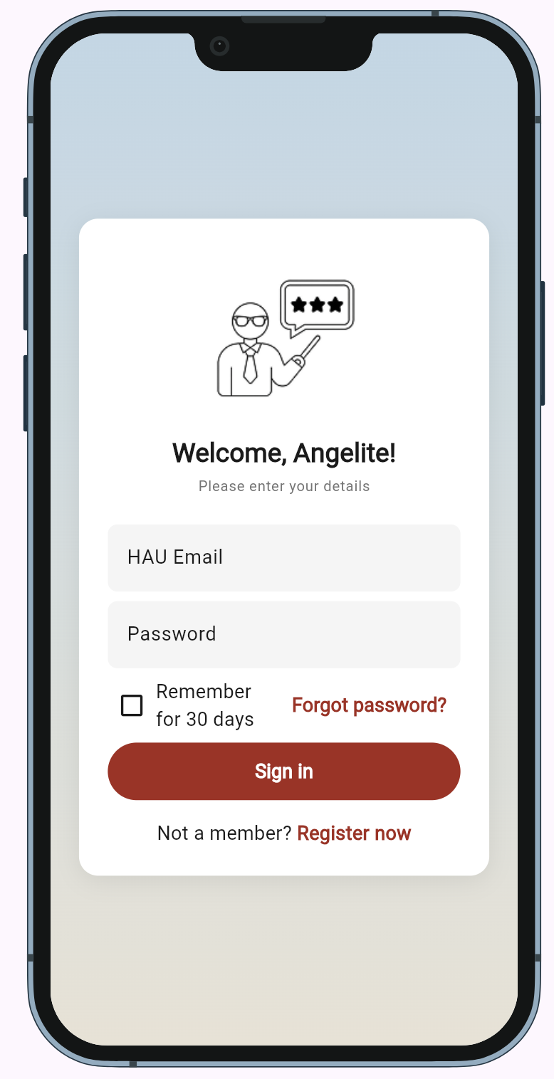
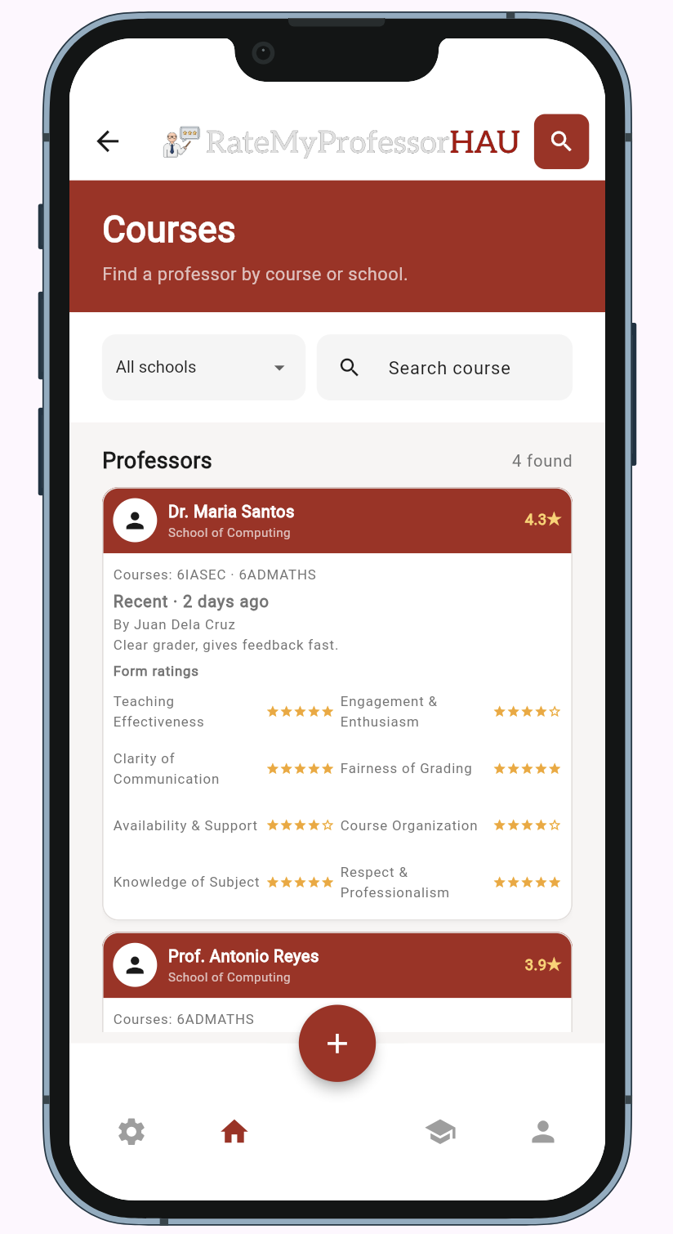
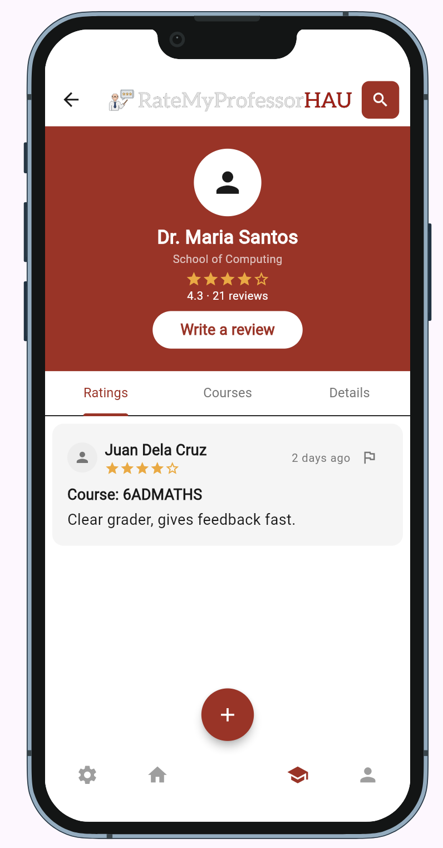
App walkthrough: login, courses, reviews
Login
Courses
Professor reviews
A sign-in layout for HAU students, with links for registration and password recovery.
Browse professors, choose a school, or search by course.
See a professor’s rating summary, course tabs, and a sample review.
RateMyProfessorHAU • 3

Slide 4
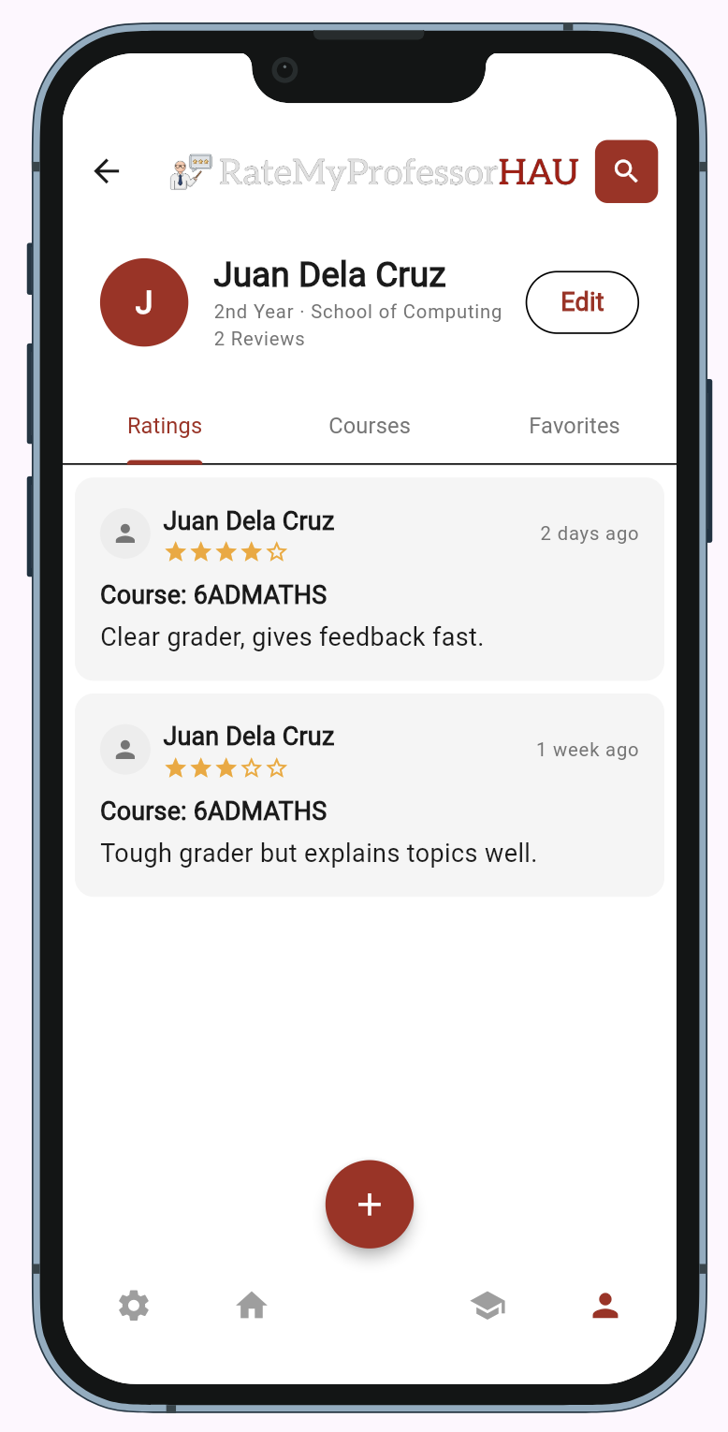
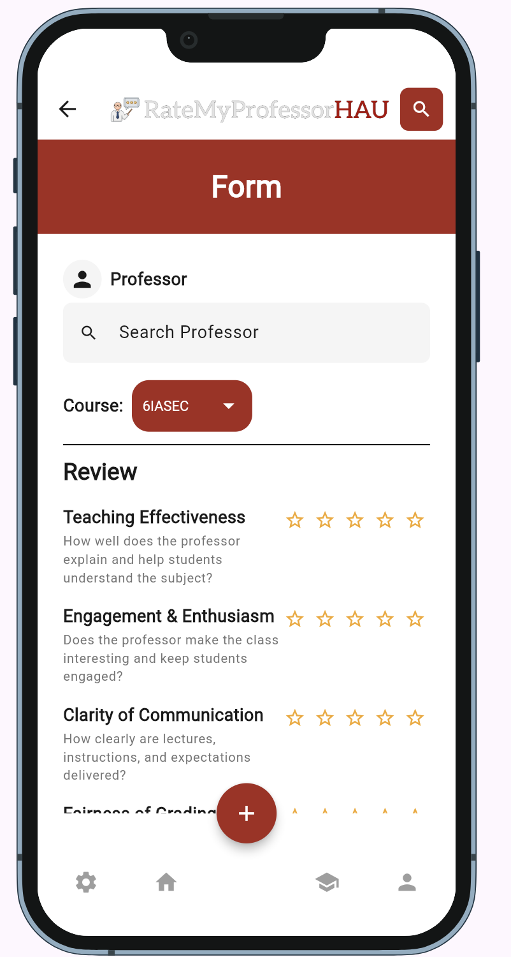
App walkthrough: profile and review form
Profile
Review form
Shows the student profile, review history, and tabs for ratings, courses, and favorites.
Students can select a professor and course, then rate eight categories and add written feedback.
The Edit control is part of the screen; profile editing is still a placeholder.
The form is not connected to persistent storage, so a submitted review is not saved yet.
RateMyProfessorHAU • 4

Slide 5
Technology in the current build
Built now
Planned backend
Flutter + Dart
The app is built as a Flutter project with Dart screens, models, and reusable widgets.
Firebase Auth + Cloud Firestore
Material theming
Selected in the proposal for school-email sign-in and shared professor/review data. The spike and integration remain to be done.
A shared light theme defines the maroon and amber palette, text styles, and spacing.
DevicePreview
Keeps a phone preview available during development and web demonstration.
Current records are hardcoded sample data.
RateMyProfessorHAU • 5

Slide 6
Challenges during development
Visual consistency
Backend and verification
The rendered colors and layout did not match the design system on the first screens. The cause has not been diagnosed yet.
Firebase setup was not completed, so reviews, reports, and account flows are not connected to persistent data.
The current code has not yet been confirmed with flutter analyze or a full run. Build errors may still need fixing.
Navigation
The professor/reviews icon initially followed the wrong route on several screens. That route behavior was later corrected.
These are open work items, not resolved claims.
RateMyProfessorHAU • 6

Slide 7
What I would do next
1 Confirm the app builds
Run flutter pub get, flutter analyze, and the web app; fix any reported errors.
2 Resolve the theme mismatch
Check shared theme usage and hardcoded colors against the design system.
3 Add Firebase
Complete a small setup spike, then wire HAU email sign-in and Firestore review reads/writes.
4 Verify and document
Test that a submitted review survives restart, then capture current screens and update security notes.
Goal: turn the current screen prototype into a tested app with shared, persistent reviews.
RateMyProfessorHAU • 7

