Slide 1
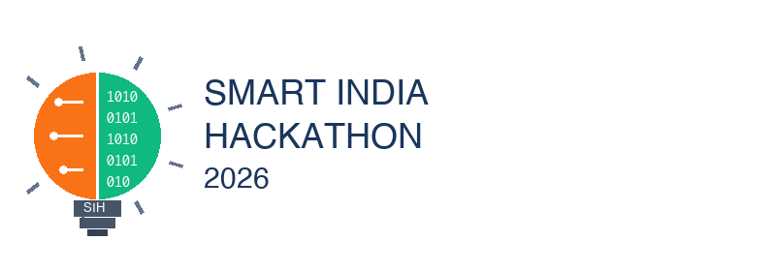
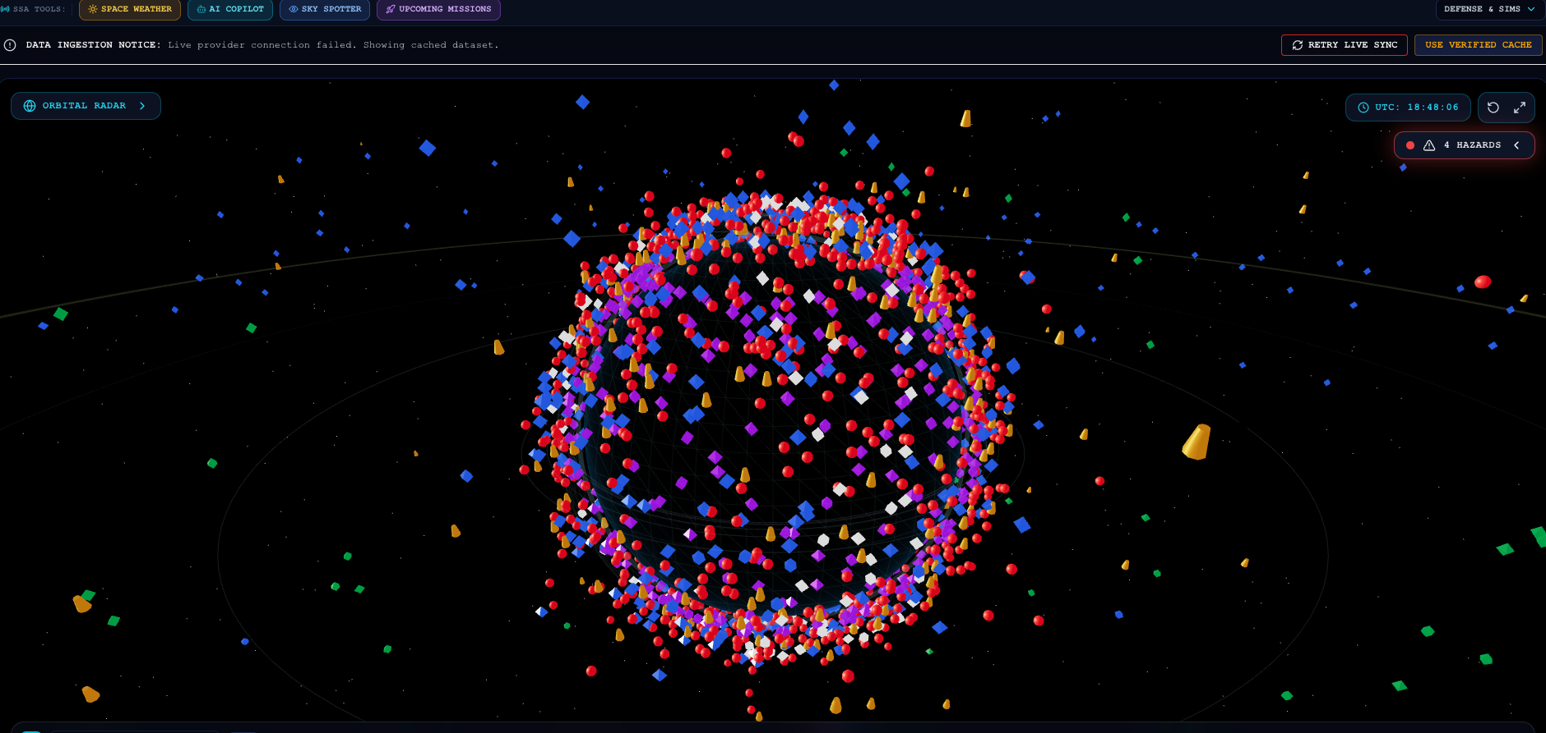
SMART INDIA HACKATHON 2026
TITLE PAGE
• Problem Statement ID – PS-04
• Problem Statement Title – Space Debris Tracking & Satellite Collision Risk Prediction Dashboard
• Theme – Space Technology
• PS Category – Software
• Team ID – SIH2026-PS04-OG01
• Team Name – ORBITGUARD (Registered on portal)
ORBITGUARD SSA PLATFORM
✔ Real-time multi-source ephemeris ingestion (CelesTrak / Space-Track)
✔ Deterministic 3-phase conjunction screening for 35,000+ catalog objects
✔ Foster-2D Pc & Explainable Multi-Factor OrbitGuard Risk Scoring (0–100)
✔ Interactive 3D WebGL celestial globe & 2D tactical ground track view
✔ Automated collision alerts, CAM Delta-V planner & CCSDS CDM export

Slide 2
Your
Team
Name
IDEA TITLE
❖ Proposed Solution (Describe your Idea/Solution/Prototype)
• Detailed Explanation of Proposed Solution
ORBITGUARD is an open, high-precision Space Situational Awareness (SSA) & Collision Risk Intelligence platform.
End-to-End Pipeline: Ingests authoritative TLEs $\to$ Validates modulo-10 checksums $\to$ Analytical SGP4 propagation $\to$ 3-Phase spatial screening sieve $\to$ Multi-factor risk calculation $\to$ Interactive 3D/2D WebGL visualizer $\to$ Real-time alerts.
Operational Scale: Fully implemented full-stack architecture tracking 35,000+ cataloged objects (payloads, debris, rocket stages) with deterministic sub-second updates.
• How It Addresses the Problem (PS-04)
Democratizes SSA Intelligence: Breaks the monopoly of expensive, closed military/enterprise systems, empowering student teams, smallsat operators, and space startups.
Solves Pairwise Bottleneck: Hierarchical apogee/perigee altitude filtering eliminates >99% non-crossing pairs in $\mathcal{O}(N \log N)$ time, preventing compute overload.
Actionable Operator Guidance: Converts raw orbital coordinates into exact Time of Closest Approach (TCA), 3D miss distance, relative velocity, and lead-time alerts.
• Innovation & Uniqueness of Solution
Dual-Engine Risk Framework: Combines an explainable 0–100 OrbitGuard Risk Score with formal Foster-2D $P_c$ & 10,000 Monte Carlo stochastic perturbations.
Scientific Data Truth Badges: Explicitly marks `LIVE SGP4`, `CALCULATED`, `MODEL PREDICTION`, `SIMULATION`, and `DATA UNAVAILABLE` (zero fabricated covariance).
Integrated Mission Toolkit: Includes Collision Avoidance Maneuver (CAM) $\Delta v$ optimization, King-Hele atmospheric decay tracking, and CCSDS CDM Blue Book export.
@SIH Idea submission- Template 2
2

Slide 3
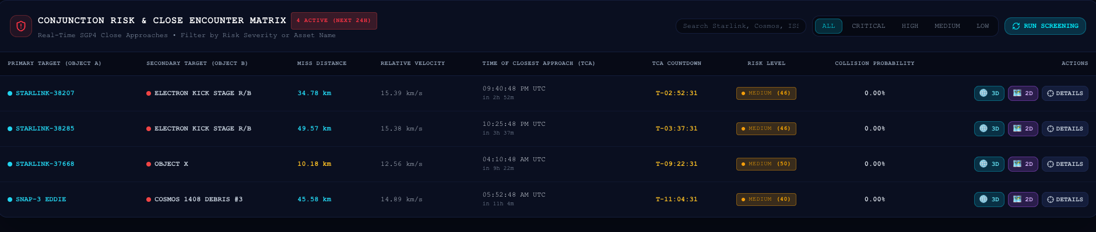
Your
Team
Name
TECHNICAL APPROACH
• Technologies to be used (Implemented Tech Stack)
Frontend: React 18.3, TypeScript, Vite, Tailwind CSS, Three.js (WebGL 3D Earth, Shaders), Recharts, Lucide.
Backend & Orbital: Python 3.9+, FastAPI (Async REST), C-accelerated SGP4/SDP4 (`sgp4.api.Satrec`), Skyfield, NumPy, SQLAlchemy.
Database & Infra: Indexed SQLite / PostgreSQL (spatial/perigee/apogee indices), Docker Compose, Background Daemons.
Data Sources: CelesTrak (CSSI / AGI), Space-Track.org (18th SDS), Launch Library 2, NOAA SWPC ($F_{10.7}$, $A_p$).
• Methodology and Process for Implementation
Astrodynamic Frame Transforms: $\text{TLE} \xrightarrow{\text{SGP4}} \text{TEME} \xrightarrow{\text{GMST}} \text{ECEF} \xrightarrow{\text{Bowring}} \text{WGS84 Geodetic } (\text{Lat, Lon, Alt})$.
3-Phase Conjunction Screening Sieve: 1. *Phase 1 (Altitude Envelope)*: Eliminates >99% non-overlapping pairs in $\mathcal{O}(N \log N)$. 2. *Phase 2 (Coarse Step)*: 3-min intervals detect candidate encounter windows. 3. *Phase 3 (Fine Step & Golden Search)*: 10s sub-stepping pinpoints exact Time of Closest Approach (TCA) and 3D miss distance ($d_{\text{miss}}$).
Multi-Factor Risk Assessment Engine: $\text{Score} = 0.55 S_{\text{dist}} + 0.25 S_{\text{vel}} + 0.20 S_{\text{time}}$ (Weighted Explainable Score) Foster-2D Isotropic Hard-Body $P_c$ & 10k Monte Carlo runs.
▲ Working Prototype: Real-Time 3D WebGL Globe & SGP4 Orbital Object Tracking
▲ Working Prototype: Real-Time Conjunction Risk & Close Encounter Matrix Dashboard
@SIH Idea submission- Template 3
3

Slide 4
Your
Team
Name
FEASIBILITY AND VIABILITY
• Analysis of Feasibility
Authoritative Public Ingestion: Ingests free, high-volume TLE ephemerides directly from CelesTrak & Space-Track (18th SDS) with zero proprietary hardware requirements.
Software-Centric Scalability: Pure mathematical SGP4 propagation and spatial sieving run efficiently on standard cloud or edge servers with sub-second execution ($<1.5\text{s}$).
Client-Side WebGL Rendering: Three.js GPU shaders offload visualization computation directly to the client browser, maintaining minimal backend server footprint.
Proven Working Prototype: Fully functional full-stack codebase with 44/44 passing automated pytest test cases verifying numerical correctness.
• Potential Challenges & Risks
Covariance Absence in TLEs: Standard public TLE sets do not provide formal $6\times 6$ error covariance matrices, making true mathematical $P_c$ unconstrained.
Combinatorial Compute Scale: Screening $N=35,000$ space objects against each other yields $\approx 6.1 \times 10^8$ pairwise interactions over a 72-hour window.
Upstream API Outages / Limits: External network latency, Space-Track rate limits, or CelesTrak upstream downtime can disrupt live data synchronization.
Client GPU Load with Thousands of Objects: Rendering tens of thousands of dynamic 3D points and trajectories simultaneously can cause client frame drops.
• Strategies for Overcoming Challenges
Transparent Heuristic vs $P_c$ Separation: Uses an explainable OrbitGuard Risk Score (0–100) and explicitly marks $P_c$ as `UNAVAILABLE` when covariance is absent (zero fake claims).
3-Phase Spatial Sieving: Geometric apogee/perigee sorting eliminates >99% non-overlapping orbits instantly, screening only $\approx 400$ candidate crossing pairs.
Resilient Multi-Tier Ingestion: In-memory cache + persistent database + deterministic verified offline fallback mode ensures 100% platform availability.
GPU Point Cloud Instancing: Instanced buffer geometries and Level-of-Detail (LOD) management deliver consistent 60 FPS WebGL rendering on commodity devices.
@SIH Idea submission- Template 4
4

Slide 5
Your
Team
Name
IMPACT AND BENEFITS
• Potential Impact on the Target Audience
SmallSat & CubeSat Operators: Provides free, research-grade collision avoidance intelligence and maneuver lead-time without million-dollar enterprise licenses.
Academic & Research Institutions: Serves as an open testbed for astrodynamics training, orbital mechanics labs, and debris modeling studies.
Space Tech Startups & Developing Space Agencies: Enhances regional Space Situational Awareness (SSA) complementing national programs (e.g., ISRO NETRA).
• Technical Benefits
✔ Unified multi-source TLE ingestion
✔ Sub-kilometer TCA spatial precision
✔ Explainable risk factor decomposition
✔ CCSDS CDM Blue Book export
• Operational Benefits
✔ Converts raw ephemerides into alerts
✔ Automated high-risk priority queue
✔ Dual 3D celestial & 2D ground track
✔ 72-hour maneuver preparation lead
• Economic Benefits
✔ Democratizes space safety software
✔ >90% reduction in SSA tooling costs
✔ Prevents catastrophic mission loss
✔ Accessible on standard web browsers
• Space Sustainability
✔ Mitigates cascading Kessler Syndrome
✔ Promotes responsible orbital slots
✔ Supports UN COPUOS debris rules
✔ Assists national space safety goals
@SIH Idea submission- Template 5
5

Slide 6
Your
Team
Name
RESEARCH AND REFERENCES
• Details / Links of the reference and research work
1. Hoots, F. R., & Roehrich, R. L. (1980): "Spacetrack Report No. 3: Models for Propagation of NORAD Element Sets (SGP4/SDP4)". Aerospace Defense Command, Peterson AFB, Colorado. Standard mathematical formulations for analytical orbital perturbation propagation.
2. Vallado, D. A., Crawford, P., Hujsak, R., & Kelso, T. S. (2006): "Revisiting Spacetrack Report #3: Rev 2 (AIAA 2006-6753)". Analytical Graphics, Inc. / CelesTrak. Comprehensive derivation and code validation for official SGP4 implementation with WGS84.
3. Foster, J. L., & Estes, H. S. (1992): "A Determination of the Probability of Collision Between Two Space Objects". NASA Johnson Space Center Internal Report, Houston, TX. Formulation for 2D isotropic hard-body encounter collision probability ($P_c$).
4. Alfano, S. (2005): "Review of Conjunction Assessment Techniques". The Journal of the Astronautical Sciences, Vol. 53, No. 4, pp. 355–375. Maximum collision probability boundary assessment and encounter geometry metrics.
5. Consultative Committee for Space Data Systems (CCSDS, 2019): "Conjunction Data Message (CDM) Recommended Standard Blue Book 508.0-B-1". CCSDS Secretariat, Washington, DC. Formal international data format standard for conjunction event data exchange (KVN & XML).
6. NASA Orbital Debris Program Office & King-Hele, D. G. (1987): "Satellite Orbits in an Atmosphere: Theory and Applications & ODMSP". Atmospheric drag modeling with King-Hele decay equations and Jacchia-Roberts scale heights for re-entry lifetime predictions.
7. 18th Space Defense Squadron & CelesTrak: "Space-Track.org REST API & CSSI Orbital Data Services". Authoritative sources for open-access Two-Line Element (TLE) ephemerides and active satellite/debris catalog tracking.
@SIH Idea submission- Template 6
6

