Slide 1
Project : Currency Converter in C++
Name | Reg No. | Task
Mesum | ( BSAI019 ) | Programmer
Humaira | ( BSAI057 ) | Presentation Designer
Kamran | ( BSAI062 ) | Assistant Coder
Masuma | ( BSAI042 ) | Researcher
Masuma Ibrahim | ( BSAI038 ) | Tester / Debugger
Eman Zehra Helen | ( BSAI009) | Data Collection
Urooj | ( BSAI012 ) | Researcher Assistant

Slide 2
Understand the problem
The goal is to create a program that converts a given amount in a selected currency to Pakistani Rupees ( PKR) .
The user selects from a list of currencies and enter the amount . The program calculates and displays the equivalent amount in PKR using fixed exchange rates .
Currency Converter in C++

Slide 3
Design the Solution
Design Menu Display Design Input System Design Conversion Logic
Design Output Display
Design Error Handling

Slide 4
Develop The algorithm
1- Start the Program 2- Displays a welcome message and group member names.
3-Display currency menu with ( 1-11 ) options .
4-Ask the user to enter a currency choice and amount .
5-Use switch – case to apply the correct exchange rate.
6-Calculate and display the result in PKR . 7-If the input is invalid , display an error message .
8-End the program .

Slide 5
Flow chart
start
Display Currency Option
Get user choice (1-11)
Yes
If choice is between (1-11)
No
Get amount to convert
Display Invalid choice try again
Convert to PKR
Display converted amount in PKR
stop

Slide 6
1- Menu Display Module
2-User Input Module
Main modules of Project
3-Currecy Conversion Logic Module
4-Output Module and 5-Error Handling

Slide 7
1-Menu Display Module
Scope
Functionality
Display the list of currency options from the user
Shows available currencies to convert in PKR . Helps user to choose the desired currency by displaying numbers ( 1-11 )

Slide 8
2-User Input Module
Scope
Functionality
Takes input from user
Asks user to enter choice ( 1-11 ) . Prompt the user to enter the amount to be converted . Stores input for use in conversion logic

Slide 9
3-Currecncy conversion logic Module
Scope
Functionality
Performs the actual calculation to convert other currency to PKR .
Uses a switch statement based on the user's choice. Applies the corresponding exchange rate. Stores the converted value in PKR .

Slide 10
4-Output Module
Scope
Functionality
Displays the final result
Displays the equivalent amount in PKR after conversion.
Includes the original amount and the converted result. Enhances usability and confirms successful operation

Slide 11
5-Error Handling
Scope
Functionality
Handles invalid choices from the user.
Displays a message asking the user to try again with a valid option

Slide 12
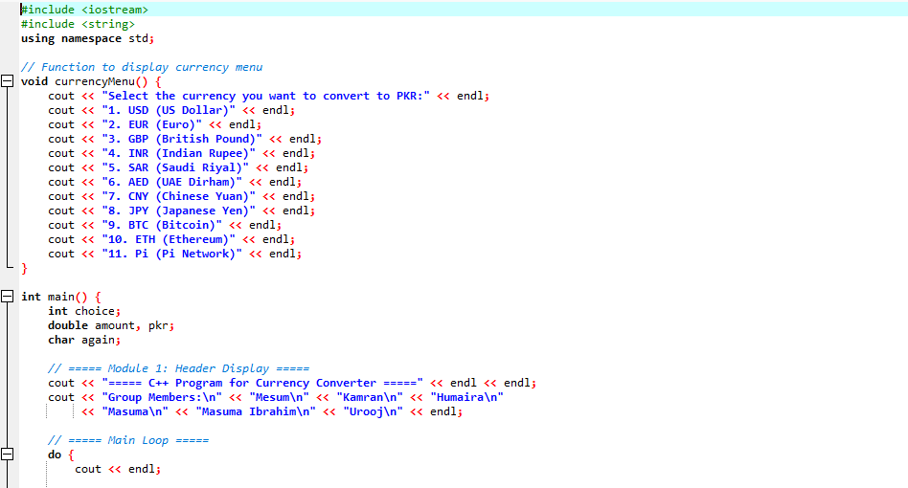
Source Code

Slide 13
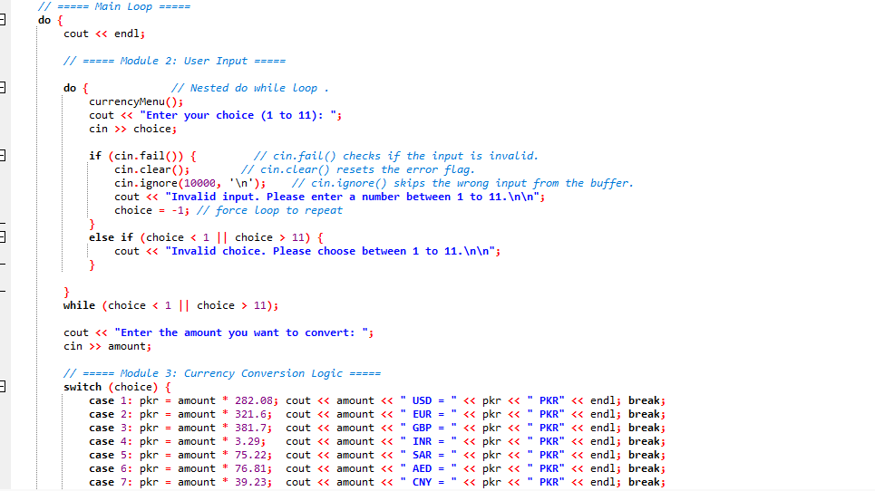

Slide 14
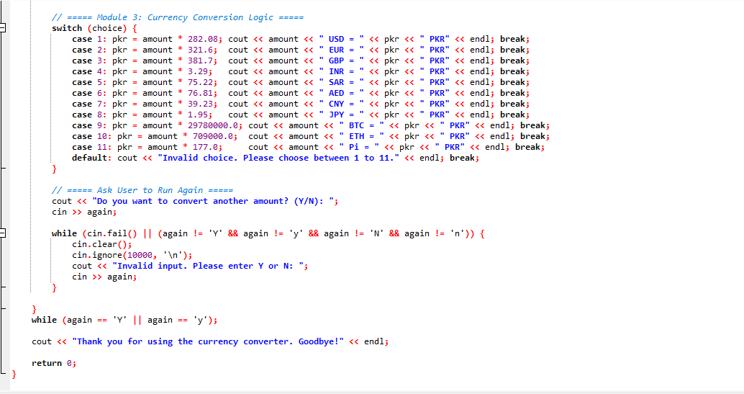

Slide 15
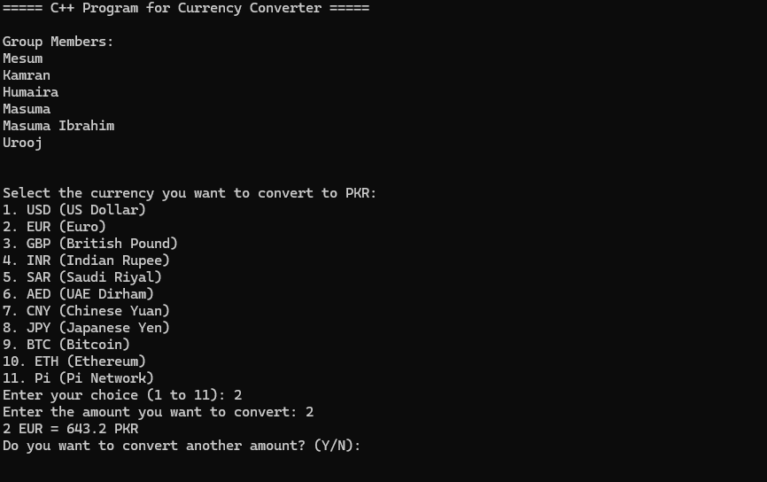
OUTPUT

Slide 16
