Slide 1

HUMAN RESOURCE MANAGEMENT
Global Edition 12e
Chapter 4
Job Analysis
Part 2 Recruitment and Placement
Copyright © 2011 Pearson Education
GARY DESSLER
PowerPoint Presentation by Charlie Cook
The University of West Alabama
Notes:
Human Resources Management 12e
Gary Dessler
Copyright © 2011 Pearson Education
1–<number>

Slide 2
LEARNING OUTCOMES
Discuss the nature of job analysis, including what it is and how it’s used.
Use at least three methods of collecting job analysis information, including interviews, questionnaires, and observation.
Write job descriptions, including summaries and job functions, using the Internet and traditional methods.
Write a job specification.
Explain job analysis in a “worker-empowered” world, including what it means and how it’s done in practice.
Copyright © 2011 Pearson Education
4–<number>
Notes:
Human Resources Management 12e
Gary Dessler
Copyright © 2011 Pearson Education
4–<number>

Slide 3

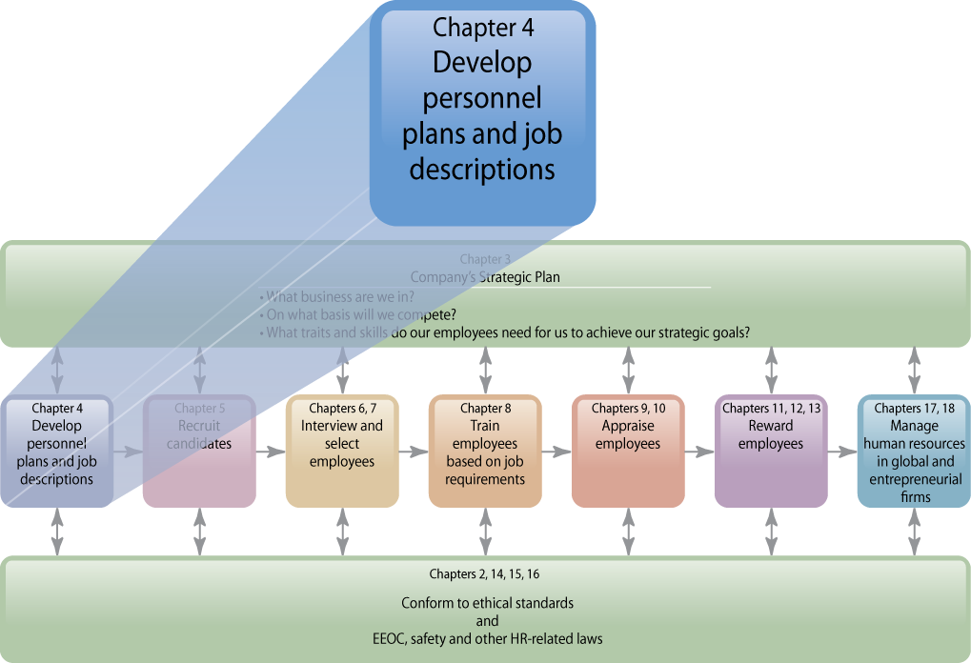
WHERE WE ARE NOW…
Copyright © 2011 Pearson Education
4–<number>
Notes:
Human Resources Management 12e
Gary Dessler
Copyright © 2011 Pearson Education
4–<number>
The human resource management process begins with deciding what the job entails. The main purpose of this chapter is to show you how to analyze a job and write job descriptions.
Analyzing jobs involves determining in detail what the job entails and what kind of people the firm should hire for the job. We discuss several techniques for analyzing jobs, and explain how to draft job descriptions and job specifications.
Then, in Chapter 5 (Personnel Planning and Recruiting), we’ll turn to the methods managers use to actually find the employees they need.

Slide 4
The Basics of Job Analysis: Terms
Job Analysis
  The procedure for determining the duties and skill requirements of a job and the kind of person who should be hired for it.
Job Description
  A list of a job’s duties, responsibilities, reporting relationships, working conditions, and supervisory responsibilities—one product of a job analysis.
Job Specifications
  A list of a job’s “human requirements,” that is, the requisite education, skills, personality, and so on—another product of a job analysis.
Copyright © 2011 Pearson Education
4–<number>
Notes:
Human Resources Management 12e
Gary Dessler
Copyright © 2011 Pearson Education
4–<number>
Organizations consist of jobs that have to be staffed. Job analysis is the procedure through which you determine the duties of these positions and the characteristics of the people to hire for them. Job analysis produces information for writing job descriptions (a list of what the job entails) and job specifications (what kind of people to hire for the job). We’ll see in a moment that every manager should understand the mechanics of analyzing jobs. Virtually every personnel-related action you take—interviewing applicants, and training and appraising employees, for instance—depends on knowing what the job entails and what human traits one needs to do the job well.
The supervisor or human resources specialist normally collects one or more of the following types of information via the job analysis (see next slide):

Slide 5
Types of Information Collected
Work
activities
Human requirements
Human
behaviors
Information Collected Via Job Analysis
Job
context
Machines, tools, equipment, and work aids
Performance standards
Copyright © 2011 Pearson Education
4–<number>
Notes:
Human Resources Management 12e
Gary Dessler
Copyright © 2011 Pearson Education
4–<number>
Actual work activities of the job—how, why, and when the worker performs each activity.
Human behaviors the job requires: communicating, deciding, and writing, lifting weights or walking long distances.
Machines, tools, equipment, and work aids used on the job: tools used, materials processed, knowledge dealt with or applied, and services rendered.
Standards of expected employee job performance: quantity and\or quality output levels that can be used to appraise employees.
The organizational and social context in which the job exists: physical working conditions, work schedules, and incentives
The job’s human requirements: job-related knowledge or skills (education, training, work experience) and required personal attributes (aptitudes, physical characteristics, personality, interests).

Slide 6
Uses of Job Analysis Information
Recruitment
and selection
EEO
compliance
Compensation
Information Collected via Job Analysis
Discovering unassigned duties
Performance appraisal
Training
Copyright © 2011 Pearson Education
4–<number>
Notes:
Human Resources Management 12e
Gary Dessler
Copyright © 2011 Pearson Education
4–<number>
Job analysis provides the information required for other organizational activities that depend on and also support the job.
Job analysis provides required duties and desired human characteristics information needed to effectively Recruit and Select individuals for jobs.
Compensation factors such as skill and education level, safety hazards, degree of responsibility, and so on are assessed by job analysis.
Knowledge of specific duties and requisite skills of a job is required for proper Training of employees.
Correctly conducting a Performance Appraisal requires knowledge of the job’s duties and standard.
Job analysis is a method for Discovering Unassigned Duties that should become a formal part of a job.
Job analysis is required to validate essential job functions and other HRM for EEO Compliance under the Uniform Guidelines on Employee Selection.

Slide 7
FIGURE 4–1 Uses of Job Analysis Information
Job analysis
Job description
and specification
Recruiting
and selection decisions
Performance appraisal
Job evaluation—wage and salary decisions (compensation)
Training requirements
Copyright © 2011 Pearson Education
4–<number>
Notes:
Human Resources Management 12e
Gary Dessler
Copyright © 2011 Pearson Education
4–<number>
As Figure 4-1 summarizes, job analysis is important because managers use it to support
just about all their human resource management activities.

Slide 8
Steps in Job Analysis
Steps in doing a job analysis:
1
Decide how you’ll use the information.
2
Review relevant background information.
3
Select representative positions.
4
Actually analyze the job.
5
Verify the job analysis information.
6
Develop a job description and job specification.
Copyright © 2011 Pearson Education
4–<number>
Notes:
Human Resources Management 12e
Gary Dessler
Copyright © 2011 Pearson Education
4–<number>

Slide 9
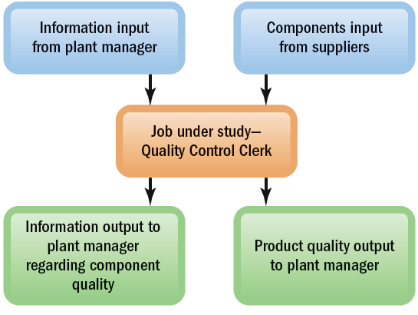
FIGURE 4–2 Process Chart for Analyzing a Job’s Workflow
Copyright © 2011 Pearson Education
4–<number>
Notes:
Human Resources Management 12e
Gary Dessler
Copyright © 2011 Pearson Education
4–<number>
A process chart provides a detailed picture of a job’s work flow. In its simplest form, a process chart shows the flow of inputs to and outputs from the job you’re analyzing.
In this figure, a quality control clerk is expected to review components from suppliers, check components going to the plant managers, and give information regarding components’ quality to these managers.
An existing job description, if there is one, usually provides a starting point for building the revised job description.

Slide 10
Collecting Job Analysis Information
Methods for Collecting Job Analysis Information
Interviews
Questionnaires
Observations
Diaries/Logs
Copyright © 2011 Pearson Education
4–<number>
Notes:
Human Resources Management 12e
Gary Dessler
Copyright © 2011 Pearson Education
4–<number>
There are various ways to collect information on a job’s duties, responsibilities, and activities. In practice, you could use any one of them, or combine several. The basic rule is to use those that best fit your purpose.
Interviews, questionnaires, observations, and diaries/logs are the most popular methods for gathering realistic information about what job incumbents actually do. Managers use these methods for developing job descriptions and job specifications.

Slide 11
Job Analysis: Interviewing Guidelines
The job analyst and supervisor should work together
to identify the workers who know the job best.
Quickly establish rapport with the interviewee.
Follow a structured guide or checklist, one that lists open-ended questions and provides space for answers.
Ask the worker to list his or her duties in order
of importance and frequency of occurrence.
After completing the interview, review and verify
the data.
Copyright © 2011 Pearson Education
4–<number>
Notes:
Human Resources Management 12e
Gary Dessler
Copyright © 2011 Pearson Education
4–<number>

Slide 12

Methods for Collecting Job Analysis Information: The Interview
Information Sources
  Individual employees
  Groups of employees
  Supervisors with knowledge of the job
Advantages
  Quick, direct way to find overlooked information
Disadvantage
  Distorted information
Interview Formats
  Structured (Checklist)
  Unstructured
Copyright © 2011 Pearson Education
4–<number>
Notes:
Human Resources Management 12e
Gary Dessler
Copyright © 2011 Pearson Education
4–<number>
Job analysis interviews range from completely unstructured interviews to highly structured ones containing hundreds of specific items to check off.
Managers may conduct individual interviews with each employee, group interviews with groups of employees who have the same job, and/or supervisor interviews with one or more supervisors who know the job.
Distortion of information is interviewing’s main problem—whether due to outright falsification, honest misunderstanding, or statements inflating the importance of their jobs by interviewees.

Slide 13
Methods for Collecting Job Analysis Information: Questionnaires
Information Source
  Have employees fill out questionnaires to describe their job-related duties and responsibilities
Questionnaire Formats
  Structured checklists
  Open-ended questions
Advantages
  Quick and efficient way
  to gather information
  from large numbers of employees
Disadvantages
  Expense and time consumed in preparing and testing the questionnaire
Copyright © 2011 Pearson Education
4–<number>
Notes:
Human Resources Management 12e
Gary Dessler
Copyright © 2011 Pearson Education
4–<number>
Questionnaires can be structured or opened-ended. A questionnaire is a quick, efficient, and cost-effective way to obtain information from a large number of employees. However, developing the questionnaire and testing it to make sure the workers understand the questions can be time consuming. And as with interviews, employees may distort their answers, consciously or unconsciously.

Slide 14
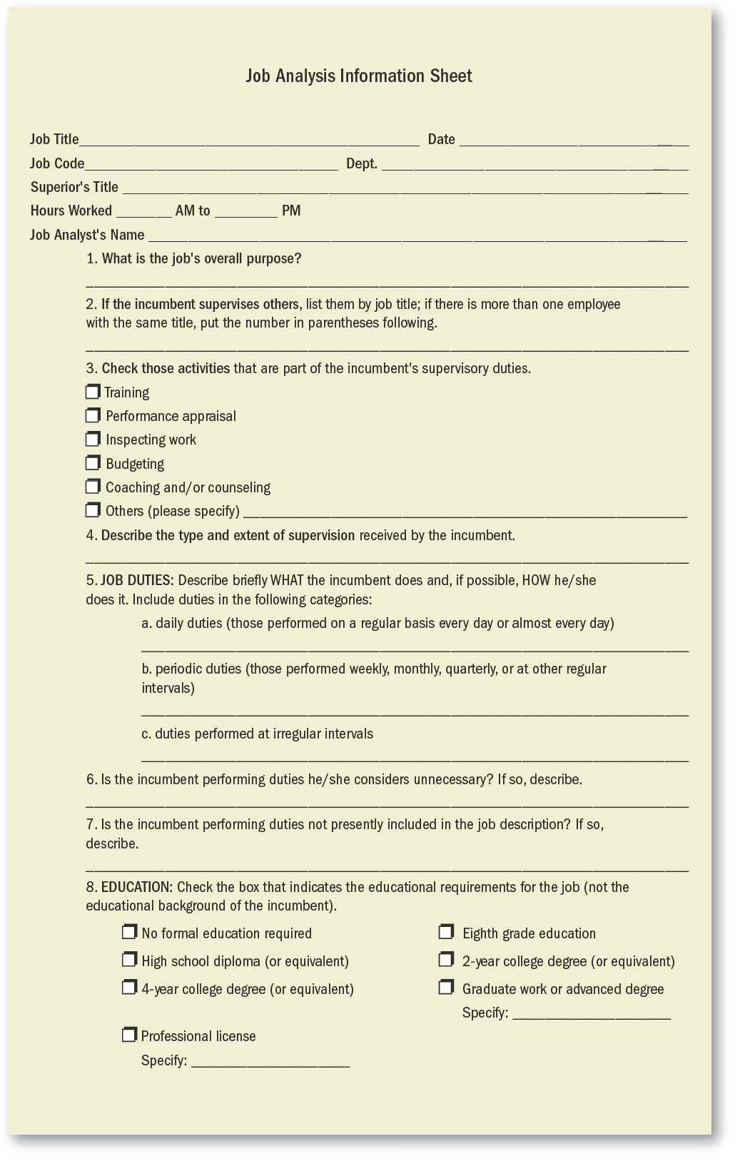
FIGURE 4–3 Job Analysis Questionnaire for Developing Job Descriptions
Note: Use a questionnaire like this to interview job incumbents, or have them fill it out.
Copyright © 2011 Pearson Education
4–<number>
Notes:
Human Resources Management 12e
Gary Dessler
Copyright © 2011 Pearson Education
4–<number>

Slide 15
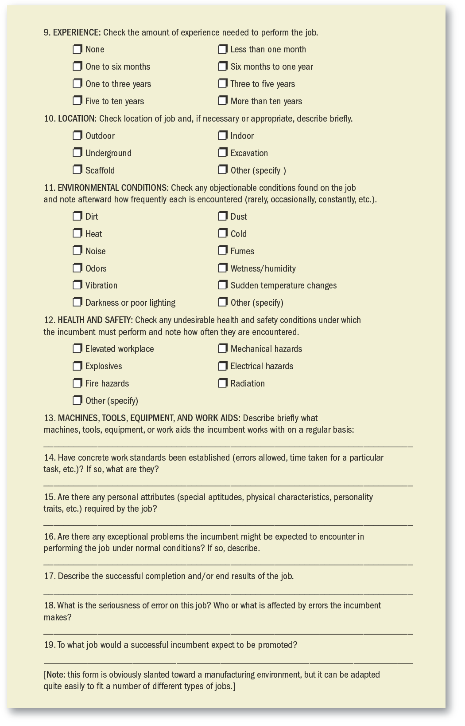
FIGURE 4–3 Job Analysis Questionnaire for Developing Job Descriptions (cont’d)
Copyright © 2011 Pearson Education
4–<number>
Notes:
Human Resources Management 12e
Gary Dessler
Copyright © 2011 Pearson Education
4–<number>

Slide 16
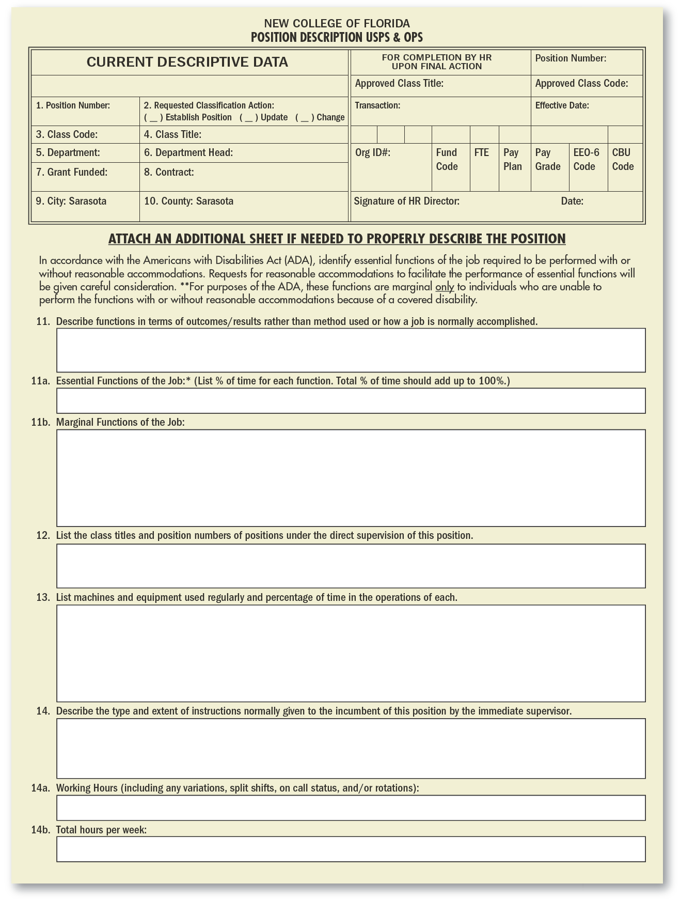
FIGURE 4–4 Example of Position/Job Description Intended for Use Online
Copyright © 2011 Pearson Education
4–<number>
Notes:
Human Resources Management 12e
Gary Dessler
Copyright © 2011 Pearson Education
4–<number>

Slide 17
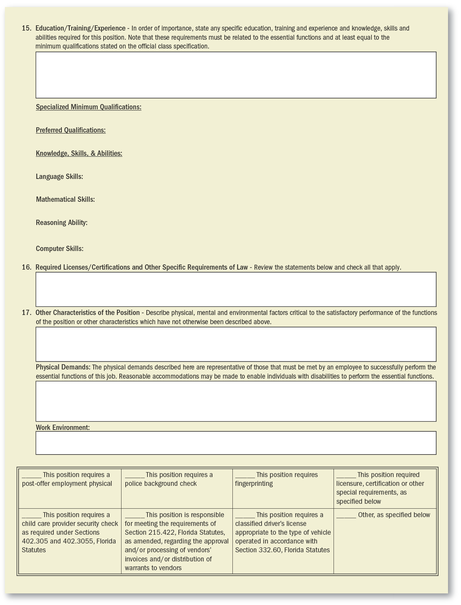
FIGURE 4–4 Example of Position/Job Description Intended for Use Online (cont’d)
Copyright © 2011 Pearson Education
4–<number>
Notes:
Human Resources Management 12e
Gary Dessler
Copyright © 2011 Pearson Education
4–<number>

Slide 18

Methods for Collecting Job Analysis Information: Observation
Information Source
  Observing and noting the physical activities of employees as they go about their jobs by managers.
Advantages
  Provides first-hand information
  Reduces distortion
  of information
Disadvantages
  Time consuming
  Reactivity response distorts employee behavior
  Difficulty in capturing
  entire job cycle
  Of little use if job involves a high level of mental activity
Copyright © 2011 Pearson Education
4–<number>
Notes:
Human Resources Management 12e
Gary Dessler
Copyright © 2011 Pearson Education
4–<number>
Direct observation is especially useful when jobs consist mainly of observable physical activities. Observation is usually not appropriate when the job entails a lot of mental activity or if the employee only occasionally engages in important activities. Reactivity—the worker’s changing what he or she normally does because you are watching—can also be a problem.

Slide 19

Methods for Collecting Job Analysis Information: Participant Diaries/Logs
Information Source
  Workers keep a chronological diary or log of what they do and the time spent on each activity
Advantages
  Produces a more complete picture of the job
  Employee participation
Disadvantages
  Distortion of information
  Depends upon employees to accurately recall their activities
Copyright © 2011 Pearson Education
4–<number>
Notes:
Human Resources Management 12e
Gary Dessler
Copyright © 2011 Pearson Education
4–<number>
Workers are asked to keep a record of what they do during the day by writing a diary/log. Employees record each of their activities (along with the time) in a log. This can produce a very complete picture of the job, especially when supplemented with subsequent interviews with the worker and the supervisor.
The employee, of course, might try to exaggerate some activities and underplay others. However, the detailed, chronological nature of the log tends to mediate against this.
Diaries/logs have gone high-tech. Some firms give employees pocket dictating machines and pagers. Then at random times during the day, they page the workers, who dictate what they are doing at that time. This approach can avoid one pitfall of the traditional diary/log method: relying on workers to remember what they did hours earlier when they complete their logs at the end of the day.

Slide 20
Quantitative Job Analysis Techniques
Quantitative Job Analysis
Position Analysis Questionnaire
Department of Labor (DOL) Procedure
Functional Job Analysis
Copyright © 2011 Pearson Education
4–<number>
Notes:
Human Resources Management 12e
Gary Dessler
Copyright © 2011 Pearson Education
4–<number>
Qualitative methods like interviews and questionnaires are not always suitable. For example, if your aim is to compare jobs for pay purposes, a mere listing of duties may not suffice.
You may need to say that, in effect, “Job A is twice as challenging as Job B, and so is worth twice the pay.” To do this, it helps to have quantitative ratings for each job. The position analysis questionnaire and the Department of Labor approach are quantitative methods for doing this.

Slide 21
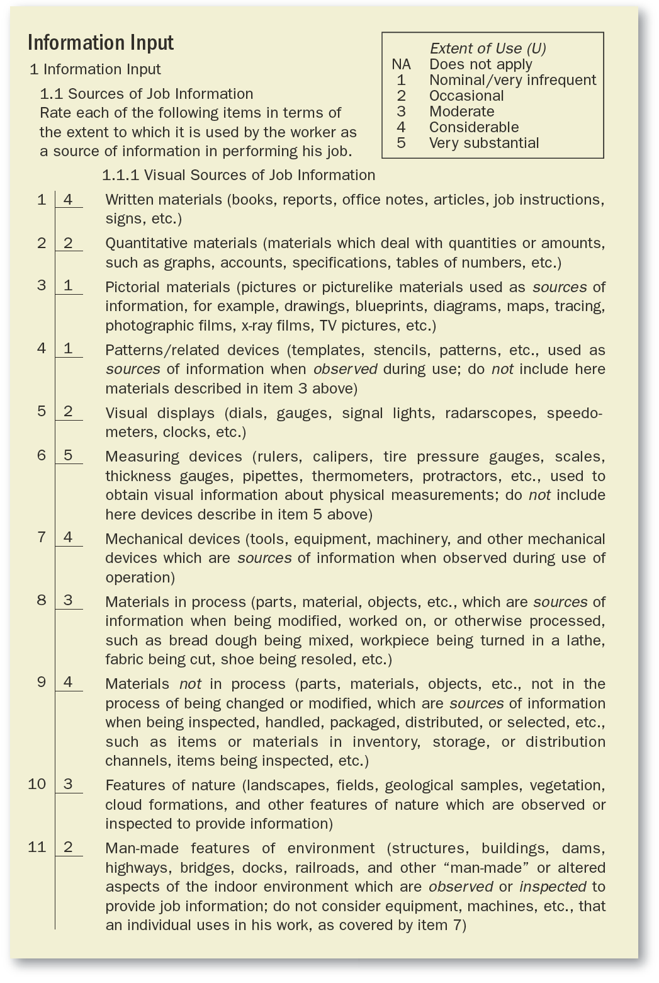
FIGURE 4–5 Portion of a Completed Page from the Position Analysis Questionnaire
The 194 PAQ elements are grouped into six dimensions. This exhibit lists 11 of the “information input” questions or elements. Other PAQ pages contain questions regarding mental processes, work output, relationships with others, job context, and other job characteristics.
Copyright © 2011 Pearson Education
4–<number>
Notes:
Human Resources Management 12e
Gary Dessler
Copyright © 2011 Pearson Education
4–<number>
The position analysis questionnaire (PAQ) is probably the most popular quantitative job analysis tool, and consists of a detailed questionnaire containing 194 items. The 194 items (such as “written materials”) each represent a basic element that may or may not play a role in the job.

Slide 22

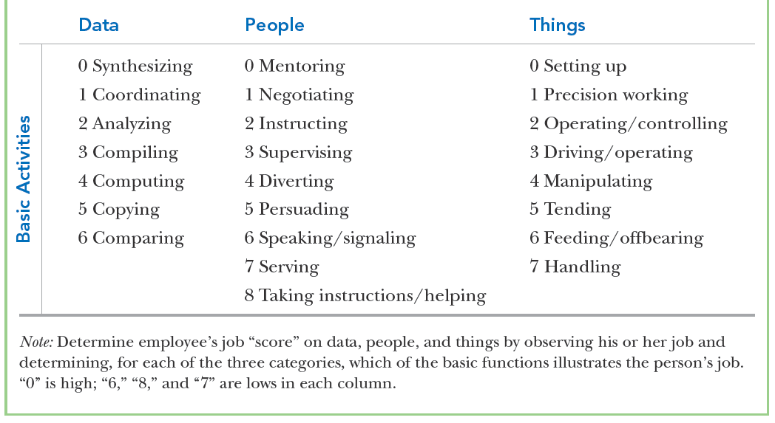
TABLE 4–1 Basic Department of Labor Worker Functions
Copyright © 2011 Pearson Education
4–<number>
Notes:
Human Resources Management 12e
Gary Dessler
Copyright © 2011 Pearson Education
4–<number>
The Department of Labor method uses a set of standard basic activities called worker functions to describe what a worker must do with respect to data, people, and things.
Another technique, functional job analysis, is similar to the DOL method. However, it rates the job not just on data, people, and things, but also on the extent to which performing the task also requires four other things—specific instructions, reasoning and judgment, mathematical ability, and verbal and language facilities.

Slide 23
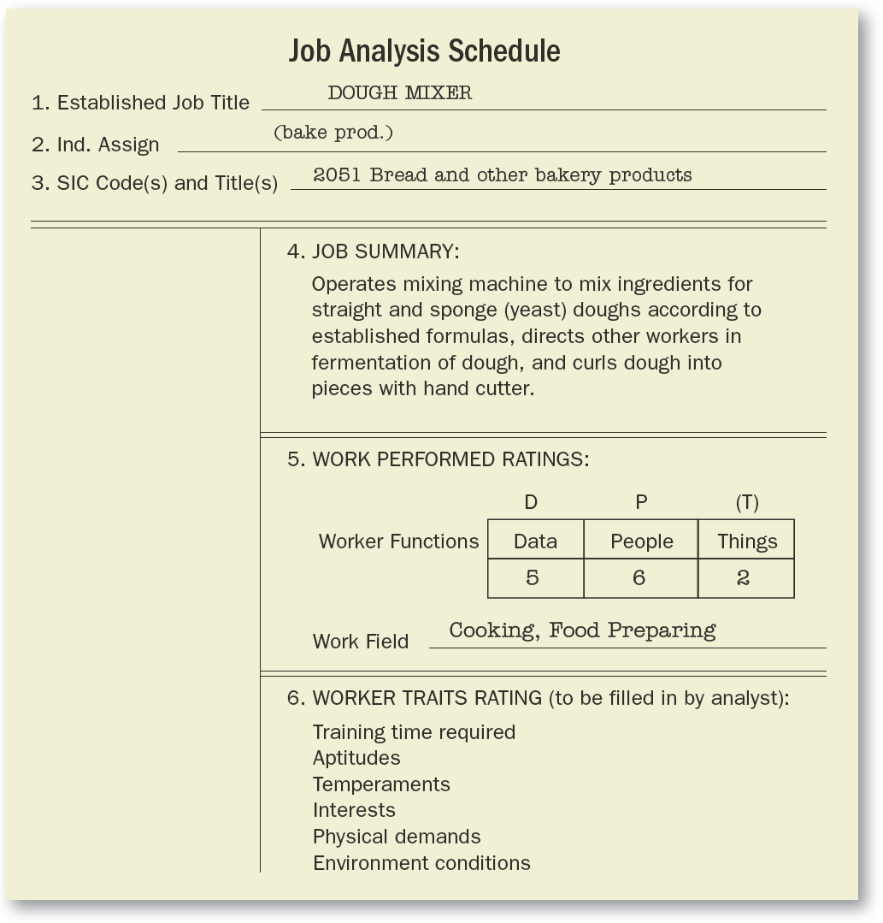
FIGURE 4–6 Sample Report Based on Department of Labor Job Analysis Technique
Copyright © 2011 Pearson Education
4–<number>
Notes:
Human Resources Management 12e
Gary Dessler
Copyright © 2011 Pearson Education
4–<number>

Slide 24

Internet-Based Job Analysis
Advantages
  Collects information in a standardized format from geographically dispersed employees
  Requires less time than face-to-face interviews
  Collects information with minimal intervention or guidance
Copyright © 2011 Pearson Education
4–<number>
Notes:
Human Resources Management 12e
Gary Dessler
Copyright © 2011 Pearson Education
4–<number>
Methods such as questionnaires and interviews present some drawbacks. For example, face-to-face interviews and observations can be time consuming. And collecting the information from geographically dispersed employees can be challenging.

Slide 25
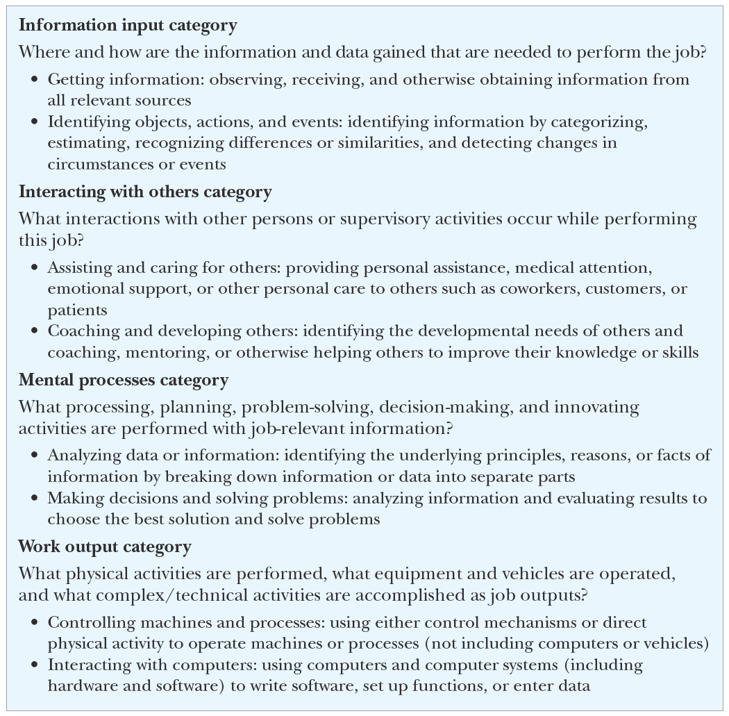
FIGURE 4–7 Selected O*NET General Work Activities Categories
Copyright © 2011 Pearson Education
4–<number>
Notes:
Human Resources Management 12e
Gary Dessler
Copyright © 2011 Pearson Education
4–<number>

Slide 26
Writing Job Descriptions
Job
identification
Job
specifications
Job
summary
Sections of a Typical Job Description
Working
conditions
Responsibilities and duties
Standards of performance
Authority of
the incumbent
Copyright © 2011 Pearson Education
4–<number>
Notes:
Human Resources Management 12e
Gary Dessler
Copyright © 2011 Pearson Education
4–<number>
There is no standard format for writing a job description. However, most descriptions contain sections that cover:
1. Job identification
2. Job summary
3. Responsibilities and duties
4. Authority of incumbent
5. Standards of performance
6. Working conditions
7. Job specifications

Slide 27
The Job Description
Job Identification
  Job title
  FLSA status section
  Preparation date
  Preparer
Job Summary
  General nature of the job
  Major functions/activities
Relationships
  Reports to:
  Supervises:
  Works with:
  Outside the company:
Responsibilities and Duties
  Major responsibilities and duties (essential functions)
  Decision-making authority
  Direct supervision
  Budgetary limitations
Standards of Performance and Working Conditions
  What it takes to do the job successfully
Copyright © 2011 Pearson Education
4–<number>
Notes:
Human Resources Management 12e
Gary Dessler
Copyright © 2011 Pearson Education
4–<number>
A job description is a written statement of what the worker actually does, how he or she does it, and what the job’s working conditions are. You use this information to write a job specification; this lists the knowledge, abilities, and skills required to perform the job satisfactorily.

Slide 28
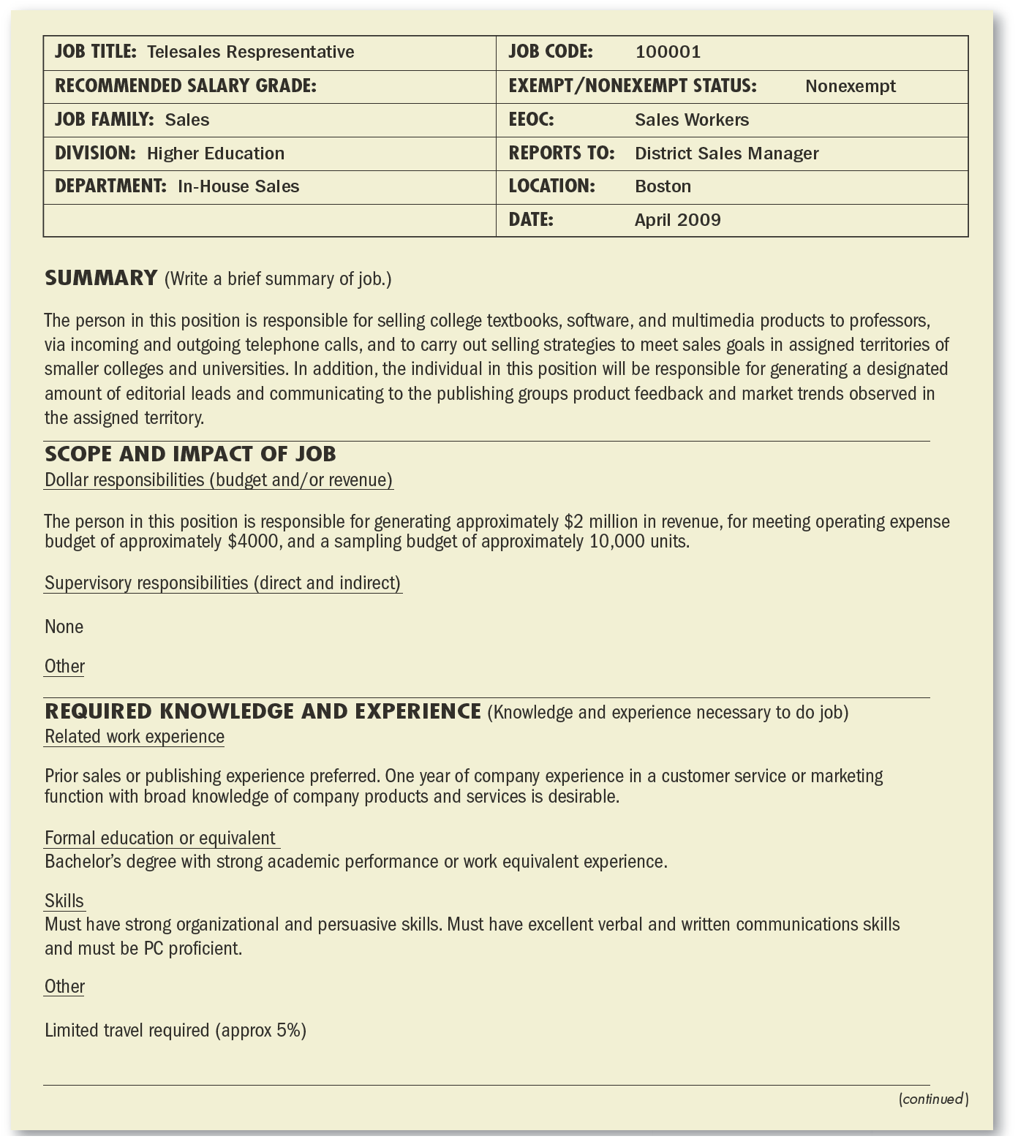
FIGURE 4–8 Sample Job Description, Pearson Education
Copyright © 2011 Pearson Education
4–<number>
Notes:
Human Resources Management 12e
Gary Dessler
Copyright © 2011 Pearson Education
4–<number>

Slide 29
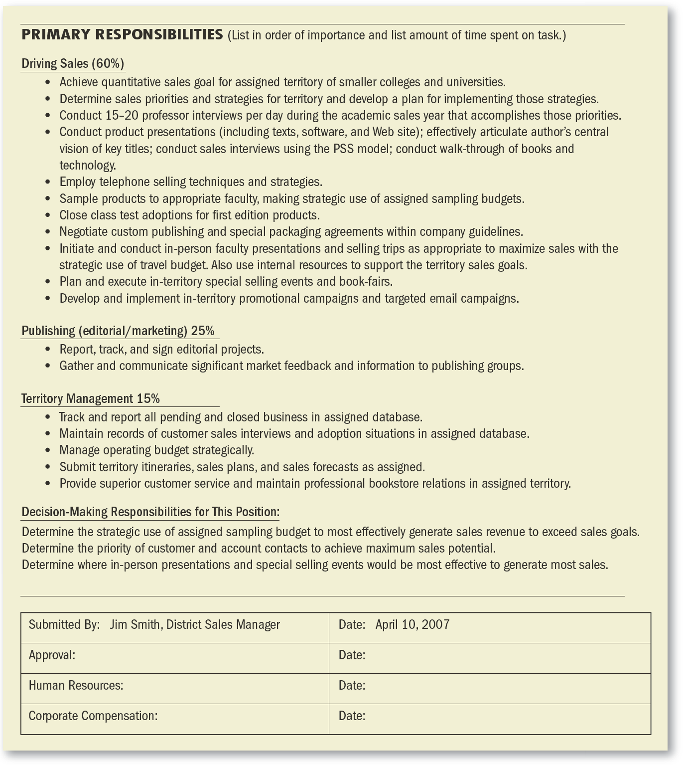
FIGURE 4–8 Sample Job Description, Pearson Education (cont’d)
Copyright © 2011 Pearson Education
4–<number>
Notes:
Human Resources Management 12e
Gary Dessler
Copyright © 2011 Pearson Education
4–<number>

Slide 30
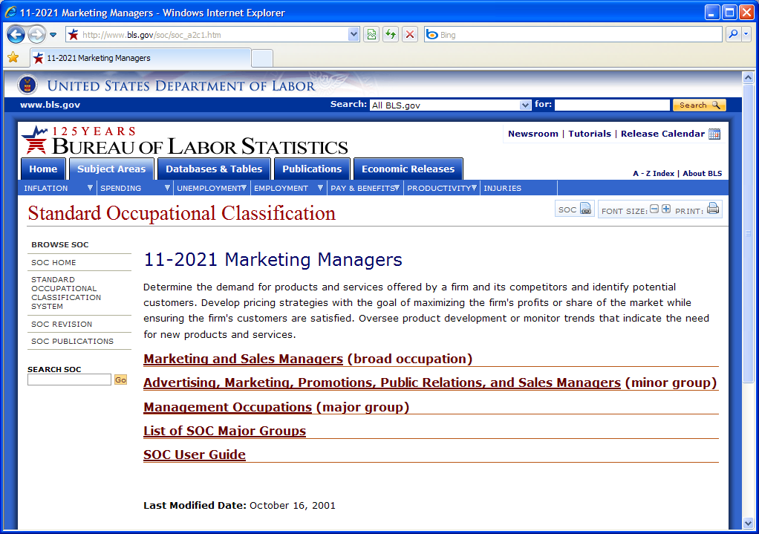
FIGURE 4–9 Marketing Manager Description from
Standard Occupational Classification
Copyright © 2011 Pearson Education
4–<number>
Notes:
Human Resources Management 12e
Gary Dessler
Copyright © 2011 Pearson Education
4–<number>
The U.S. Labor Department’s printed Dictionary of Occupational Titles is now evolved in an Internet-based resource for managers both within and outside the government to turn to for standard job descriptions.
The Standard Occupational Classification (SOC) classifies all workers into one of 23 major groups of jobs.

Slide 31
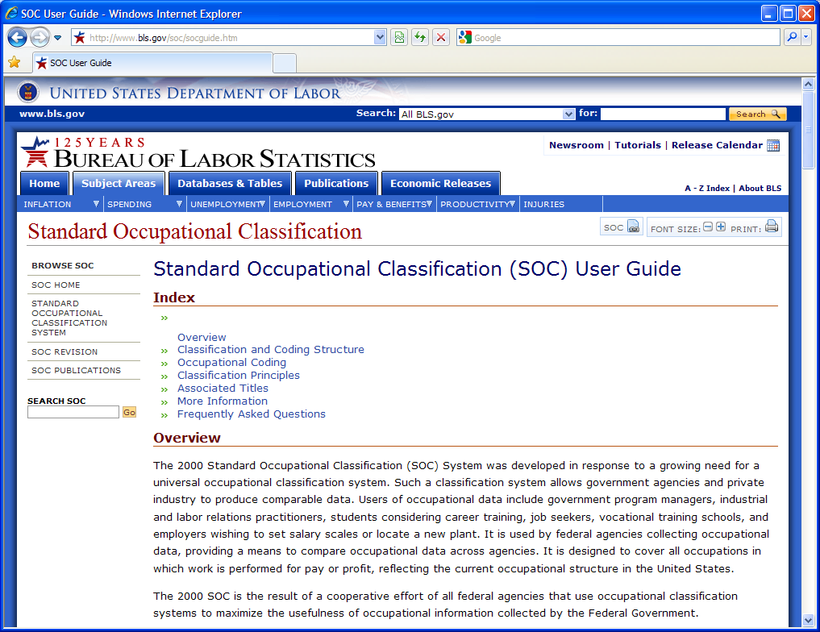
Using the Internet for Writing Job Descriptions
Copyright © 2011 Pearson Education
4–<number>
Notes:
Human Resources Management 12e
Gary Dessler
Copyright © 2011 Pearson Education
4–<number>
The Standard Occupational Classification User Guide provides detailed descriptions of thousands of jobs and their human requirements.

Slide 32
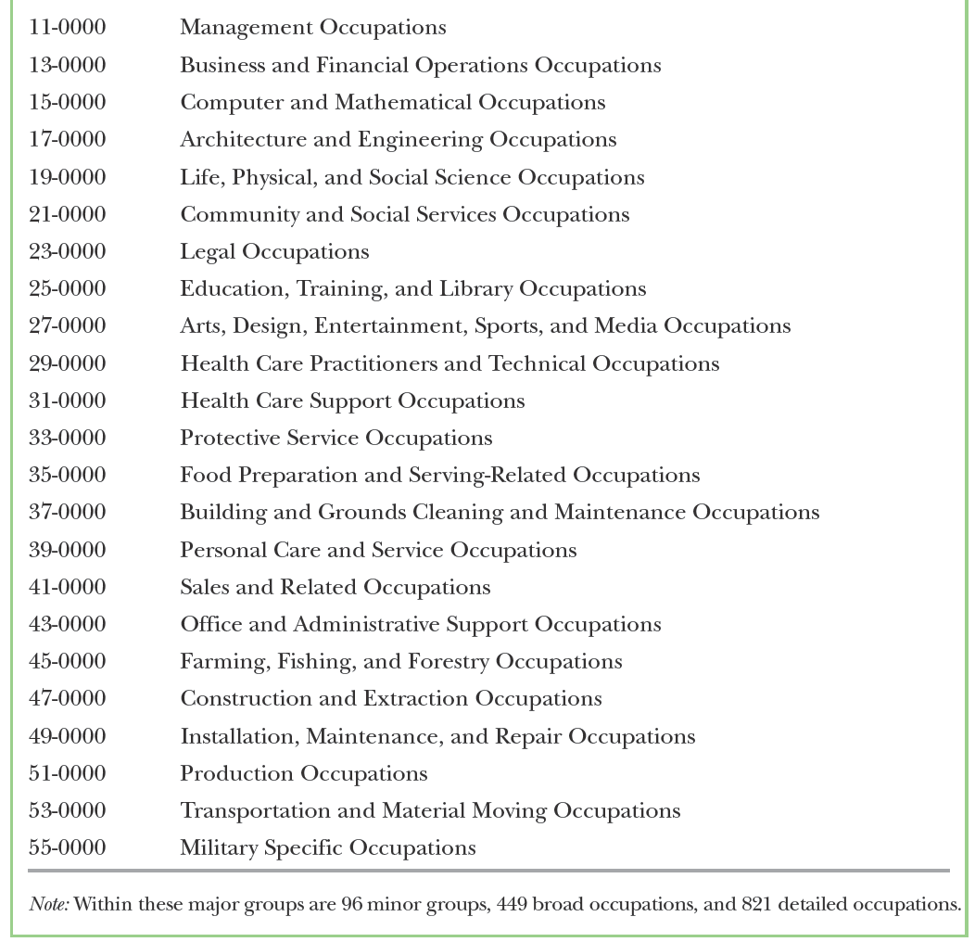
TABLE 4–2 SOC Major Groups of Jobs
Copyright © 2011 Pearson Education
4–<number>
Notes:
Human Resources Management 12e
Gary Dessler
Copyright © 2011 Pearson Education
4–<number>
The Department of Labor’s Standard Occupational Classification (SOC) guide classifies all workers into one of 23 major groups of jobs.

Slide 33
Writing Job Descriptions (cont’d)
Step 1. Decide on a Plan
Step 2. Develop an Organization Chart
Step 3. Use a Simplified Job Analysis Questionnaire
Step 4. Obtain List of Job Duties from O*NET
Step 5. Compile the Job’s Human Requirements
from O*NET
Step 6. Finalize the Job Description
Copyright © 2011 Pearson Education
4–<number>
Notes:
Human Resources Management 12e
Gary Dessler
Copyright © 2011 Pearson Education
4–<number>
We’ll focus here on the steps in writing a job description using job information gathered from the Bureau of Labor’s O*NET site.

Slide 34
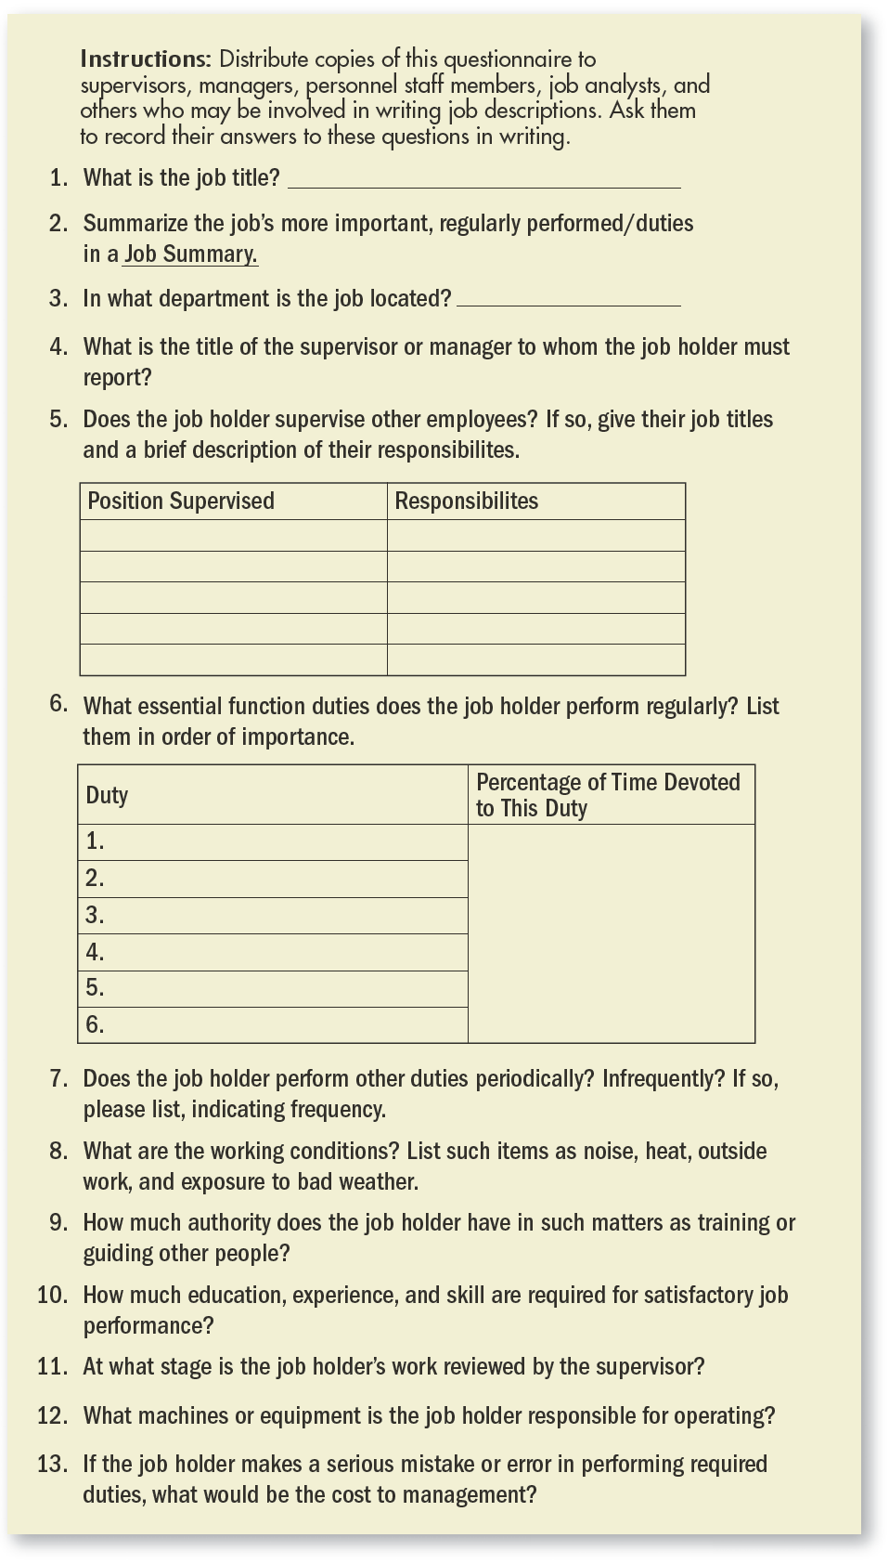
FIGURE 4–10 Preliminary Job Description Questionnaire
Copyright © 2011 Pearson Education
4–<number>
Notes:
Human Resources Management 12e
Gary Dessler
Copyright © 2011 Pearson Education
4–<number>

Slide 35

Using O*Net for Writing Job Descriptions
Copyright © 2011 Pearson Education
4–<number>
Notes:
Human Resources Management 12e
Gary Dessler
Copyright © 2011 Pearson Education
4–<number>
The U.S. Department of Labor’s occupational information network, called O*NET, allows users to see the most important characteristics of various occupations, as well as the experience, education, and knowledge required to do each job well.

Slide 36
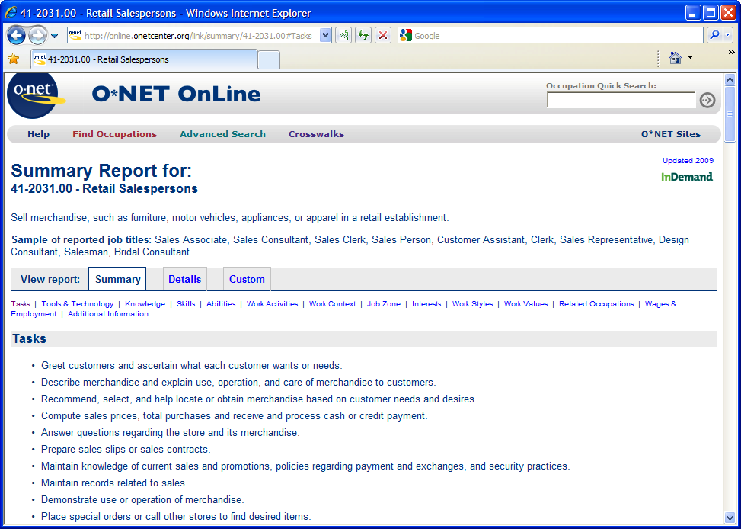
Using O*Net for Writing Job Descriptions (cont’d)
Copyright © 2011 Pearson Education
4–<number>
Notes:
Human Resources Management 12e
Gary Dessler
Copyright © 2011 Pearson Education
4–<number>
O*NET descriptions include the specific tasks associated with many occupations. O*NET also lists skills, including basic skills such as reading and writing, process skills such as critical thinking, and transferable skills such as persuasion and negotiation.

Slide 37
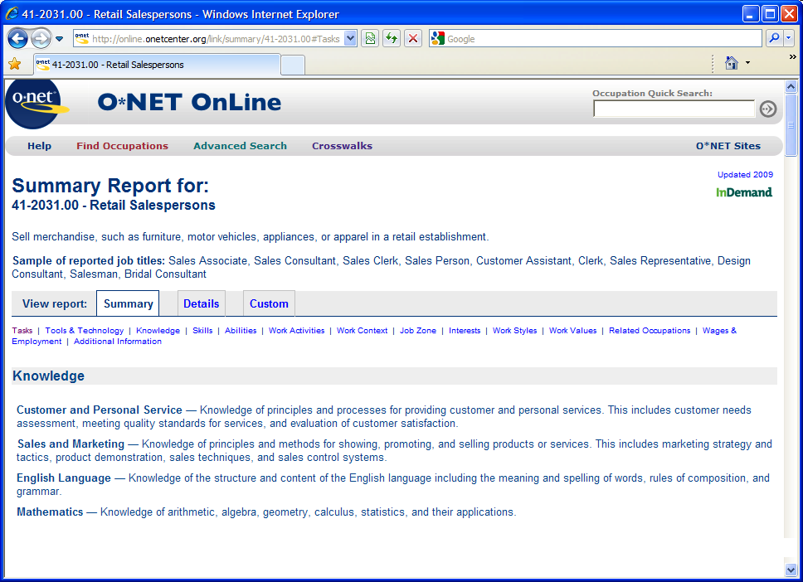
Using O*Net for Writing Job Descriptions (cont’d)
Copyright © 2011 Pearson Education
4–<number>
Notes:
Human Resources Management 12e
Gary Dessler
Copyright © 2011 Pearson Education
4–<number>
O*NET job listings include information on worker requirements such as the required knowledge, occupation requirements, and experience requirements (including education and job training).
You can also use O*NET to check the job’s labor market characteristics, such as employment projections and earnings data.

Slide 38
Writing Job Specifications
“What human traits and experience are required to do this job well?”
Job specifications
for trained versus untrained personnel
Job specifications based on judgment
Job specifications based on statistical analysis
Copyright © 2011 Pearson Education
4–<number>
Notes:
Human Resources Management 12e
Gary Dessler
Copyright © 2011 Pearson Education
4–<number>
The job specification focuses on the person in answering the question, “What human traits and experience are required to do this job effectively?”
It shows what kind of person to recruit and for what qualities you should test that person. The job specification may be a section of the job description, or a separate document.
Job specifications for trained employees focus on traits like length of previous service, quality of relevant training, and previous job performance.
Job specifications can be based on the best judgments of the common-sense experiences of supervisors and human resource managers. The basic procedure here is to ask, “What does it take in terms of education, intelligence, training, and the like to do this job well?”
Basing job specifications on statistical analysis is more defensible than the judgmental approach because equal rights legislation forbids using traits that can’t be proved to distinguish between high and low job performers.

Slide 39
Writing Job Specifications (cont’d)
Steps in the Statistical Approach
  Analyze the job and decide how to measure job performance.
  Select personal traits that you believe should predict successful performance.
  Test candidates for these traits.
  Measure the candidates’ subsequent job performance.
  Statistically analyze the relationship between the human traits and job performance.
Copyright © 2011 Pearson Education
4–<number>
Notes:
Human Resources Management 12e
Gary Dessler
Copyright © 2011 Pearson Education
4–<number>
The aim of the statistical approach is to determine the statistical relationship between (1) some predictor (human trait, such as height, intelligence, or finger dexterity), and (2) some indicator or criterion of job effectiveness, such as performance as rated by the supervisor.

Slide 40
Job Analysis in a Worker-Empowered World
Job Design:
From Specialized
to Enriched Jobs
Job
Enlargement
Job
Rotation
Job
Enrichment
Copyright © 2011 Pearson Education
4–<number>
Notes:
Human Resources Management 12e
Gary Dessler
Copyright © 2011 Pearson Education
4–<number>
Job enlargement attempts to make work more motivating by assigning workers additional same-level activities.
Job rotation involves systematically moving workers from one job to another.
Job enrichment involves redesigning jobs in a way that increases the opportunities for the worker to experience feelings of responsibility, achievement, growth, and recognition.

Slide 41
Other Changes at Work
Changing the Organization and
Its Structure
Flattening the organization
Using self-managed work teams
Reengineering business processes
Copyright © 2011 Pearson Education
4–<number>
Notes:
Human Resources Management 12e
Gary Dessler
Copyright © 2011 Pearson Education
4–<number>
Changes in how work is organized is evidenced by flattening of the organization, the rise of self-managed teams, and the constant focus on improving productivity through reengineering.

Slide 42
Competency-Based Job Analysis
Competencies
  Demonstrable characteristics of a person that enable performance of a job.
Reasons for Competency-Based Job Analysis
  To support a high-performance work system (HPWS).
  To create strategically-focused job descriptions.
  To support the performance management process in fostering, measuring, and rewarding:
    General competencies
    Leadership competencies
    Technical competencies
Copyright © 2011 Pearson Education
4–<number>
Notes:
Human Resources Management 12e
Gary Dessler
Copyright © 2011 Pearson Education
4–<number>
Competency-based job analysis means describing the job in terms of measurable, observable, behavioral competencies (knowledge, skills, and/or behaviors) that an employee doing that job must exhibit to do the job well.

Slide 43
How to Write Job Competencies-Based Job Descriptions
Interview job incumbents and their supervisors
  Ask open-ended questions about job responsibilities and activities.
  Identify critical incidents that pinpoint success on the job.
Use off-the-shelf competencies databanks
Copyright © 2011 Pearson Education
4–<number>
Notes:
Human Resources Management 12e
Gary Dessler
Copyright © 2011 Pearson Education
4–<number>
Defining the job’s competencies and writing them up involves a process that is similar to traditional job analysis. In other words, you might interview job incumbents and their supervisors, ask open-ended questions regarding job responsibilities and activities, and perhaps identify critical incidents that pinpoint success on the job.
But there the similarity ends. Instead of compiling lists of job duties, you will ask, “In order to perform this job competently, the employee should be able to . . . ?” You can use your knowledge of the job to answer this, or use a list like that mentioned at O*NET. There are also off-the-shelf competencies databanks.

Slide 44
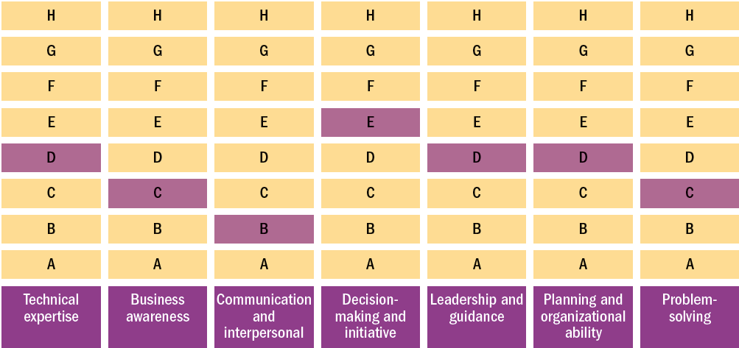
FIGURE 4–11 The Skills Matrix for One Job at BP
Note: The lighter color boxes within the individual columns indicate the minimum level of skill required for the job.
Copyright © 2011 Pearson Education
4–<number>
Notes:
Human Resources Management 12e
Gary Dessler
Copyright © 2011 Pearson Education
4–<number>
The skills matrix lists the basic skills needed for that job (such as technical expertise) and the minimum level of each skill required for that job or job family. The emphasis is no longer on specific job duties. Instead, the focus is on developing the new skills needed for the employees’ broader and empowered responsibilities.

Slide 45
K E Y T E R M S
job analysis
job description
job specifications
organization chart
process chart
diary/log
position analysis questionnaire (PAQ)
Standard Occupational Classification (SOC)
job enlargement
job rotation
job enrichment
competency-based job analysis
Copyright © 2011 Pearson Education
4–<number>
Notes:
Human Resources Management 12e
Gary Dessler
Copyright © 2011 Pearson Education
4–<number>

Slide 46
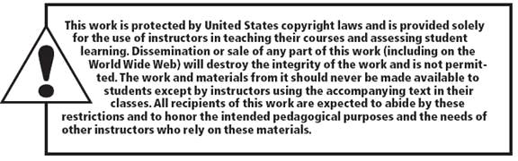
All rights reserved. No part of this publication may be reproduced, stored in a retrieval system, or transmitted, in any form or by any means, electronic, mechanical, photocopying, recording, or otherwise, without the prior written permission of the publisher. Printed in the United States of America.
Copyright © 2011 Pearson Education
4–<number>
Notes:
Human Resources Management 12e
Gary Dessler
Copyright © 2011 Pearson Education
4–<number>

