Slide 1
Strategic Human Resource
Management and the HR Scorecard

Slide 2

After studying this chapter, you should be able to:
Outline the steps in the strategic management process.
Explain and give examples of each type of companywide and competitive strategy.
Explain what a high performance work system is and why it is important.
Illustrate and explain each of the seven steps in the HR Scorecard approach to creating HR systems.
3–<number>
© 2005 Prentice Hall Inc. All rights reserved.

Slide 3
HR’s Strategic Challenges
Strategic plan
  A company’s plan for how it will match its internal strengths and weaknesses with external opportunities and threats in order to maintain a competitive advantage.
Three basic challenges
  The need to support corporate productivity and performance improvement efforts.
  That employees play an expanded role in employers’ performance improvement efforts.
  HR must be more involved in designing—not just executing—the company’s strategic plan.
3–<number>
© 2005 Prentice Hall Inc. All rights reserved.

Slide 4
The Strategic Management Process
Strategic management
  The process of identifying and executing the organization’s mission by matching its capabilities with the demands of its environment.
Strategy
  A strategy is a course of action.
  The company’s long-tem plan for how it will balance its internal strengths and weaknesses with its external opportunities and threats to maintain a competitive advantage.
3–<number>
© 2005 Prentice Hall Inc. All rights reserved.

Slide 5
Business Mission and Its Vision
Vision
  A general statement of its intended direction that evokes emotional feelings in organization members.
Mission
  Spells out who the company is, what it does, and where it’s headed.
3–<number>
© 2005 Prentice Hall Inc. All rights reserved.

Slide 6
Strategic Management Process (cont’d)
Strategic management tasks
  Step 1: Define the Business and Its Mission
  Step 2: Perform External and Internal Audits
  Step 3: Translate the Mission into Strategic Goals
  Step 4: Formulate a Strategy to Achieve the
  Strategic Goals
  Step 5: Implement the Strategy
  Step 6: Evaluate Performance
3–<number>
© 2005 Prentice Hall Inc. All rights reserved.

Slide 7
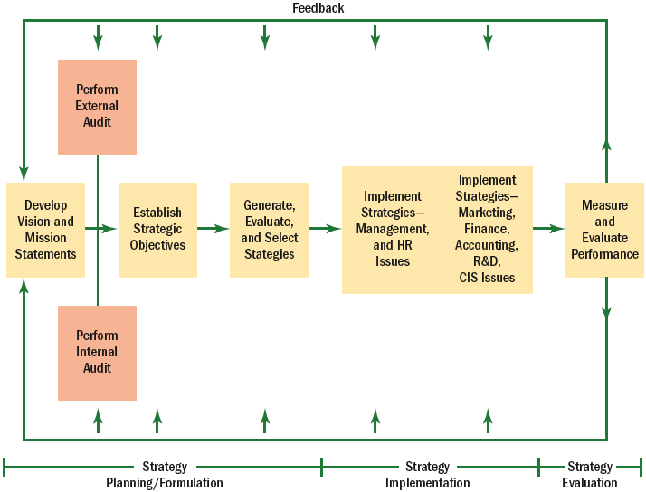
Overview of Strategic Management
Figure 3–1
3–<number>
© 2005 Prentice Hall Inc. All rights reserved.

Slide 8
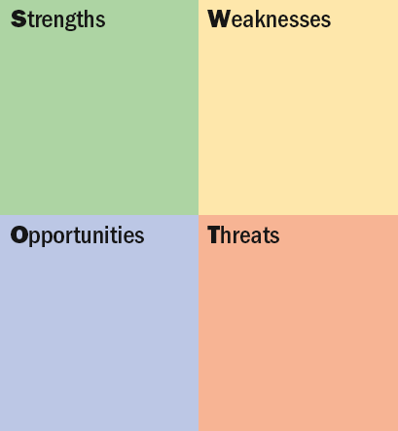
A SWOT Chart
SWOT Analysis
The use of a SWOT chart to compile and organize the process of identifying company
Strengths,
Weaknesses,
Opportunities, and Threats.
Figure 3–2
3–<number>
© 2005 Prentice Hall Inc. All rights reserved.

Slide 9
Strategies in Brief
Company Strategic Principle
Dell Be direct
eBay Focus on trading communities
General Electric Be number one or number two in every
industry in which we compete, or get out
Southwest Airlines Meet customers’ short-haul travel needs
at fares competitive with the cost of automobile travel
Vanguard Unmatchable value for the investor-owner
Wal-Mart Low prices, every day
Source: Arit Gadiesh and James Gilbert, “Frontline Action,” Harvard Business Review, May 2001, p. 74.
Figure 3–3
3–<number>
© 2005 Prentice Hall Inc. All rights reserved.

Slide 10
Types of Strategic Planning
Corporate-level strategy
  Identifies the portfolio of businesses that, in total, comprise the company and the ways in which these businesses relate to each other.
    Diversification strategy implies that the firm will expand by adding new product lines.
    Vertical integration strategy means the firm expands by, perhaps, producing its own raw materials, or selling its products direct.
    Consolidation strategy reduces the company’s size
    Geographic expansion strategy takes the company abroad.
3–<number>
© 2005 Prentice Hall Inc. All rights reserved.

Slide 11
Types of Strategic Planning (cont’d)
Business-level/competitive strategy
  Identifies how to build and strengthen the business’s long-term competitive position in the marketplace.
    Cost leadership: the enterprise aims to become the low-cost leader in an industry.
    Differentiation: a firm seeks to be unique in its industry along dimensions that are widely valued by buyers.
    Focus: a firm seeks to carve out a market niche, and compete by providing a product or service customers can get in no other way.
3–<number>
© 2005 Prentice Hall Inc. All rights reserved.

Slide 12
Types of Strategic Planning (cont’d)
Functional strategies
  Identify the basic courses of action that each department will pursue in order to help the business attain its competitive goals.
3–<number>
© 2005 Prentice Hall Inc. All rights reserved.

Slide 13
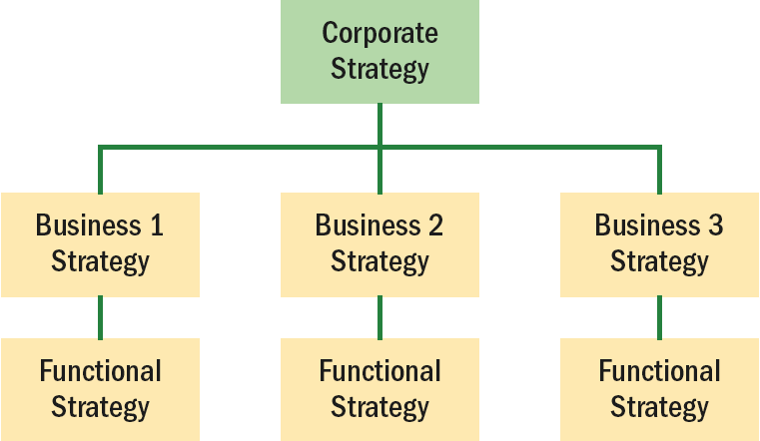
Relationships Among Strategies in Multiple- Business Firms
Figure 3–4
3–<number>
© 2005 Prentice Hall Inc. All rights reserved.

Slide 14
Achieving Strategic Fit
Michael Porter
  Emphasizes the “fit” point of view that all of the firm’s activities must be tailored to or fit its strategy, by ensuring that the firm’s functional strategies support its corporate and competitive strategies.
Gary Hamel and C. K. Prahalad
  Argue for “stretch” in leveraging resources—supplementing what you have and doing more with what you have—can be more important than just fitting the strategic plan to current resources.
3–<number>
© 2005 Prentice Hall Inc. All rights reserved.

Slide 15
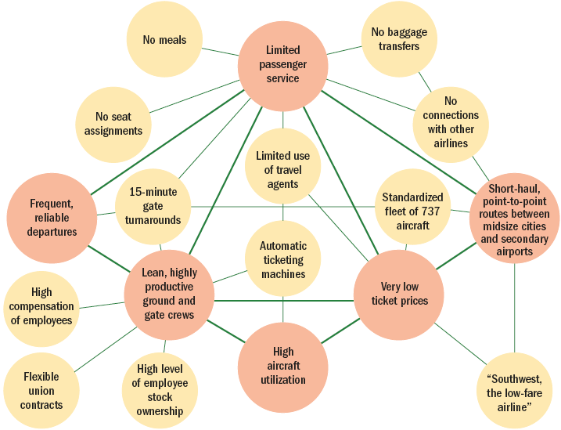
The Southwest Airlines’ Activity System
Source: Reprinted by permission of Harvard Business Review. From “What is Strategy?” by Michael E. Porter, November–December 1996. Copyright © 1996 by the President and Fellows of Harvard College, all rights reserved.
Figure 3–5
3–<number>
© 2005 Prentice Hall Inc. All rights reserved.

Slide 16
HR and Competitive Advantage
Competitive advantage
  Any factors that allow an organization to differentiate its product or service from those of its competitors to increase market share.
  Superior human resources are an important source of competitive advantage
3–<number>
© 2005 Prentice Hall Inc. All rights reserved.

Slide 17
Strategic Human Resource Management
Strategic Human Resource Management
  The linking of HRM with strategic goals and objectives in order to improve business performance and develop organizational cultures that foster innovation and flexibility.
  Formulating and executing HR systems—HR policies and activities—that produce the employee competencies and behaviors the company needs to achieve its strategic aims.
3–<number>
© 2005 Prentice Hall Inc. All rights reserved.

Slide 18
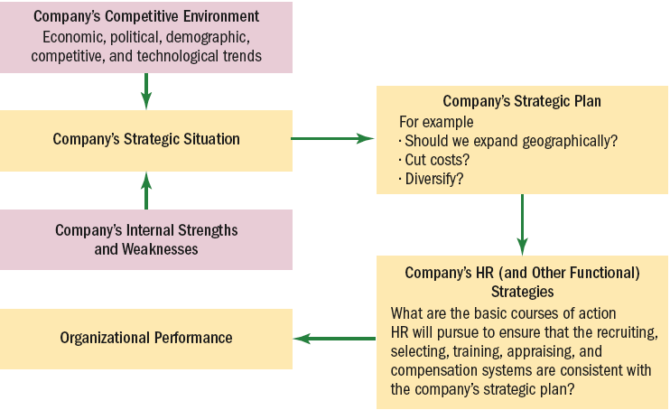
Linking Corporate and HR Strategies
Source: © 2003, Gary Dessler, Ph.D.
Figure 3–6
3–<number>
© 2005 Prentice Hall Inc. All rights reserved.

Slide 19
HR’S Strategic Roles
HR professionals should be part of the firm’s strategic planning executive team.
  Identify the human issues that are vital to business strategy.
  Help establish and execute strategy.
  Provide alternative insights.
  Are centrally involved in creating responsive and market-driven organizations.
  Conceptualize and execute organizational change.
3–<number>
© 2005 Prentice Hall Inc. All rights reserved.

Slide 20
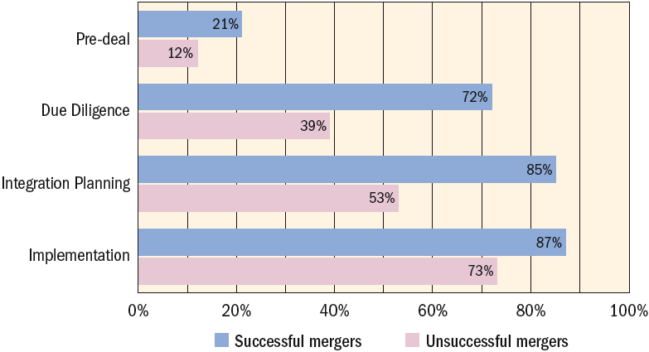
HR Involvement in Mergers
Source: Jeffrey Schmidt, “The Correct Spelling of M & A Begins with HR,” HR Magazine, June 2001, p. 105.
Figure 3–7
3–<number>
© 2005 Prentice Hall Inc. All rights reserved.

Slide 21
HR’s Strategy Execution Role
The HR department’s strategies, policies, and activities must make sense in terms of the company’s corporate and competitive strategies, and they must support those strategies.
3–<number>
© 2005 Prentice Hall Inc. All rights reserved.

Slide 22
HR’s Strategy Formulation Role
HR helps top management formulate strategy in a variety of ways by.
  Supplying competitive intelligence that may be useful in the strategic planning process.
  Supplying information regarding the company’s internal human strengths and weaknesses.
  Build a persuasive case that shows how—in specific and measurable terms—the firm’s HR activities can and do contribute to creating value for the company.
3–<number>
© 2005 Prentice Hall Inc. All rights reserved.

Slide 23
Creating a Strategy-oriented HR System
Components of the HR process
  HR professionals who have strategic and other skills
  HR policies and activities that comprise the HR system itself
  Employee behaviors and competencies that the company’s strategy requires.
3–<number>
© 2005 Prentice Hall Inc. All rights reserved.

Slide 24
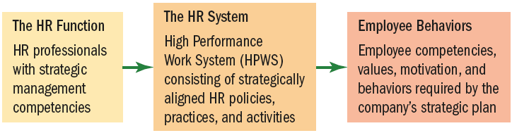
The Basic Architecture of HR
Source: Adapted from Brian Becker et al., The HR Scorecard: Linking People, Strategy, and Performance (Boston: Harvard Business School Press, 2001), p. 12.
Figure 3–8
3–<number>
© 2005 Prentice Hall Inc. All rights reserved.

Slide 25
The High-Performance Work System
High-performance work system (HPWS) practices.
  High-involvement employee practices (such as job enrichment and team-based organizations),
  High commitment work practices (such as improved employee development, communications, and disciplinary practices)
  Flexible work assignments.
  Other practices include those that foster skilled workforces and expanded opportunities to use those skills.
3–<number>
© 2005 Prentice Hall Inc. All rights reserved.

Slide 26
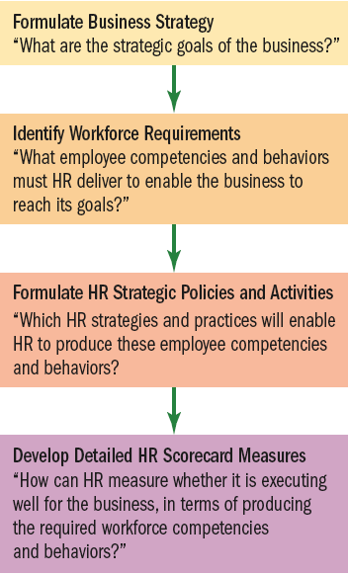
Basic Model of How to Align
HR Strategy and Actions with Business Strategy
Translating Strategy into HR Policy and Practice
Source: Adapted from Garrett Walker and J. Randal MacDonald, “Designing and Implementing an HR Scorecard,” Human Resources Management 40, no. 4 (2001), p. 370.
Figure 3–9
3–<number>
© 2005 Prentice Hall Inc. All rights reserved.

Slide 27
The HR Scorecard Approach
HR scorecard
  Measures the HR function’s effectiveness and efficiency in producing employee behaviors needed to achieve the company’s strategic goals.
Creating an HR scorecard
  Must know what the company’s strategy is.
  Must understand the causal links between HR activities, employee behaviors, organizational outcomes, and the organization’s performance.
  Must have metrics to measure all the activities and results involved.
3–<number>
© 2005 Prentice Hall Inc. All rights reserved.

Slide 28
Strategic HR Relationships
HR
Activities
Emergent Employee Behaviors
Strategically Relevant Organizational Outcomes
Organizational Performance
Achieve Strategic Goals
Figure 3–10
3–<number>
© 2005 Prentice Hall Inc. All rights reserved.

Slide 29
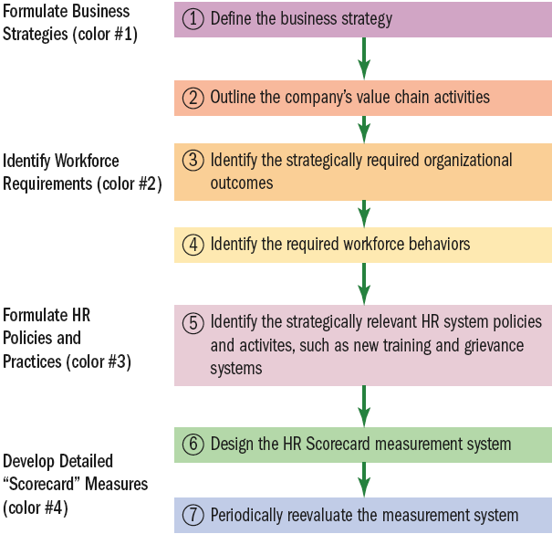
The HR Scorecard Approach to Formulating HR Policies,
Activities, and Strategies
Source: Copyright © Gary Dessler, Ph.D.
Figure 3–11
3–<number>
© 2005 Prentice Hall Inc. All rights reserved.

Slide 30
Using the HR Scorecard Approach
Step 1: Define the Business Strategy
Step 2: Outline the Company’s Value Chain
Step 3: Identify the Strategically Required Organizational Outcomes
Step 4: Identify the Required Workforce Competencies and Behaviors
Step 5: Identify the Strategically Relevant HR
System Policies and Activities
Step 6: Design the HR Scorecard Measurement System
Step 7: Periodically Evaluate the Measurement System
3–<number>
© 2005 Prentice Hall Inc. All rights reserved.

Slide 31
Outlining the Company’s Value Chain
Value chain analysis
  A tool for identifying, isolating, visualizing, and analyzing the firm’s most important activities and strategic costs.
  Identifying the primary and crucial activities that create value for customers and the related support activities.
    Each activity is part of the process of designing, producing, marketing, and delivering the company’s product or service.
  Shows the chain of essential activities.
  Prompts future questions.
3–<number>
© 2005 Prentice Hall Inc. All rights reserved.

Slide 32
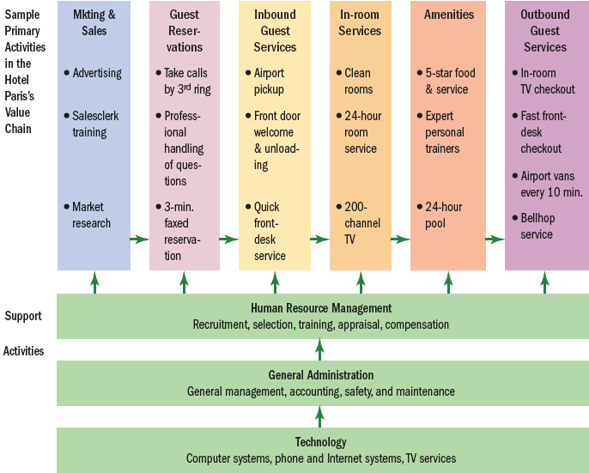
Simple Value Chain for “the Hotel Paris”
Figure 3–12
Source: Copyright © Gary Dessler, Ph.D.
3–<number>
© 2005 Prentice Hall Inc. All rights reserved.

Slide 33
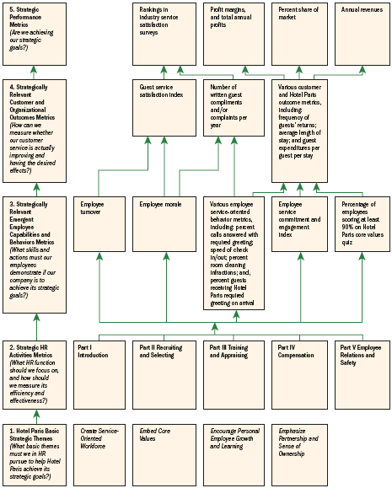
HR Scorecard for the Hotel Paris International Corporation*
Note:*(An abbreviated example showing selected HR practices and outcomes aimed at implementing the competitive strategy, “To use superior guest services to differentiate the Hotel Paris properties and thus increase the length of stays and the return rate of guests, and thus boost revenues and profitability”).
Figure 3–13
3–<number>
© 2005 Prentice Hall Inc. All rights reserved.

Slide 34
Key Terms
competitive advantage
HR Scorecard
leveraging
metrics
mission strategic control
strategic human resource
manager
strategic management
strategic plan
strategy
SWOT analysis
value chain analysis
vision
3–<number>
© 2005 Prentice Hall Inc. All rights reserved.

