Slide 1
CAMPUS ELECTRICITY
CONSUMPTION FORECASTING
Mini Project — Predictive Analysis Theory
M.Sc. (Data Science), Semester III | Activity 2
Roll Number: 11 | Academic Year: 2026–27
Department of Computer Science, Dr. D. Y. Patil Arts, Commerce & Science College, Pimpri

Slide 2
Problem Statement & Motivation
Campus electricity demand changes with class schedules, lab use, weekends, seasons, and facility operations.
Forecasts can support energy budgeting, operational planning, and identifying unusual consumption.
Goal: compare time-series baselines with a feature-based machine-learning model for daily kWh.

Slide 3
Objectives
Prepare and validate timestamped electricity data.
Visualise daily and calendar-based patterns.
Build lag and calendar features for forecasting.
Compare four methods using MAE, RMSE, and MAPE.
Generate an illustrative 14-day forecast and explain limitations.

Slide 4
Dataset & Provenance
Data integrity note: synthetic values are clearly labelled throughout
Included dataset is SYNTHETIC and generated for this demonstration—not measured college usage.
Period: 1 Jan–31 Dec 2025; 8,760 hourly rows.
Fields: timestamp and consumption_kwh; hourly values are aggregated into daily kWh.
Demo mean daily total: 112.2 kWh/day; demo daily standard deviation: 17.9 kWh/day.
Replace with authorised meter readings before making campus-specific claims.

Slide 5
Methodology Workflow
1. Parse timestamps, sort, inspect duplicates/missing intervals.
2. Aggregate hourly readings to daily kWh totals.
3. Plot the time series and inspect weekly/seasonal structure.
4. Create lag-1, lag-7, trailing 7-day mean, and calendar features.
5. Use chronological 80/20 train/test split; do not shuffle.
6. Evaluate baselines and Random Forest on the holdout period.

Slide 6
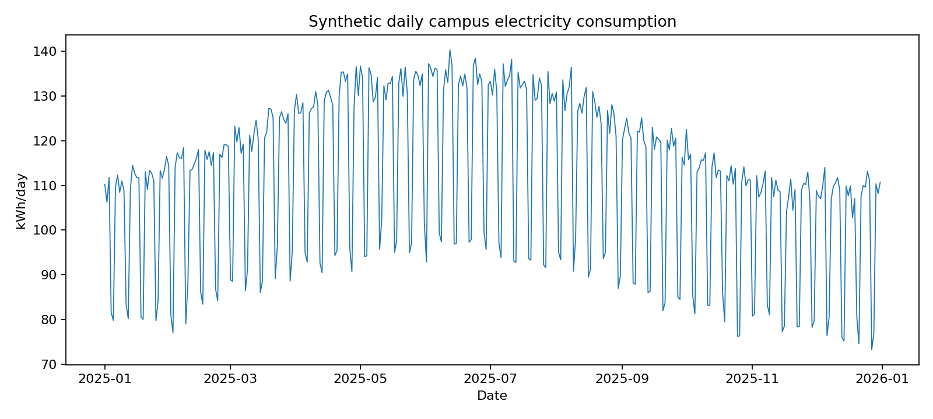
Daily Consumption Pattern
Synthetic demonstration data; not real campus readings

Slide 7
Preprocessing & Feature Engineering
Timestamp parsing and chronological sorting establish a valid time index.
Daily kWh = sum of hourly kWh observations for each calendar day.
Lag 1 captures recent demand; lag 7 captures the previous same weekday.
Trailing 7-day average smooths short-term fluctuations.
Calendar features: day of week, day of year, month, and weekend indicator.
Real data: investigate missing meter intervals; do not automatically fill with zero.

Slide 8
Forecasting Models
Persistence: forecast tomorrow using yesterday’s daily total.
Seasonal naive: use the daily total from seven days earlier.
7-day moving average: average the previous seven daily totals.
Random Forest: nonlinear ensemble using lag and calendar features.
Baselines matter: a complex model should beat simple, transparent methods.

Slide 9
Model Evaluation
Chronological test period; one-step-ahead rolling evaluation
Model | MAE (kWh/day) | RMSE (kWh/day) | MAPE (%)
Persistence (yesterday) | 10.68 | 16.96 | 11.55
Seasonal naive (7 days) | 2.95 | 3.86 | 3.01
7-day moving average | 12.63 | 14.33 | 13.84
Random Forest | 3.78 | 4.43 | 3.99
Lowest MAE in this synthetic run: Seasonal naive (7 days). Lower is better; do not generalise this ranking to real campus data.

Slide 10
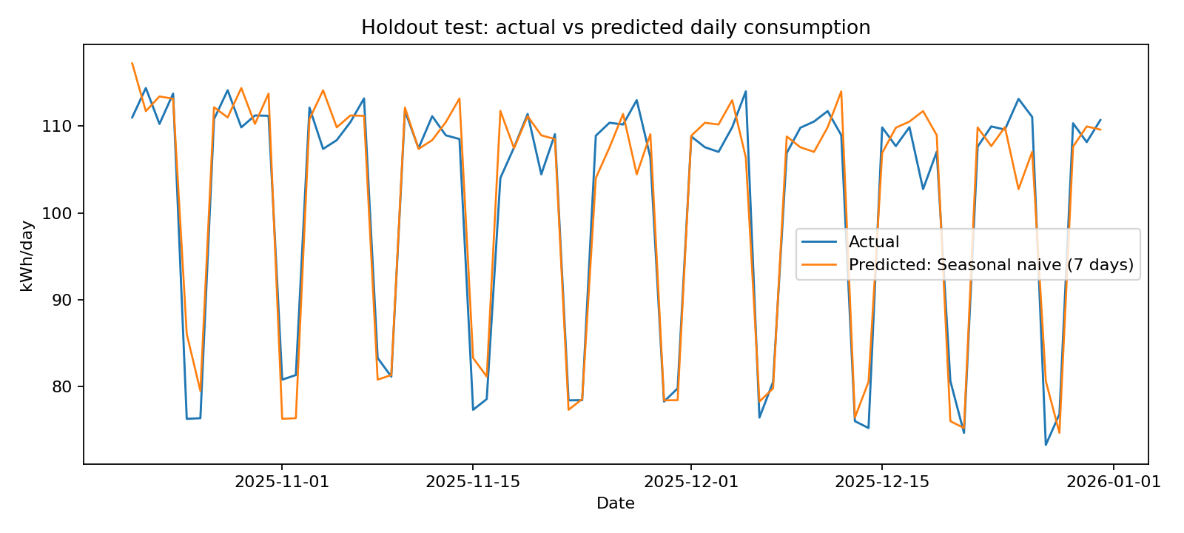
Actual vs Predicted
Synthetic holdout period

Slide 11
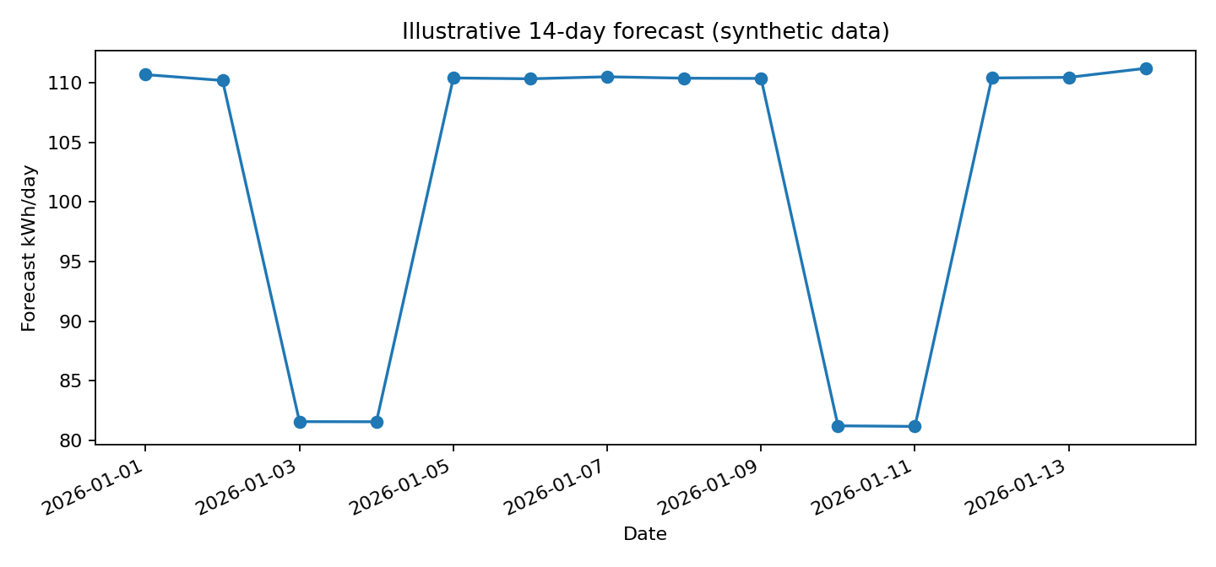
Illustrative 14-Day Forecast
Recursive forecast generated from synthetic data

Slide 12
Interpretation & Practical Use
Daily and weekly patterns can inform staffing, lab schedules, and energy planning.
Forecasts can support budgeting and flag days that differ sharply from expectations.
Combine meter readings with holidays, weather, occupancy, and equipment schedules when available.
Use prediction intervals or scenarios—not only point forecasts—for operational decisions.

Slide 13
Limitations & Next Steps
All supplied values are synthetic; the results are methodological examples only.
Simulation cannot capture real holidays, occupancy, weather extremes, outages, or campus-specific equipment.
Collect 12–24 months of authorised hourly or 15-minute meter readings.
Tune on a validation period, retain a final chronological test set, and compare seasonal baselines.
Re-run the analysis and update all charts/tables before submitting real campus findings.

Slide 14
Conclusion
The project demonstrates preprocessing, time-series visualisation, feature engineering, forecasting, and evaluation.
MAE, RMSE, and MAPE provide complementary measures of forecast error.
The best real-world model must be selected using actual campus meter data.
A reproducible pipeline can be extended with weather, academic calendar, and occupancy features.

Slide 15
References
Hyndman & Athanasopoulos (2021), Forecasting: Principles and Practice, 3rd ed. — otexts.com/fpp3/
Pedregosa et al. (2011), Scikit-learn: Machine Learning in Python, JMLR 12, 2825–2830.
McKinney (2010), Data Structures for Statistical Computing in Python, SciPy 2010.
Matplotlib documentation — matplotlib.org/stable/
Dataset provenance: synthetic hourly series generated for this demonstration; no empirical dataset used.

