Slide 1

Smart food disturbution system TEAM DETAILS
Team Name:Smart serve
Team members:
V.Kavya Sri - 24A31A1228( 2nd Year IT)
T.Sirisha - 24A31A1227( 2nd Year IT)
V.Meghana - 24A31A1229( 2nd Year IT)
M.Gayathri - 24A31A1214( 2nd Year IT)
M.Anitha - 24A31A1215 ( 2nd Year IT)
Ps Category:software
THEME
Environment & Sustainability

Slide 2
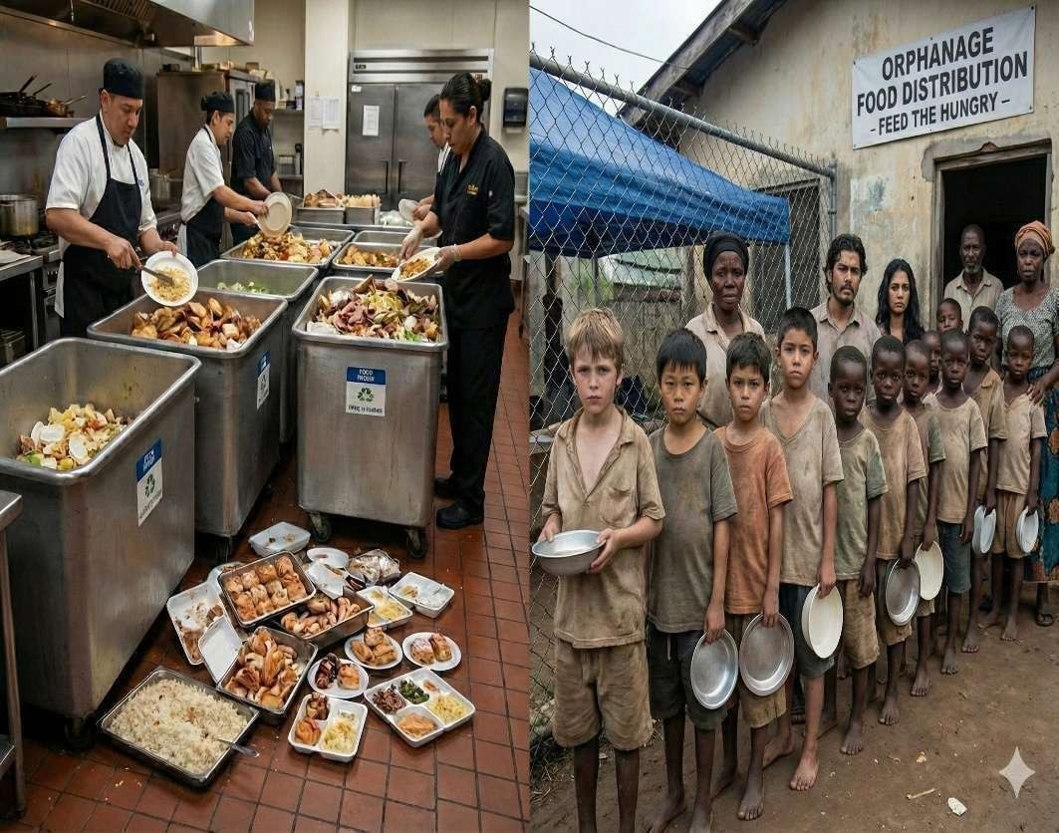
Problem Statement
Every day, a lot of food is wasted from restaurants, events, and homes, while many people go hungry. The main problem is the lack of a proper system to connect people who have extra food with those who need it.
Currently, food distribution is not well organized, and there is no real-time platform to manage donations. Because of this, food gets spoiled, and needy people do not receive it on time.

Slide 3
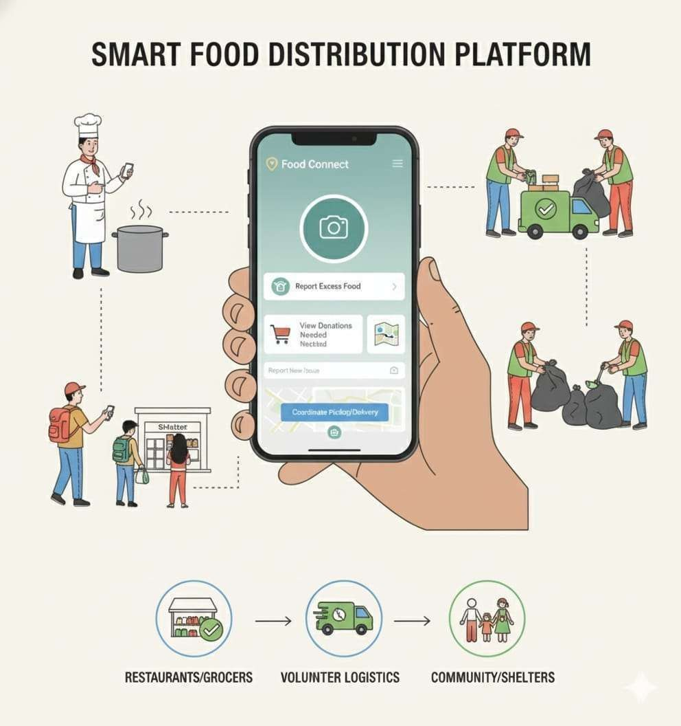
Proposed Solution with Architecture and Key Features
Proposed solution:
We propose a Smart Food Distribution System
that uses technology to connect food donors,
NGOs, volunteers, and homeless people in real time.
Flowchart:
User (Donor App) → Uploads food
↓
Backend (Database + API)
↓
NGO/Volunteer App → Accepts
Key features:
Reduced food wastage
More people get meals
Faster food delivery
Increased transparency
Trust between donors &
NGOs
pickup ↓
Maps API → Navigation
↓
Distribution Completed
↓
Dashboard (Admin Transparency)

Slide 4
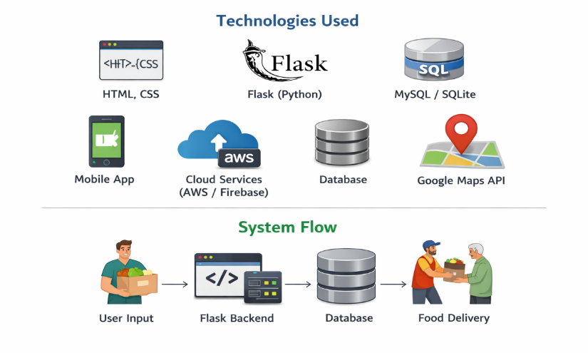
Technologies Used & System Flow
🔹 Technologies Used
Frontend: HTML, CSS, JavaScript
Backend: Python (Flask Framework)
Database: MySQL / SQLite
APIs: REST APIs (Flask routes)
Cloud (optional): Firebase / AWS
Location Services: Google Maps API
🔹 System flow as follows:
[Start]
↓
[User Enters Details]
↓
[Frontend Sends Data]
↓
[Flask Backend Processes]
↓
[Store in Database]
↓
[Match Donor & Receiver]
↓
[Send Notification]
↓
[Food Pickup & Delivery]
↓
[End]

Slide 5
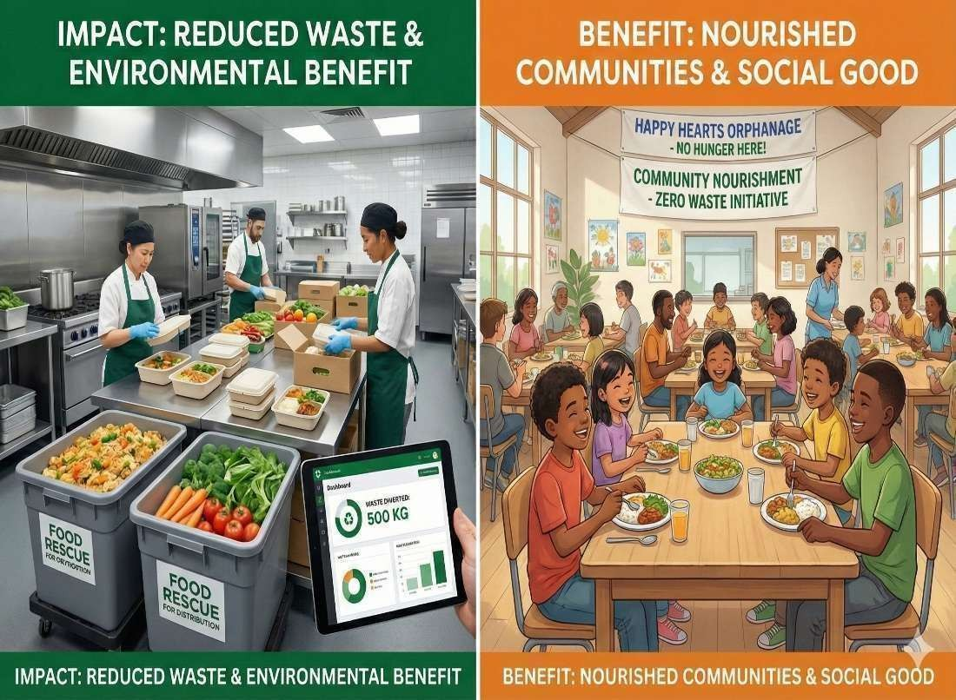
Impacts and Benefits
l
Reduces food
wastage by
utilizing surplus food effectively
Provides timely meals to homeless and needy people
Faster food distribution through real-time alerts
Better coordination between donors, NGOs, and volunteers
Increases transparency & trust
with tracking and proof
Supports Zero Hunger (SDG-2)
goal

Slide 6
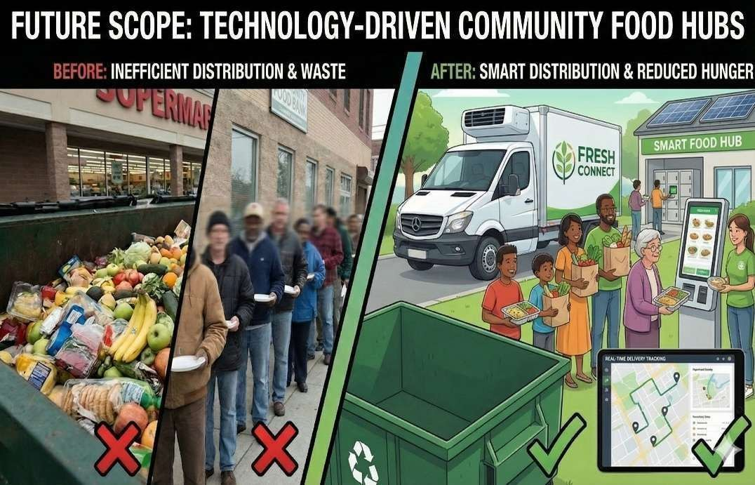
Future Scope
Improved coordination between food donors and receivers to ensure surplus food reaches the hungry on time.
Smart matching systems to distribute food based on location, urgency, and quantity, helping reduce hunger efficiently.
Expansion to more communities including rural, urban, and disaster- affected areas to support hunger reduction
efforts.
Use of data analytics to identify high-need areas and plan better food distribution strategies.
Mobile and web platform upgrades to involve more volunteers, NGOs & institutions
Real-time tracking and alerts to minimize food spoilage and maximize food utilization.
Support for emergency situations such as floods, pandemics, or natural
disasters to prevent hunger crises.

Slide 7
Outcomes of project
Developed a Smart Food Distribution System
Users can easily donate and request food
Improved connection between donors and needy people
Reduced food wastage
Faster food collection and delivery
Easy tracking and management of food distribution
User-friendly and efficient system

Slide 8
THANK YOU

