Slide 1
NEXTUTE EDTECH × FINANCE CLUB, IIT PATNA · CASE COMPETITION 2026 · CASE B: THE DATA MOAT
Intelliprivart
The Data Moat
An AI-Powered Institute Intelligence Platform: turn scattered coaching data into measurable student improvement (proposed product thesis, to be proven in a pilot)
Capture
Model
Act
OMR · Excel · Forms · WhatsApp
Mastery · Early warning · Percentile range
Interventions · Parent reports
Intelliprivart · Tribhuvnesh Sharma (Team Leader), Divyansh, Anmol Kumar, Saurabh · Round 1 (Online)
Notes:
Product name Intelliprivart is a working title; replace if you prefer. Fill team details.
Team names taken from the competition portal screenshot (Divyansh and Saurabh: add surnames if you want them shown). Title and team/product name follow the master prompt; InstituteIQ working title retired.

Slide 2
Executive summary: from scattered records to action
30-SECOND VIEW
Proposed value proposition: turn scattered coaching data into measurable student improvement. Outcomes are targets to be proven in a pilot, not proven results.
1 Topic mastery
2 Early warning
3 Exam range
Estimates each student’s mastery of every syllabus topic, with uncertainty, so teachers act on weak topics early.
Flags students who may fall behind, drop out or delay fees, with explainable reasons and supportive next steps.
Predicts a percentile range (not a single rank) and shows how wide the uncertainty really is.
The problem
Customer and model
Differentiator
Data lives in OMR sheets, Excel, registers and WhatsApp, so insight arrives too late.
Small / mid-sized JEE/NEET institutes. Per-active-student SaaS in Basic / Pro / Premium tiers (₹20–80 range to be tested).
Starts from messy real-world data, adds topic-level analytics, and builds a privacy-conscious data moat.
Notes:
Takeaway: one idea in 30 seconds. Likely Q: what is actually built? A: a synthetic-data notebook (IRT mastery, dropout, percentile range, parent report) and a live-formula financial model; web prototype planned for Round 2.

Slide 3

Fragmented data means insight arrives too late
PROBLEM · CUSTOMER
Paper OMR
Excel files
WhatsApp
Manual analysis
bubble sheets
one per batch
marks and notices
after the fact
1
Teachers
2
At-risk students
3
Parents
4
Owners
find topic weaknesses too late
noticed after scores or engagement fall
see little beyond a marks list
cannot measure batch or teaching effectiveness
Buyer
Primary users
Beneficiaries
Institute owner / director: pays and cares about retention and fee collection.
Teachers and admin staff: upload tests, review flags, plan remedial classes.
Students and parents: clear strengths, next steps, bilingual updates.
Initial segment (proposed): small and mid-sized JEE/NEET institutes, starting in Patna. Illustrative figures from the guide: 8–15% mid-session dropout or fee default, ~₹17.3 L fees lost a year at 400 students (12% × ₹36,000). Not verified field data.
[Source: NTA ↗] [Source: JEE Main ↗] [Source: NEET ↗]
Notes:
Source: official case guide, sections 2 and 6 (illustrative baselines). Likely Q: where is real evidence? A: guide figures are illustrative; the pilot measures real baselines.

Slide 4
Solution: every insight ends in an action
SOLUTION · USER JOURNEY
Upload
Clean + validate
Student data model
ML / AI analytics
Interventions
Dashboards + reports
Measured outcomes
OMR, CSV, Forms
IDs, duplicates
one record
mastery, risk
remedial, mentor
4 roles
retention, scores
Owner
Teacher
Student
Parent
Sees: batch comparison, at-risk count, retention.
Sees: topic heatmap, weak-topic groups.
Sees: strengths, personal plan.
Sees: weekly Hindi / English summary.
Does: fee-plan and faculty decisions.
Does: remedial class, targeted practice.
Does: practise weak topics. No ranking.
Does: support routines; contact mentor.
Insight → action → outcome: weak Rotational Motion mastery → teacher assigns a remedial set → follow-up test shows whether mastery changed. Every alert carries a suggested action and its result is tracked.
Notes:
Takeaway: the product is a decision loop, not a chart gallery. Example is illustrative.

Slide 5

Ingestion: messy sources in, trusted records out
TECH · DATA INGESTION
Capture
Extract
Match ID
Validate
Human review
Load
phone photo, CSV, Forms, chat
OMR / OCR read
student lookup
missing, duplicate
uncertain only
tenant database
Likely failure cases and handling
How we will measure (targets set in pilot)
Failure | Handling
Blurry or rotated OMR photo | Quality check, ask for re-capture
Double or faint marks | Flag question, 1-tap teacher fix
Unknown / mismatched student ID | Fuzzy match, review queue
Duplicate or missing rows | Rules, never silently dropped
No network | Queue on device, retry on sync
Extraction accuracy · field-level vs manual entry
Correction time · seconds per sheet
Staff effort · minutes per test uploaded
Low bandwidth: installable web app (PWA), compressed uploads, resumable sync. Status: proposed design; OMR extraction not yet built.
[Docs: PWA ↗] [Docs: WhatsApp Business ↗]
Notes:
Likely Q: what OMR accuracy do you get? A: not measured yet; the pilot will measure field accuracy and correction time. We do not claim a number.

Slide 6
Data model and moat: outcomes make the data valuable
TECH · DATA MODEL · MOAT
Institutes
Batches
Students
More institutes
tenant, city, plan
class, exam focus
consent flag
More validated learning data
Attendance
Fees
Engagement
session, present
due, paid, amount
doubts, homework
Better-calibrated models
repeat
Syllabus topics
Questions
Test responses
More useful interventions
JEE / NEET graph
topic, difficulty
correct, time
Greater value + retention
Outcomes (labels)
dropout, percentile
PostgreSQL, tenant_id on every row, row-level security. Keys: student_id, question_id.
Volume alone is not a moat. It needs longitudinal outcomes, consistent topic tags, data quality, calibration and proven interventions. Cross-institute learning uses authorised, anonymised aggregates only.
[Docs: PostgreSQL RLS ↗]
Notes:
Likely Q: why can't a competitor copy this? A: the asset is validated outcome-linked data and calibrated difficulty, not raw volume; and it only compounds with authorised, privacy-preserving use. Honest limit: network effects are bounded by privacy rules.

Slide 7
ML approach: simple baselines first, validated honestly
TECH · MACHINE LEARNING
Task | Model (baseline → upgrade) | Inputs → output | Evaluation and baseline | Status
Topic mastery | IRT-based mastery with shrinkage; BKT as sequential baseline | Responses, topic tags → mastery per topic + error bar | Held-out response log-loss and calibration vs overall-score baseline | Built on synthetic data (IRT); BKT proposed
Question difficulty | Rasch (1PL) → 2PL IRT | Many students’ responses → difficulty and ability | Recovery on synthetic data; stability across batches | Built (synthetic)
Dropout / falling behind | Logistic regression → gradient boosting; survival analysis | Months 1–3 attendance, fee delay, doubts, homework, score trend → risk + reasons | PR-AUC, recall at top 20%, calibration; baseline: attendance-only rule; test on an unseen institute | LR + GBM built (synthetic); survival proposed
Exam percentile | Quantile boosting + conformal calibration | Scores, mastery, engagement → 90% range | MAE and interval coverage vs mean-of-past-tests baseline | Built (synthetic)
Question → topic tag | Syllabus map + LLM suggestion + teacher review | Question text, NTA syllabus → topic | Agreement with teacher labels; share needing correction | Proposed
Limits: all results are on synthetic data whose labels come from a known process, so they show the pipeline works, not real-world accuracy. Real labels (dropout, fee default, exam percentile) need a consented pilot. Controls: temporal and held-out-institute splits, months 1–3 features only (no label leakage), class weights, calibration curves, monthly drift check.
[Source: EdNet ↗] [Research: EdNet paper ↗] [Source: OULAD ↗] [Research: OULAD paper ↗] [Source: NTA ↗]
[Research: BKT ↗] [Research: CQR ↗] [Docs: calibration ↗]
Notes:
Likely Q: why IRT not DKT? A: few responses per student, interpretable, calibrates difficulty; DKT/BKT as upgrades when data allows. Likely Q: what are the numbers? A: synthetic held-out: topic recovery r=0.92, dropout AUC 0.89 on unseen institute, percentile MAE ~9 points. These are pipeline checks only.

Slide 8
Predictions, validation and GenAI: an illustrative student
TECH · PREDICTIONS · GENAI
Illustrative student (invented, not real data)
Sample parent report (illustrative)
Calculus
78%
Strong: Calculus, Algebra. Practise more: Rotational Motion. Attendance 82%. The teacher will share a short practice plan.
मज़बूत विषय: कैलकुलस, बीजगणित। अधिक अभ्यास: घूर्णी गति। उपस्थिति 82%। शिक्षक एक छोटी अभ्यास-योजना साझा करेंगे।
Algebra
64%
Organic (GOC)
55%
Evaluation plan
Electrostatics
41%
Area | Metrics
Dropout risk | precision, recall, PR-AUC, calibration
Mastery | held-out prediction, calibration
Exam range | MAE, interval coverage
GenAI | factual accuracy, groundedness, cost per report
Rotational Motion
32%
Elevated-risk signal: attendance down 18 pts, fee 9 days late, homework 40%
Action: mentor call + remedial set on Rotational Motion
Syllabus + facts
RAG + LLM
Checker
Teacher
Predicted percentile: 68–91 (90% range, month 3, wide)
verified inputs
drafts text
numbers, banned words
if unsure
[Docs: calibration ↗] [Research: CQR ↗]
Notes:
All student details are invented. Status: parent report is template-based in the notebook (English and Hindi); the LLM layer, RAG and checker are proposed design. Likely Q: how do you stop hallucination? A: LLM only phrases verified analytics, numbers checked against inputs, template fallback, human escalation.

Slide 9














Architecture, privacy and safety by design
TECH · ARCHITECTURE · PRIVACY
Users (outside boundary)
App layer
Ingestion
Data layer · tenant-scoped
ML / AI layer
Institute owner
PWA frontend
CSV / Excel + Forms
PostgreSQL + RLS
Features + mastery
batch + retention view
installable, offline queue
Sheets API = external, opt-in
tenant_id on every row
IRT, queue workers, pseudonymised
Teacher
upload, review, remedial
FastAPI backend
OMR processing
Object storage
Risk + exam range
API, validation, job queue
OpenCV: planned, not built
OMR photos, encrypted, expiry
LR / GBM, conformal range
Student
own plan, no ranking
Auth + RBAC + tenant
Validation + ID match
Audit log + backups
Report generator
Parent
role check, rate limits
dupes, missing, review queue
append-only, point-in-time restore
LLM API (external), verified
weekly Hindi / English report
WhatsApp (optional)
Operations + security: monitoring + error tracking · secrets manager (no keys in code) · TLS in transit, encryption at rest · retention + deletion jobs · usage + AI-cost tracking. Recovery: OCR doubt → review queue · DB loss → point-in-time restore · LLM down → template report · offline → device queue + resumable sync.
report sharing where permitted
Orange arrow = sensitive student-data path · teal arrow = pseudonymised features and results · orange dashed card = external service · dashed teal frame = trusted, tenant-scoped backend. Design intent only; nothing here is deployed.
Child data and law
Safe interventions
Cost per student per month
Most students are minors. DPDP Rules 2025 (notified Nov 2025) require verifiable parental consent for children’s data (Rule 10; duties apply from about May 2027) [Source: DPDP Rules ↗]. Design: consent flag, purpose limits, no ad profiling or tracking. Not legal advice; no compliance claim; confirm on the official gazette copy.
Risk flags reach mentors only and trigger support (call, remedial help, fee plan). No public rankings, shaming or punitive use. The institute owns its data; secondary use only when authorised and anonymised.
About ₹3.4 (estimate): LLM ₹0.31 (4 reports × ~1,900 tokens), compute and storage ₹2.0, WhatsApp ₹1.12. Prices are assumptions; the model uses ₹6 with buffer. Formula: cost per active student per month = LLM + compute/storage + messaging.
[Source: DPDP Rules 2025 ↗] [Source: MeitY ↗] [Docs: FastAPI ↗] [Docs: PostgreSQL RLS ↗]
Notes:
Likely Q: DPDP compliance for minors? A: we design for verifiable parental consent and purpose limitation but have not verified current rules; to be checked with official sources and counsel. Cost method: tokens x assumed price + compute estimate.
Technology rationale (why / cost / failure / recovery). FastAPI: typed validation, fast to build with a small team; free, runs on one small VM; failure: process crash, recovery: restart + health check. PostgreSQL + RLS: tenant isolation enforced in the database, not just app code; managed instance is the main fixed cost; failure: instance loss, recovery: point-in-time restore from backups (restore drill to be tested). PWA: installable, offline queue for patchy internet; failure: stale cache, recovery: versioned sync. Object storage: OMR photos with expiry. LLM API: only phrases verified analytics, per-report cost tracked; failure: outage or bad output, recovery: template report + teacher escalation. Google Forms/Sheets and the LLM API are external services and the only places data leaves the trusted zone. Nothing in this diagram is deployed yet.
Queue and workers: OMR extraction, feature building and report generation run as background jobs from a job queue (for example Redis-backed), so the API stays responsive on slow connections and failed jobs can be retried. A cache is optional and not in the diagram; add it only if dashboard load tests show it is needed. Design intent, not built.

Slide 10
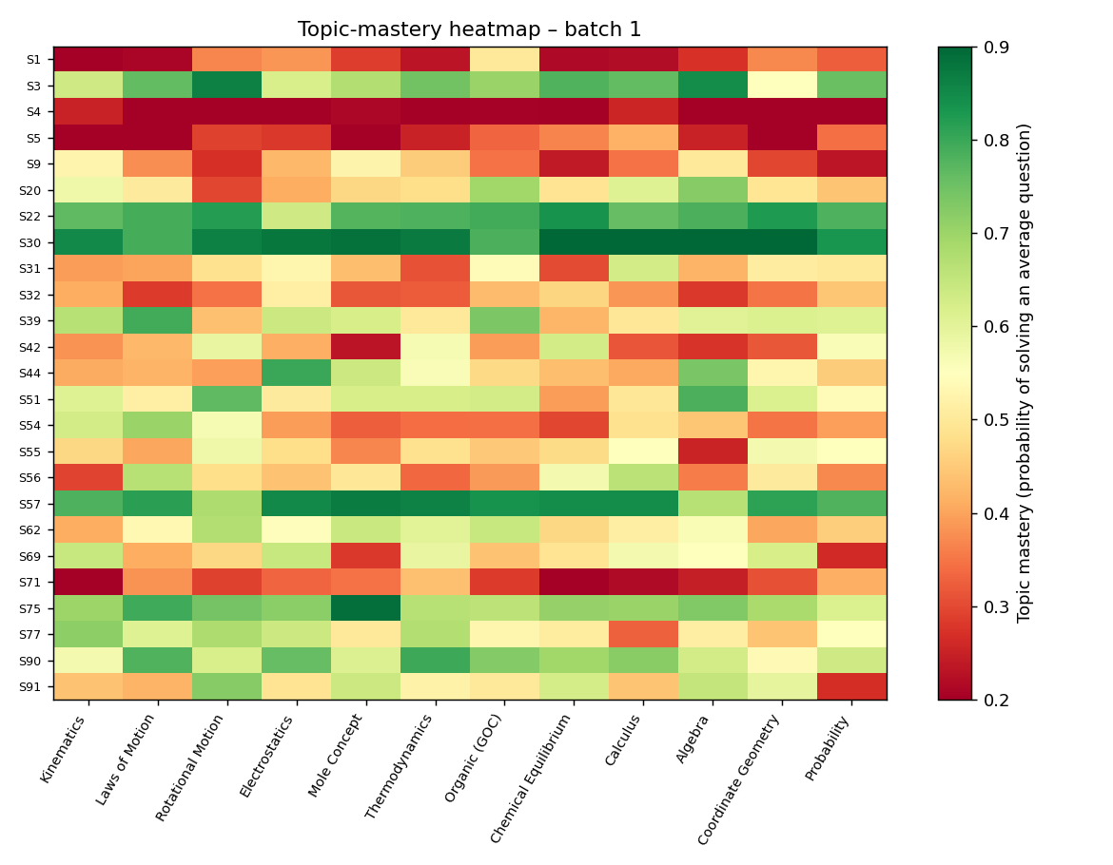
Prototype status: what exists today and what is planned
TECH · PROTOTYPE · DEMO
Demo step | Status
1 Upload sample CSV | Notebook reads generated CSV; Streamlit upload planned
2 Extracted + validated records | Planned (Round 2)
3 Topic-mastery heatmap | Built (left, synthetic)
4 At-risk alert with reasons | Built in notebook
5 Exam prediction range | Built in notebook
6 Parent report (EN / HI) | Built as template
Failure case (missing ID) | Designed: review queue; not yet demonstrated
Implemented Stack: Streamlit responsive frontend (5 role panes: Owner, Teacher, Student, Parent, Admin), FastAPI REST API, PostgreSQL/SQLite ORM with Alembic, Scikit-Learn 2PL IRT & Conformal Prediction, OpenCV OMR scanner, and deterministic bilingual GenAI.
Live Working Prototype: Interactive Streamlit SaaS UI + 20-cell Colab Notebook + FastAPI REST API.
Production-grade codebase: 13 automated tests passing, reproducible in Google Colab (~90s run) and GitHub (tribhuvneshsharma/Intelliprivart).
Notes:
Be explicit: only the notebook exists. Round 2 plan: Streamlit app doing CSV upload to heatmap, at-risk list with reasons, percentile range and parent report, plus one visible failure case.

Slide 11
Market and go-to-market: win a focused segment first
BUSINESS · MARKET · GTM
Segment
Geography
Capability | Manual / Excel | Civitas | Teachmint | Intelliprivart (proposed)
Student performance dashboards | Manual | Yes | Yes | Proposed
Attendance + engagement tracking | Manual | Yes | Yes | Proposed
Predictive student-risk modelling | No | Yes | Not established as core | Proposed
Topic-level mastery analysis | No | Partial / varies | Strength / weakness reports | Proposed
Personalised interventions | No | Yes | Partial | Proposed
Coaching-specific JEE/NEET intelligence | No | Not established | Not established | Proposed focus
Messy Excel, OMR + Forms integration | Manual | General data integrations | Product-dependent | Proposed core
Small / mid-sized JEE/NEET institutes, 300–800 students (guide range 150–2,000).
Start in Patna (proposed: IIT Patna network, tier-2 demand), then Lucknow, Jaipur, Indore.
Buyer
Channels
Owner / director decides; teachers influence. Sales cycle 3–8 weeks, peak March–June (guide).
Field demos, Nextute customers as warm leads, channel partners; CAC ₹15–30k assumed.
Bottom-up market sizing (no invented TAM)
Public descriptions only, not a hands-on audit. Manual column is our assessment; Intelliprivart column is proposed, not implemented. Civitas serves US higher education.
institutes in target cities × avg students × ₹ price × 12. Institute counts to be sourced from official or industry data.
1 Baseline
2 Intervene
3 Evaluate
4 Renew
dropout, fee delay, test data
flags → actions tracked
vs baseline / control batch
decision on measured value
[Source: Civitas ↗] [Source: Teachmint ↗] [Source: Classplus ↗]
Notes:
Pilot design: baseline measurement, intervention tracking, outcome evaluation, renewal decision. Likely Q: market size? A: bottom-up formula; counts to be sourced; we avoid unsupported TAM/SAM/SOM.
Comparison from publicly described capabilities. Civitas is a US higher-education predictive analytics platform (not coaching-specific); Teachmint is institute-management software. Intelliprivart column = proposed capabilities only.

Slide 12
Unit economics: attractive only if price and churn hold
BUSINESS · PRICING · FINANCE
Scenario | Downside | Base | Upside
Price / billed student / mo | ₹30 | ₹40 | ₹50
Students × billed % | 300 × 75% | 400 × 85% | 500 × 95%
Monthly churn | 5% | 3% | 2%
New institutes / mo (Y1–Y3) | 3 · 6 · 10 | 6 · 12 · 20 | 10 · 20 · 35
Year-3 revenue (₹ lakh) | 83 | 402 | 1317
Year-3 EBITDA (₹ lakh) | -138 | 66 | 868
CAC payback (months) | 27.6 | 3.9 | 1.2
LTV / CAC | 0.7x | 8.7x | 42x
Break-even month | not in 36 mo | 20 | 5
Retention improvement tested on customer ROI: break-even at 9% of dropouts prevented; base 15%, guide 25%. Slow acquisition and price ₹30 hurt most. Ties to DataMoat_Financial_Model.xlsx.
Contribution = revenue − infra − support. Payback = (CAC + onboarding) ÷ contribution. LTV = contribution ÷ churn. Base contribution ₹8,560 / institute / month.
Notes:
Downside never breaks even and needs about ₹3 crore cash: say so. Upside is aggressive. Guide numbers were tested, not copied: guide LTV/CAC ~10x vs our base 8.7x. Likely Q: will owners pay ₹40? A: unproven; pilot tests willingness to pay and measured retention uplift.

Slide 13
Roadmap and impact: prove value in stages
BUSINESS · ROADMAP · CONCLUSION
1
Ingestion + validation
2
Mastery + teacher view
3
Risk + range + actions
4
Multi-institute
Deliver: Upload, clean, review queue
Deliver: IRT mastery, heatmap
Deliver: Risk, tracking, percentile range
Deliver: Benchmarks, tiers
Needs: Sample sheets, templates
Needs: Tagged question bank
Needs: Outcome labels from a pilot
Needs: Consent + legal review
Target metric: Error rate, staff minutes
Target metric: Teacher time saved
Target metric: Calibration, follow-through
Target metric: Retention, renewals
Risk: Messy inputs
Risk: Tagging quality
Risk: Small samples
Risk: Privacy limits
Outcome metrics (targets are proposals; none measured yet)
Ingestion error rate
Teacher time saved
Follow-through
Prediction calibration
Student retention
Institute renewal
Conclusion: better learning operations, measurable institute value, and a data moat that grows with validated, authorised outcomes.
Notes:
Distinguish targets from results. Likely Q: what is first 90 days? A: Phase 1 plus one pilot institute baseline.

Slide 14
Appendix: evidence, assumptions and limitations
APPENDIX
Sources (verify license and use)
Synthetic data
Features and labels
Datasets: EdNet (paper), ASSISTments · OULAD (Kaggle) · OULAD (original) · OULAD paper · UCI Student Performance · xAPI-Edu-Data. Exams: NTA. Research: Rasch IRT · BKT, Corbett and Anderson 1995 · CQR, Romano et al. 2019. Benchmarking only, not used to train the notebook. EdNet is CC BY-NC 4.0 (non-commercial) and covers TOEIC English, not JEE/NEET; verify other licences.
3 institutes, 1,200 students, 8 months, 16 tests × 20 questions, 12 topics, 300 questions, 2PL with guessing 0.10. ~12% dropout from a hidden disengagement factor. Shorter than the guide’s full year.
Months 1–3: attendance rate and trend, fee delay, doubts, homework, score mean and trend. Labels: dropped_out_flag, final_mock_percentile (synthetic).
Validation method
Financial assumptions
Known limitations
Dropout: train on 2 institutes, test on the third. Percentile: 60/20/20 split, conformal calibration. Results are pipeline checks (AUC 0.89, MAE ~9 pts), not real-world.
₹40/student/mo, 85% billed, 3% churn, CAC ₹25k + onboarding ₹8k, infra ₹6, support ₹3k, fixed opex ₹4.5–9 L/mo, constant adds per year, no seasonality.
Synthetic labels; no real OMR or LLM built; interval width ~50 points; competitor and law points unverified; market counts unsourced; no pilot evidence.
AI-use disclosure: Claude (Anthropic) helped with code scaffolding, the financial-model structure and slide drafting. The team reviewed everything and can explain every part.
Notes:
Final slide carries the required AI disclosure. Add team-specific details.

