Slide 1

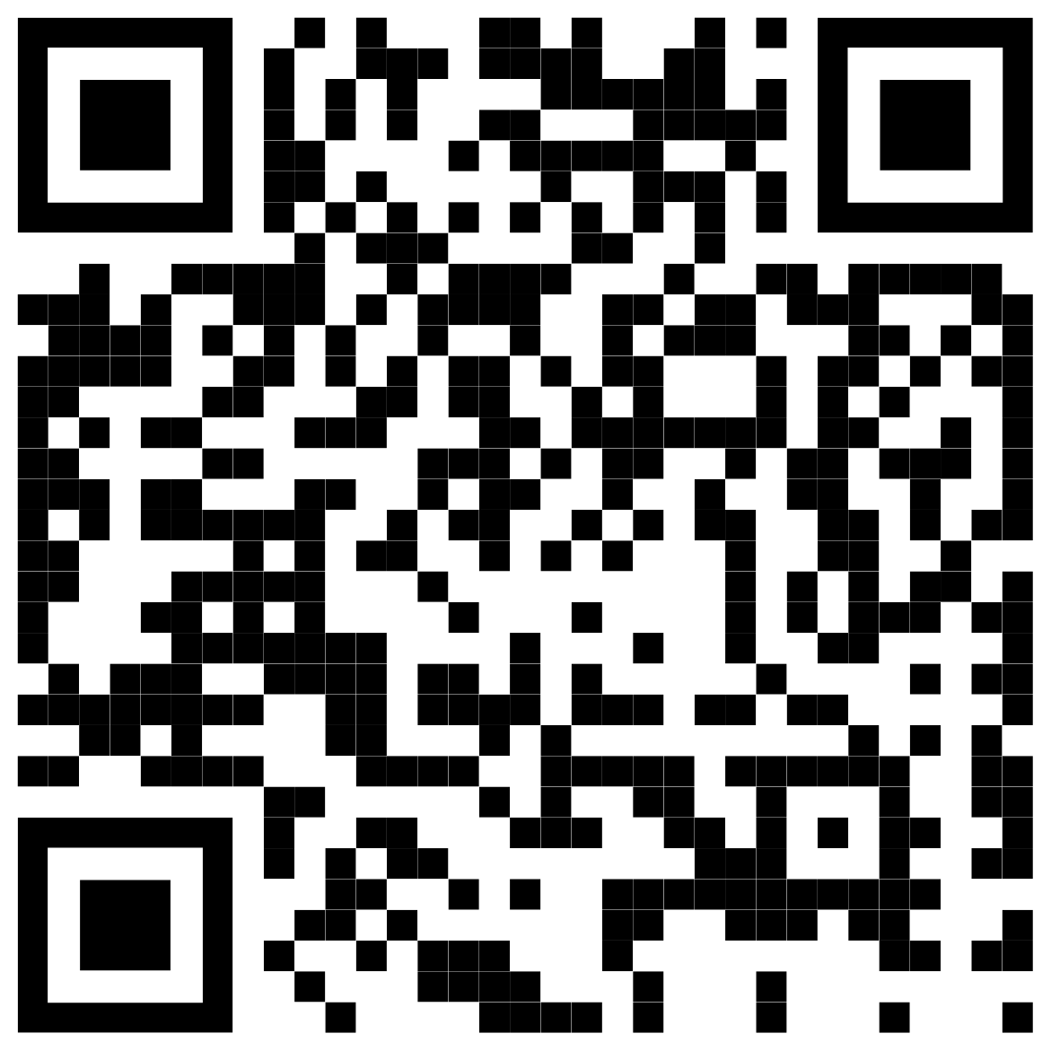
BAPU GUJARAT KNOWLEDGE VILLAGE
SSIP IDEA PRESENTATION
NearKart
Your local shops, delivered fast.
A hyperlocal quick-commerce platform that turns neighbourhood stores into micro-fulfilment centres — 15–30 minute delivery, zero warehouses.
Scan to try the live demo
near-kart-iota.vercel.app
Aryan Patel Computer Engineering · ENO 240753107021
Guided by Dr. Anil Suthar, Principal
Notes:
SSIP idea presentation. Introduce yourself: Aryan Patel, Computer Engineering, ENO 240753107021, guided by Dr. Anil Suthar (Principal). One line: NearKart delivers from your local kirana in 15-30 minutes - no dark stores.

Slide 2
THE PROBLEM
Quick commerce boomed — but the neighbourhood paid for it
12–13M
kirana stores in India — fewer than 5% meaningfully digitised
1
Dark stores displace kiranas.
Apps like Blinkit & Zepto rent warehouses inside residential areas and stock only ~2,000 high-margin SKUs — local shops lose customers to a network they can't join.
2
The economics are broken.
High rent, deep discounts and delivery subsidies mean most quick-commerce orders lose money; the cost is pushed back as fees on customers and commissions on shops.
~2,000
SKUs per dark store — a fraction of a real neighbourhood's depth
3
Everyone else is in the dark.
Shops lose direct contact with their customers, riders can't see their payout before accepting a job, and 10-minute promises break when stock or distance is unforgiving.
₹0
typical profit per order — growth is funded by burning investor cash
Sources: IBEF retail reports; RedSeer quick-commerce research; company unit-economics disclosures.
02
Notes:
Frame the problem around the dark-store model: it wins on speed but displaces local shops, loses money per order, and is opaque for shops and riders.

Slide 3
THE SOLUTION
NearKart: the neighbourhood becomes the warehouse
“Dark stores rent your neighbourhood. NearKart lives in it.”
1
2
3
4
Customer App
→
Shop Dashboard
→
Rider App
→
Admin Console
Orders groceries from nearby verified shops in 15–30 min
Accepts in a 2-minute window; stock deducts automatically
Transparent job cards, OTP pickup & delivery, instant payout
Live ops, verification queues, disputes & analytics
One shared live order engine. All four modules run on a single state machine — an order placed on the customer app appears in the shop dashboard, routes to a rider, and lands in the admin feed in real time, even across browser tabs.
03
Notes:
The key architectural idea: not four separate apps, but one live order engine shared by four views. This is what makes the demo feel real.

Slide 4
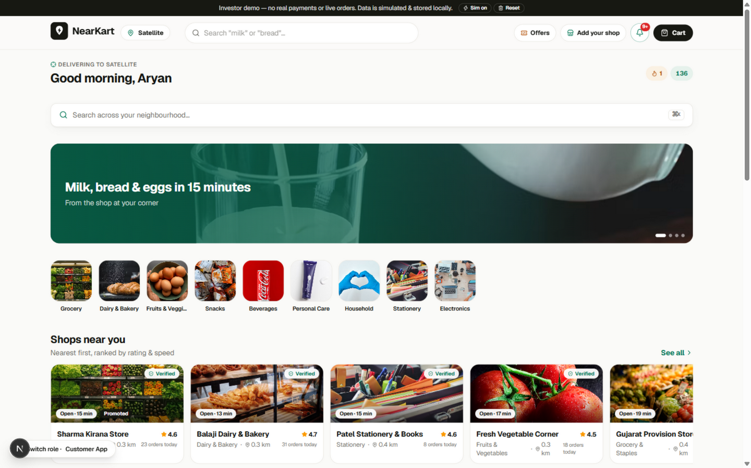
MODULE 1 · CUSTOMER
Discovery to doorstep, built on honest nudges
Smart ranking. Shops ordered by rating, distance, speed & reliability.
Honest basket building. ₹100 minimum with a free-delivery progress bar.
Live tracking. Order timeline with rider OTP verification.
Loyalty that sticks. NearCoins, daily streaks and ₹50 referrals.
Real urgency only. “Only 3 left” comes from actual live stock.
Customer app — Satellite, Ahmedabad. 8 shops · 90+ products in the demo catalogue.
04
Notes:
Demo path: add to cart, watch the free-delivery bar, apply coupon NEAR25, checkout COD or demo UPI, then track with OTP.

Slide 5
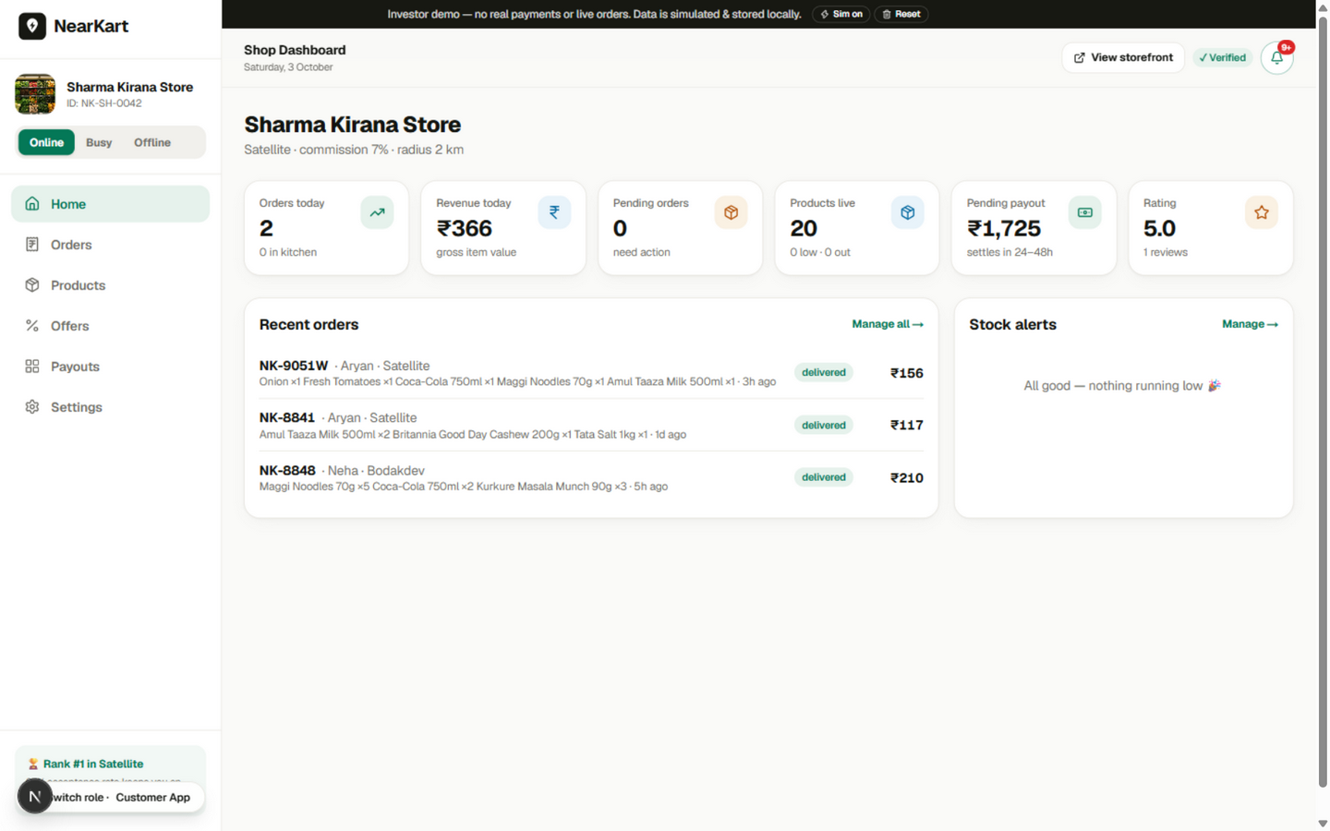
MODULE 2 · SHOP OWNER
A kirana gets a quick-commerce cockpit
2-minute accept timer. With an auto-accept guard that protects ratings.
Inventory automation. Accept deducts stock; cancel restores it; zero auto-hides.
Transparent payouts. 7% commission + GST TCS, shown line by line.
Offers manager. Coupons and sponsored placement with performance data.
Availability control. Online / Busy / Offline in one tap.
Shop dashboard — live orders, stock alerts and payouts at a glance.
05
Notes:
Demo path: accept the incoming order inside 2 minutes, watch stock auto-deduct, mark packed, then show the payout ledger breakdown.

Slide 6
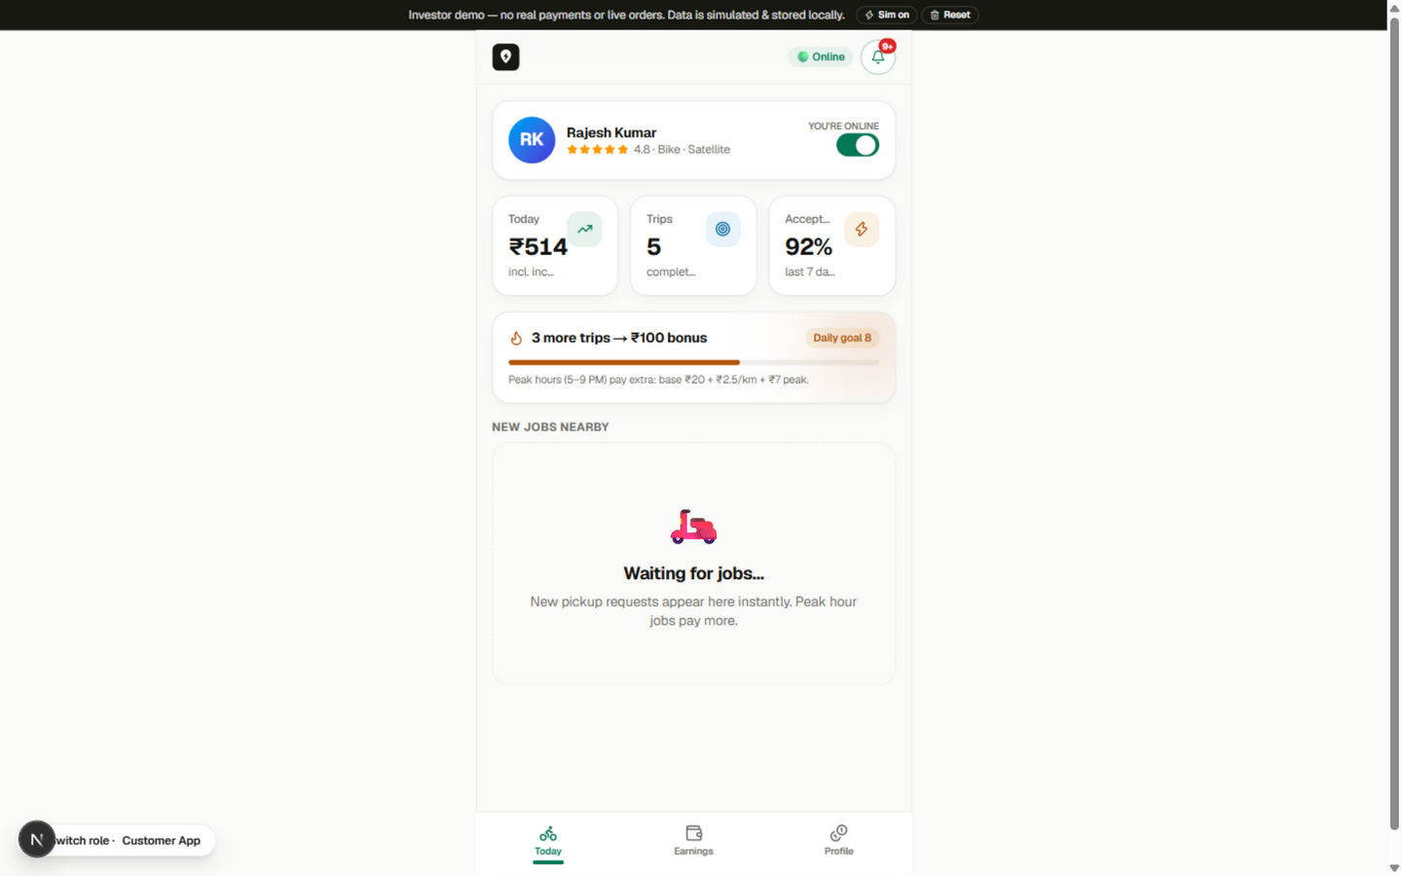
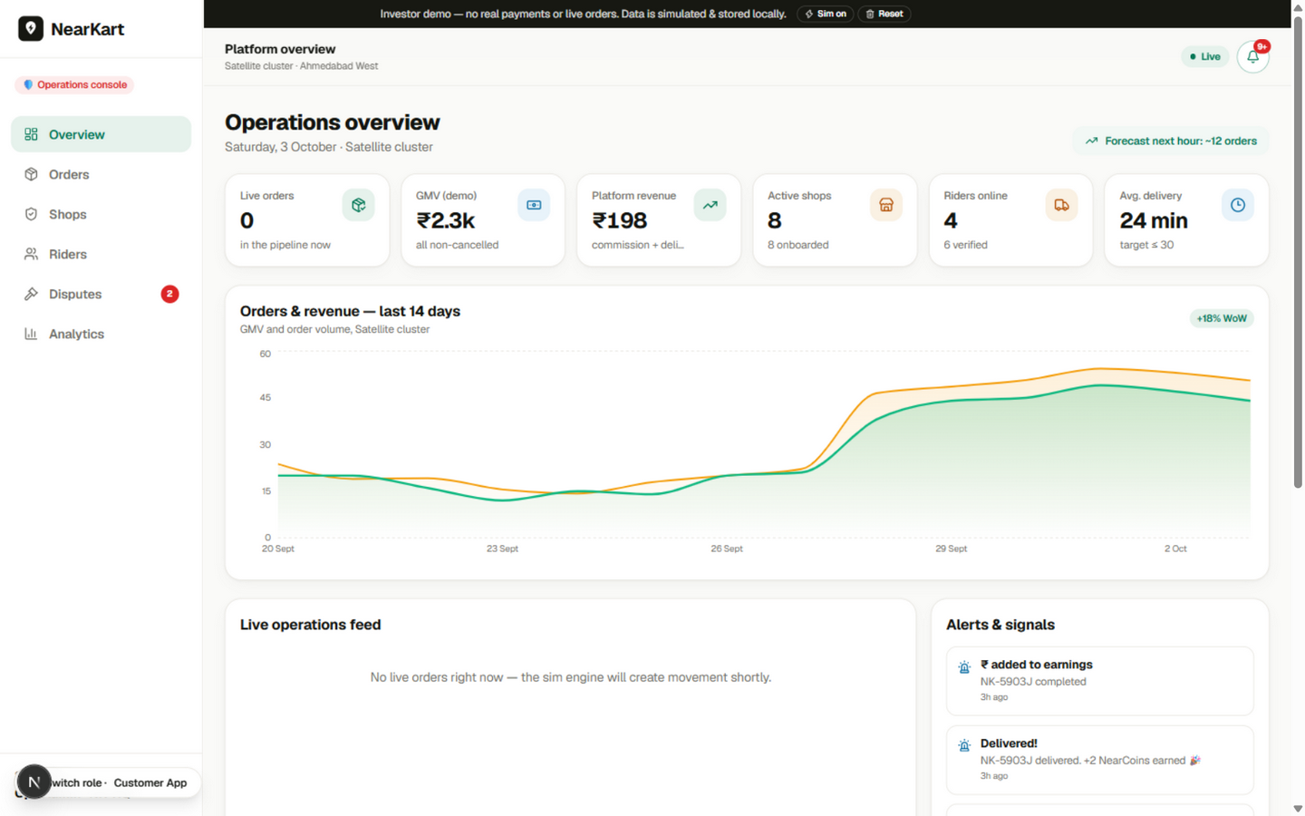
MODULES 3 & 4 · RIDER AND ADMIN
Every side of the marketplace, in one engine
Rider app
Admin console
Payout shown before accepting (₹20 base + ₹2.5/km + ₹7 peak + 100% tips), OTP-verified trips, photo proof, daily goal bonuses and instant payout.
KPI deck with live ops feed, shop & rider verification queues, dispute centre with a liability matrix, demand forecast and zone×hour heatmaps.
06
Notes:
Rider: job card shows distance and payout before accepting. Admin: verification queues, disputes with liability matrix, analytics.

Slide 7
TRY IT LIVE
Four apps. One order. Real time.
near-kart-iota.vercel.app/customer
Customer
browse, cart & track an order
near-kart-iota.vercel.app/shop
Shop owner
accept, pack & manage inventory
near-kart-iota.vercel.app/rider
Rider
accept jobs, OTP delivery, earnings
near-kart-iota.vercel.app/admin
Admin
ops console, disputes, analytics
near-kart-iota.vercel.app
Deployed on Vercel
Pro move: open Customer and Shop in two tabs — the order syncs live via cross-tab storage events.
07
Notes:
Hand this QR over during Q&A or a poster. All four role apps are one click away; everything runs on the shared live order engine.

Slide 8
THE INTELLIGENCE LAYER
Algorithms that make a local network feel like a giant
01
02
03
Shop ranking
Dynamic ETA
Rider matching
0.30 rating + 0.25 proximity + 0.20 speed + 0.15 reliability + 0.10 demand — boosted for sponsored, damped when busy.
prep + 3.2 × distance + supply buffer, clamped to 12–38 min. No fake 10-minute promises.
rating × 12 + acceptance × 0.1 − 3 × distance-to-shop, over online riders only.
04
05
06
Fraud engine
Demand forecast
Stock automation
COD value bands + new customer + radius + cancellations → normal / watch / review.
hour-of-day curve predicts next-hour orders; flags surge when jobs exceed riders by 20%.
accept → deduct; cancel → restore; zero → auto-hide; repeated unavailability → pause + alert.
All six run live in the demo — observable in discovery ordering, checkout ETAs, rider job cards, and the admin forecast banner.
08
Notes:
These are implemented in src/lib/algorithms.ts and all observable in the demo. This is the moat: local supply orchestrated well.

Slide 9
BUSINESS MODEL
Six revenue streams on a single order
1
Shop commission — 7% per order + 1% GST TCS in the ledger
The cross-side flywheel
2
Delivery fee — ₹25 · free above ₹299 to grow basket size
→ More local shops
Shop subscriptions — ₹299–₹999/month for pro tooling (Phase 2)
→ Wider inventory
3
→ More customers
4
Sponsored listings — shops bid for discovery, labelled “Promoted”
→ More rider earnings
5
White-label storefronts — shops sell on WhatsApp over NearKart rails
→ Faster delivery
6
Ads & insights — category demand & zone analytics post-density
…which onboards more shops. NearCoins & referrals keep demand spinning.
09
Notes:
Revenue shown line-by-line in the demo: shop payout ledger has 7% commission and 1% GST TCS. Delivery fee free above 299 drives AOV.

Slide 10
MARKET SURVEY
A $30–40B market — and an untouched supply side
India quick-commerce GMV (US$ billion)
~35–40% CAGR
quick commerce is the fastest-growing slice of Indian e-grocery — expanding 4–5× faster than conventional e-commerce.
12–13M kiranas
still handle 85–90% of FMCG sales — yet fewer than 5% participate in any delivery platform.
The gap
dark-store players fight over metro pin codes; tier-2 and non-metro neighbourhoods are underserved. NearKart aggregates existing shops — near-zero capex per store.
Source: RedSeer Consulting, industry estimates — 2026/2030 figures are projections.
10
Notes:
Market numbers are from RedSeer and public investor disclosures; projections are labelled as estimates. The strategic point: aggregating existing kiranas has near-zero capex per store.

Slide 11
TECHNOLOGY & ROADMAP
Built on a modern stack — production-ready next
Next.js 16
TypeScript
Tailwind v4
Zustand engine
Framer Motion
Vercel
From demo to district — the path forward
1
Months 1–2
2
Months 2–4
3
Months 4–6
4
Month 6+
Production backend
PostgreSQL + Prisma, NestJS order & inventory services, Redis + BullMQ state machine
Real infrastructure
Razorpay/Cashfree payments, Google Maps/MapmyIndia, WhatsApp & SMS notifications
Ahmedabad pilot
10–20 shops in one locality, rider onboarding, GST TCS & FSSAI compliance
Scale
Rider batching, demand forecasting on real data, POS integrations, white-label storefronts
Simulated in the demo (payments, OTPs, maps) are exactly the layers the roadmap makes real.
11
Notes:
Be explicit about what is simulated in the demo vs what production adds. The pilot is one Ahmedabad locality with 10-20 shops.

Slide 12
Thank you.
NearKart — your local shops, delivered fast.
Aryan Patel Computer Engineering · ENO 240753107021
Guided by Dr. Anil Suthar, Principal
aryan04102001@gmail.com · near-kart-iota.vercel.app
Try the live demo
Notes:
Close with the one-liner: Blinkit speed, kirana soul, zero dark stores. Offer the QR for a live walkthrough.

