Slide 1






NearKart – Your Local Shops, Delivered Fast
Team Members :
Team Leader : Aryan Patel
Computer Engineering
ENO : 240753107021
Mentor :
Dr. Anil Suthar
Principal
Bapu Gujarat Knowledge Village

Slide 2
Outline
Team formation
Brief Description
Value Proposition
Market Survey
Proposed Solution
Innovation Component in Proposed Solution
– Patentable Innovative Component
Project Status
Fund Requirements
Outcome and Path Forward
References

Slide 3
Team Strength
Aryan built the complete NearKart platform solo — four apps (Customer, Shop, Rider, Admin) on one live order engine, deployed on Vercel.
Name of Team Member | Project title
Aryan Patel | NearKart – hyperlocal quick-commerce platform (working prototype)
Aryan Patel | WISPA – voice-activated AI assistant (SSIP idea submission)

Slide 4
Brief Description
PROBLEM — what NearKart is trying to solve:
India’s quick commerce runs on “dark stores” — private warehouses placed inside residential areas
12–13 million local kirana stores have no app, no delivery network, no digital storefront
Dark stores stock only ~2,000 SKUs and lose money on most orders — costs return as fees
Shops lose direct customer contact; riders can’t see payout before accepting a job
Needed: dark-store speed with kirana trust — without building a single warehouse

Slide 5
Value Proposition
For customers — 15–30 min delivery from trusted local shops, honest ETAs, live OTP tracking
For kiranas — a full digital storefront: order timers, inventory automation, transparent payouts
For riders — payout shown before accepting, OTP-verified trips, 100% of tips, instant payout
For society — local businesses stay competitive; zero warehouse capex per store
For the platform — six revenue streams on a single order (commission, fees, subscriptions, ads)

Slide 6
Market Survey
Existing systems:
Blinkit, Zepto, Swiggy Instamart — dark-store networks, metro pin codes only
ONDC / Shopify — storefronts without 15–30 min delivery logistics
NearKart difference — existing shops become the fulfilment network (zero dark stores)
Quick commerce: ~US$3.3B (2023) → US$30–40B by 2030 (RedSeer)
Kiranas hold 85–90% of FMCG sales; fewer than 5% digitised
Target segment: tier-2 neighbourhoods, starting Satellite, Ahmedabad

Slide 7
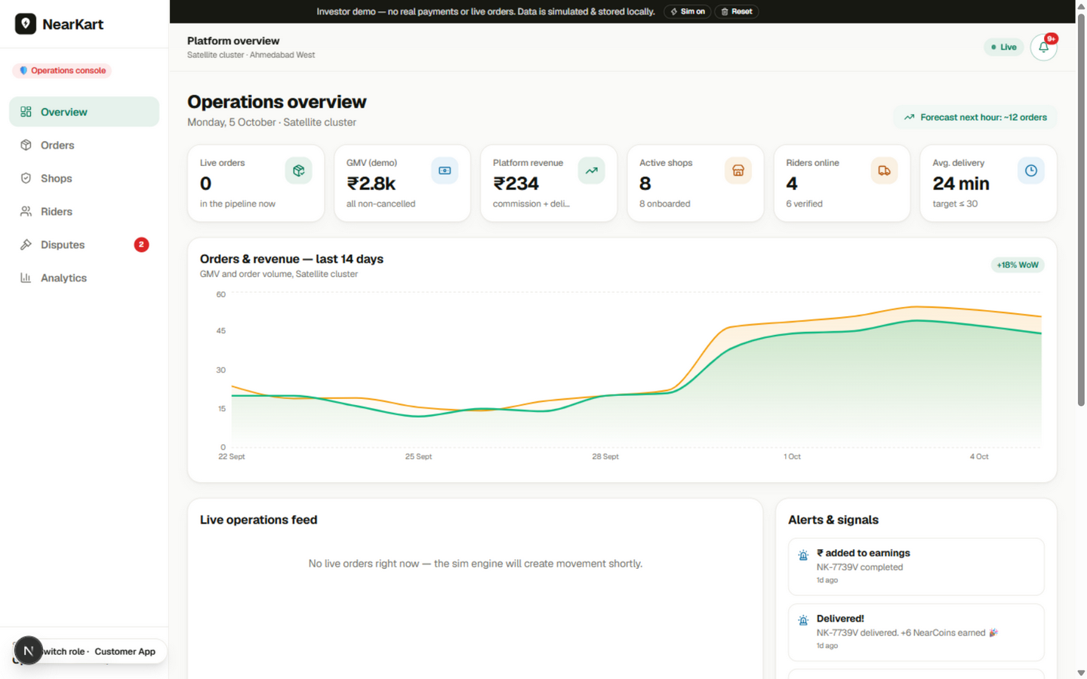
Current Status of Project
Working since September 2026
All four modules built & deployed live on Vercel
One shared live order engine — orders sync across apps in real time
Ranking, ETA, rider-matching, fraud & forecasting algorithms implemented
Version-controlled on GitHub; code + demo available today
Distance to goal: production backend + a paid pilot locality

Slide 8
Project Work to be accomplished (1 of 2)
Current status is successful — a complete, working prototype exists today
What is needed next:
Production backend — PostgreSQL + Prisma, NestJS order services
Redis + BullMQ for the live order state machine
Real payments — Razorpay/Cashfree; maps — Google/MapmyIndia
WhatsApp/SMS notifications; GST TCS & FSSAI compliance

Slide 9
Project Work to be accomplished (2 of 2)
Ahmedabad pilot (months 4–6):
Onboard 10–20 shops in one locality with rider onboarding
Payout settlements, dispute handling and verification workflows
Scale (month 6+): rider batching, demand forecasting on real data
POS integrations, shop credit and white-label storefronts

Slide 10
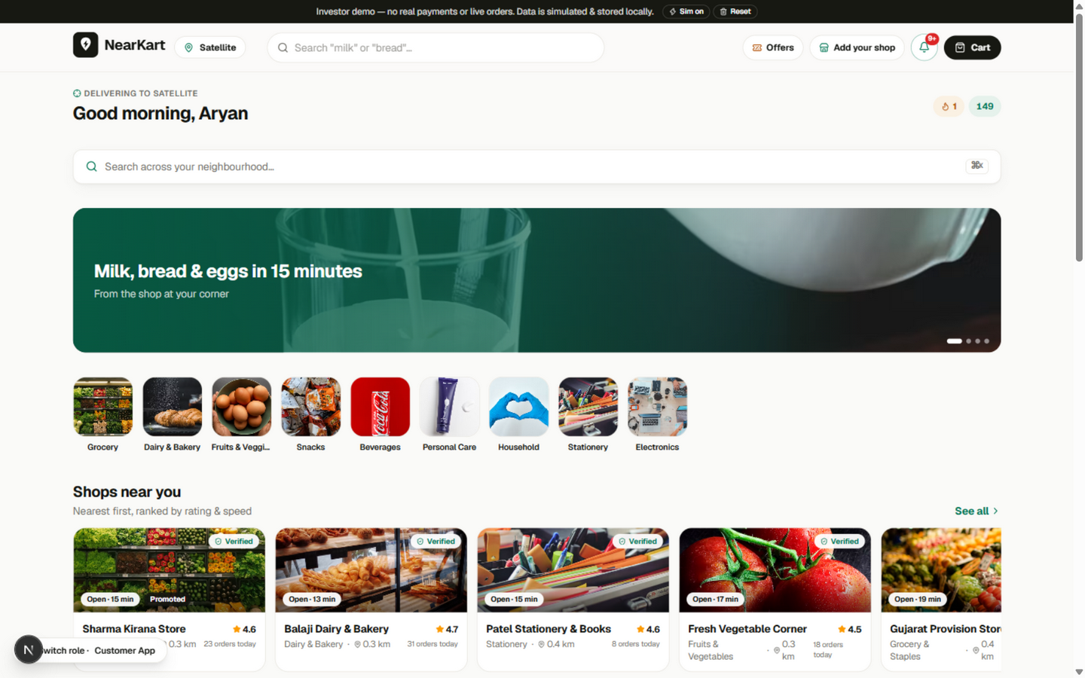
Proposed Solution
Four apps, one live order engine:
Customer app — order, pay, track with OTP
Shop dashboard — 2-min accept timer, stock automation
Rider app — transparent job cards, OTP delivery
Admin console — verification, disputes, analytics
Objectives: live engine · inventory automation · fair rider UX · intelligence layer · trust tooling

Slide 11
Innovation in Proposed Solution
Patentable innovative components (candidate):
Automated stock-lifecycle method — deduct on accept, restore on cancel, auto-hide at zero, pause on repeat
Multi-objective shop-ranking process (rating, proximity, speed, reliability, demand)
Pre-acceptance payout-transparency mechanism for gig riders
Rule-based COD fraud-risk scoring engine (value bands, radius, history)
Category: Utility — computer-related process/method

Slide 12
Fund Requirements
Total cost (including consumables, non consumables, recurring and non recurring): RS. 3,00,000

Slide 13
Materials / Components
Component Name | Where it will be used? | Quantity | Price per Unit (INR) | Total
Cloud hosting & CDN (Vercel Pro) | All four apps, 12 months | 12 | 1,250 | 15,000
Google Maps API credits | ETA, distance & zones | 1 | 20,000 | 20,000
Payment gateway (Razorpay) | UPI / card payments | 1 | 15,000 | 15,000
WhatsApp Business API | Order notifications | 1 | 10,000 | 10,000
Total(A) |  |  |  | 60,000
Total(A)

Slide 14
Other Expenses
Expense Head (Mention whichever are applicable) | Give details of the items | Total Price
Consumables | Test devices, data plans, shop-onboarding travel | 20,000
Minor works | Workstation upgrades, connectivity | 20,000
Professional services (from outside) | UI/UX & backend development support | 80,000
Mentoring services (from outside) | Domain experts — retail ops & gig-work compliance | 30,000
Patent filing | Innovation/patent filing support | 40,000
Any other (Pl. Specify) | Pilot marketing, shop onboarding & demo events | 50,000
 | Total(B) | 2,40,000

Slide 15
Outcome
A reusable live order engine for any hyperlocal marketplace
Open reference implementation of ranking, ETA, matching, fraud & forecasting
A template for kirana digitisation others can extend (POS, credit, WhatsApp)
Learning: real-time systems design, algorithms and honest UX at production quality

Slide 16
Path Forward
Yes — moving from prototype to product:
Prototype → production platform (backend, payments, maps)
Pilot → paid deployment with 10–20 shops in Ahmedabad
Patent filing for the stock-lifecycle & ranking methods
Startup path — city-scale expansion and white-label storefronts

Slide 17
References
RedSeer Consulting — India Quick Commerce Market Report
https://www.redseer.com/newsletters/quick-commerce-in-india
IBEF — Indian Retail Industry Report
https://www.ibef.org/industry/retail-india-presentation
Economic Times Retail — dark-store expansion & unit economics
https://retail.economictimes.indiatimes.com
Live demo — near-kart-iota.vercel.app
Code — github.com/codewitharyan-01/near-kart

Slide 18
THANK YOU
NearKart — near-kart-iota.vercel.app

