Slide 1
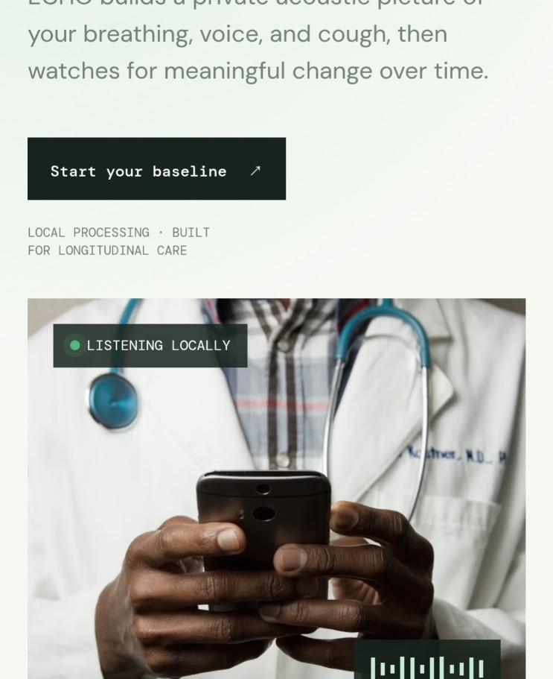
PERSONAL ACOUSTIC HEALTH / 01
Hear the change
before it feels loud.
ECHO builds a private acoustic picture of breathing, voice and cough — then watches for meaningful change over time.
LOCAL-FIRST • PERSONAL BASELINE • EXPLAINABLE
TEAM VOID_ELIMINATORS()
SRMIST • MED VISION’26
ECHO / MED VISION’26
01

Slide 2
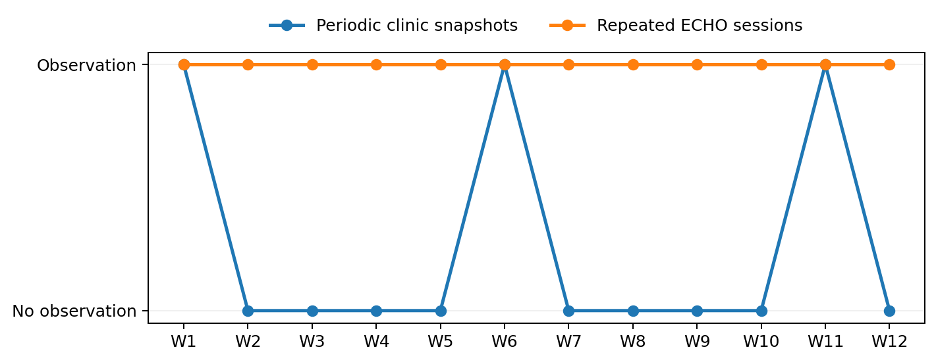
THE PROBLEM
Respiratory change can hide between check-ups.
ECHO focuses on the missing longitudinal layer: a person's own acoustic reference.
CLINIC SNAPSHOTS
PERSONAL TREND
One test
Many small signals
episodic • clinic-bound • effort-dependent
repeated • comparable • personal
Conceptual illustration — not clinical outcome data.
THE GAP
A repeatable, private reference for how this person normally sounds.
ECHO / MED VISION’26
02

Slide 3
THE GAP
Existing tools answer different questions.
01
SPIROMETRY / PFT
02
DIGITAL STETHOSCOPE
Clinical test • equipment • trained supervision
Placement-sensitive • interpretation required
03
COUGH CLASSIFIER
04
WEARABLES
Population model • one-shot classification
SpO₂ / heart rate • acoustic dimension missing
ECHO's target is not one-shot diagnosis. It is longitudinal personal change.
ECHO / MED VISION’26
03

Slide 4
THE IDEA
ECHO changes the question.
TRADITIONAL AI
ECHO
“Does this sound like disease?”
“Has this person changed from their own normal?”
N = 1 reference
Monitoring change ≠ diagnosing disease.
ECHO / MED VISION’26
04

Slide 5
MVP WORKFLOW
From a short recording to an interpretable change signal.
01
02
03
04
05
CAPTURE
→
PROCESS
→
EXTRACT
→
COMPARE
→
EXPLAIN
~55 sec guided script
Local audio + DSP
Acoustic features
Personal baseline
Score + feature shifts
Guided stages: normal breathing • deep breathing • sustained “aaa” • two coughs
ECHO / MED VISION’26
05

Slide 6
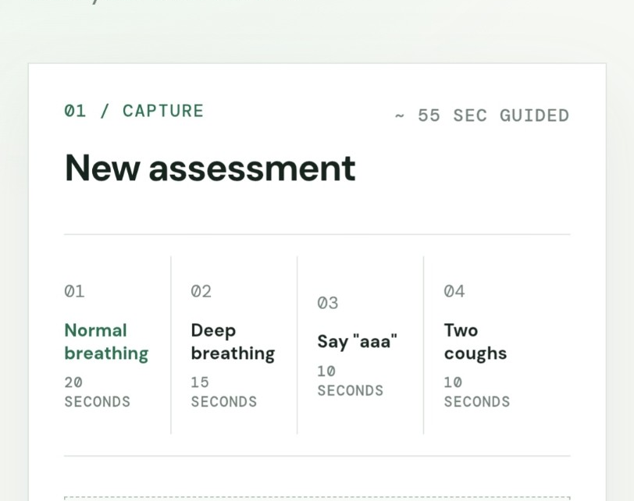
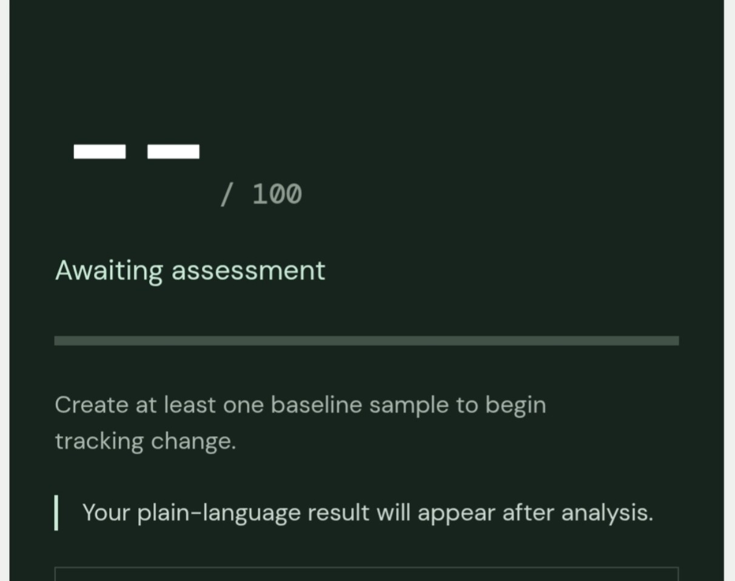
PRODUCT DEMO
The ECHO MVP is a real, navigable workflow.
01 GUIDED CAPTURE
02 PERSONAL SIGNAL
ECHO / MED VISION’26
06

Slide 7
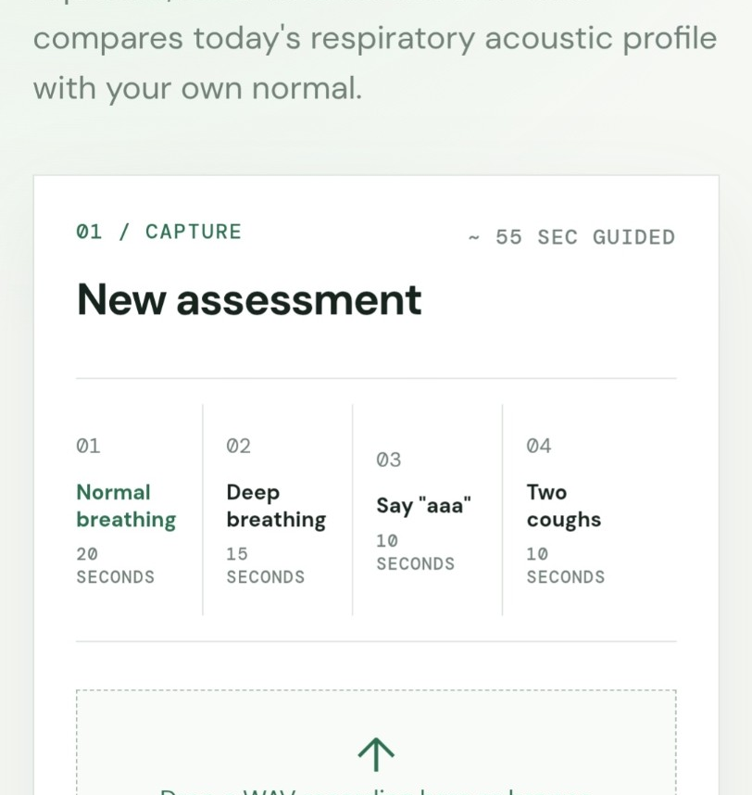
PERSONAL BASELINE
Your normal becomes the reference.
BASELINE
Several normal recordings → stable personal reference
NORMAL SESSIONS
NEW ASSESSMENT
The current MVP asks whether the new recording moves away from the user's own baseline.
ECHO / MED VISION’26
07

Slide 8
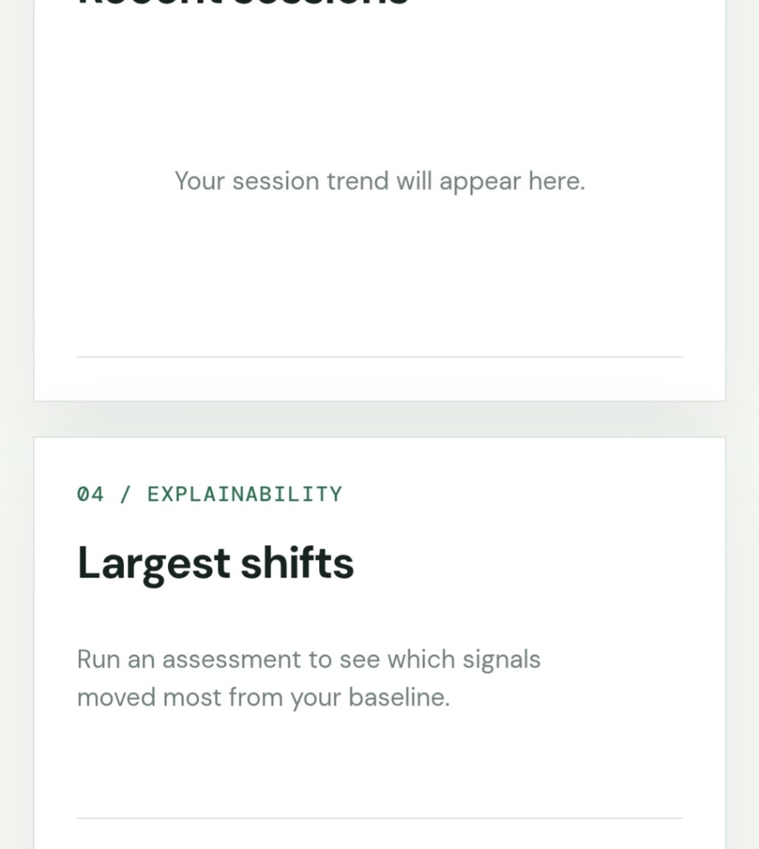
DEVIATION SCORE
A multi-signal monitoring score.
0–100
personal deviation signal
The dashboard is designed to show the score only after a baseline exists and an assessment has been analyzed.
WITHIN BASELINE
REVIEW CHANGE
No clinical threshold is claimed.
ECHO / MED VISION’26
08

Slide 9
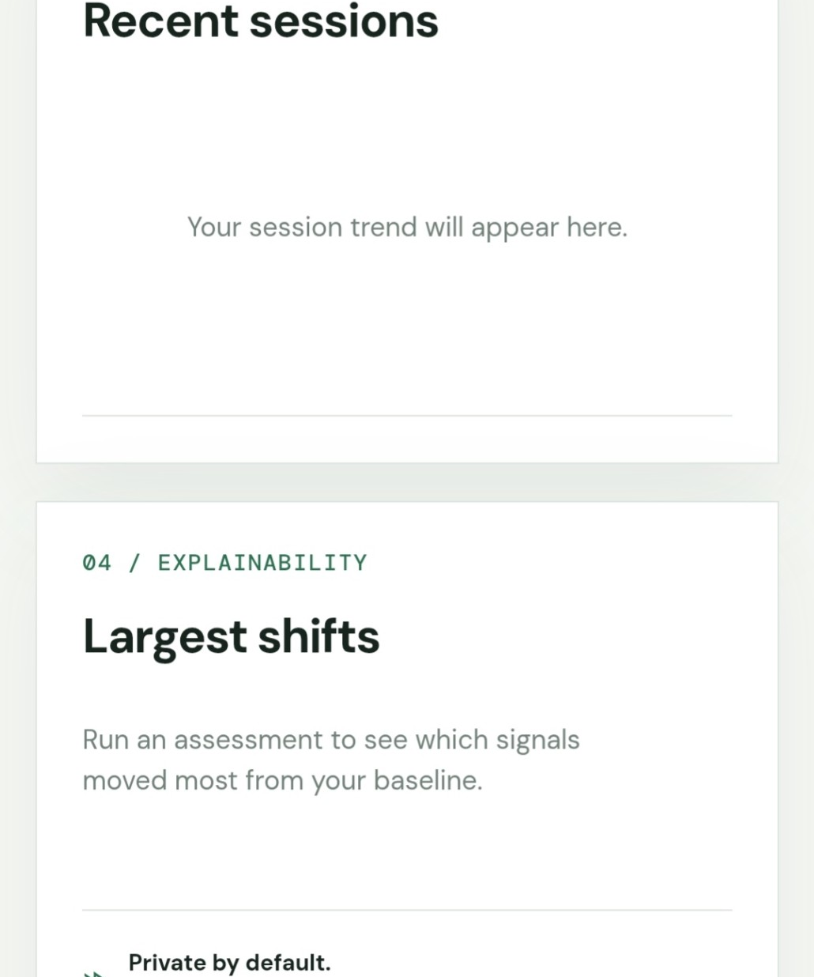
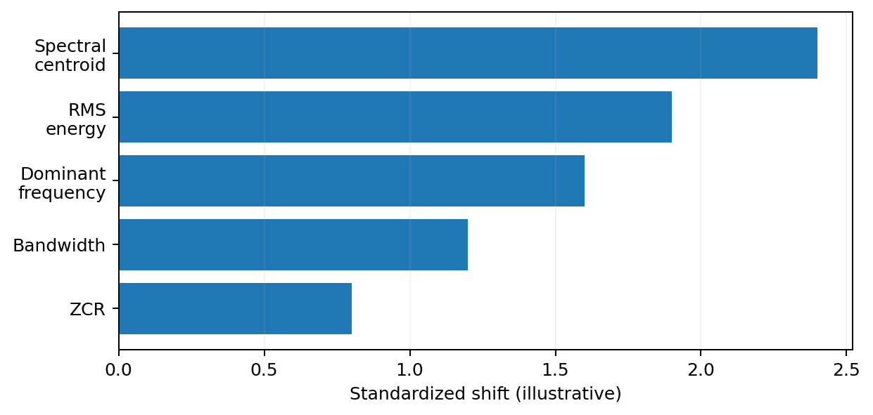
EXPLAINABILITY
ECHO does not hide behind a number.
Illustrative feature-shift chart — replace with actual MVP output when available.
The dashboard highlights the largest standardized feature shifts.
ECHO / MED VISION’26
09

Slide 10
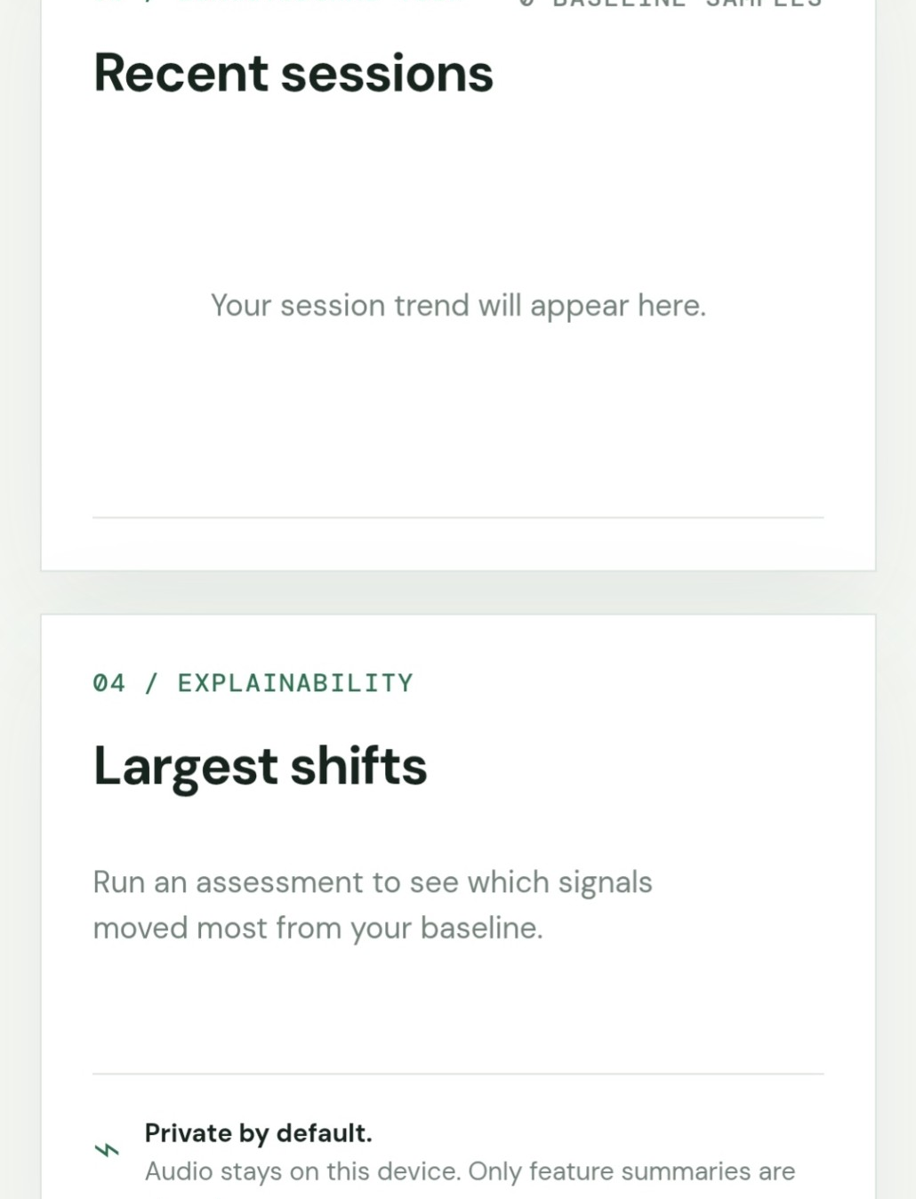
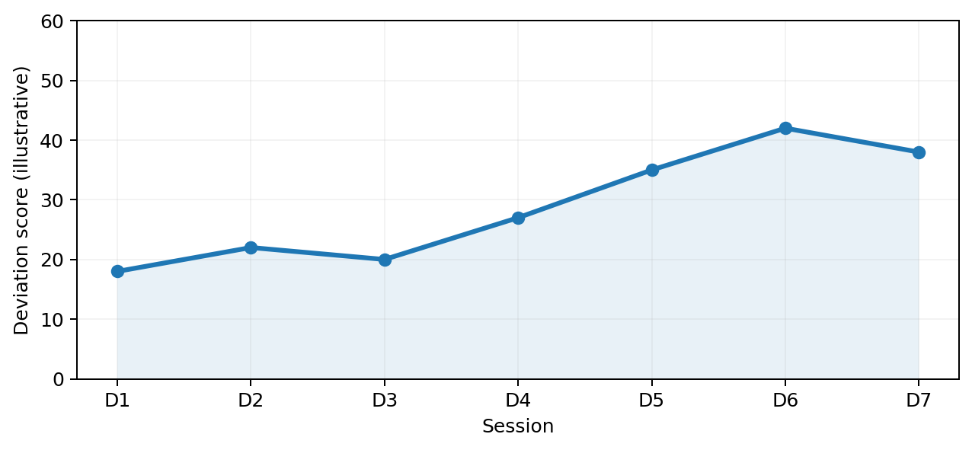
LONGITUDINAL VIEW
A session becomes a point in a trend.
Illustrative trend — not a patient result.
Repeated sessions create context that a one-shot classifier cannot provide.
ECHO / MED VISION’26
10

Slide 11
PRIVACY BY DESIGN
Keep the raw acoustic signal local whenever possible.
MICROPHONE
→
LOCAL DSP
→
ENCRYPTED DB
→
DASHBOARD
raw audio
features
feature vectors
trend + score
RAW AUDIO
is processed in memory by the MVP and is not written to disk by the app.
Feature vectors are encrypted in SQLite; deployment secrets should be managed securely.
ECHO / MED VISION’26
11

Slide 12
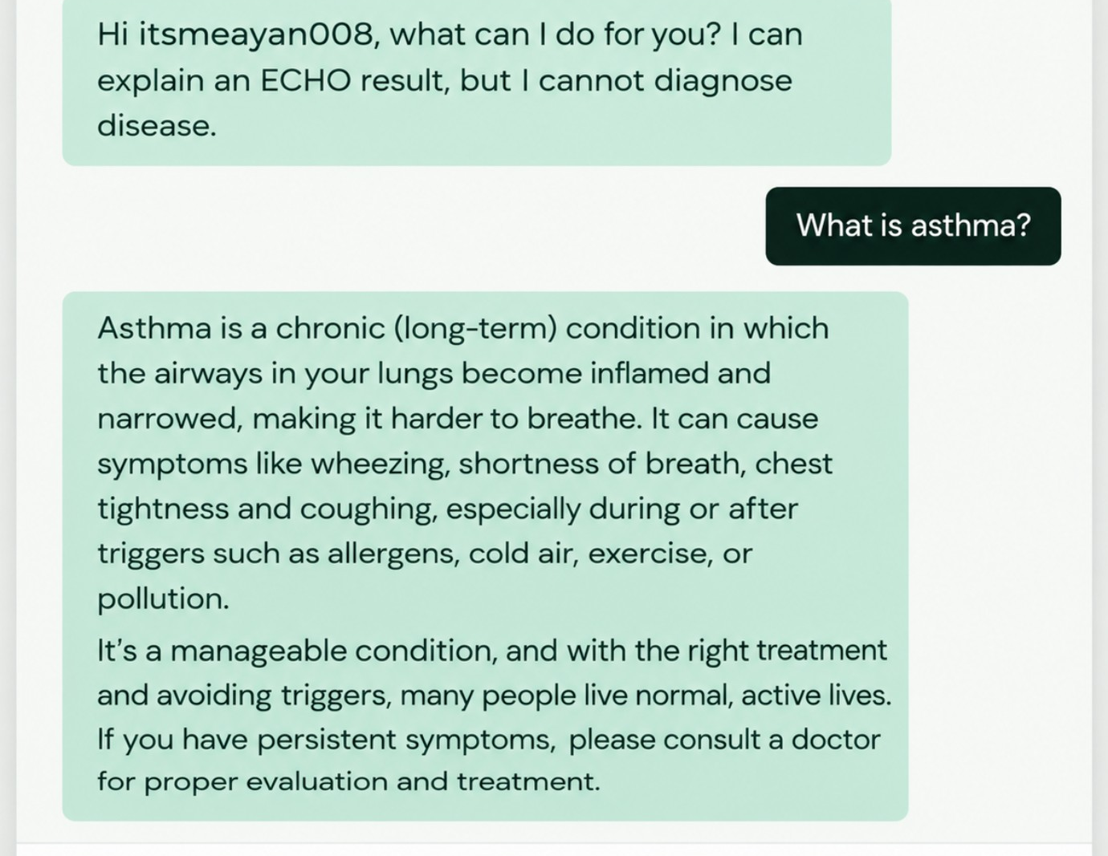
LOCAL AI GUIDE
A conversational layer with explicit safety boundaries.
OLLAMA / LOCAL MODEL
Summarizes ECHO results in plain language.
NO DIAGNOSIS
Explains the monitoring output only.
NO PRESCRIPTION
Does not recommend medication.
EMERGENCY ROUTING
Directs urgent situations to local medical services.
ECHO / MED VISION’26
12

Slide 13
TECH STACK
Commodity hardware. Open-source software. CPU-friendly inference.
HARDWARE
Raspberry Pi + microphone
APP
Python 3 + Flask
SIGNAL PROCESSING
NumPy • SciPy • SoundFile
STORAGE
SQLite + Fernet
ML
Scikit-learn • anomaly detection
LOCAL AI
Ollama
DEPLOYMENT
Docker • Render
Future clients: React/Vite web frontend • native Kotlin Android app
ECHO / MED VISION’26
13

Slide 14
VALIDATION
How we test the engineering without overclaiming.
01
02
03
PERSONAL BASELINE
PUBLIC DATASETS
CONTROLLED PILOT
Repeated recordings from the same person
Coswara • COUGHVID • ICBHI — separate experiments
Future clinical partner + standardized protocol
ENGINEERING
OFFLINE
VALIDATION
CONTROLLED
PILOT
CLINICAL
VALIDATION
Public datasets support offline engineering validation — not a disease claim.
ECHO / MED VISION’26
14

Slide 15
CLOSING / ECHO
From a microphone
to a personal respiratory signal.
ECHO does not try to diagnose from one sound.
It tries to notice meaningful change from your own normal.
TODAY
Guided capture • personal baseline • deviation score • explainability • local AI
RESEARCH PROTOTYPE — NOT A DIAGNOSTIC DEVICE
TEAM VOID_ELIMINATORS() • SRMIST • MED VISION’26
ECHO / MED VISION’26
15

