Slide 1
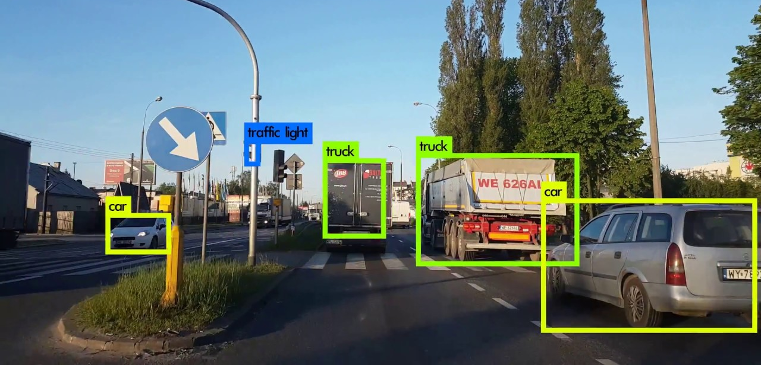
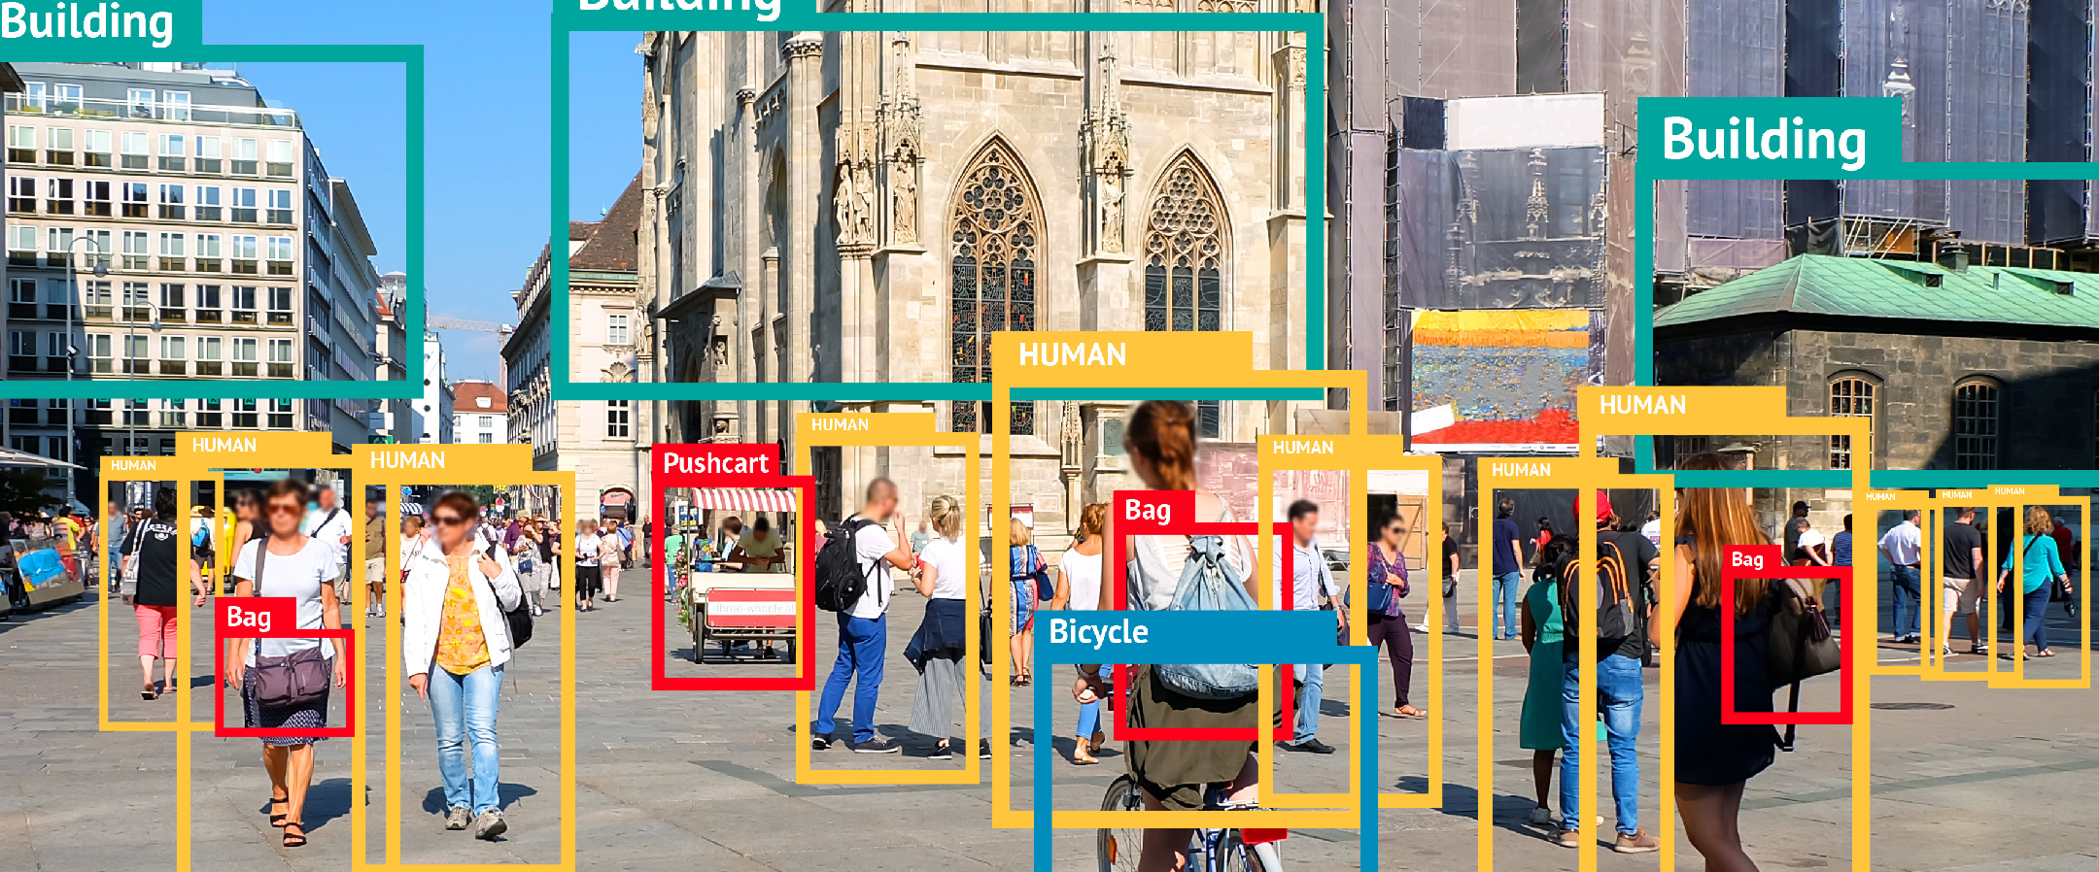
End To End Object Detection using Deep Learning with TensorFlow, Detectron & Yolov5
Training a Custom Chess Piece Detector
using Tensorflow2.x

Slide 2
Section 8 Introduction
Our Custom Dataset
Doing Annotations or Labeling data
Preparing the Dataset for Training
Selection of Pretrained Model from Model Zoo
Doing Changes in Configuration Files
Let's start Training
Stop Training or resume Training
Converting CKPT to Saved Model
Inferencing with our custom mask model

Slide 3
Our Custom Dataset
About our data
Folder Structure
Dataset Contents
Train and Test Split
Images and Annotation Files

Slide 4
Doing Annotations or labeling data
LabelImg
Installing Labelimg
About the Tool
Loading Data
Doing Annotations
Contents of XML Files
Other Annotation Tools Used

Slide 5
Preparing the Dataset for Training
Google Colab Setup
Loading data from Google Drive to Colab
Unzipping it
Visual Inspection of data

Slide 6
Selection of Pretrained Model from Model Zoo
Visiting the Model Zoo
Selecting model for our use case
Downloading the model
Unzipping the tar file

Slide 7
Files Setup for Training
Generate_tfrecords file
Labelmap.pbtxt file
Configuration file changes

Slide 8
Let's start Training
Using model_main_tf2.py for training
Saving checkpoints in training folder
Train for 25000 steps

Slide 9
Stop Training or resume Training
Stop Training
Resume Training

Slide 10
Converting CKPT to Saved Model Format
exporter_main_v2.py
Executing the file
Finally converted to savedmodel format

Slide 11
Inferencing with our trained model
Using the object_detection_tutorial.ipynb
Giving the paths of model and lablemap.pbtxt
Inferencing on some test images

Slide 12
Inferencing in Local PC
Using the object_detection_tutorial.ipynb
Giving the paths of model and labelmap.pbtxt
Inferencing on some test images

