Slide 1
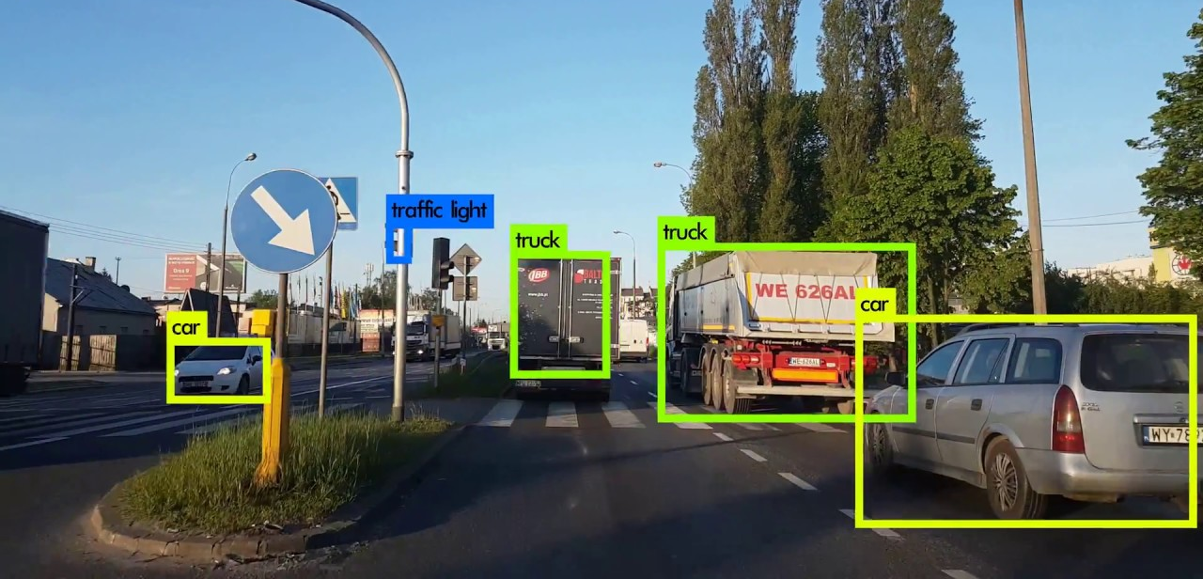
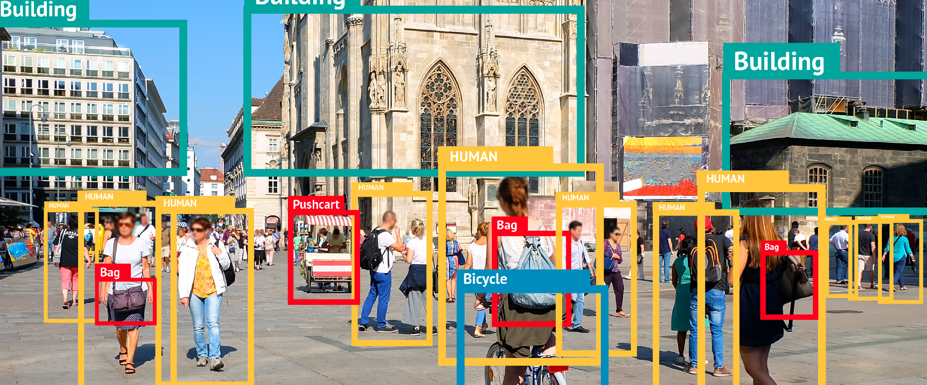
End To End Object Detection using Deep Learning with TensorFlow, Detectron & Yolov5
Object Detection using TensorFlow 1.x

Slide 2
Object Detection using TensorFlow 1.x
Introduction to TFOD 1.x
Using Google Colab with Google Drive
Installation of Libraries in Colab
TFOD 1.x Environment Setup in Colab
Important Configuartion Files
Visiting the Model zoo
Inference using Pretrained Model
Project Setup in Local PC

Slide 3
Introduction to TensorFlow 1.x Object Detection
Introduction to Tensorflow Models Repository
Going through Object Detection research
Sample Output Image

Slide 4
Using Google Colab and Google Drive
Google Colab Introduction
Similar to Jupyter Notebook
System Specs
Connecting to Google Drive

Slide 5
Installation of Libraries in Colab
Google Colab comes with preinstalled packages
Uninstalling few packages
Installing packages for our setup

Slide 6
TFOD1.x Setup in Colab
Connect to Google Drive
Setting up Google Drive
Keeping project files in Drive

Slide 7
Visiting the Model Zoo
Naming Conventions of Models
Model Zoo of TF 1.x
Coco trained Models
Kitti trained Models
Open images trained Model
Parameters to select the models

Slide 8
Inference using Pretrained Model in Colab
Setup verification
Inferencing using pretrained model default
Inferencing using other pretrained model
Inferencing with sample images
Inferencing with custom images

Slide 9
Project Setup in Local PC
Setting up environment
Installing Packages
Cloning Official Tensorflow models Repo
Installing Protobuff
Installing Object Detection
Setup Verification
Inferencing using Pretrained Models

Slide 10
Webcam Testing
Testing pretrained models with Webcam

Slide 11
Important Files
Object Detection Notebook
Frozen inference grapgh
Labelmap.pbtxt
Config file for pretrained models

