Slide 1
INTERNSHIP PRESENTATION
Full Stack Development
Presented by:
Daksh Pratap Singh
(Roll No. 2410030168)
B.Tech (Computer Science and Engineering)
IILM University, Greater Noida
IILM University | Thiranex Full Stack Development Internship 1

Slide 2
Internship Overview
Organization
Thiranex
Role
Intern – Full Stack Development
Duration
20 Aug 2026 – 19 Sept 2026
Remote / project-based internship.
Practical projects under industry mentorship.
Focus on frontend, backend, databases and full-stack workflows.
Four major development projects were completed and submitted on track.
IILM University | Thiranex Full Stack Development Internship 2

Slide 3
Objectives of the Internship
Understand full-stack web application development.
Strengthen frontend and responsive UI skills.
Understand backend development and REST-style API integration.
Learn database integration and persistent data management.
Practice authentication, authorization and CRUD operations.
Gain practical experience through project-based assignments.
Understand the basic workflow of deploying web applications.
IILM University | Thiranex Full Stack Development Internship 3

Slide 4
Technologies & Concepts
Frontend
HTML, CSS, JavaScript
React.js where applicable
Backend
Node.js / Express.js
Django / Flask
Database
MySQL
PostgreSQL / MongoDB
APIs
RESTful APIs
Backend integration
Security
Authentication
Authorization / role-based access
Other
Responsive design
Deployment & debugging
IILM University | Thiranex Full Stack Development Internship 4

Slide 5
Completed Internship Projects
1. Personal Portfolio Website
Full-stack portfolio to showcase projects and skills.
2. Task Management Application
Create, update and track tasks with authentication and CRUD.
3. E-Commerce Web Application
Product catalogue, cart, checkout and order management.
4. Blog Platform with Comments
User accounts, post management, comments and REST APIs.
IILM University | Thiranex Full Stack Development Internship 5

Slide 6
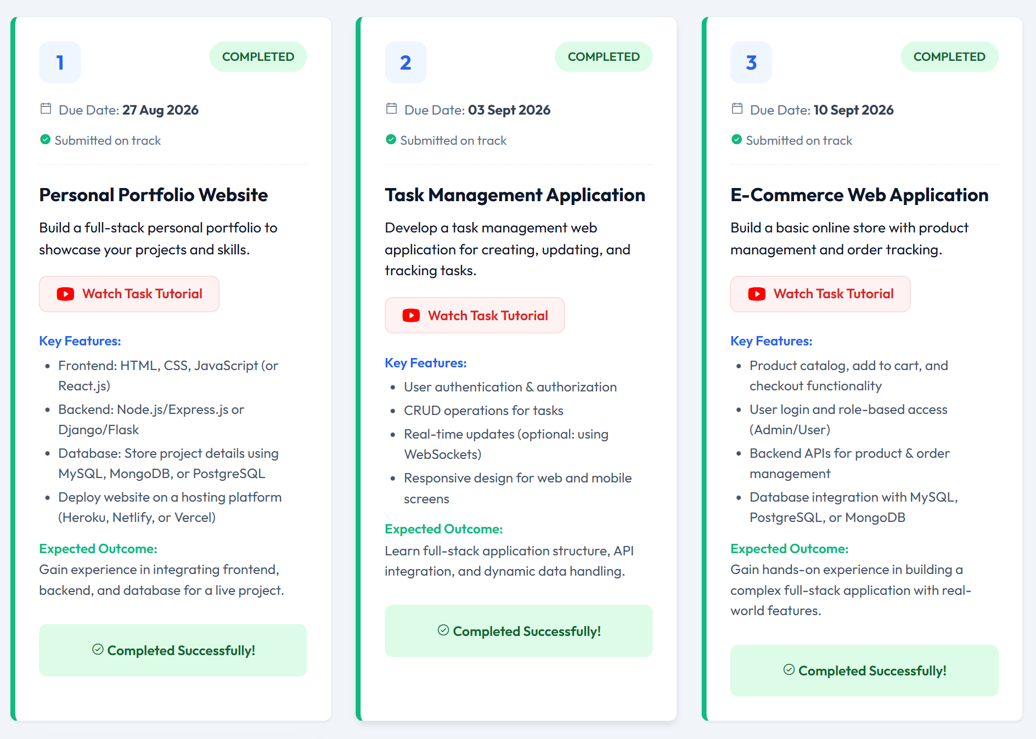
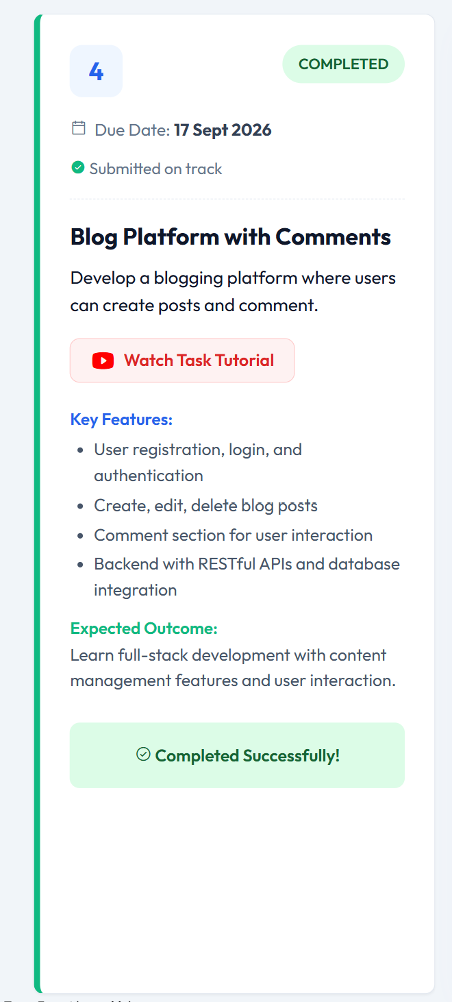
Completed Work – Project Dashboard
IILM University | Thiranex Full Stack Development Internship 6

Slide 7
Project Features
Personal Portfolio Website
Frontend + backend + database integration and deployment workflow.
Task Management Application
Authentication, authorization, CRUD operations, responsive design.
E-Commerce Web Application
Product catalogue, cart, checkout, user roles and order management.
Blog Platform with Comments
Registration/login, post CRUD, comments, RESTful APIs and database integration.
IILM University | Thiranex Full Stack Development Internship 7

Slide 8
General Full-Stack Architecture
User / Client
Web pages and responsive interfaces
Frontend
UI, forms, navigation and API communication
Backend / API
Business logic, authentication and CRUD operations
Database
Users, tasks, products, orders, posts and comments
Deployment
Hosting and serving the completed application
IILM University | Thiranex Full Stack Development Internship 8

Slide 9
Learning Outcomes
Better understanding of the frontend–backend–database relationship.
Practical exposure to responsive web interfaces.
Understanding of backend APIs and CRUD operations.
Experience with authentication and authorization concepts.
Understanding of SQL/NoSQL database integration.
Improved debugging and problem-solving skills.
Experience with real-world style application features.
Basic understanding of deployment and hosting workflows.
IILM University | Thiranex Full Stack Development Internship 9

Slide 10
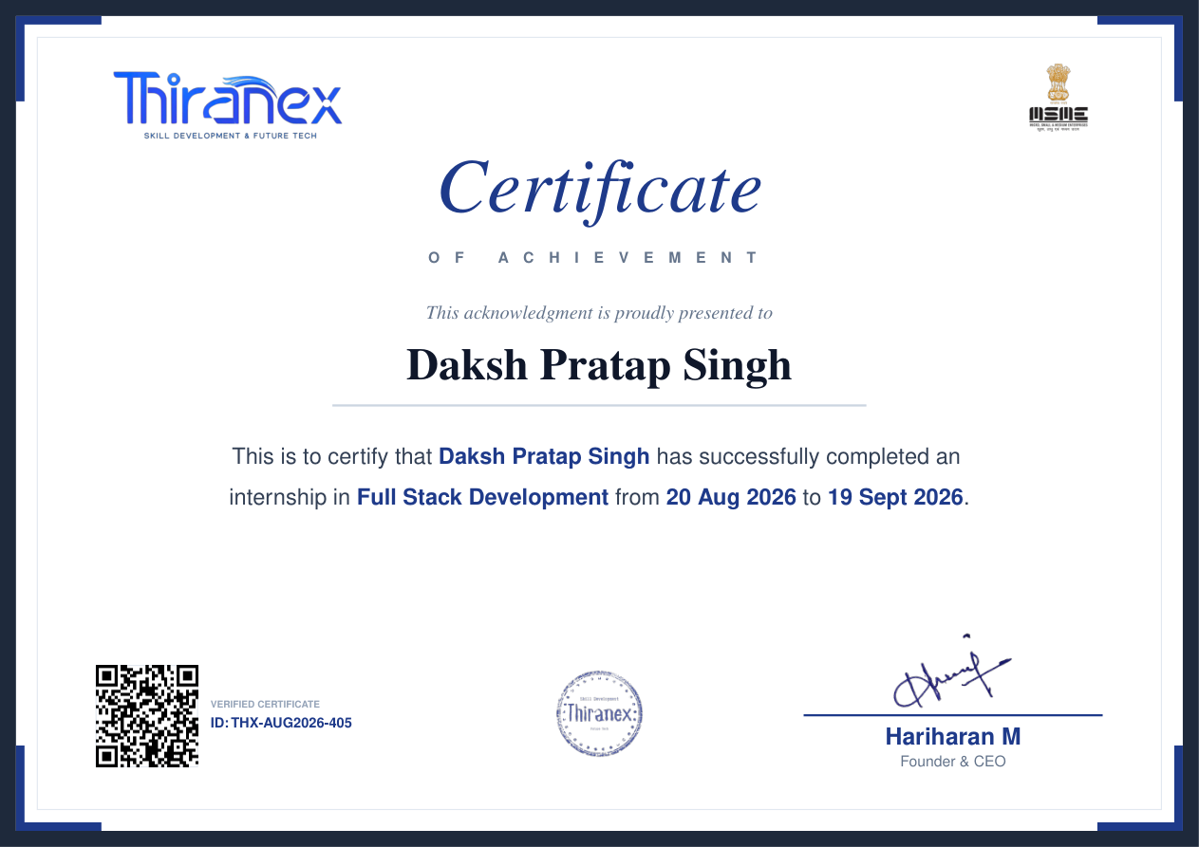
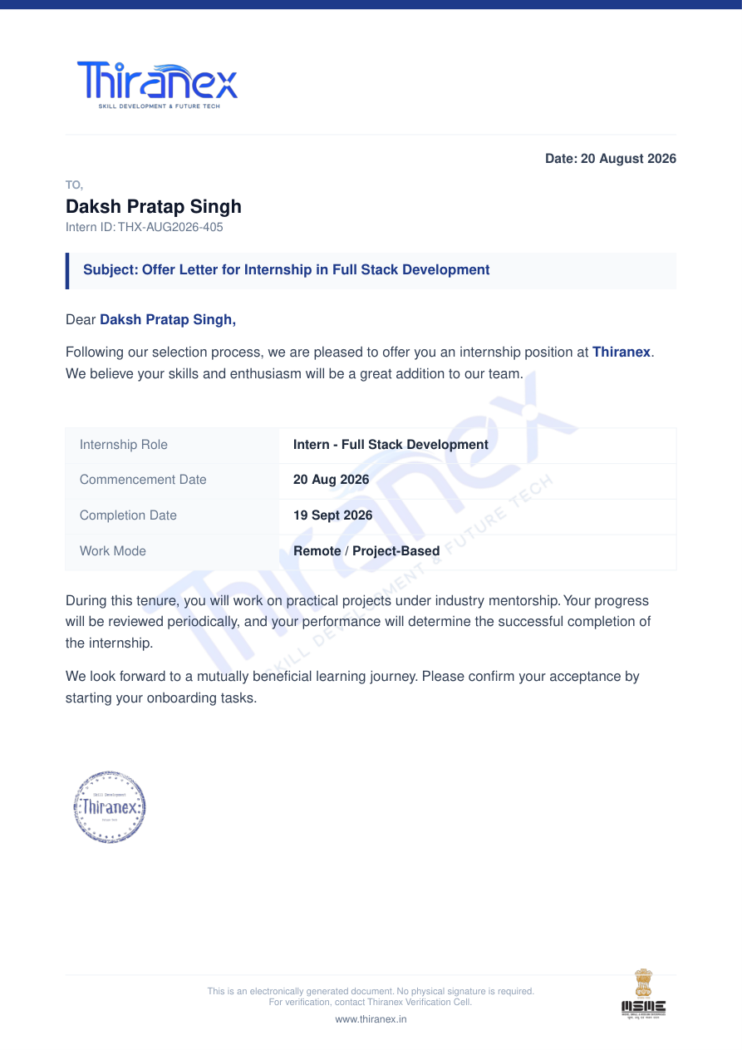
Internship Completion Evidence
Status
Successfully completed
Intern ID
THX-AUG2026-405
IILM University | Thiranex Full Stack Development Internship 10

Slide 11
CONCLUSION
The internship provided practical exposure to complete full-stack application development.
Four projects covered portfolio development, task management, e-commerce and blogging.
The experience strengthened skills in frontend, backend, APIs, databases and authentication.
The internship connected academic programming knowledge with practical software development.
IILM University | Thiranex Full Stack Development Internship 11

