Slide 1

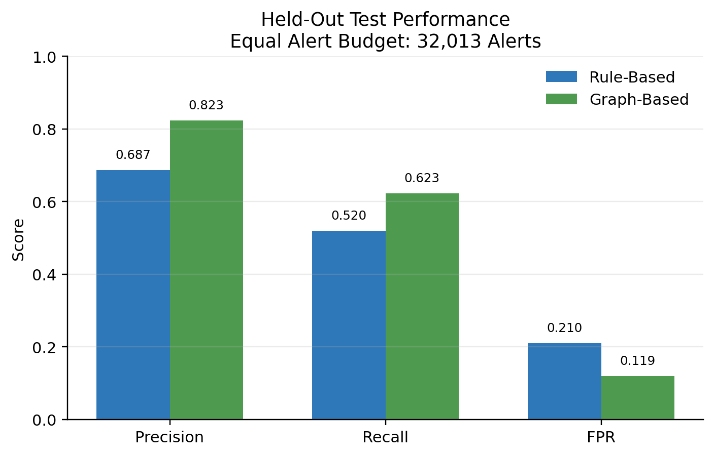
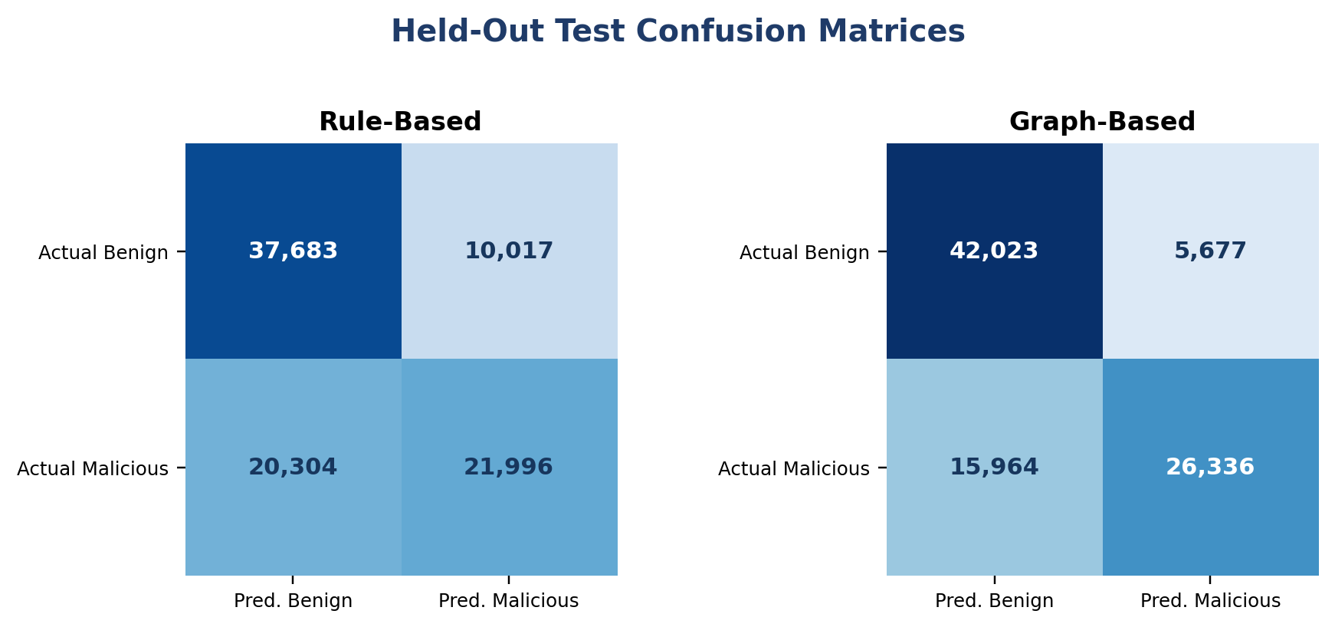
Detecting Post-Compromise Lateral Movement
Using Authentication Logs
A Graph-Based Anomaly Detection Framework - Independent Synthetic Benchmark
Daniel Peng
New York University, New York, NY, USA
ABSTRACT
I. INTRODUCTION
Perimeter defenses focus on preventing initial access, but once valid credentials are compromised, lateral movement toward high-value systems can blend with legitimate activity. This poster independently evaluates whether graph-assisted authentication analysis improves detection over a simple novelty-rule baseline. The public synthetic dataset contains 180,000 events across 30 days, 498 active users, 150 destination hosts, and 16,391 labeled attack chains aligned with MITRE ATT&CK T1078 and T1021. A chronological baseline, fit, and held-out test design is used. Under the same 32,013-alert review budget, the graph-based method achieved 0.823 precision, 0.623 recall, and 0.119 FPR, compared with 0.687, 0.520, and 0.210 for the baseline. Because the data and labels are synthetic and attack-enriched, the results demonstrate feasibility rather than validated production performance.
Enterprise security often prioritizes initial compromise through firewalls, multifactor authentication, and intrusion prevention. After an attacker obtains valid credentials, subsequent activity can resemble normal employee or administrator behavior.
Lateral movement is the bridge from one compromised endpoint to wider enterprise access. Static rules can over-alert on benign novelty or miss pivots that reuse familiar systems in an unusual order.
This study asks a narrow question: on a controlled synthetic benchmark, does relational context improve separation between benign and malicious authentication events when both detectors receive the same alert budget?
180K
498
150
16,391
Research question: does relational context improve detection under the same alert budget?
events
active users
destination hosts
attack chains
II. PROBLEM DOMAIN
III. METHODOLOGY
Credential-based attacks are difficult to detect after compromise because stolen credentials can produce technically valid logins. Attackers can pivot through ordinary workstations and servers while appearing similar to legitimate administrative activity.
Entry-point controls such as IP blocking and account lockouts do not directly model the sequence or relational context of internal movement. This can create high false-positive volume while still missing low-and-slow pivots.
A. Detection Pipeline
Authentication
Logs
Feature
Extraction
Graph-Assisted
Model
Anomaly
Scoring
Detection
Output
B. Detection Approaches
Fig. 1. Analysis pipeline from authentication events to alert output.
1) Rule-Based Baseline
2) Graph-Based Method
Flags a first-time destination host for a user
Flags a previously unseen source subnet
Updates observed history in chronological order
Simple benchmark, not a modern commercial UEBA system
N: new user-to-destination relationship
R: destination is closer to DC-01 than the user's historical footprint
D: positive deviation in daily distinct-user activity at the destination
Logistic regression fitted on the chronological fit period
The central challenge is balancing detection effectiveness with analyst usability. Event-level novelty can be benign, while a familiar host may become suspicious when it appears in an unusual path, sequence, or burst of activity. This motivates models that consider who normally accesses which systems and how those relationships change over time.
logit P(malicious) = beta0 + beta1 N + beta2 R + beta3 D
Coefficients are learned from labeled fit-period events. Final test alerts are ranked without using test labels.
C. Relational Representation
Techniques represented in the dataset
Historical user-host relationships define normal access. Hosts co-accessed by users form a graph used to estimate paths toward DC-01.
Normal path
T1078 Valid Accounts
Use of stolen or otherwise compromised credentials.
T1021 Remote Services
Lateral movement through internal remote-access services.
High-value target
A simulated domain controller named DC-01.
Suspicious path
User A
Server 1
Server 2
User B
Server 3
DC-01
Fig. 2. Example of ordinary and suspicious access relationships.
IV. EVALUATION SETUP
V. RESULTS
Observed dataset
Under the same 32,013-alert review budget, the graph-based method improved every event-level metric on the held-out test set.
Events
180,000 across 30 days
Method | Precision | Recall | FPR
Rule-Based | 0.687 | 0.520 | 0.210
Graph-Based | 0.823 | 0.623 | 0.119
Users
498 active users
Method
Precision
Recall
FPR
Rule-Based
0.687
0.520
0.210
Rule-Based
0.687
0.520
0.210
Graph-Based
0.823
0.623
0.119
Hosts
150 destination hosts, including DC-01
Graph-Based
0.823
0.623
0.119
Chains
16,391 labeled T1078/T1021 chains
Labels
115,140 benign and 64,860 malicious events
Chronological design
Baseline: 42,000 benign events, days 1-7
Fit: 48,000 events, days 8-15
Held-out test: 90,000 events, days 16-30
Equal test alert budget: 32,013 alerts per method
Observed interpretation
Precision increased by 13.6 percentage points
Recall increased by 10.3 percentage points
FPR decreased by 9.1 percentage points
Attack-chain detection: 97.4% graph vs 94.1% baseline
Tradeoff: DC-target recall was 65.6% graph vs 100% baseline
Metrics
Precision
Fraction of alerts that are malicious
Recall
Fraction of malicious events detected
FPR
FP divided by all benign events
Attack-enriched benchmark: 36% malicious overall and 47% malicious in the test period.
Fig. 3. Point estimates from one held-out test set. No target metrics or repeated-run averages are used.
VI. CONCLUSION
VII. FUTURE WORK
REFERENCES
On the held-out test period, graph-assisted scoring improved precision and recall while reducing the false-positive rate under the same alert volume. It also detected a larger fraction of attack chains. However, the simple rule baseline captured more malicious DC-01 target events, showing that aggregate gains can hide target-specific tradeoffs. The study supports graph context as a useful feasibility direction, not as evidence of production readiness.
Validate on real datasets such as LANL and CERT
[1] C. Herley and D. Florencio, "Protecting Financial Institutions from Brute-Force Attacks," IFIP SEC, 2008.
[2] R. Sommer and V. Paxson, "Outside the Closed World: On Using Machine Learning for Network Intrusion Detection," IEEE S&P, 2010.
[3] V. Chandola et al., "Anomaly Detection: A Survey," ACM Computing Surveys, 41(3), 2009.
[4] MITRE ATT&CK, T1078 and T1021.
[5] A. D. Kent, "Comprehensive, Multi-Source Cyber-Security Events," LANL, 2015.
[6] D. Peng, "Synthetic Enterprise Authentication Logs," Kaggle, 2026.
Test realistic low-prevalence and noisy-label settings
Compare with peer-group, UEBA, and stronger temporal baselines
Add endpoint and network telemetry; evaluate temporal GNNs
+13.6 pts
+10.3 pts
-9.1 pts
Measure scalability and streaming latency in larger environments
Precision
Recall
FPR
Public dataset: danielpeng1995/synthetic-enterprise-auth-logs

