Slide 1


Learn JavaScript Introduction to JavaScript
Nagaraju Katta

Slide 2


Today’s Agenda
Client and Server Overview
What is JavaScript
Introduction to DOM
Introduction to BOM
What is JavaScript Engine
JavaScript Runtime
JavaScript Fundamentals
VS Code Editor
Chrome Dev Tools

Slide 3
Client & Sever Overview
Web Server : The term web server can refer to hardware or software, or both of them working together
On the hardware side : A web server is a computer that stores web server software and a website’s component files. E.g HTML documents, images, CSS stylesheets, and JS files) A web server connects to the internet and supports physical data interchange with other devices connected to the web
On the software side : A web server includes several parts that control how web users access hosted files.
E.g HTTP server

Slide 4
Web servers and HTTP
Web browsers communicate with web servers using the HTTP ( Hyper Text Transfer Protocol )
When you click a link on a web page, submit a form, or run a search, the browser sends an HTTP Request to the server
Web servers wait for client request messages, process them when they arrive, and reply to the browser with an HTTP Response message

Slide 5
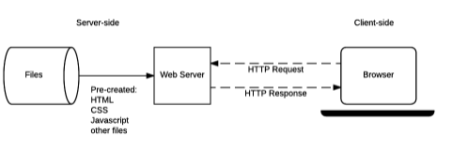
Static sites
A static site is one that returns the same hard coded content from the server whenever a particular resource is requested.

Slide 6
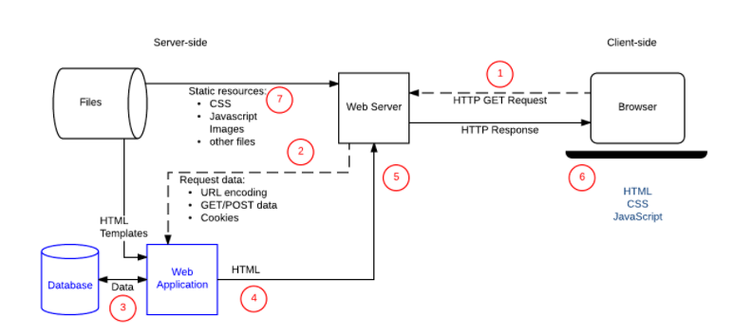
Dynamic sites
A dynamic site is one that can generate and return content based on the specific request URL and data ( rather than always returning the same hard-coded file for a particular URL)

Slide 7

Questions……

Slide 8
What is JavaScript ?
JavaScript is a programming language initially designed to interact with elements of web pages.
JavaScript allows you to add interactivity to a web page. JavaScript is often used with HTML and CSS to enhance a web page’s functionality such as validating forms , creating interactive maps, and displaying animated charts.
Important : When a web page is loaded, i.e after HTML and CSS have been downloaded, the JavaScript engine in the web browser executes the JavaScript code. The JavaScript code then modifies the HTML and CSS to update the interface dynamically.

Slide 9
Client-side vs Server-side JavaScript
Client side : When JavaScript used on a web page, it is executed in the user’s web browsers. In this case, JavaScript works as a client-side language.
Server side : Server side JavaScript executes on the server that allows you to access databases, file systems, etc.
E.g : JavaScript server-side environment is Node.js

Slide 10

JavaScript History
In 1995, JavaScript was created by a Netscape developer named Bredan Eich. First, it was called Mocha. Later, it was renamed LiveScript
Netscape decided to change LiveScript to JavaScript to leverage Java’s fame, which was popular at that time
In 1997, JavaScript 1.1 was submitted to the ECMA as a proposal

Slide 11
JavaScript consists of three main parts
ECMAScript provides the core functionality.
The Document Object Model ( DOM ) provides interfaces for interacting with elements in the web pages
The Browser Object Model ( BOM ) provides the browser API for interacting with the web browser

Slide 12
Document Object Model
The Document Object Model ( DOM) is an application programming interface (API) for manipulating HTML and XML documents
The DOM represents a document as a tree of nodes. It provides API that allows you to add, remove, and modify parts of the documents effectively.
The DOM is cross-platform and language-independent ways od manipulating HTML and XML documents

Slide 13
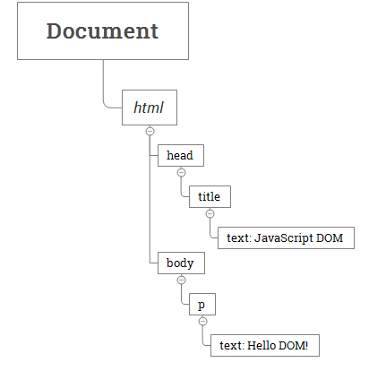
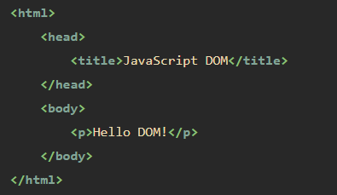
A document as a hierarchy of nodes

Slide 14
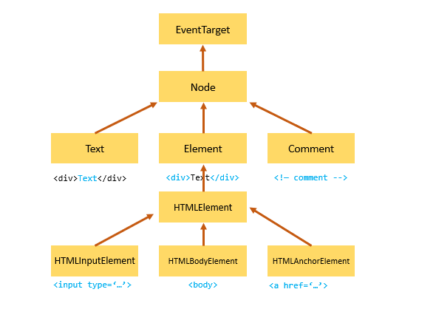
Node and Element
The node is generic type of the element. The element is a specific type of the node with the node type Node.ElEMENT_NODE.

Slide 15
JavaScript BOM
The Browser Object Model (BOM) is the core of JavaScript on the web.
The BOM provides you with objects that expose the web browser’s functionality
Example : Window object
The global object of JavaScript in the browser is the window object. It means that all variables and functions declared globally with the var keyword become the properties and methods of window object.

Slide 16
JavaScript Engine
JavaScript is an interpreted programming language. It means that source code isn’t compiled into binary code prior to execution.
How your computer can understand what to do with a plain text script ?
That’s the job for JavaScript engine.
A JavaScript engine is a program responsible for translating source code into machine code and executing the translation result on a computers central processing unit ( CPU )

Slide 17
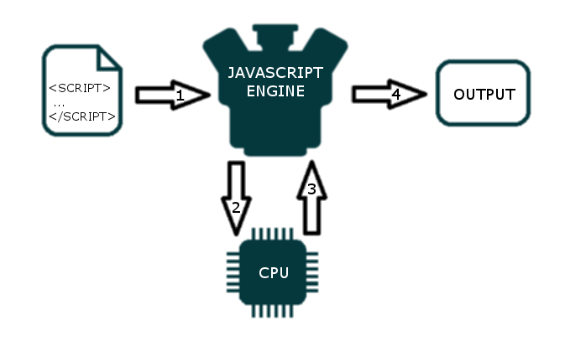
The JavaScript Engine

Slide 18
Most important JavaScript engines
Chome V8 – Its an open source project written in C++. V8 is used in Google Chrome, Opera, NodeJS and Couchbase
SpiderMonkey - The open source engine implemented in C++. It’s maintained by Mozilla Foundation. You can find it in Firfox
Nitro – The engine developed by Apple. It’s used in Safari
Chakra – Developed by Microsoft as the JavaScript engine for Edge browser

Slide 19
Want to explore more on JS Engine ?
References :
https://www.geeksforgeeks.org/what-happens-inside-javascript-engine/
https://dev.to/lydiahallie/javascript-visualized-the-javascript-engine-4cdf

Slide 20
JavaScript Runtime
Execution context : When JavaScript engine executes a script, it creates execution contexts. Each execution context has two phases :
Creation phase
Execution phase

Slide 21
The creation phase
When a script executes for the first time, the JavaScript engine creates a Global Execution Context. During this creation phase, it performs the following tasks
Create a global object i.e window in the web browser or global in Node.JS
Create a this object binding which points to the global object above
Setup a memory heap for storing variables and function references
Store the function declarations in the memory heap and variables within the global context with the initial values as undefined

Slide 22
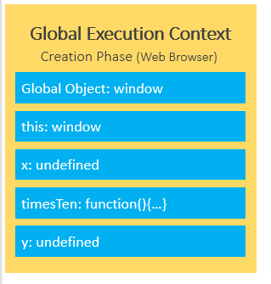
Global Execution Context

Slide 23
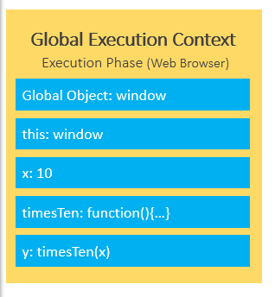
The execution phase
During the execution phase, the JavaScript engine executes the code line by line. In this phase, it assigns values to variables and executes the function calls.
For every function call, the JavaScript engine creates a new Function Execution Context

Slide 24
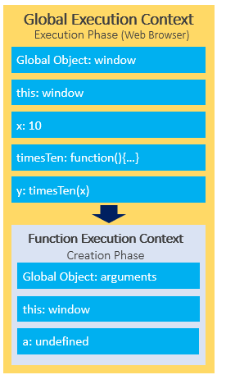
Function Execution Context

Slide 25
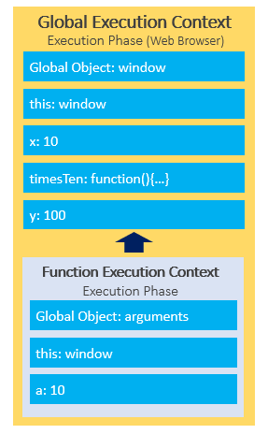

Slide 26
JavaScript Event Loop
JavaScript single-threaded model : JavaScript is a single-threaded programming language. In other words, it can do only one thing at a time.
JavaScript engine executes a script from the top and works its way down creating execution contexts and pushing and popping functions onto and off the call stack.
Blocking functions : A function that takes a long time to execute is known as a blocking function. Technically, the blocking functions block all the interactions with the webpage such as mouse click.

Slide 27
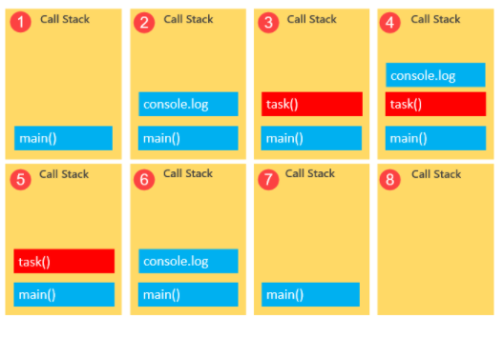
Call Stack

Slide 28
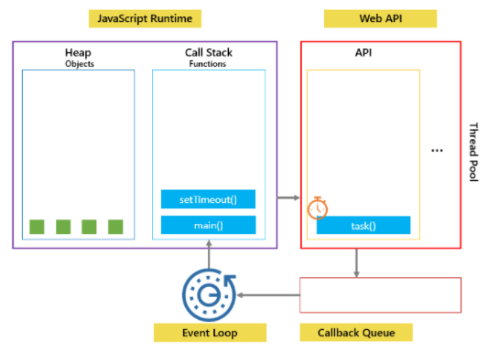
Callbacks to the recue
To prevent blocking functions from blocking other activities, we typically wrap them in callback functions which can be executed later.

Slide 29
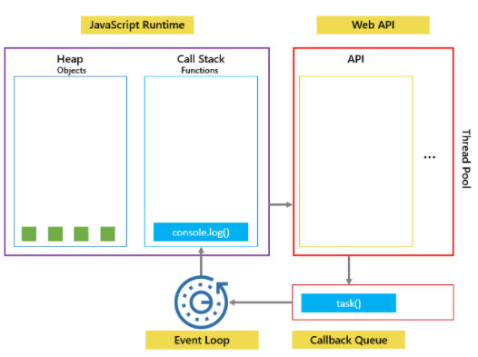

Slide 30
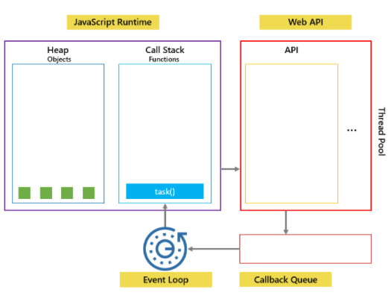

Slide 31
JavaScript variable scopes
Scope determines the visibility and accessibility of a variable. JavaScript has three scopes: global scope, local scope, and block scope

Slide 32
JavaScript Hoisting
During the creation phase, the JavaScript engine moves the variable and function declarations to the top of your code. This feature is known as hoisting in JavaScript.
Variable Hoisting : Variable hoisting means the JavaScript engine moves the variable declarations to the top of the script
Function Hoisting : Like variables, the JavaScript engine also hoists the function declarations. It moves the function declarations to the top of the script

Slide 33
Home work & Reading assignment
Reading assignment
Read about What is a web server in detail
What HTTP request includes ?
What HTTP response contains ?

Slide 34
References
https://developer.mozilla.org/en-US/docs/Learn/Common_questions/What_is_a_web_server

