Slide 1
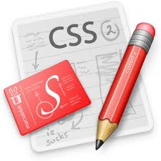


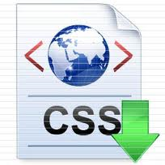
Web Application Development
Cascading Style Sheet (CSS)

Slide 2
Aim/ Objectives
To build student awareness of style sheet mechanism available to web programmers seeking to develop and interactive web sites.
At the same time students will develop practical expertise in CSS providing them with a solid foundation from which to develop a mastery of web programming techniques

Slide 3
Learning Outcome
Use style sheets to enhance the user interface of a web site.

Slide 4
Cascading Style Sheet
Cascading Style Sheet (CSS) is a style sheet language used to describe the presentation of a document written in a markup language (e.g. HTML and XHTML).
CSS is a list of statements (rules) that define colors, fonts, layout, and other aspects to HTML elements.

Slide 5
Why Use Style Sheets?
It allows much greater degree of layout and display control.
The amount of format coding necessary to control display characteristics can be greatly reduced.
It allows multiple styles to be attached to a document at once.
It also allows for all the style formatting in a document to be changed at once, thus a document can be easily formatted for different purposes (online, brochures, printing, etc.).

Slide 6
Three ways to insert CSS
External style sheets, i.e. a separate CSS-file referenced from the document
Embedded style (internal), blocks of CSS information inside the HTML document itself
Inline style, attaches a style definition within the HTML element it is modifying

Slide 7
Inline Style
To use inline styles you use the style attribute in the relevant tag. The style attribute can contain any CSS property.
<html>
<head>
</head>
<body>
<img src="images\dog1.jpg" style="border-bottom-width:thick; border-bottom-style:solid;border-color:red;" >
</body>
</html>

Slide 8
Embedded / internal Style Sheet
An internal style sheet should be used when a single document has a unique style. You define internal styles in the head section of an HTML page, by using the <style> tag
<html><head>
<style type="text/css">
.border{
border-bottom-width:thick;
border-bottom-style:double;
border-bottom-color:red;
}
</style></head>
<body>
<img src="images\dog1.jpg" class="border" >
</body>
</html>

Slide 9
External Style Sheet
An external style sheet is ideal when the style is applied to many pages. With an external style sheet, you can change the look of an entire Web site by changing one file. Each page must link to the style sheet using the <link> tag. The <link> tag goes inside the head section
<html>
<head>
<link rel="stylesheet" type="text/css" href="externalstyle.css"/>
</head>
<body>
<img src="images\dog1.jpg" class="border" >
</body>
</html>
.border{
border-bottom-width:thick;
border-bottom-style:double;
border-bottom-color:red;
}
Externalstyle.css

Slide 10
Cascading order
What style will be used when there is more than one style specified for an HTML element? (multiple style sheets)
Inline style (inside an HTML element)
Internal style sheet (in the head section)
External style sheet
Browser default
Notes:
So, an inline style (inside an HTML element) has the highest priority, which means that it will override a style defined inside the <head> tag, or in an external style sheet, or in a browser (a default value).
Note: If the link to the external style sheet is placed after the internal style sheet in HTML <head>, the external style sheet will override the internal style sheet!

Slide 11
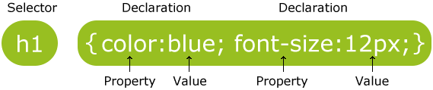
Defining a Style
CSS style definitions follow the format given below:
selector_expression {
element_property: property_value(s);
element_property: property_value(s);
…
}
The selector_expression is an expression that can be used to match specific elements (HTML elements/tags) in the document; the element_property specifies which properties of the element the definition will affect, and each property can take a value. The property and value are separated by a colon, and surrounded by curly braces.
Notes:
The selector is normally the HTML element you want to style.
Each declaration consists of a property and a value.
The property is the style attribute you want to change. Each property has a value.

Slide 12
Example Code
<html>
<head>
<style type="text/css">
body
{
background-color:yellow;
}
h1
{
background-color:#00ff00;
}
p
{
background-color:rgb(255,0,255);
}
</style>
</head>
<body>
<h1>This is heading 1</h1>
<p>This is a paragraph.</p>
</body>
</html>

Slide 13
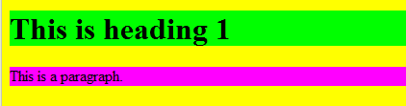
Example -view

Slide 14
Property Values and Units
CSS supports the following metrics for property values :
CSS keywords and other properties, such as thin, thick, transparent, ridge, and etc.
Real-world measures
Inches (in)
Centimeters (cm)
Millimeters (mm)
Points (pt) – The points used by CSS2 are equal to 1/72 of an inch
Picas (pc) – 1 pica is equal to 12 points
Screen measures in pixels (px)
Relational to font size (font size (em) or x-height size (ex))
Percentages (%)
Color codes (#rrggbb or rgb(r,g,b) )
Notes:
if the font-size of the document is 12pt, 1em is equal to 12pt. Ems are scalable in nature, so 2em would equal 24pt, .

Slide 15
Property Values and Units
Angles
Degrees (deg)
Radians (rad)
Time values (seconds (s) and milliseconds (ms)) – Used with aural style sheets
Frequencies (hertz (Hz) and kilohertz (kHz)) – Used with aural style sheets

Slide 16
Selectors
Selectors are essentially patterns that enable a user agent to identify what elements get what styles.
– E.g. “If it is a paragraph tag, give it this style”:
p { text-indent: 2em; }
The ways of matching:
Matching elements by name
Matching using the universal selector
Matching elements by class
Matching elements by identifier
Matching elements by specific attributes

Slide 17
Matching Elements by Name
Example:
h1 { color: green; }
Causes all occurrences of the selector tags (h1) to be formatted with the property/value section of the definition (color: green)
Multiple selectors
Example
h1, h2, h3, h4 { color: green; }

Slide 18
Matching Using the Universal Selector
The universal selector (*) can be used to match any element in the document.
E.g.
Match every tag and apply the color red:
* { color: red; }
Match any <ol> tag that is a descendant of a <td> tag, which is a descendant of a <tr> tag: tr td ol { color: red; }

Slide 19
Matching Elements by Class
With the class selector you can define different styles for the same type of HTML element.
Say that you would like to have two types of paragraphs in your document: one right-aligned paragraph, and one center-aligned paragraph. Here is how you can do it with styles:
p.right {text-align: right}
p.center {text-align: center}
You have to use the class attribute in your HTML document:
<p class="right">This paragraph will be rightaligned.</p>
<p class="center">This paragraph will be centeraligned.</p>

Slide 20
Matching Elements by Class
To apply more than one class per given element, the syntax is:
<p class="center bold"> This is a paragraph. </p>
The paragraph above will be styled by the class "center" AND the class "bold".
You can also omit the tag name in the selector to define a style that will be used by all HTML elements that have a certain class. In the example below, all HTML elements with class="center" will be center-aligned:
.center {text-align: center}
<h1 class="center">This heading will be center-aligned. </h1>
<p class="center">This paragraph will be centeraligned.</
p>

Slide 21
Matching Elements by Identifier
You can also match element identifiers (the id attribute).To match identifiers, you use the pound sign (#) in the selector as a prefix for the id. E.g.
#comment {background-color: green}
…
<p id=“comment”>This paragraph is a comment.</p>

Slide 22
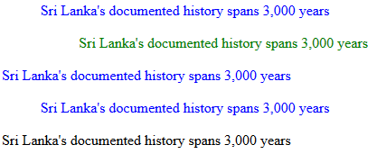
Example
<html>
<head>
<style type="text/css">
p{
color:blue;
text-align:center;
}
#para1
{
text-align:left;
color:green;
}
p.left{text-align:left;}
.center{text-align:center;}
</style>
</head>
<body>
<p>
Sri Lanka's documented history spans 3,000 years
</p>
<p id="para1">
Sri Lanka's documented history spans 3,000 years
<p class="left">
Sri Lanka's documented history spans 3,000 years
</p>
<p class="center">
Sri Lanka's documented history spans 3,000 years
</p>
Sri Lanka's documented history spans 3,000 years
</body> </html>

Slide 23
Matching elements by Specific Attributes
To match any attribute in elements, not just class and id, the attribute and the value(s) have to be specified at the end of the selector, offset in square brackets. E.g.
Match any table with a border attribute set to 3, table[border=“3”]
Match any table with a border attribute, table[border]
Match any table elements with a class value of datalist and border value of 3, table.datalist[border=“3”]

Slide 24

Example
<html>
<head>
<style>
a[target] {
background-color: yellow;
}
</style></head>
<body>
<p>The links with a target attribute gets a yellow background:</p>
<a href="http://www.w3schools.com">w3schools.com</a>
<a href="http://www.disney.com" target="_blank">disney.com</a>
<a href="http://www.wikipedia.org" target="_top">wikipedia.org</a>
</body>
</html>

Slide 25
Pseudo-classes
Pseudo classes are identifiers that are understood by user agents and apply to elements of certain types without the elements having to be explicitly styled. E.g. Anchor styles
<html>
<head>
<style type="text/css">
:link{color:#FF00FF}
:visited{color:#FF00FF}
:active{color:#FF00FF}
</style>
</head>
<body>
<a href="http://www.sliate.ac.lk/"> Visit SLIATE Web </a>
</body>
</html>
Notes:
a:link {color:#FF0000;} /* unvisited link */ a:visited {color:#00FF00;} /* visited link */ a:hover {color:#FF00FF;} /* mouse over link */ a:active {color:#0000FF;} /* selected link */
When setting the style for several link states, there are some order rules:
a:hover MUST come after a:link and a:visited
a:active MUST come after a:hover

Slide 26
Fonts
Fonts are styled collection of letters and symbols. Different fonts can be used to convey different information.
CSS supports five different font family types:
Serif fonts They are used in body text; the finishing strokes, flared or tapering ends, or serifed endings, make the lines of characters flow and tend to be easier on the eyes.
Sans serif fonts They are used for headings or other large areas of emphasis.
Cursive fonts They are used in extreme cases where emphasis is on ornamentation rather than legibility.
Fantasy fonts They are used for logos and other ornamentation purposes where legibility is secondary.
Monospace fonts They are used in code listings and other approximating terminal output.

Slide 27
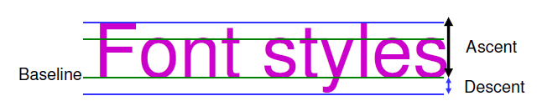
Font Characteristics
Fonts are mapped according to a system similar to ruled paper.
The line that the characters or symbols sit on is called the baseline.
The distance between the baseline and the top of the highest characters (usually capital letters and lowercase letters such as l, f or t ) is known as the ascension.
The distance between the baseline and the lowest point of characters that dip below it (such as p, g or q) is known as the descension.

Slide 28
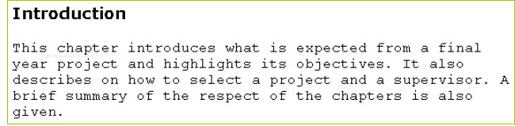
Defining a Font Family
The font-family property defines the font or fonts should be used for elements in the document.
More than one font family names is defined with a generic family name for versatility.

Slide 29
CSS font
p{font-family:"Times New Roman", Times, serif;}
p.normal {font-style:normal;}
p.italic {font-style:italic;}
p.oblique {font-style:oblique;}
h1 {font-size:40px;} h2 {font-size:30px;} p {font-size:14px;}
h1 {font-size:2.5em;} /* 40px/16=2.5em */ h2 {font-size:1.875em;} /* 30px/16=1.875em */ p {font-size:0.875em;} /* 14px/16=0.875em */
H1{font-weight:normal;}
H1{font-weight: bold ;}
H1{font-weight:lighter;}

Slide 30
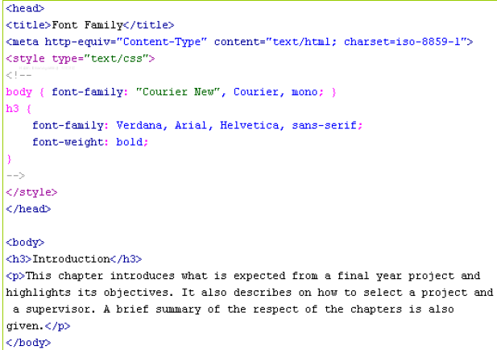
Defining a Font Family

Slide 31
Some Other Font Properties
Font sizing
– Two properties can be used to control font sizing: font-size and font-size-adjust. Both properties can adjust a font absolutely or relative to the current font size.
Font styling
Four properties can be used to affect font styling: font-style, font-variant, font-weight, and font-stretch.
Line spacing
The line-height property controls the line height of text, i.e. the distance between the baseline of two vertically stacked lines of text.

Slide 32
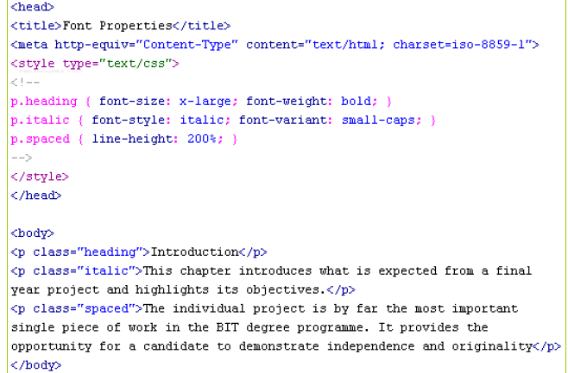
Example -Code

Slide 33
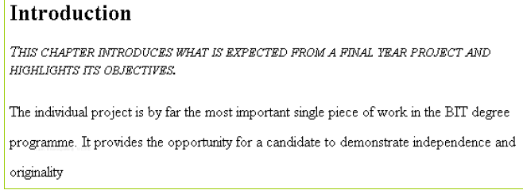
Example - View

Slide 34
Colors
CSS options for defining colors can entirely replace the color attributes in plain HTML. In addition CSS has the following advantages:
In plain HTML, when you wanted to create an area with a specified color, you were forced to create a table. However, with CSS, you can define an area to have a specific color without that area being part of a table.
In plain HTML, specially when working with tables, you had to specify font attributes and colors etc. for each and every table cell. However, with CSS you can simply refer to a certain class.

Slide 35
Specifying a Color
The color value can be expressed using one of three methods:
Color keywords
blue, black, green, and so on
Color hexadecimal values
values specified in the form #rrggbb
•E.g. #FF0000 for red, #000000 for black
– Color decimal or percentage values
Values specified using the rgb() function. The value can be an integer between 0 and 255 or a percentage.
E.g. rgb(100, 0, 100), rgb(50%, 0, 50%)

Slide 36
Specifying a Color
Most elements in a HTML document have two color properties: a foreground color and a background color.
Setting the foreground color for contents
color: <color_value>;
Setting the background color for an area
background-color: <color_value>;
Setting a background image to fill out an area background-image: url(“<url_to_image>”);

Slide 37
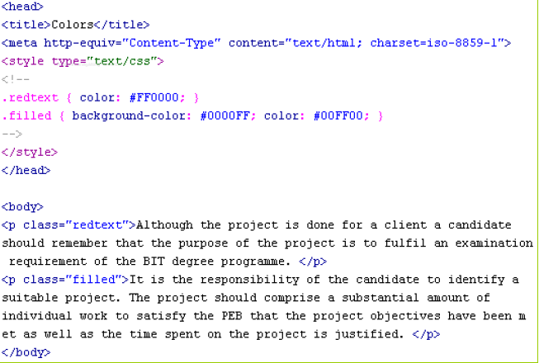
Example- Code

Slide 38
CSS Background image -Example
Body { background-image:url(‘paper.gif’);}
Body { background-image:url(‘paper.gif’);
background-repeat:repeat-x;
}
Body { background-image:url(‘paper.gif’);
background-repeat:no-repeat;
background-position:right top;
}

Slide 39
CSS Background color-Example
Body { background-color:#b0c4de;}
h1 { background-color:red;}
div { background-color:rgb(255,255,0);}

Slide 40
Text color- Example
body {color:blue;}
h1 {color:#00ff00;}
h2 {color:rgb(255,0,0);}

Slide 41
Text alignment- Example
h1 {text-align:center;} p.date {text-align:right;} p.main {text-align:justify;}

Slide 42
Text decoration -Example
h1 {text-decoration:overline;}
h2 {text-decoration:line-through;}
h3 {text-decoration:underline;}
h4 {text-decoration:blink;}
a{text-decoration:none;}

Slide 43
Text Transformation
p.uppercase {text-transform:uppercase;}
p.lowercase {text-transform:lowercase;}
p.capitalize {text-transform:capitalize;}

Slide 44
Text Indentation
P{text-indent:50px;}

Slide 45
CSS Lists -Example
ul.a {list-style-type: circle;}
ul.b {list-style-type: square;}
ol.c {list-style-type: upper-roman;}
ol.d {list-style-type: lower-alpha;}
ul { list-style-image: url('sqpurple.gif'); }

Slide 46
Values for Unordered Lists
Values for Unordered Lists
Value | Description
none | No marker
disc | Default. The marker is a filled circle
circle | The marker is a circle
square | The marker is a square

Slide 47
Values for Ordered Lists
Value | Description
armenian | The marker is traditional Armenian numbering
decimal | The marker is a number
decimal-leading-zero | The marker is a number padded by initial zeros (01, 02, 03, etc.)
georgian | The marker is traditional Georgian numbering (an, ban, gan, etc.)
lower-alpha | The marker is lower-alpha (a, b, c, d, e, etc.)
lower-greek | The marker is lower-greek (alpha, beta, gamma, etc.)
lower-latin | The marker is lower-latin (a, b, c, d, e, etc.)
lower-roman | The marker is lower-roman (i, ii, iii, iv, v, etc.)
upper-alpha | The marker is upper-alpha (A, B, C, D, E, etc.)
upper-latin | The marker is upper-latin (A, B, C, D, E, etc.)
upper-roman | The marker is upper-roman (I, II, III, IV, V, etc.)

Slide 48
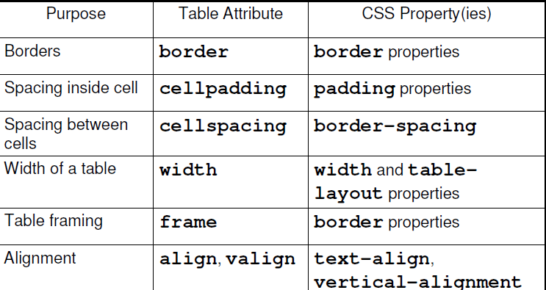
Tables
CSS properties available for table attributes:
:

Slide 49
Table-Examples
table, th, td { border: 1px solid black; }
td { text-align:right; }
td { height:50px; vertical-align:bottom; }
td { padding:15px; }
th { background-color:green; color:white; }
Notes:
Table Padding
To control the space between the border and content in a table, use the padding property on td and th elements:

Slide 50
CSS Border- Example
p.one { border-style:solid; border-width:5px; }
p.two { border-style:solid; border-width:medium; }
p.one { border-style:solid; border-color:red; }
p.two { border-style:solid; border-color:#98bf21; }
p { border-top-style:dotted; border-right-style:solid; border-bottom-style:dotted; border-left-style:solid; }

Slide 51
CSS Margin- Examples
margin-top:100px; margin-bottom:100px; margin-right:50px; margin-left:50px;

Slide 52
CSS Margin- Examples
The margin property can have from one to four values.
margin:25px 50px 75px 100px;
top margin is 25px
right margin is 50px
bottom margin is 75px
left margin is 100px
margin:25px 50px 75px;
top margin is 25px
right and left margins are 50px
bottom margin is 75px
margin:25px 50px;
top and bottom margins are 25px
right and left margins are 50px
margin:25px;
all four margins are 25px

Slide 53
CSS Padding - Examples
padding-top:25px;
padding-bottom:25px;
padding-right:50px;
padding-left:50px;

Slide 54
CSS Padding - Examples
The padding property can have from one to four values.
padding:25px 50px 75px 100px;
top padding is 25px
right padding is 50px
bottom padding is 75px
left padding is 100px
padding:25px 50px 75px;
top padding is 25px
right and left paddings are 50px
bottom padding is 75px
padding:25px 50px;
top and bottom paddings are 25px
right and left paddings are 50px
padding:25px;
all four paddings are 25px

