Slide 1


</>
“ Learn Programming For Beginners – Free Full Course “
#1 – HTML
#1
HTML
</>

Slide 2
HTML is the standars markup language for creating web pages
HTML stands for Hyper Text Markup Language
HTML Describes the structure of A web pages
#1
HTML ELEMENT tell the Broswer how to display the content
HTML

Slide 3
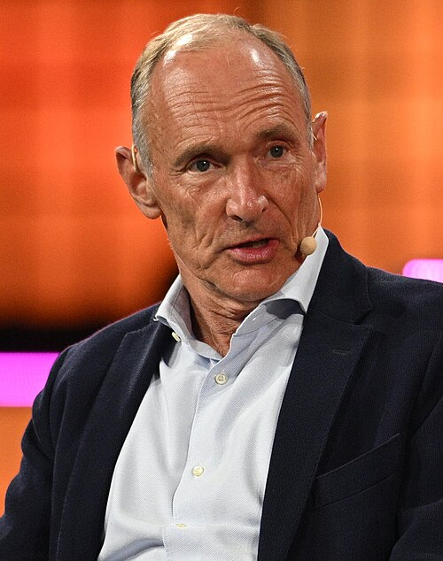
HTML was created BY TIM-BERNES-LEE
He was inventor HTTP, HTML, WWW, Web Browser, Web Server, Web Page
#1
He was Founder of the world wide web Consortium (W3C) in 1994
HTML

Slide 4

World Wide Web Consortium
The World Wide Web Consortium (W3C) is an international public-interest non-profit organization where Member organizations, a full-time staff, and the public work together to develop web standards.
Web inventor Tim Berners-Lee founded the World Wide Web Consortium in 1994 to ensure the long-term growth of the web. He remains W3C's Emeritus Director and Honorary Member of the Board of Directors.
#1
HTML

Slide 5

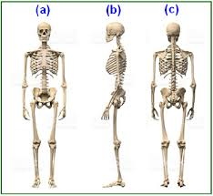



Illustration Web
#1
HTML

Slide 6
HTML Basic & Element
Declaration HTML5
<!DOCTYPE html>
<html lang="en">
<head>
<title>Document</title>
</head>
<body> </body>
</html>
Element <html></html>
#1
Element <head></head>
Element <body></bod>
HTML

Slide 7
ELEMENT <head></head>
Title Page
Metadata
<meta charset="UTF-8" />
<meta name=“description” content=“tutorial-web-programming”></meta>
<meta name="viewport" content="width=device-width, initial-scale=1.0" />
<meta name=“keywords” content=“html-css-js-react”></meta>
<meta name=“author” content=josse-surya-pinem”></meta>
<title></title>
CSS
<style></style>
#1
Javascript
HTML
<script></script>

Slide 8
ELEMENT <body></ body>
Headings
Horizontal Rules
<h1></h1> to <h6></h6>
<hr>
Paragraphs
Line Breaks
<br>
<p></p>
#1
Image
Links
<img src=“./codewithjoee.jpg" title=“Josse Surya Pinem" alt="W3Schools.com" width="104" height="142" />
<a href="https://josserich.github.io">This is a link</a>
HTML

Slide 9
<table>
<thead>
<tr>
<th>Name</th>
</tr>
</thead>
<tbody>
<tr>
<td>Josse Surya Pinem</td>
</tr>
</tbody>
</table>
Table
Script
<script src=“./script.js”></script>
Grouping
<div></div>,<span></span>
Lists
#1
Description Lists <dl>
<dt>Josse</dt>
<dd> software-developer </dd> </dl>
Unordered Lists <ul>
<li>Josse</li>
<li>Surya</li>
<li>Pinem</li> </ul>
Ordered Lists <ul>
<li>Josse</li>
<li>Surya</li>
<li>Pinem</li> </ul>
HTML

Slide 10
<form action="">
<label for="username">Username :</label>
<input type="text" id="username" />
<label for="password">Password :</label>
<input type="password" id="password" />
<label for="role">Role :</label>
<select name="" id="role">
<option value="user">User</option>
<option value="admin">Admin</option>
</select>
<label for="desc">Description</label>
<textarea name="" id="desc"></textarea>
<button type="submit">Register!</button>
</form>
Form
#1
HTML
Comment
<!-- This is Element Comment -->

Slide 11
HTML Semantic Elements
Semantic elements = elements with a meaning
Non-semantic elements : <div>, <span>
semantic elements : <article>, <aside>, <details>, <figcaption>, <details>, <figure>, <footer>, <header>, <main>, <mark>, <nav>, <section>, <summary>, <time>.
#1
HTML

Slide 12
Source :
https://www.w3schools.com/
https://www.w3.org/
https://en.wikipedia.org/wiki/Tim_Berners-Lee
#1
HTML

Slide 13
Thank you ! Don’t forget to visit https://josserich.github.i0
#1
HTML

