Slide 1


</>
“ Learn Programming For Beginners – Free Full Course “
#3 – Javascript
#3
Javascript
</>

Slide 2
Programming Programming is the way we give instructions to a computer to perform specific tasks. The instructions must be correct, well-structured, follow rules of the programming language being used.
#3
f
Javascript

Slide 3
D-1
D-2
D-3
D-4
D-5
D-6
500m
The Instruction :
C-1
C-2
C-3
C-4
C-5
C-6
1.Go Straight from Gate In 500m
2.Turn Right 500m
3. Find House Number D-6
500m
B-1
B-2
B-3
B-4
B-5
B-6
#3
A-1
A-2
A-3
A-4
A-5
A-6
Javascript
In
Out

Slide 4
D-1
D-2
D-3
D-4
D-5
D-6
C-1
C-2
C-3
C-4
C-5
C-6
B-1
B-2
B-3
B-4
B-5
B-6
#3
A-1
A-2
A-3
A-4
A-5
A-6
Javascript
In
Out

Slide 5
D-1
D-2
D-3
D-4
D-5
D-6
C-1
C-2
C-3
C-4
C-5
C-6
B-1
B-2
B-3
B-4
B-5
B-6
#3
A-1
A-2
A-3
A-4
A-5
A-6
Javascript
In
Out

Slide 6
D-1
D-2
D-3
D-4
D-5
D-6
C-1
C-2
C-3
C-4
C-5
C-6
B-1
B-2
B-3
B-4
B-5
B-6
#3
A-1
A-2
A-3
A-4
A-5
A-6
Javascript
In
Out

Slide 7
D-1
D-2
D-3
D-4
D-5
D-6
The Instruction :
C-1
C-2
C-3
C-4
C-5
C-6
1.Go Straight from Gate In 500m
2.Turn Right 500m
3. Find House Number D-6
B-1
B-2
B-3
B-4
B-5
B-6
#3
A-1
A-2
A-3
A-4
A-5
A-6
Javascript
In
Out

Slide 8
D-1
D-2
D-3
D-4
D-5
D-6
The Instruction :
C-1
C-2
C-3
C-4
C-5
C-6
3. Find House Number D-6
1.Go Straight from Gate In 500m
2.Turn Right 500m
B-1
B-2
B-3
B-4
B-5
B-6
#3
A-1
A-2
A-3
A-4
A-5
A-6
Javascript
In
Out

Slide 9
D-1
D-2
D-3
D-4
D-5
D-6
The Instruction :
C-1
C-2
C-3
C-4
C-5
C-6
3. Find House Number A-6
1.Go Straight from Gate In 600m
2.Turn Right 1000m
B-1
B-2
B-3
B-4
B-5
B-6
#3
A-1
A-2
A-3
A-4
A-5
A-6
Javascript
In
Out

Slide 10
D-1
D-2
D-3
D-4
D-5
D-6
The Instruction :
C-1
C-2
C-3
C-4
C-5
C-6
3. Liat Rumah No A-6
1.Jalan Lurus saja sampai 600m
2.Belok kanan 1000m
B-1
B-2
B-3
B-4
B-5
B-6
#3
A-1
A-2
A-3
A-4
A-5
A-6
Javascript
In
Out

Slide 11
#3
Javascript

Slide 12
???
01010101010101010101010010101001010101001010101001010101010101001010101010101001010100101010101001010101010010101010010101001010100101010100101010100101
#3
Javascript

Slide 13
Javascript Typescript
High Language
Ruby Python Vb.net C++
C Assembly
Low Language
#3
01010101010101010101010010101001010101001010101001010101010101001010101010101001010100101010101001010101010010101010010101001010100101010100101010100101
Javascript

Slide 14
Why Javascript ????
The Programming Language of the web
(modify element web by event)
- Free
#3
- Easy to Understand
- Versatile
Javascript

Slide 15
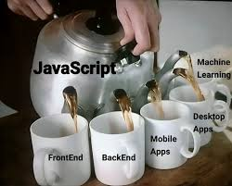
#3
Javascript

Slide 16
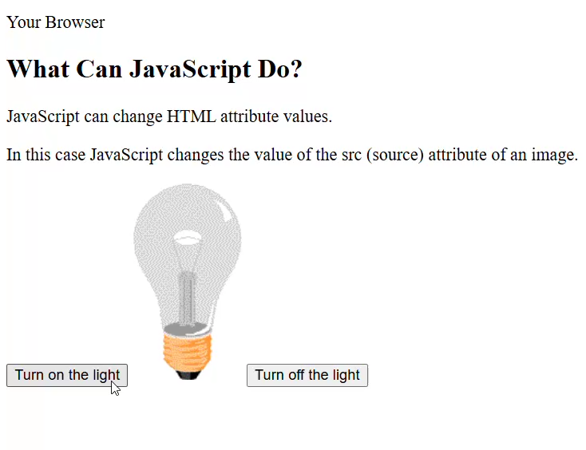
#3
Javascript

Slide 17
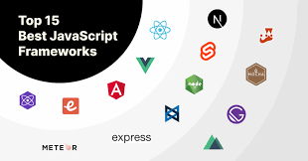
#3
Javascript

Slide 18
History Javascript
1992
National Center for Supercomputing Applications (NCSA),
University of Illinois at Urbana–Champaign developed Mosaic,
#3
1994
The Mosaic team created Netscape and launched Netscape Navigator
Javascript

Slide 19
Brendan Eich get hired
Created A New language inspire by Java + Scheme + Self = Mocha (in just 10 days!)
Mocha -> Livescript -> Javascript
1995
Netscape sought Standardization
W3C rejected the proposal, so Netscape turned to ECMA International
1996
#3
Javascript

Slide 20
ECMAScript editions
ECMAScript 1 (1997) -> First Edition
ECMAScript 2 (1998) -> Only Editorial Changes
ECMAScript 3 (1999) -> Regex, Try/Catch, Switch, do-while
#3
Javascript
ECMAScript 4 -> Never Released

Slide 21
ECMAScript 5 (2009) -> use strict, JSON Support, String.trim(), Array.isArray(), Array iteration methods, Allows trailing commas for object literals
ECMAScript 6 (2015) -> Added let and const, Default parameter values, Array.find(), Array.findIndex()
#3
Javascript

Slide 22
How To Add
it can be placed in the <body>, or in the <head> section of an HTML page
<script src=“./script.js”></script>
<script>//your code </script>
#3
Javascript

Slide 23
Output
console.log(“display”)
document.getElementById("demo").innerText = “output”
document.write(“output”)
#3
Javascript
window.alert(“output”)

Slide 24
Variable
Variable = containers for storing data
Const
Rules Variable :
Variable can contain letter, digits, underscores, and dollarsign
Let
Variable must begin with a letter or a $ sign or an underscore
Var (obsolete)
#3
Hyphens are not allowed in Javascript
Automatically (obsolete)
JavaScript programmers tend to use lower camel case
Javascript
example : const yourName = “Josse Surya Pinem

Slide 25
8 DataTypes
String = A Text of Characters enclosed
example :
const person = “Josse Surya Pinem”;
Number = A number representing a mathematical value
example :
const length = 18.95;
#3
Bigint = A number representing a large integer
example :
const x = 1234567890123456789012345n;
Javascript

Slide 26
Boolean = A data type representing true of false
example :
const correct = true;
Object = A collection of key-value pairs of data
example :
const employee = {
name: ”Josse Surya Pinem”, position: ”Software Developer” };
#3
Javascript

Slide 27
Undefined = A primitive variable with no assigned value
example :
let x;
Null = A primitive value representing object absence
example :
let x = null
#3
Symbol = A unique and primitive indentifier
example :
const x = Symbol()
Javascript

Slide 28
Operator
Operators are for Mathematical and Logical Computations
+ = Addition
% = Modulus(remainder)
- = Subtraction
++ = increment
* = Multiplication
#3
-- = decrement
/ = Division
Javascript

Slide 29
== = equal to
=== = equal value dan equal data type
!= = not equal
#3
!== = not equal value or not equal data type
Javascript

Slide 30
> = greater than
|| = OR
< = less than
&& = and
>= = greater than or equal to
#3
<= = less equal than or equal to
Javascript

Slide 31
Conditionals
Conditional Statements allow us to perform different actions for different conditions
Conditional Statements run different code depending on true or false conditions
#3
Javascript

Slide 32
Syntax
If (condition1) {
// code to execute if condition1 is true
} else if (condition2){ // code to execute if the condition1 is false and condition2 is true
} else {
// code to execute if the condition1 is false, and condition2 is false
}
#3
Javascript

Slide 33
switch(expression){
case x:
//code block
break;
case y:
//code block
break;
default:
//code block
}
condition ? expression1 : expression2
#3
Javascript

Slide 34
Loops
Loops are handy, if you want to run the same code over and over again, each time with a different value
Start
condition
updates
script.js
script.js
console.log(1);
for (let i = 1; i < 6; i++){
console.log(i);
}
console.log(2);
console.log(3);
#3
console.log(4);
Javascript
console.log(5);

Slide 35
script.js
script.js
let i = 0;
do{
console.log(i)
i++;
}
while ( i < 6 );
let i = 0;
while (i < 6){
console.log(i)
i++;
}
#3
Javascript

Slide 36
Function
Functions are fundamental building blocks in all programming
Functions are resuable block of code designed to perform a particular task
Functions are executed when they are called invoked
#3
Javascript

Slide 37
Syntax
{ // code to be executed
}
function
myFunction
(param)
const myFunction =
(param)
=>
{
// code to be executed
}
#3
Javascript
// call or invoke function
myFunction(args)

Slide 38
Objects
An Object is a variable that can hold many variables
Objects are collections of key-value pairs, where each key (known as property name ) has a value
Objects can describe anything like person, houses, cars, animals, or any other subjects
Objects are container for Properties and Method
#3
Javascript

Slide 39
example
const person =
{
}
firstName : “Josse”,
lastName : “Pinem”,
id: 1,
Property
fullName: function(){
return this.firstName + “ ” + this.lastName
}
#3
Javascript
Method

Slide 40
Array
An Array is an object type designed for storing data collections
example:
const lecturer1 = “josse”
[
];
const lecterures =
const lecturer2 = “surya”
“josse”, “surya”, “pinem”, “john”
#3
const lecturer3 = “pinem”
Javascript
const lecturer4 = “john”

Slide 41
Array Method
push() = method adds new items to the end of an array
filter() = creates a new array with every element in an array that pass a test
#3
map() = creates a new array with the result of calling a function for each array element
Javascript

Slide 42
splice() = add or removes array elements
array.splice(index, count, item1, …, itemX)
Index = position array
count = many of items to be placed or removed Item1 = element to be added
reverse() = reverses the order of the elements in an array
#3
Javascript
sort() = sort the elements of an a array

Slide 43
findIndex() = it returns that index of the first element that passes the test.
split() = it returns that An array containing the splitted values.
#3
Javascript

Slide 44
DOM ( Document Object Model )
The HTML DOM is a standard for how to get, change, add, or delete HTML elements.
#3
The HTML DOM is a standard for how to find and manipulate HTML elements
Javascript

Slide 45
Finding HTML elements :
document.querySelector()
document.getElementById()
document.getElementsByTagName()
document.getElementsByClassName()
Changing elements :
element.innerHTML = new html content
element.style.property = new style
element.classList.add|remove|toggle.(“selectorclass”)
#3
Javascript
Adding Events Handlers :
element.addEventListener(“click”, myFunction)

Slide 46
Adding Event Handlers Drag :
1. dragstart
2. dragover
3. dragenter
4. dragleave
5. drop
6. dragend
#3
Javascript

Slide 47
Synchronous
Script.js
Browser
1
console.log(“A”)
A
2
console.log(“B”)
B
C
#3
3
console.log(“C”)
Javascript

Slide 48
Asynchronous
Script.js
Browser
1
console.log(“A”)
setTimeout(()=>{ console.log(“B”) ,1000}
A
2
#3
console.log(“C”)
Javascript

Slide 49
Asynchronous
Script.js
Browser
1
console.log(“A”)
setTimeout(()=>{ console.log(“B”) ,1000}
A
C
#3
2
console.log(“C”)
Javascript

Slide 50
Asynchronous
Script.js
Browser
1
console.log(“A”)
setTimeout(()=>{ console.log(“B”) ,1000}
A
C
3
B
#3
2
console.log(“C”)
Javascript

Slide 51
Analogy Synchronous
VS
Analogy Asynchronous
Customer orders the coffee
Customer orders the coffee
Barista creates the coffee
Barista creates the coffee
Customer Drinks the coffee
Customer has to wait in line
#3
Customer Drinks the coffee
Javascript

Slide 52
Callback
A callback is a function passed as an argument to another function
example
const getData = (callback) => {
}
setTimeout(()=>{
callback(“Data Loaded”)
}, 1000);
#3
getData((result))=>{
console.log(result)
});
Javascript

Slide 53
getUser(id, (user) => {
});
getPosts(user, (posts) => {
});
getComments(posts, (comments) => {
});
processComments(comments, (result) =>{
console.log(result); });
#3
Callback Hell !!!
Javascript

Slide 54
getUser(id)
.then(user => getPosts(user))
.then(posts => getComments(posts))
.then(comments => processComments(comments))
.then(result => console.log(result))
#3
.catch(error => console.error(error));
Javascript

Slide 55
Promise
A object represents a value that will be available now, later, or never
States = pending, fulfilled, rejected
#3
Javascript
then
catch

Slide 56
Example Promise & Fetch API
const getUser = () => {
}
fetch(`https://fakestoreapi.com/users`)
.then(res => response.json())
.then(res => console.log(res))
.catch(err => console.log(err))
#3
getUser()
Javascript

Slide 57
Example Promise with async await
const getUser = () => {
async
try {
const res = await fetch(`https://fakestoreapi.com/users`)
const data = await res.json()
console.log(data)
}
catch (err) {
#3
console.error(err)
}
Javascript
}
getUser()

Slide 58
References :
https://www.w3schools.com/js/default.asp
#3
Javascript

Slide 59
</>
Thank you ! Don’t forget to visit https://josserich.github.io
#3
Javascript
</>

