Slide 1


</>
“ Learn Programming For Beginners – Free Full Course “
#8 – GIT & GITHUB
</>

Slide 2
GIT
GIT is a tool in your local device that helps you save and manage your code, work with others, keep track of changes , and undo mistake
GIT is a popular version control system
GIT was created by Linus Torvalds in 2005, and has been maintained by Junio Hamano since then
GITHUB
GITHUB is a website that works like a GIT
GITHUB is a provider or service that stores and manages source code All of developers

Slide 3
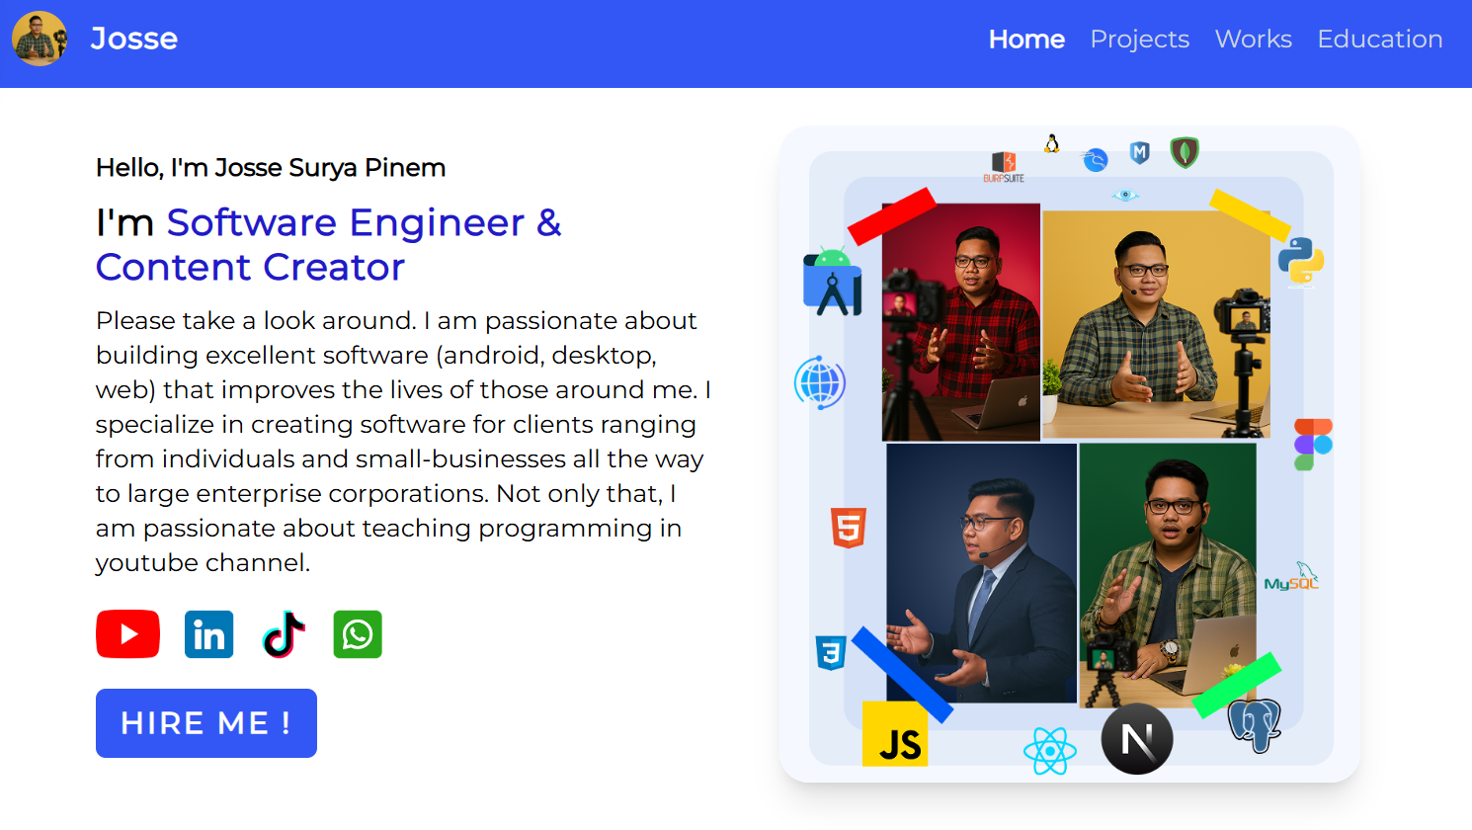




WITHOUT GIT & GITHUB
Error…
Error.
Who does overwrite line of code number 2 ???
Where should we put this code securely and you can access easily ???
Who does create feature-c ???
???
???
???

Slide 4
WITH GIT & GITHUB
To see our history
Run command
git log --all
Put our code in cloud github
Easy management team work

Slide 5
git log --all
commit ba04ef0dc1db872164369132770ce70875f53913 (HEAD -> main, origin/main)
Merge: 60667a4 3ee3984
Author: josserich <pinemjosse@gmail.com>
Date: Fri May 1 13:29:36 2026 +0700
solve merge conflicts
commit 3ee39840aad56e7ddae4a4611d7dca9754bd33e1 (origin/feature-c)
Author: ieltsjoee-dev <ieltsjoee@gmail.com>
Date: Sun Apr 26 20:02:44 2026 +0700
adding feature-c
commit 60667a4d31abe7238f4d281bfdd02679a0dba228 (origin/feature-b)
Author: codewithjoees <codewithjoee@gmail.com>
Date: Sun Apr 26 19:58:32 2026 +0700
adding feature-b
commit 3ad3096a65656c180e3aebc03ccc364588d68893
Author: josserich <pinemjosse@gmail.com>
Date: Sun Apr 26 19:53:27 2026 +0700
first commit
He created feature-c
GIT LOG
C:\\desktop >
git log –all

Slide 6
GIT AREA
Remote / Internet Repository
GIT FETCH
GIT CLONE / PULL
GIT PUSH
Local Repository
Local Repository
GIT MERGE
GIT COMMIT
Staging Area
Staging Area
GIT ADD
Working DIrectory

Slide 7

CASE - 1
Upload source code to cloud github
C:\Desktop >
git init
git add .
git commit –m
“<message>”
git remote add origin
<link_github>
git push

Slide 8
CASE - 2
download source code from cloud github to local system for the first time
C:\Desktop >
git clone <link_github>

Slide 9
CASE - 3
Update latest source code from cloud github to local system
C:\Desktop >
git pull

Slide 10
CASE - 4
Separate workspace without affecting the main project or your colleagues
C:\Desktop >
git branch <feature>
git switch <feature>
<feature-a>
<main>
<feature-b>
010101010010101010101
010101010010101010101
010101010010101010101

Slide 11
WITH GIT BRANCH & SWITCH
<feature-a>
<main>
<feature-b>
010101010010101010101
010101010010101010101
010101010010101010101
WITHOUT GIT BRANCH & SWITCH
010101010010101010101
010101010010101010101
010101010010101010101

Slide 12
CASE - 5
Create a new branch named <branch> from commit <7_digit_hash_commit> and immediately switch to that branch.
C:\Desktop >
git switch - c feature-b 0e27106
606b21e (HEAD -> master) adding feature-c.js
0e27106 adding feature-b.js
c59fe18 adding feature-a.js

Slide 13
CASE -6
combining the changes from one branch into another
C:\Desktop >
git merge <branch>
0001010
0001010
0101010
0101010

Slide 14

</>
Thank you ! Don’t forget to visit https://josserich.github.io
</>

