Slide 1


2023 26th International Conference on Computer and Information Technology (ICCIT) Hosted By : LONG BEACH HOTEL, COX’S BAZAR
An Intelligent System for Obesity Detection through Human Activity Recognition and BMI Prediction
Paper ID: 371

Slide 2



Team Members
Khorshed Alam
CSE, East Delta University.
Diganta Chowdhury
CSE, East Delta University
Promila Haque
Faculty Member, East Delta University

Slide 3
Contents of the Presentation
Problem Domain
Contribution
Related Work
Methodology
Database Formation
Model Development
Obesity Prediction
Result Analysis
References

Slide 4
Problem Domain
Obesity Definition and Prevalence: Obesity is a condition characterized by excessive body fat. Since 1975, global obesity rates have tripled, making it a major health concern.
Impact on Health and Mortality: Obesity and overweight are linked to higher death rates than being underweight. Over 4 million deaths annually are attributed to overweight or obesity.
Prevalence in Overpopulated Countries: Countries like India, Bangladesh, and Pakistan face significant obesity and overweight issues.
Associated Health Risks: Obesity increases the risk of diseases such as heart disease, diabetes, high blood pressure, and various cancers.
Causes of Obesity: It is caused by the consumption of excessive energy, particularly from fats and sugars, and a lack of physical activity.
Prevention and Treatment: Managing obesity involves reducing energy intake from fats, engaging in physical activities, and consuming more vegetables.
Measuring Obesity with BMI: Body Mass Index (BMI) is used to measure obesity, with a BMI over 25 indicating overweight and over 30 indicating obesity.

Slide 5
Contributions
The contributions in this research are as follows:
Authors focus on Human Activity Recognition (HAR) technology to precisely capture human movement patterns, which is vital for understanding and combating obesity. The proposed Human Activity Recognition model in this study is based on a Stacked Long Short-Term Memory (LSTM), which offers 99% accuracy for predicting physical activity across six classes as a time series problem.
The proposed method computes the duration of each user's activities and the corresponding calorie expenditure, while also considering their dietary habits to estimate total calorie intake. By analyzing the calorie intake and expenditure, authors establish a meaningful connection between physical activity and BMI.
Users can proactively plan for obesity prevention or anticipate the timeline for developing obesity within the next 12 months using proposed method. The system enables users to set short-term goals, such as 7 days, 15 days, and 30 days, with the application running seamlessly in the background. The application continuously monitors daily physical activities, including sitting, standing, walking, jogging, and stair climbing.
Authors provide the result of 15 participants who used our solution to predict obesity. In Table III, we showed the predicted weight vs actual weight of each participants. By that we can see how well it performed.
The system not only provides BMI predictions for the upcoming one month, six months, and one-year periods but also predicts the likelihood of developing obesity over at least a year.

Slide 6
Related Work
Paper Reference | Work and Methodology | Limitations
[1] | Developed a machine-learning-based approach for predicting obesity risk. Machine learning algorithms: k-NN, MLP, logistic regression, Naïve Bayes, and decision trees. They have taken 1100 data from many kinds of people where people are facing obesity or not including other information like food habits. | However, there were no solutions that could track the user's physical activity for an N amount of time and predict the risk of obesity in real time. The dataset is comparatively small to draw a conclusion.
[2] | They used Logistic Regression and Naïve Bayes to classify the possible risk of obesity among adults. | There is no clear explanation of human physical activity tracking, only food consumption-based research, and no real-time software implementation.
[3] | The study aims to construct the Human Activity Recognition model using machine learning methods such as KNN, SGD, Random Forest, Naive Bayes, and Logistic Regression. | There is no explanation for detecting jogging or running activity in humans.
[4] | The study is based on Channel State Information (CSI) for Human Activity Recognition. Wi-Fi hardware is a radio frequency-based approach to sensing. | Without Wi-Fi access, this solution does not work. And there is no explanation for detecting jogging or running activity in humans and no real-time software implementation.
[5] | The study's [8] objective was to categorize potential human activities using logistic regression, support vector machines (SVM), random forests, decision trees, and gradient-boosted decision trees. | There is no explanation for detecting jogging or running activity in humans.

Slide 7
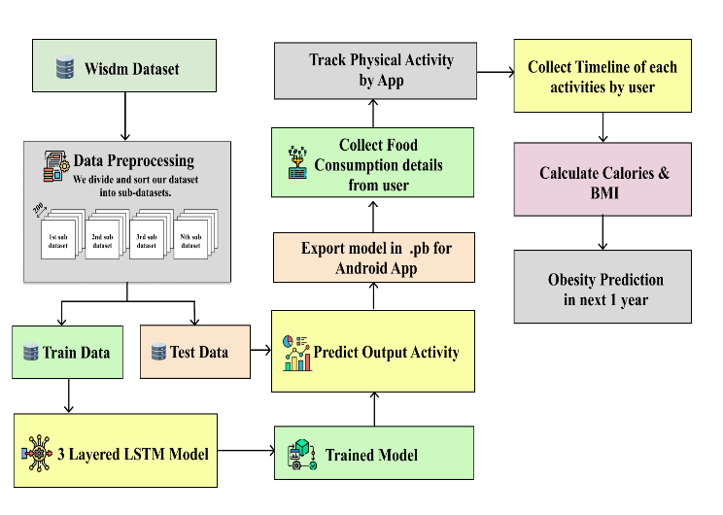
Methodology

Slide 8
Dataset
In this research, we have used a dataset called WISDM (Wireless Sensor Data Mining) [11] lab activity sensor dataset.
The WISDM Lab in the Department of Computer and Information Science of Fordham University collected data from the accelerometer and gyroscope sensors in the smartphones and smartwatches of 36 subjects as they performed six diverse activities of daily living.
The dataset contains raw time series data from the phone and watch’s accelerometer and gyroscope (X-, Y-, and Z-axis).
The raw accelerometers consist of a value related to each of the three axes. There is a total of 1098207 entries, and the number of classes is six.
The classes are sitting, standing, walking, jogging, upstairs, and downstairs.

Slide 9
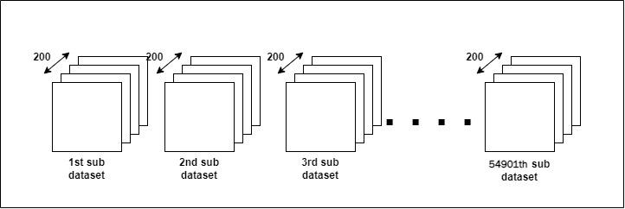
Data Preprocessing
To get the maximum out of this dataset, we have performed pre-processing of our data. We have sorted the data according to user and timestamps. Then, we divided our dataset into sub-datasets. Each dataset carries 200 data points. Based on the maximum number of activity outcomes in the sub-dataset according to the timestep, the rest of the data are dropped. The total sub-dataset is 54,901. The number of train sub-dataset is 43920, and the Test sub-dataset is 10981.

Slide 10
Model Architecture
Layer (type) | Output Shape | Param
Lstm 1 (LSTM) | (None, 200, 128) | 67584
Lstm (LSTM) | (None, 200, 128) | 131584
Lstm 1 (LSTM) | (None, 128) | 131584
Flatten (Flatten | (None, 128) | 0
Dense_1 (Dense) | (None, 128) | 16512
Dense_2 (Dense) | (None, 6) | 774
Total Params |  | 348038
Trainable Prams |  | 348038
Non-trainable params |  | 0

Slide 11
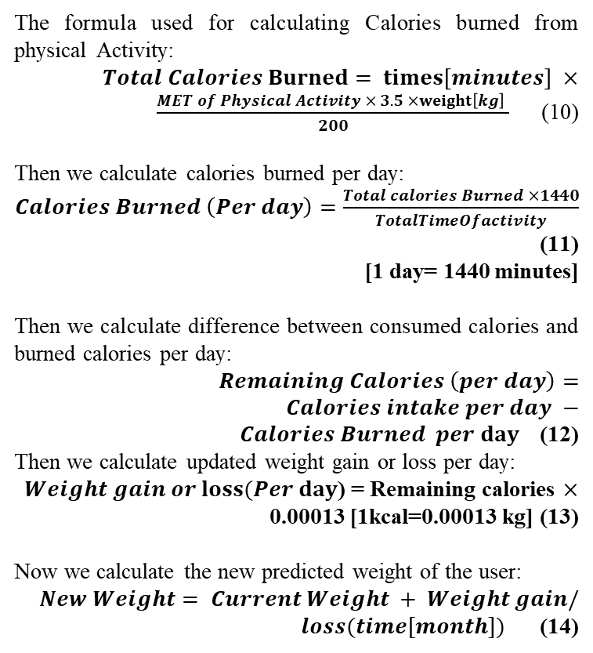
Obesity Prediction Phase
Here are the steps we followed in this phase:
We collected user’s daily food consumption details (calories count) in app.
User sets a timeline of 7/15/30 days for tracking physical activity. Our app uses the model to detect physical activity using in built accelerometer sensor.
After timeline, our app calculates calories based on activity data collected. Our app uses foreground service to run our model in background.
Then, our app calculates new weight and predicts outcomes of obesity based on the rate of weight change.
If the BMI result is greater than 30 then our app will give the result as obesity might occur in N month.
The formula used for calculating Calories burned from physical Activity:
$Total Calories Burned= times\left[minutes\right] ×\frac{MET of Physical Activity × 3.5 ×weight\left[kg\right] }{200}$ (10)
Then we calculate calories burned per day:
$Calories Burned \left(Per day\right)=\frac{Total calories Burned ×1440}{TotalTimeOfactivity}$ (11)
[1 day= 1440 minutes]
Then we calculate difference between consumed calories and burned calories per day:
$Remaining Calories \left(per day\right)=Calories intake per day −Calories Burned per day$ (12)
Then we calculate updated weight gain or loss per day:
$Weight gain or loss(Per day$) = Remaining calories $×$ 0.00013 [1kcal=0.00013 kg] (13)
Now we calculate the new predicted weight of the user:
$New Weight= Current Weight + Weight gain/loss(time[month])$ (14)

Slide 12
Result Analysis (HAR Model)
Model | Train Acc | Test Acc | Loss | Test Loss
Stacked LSTM | 99.59% | 99.20% | 0.0154 | 0.0218

Slide 13
Result Analysis (HAR Model)
Class | Precision | Recall | F1-Score
Downstairs | 0.93 | 0.92 | 0.92
Jogging | 0.99 | 1.00 | 0.99
Sitting | 0.99 | 0.98 | 0.99
Standing | 0.99 | 0.99 | 0.99
Upstairs | 0.92 | 0.91 | 0.92
Walking | 0.99 | 0.99 | 0.99

Slide 14
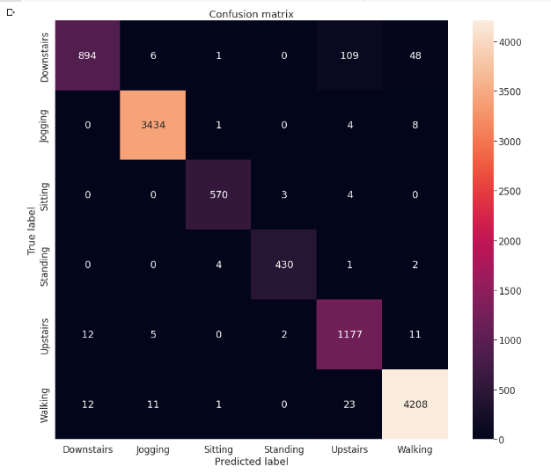
Result Analysis (HAR Model)

Slide 15
Result Analysis (Obesity Prediction)
Participant No. | Gender | Predicted Weight | Actual Weight
1 | M | 76.8 | 78
2 | M | 82.2 | 80
3 | M | 62.8 | 66
4 | M | 55.9 | 59
5 | F | 76.3 | 78
6 | F | 56.7 | 54
7 | M | 78.9 | 81
8 | M | 75.6 | 72
9 | F | 60.5 | 56
10 | M | 68.1 | 66
11 | F | 52.3 | 50
12 | F | 59.8 | 61
13 | F | 66.8 | 65
14 | M | 86.9 | 85
15 | M | 70.0 | 72

Slide 16
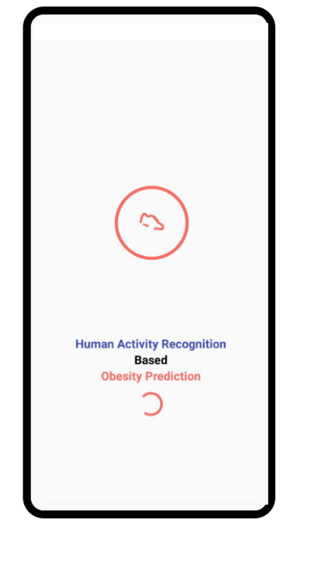
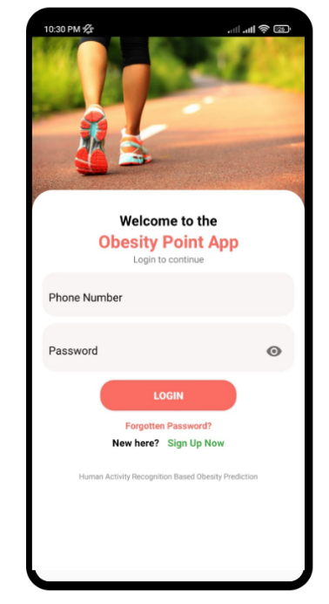
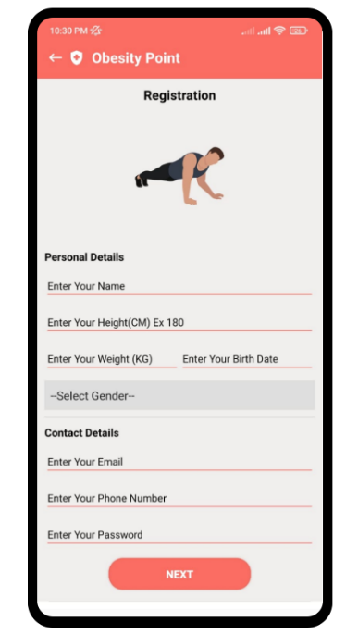
App UI

Slide 17
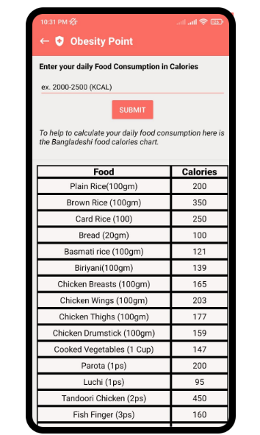
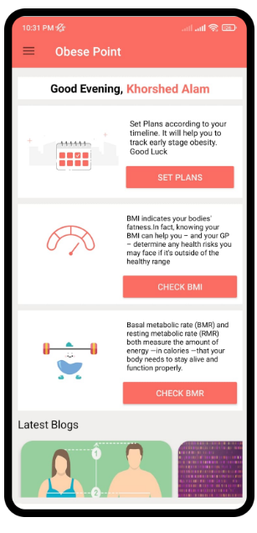
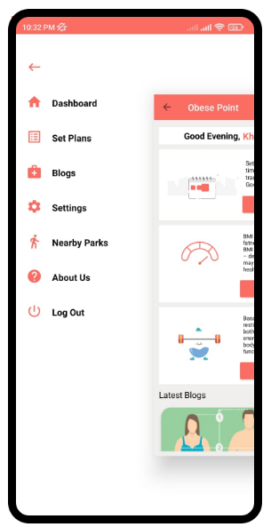
App UI

Slide 18
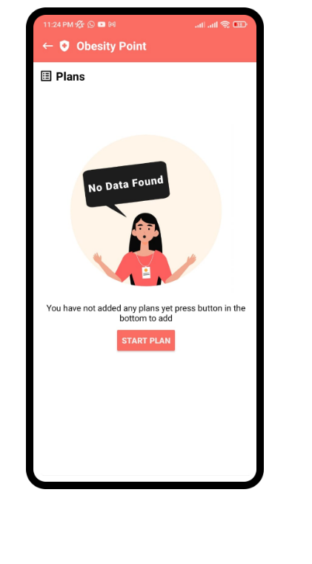
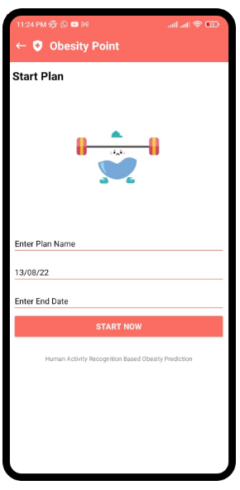
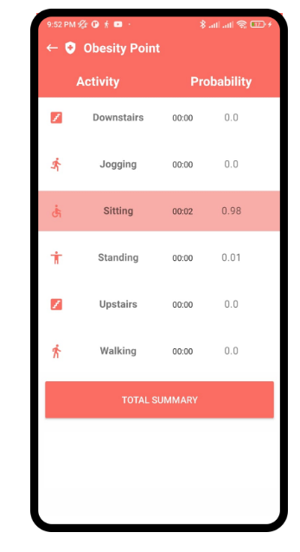
App UI

Slide 19
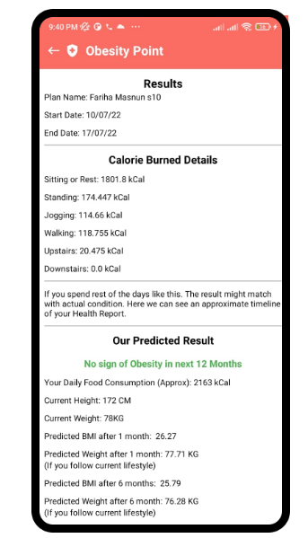
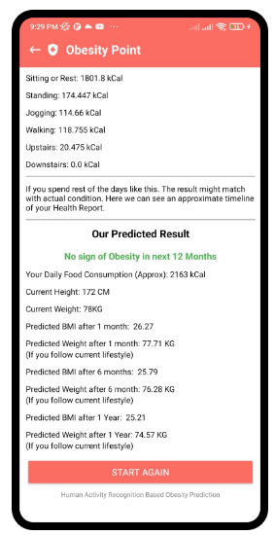
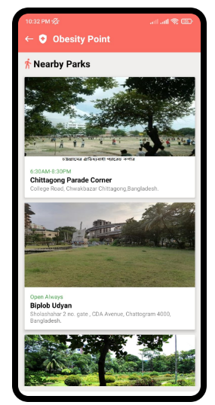
App UI

Slide 20
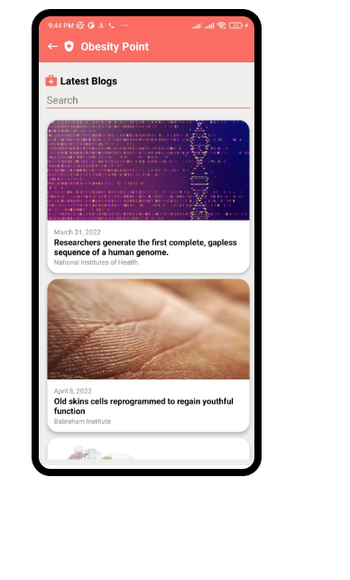
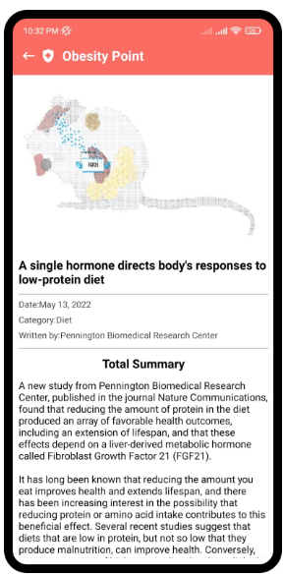
App UI

Slide 21
References
[1] F. Ferdowsy, K.S. Alam Rahi, Md. I. Jabiullah, Md. T. Habib, "A Machine Learning Approach for Obesity Risk Prediction," in Current Research in Prediction," in Current Research in Behavioral Sciences (CRBS) Vol-2, November 2021.
[2] S. A. Thamrin, D. S. Arsyad, H. Kuswanto, A. Lawi, S. Nasir "Predicting Obesity in Adults Using Machine Learning Techniques: An Analysis of Indonesian Basic Health Research 2018," in Frontiers in Nutrition, 2021.
[3] Z. Gulzar, A. Leema, "Human Activity Recognition using Machine Learning Classification Techniques," in International Journal of Innovative Technology and Exploring Engineering (IJITEE), pp: 3252- 3258, Vol-9 Issue-2, December 2019.
[4] G. Forbes, S. Massie and S. Craw, "WiFi-based Human Activity Recognition using Raspberry Pi," 2020 in IEEE 32nd International Conference on Tools with Artificial Intelligence (ICTAI), 2020, pp. 722-730, doi: 10.1109/ICTAI50040.2020.00115.
[5] L. Latha, Cynthia Jayapal, G. Seetha Lakshmi, Raajshre B, "Human Activity Recognition Using Smartphone Sensors," in Special Issue on Computing Technology and Information Management, Webology, Vol-18, 2021

Slide 22
Any Questions?

Slide 23
If you need the dataset and source code Please do Contact with me Email: khorshed@ieee.org

Slide 24
Thank You

