Slide 1









WebSystems and Technology
DEAR BUP
OBJECTIVES
The primary objective of this website is to centralize university communications whereas students can track, join, and evaluate school events.
Learn
Discover

Slide 2
WebSystems and Technology
DEAR BUP
OBJECTIVES
Provide safe environment for emotional expression
Digital bridge between students, campus organization, and administration
Share thoughts, concerns and feedback about the services
Learn
Discover

Slide 3






WHAT IS IT?
DEAR BUP
Is an exclusive online community platform designed to connect students of Bicol University - Polangui. It is made to bridge the gap of expressing one’s feelings and expression towards themselves and also the opinion about the school.
Learn
Discover

Slide 4
Technology Stack
DEAR BUP
User Interface: Developed using React and HTML Templates to create a dynamic and responsive user experience.
Styling: Utilizes Tailwind CSS or CSS for modern, mobile-friendly design.
Core Logic: Powered by JavaScript to handle client-side interactivity.
Learn
Discover

Slide 5
Technology Stack
DEAR BUP
Backend (Server-Side)
Runtime Environment: Built on Node.js, providing a scalable environment for server-side operations.
Web Framework: Employs Express.js to manage routing and HTTP requests.
Authentication & Security: Uses Auth Middleware to secure user accounts and verify access.
API Communication: Uses Axios to perform REST API requests, specifically for song data retrieval.
Learn
Discover

Slide 6
Technology Stack
DEAR BUP
Database & Storage
Database Engine: Utilizes MongoDB Atlas, a cloud-based NoSQL database, for flexible and scalable data storage.
Object Modeling: Employs Mongoose to handle database logic and CRUD (Create, Read, Update, Delete) operations.
Learn
Discover

Slide 7
Technology Stack
DEAR BUP
External Integrations
Spotify API: Integrated into the system to allow users to add music metadata to their digital letters
Learn
Discover

Slide 8

Key Features
DEAR BUP
CREATIVE EXPRESSION.Allows students to share thoughts or confessions which can be customized with specific songs to integrate an emotional depth.
Learn
Discover

Slide 9
Key Features
DEAR BUP
CBO MANAGEMENT. A dedicated portal provides a directory of all accredited campus organizations, where each group can manage profile and post updates.
Learn
Discover

Slide 10
Key Features
DEAR BUP
CENTRALIZED CAMPUS UPDATES.Features an activity tracker for chronological event lists and a campus news feed for real time community engagement.
Learn
Discover

Slide 11
Key Features
DEAR BUP
INSTITUTIONAL FEEDBACK. A system that allows students to provide honest, sometimes anonymous, feedback regarding university services.
Learn
Discover

Slide 12





Watch our Web
DEAR BUP
LIVE DEMO
PRESENTATION
Learn
Discover

Slide 13
DEAR BUP
Challenges Encountered
MongoDB not connecting sometimes
The Spotify API is not unlimited
Creating a user
Learn
Discover

Slide 14

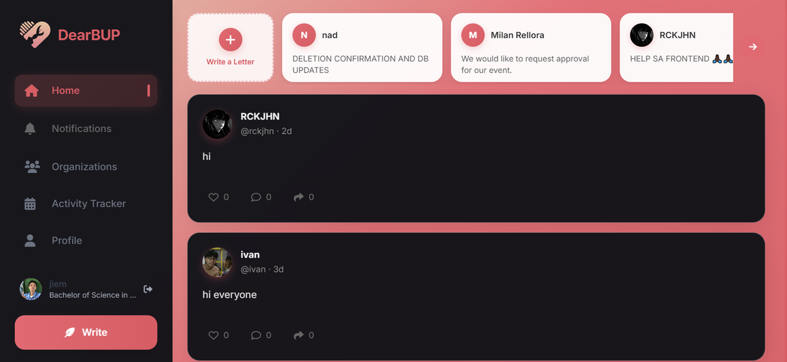
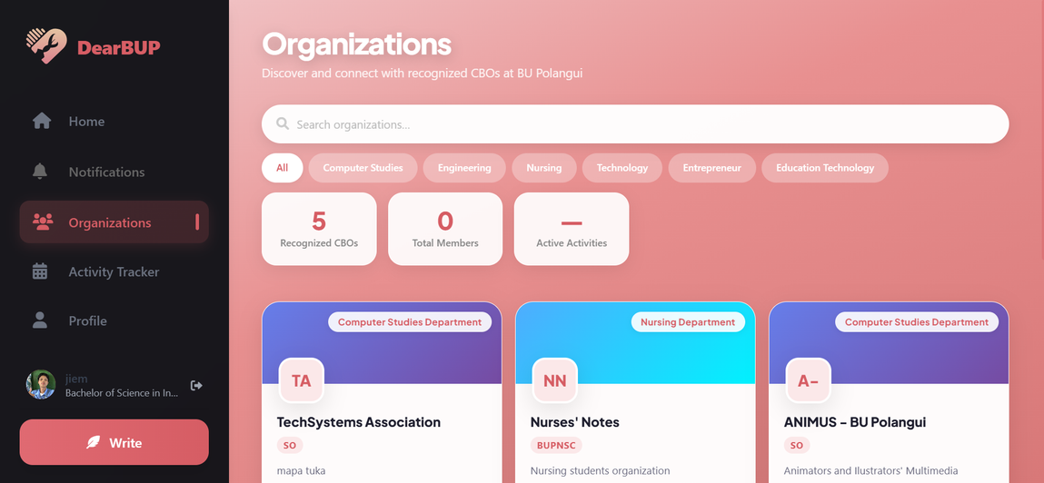


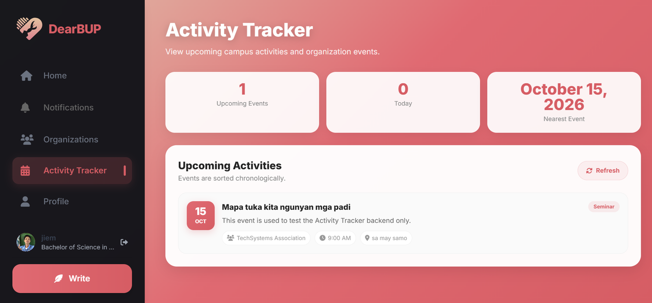
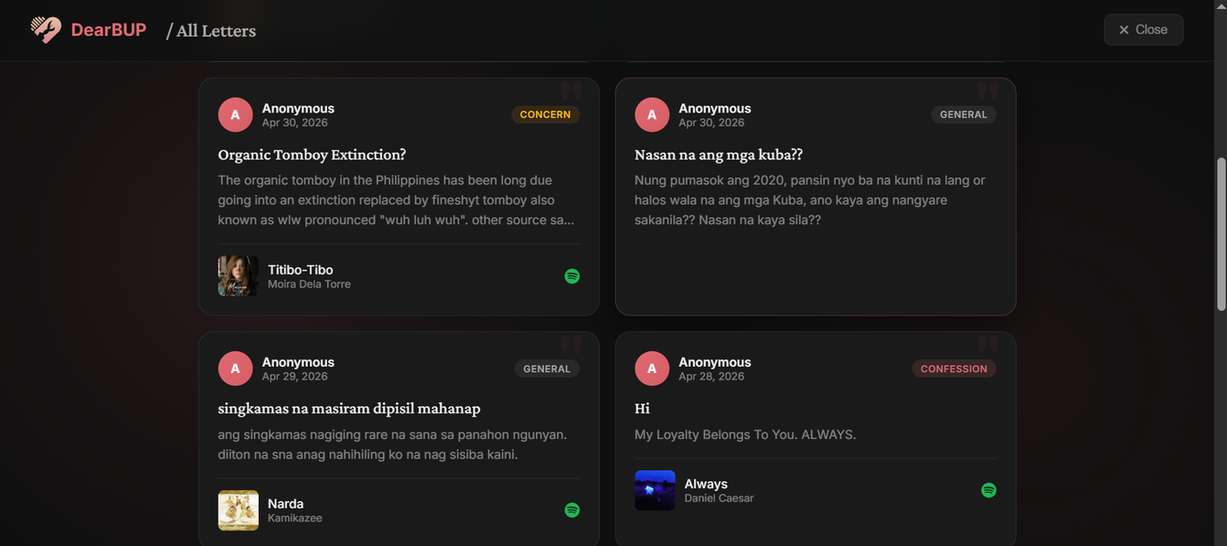
DEAR BUP
WebSystems and Technology
Learn
Discover

Slide 15
DEAR BUP
FUTURE IMPROVEMENTS
At the end of this presenation we would also ask for your suggestions on how can we improve our website, but for now these are the list of needed improvements we will implement soon.
Help center
Report button
Pagination
Learn
Discover

Slide 16
IMPROVEMENTS
DEAR BUP
READY TO ASK?
Learn
Discover

Slide 17
DEAR BUP
Websystems and Technology
Thank You
For Listening!
Learn
Discover

