Slide 1
Capstone:
Improving Content Discovery on Netflix
Under Cold-Start Conditions
An Explainable, Bias-Aware Recommendation Approach
Marvin L. Ford, MBAA
Postgraduate Diploma in Artificial Intelligence and Machine Learning
December 2024-December 2025 Cohort
Asian Institute of Management
Notes:
GitHub Repository, Source Code & Documentation: https://github.com/codewithmford/Marvin_Ford_Pillar_5_Capstone_Project

Slide 2
Business Problem and Proposed Solution
Business Problem:
  Users of large streaming platforms often struggle to discover content that matches their interests due to the size and diversity of the catalog, especially when user interaction data is limited. This leads to longer browsing time, over-exposure to popular titles, and weaker engagement for new or infrequent viewers.
Proposed Solution:
  Deploy a content-based recommendation approach that leverages title metadata rather than user history, enabling effective discovery under cold-start (when little or no user history is available) and data-limited conditions. This reduces browsing friction, broadens exposure beyond popularity-driven content, and supports scalable deployment with lower data dependency and regulatory risk.

Slide 3
Success Metrics (KPIs)
These metrics assess whether the recommendation approach improves content discovery under cold-start and data-limited conditions. Because the system retrieves similar titles rather than predicting user behavior, success is measured through discovery quality, variety, fairness, and transparency, directly aligning performance with business outcomes rather than model accuracy.
Recommendation Relevance
  Measures how well suggested titles align with the selected content.
  Ensures recommendations are useful and contextually appropriate.
Content Variety
  Tracks diversity within recommendation lists to prevent repetitive or overly narrow suggestions.
  Balances relevance with exploration to improve user experience.
Catalog Exposure
  Assesses how broadly recommendations surface titles across the catalog.
  Reduces over-reliance on already popular content and supports fair visibility.
Recommendation Transparency
  Confirms that recommendations can be clearly explained using observable content features.
  Transparency and explainability (Explainability Coverage) to support trust, governance, and auditability..

Slide 4
Data Overview & Readiness
Data Source: Netflix Movies and TV Shows Dataset (Kaggle)
Dataset Snapshot:
  8,809 titles across Movies (6,132) and TV Shows (2,677).
  26 metadata fields covering descriptions, genres, cast, director, country, and release details.
Data Quality Summary:
  Data was assessed for completeness, duplicate title handling, and structural quality.
  Missing values primarily in director (~30%), cast (~9%), and country (~9%).
  No critical gaps in core content fields (description, genre).
  Minor structural issues (empty placeholders, few duplicates) addressed during preprocessing.
  Core semantic fields (description, genres) are complete enough to support similarity modeling, while partial metadata gaps were handled without reducing catalog size.
Business Relevance:
  Enables scalable, metadata-driven recommendations.
  Preserves full catalog coverage while maintaining explainability and low operational risk.
Notes:
Data Source: https://www.kaggle.com/datasets/shivamb/netflix-shows

Slide 5



Proposed Solution: Metadata-Driven Recommender System
Approach:
  Uses title metadata (descriptions, genres, cast, director, country) to identify content similarity.
  Operates without user profiles, ratings, or behavioral tracking, making it effective in cold-start scenarios.
  Applies type-aware similarity so movies are compared with movies and TV shows with TV shows.
Key Design Decisions:
  Tolerant preprocessing preserves catalog breadth rather than discarding imperfect titles.
  Feature selection prioritizes semantic meaning and explainability over dimensional reduction.
  Balanced weighting and diversity controls prevent dominance by popular genres or regions.
Business Value Enabled:
  Enables relevant recommendations even with limited data.
  Maintains transparency and auditability in similarity decisions.
  Reduces bias from catalog imbalance while preserving discovery quality.
Metadata
Similarity Engine
Recommendations

Slide 6
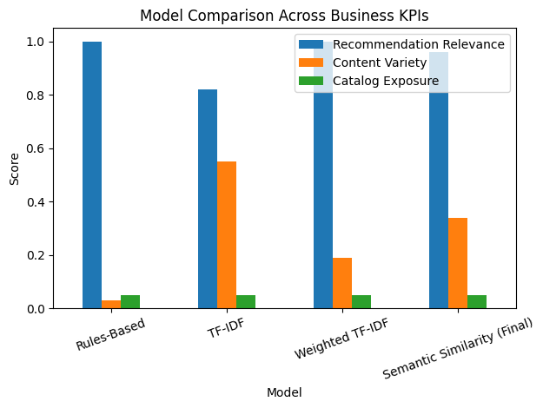
Model Evaluation & Selection Rationale
Multiple recommendation approaches were evaluated to balance relevance, variety, and fair catalog exposure under cold-start.
Evaluation Framework:
  Models were compared using a composite score prioritizing relevance while enforcing diversity and catalog exposure controls.
  Evaluation Focus:
    Relevance: alignment with selected title
    Variety: avoidance of repetitive suggestions
    Exposure: broader and fairer catalog visibility
Key Findings:
  Simple and heavily weighted models were relevant but repetitive
  Balanced models improved variety but required tuning
  Semantic similarity delivered the strongest overall balance.
Outcome:
  Final model selection reflects controlled trade-offs across relevance, variety, and exposure, rather than optimizing a single metric.
Evaluation metrics are computed using offline, fixed Top-K recommendations and reflect controlled model behavior rather than live user interaction.

Slide 7
Final Model Selection & Business Rationale
Model Selection:
  Selected a semantic similarity model that prioritizes relevance while enforcing diversity and exposure, without user data.
Business Rationale:
  Improves content discovery without excessive repetition.
  Supports fairer catalog exposure.
  Remains explainable, auditable, and suitable for cold-start deployment.

Slide 8
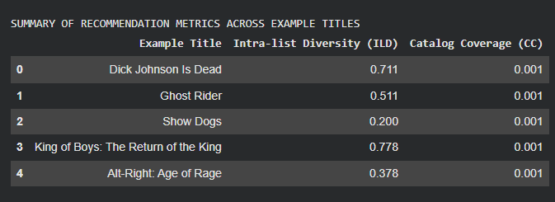
Recommendation Function Performance & Validation
The final recommender is evaluated using relevance, diversity, and exposure metrics selected to reflect real content discovery outcomes rather than technical accuracy alone. The system delivers consistent, relevant, and controlled recommendations across diverse titles, demonstrating stable behavior under cold-start and data-limited conditions.
Observed Recommendation Quality:
  Anchor titles (e.g., Dick Johnson Is Dead, Ghost Rider, Show Dogs) return thematically and genre-consistent recommendations.
  Confirms semantic similarity captures meaningful content relationships beyond keyword overlap.
Diversity & Exposure Behavior:
  Intra-List Diversity (ILD) varies appropriately by content type:
    Narrow titles show focused results; broader titles surface wider variety.
  Catalog Coverage remains consistent per Top-K list, reflecting controlled exposure rather than random drift.
Stability Across Anchors:
  Low variance in diversity and exposure metrics across multiple anchor titles.
  Demonstrates stable and predictable recommendation behavior, validated through multi-anchor evaluation.
Business Interpretation:
  These results confirm the system behaves consistently and predictably across different titles, reducing operational risk in real-world deployment.

Slide 9
Trust, Safety & Ethical AI
This solution is designed for transparency, fairness, and governance, ensuring responsible recommendations even under cold-start and data-limited conditions. Ethical risk is managed through explainable logic and measurable exposure controls rather than opaque user profiling.
Transparency & Explainability:
  Recommendations are clearly explainable using observable content signals (e.g., shared themes and keywords).
  Feature weighting is controlled and interpretable, avoiding black-box behavior.
  No user profiles, demographics, or behavioral predictions are used.
Bias Risk Detection & Control:
  Reduces over-promotion of already dominant genres and regions, supporting fairer catalog exposure at platform scale.
  Identified exposure shifts are mitigated through Intra-List Diversity (ILD), balanced feature weighting, and coverage-aware hybrid similarity
Governance & Risk Impact:
  Lower regulatory and privacy risk due to absence of user profiling.
  Auditable, controllable recommendation behavior aligned with Responsible AI principles.
  Suitable for large-scale deployment in cold-start and metadata-only environments.
Future Readiness:
  Provides a governance-ready foundation for future hybrid or personalized recommender extension.
Key Takeaway:
  The system delivers explainable, bias-aware recommendations with low regulatory risk, supporting responsible and scalable deployment.

Slide 10
Limitations & Future Readiness
Current Limitations:
  Metadata-only approach; no personalization or real-time user signals.
  Top-K recommendations constrain catalog coverage by design.
  Semantic similarity reflects content signals, not individual taste.
Future Readiness:
  Strong foundation for hybrid models (content + behavior).
  Can integrate user signals incrementally without redesign.
  Governance-safe starting point for scalable personalization.

Slide 11
Business Value & Key Takeaways
Business Impact:
  Improves content discovery under cold-start and data-limited conditions.
  Reduces repetitive recommendations while maintaining relevance.
  Supports broader and fairer catalog exposure without relying on user profiling.
Key Takeaways:
  A semantic, metadata-driven recommender can deliver strong discovery quality without user data.
  The solution behaves consistently, predictably, and transparently across content types.
  Provides a low-risk, explainable foundation that is ready for future personalization and scale.
Notes:
GitHub Repository, Source Code & Documentation: https://github.com/codewithmford/Marvin_Ford_Pillar_5_Capstone_Project

