Slide 1
Capstone:
Netflix Content-Based Recommender System
Technical Presentation
Marvin L. Ford, MBAA
Postgraduate Diploma in Artificial Intelligence and Machine Learning
December 2024-December 2025 Cohort
Asian Institute of Management

Slide 2
Business Problem and Machine Learning Task Type
Business Problem:
  Users of large streaming platforms often struggle to discover content
  that matches their interests due to the size and diversity of the catalog.
  This challenge is amplified when user interaction data is limited or unavailable, leading to popularity bias, cold-start scenarios, and excessive browsing instead of meaningful content consumption.
Machine Learning Task Type:
  Unsupervised Learning
  Recommendation (Content-Based Similarity and Informational Retrieval)
  Target Variable is not applicable as this does not predict a label and instead retrieves similar items based on content features.

Slide 3
Success Metrics (KPIs)
The metrics balance relevance, diversity, exposure, and transparency to evaluate performance under cold-start and data-limited conditions. Because the system retrieves similar content rather than predicting user behavior, evaluation focuses on content quality and discovery outcomes, not supervised accuracy. Together, these KPIs align technical performance with business goals of faster discovery, reduced browsing effort, and fair catalog exposure.
Precision@K (P@K):
  0.00–1.00, higher is better (target ≥ 0.60)
  Measures relevance and how well the Top-K recommendations match the anchor title’s content, ensuring practical usefulness.
Intra-list Diversity (ILD):
  0.00–1.00, higher is better (target 0.50–0.70)
  Evaluates variety within recommendations to avoid repetitive or overly narrow suggestions.
Catalog Coverage (CC):
  0.00–1.00, higher is better (target ≥ 0.40)
  Assesses how broadly recommendations surface titles across the catalog, limiting popularity bias.
Explainability Coverage (EC):
  0.00–1.00, higher is better (target ≥ 0.80)
  Ensures recommendations can be clearly justified using observable content features.

Slide 4
Data Preprocessing, EDA & Feature Engineering
Exploratory data analysis identified missing metadata, duplicate title strings, catalog imbalance, and concentration across geography and genres, requiring targeted handling without reducing catalog size or semantic value.
Missing Data:
  Removed 14 fully empty placeholder columns (100% missing, 8,809 rows) as these were non-informative noise
  Director missing: 29.9% (2,634 titles)
  Cast missing: 9.4% (825 titles)
  Country missing: 9.4% (831 titles)
  Partially missing semantic fields were retained using tolerant preprocessing to preserve catalog coverage and support cold-start scenarios
Duplicates:
  3 duplicate title strings identified
  Duplicate rows were not removed to avoid discarding valid titles with shared names
  Unique row indices were used for similarity computation and recommendation retrieval to ensure deterministic lookups and prevent ambiguity

Slide 5
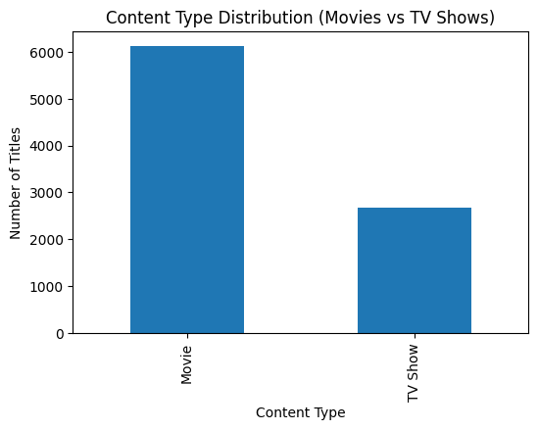
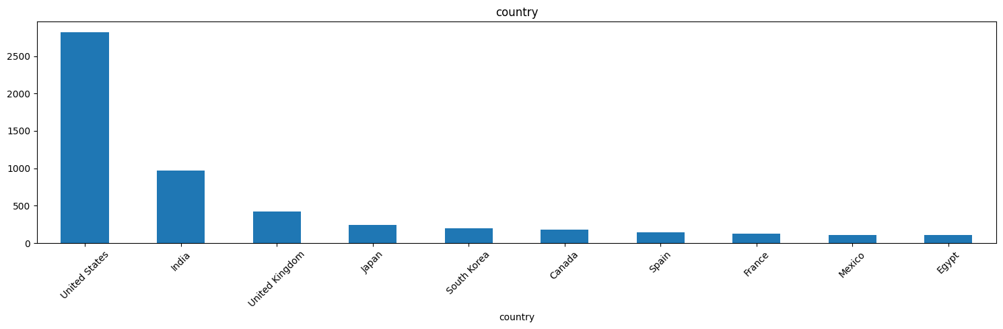
Data Preprocessing, EDA & Feature Engineering
Catalog Imbalance:
  Movies: 6,132 titles
  TV Shows: 2,677 titles
  Type-aware similarity logic ensures movies are compared only with movies and TV shows with TV shows to maintain relevance.
Geographic Concentration:
  United States: 2,819 titles (dominant production region)
  Catalog Coverage (CC) addresses this and applies balanced feature weighting to reduce repeated exposure to dominant regions.

Slide 6
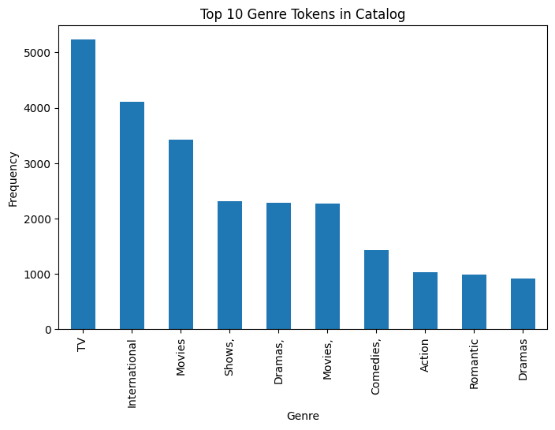
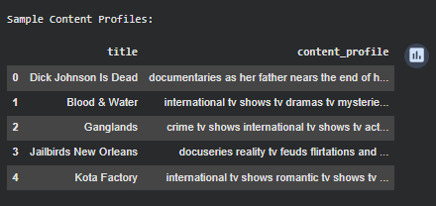
Data Preprocessing, EDA & Feature Engineering
Genre Dominance:
  Top genre token “TV” appears 5,230 times
  Intra-List Diversity (ILD) and tuning genre weighting limits overly repetitive recommendations.
Feature Engineering & Selection:
  Selected semantic signals: description, listed_in (genres), cast, director, country
  Excluded non-semantic metadata: release year, rating, duration, date added
  Constructed a unified content_profile through text normalization and field merging
  PCA dimensionality reduction was not applied, as preserving semantic meaning and explainability is critical for text-based similarity modeling. PCA would obscure token-level explainability.
  These preprocessing and feature engineering steps prepare a semantically coherent, feature-ready dataset for similarity modeling and downstream evaluation.
Output:
  Cleaned, feature-ready dataset exported for similarity modeling and downstream evaluation

Slide 7
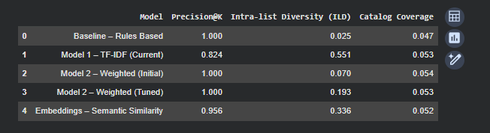
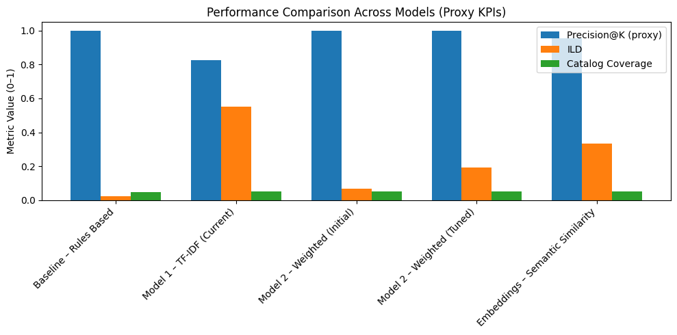
Model Building, Hyperparameter Tuning, Evaluation & Final Model Selection
Models were evaluated progressively, starting from simple and fully explainable baselines and advancing toward richer semantic representations to assess trade-offs between relevance, diversity, and catalog exposure, with final selection (Selection Score) based on a composite score that weighted relevance highest while enforcing diversity and coverage constraints.
Evaluation Sequence:
  Rules-based baseline → TF-IDF → Weighted TF-IDF (hybrid) → Semantic embeddings
  Designed to isolate gains from increasing model complexity and semantic depth
Vectorization Scale:
  TF-IDF matrix: 8,809 titles × 5,000 features
  Cosine similarity: 8,809 × 8,809 (full-catalog retrieval enabled)
Key Observations:
  Rules-based and heavily weighted TF-IDF achieved P@K = 1.00 but very low diversity (ILD ≈ 0.03–0.19), indicating repetitive recommendations
  Standard TF-IDF improved diversity (ILD = 0.55) but showed reduced relevance stability
  Confirms that excessive genre weighting narrows recommendations, motivating balanced approaches

Slide 8
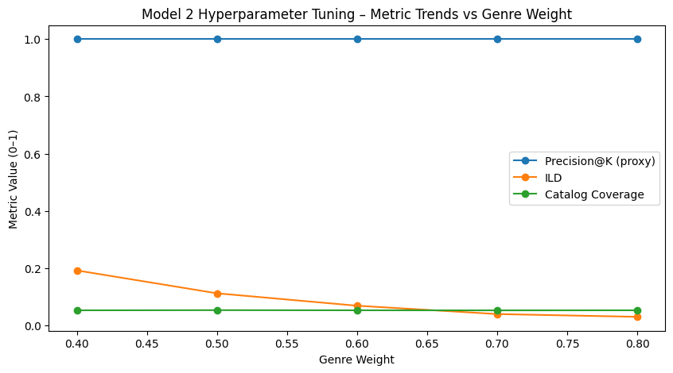
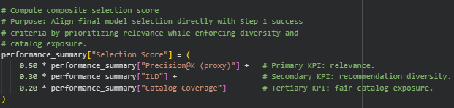
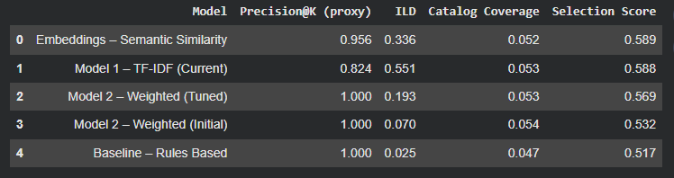
Model Building, Hyperparameter Tuning, Evaluation & Final Model Selection
Model comparison (Proxy KPIs):
  Baseline (Rules-based): P@K 1.00, ILD 0.03, CC 0.05
  TF-IDF (Model 1): P@K 0.82, ILD 0.55, CC 0.05
  Weighted TF-IDF (Tuned): P@K 1.00, ILD 0.19, CC 0.05
  Embeddings (Semantic): P@K 0.96, ILD 0.34, CC 0.05.
Hyperparameter Tuning (Model 2 Only):
  Genre weight tested: 0.4–0.8
  P@K peaks around 0.4; higher weights reduce diversity and coverage
  Tuning applied only to Model 2 due to its interpretable control parameter; other models are fixed or pretrained.
Final model selected: Embeddings - Semantic Similarity
  P@K: 0.96
  ILD: 0.34
  CC: 0.05
  Composite Selection Score (Relevance–Diversity–Exposure weighted): 0.59
Business & technical rationale:
  Strong relevance without excessive repetition
  Improved semantic matching beyond keyword overlap
  Maintains diversity and catalog exposure
  Explainable and robust for real-world, data-limited deployment
Output:
  Final similarity artifacts saved for downstream recommendation delivery

Slide 9
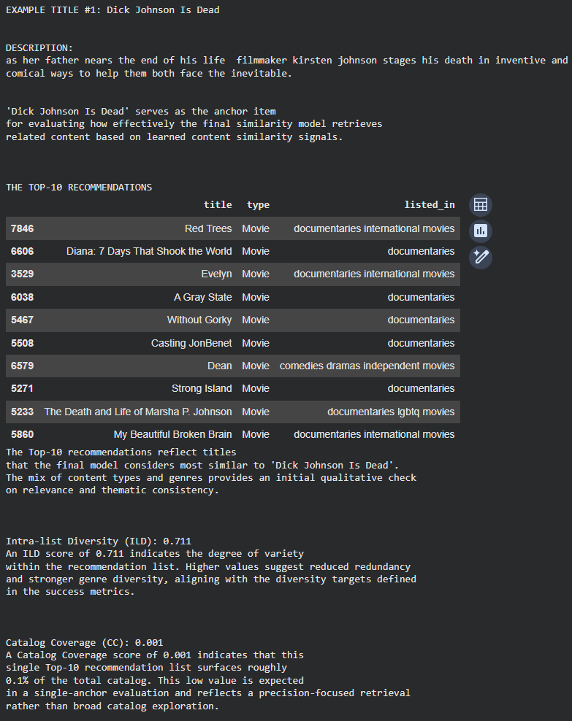
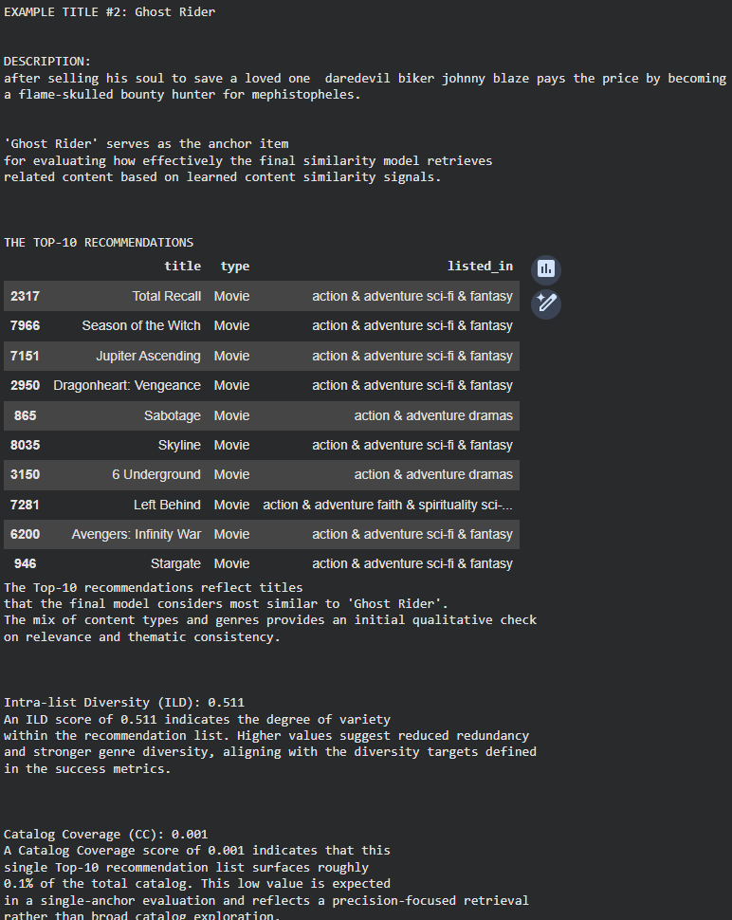
Recommendation Function & Evaluation Metrics
The final recommender produces thematically consistent, context-aware recommendations across diverse anchor titles, demonstrating stable behavior under data-limited conditions.
Qualitative Relevance:
  Anchor titles (e.g., Dick Johnson Is Dead, Ghost Rider, Show Dogs) retrieve genre-and theme-consistent results, validating semantic similarity behavior.

Slide 10
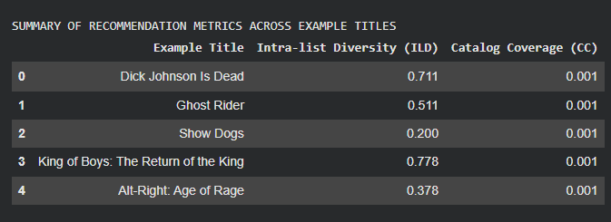
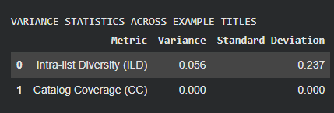
Recommendation Function & Evaluation Metrics
Intra-List Diversity (ILD):
  Ranges from 0.20 (narrow family titles) to 0.78 (broader crime/drama titles);
  documentaries show moderate diversity (0.38–0.71).
  Low variance (0.056, Std. Dev. 0.237) confirms stable diversity across anchors.
Catalog Coverage (CC):
  Consistently 0.001 per Top-10 list (~0.1% of 8,809 titles)
  Near-zero variance confirms coverage is structurally constrained by fixed Top-K size, not model instability
Robustness & Business Interpretation:
  Multi-anchor evaluation shows predictable, controlled behavior.
  Delivers precision-focused recommendations with appropriate diversity, suitable for cold-start and metadata-only deployment.
Variance Across Anchors:
  Low variance in ILD (0.056, SD = 0.237) and zero variance in CC(0.000) confirm that recommendation quality is stable across different anchor titles, indicating controlled system behavior rather than sensitivity to specific content.

Slide 11
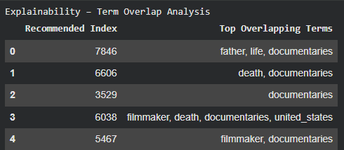
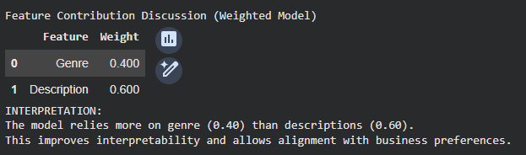
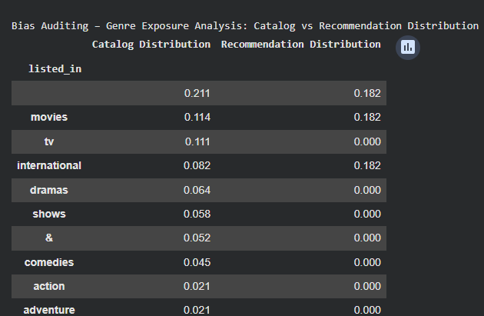
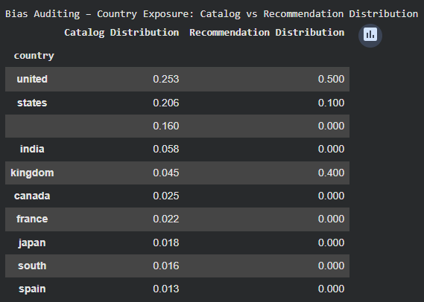
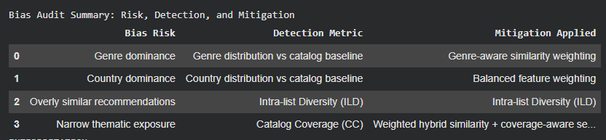
Critical Thinking, Explainability, Ethical AI, Bias Auditing, and Conclusion
This step evaluates the recommender system through explainability, ethical AI, and bias auditing, and concludes with its technical, business, and future-readiness implications under cold-start and data-limited conditions.
Explainability:
  Similarity decisions explained via term overlap (e.g., father, life, death, documentaries)
  Controlled feature weighting: genre = 0.40, description = 0.60, ensuring interpretability without black-box behavior.
Bias Auditing
  Exposure risks (genre, country, repetition, narrow themes) are detected via distribution metrics, ILD, and Catalog Coverage and mitigated through balanced feature weighting, ILD, and coverage-aware hybrid similarity, ensuring auditable and responsible recommendations.
  Highlights risks of regional and genre dominance when relevance is unconstrained.
  Exposure shift observed: U.S. titles ~0.25 (catalog) → ~0.50 (recommendations)

Slide 12
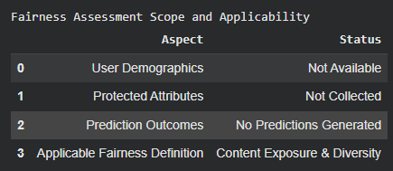
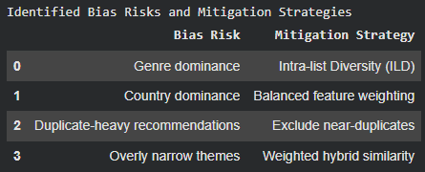
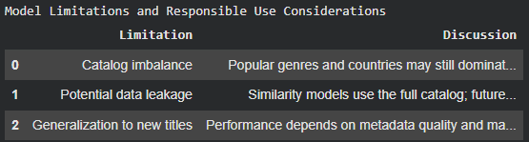
Critical Thinking, Explainability, Ethical AI, Bias Auditing, and Conclusion
Mitigation & Fairness:
  ILD, balanced feature weighting, and coverage-aware selection applied
  No user data or predictions used; fairness evaluated through content exposure and diversity.
Limitations
  Catalog imbalance may persist, similarity uses the full catalog, and performance depends on metadata quality for new titles—explicitly stated to support responsible use.
Technical Outcome
  Progresses from explainable baselines to semantic similarity modeling
  Stable, interpretable behavior confirmed via evaluation, explainability, and bias audits
Business Impact
  Improves discovery for new and infrequent viewers
  Reduces browsing time while avoiding over-exposure to popular titles
Ethical Implications for Netflix:
  Transparent, auditable recommendations
  Reduced popularity and regional bias without user profiling
  Low regulatory risk; suitable for cold-start deployment.
Future Readiness:
  Scalable foundation for hybrid and personalized recommenders aligned with governance and ethical AI requirements.

