Slide 1
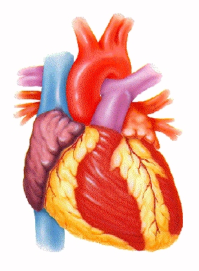
Introduction to the Human Cardiovascular System

Slide 2
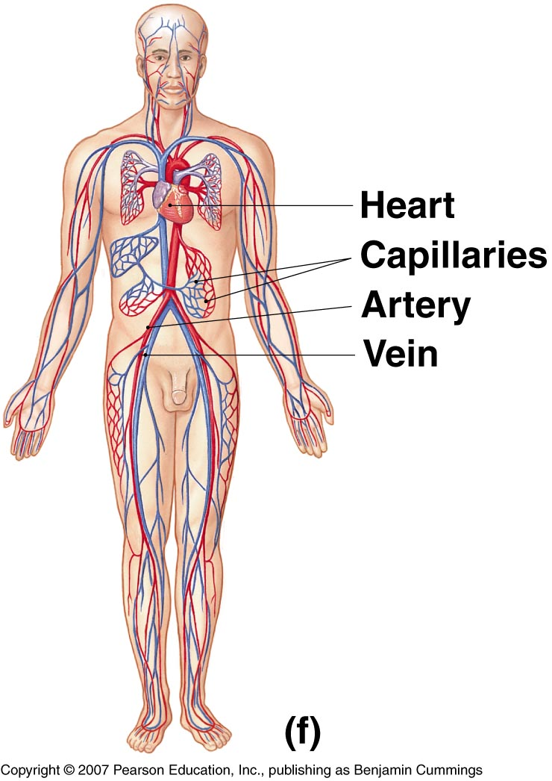
INTRODUCTION
The cardiovascular system is transport system of body
It comprises blood, heart and blood vessels.
The system supplies nutrients to and remove waste products from various tissue of body.
The conveying media is liquid in form of blood which flows in close tubular system.
Figure 1-2(f)

Slide 3
FUNCTION OF CARDIOVASCULAR SYSTEM
Transport nutrients, hormones
Remove waste products
Gaseous exchange
Immunity
Blood vessels transport blood
  Carries oxygen and carbon dioxide
  Also carries nutrients and wastes
Heart pumps blood through blood vessels

Slide 4
COMPONENTS OF CARDIOVASCULAR SYSTEM
BLOOD
HEART
BLOOD VESSELS

Slide 5
BLOOD
The Blood: Blood cells & Plasma
Blood cells
1- Erythrocytes - Red Blood Cells
2- Leucocytes
3- Thrombocytes
Plasma is fluid portion

Slide 6
HEART
Heart is a four chambered, hollow muscular organ approximately the size of your fist
Location:
  Superior surface of diaphragm
  Left of the midline
  Anterior to the vertebral column, posterior to the sternum
Chapter 18, Cardiovascular System

Slide 7
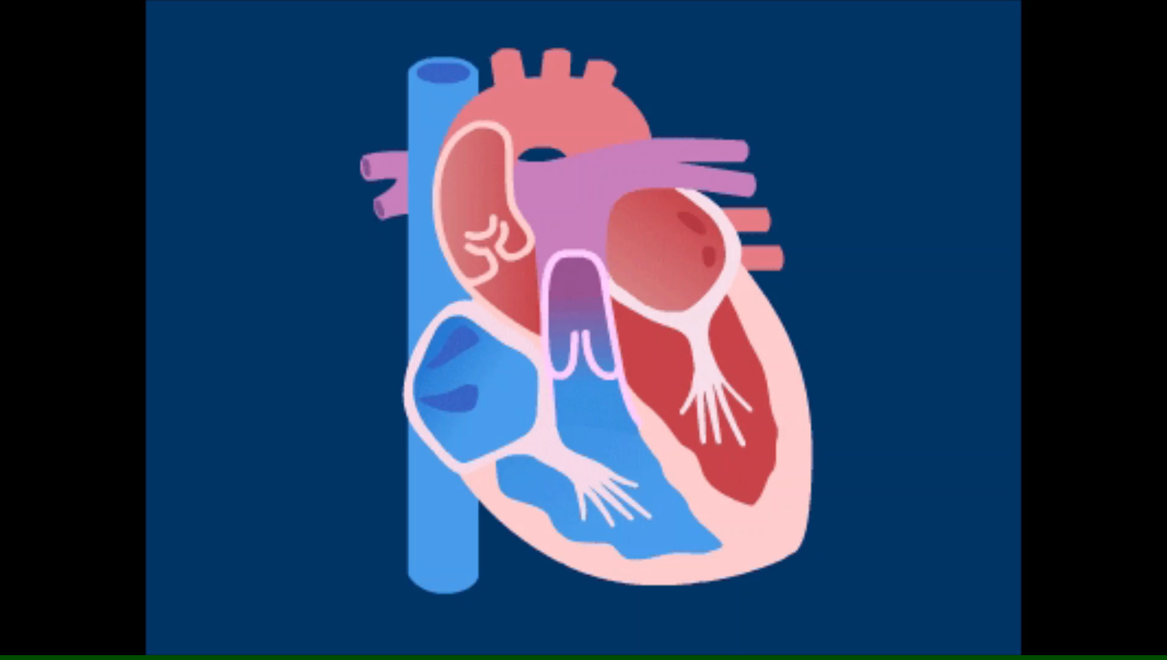

Slide 8
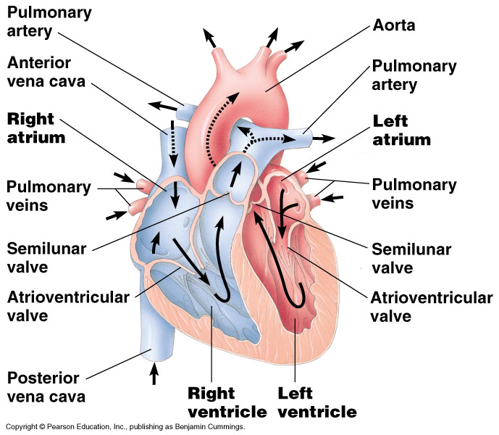

Slide 9
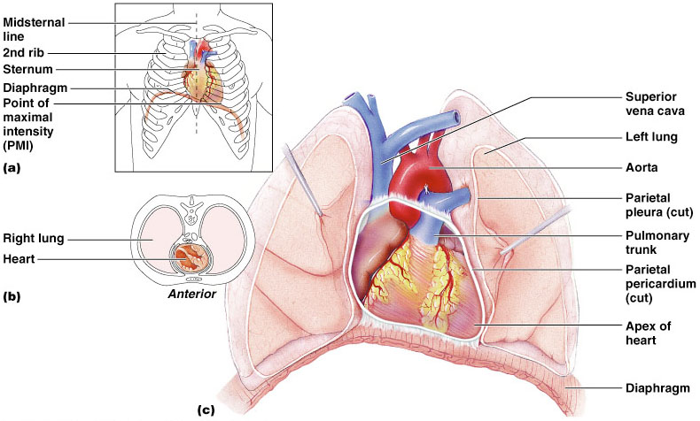
HEART
Chapter 18, Cardiovascular System
Figure 18.1

Slide 10
FUNCTIONS OF THE HEART
Generating blood pressure
Routing blood
  Heart separates pulmonary and systemic
  circulations
Ensuring one-way blood flow
  Heart valves ensure one-way flow
Regulating blood supply
  Changes in contraction rate and force match
  blood delivery to changing metabolic needs

Slide 11
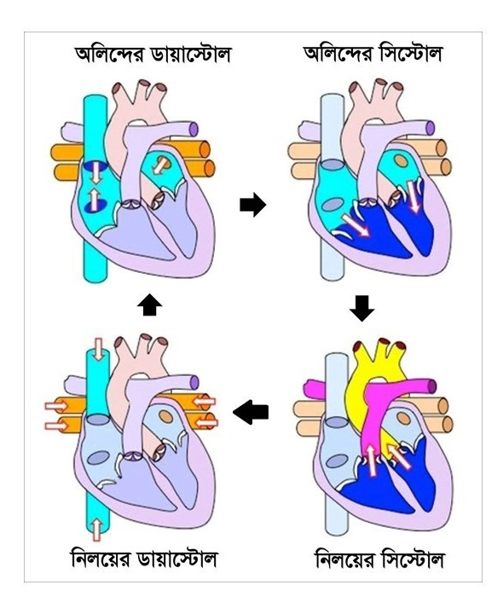
হৃৎপিণ্ডের অন্ত:গঠন ও রক্ত সঞ্চালন পদ্ধতিঃ

Slide 12
BLOOD VESSELS
Blood Vessels -A closed network of tubes
These includes:
Arteries
Capillaries
Veins

Slide 13
BLOOD VESSELS
  -Arteries(Distributing channel)
    Thick walled tubes
    Elastic Fibers
    Circular Smooth Muscle
  Capillaries (microscopic vessels)
    One cell thick
    Serves the Respiratory System
  Veins (draining channel)

Slide 14
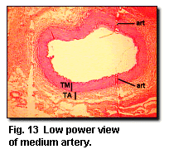
BLOOD VESSELS
General structure
1.Tunica intima
2.Tunica media
3.Tunica adventitia

Slide 15
CLASSIFICATION OF BLOOD VESSELS
Conducting Vessels
Distributing Vessels
Resistance Vessels
Exchange Vessels
Capacitance / Reservoir Vessels

Slide 16
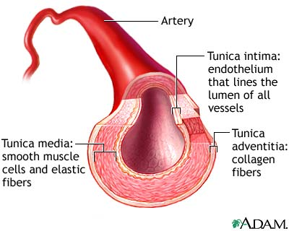
ARTERIES
Blood vessels that carry blood away from the heart are called arteries.
They are the thickest blood vessels and they carry blood high in oxygen known as oxygenated blood (oxygen rich blood).

Slide 17
ARTERIES
Accompanied by vein and nerves
Lumen is small
No valves
Repeated branching

Slide 18
CLASSIFICATION OF ARTEIES
Elastic- e.g. (Aorta & its Major branches)
Muscular -e.g.(Renal, Testicular, Radial, Tibial etc.)
Arterioles (<0.1 mm)-
Terminal arterioles
Meta-arterioles
Thoroughfare
channel/ preferred

Slide 19
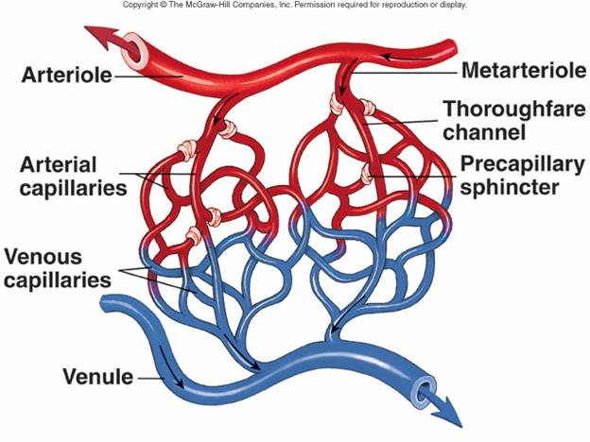
CAPILLARIES (5-8 micron)
The smallest blood vessels are capillaries and they connect the arteries and veins.
This is where the exchange of nutrients and gases occurs.

Slide 20
BODY CONTAINS TWO KINDS OF CAPILLARIES
CONTINUOUS-SKIN, LUNG, SMMOTH MUSCLE, CONNECTIVE TISSUES
FENESTRATED- PANCREAS,ENDOCRINE GLANDS, SMALL INTESTINE,CHOROID PLEXUS,CILLIARY PROCESS etc.

Slide 21
SINUSOIDS
SINUSOIDS- Large irregular vascular space (30-40 micron) eg.Liver, Spleen, Bone marrow, suprarenal, Parathyroid etc.

Slide 22
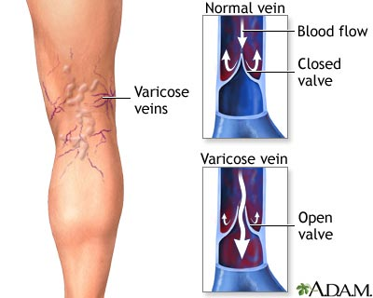
VEINS
Blood vessels that carry blood back to the heart are called veins.
They have one-way valves which prevent blood from flowing backwards.
They carry blood that is high in carbon dioxide known as deoxygenated blood (oxygen poor blood).

Slide 23
VEINS
Thin Walled
Large irregular lumen
Have valves
Dead space around
Types:
Large
Medium
Small

Slide 24
VEINS
Veins without valves:
SVC & IVC
Hepatic, Renal
Uterine, Ovarian not Testicular
Facial
Pulmonary
Umbilical
Emissary
Portal Veins <2mm

Slide 25
VEINS
Veins without Muscular tissue:
Dural venous sinuses
Pial Veins
Retinal
Veins of erectile tissue of sex organs
Veins of spongy bones

Slide 26
VEINS
Factors responsible for venous return:
Muscle contraction
Negative intrathoracic pressure
Pulsation of arteries
Gravity
Valves

Slide 27
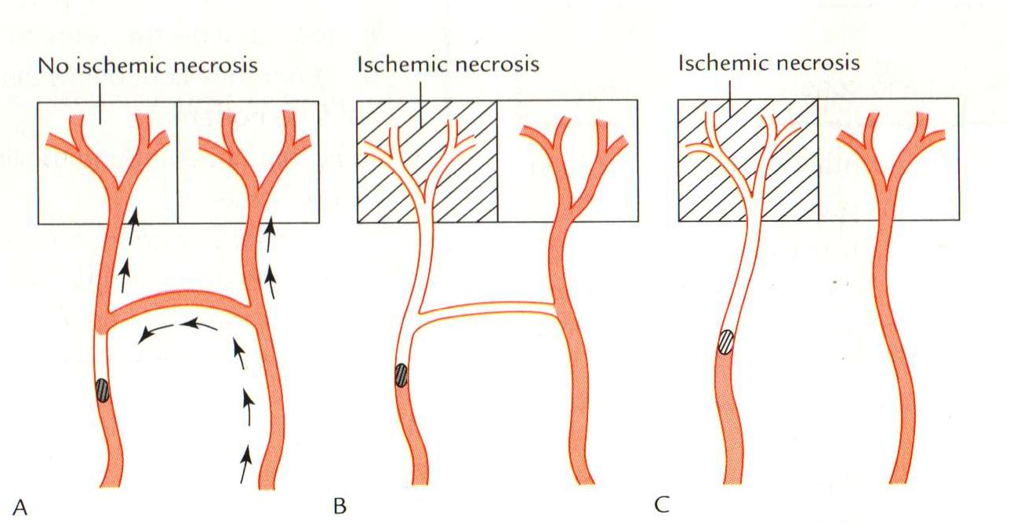
ANASTOMOSIS
Communication between vessels
ARTERIAL:
Actual( end to end & convergent)-Palmar, plantar, Circle of Willis, Labial Intestinal arcade, etc.
Potential-Coronary, around joints etc.

Slide 28
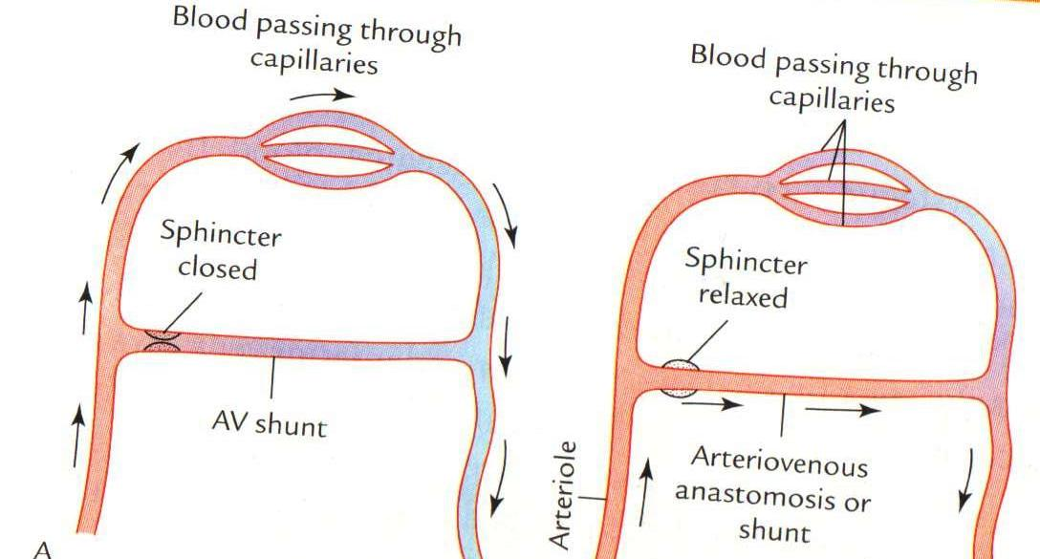
ANASTOMOSIS
ARTERIOVENOUS ANASTOMOSIS:
Skin of nose
Lips
External Ear
Mucus membrane of GI & nose
Erectile tissue of sex organ
Thyroid
Tongue

Slide 29
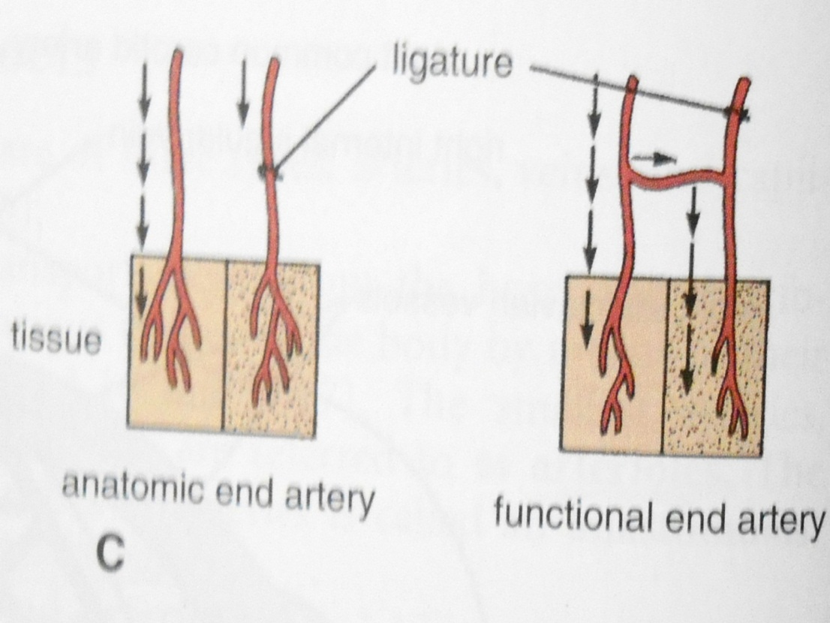
END ARTERIES
END ARTERIES:
Central artery of retina
Arteries of spleen, liver, kidneys, metaphyses of long bones
Central branches of cerebral cortex

Slide 30
CIRCULATION
  Coronary circulation – the circulation of blood within the heart.
  Pulmonary circulation – the flow of blood between the heart and lungs.
  Systemic circulation – the flow of blood between the heart and the cells of the body.
  Fetal Circulation

Slide 31
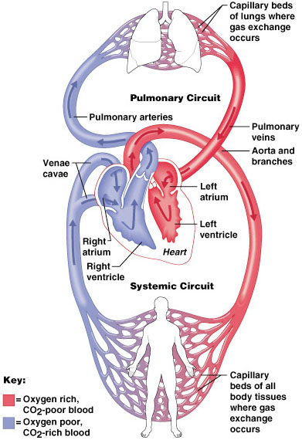
SYSTEMIC AND PULMONARY CIRCULATION
  Pulmonary circulation
  The flow of blood between the heart and lungs.
  Systemic circulation The flow of blood between the heart and the cells of the body.
Chapter 18, Cardiovascular System
Figure 18.5

Slide 32
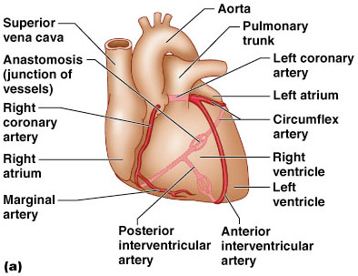
CORONARY CIRCULATION: ARTERIAL SUPPLY
Chapter 18, Cardiovascular System
Figure 18.7a

Slide 33
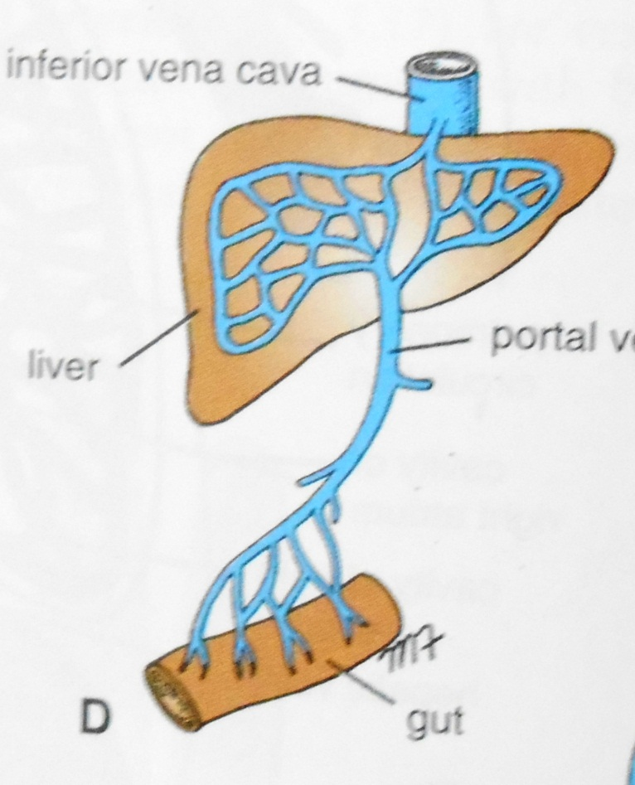
PORTAL CIRCULATION
  Portal circulation - the flow of blood between tow set of capillaries before draining in systemic veins.

Slide 34
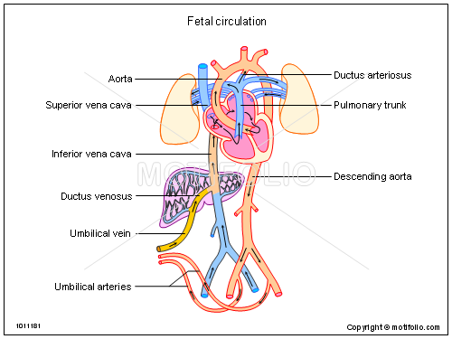
FETAL CIRCULATION

Slide 35
UMBILICAL ARTERY
DESCENDING AORTA
(Through Ductus Arteriosus)
PULMONARY TRUNK
RIGHT VENTRICLE
ASCENDING AORTA
UMBILICAL VEIN
PORTAL VEIN
(Through Ductus Venosus)
INFERIOR VENA CAVA
RIFHT ATRIUM
(Through Foramen Ovale)
LEFT ATRIUM
PLACENTA

Slide 36
Diseases and Disorders
  HIGH BLOOB PRESSURE/HYPERTENSION
  HAEMORRHAGE/STROKE
  CORONARY ARTERY DISEASE (CAD)
  HEART ATTACK
  CONGESTIVE HEART FAILURE (CHF)
  ANEMIA
  HEMOPHILIA
  LEUKEMIA

