Slide 1


Company Profile & Corporate Mobility Solutions
Assessment Presentation
Prepared By Nikhil Goswami

Slide 2
About WTi Cabs
Company Overview
WTi Cabs is an integrated corporate mobility and travel solutions company founded in 2009 and headquartered in New Delhi, India. The company specializes in employee transportation, corporate mobility, airport transfers, fleet management, and technology-enabled transportation solutions. Today, WTi Cabs operates across India, helping enterprises manage safe, reliable, and efficient workforce mobility.
Key Highlights
Founded in 2009
Headquarters: New Delhi
Pan-India operations
Corporate mobility specialist
Technology-enabled transportation solutions
Focus on safety, operational excellence, and customer experience

Slide 3
Mobility Solutions & Services
Services Offered
WTi Cabs provides end-to-end mobility solutions designed for businesses, institutions, and enterprise customers.
Core Services
Employee Transportation Services (ETS)
Corporate Car Rental
Airport Mobility & Airport Transfers
Fixed & Monthly Rentals
Fleet Management
Project & Site Transportation
Event Commute Management
Mobility Technology Solutions
EV Transportation Solutions
Consulting & Advisory Services

Slide 4
WTi Cabs at a Glance
Company Growth & Scale
WTi Cabs has expanded significantly since its establishment.
Growth Highlights
₹600+ Cr
14,000+
750+
Revenue Growth
Fleet Growth
Enterprise Clients
₹32 Cr → ₹600+ Cr
556 → 14,000+ Vehicles
28 → 750+
10,000+
1,400+
Service Partners
Team Strength
51 → 10,000+
84 → 1,400+ Professionals
These figures demonstrate the company's strong growth and nationwide operational capabilities.

Slide 5
Technology & Operations
Technology-Driven Mobility
WTi Cabs combines transportation services with technology to improve operational efficiency and customer experience.
Technology Capabilities
Mobility Technology Solutions
Employee Transportation Technology Platform
Corporate Fleet Management
Route Planning & Fleet Coordination
Transportation Compliance Management
Enterprise Mobility Solutions
Managed Mobility Services
Women Safety Transportation Solutions

Slide 6
Why Choose WTi Cabs?
Business Strengths
WTi Cabs differentiates itself through its integrated mobility ecosystem and enterprise-focused transportation services.
Strengths
Pan-India Mobility Operations
Corporate Mobility Expertise
Technology-Enabled Operations
Large Fleet & Service Partner Network
Enterprise Transportation Solutions
Customer-Centric Service Model
Scalable Mobility Solutions
Strong Focus on Safety & Compliance

Slide 7
SWOT Analysis (Business Analysis)
This slide is my analysis based on the company's business model.
Strengths
Weaknesses
Established corporate mobility brand
Large nationwide fleet network
Technology-enabled operations
Strong enterprise customer base
High operating and fleet maintenance costs
Dependence on transportation infrastructure
Complex vendor management
Threats
Opportunities
Fuel price volatility
Increasing market competition
Regulatory changes
Driver availability challenges
Growth in EV mobility
AI-powered fleet optimization
Expansion into Tier-2 & Tier-3 cities
Increasing demand for organized corporate mobility

Slide 8
Strategic Recommendations (Business Analysis)
Recommendations
To strengthen future growth, WTi Cabs can consider:
1
Accelerate EV fleet adoption
2
Expand AI-based route optimization
3
Strengthen predictive vehicle maintenance
4
Increase data analytics for operational decisions
5
Expand sustainable mobility initiatives
6
Enhance customer self-service digital platforms
7
Continue investment in employee safety technologies

Slide 9
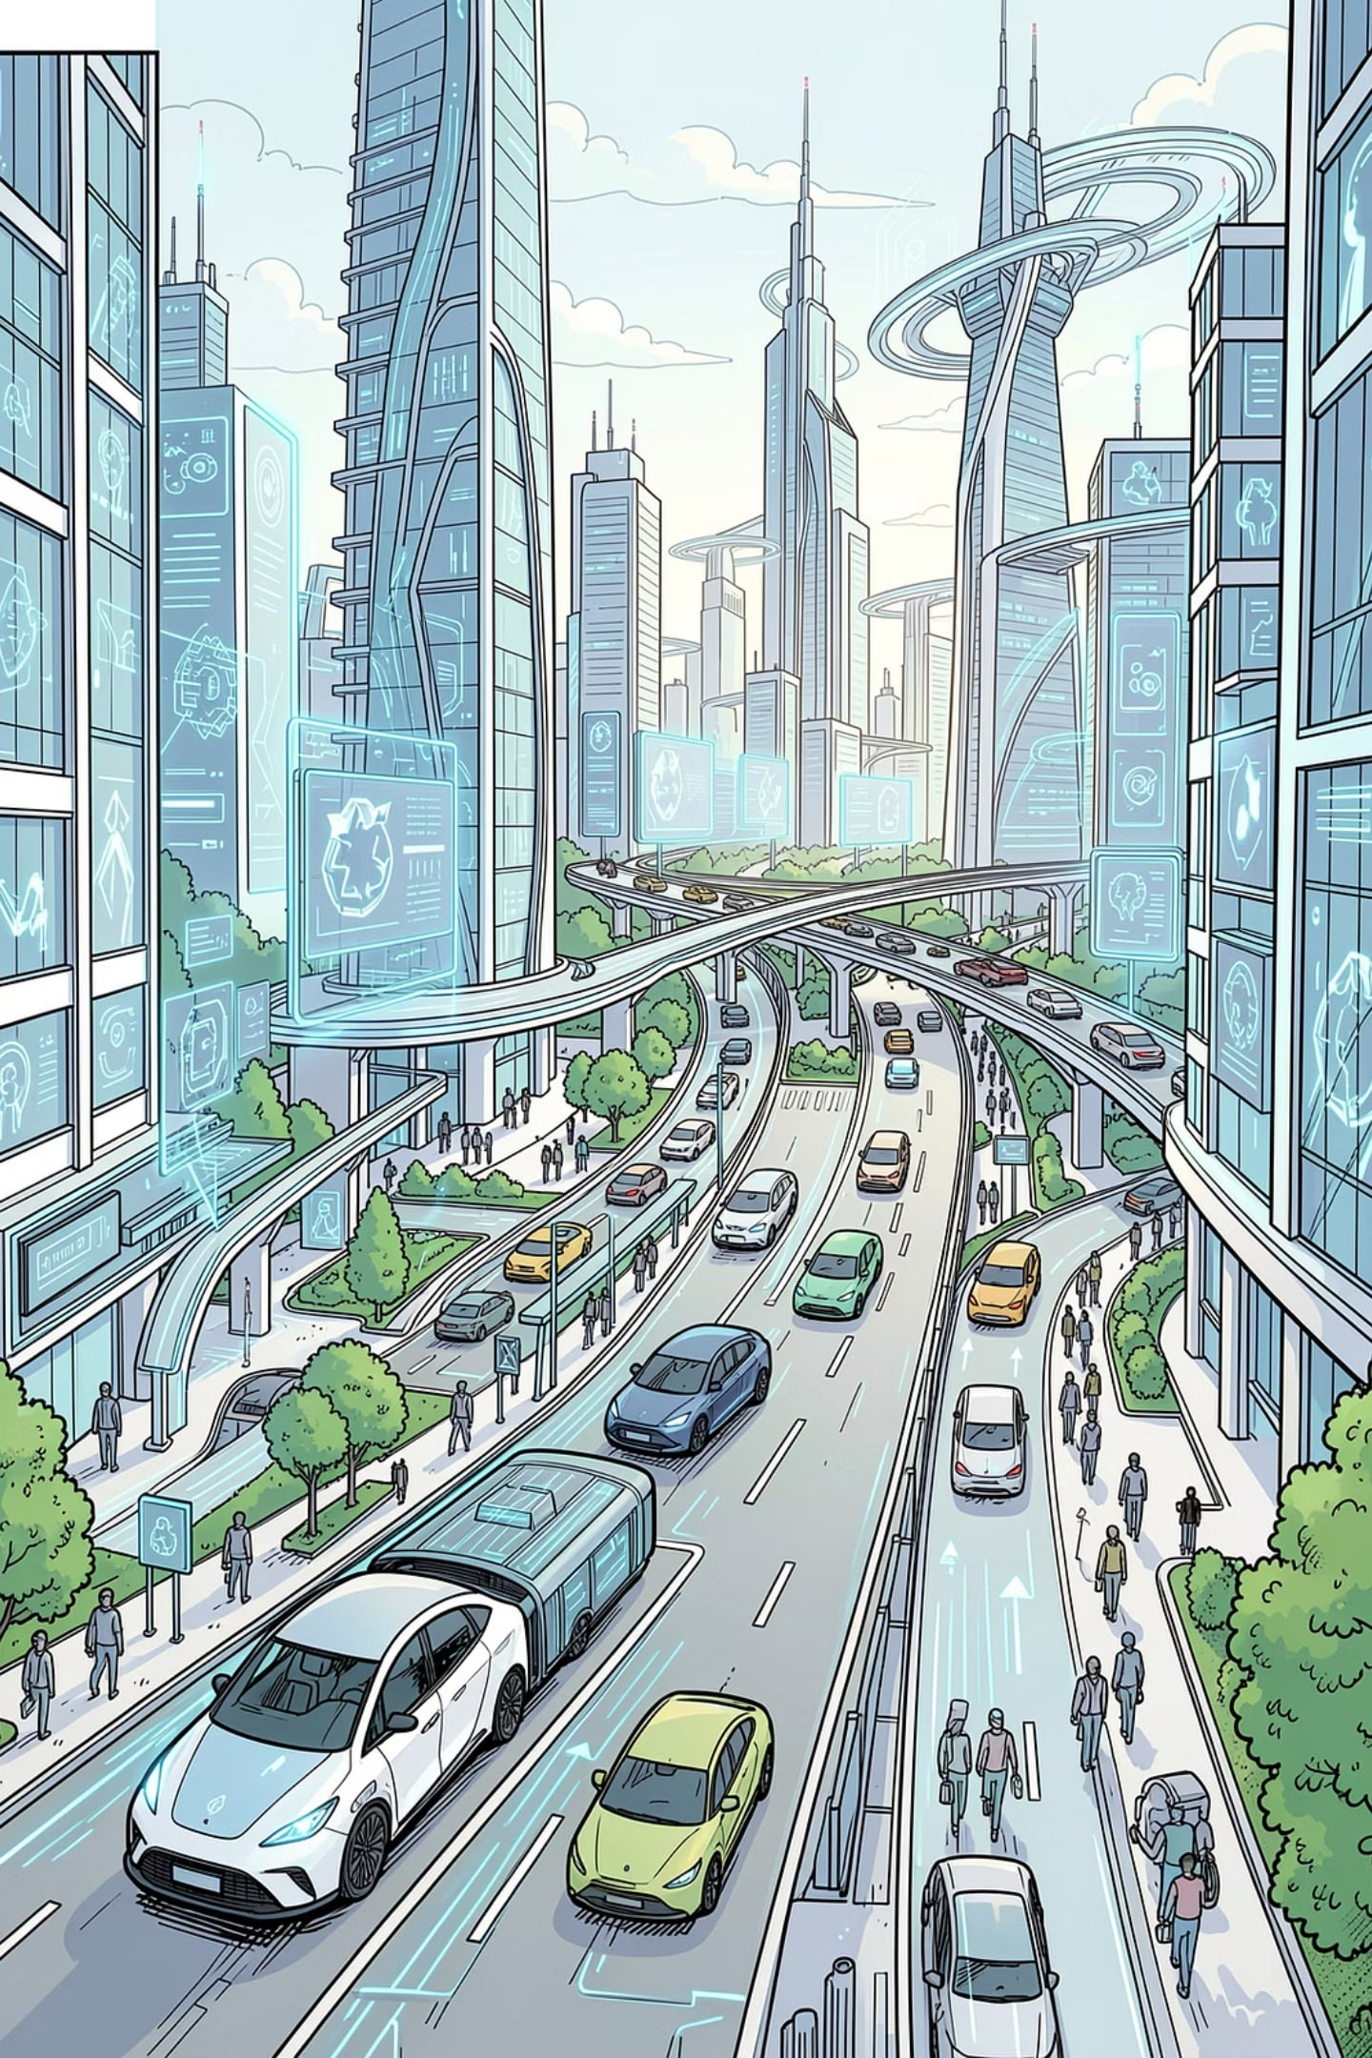
Future Vision
Driving the Future of Corporate Mobility
WTi Cabs continues to focus on building an intelligent and sustainable mobility ecosystem by combining technology, operational excellence, and customer-centric transportation solutions. The company's emphasis on EV mobility, digital transformation, enterprise mobility solutions, and nationwide expansion positions it for continued growth in India's corporate transportation sector.

Slide 10

Thank You
Questions & Discussion
Prepared By
Nikhil Goswami

