Slide 1
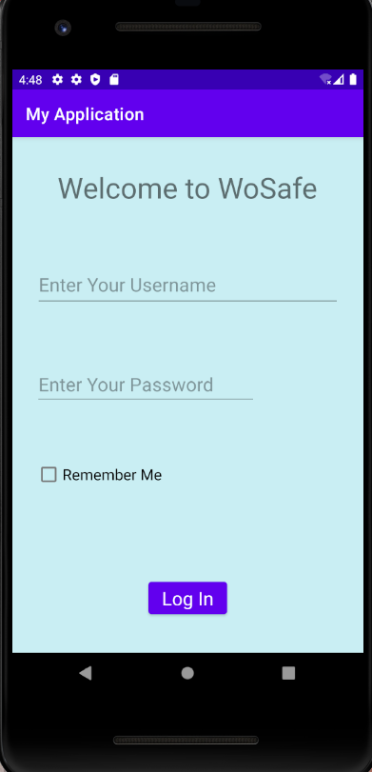
WoSafe- Your Security Is our priority
This app provides all types of security-helps bundled at one corner . The app is mainly designed for places like India where a women steps outside along with a fear of insecurity.
The app begins with a welcome note with our POLICY documentation and a button to register a new user.

Slide 2
Here the user can log in. After logging in once, here the user will get a ‘Remember me’ checkbox. This checkbosx will help the user to avoid log in again and again.
Just a single click, the user will be redirected to the main page.

Slide 3
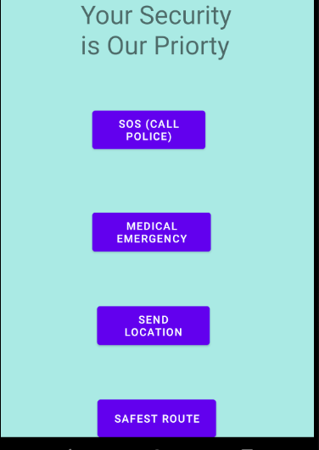
Just One click and Security services will be at your dootsteps.
The next page shows four button-blocks, whose function are briefed on next pages.

Slide 4
1. SOS (Police) – If the woman is feeling a sence of insecurity , then she can click on this button . An immediate message will be droped at the nearest police station in her location zone.
2. Medical Emergency – Most of the women die because they do not manage to contact for help during medical emergencies. After pressing this button, a sudden call will reach to the nearest authorised hospitals/clinics.

Slide 5
3. Send Location – During high emergency situations, a call along with currant location will reach to the near-by police stations and guardians.
4. Safest Route – This button utilizes Google Maps and will help the women to get a safest route to reach her destination.

Slide 6
thankyou
Since we do not had much time to take the app at a slight advanced level. It is just a representation of an revolutionary idea.
-Team Binary Beasts

