Slide 1
Live Virtual Class 4
RESTful Web Services Rahul Dixit

Slide 2

Agenda
Learn about Spring Boot’s Database handling.
JPA
Mongo Atlas | Embedded Mongo
Learn about Spring Boot’s Restful Web Services
Rest Controller Request Mapping Request Body
Path Variable Request Parameter POST API
PUT API DELETE API
Introduction to RESTful Web Service :- Initializing RESTful Web Services

Slide 3
Steps
Add Dependency
Write Configuration
Properties file
Create Entity to be persist
Create Class Repository

Slide 4
Rest Api Using Spring Boot

Slide 5
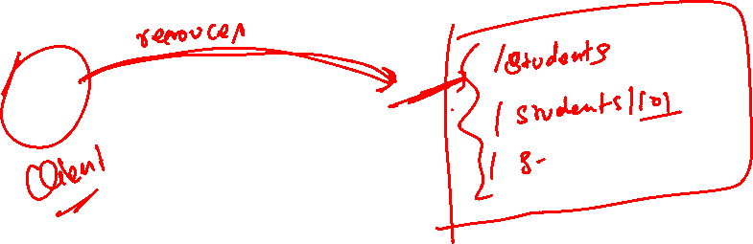

Introduction to RESTful Web Services
RESTful web services are a popular architectural style for designing and implementing web APIs (Application Programming Interfaces).
REST, which stands for Representational State Transfer
provides a set of guidelines and constraints for building scalable, interoperable, and stateless web services.

Slide 6
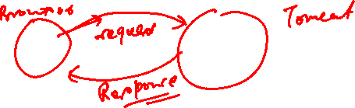

Key Principle
Stateless: The server does not store any session or client-specific data between requests.
Client – Server Architecture : client is responsible for initiating requests and the server is responsible for processing those requests and returning responses.
Uniform Interface : provides a set of standard HTTP methods (GET, POST, PUT, DELETE) to perform operations on resources.
Resource Oriented : clients can perform operations on these resources using the standard HTTP methods.

Slide 7
Benefits
Scalability : RESTful services are inherently scalable due to their stateless nature.
Interoperability : RESTful web services can be consumed by clients written in different programming languages and running on different platforms. They communicate over standard protocols like HTTP, making them highly interoperable.
Simplicity : RESTful services follow a simple and intuitive design approach, leveraging the existing capabilities of the HTTP protocol.

Slide 8
How to Build Rest Api
Identifying Resources (/users, /users/{id}/posts)
Identifying Actions (GET, POST, PUT, DELETE, ...)
Defining Request and Response structures Using appropriate Response Status (200, 404, 500, ..)
Understanding REST API Best Practices Thinking from the perspective of your consumer Validation, Internationalization - i18n, Exception Handling, HATEOAS, Versioning, Documentation, Content Negotiation and a lot more!

Slide 9
Our Project
Build 3 Simple Hello World REST API
Understand the magic of Spring Boot
Understand fundamentals of building REST API with Spring Boot @RestController, @RequestMapping, @PathVariable, JSON
conversion 2: Build a REST API for a Social Media Application
Design and Build a Great REST API
Choosing the right URI for resources (/users, /users/{id}, /users/{id}/posts)
Choosing the right request method for actions (GET, POST, PUT, DELETE, ..)
Designing Request and Response structures
Implementing Security, Validation and Exception Handling

Slide 10
Build Advanced REST API Features
Internationalization, HATEOAS, Versioning, Documentation, Content Negotiation, ...
Connect your REST API to a Database Fundamentals of JPA and Hibernate Use H2 and MySQL as databases

Slide 11
What's Happening in the Background?
Let's explore some Spring Boot Magic: Enable Debug Logging
How are our requests handled?
DispatcherServlet - Front Controller Pattern
Mapping servlets: dispatcherServlet urls=[/]
Auto Configuration (DispatcherServletAutoConfiguration)
How does HelloWorldBean object get converted to JSON?
@ResponseBody + JacksonHttpMessageConverters
Auto Configuration (JacksonHttpMessageConvertersConfiguration)

Slide 12
Who is configuring error mapping?
Auto Configuration (ErrorMvcAutoConfiguration)
How are all jars available(Spring, Spring MVC, Jackson, Tomcat)?
Starter Projects - Spring Boot Starter Web (spring-webmvc, spring-web, springboot-starter-tomcat, spring-boot-starter-json)

Slide 13
Student Rest Api With Crud Operation
Build a REST API for a Social Media Application
Key Resources:
Student
Course
Details:
Student: id, name, email, Course
Course: id, cname,

Slide 14
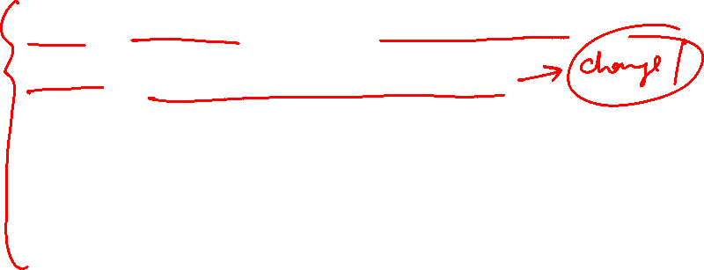
Request Methods for REST API
GET - Retrieve details of a resource
POST - Create a new resource
PUT - Update an existing resource
PATCH - Update part of a resource D
DELETE - Delete a resource

Slide 15
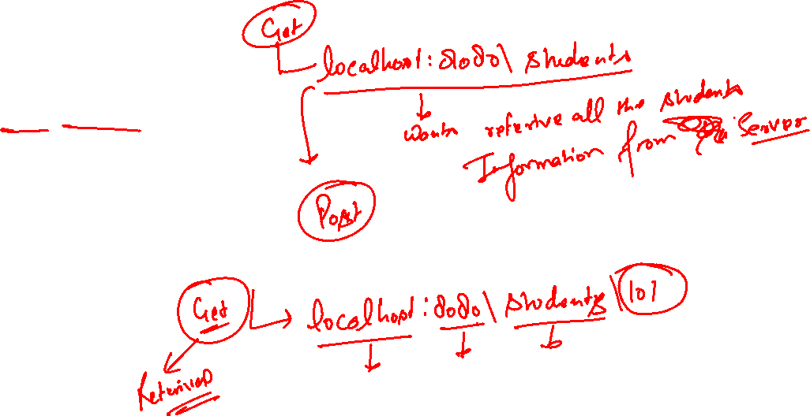
Resources and methods
Users REST API
Retrieve all Users
GET /students
Create a User
POST /students
Retrieve one User
GET /students/{id} -> /students/1

Slide 16
Resources & Methods (continued…)
Delete a User
DELETE /students/{id} -> / students /1
Posts REST API
Retrieve all posts for a User
GET / students /{id}/courses
Create a post for a User
POST / students /{id}/courses
Retrieve details of a post
GET / students /{id}/courses/{post_id}

Slide 17
Response status for RestApi
Return the correct response status
Resource is not found => 404
Server exception => 500
Validation error => 400

Slide 18
Response Status for Rest Api
Important Response Statuses
200 — Success
201 — Created
204 — No Content
401 — Unauthorized (when authorization fails)
400 — Bad Request (such as validation error)
404 — Resource Not Found
500 — Server Error

Slide 19

5 min break
This a 5 min break for you
Have a glass of water
Take a deep breath
Note down any doubt you have till now
Join back
DO NOT WRITE ANYTHING
HERE. LEAVE THIS SPACE FOR
WEBCAM

Slide 20
Any doubts?

Slide 21
Objectives
Understand the fundamentals of microservices.
Gain proficiency in creating a project structure suitable for microservices using Spring Boot.
Including building and deploying individual services, as well as managing their interactions and dependencies.
Develop an understanding of coding standards specific to microservices development, such as defining RESTful APIs, error handling, and versioning strategies.

Slide 22
Benefits
Scalability : RESTful services are inherently scalable due to their stateless nature.
Interoperability : RESTful web services can be consumed by clients written in different programming languages and running on different platforms. They communicate over standard protocols like HTTP, making them highly interoperable.
Simplicity : RESTful services follow a simple and intuitive design approach, leveraging the existing capabilities of the HTTP protocol.

Slide 23
Spring Boot with Microservices

Slide 24
5 min break
This a 5 min break for you
Have a glass of water
Take a deep breath
Note down any doubt you have till now
Join back
DO NOT WRITE ANYTHING
HERE. LEAVE THIS SPACE FOR
WEBCAM

Slide 25
Summary
Point 1
Point 2
Point 3
DO NOT WRITE ANYTHING
HERE. LEAVE THIS SPACE FOR
WEBCAM

