Slide 1
Live Virtual Class 5
Spring Boot with Microservices Rahul Dixit

Slide 2
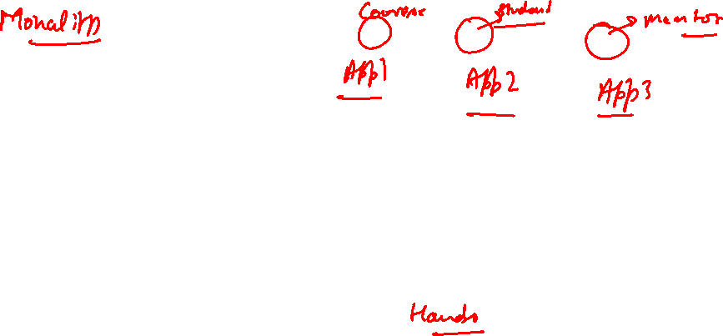
Agenda
In this Unit you will learn : -
Understand the fundamentals of microservices, including their architecture and the benefits they offer in developing scalable and modular applications.
Gain proficiency in creating a project structure suitable for microservices using Spring Boot.
Acquire practical knowledge of implementing microservices using Spring Boot, including building and deploying individual services, as well as managing their interactions and dependencies.
Develop an understanding of coding standards specific to microservices development.

Slide 3
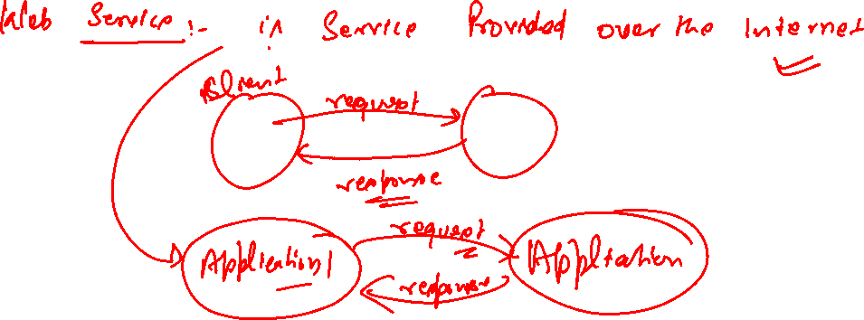
Learning Outcome:
Learn about Spring Boot Microservices

Slide 4
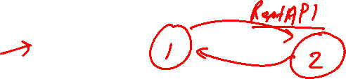
Web Services
Service which is delivered over the web
Output format which is consumed by other application.
Software system designed to support interoperable machine to machine interaction over the web.
Designed for machine to machine (application to application) interaction
Should be interoperable – Not platform dependent
Should allow communication over the network.

Slide 5
?
Q1 : How does data exchange between application takes place ?
Q2 : How can we make web service platform independent?
Request | Response object should be platform Independent.
Q3 : How does application know the format of Request and response ?
Service Definition :
Request | Response format (XML | Json)
Request Structure :
Response Structure :
End Point : url Exposed.

Slide 6
Introduction to Microservices
Microservices :-
architectural style that structures an application as a collection of small, loosely coupled, and independently deployable services.
Each microservice focuses on a specific business capability and operates as a separate entity that communicates with other services through well-defined APIs.
Microservices promote modularity, scalability, and flexibility in software development, allowing teams to work on different services independently, using different technologies and deployment strategies.

Slide 7

Microservices Architecture

Slide 8
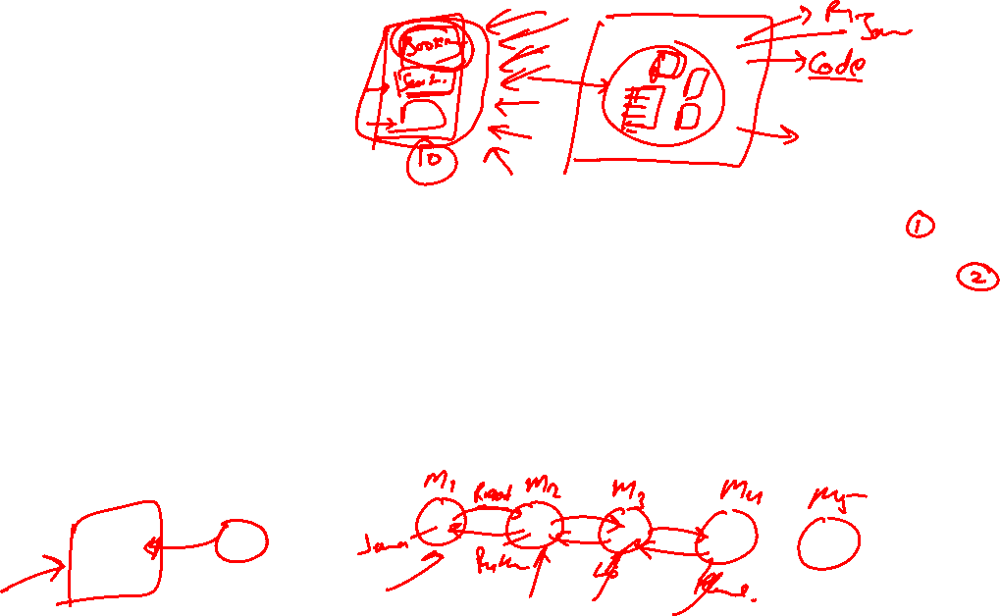
What is Monolith?
A Monolith is a large application.
Challenges :
Deployment Complexity :- Minor Updates need complete redeployment.
Tightly coupled Component : changes in one part of can affect others longer release cycle.
Scalability limitation: Scaling can be resources intensive. Entire app to be scaled even if only one part of it needs more capacity.
Technological Lock-In : Entire app built on single technology stack , adopting new technologies is challenging.

Slide 9
Definition
Small autonomous Services that work together.
Sem NewMan

Slide 10
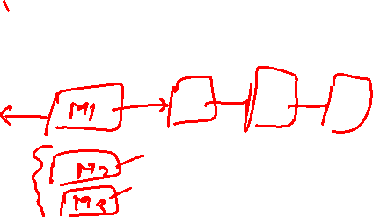
Understanding of microservices
REST : Your Micro Services should be built on top of light weight protocol like REST.
Built following rest api standard & Best Practices.
Small well chosen deployable units: Independently deployable units of small services.
Cloud Enabled: Possible t scaleup and down independent of each other.

Slide 11
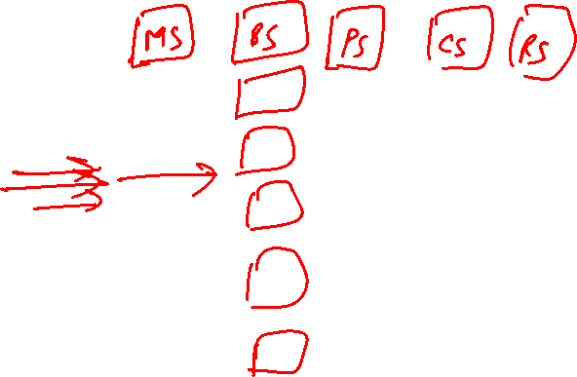
Example : Movie Application
Movie Service : Central service managing movie details, showtimes and availability.
Booking Service : Handle ticket booking , seat allocation and booking management.
Pricing Service : Manage ticket pricing discounts and special offers.
Customer Service : Manages customer profile , authentication and customer support.
Review Service : Allow user to submit and view reviews , ratings and comments
Microservice is target to provide small independent services which has a well defined boundaries and communicating with each other in lace of monolith application.

Slide 12
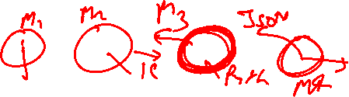
Advantages
New Technology & Process adoption : Team can adopt new technologies and process for individual services.
Flexibility : Choose best frameworks and languages for each services
Innovation : Easier to experiment and use emerging technologies.
Dynamic Scaling : Enable scaling and individual component based on demand.
Efficiency : scale only the services that need it reducing cost.
Faster release cycle : smaller independent services can be developed tested and deployed more quickly.
Agility : Allows more frequently updates and quicker response to market demands

Slide 13
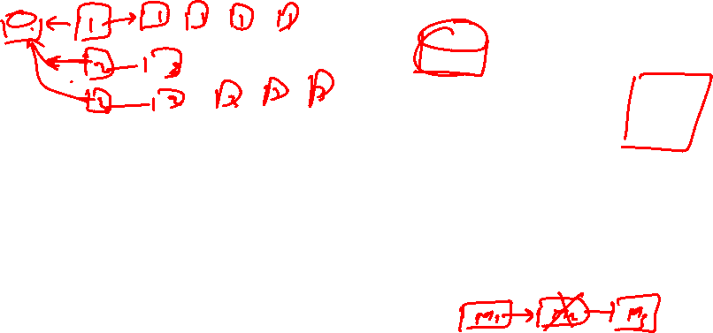
Challenges
Bounded Context : Defining clear boundaries for each service is crucial but challenging.
What should do : what should not do : @The Initial phase of development we don’t know the exact boundaries.
Configuration Management : Managing configuration for multiple services across environment can be complex.
100’s of microservices X multiple instances Y multiple environment Z.
Dynamic Scaling : Scaling services up or down in response to demand require robust infrastructure.
Visibility : Ensuring you have insights into services performance and health across the system is essential.
Need to Monitoring the system : Which microservices has an error : which is down : find bug: should be automated

Slide 14
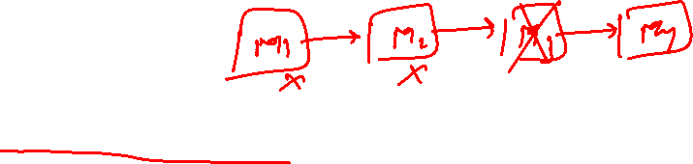
Interdependencies : Services can a “Pack of cards” where failure in one can affect.
Orchestration : Coordinating multiple services to work together seamlessly is critical and challenging.

Slide 15
Microservices architecture is an architectural style where an application is composed of multiple small, independent services that work together to fulfill business functionalities.
Here are some key aspects of microservices architecture:
Decentralized Data Management : each service has its own dedicated database or data store.
Service Independence and Autonomy : Each service is responsible for a specific business capability and operates independently of other services.
Scalability and Fault Tolerance : Microservices architecture enables horizontal scalability, where individual services can be scaled independently based on their specific demands. This allows efficient resource utilization and better handling of varying traffic patterns.

Slide 16
4. API Gateways and Service Discovery : an API gateway acts as a single entry point for clients to interact with the system. The API gateway handles requests from clients, performs necessary authentication, routing, and load balancing, and forwards the requests to the appropriate microservices.

Slide 17
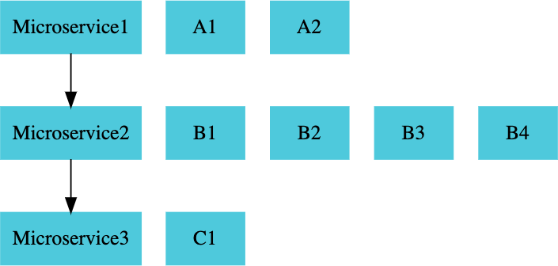
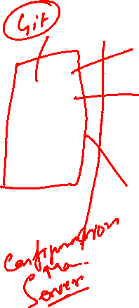

Slide 18
Challenges :
Bounded Context : Deciding the boundary is an Evolutionary process.
Configuration Management : There are many microservices with multiple instances . How is the Configuration Done?
Dynamic Scale Up and Scale Down : Load Balancing
Visibility : Need Monitoring | When service has an error | Which service is down | find bug | is Automated.
Pack of Cards : How we prevent if one service is down & rest services must be functional.

Slide 19
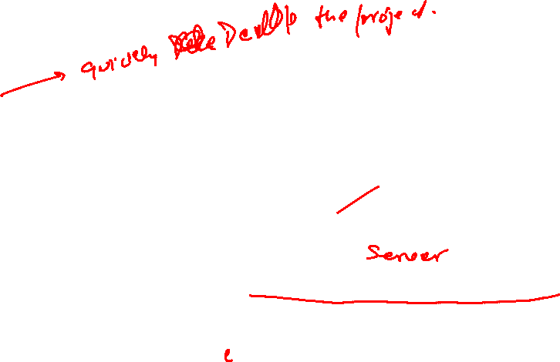
Key Solution
Spring Boot : Enables rapid development of rest API easy to setup and quickly deployable
Spring Cloud : Umbrella project that provides essential microservices needs.
Configuration Management : Centralized Configuration Manage Configuration for multiple Microservices in central git repository
Load Balancing : Distribute rquests across active instances of microservices dynamically.
Service discovery : Enables automatic discovery of microservices.
Not hard coded urls
Naming Server : Eureka server

Slide 20

Key Solution
Distributed Tracing : Single request might go through multiple microservice. Trace request across multiple microservices (Zipkin)
Edge Server : Single Entry Point : Implement common feature like authentication
Fault tolerance : Ensure that failure in one microservice does not cascade and make other microservice to fail. (Resiliance4j)
Spring Cloud provides you a number of solution wrt implement to microservices.

Slide 21
Key Solution
How do you ensure consistant deployment approach for all microservices
May implemented different languages .
May using different platforms.
Hence Docker Comes into the picture.
Consistent deployment approach for microservices programming languages and environment independent.

Slide 22
Key Solution
Kubernetes : orchestrate thousand of microservies with advanced features (service discovery , Load balancing ,Release management …… )

Slide 23
Spring Cloud
Spring Cloud Umbrella Projects
Centralized Configuration Management (Spring Cloud Config Server)
Location Transparency - Naming Server (Eureka)
Load Distribution (Ribbon, Spring Cloud Load Balancer) Visibility and Monitoring (Zipkin)
API Gateway (Zuul, Spring Cloud Gateway)
Fault Tolerance (Hystrix, Resilience4j)

Slide 24
Microservices - Advantages
New Technology & Process Adoption
Dynamic Scaling
Faster Release Cycles

Slide 25
Need for Centralized Configuration :
Lot of configuration required handled by Spring Cloud Config Server :
Provide an approach where you can store all the configuration different environment of all the different microservices in just one place.
Hence it becomes easy to maintain.

Slide 26

Standard Port
Application | Port
Course Microservice | 8080, 8081, ...
Spring Cloud Config Server | 8888
Currency Exchange Microservice | 8000, 8001, 8002, ..
Currency Conversion Microservice | 9000,9001,9002, …..
Netflix Eureka Naming Server | 8761
API Gateway | 8765
Zipkin Distributed Tracing Server | 9411

Slide 27
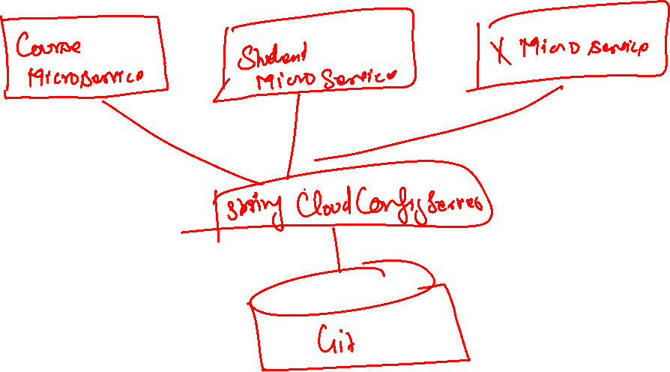
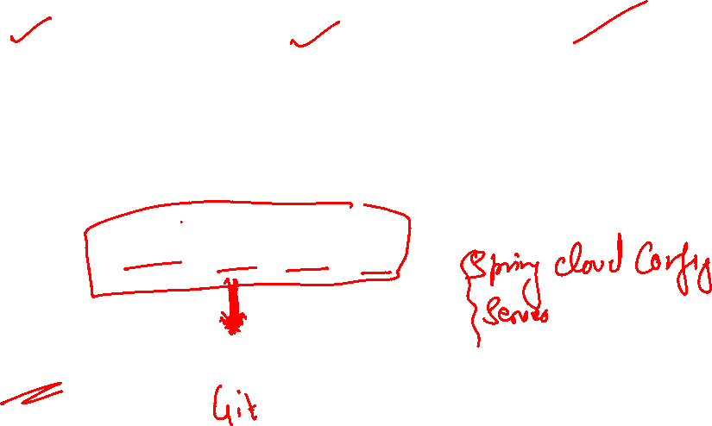
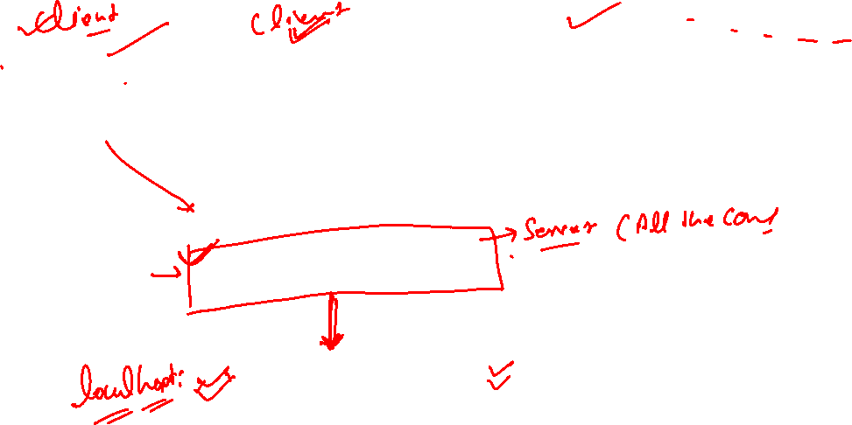


Slide 28
URL
Application | Url
Course Microservice | http://localhost:8080/courses
Spring Cloud Config Server | http://localhost:8888/courses-service/default http://localhost:8888/courses-service/qa http://localhost:8888/courses-service/dev
Mentor Microservice | http://localhost:8000/mentor-service/{mname}/
Netflix Eureka Naming Server | 8761
API Gateway | 8765
Zipkin Distributed Tracing Server | 9411

Slide 29
Check if you have the right repository url in
/src/main/resources/application.properties
- spring.cloud.config.server.git.uri=file:///C:/path/microrepo
Do not have any spaces in your git repository path.
If you are on windows, make sure that you are using one of these formats for your git repository
file:///C:/microservices/git-localconfig-repo
file:\\C:/WORKSPACE/GIT/git-localconfig-repo
file:///C:/Users/Gautham/Documents/workspace-sts-3.9.4.RELEASE/git-localconfig-repo
file:\\C:/Users/Gautham/Documents/workspace-sts-3.9.4.RELEASE/git-localconfig-repo
Make sure that you have committed all the code to GIT Local Repo

Slide 30
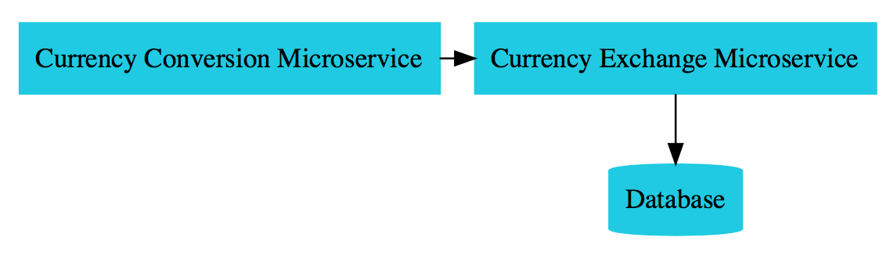
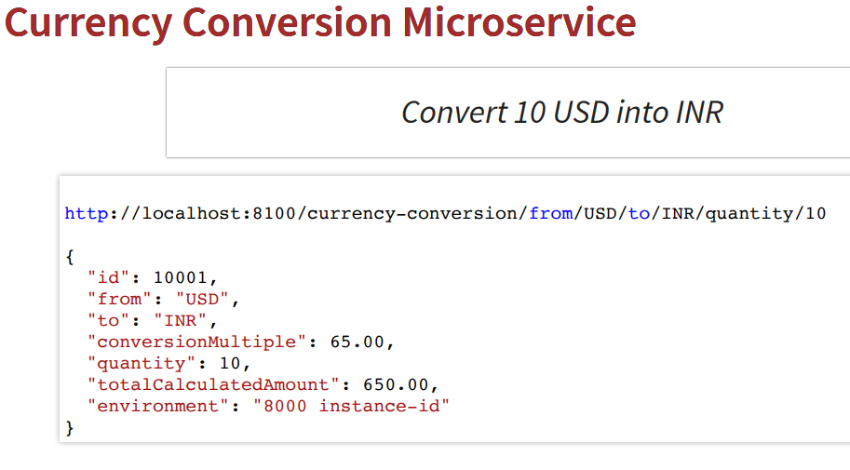
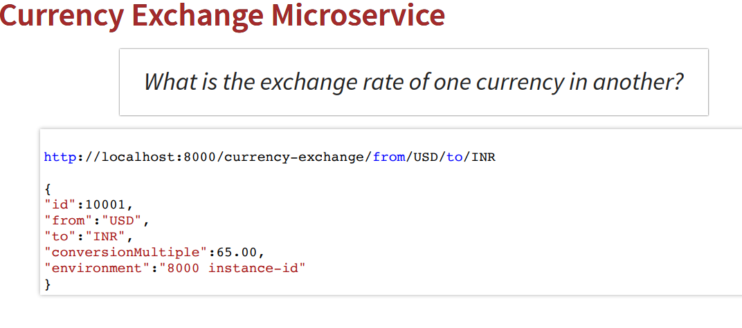
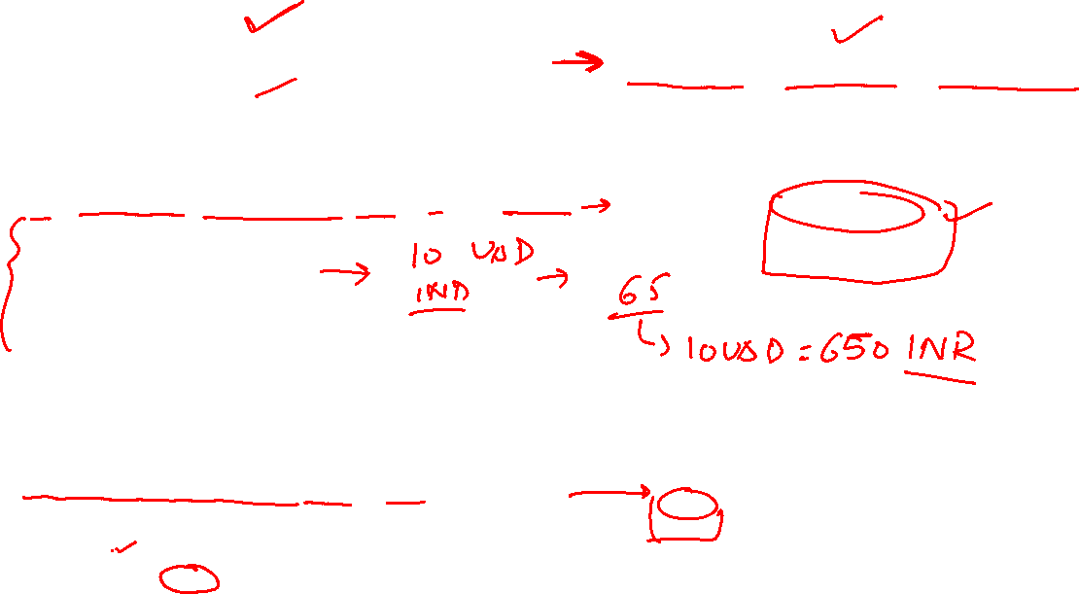

Slide 31

Currency-Exchange | Currency-Conversion
Spring Web
Actuator
Data JPA
MySql Connector
Devtools
ConfigClient

Slide 32
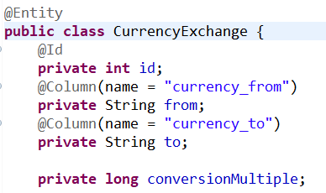
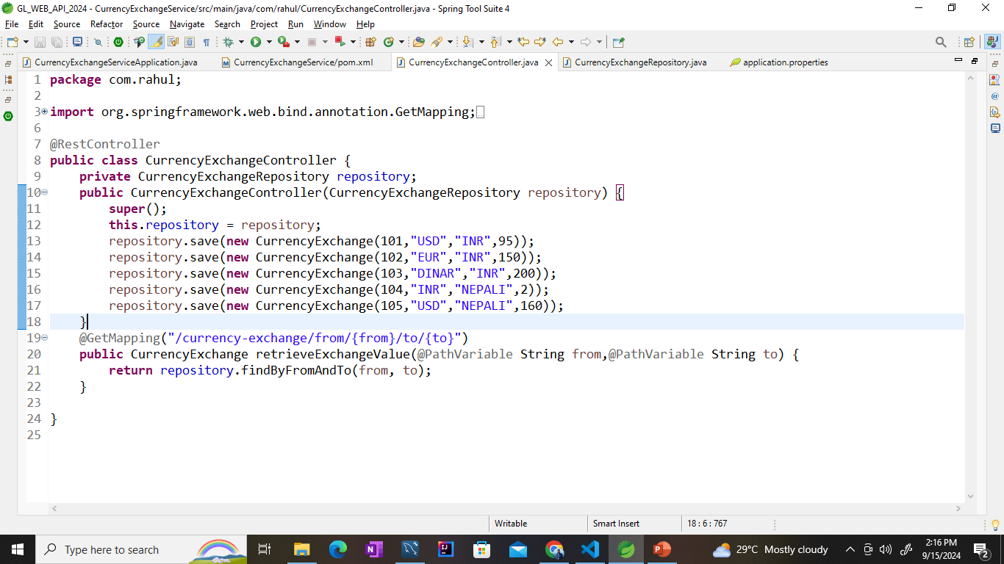
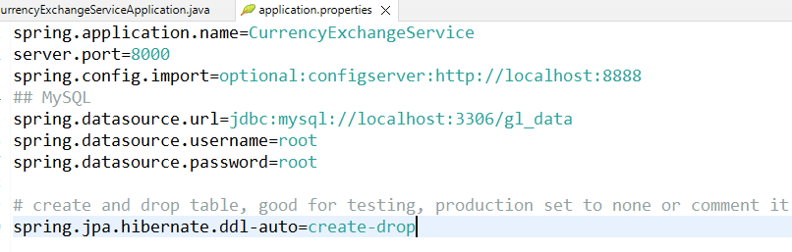
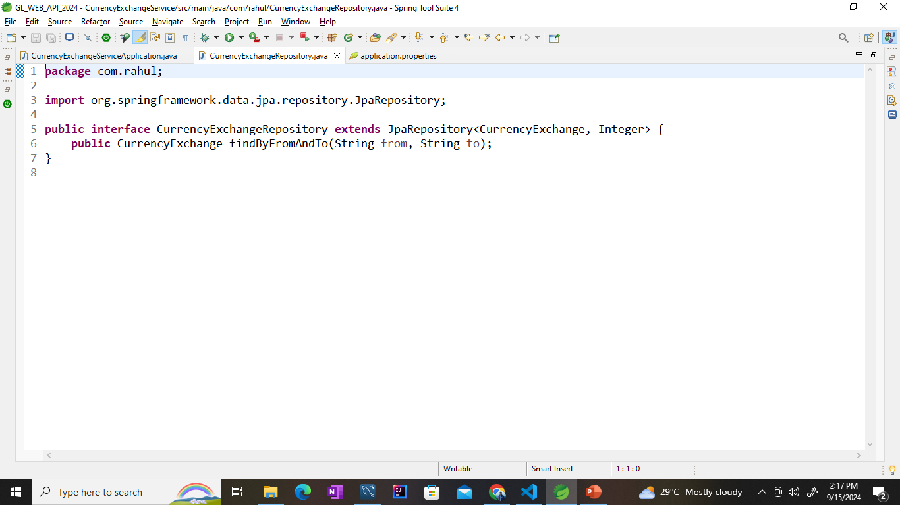

Currency-Exchange-Bean

Slide 33
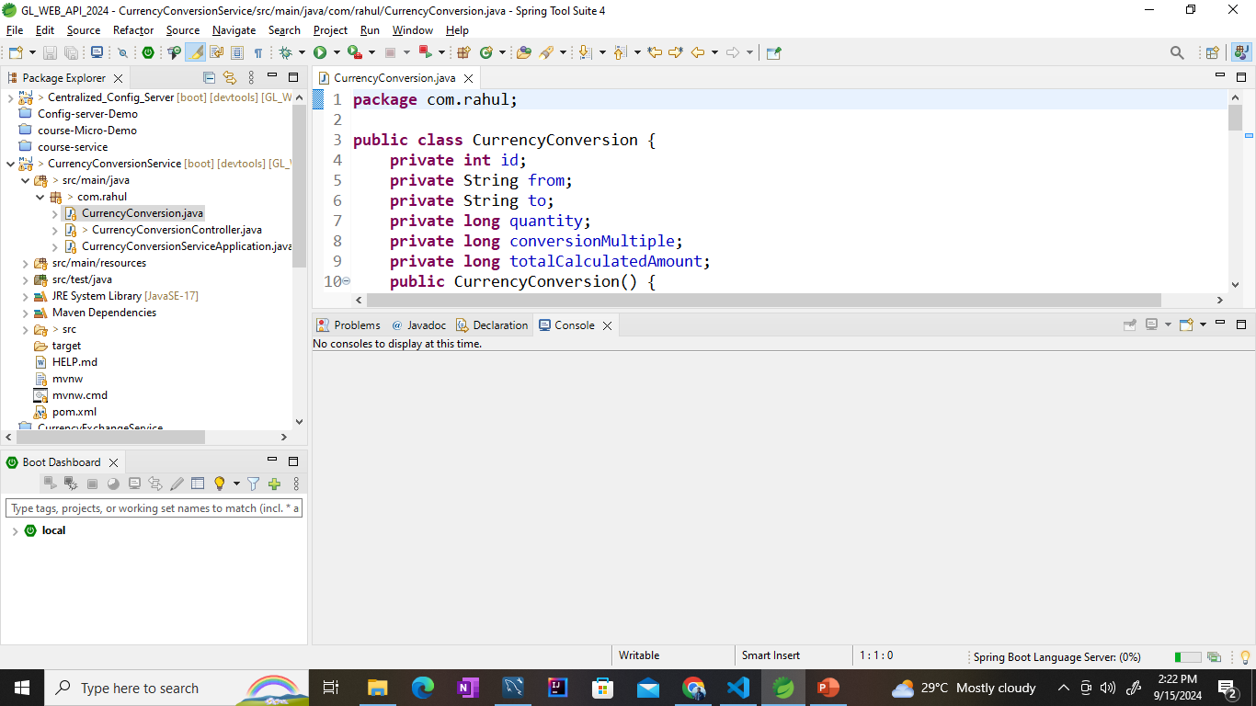
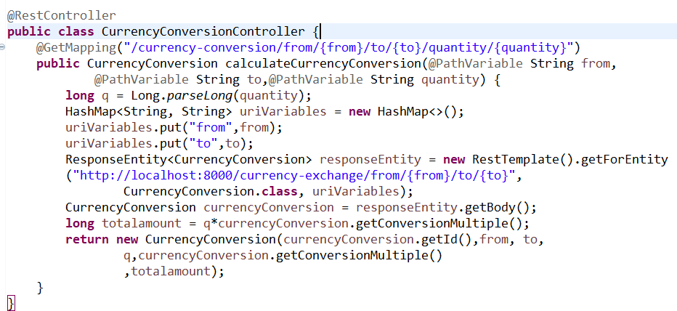
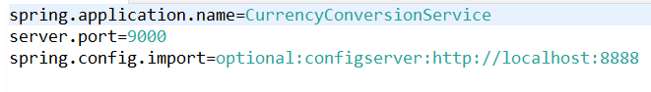
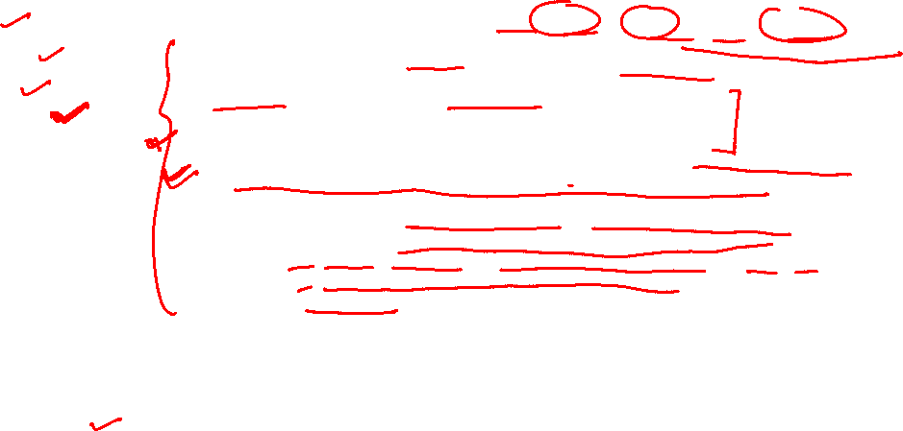
Currency-Conversion

Slide 34
Currency-Conversion

Slide 35

5 min break
This a 5 min break for you
Have a glass of water
Take a deep breath
Note down any doubt you have till now
Join back
DO NOT WRITE ANYTHING
HERE. LEAVE THIS SPACE FOR
WEBCAM

Slide 36
Any doubts?

Slide 37
Summary
Point 1
Point 2
Point 3
DO NOT WRITE ANYTHING
HERE. LEAVE THIS SPACE FOR
WEBCAM

