Slide 1

MACHINE LEARNING PROJECT
GD Arena
ML-Based Group
Discussion Practice
Practice your perspective.
Understand the other side.
Presented by: [Your Name]
[Roll Number] · [Course / College]
PROJECT PRESENTATION
Notes:
Good morning. My project is GD Arena, a machine-learning-based application for interview-style group discussion practice. Users choose a topic, speak or type their point, and practise with three virtual partners in a meeting-style interface. The project combines a trained text stance classifier, pretrained speech recognition, and a Python web application. The aim is to make individual practice easier and help users explore different perspectives. I will explain the application, its workflow, the training process, the technology stack, and the results.
Photo credit: Monstera Production / Pexels, “Diverse students discussing project at table.” Illustrative stock photograph, not a photograph of the project's users. https://www.pexels.com/photo/diverse-students-discussing-project-at-table-6238033/

Slide 2
PROJECT OVERVIEW
A practice room for interview-style GDs
THE NEED
10
Preset topics
Practising alone makes it
hard to hear different
points of view.
AI and jobs, remote work, skills vs degrees
03
Virtual practice partners
Supportive, challenging and neutral perspectives
GD Arena brings topic-based discussion,
voice input and stance feedback into
one guided practice session.
01
Complete practice session
Choose a topic, contribute, review your recap
Goal: practise expressing, challenging and clarifying ideas.
GD ARENA / ML TRAINING PROJECT
02 / 07
Notes:
This project addresses a practical need: a student may want to practise a group discussion when other people are not available. GD Arena offers ten predefined topics and three virtual partners. Aanya offers supporting perspectives, Kabir challenges assumptions, and Riya asks for clarity. Their responses come from prepared topic content. The user can practise with voice or text and review the discussion afterwards. The system predicts whether a contribution supports, opposes or stays neutral toward the selected topic proposition. This prediction is not an interview score, a grammar score or a measure of speaking confidence.
Sources: project topics.json, server.py, gd_arena.py, README.md and the live application's meeting interface in outputs/gd_arena_model/.

Slide 3
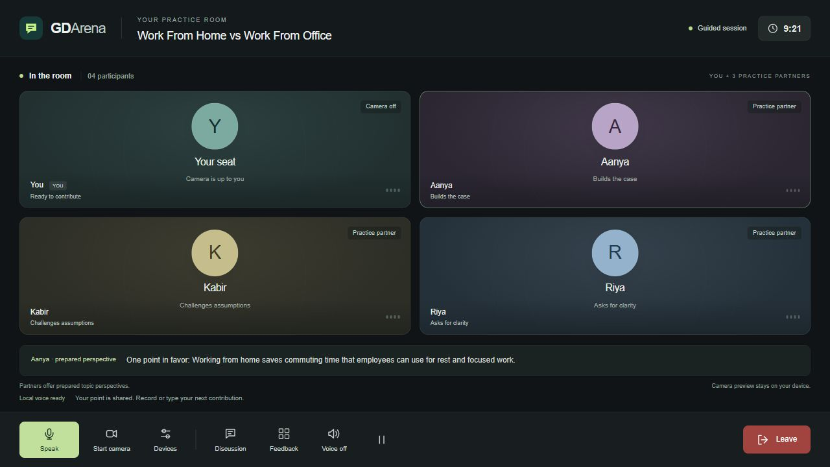
APPLICATION DEMO
A meeting-style interface for practice
One user + three virtual practice partners. Camera is optional.
01
Voice + text
Speak, type or upload audio.
02
Pause to share
Recording ends after 2 seconds of silence.
03
Optional webcam
Camera off shows an avatar.
04
Session recap
Review feedback and download the transcript.
GD ARENA / ML TRAINING PROJECT
03 / 07
Notes:
This is an actual screenshot of the working application. The four tiles represent the user and the three virtual practice partners. A user can turn on their webcam, but it is optional; with the camera off, the tile shows an avatar. The user can select the microphone, record speech, type a point or upload a recording. When the pause-sharing option is enabled, recording finishes after two seconds of silence following speech. English points can then be shared automatically when eligible. Hindi or Hinglish transcripts need an English review before they are used by the stance model. The application also includes a session timer, voice playback, discussion history and a recap.
Source: actual project screenshot outputs/GD_Arena_Loading_Fixed.png. Implementation: web/app.js, camera.js and server.py in the project. The screenshot contains prepared virtual perspectives, not a live video call.

Slide 4
SYSTEM WORKFLOW
From a spoken idea to a practice response
First choose a topic. Its proposition provides context for the model and the reply.
Speak / upload
Stance model
Pretrained Whisper
converts audio to text
TF-IDF + Logistic Regression
Support / oppose / neutral
English draft
Session
Review and share
your point
Feedback + reply
Optional voice playback
Continue → recap
Type a point
Topic reply
Direct text input
Retrieve a prepared
partner perspective
LANGUAGE SUPPORT
Hindi / Hinglish speech is transcribed; review it in English before stance analysis.
GD ARENA / ML TRAINING PROJECT
04 / 07
Notes:
The user begins by selecting a topic. There are two input paths. For voice, the browser records audio and the Python server uses a pretrained Whisper model to transcribe it. Typed text enters directly. Both paths produce a draft that the user can review. The stance model expects English and uses the selected topic proposition as context. After a point is shared, two separate operations occur: the trained classifier predicts the stance, and a retrieval component chooses a prepared partner perspective for that topic and role. The response may be read aloud using browser speech synthesis. The session continues until the user leaves and reviews the recap. Whisper was not trained in this project, and the partner replies are retrieved rather than freely generated by a large language model.
Sources: outputs/gd_arena_model/server.py and gd_arena.py; https://github.com/SYSTRAN/faster-whisper .

Slide 5
ML TRAINING
Training the stance classifier
Three labels: support, oppose and neutral — relative to the topic proposition.
11,484
AUTHORED GD DATASET
300 English examples
training examples
10 topics × 3 labels × 10 examples
11,304 cleaned VAST examples
+ 180 authored GD examples
180 train / 60 validation / 60 test
01 Prepare
02 Vectorize
03 Compare
04 Select
Clean + split data
Fit TF-IDF on train only
Logistic Regression / SVM
Save Logistic Regression
Selection uses validation macro-F1. Final results use held-out test sets.
GD ARENA / ML TRAINING PROJECT
05 / 07
Notes:
The project trains its own stance classifier. Its training set contains 11,484 examples: 11,304 cleaned examples from the public VAST dataset and 180 authored GD examples. The complete authored dataset has 300 English examples across ten topics and three stance labels, with 180 training, 60 validation and 60 test examples. These authored examples are assistant-generated synthetic material, so they are not an independent real-user benchmark. The feature pipeline combines argument word TF-IDF, character TF-IDF, target words and target-word pair features. It is fitted only on training data. A majority baseline, Logistic Regression and Linear SVM were compared. Logistic Regression was selected using the mean macro-F1 on the two validation sets. It is a one-vs-rest classifier, saved with joblib. Test data was reserved for final evaluation.
Sources: outputs/gd_arena_model/artifacts/metrics.json, RESULTS.txt, DATA_SOURCES.txt and training code. VAST: Emily Allaway and Kathleen McKeown (2020), https://aclanthology.org/2020.emnlp-main.717/ ; https://github.com/emilyallaway/zero-shot-stance .

Slide 6
TECHNOLOGY STACK
Python ML with a browser-based interface
Layer | Technology | Role in the project
Frontend | HTML, CSS, JavaScript | Meeting room, controls and feedback
Backend | Python 3.12 · ThreadingHTTPServer | JSON API and local application server
Machine learning | scikit-learn · TF-IDF · Logistic Regression | Text features and stance prediction
Data & model storage | NumPy · SciPy · CSV · joblib | Sparse features, datasets and saved model
Voice & camera | faster-whisper · Browser media APIs | Transcription, recording, speech and webcam
Development | VS Code · Google Colab · Matplotlib | Local demo, training notebook and plots
Local Python demo • No paid API key required • Colab notebook included
GD ARENA / ML TRAINING PROJECT
06 / 07
Notes:
The frontend is built with plain HTML, CSS and JavaScript. The server is written in Python and uses ThreadingHTTPServer from the standard library to serve the interface and JSON endpoints. The machine-learning pipeline uses scikit-learn for TF-IDF and Logistic Regression. NumPy and SciPy support numerical and sparse feature processing, while CSV files hold datasets and joblib stores the trained model. The voice recognizer is faster-whisper with the pretrained Whisper tiny model. In the browser, MediaRecorder captures audio, speechSynthesis reads replies, and getUserMedia provides optional webcam access. VS Code is used for the local project, and Google Colab notebooks support training and demonstration. The local demo does not require a paid API key.
Sources: outputs/gd_arena_model/requirements.txt, server.py, gd_arena.py and web/app.js; provided Google Colab notebooks. faster-whisper: https://github.com/SYSTRAN/faster-whisper .

Slide 7
EVALUATION & NEXT STEPS
Results, limitations and future scope
HELD-OUT TEST RESULTS
Test dataset | Examples | Accuracy | Macro-F1
Cleaned public VAST | 2,907 | 43.31% | 0.387
Authored GD examples | 60 | 63.33% | 0.638
The GD test set is small and synthetic; it is not an independent real-user benchmark.
What works
Current limitation
Next improvements
An end-to-end voice/text demo
with a trained stance classifier.
Stance prediction is imperfect;
it does not grade interview quality.
Real-user labelled data, stronger
models and multilingual support.
GD ARENA / ML TRAINING PROJECT
07 / 07
Notes:
The selected Logistic Regression model achieved 43.31 percent accuracy and about 0.387 macro-F1 on 2,907 cleaned public VAST test examples. On the 60 authored GD test examples, it achieved 63.33 percent accuracy and about 0.638 macro-F1. Accuracy measures the proportion of correct predictions. Macro-F1 averages the F1 score equally across all three labels, which helps assess class balance. These numbers show that the demo works but classification remains imperfect, especially beyond its authored topic examples. The GD test data is small and synthetic, and the cleaned VAST setup is not directly comparable with the original paper's reported experiments. The application should therefore be presented as an educational prototype, not a validated interview evaluator. Future work includes independent real-user annotations, stronger contextual models and better multilingual handling. I would now demonstrate one topic, submit a point and show the response and recap.
Sources: outputs/gd_arena_model/artifacts/metrics.json and RESULTS.txt. Exact macro-F1: VAST 0.3868; authored GD 0.6376. No calibrated confidence or interview-quality score is claimed.

