Slide 1
Server Less AWS
@Venky

Slide 2
What is Server ?

Slide 3
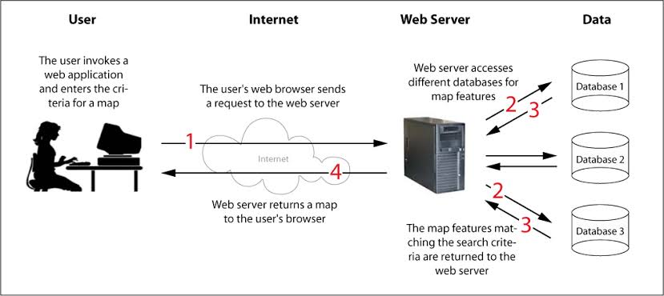

Slide 4
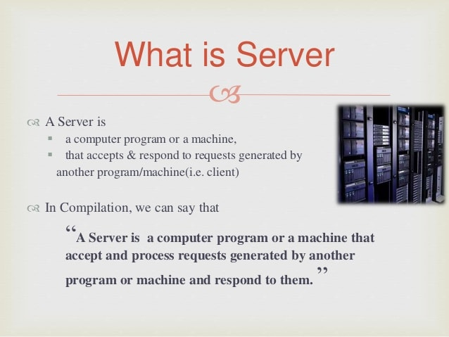

Slide 5
What is Serverless ?

Slide 6
Serverless is a way to describe the services, practices, and strategies that enable you to build more agile applications so you can innovate and respond to change faster. With serverless computing, infrastructure management tasks like capacity provisioning and patching are handled by AWS, so you can focus on only writing code that serves your customers.

Slide 7
Serverless Services on AWS?

Slide 8
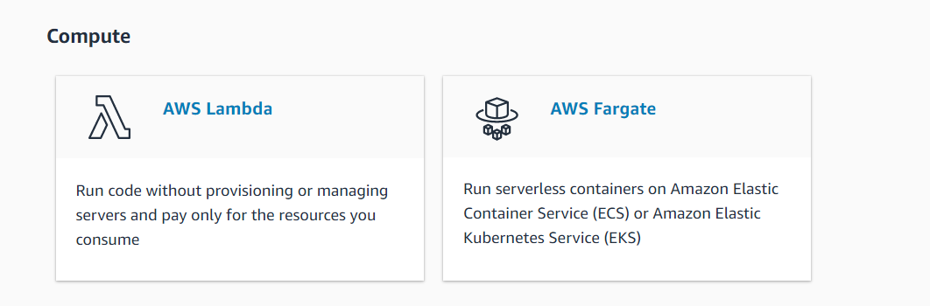

Slide 9
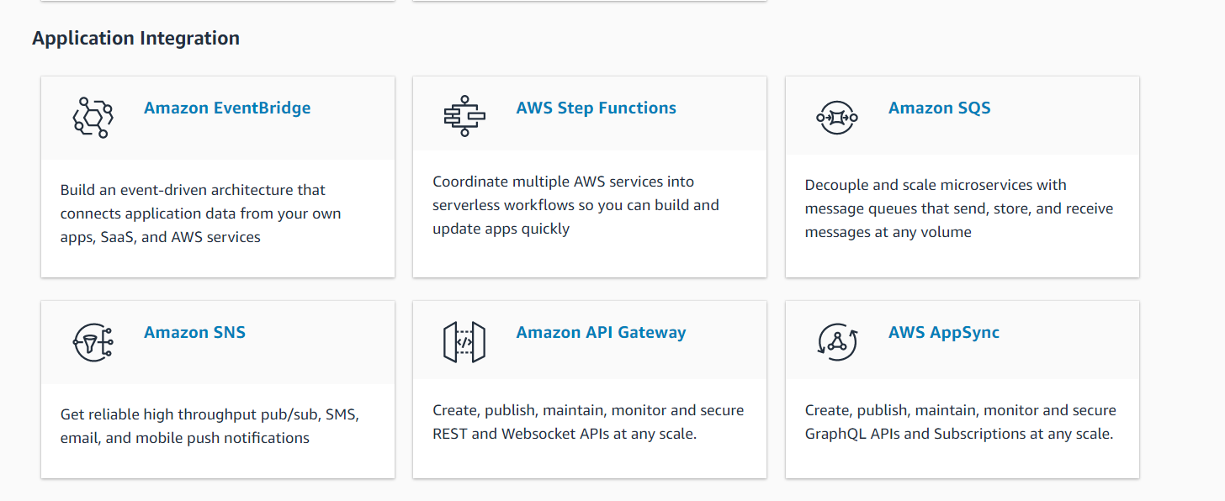

Slide 10
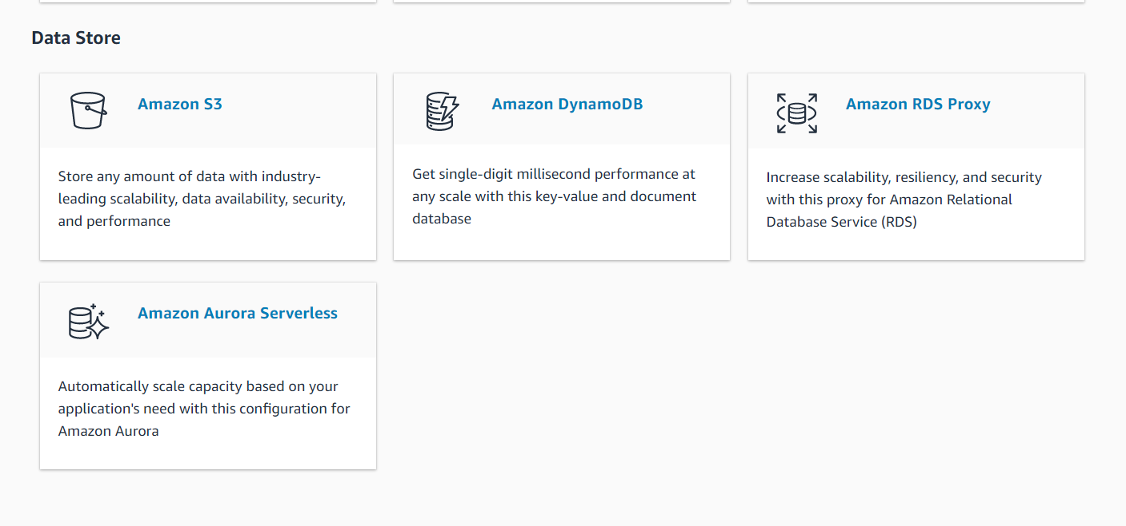

Slide 11


Slide 12
Amazon released Lambda in 2015.
What is Lambda?
Lambda is used to encapsulate Data centres, Hardware, Assembly code/Protocols, high-level languages, operating systems, AWS APIs.
Lambda is a compute service where you can upload your code and create the Lambda function.
Lambda takes care of provisioning and managing the servers used to run the code.
While using Lambda, you don't have to worry about scaling, patching, operating systems, etc.

Slide 13
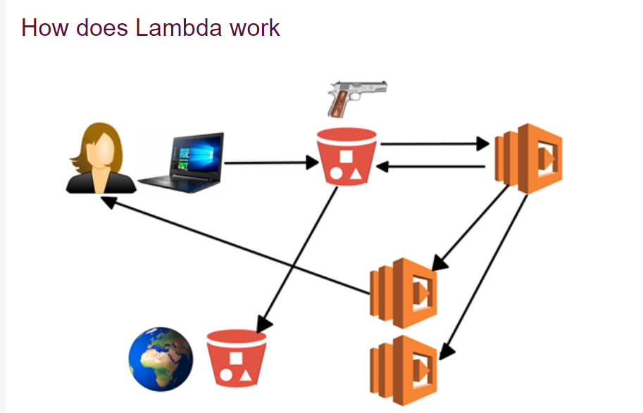


Slide 14
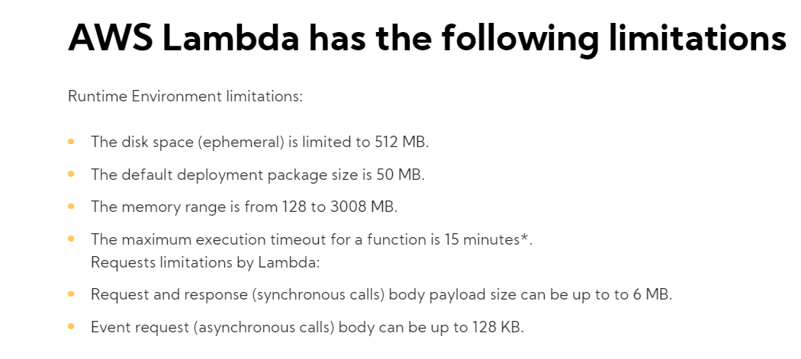


Slide 15
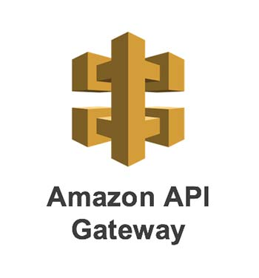
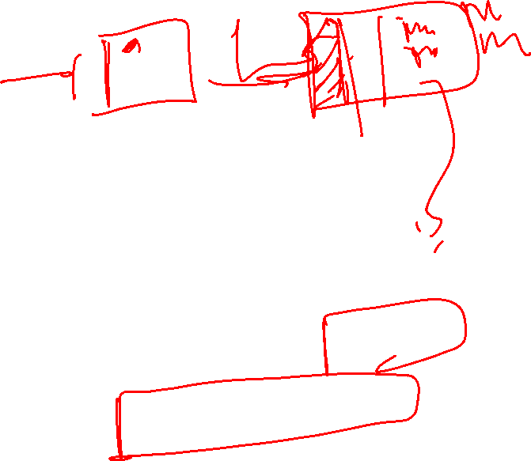

Slide 16
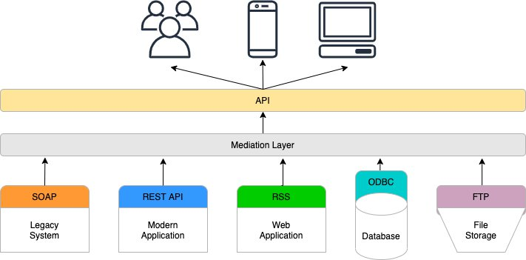

Slide 17
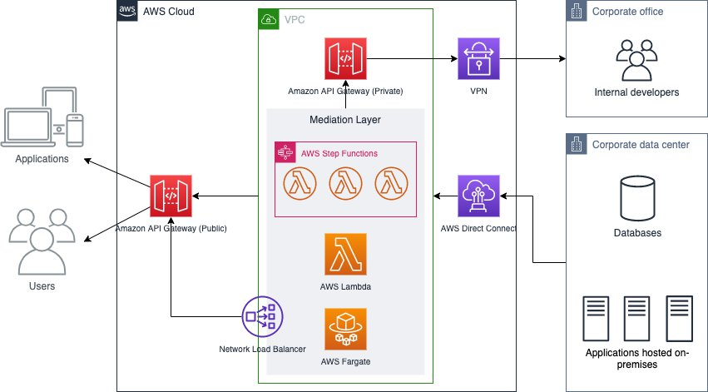

Slide 18
Why it is recommended to interact with AWS using CLI during serverless development and deployment

Slide 19
What are the benefits of AWS SAM?

