Slide 1
Google Search Engine

Slide 2
Functional Requirements:
Search engine
Web Crawling
Non-functional Requirements:
Latency : 300ms – 1sec
Storage:
100B unique pages on internet. Each page is 1MB on avg. 100B*1 = 1PB storage daily for Web
1B users their metadata and search history = 1B*10*500Bytes = 57 MB per day.
Scalability:
Users: 1B users use Google daily
Reads: Each user on avg does 10 searches a day. 1B*10 = 10B requests daily. 1.1 K TPS
Write: 100B unique pages on internet.

Slide 3
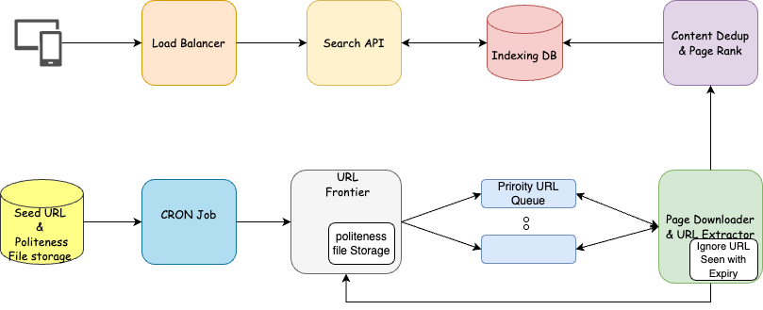
Url Frontier: Takes URL as Input. Maintains ParentUrL last queried and to not send the subdomain URL to URL Queue till politeness time is obeyed. The URLs that go to URL Frontier are sticky.
URL Queue: The URL is sticky to the Queue it has to go. URL which will have frequent update will go to a different queue. URL which has less update will go to a different queue. The stickiness can be determined by hash of the parent URL.
Page Download & URL Extractor: Downloads page from internet. Parses the page and sends content to ContentDedup. Extracts URLs from Downloaded page and sends to URL Frontier
CRON Job: Loads the Seed URLs and Politeness file into URL Frontier.
Content Dedup: Dedup the content of the page if it already exists. This can be done using bloom filter.
URL Queue: The URL is sticky to the Queue it has to go to always same queue. Each URL will have a priority <ReceivedAtTime+WaitTime>.
Page Download & URL Extractor: Downloads page from internet. Parses the page and sends content to ContentDedup. Extracts URLs from Downloaded page and sends to URL Frontier

Slide 4
References:
InterviewPen: https://www.youtube.com/watch?v=0LTXCcVRQi0
System Design distributed web crawler to crawl Billions of web pages: https://www.youtube.com/watch?v=BKZxZwUgL3Y&t=1992s
How Google searches one document among Billions of documents quickly? : https://www.youtube.com/watch?v=CeGtqouT8eA

