Slide 1
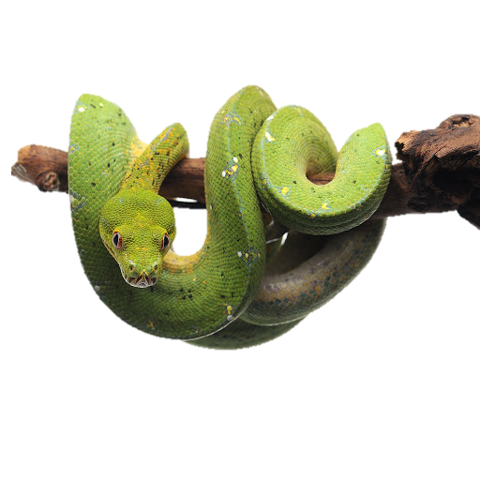

Introduction to Python (Part II)
Materials developed by McKenna Burns and Mehrnaz Afkhami

Slide 2

Lists Review
What is a List?
A list is a group of data that separated by commas, surrounded by square brackets, and has a list name.
>>> weekdays = ['Monday', 'Tuesday', 'Wednesday', 'Thursday', 'Friday']
>>> birds = ['emu', 'ostrich', 'cassowary']
Make a list of your 3 favorite animals in order of how much you like them with the name favanimal= ['','',''] and call that list now.

Slide 3
Lists Review
What is a List?
A list is a group of data that separated by commas, surrounded by square brackets, and has a list name.
>>> weekdays = ['Monday', 'Tuesday', 'Wednesday', 'Thursday', 'Friday']
>>> birds = ['emu', 'ostrich', 'cassowary']
Make a list of your 3 favorite animals in order of how much you like them with the name favanimal= ['','',''] and call that list now.

Slide 4
Lists Review
What is a List?
Lists can be ANY data type, even within the same list!
>>> weekdays = [‘John', '123', '1.23', 'Friday']
>>> birds = ['emu', 'ostrich', 'cassowary']
And they can be empty!
>>> empty_list = [ ]

Slide 5
Lists Review
How do we Access List Elements or Items?
We can extract a single value from a list by specifying its offset (just like we did with strings!).
0
1
2
>>> sequences = ['AAA', 'TTT', 'GGG’]
>>> sequences[0]
'AAA'
>>> sequences[1]
'TTT’
NOTE! The first element is 0!

Slide 6

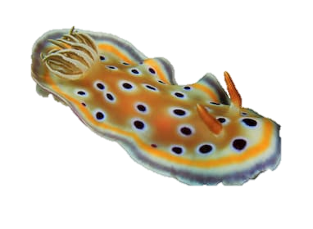
Lists Review
How do we Access List Elements or Items?
What is your second favourite animal in your list?
0
1
2
>>> favanimal = ['Fox', ‘Otter', 'Nudibranch']
>>> sequences[1]
‘Otter'

Slide 7
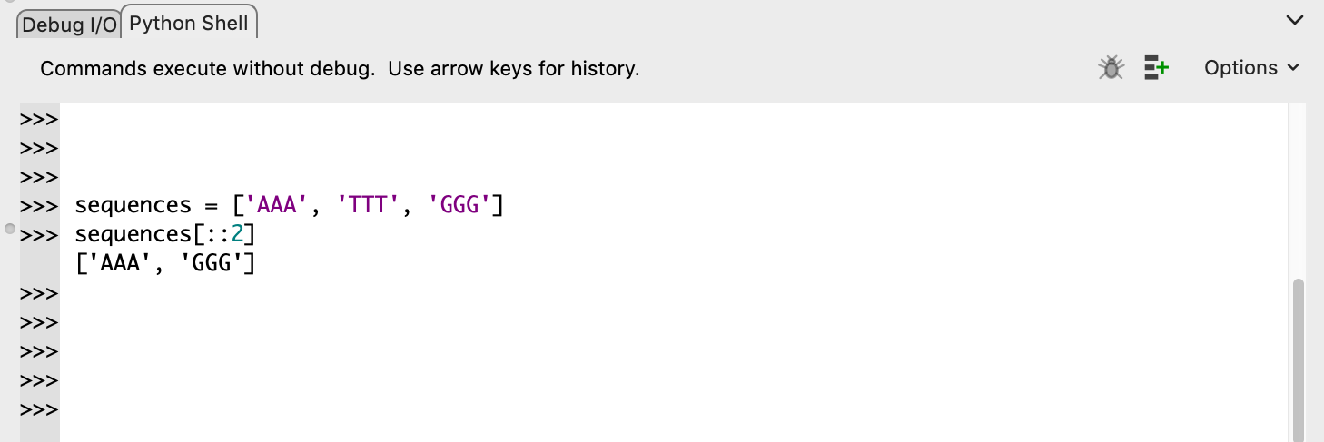
Lists
Get a Slice to Extract Items by Offset Range
Extract a subsequence of a list by using a slice
>>> sequences = ['AAA', 'TTT', 'GGG']
>>> sequences[0:2]
['AAA', 'TTT']
# get items from position 0 and 1
As with strings, slices can step by values other than one.
>>> sequences[::2] # get the first element and jump by two
['AAA', 'GGG']

Slide 8

A little bit about functions, You will learn much more later in the course:
A Function is a block of code.
You can run functions by calling them
In python functions look like this
Function_name()
Pay attention to the parenthesis!

Slide 9
List Functions and Methods
len() is a function that returns the number of items in the list
>>> sequences = ['AAA', 'TTT', 'GGG’, ‘CCC’]
>>> len(sequences)
4

Slide 10
List Functions and Methods
len() is a function that returns the number of items in the list
Use the len() function on you favanimal [] list to make sure it works.

Slide 11
List Functions and Methods
>>> ages = [23, 16, 14, 28, 19, 11, 38]
>>> youngest = min(ages)
>>> oldest = max(ages)
>>> total_years = sum(ages)
min() -- returns the smallest number of items in the list
max() -- returns the largest number of items in the list
sum() -- returns the total of all numbers in the list

Slide 12
List Functions and Methods
>>> ages = [23, 16, 14, 28, 19, 11, 38]
>>> youngest = min(ages)
>>> oldest = max(ages)
>>> total_years = sum(ages)
>>> youngest
11
>>> oldest
38
>>> total_years
149
min() -- returns the smallest number of items in the list
max() -- returns the largest number of items in the list
sum() -- returns the total of all numbers in the list

Slide 13
List Functions and Methods
Now use these functions on the list we’ve typed into Zoom chat (it’s too big to do by hand!) First person to get all three correct in Zoom chat wins.
min() -- returns the smallest number of items in the list
max() -- returns the largest number of items in the list
sum() -- returns the total of all numbers in the list

Slide 14
List Functions and Methods
list.sort() -- sort the list itself, in place.
Question for the students: What is the difference between list.sort() and sort()?
>>> sequences = ['AAA', 'TTT', 'GGG']
>>> sequences.sort()
>>> sequences
['AAA', 'GGG', 'TTT']
>>> numbers = [2, 1, 4.0, 3]
>>> numbers.sort()
>>> numbers
[1, 2, 3, 4.0]

Slide 15
Control Statements
Do not mix space and tab together!!!
Indentation
Code blocks are defined by their indentation.
Leading whitespace (spaces and tabs) at the beginning of a logical line is used to compute the indentation level of the line.
Block 1
if attr==-1:
while x<5:
print("Waiting...")
#wait(1)
x = x + 1
print("Everything is OK")
else:
print("There is an error")
Block 2
Block 3
Block 2, continuation
Block 1, continuation

Slide 16
Indentation
Indentation gives priority to a line of code, lets look at our example
Our machine will this check first.
If the statement does not hold it will go directly to else.
if attr==-1:
while x<5:
print("Waiting...")
#wait(1)
x = x + 1
print("Everything is OK")
else:
print("There is an error")
If our statement is true the machine will run the code indented under it.

Slide 17
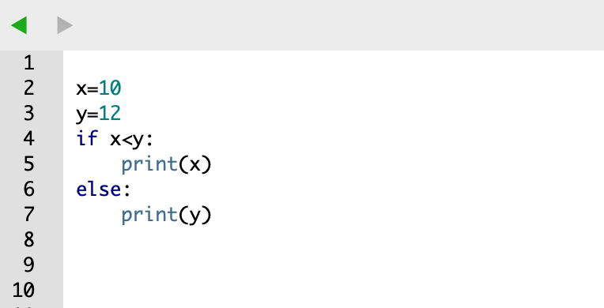
Control Statements
Conditional Statements: IF-ELSE
If statement evaluates an expression. If the expression is true, the block of code just after the if clause is executed. Otherwise, the block under else is executed.
if EXPRESSION1:
STATEMENT1
elif EXPRESSION2:
STATEMENT2
elif EXPRESSION3:
STATEMENT3
else:
STATEMENT4
elif is optional, you can use as many elif’s as you want.

Slide 18
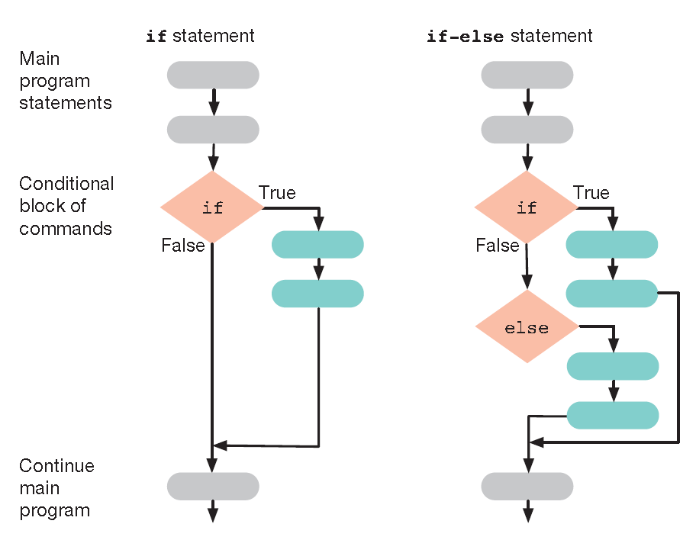
Control Statements
Conditional Statements: IF-ELSE
Take into account that once a condition is evaluated as true, the remaining conditions are not checked.
if EXPRESSION1:
STATEMENT1
elif EXPRESSION2:
STATEMENT2
elif EXPRESSION3:
STATEMENT3
else:
STATEMENT4
if EXPRESSION1:
STATEMENT1
if EXPRESSION2:
STATEMENT2
if EXPRESSION3:
STATEMENT3
if EXPRESSION4:
STATEMENT4
VS.
What’s the difference between these two?

Slide 19
Fill in the bubbles with our Example

Slide 20
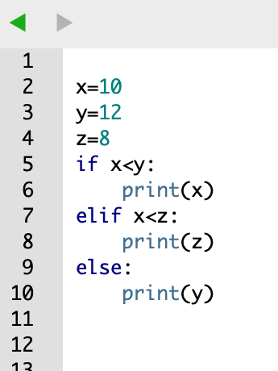
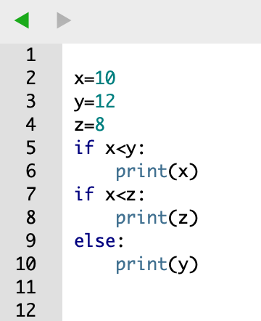
Control Statements
Conditional Statements: IF-ELSE
Take into account that once a condition is evaluated as true, the remaining conditions are not checked.
VS.
10
12
10

Slide 21
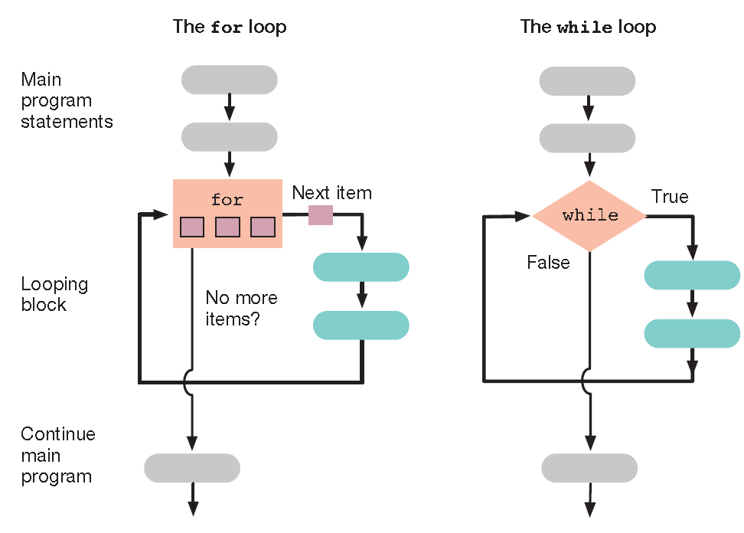
Control Statements
Loops: for and while loops
A loop is a block of statements that gets executed repeatedly as long as some condition is true.

Slide 22
Fill in the bubbles with our Example

Slide 23
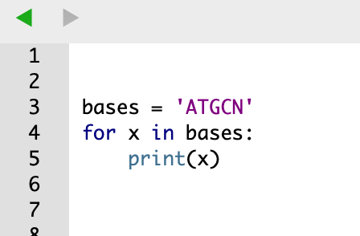
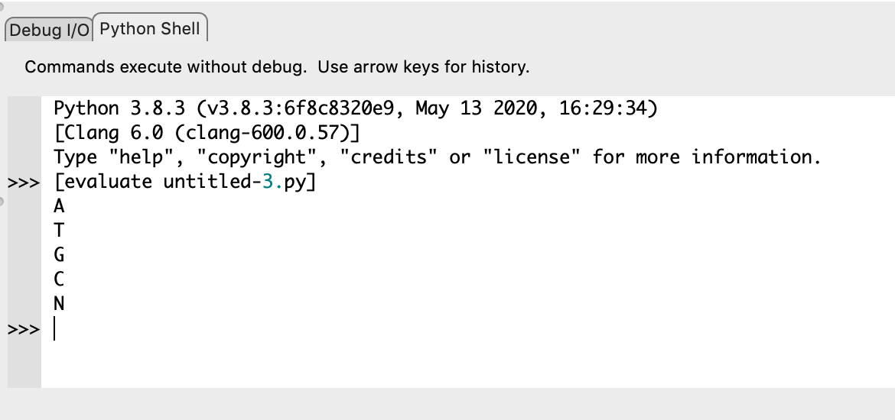
Control Statements
Loops: for loops
A for loop structure allows code to be repeatedly executed while keeping a variable with the value of an iterable object.
Iterable objects: lists, tuples, strings and dictionaries.
A for loop structure:
for VAR in ITERABLE:
Statement
bases = 'ATGCN'
for x in bases:
print(x)
A
T
G
C
N

Slide 24
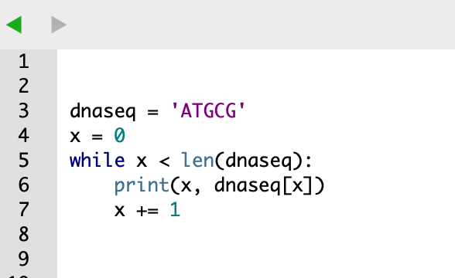
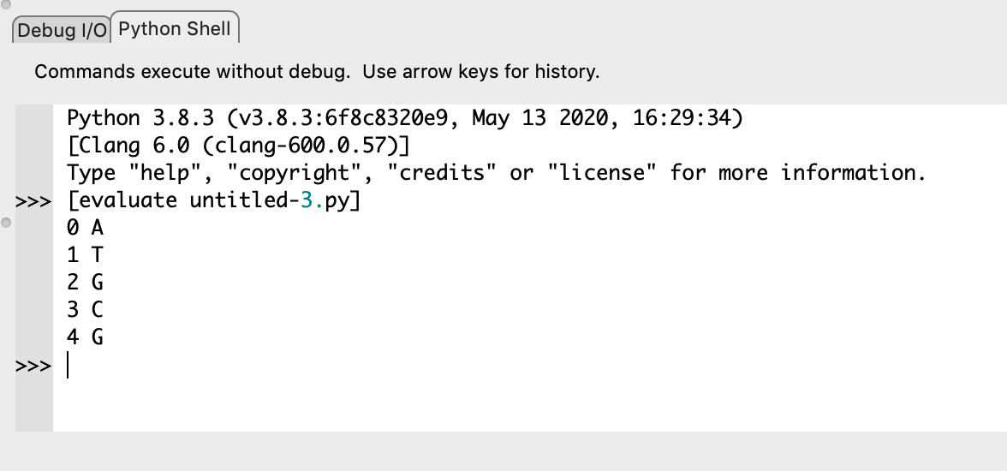
Control Statements
Loops: while loops
while loop executes a set of statements as long as a condition is true.
while loop structure
while EXPRESSION:
STATEMENT
dnaseq = 'ATGCG'
x = 0
while x < len(dnaseq):
print(x, dnaseq[x])
x += 1
0 A
1 T
2 G
3 C
4 G

Slide 25
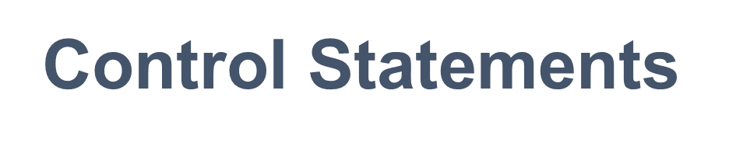
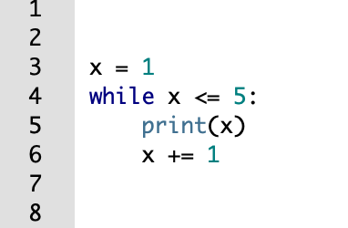
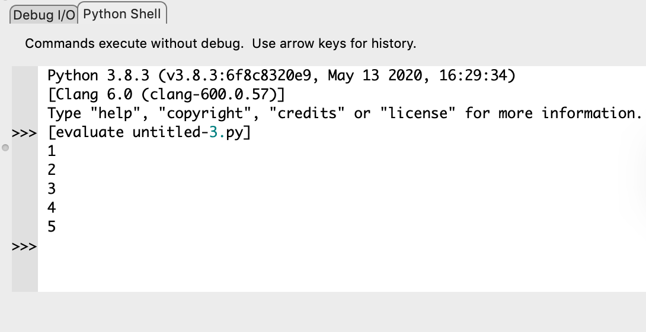
Loops: while loops
x = 1
while x <= 5:
print(x)
x += 1
1
2
3
4
5

Slide 26
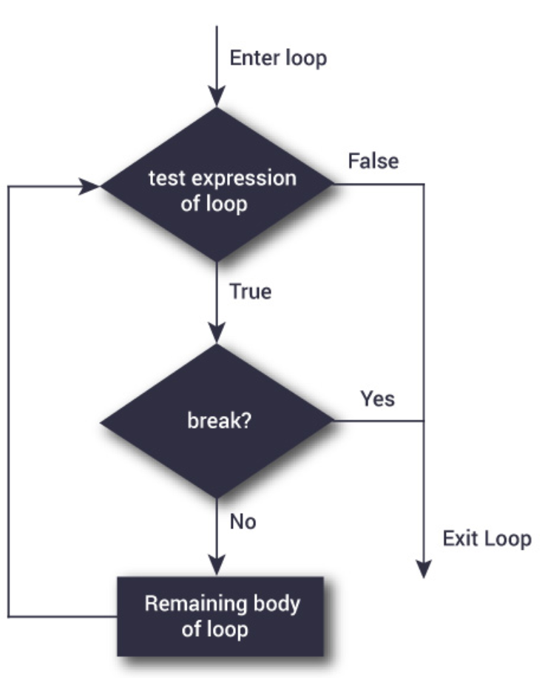
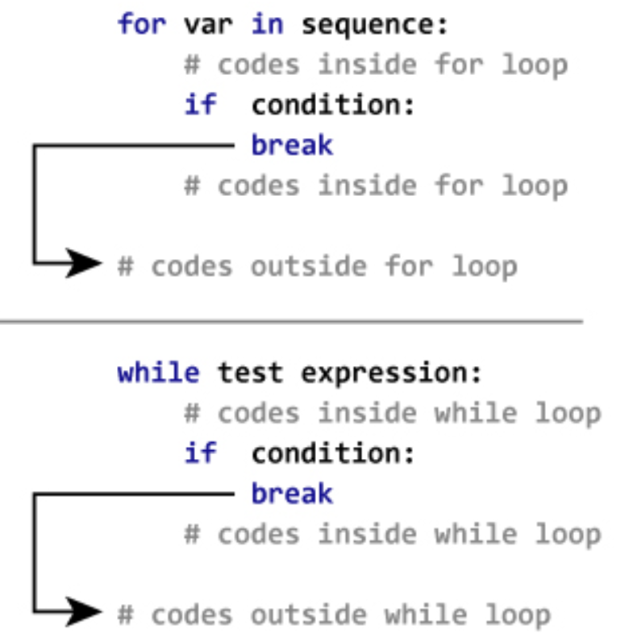
Control Statements
Break Statement: break the loop
break can be used to escape from a loop structure, either for or while loop

Slide 27
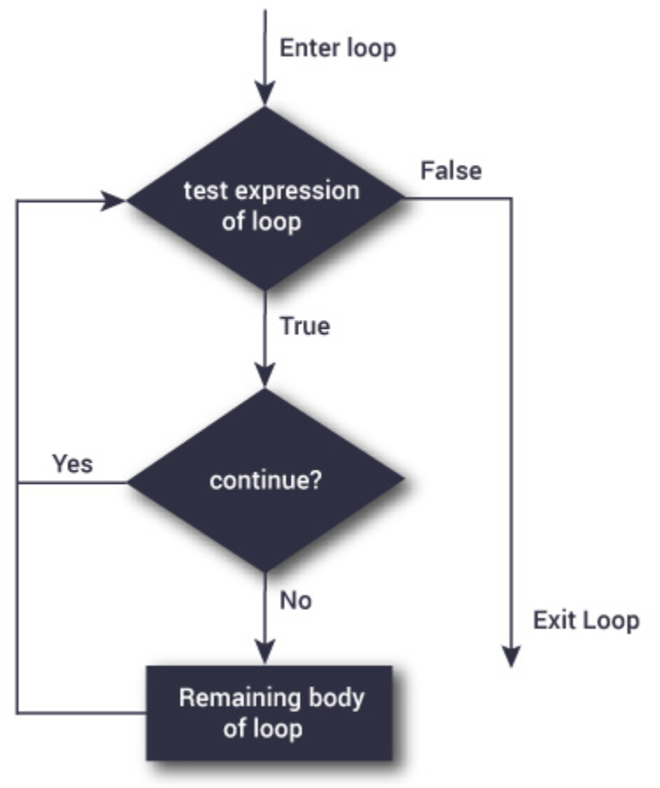
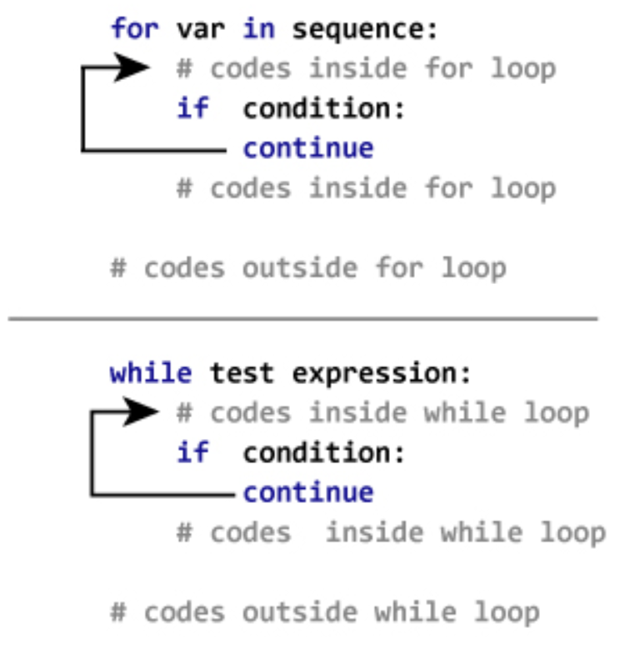
Control Statements
Continue Statement
The continue statement is used to skip the rest of the code inside a loop for the current iteration only. Loop does not terminate but continues on with the next iteration.

Slide 28
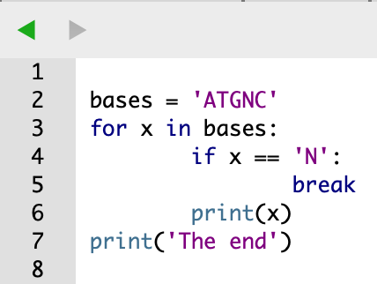
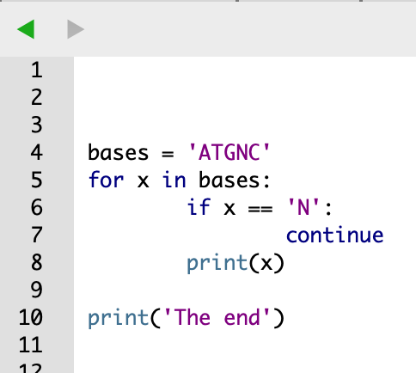
Control Statements
Continue Statement
The continue statement is used to skip the rest of the code inside a loop for the current iteration only. Loop does not terminate but continues on with the next iteration.
bases = 'ATGNC'
for x in bases:
if x == 'N':
continue
print(x)
print('The end')
bases = 'ATGNC'
for x in bases:
if x == 'N':
break
print(x)
print('The end')
A
T
G
C
The end
A
T
G
The end

Slide 29

Functions
Defining Functions of Your Own
Code reuse or DRY (Don’t Repeat Yourself)
A function is a piece of code written to carry out a specified task, and called by name.
Two important things with a function
Define it
Call it
Definition statements have the general form:
def functionname(arg1, arg2, …, argN):
statements
return values
Call the function
functionname(expression)

Slide 30
Functions
Defining Functions of Your Own
Creating a function
function name
def Hello():
print("Hello World!")
Define a function named “Hello”.
Does not print anything until you call the function.
Calling a function
Hello()
Hello World!
def Hello():
print("Hello User!")
Hello()
Hello()
Hello()
Hello()
How function works
print("Hello User!")
print("Hello User!")
print("Hello User!")
print("Hello User!")

Slide 31
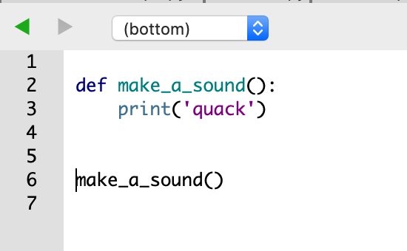

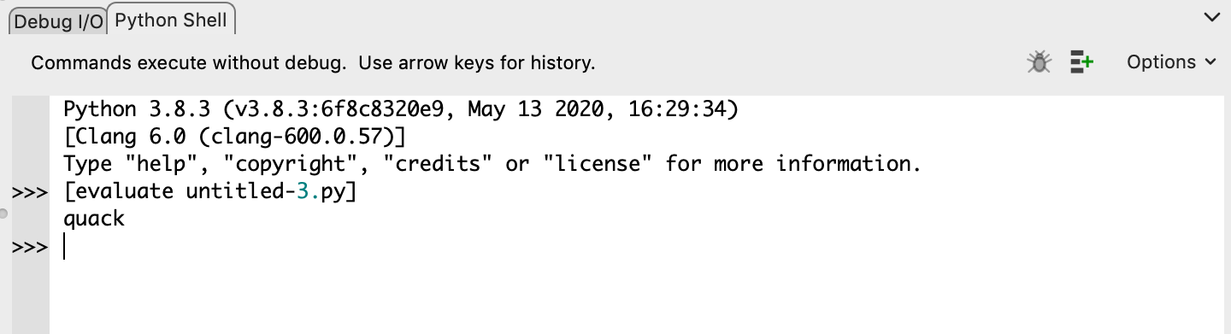
def make_a_sound():
print('quack')
make_a_sound()
quack

Slide 32
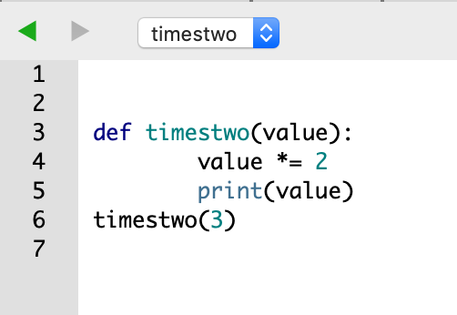
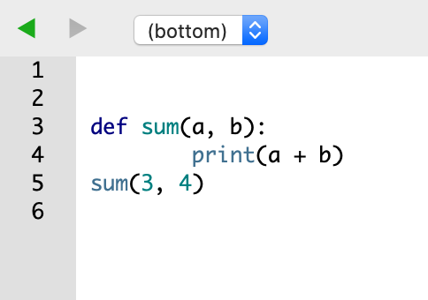
Functions
Defining Functions of Your Own
Arguments and Parameters
Information can be passed to functions as Arguments
The values of those arguments are copied to their corresponding parameters inside the function
Assigns the first parameter name to the first argument’s value, the second parameter name to the second value, and so on
def timestwo(value):
value *= 2
print(value)
timestwo(3)
def sum(a, b):
print(a + b)
sum(3, 4)
6
7

Slide 33
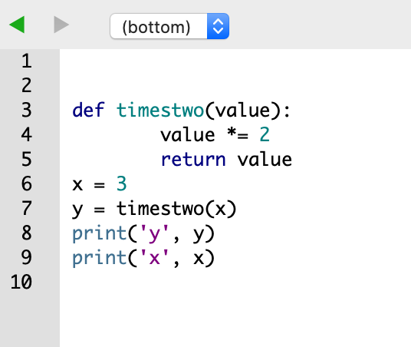
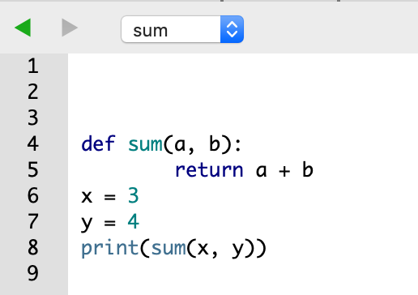
Functions
Defining Functions of Your Own
Return value
The statement return [expression] exits a function, optionally passing back an expression to the caller.
A return statement with no arguments is the same as return None.
def timestwo(value):
value *= 2
return value
x = 3
y = timestwo(x)
print('y', y)
print('x', x)
def sum(a, b):
return a + b
x = 3
y = 4
print(sum(x, y))
y 6
x 3
7

Slide 34
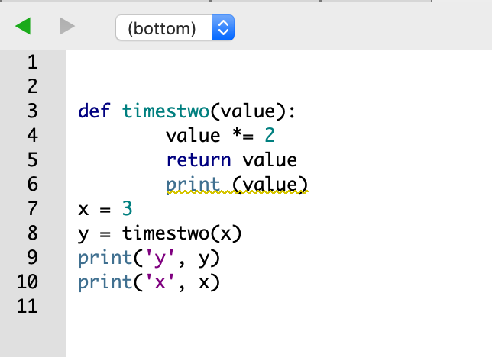
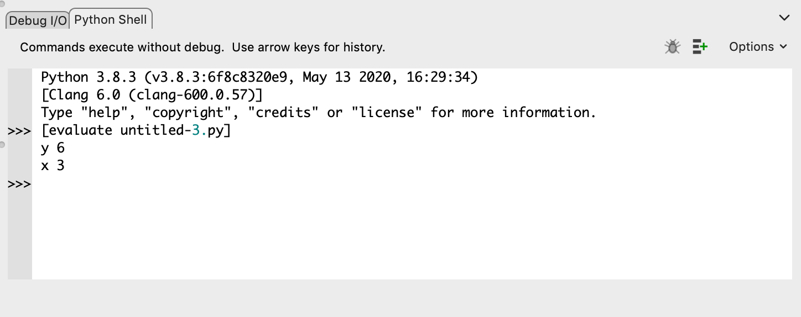
Functions
Defining Functions of Your Own
Return value
Once you return a value from a function, it immediately stops being executed. Any code after the return statement will never happen.
def timestwo(value):
value *= 2
return value
print (value)
x = 3
y = timestwo(x)
print('y', y)
print('x', x)
This won’t be printed!

Slide 35
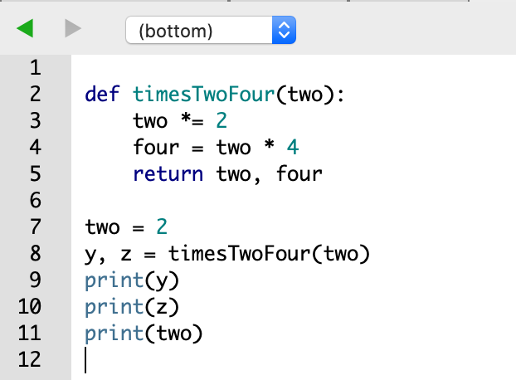
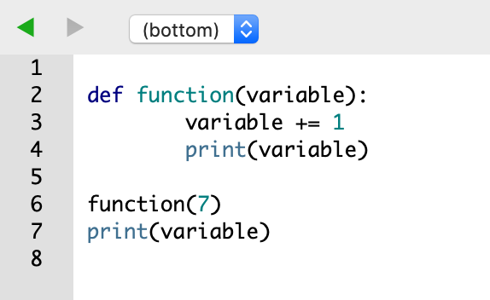
Functions
Defining Functions of Your Own
Variable names inside methods are stored separately -- Local Variables
Global variables defined and declared outside a function
def timesTwoFour(two):
two *= 2
four = two * 4
return two, four
two = 2
y, z = timesTwoFour(two)
print(y)
print(z)
print(two)
def function(variable): variable += 1
print(variable)
function(7)
print(variable)
8
4
NameError: name ‘variable’ is not defined
16
2

Slide 36
Functions
Defining Functions of Your Own
Variable names inside methods are stored separately -- Local Variables
Global variables defined and declared outside a function

Slide 37
Functions
Defining Functions of Your Own
Variable names inside methods are stored separately -- Local Variables
Global variables defined and declared outside a function
def my_func():
x = 10
print("Value inside function:",x)
x = 20
my_func()
print("Value outside function:",x)

Slide 38
Functions
Defining Functions of Your Own
def absolute_value(num):
"""This function returns the absolute
value of the entered number"""
if num >= 0:
return num
else:
return -num
print(absolute_value(2))
print(absolute_value(-4))

Slide 39
Functions
What happens when functions go wrong?
def greet(name, msg):
"""This function greets to
the person with the provided message"""
print("Hello", name + ', ' + msg)
greet("Monica", "Good morning!")

Slide 40
Functions
Exercise
We can combine a loop and an argument and a tuple (think back to Meixia) to greet all of our students. We have six students,
Jeff, McKenna, Fatemeh, Frida, Jung, and Nils.

Slide 41
Functions
Exercise
We can combine a loop and an argument and a tuple (think back to Day 1) to greet all of our students. We have six students,
Jeff, McKenna, Fatemeh, Frida, Jung, and Nils.
How would we have a printed list that greets everyone and greets their names in alphabetical order?

Slide 42
Functions
Exercise
We can combine a loop and an argument and a tuple (think back to Day 1) to greet all of our students. We have six students,
Jeff, McKenna, Fatemeh, Frida, Jung, and Nils.
How would we have a printed list that greets everyone and greets their names in alphabetical order? (hint, using a tuple, we can refer to multiple names as (*names) instead of name like how we used name earlier)

Slide 43
Functions
Exercise
given_list=[‘Jeff’, ‘McKenna’, ‘Fatemeh’, ‘Frida’, ‘Jung’, ‘Nils’]
list.sort(alphabetical)
print(alphabetical)
def greet(*names):
"""This function greets all
the person in the names tuple."""
# names is a tuple with arguments
for name in names:
print("Hello", name)
greet(“xxx")

Slide 44
Functions
Exercise H1N1
def GCTotal(sequence):
GC_total = 0
for item in sequence:
GC = item.count("G") + item.count("C")
GC_total +=GC
return GC_total

Slide 45
Structured programming
Definition
Modular programming, enforces a logical structure on the program being written to make it more efficient and easier to understand and modify.
In SP, control of program flow is restricted to three structures, sequence, IF THEN ELSE, and DO WHILE, or to a structure derivable from a combination of the basic three.
Three main parts:
Loops (for and while)
Flow control (IF-ELSE)
Function

Slide 46
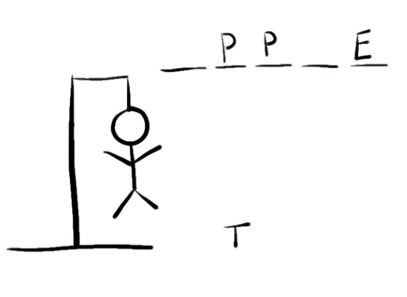
Structured programming
SP Example -- Hangman
Hangman is a slightly macabre children’s game
Player one thinks of a secret word, indicated by a number of dashes
On each turn, player two guesses one letter
if the letter occurs in the word, the blanks are filled in
if the letter does not occur, a “body part” is added to the man
Player one wins if the body is completed before the word is guessed
Player two wins is the word is guessed before the body is completed

Slide 47
Structured programming
SP Example -- Hangman
Get the list of words
Randomly choose the secret word from the list
For each turn
Display current word, guessed letters, and hanging man
Get user guess and check it is valid
Update current word, guessed letters, and hanging man
Check if computer won (body is complete)
Check if user won (word is complete)

Slide 48
Structured programming
SP Example -- Hangman
Get the list of words
wordlist = ['Python', 'Happy', 'learning']
Choose the secret word from the list
secret_word = random.choice(words)
For each turn
While True:
Display current word, guessed letters, and hanging man
Get user guess and check it is valid
Update current word, guessed letters, and hanging man
Check if computer won (body is complete)
Check if user won (word is complete)

Slide 49
Structured programming
SP Example -- Hangman
Get the list of words
wordlist = ['Python', 'Happy', 'learning']
Choose the secret word from the list
secret_word = random.choice(words)
'''============================================================
This is a python script to play the hangman game
The computer acts as player 1 and selects a secret word. The user is player
on each turn
player 2 guesses a letter
if correct it is added to the word
if incorrect, loss one score
============================================================='''
import random
wordlist = ['Python', 'Happy', 'learning']
secret_word = random.choice(wordlist)

Slide 50
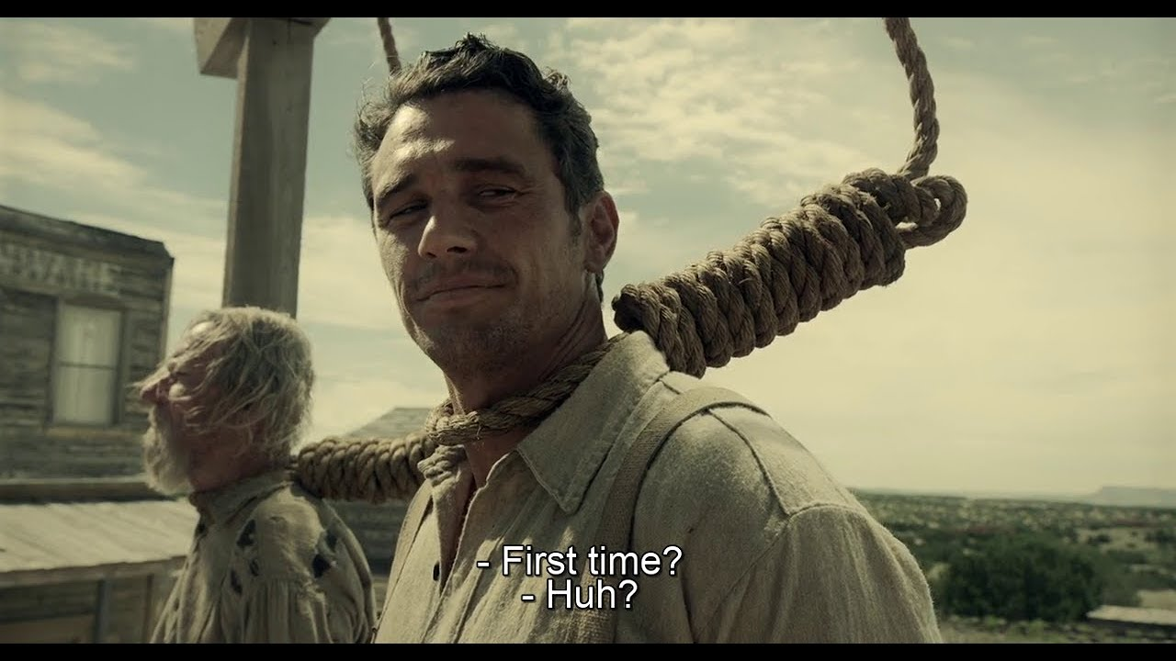
Structured programming
SP Example -- Hangman
Call GetGuess Function
GetGuess()
In Class Exercises
To use the 3 uploaded part scripts to combine them together into a complete script to let it work!!! (Don’t worry, it will take some fiddling with!)
(Buster Scruggs Movie Reference)

Slide 51
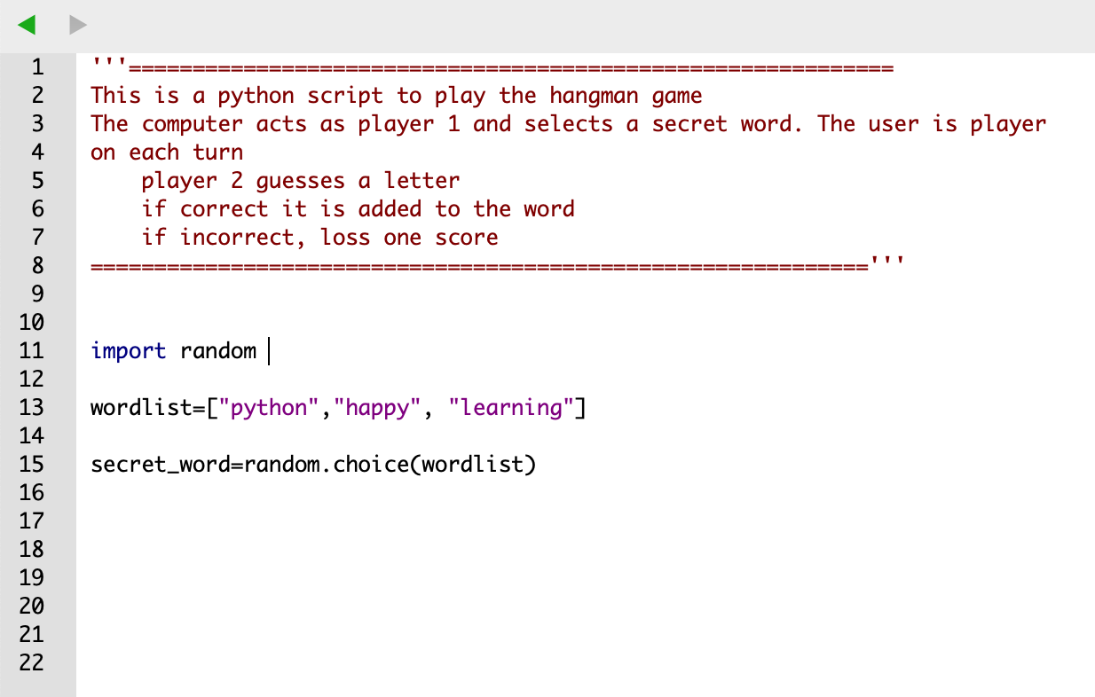
Structured programming
SP Example -- Hangman

Slide 52
Structured programming
SP Example -- Hangman
Define GetGuess function
def GetGuess():
'''Set the dashes to the length of the secret word and set the amount of guesses
let the player guess if the letter in the selected word
'''
dashes = "-" * len(secret_word)
guesses_left = 10

Slide 53
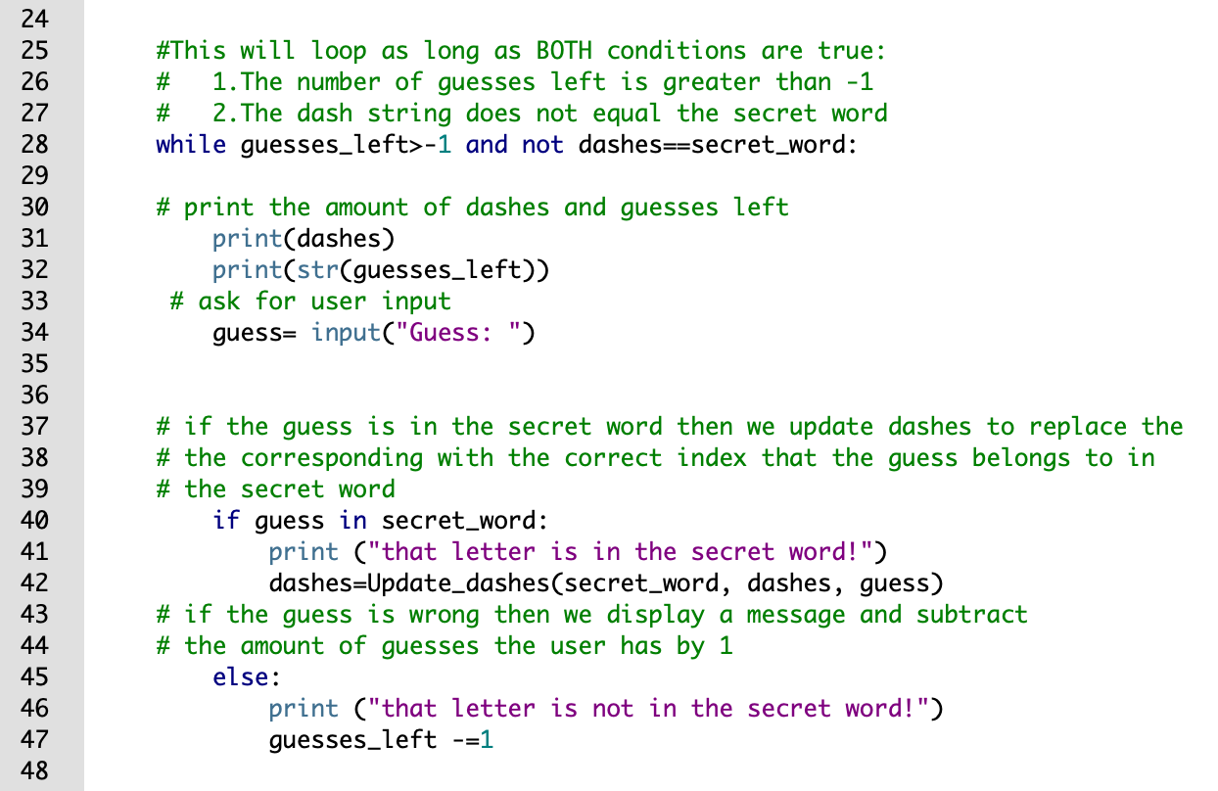
Structured programming
SP Example -- Hangman
Define GetGuess function
Use loops to let player to enter the guessed letter
Call Function update_dashes

Slide 54
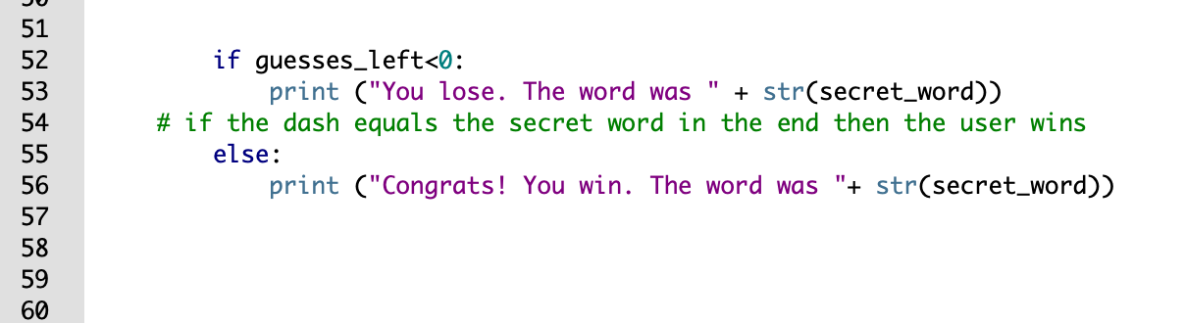
Structured programming
SP Example -- Hangman
Define GetGuess function
After the while loop is False

Slide 55
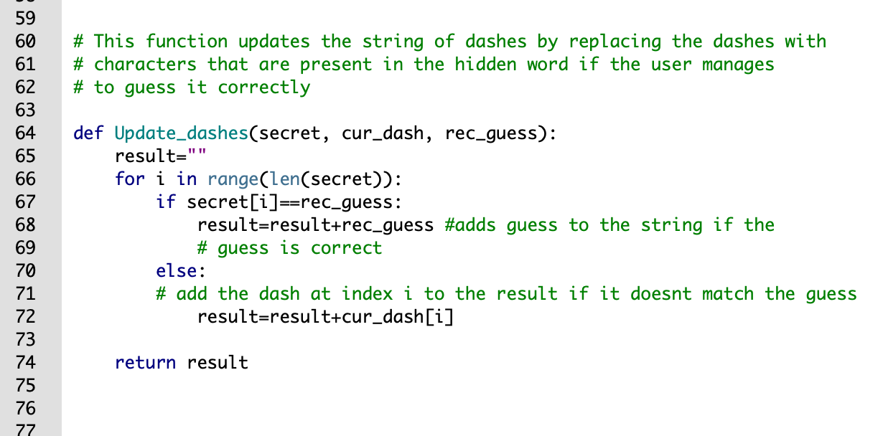
Structured programming
SP Example -- Hangman
Second function – Update dashes
dashes = update_dashes(secret_word, dashes, guess)

Slide 56
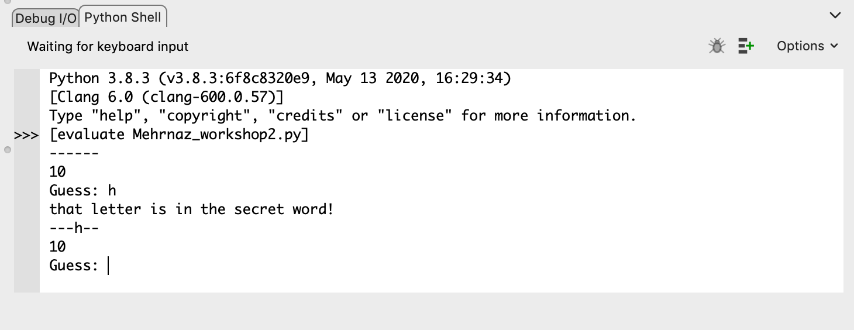
Don’t forget to CALL!
Call your function to run it:
GetGuess()

