Slide 1
Introduction to R
Day One

Slide 2
Who are we?
Austin Link: Instructor
Aiyesha Ghani: Teaching Assistant
Feel free to ask us questions at any point, I don’t mind stopping to address any confusion!!

Slide 3
Why use R?
It’s free; accessibility to those with a system that can run it
Powerful, high-quality graphics
Can perform simple and complex mathematical and statistical calculations
Large, growing user base and community to engage with
Lots of resources for collaboration and receiving help with coding

Slide 4
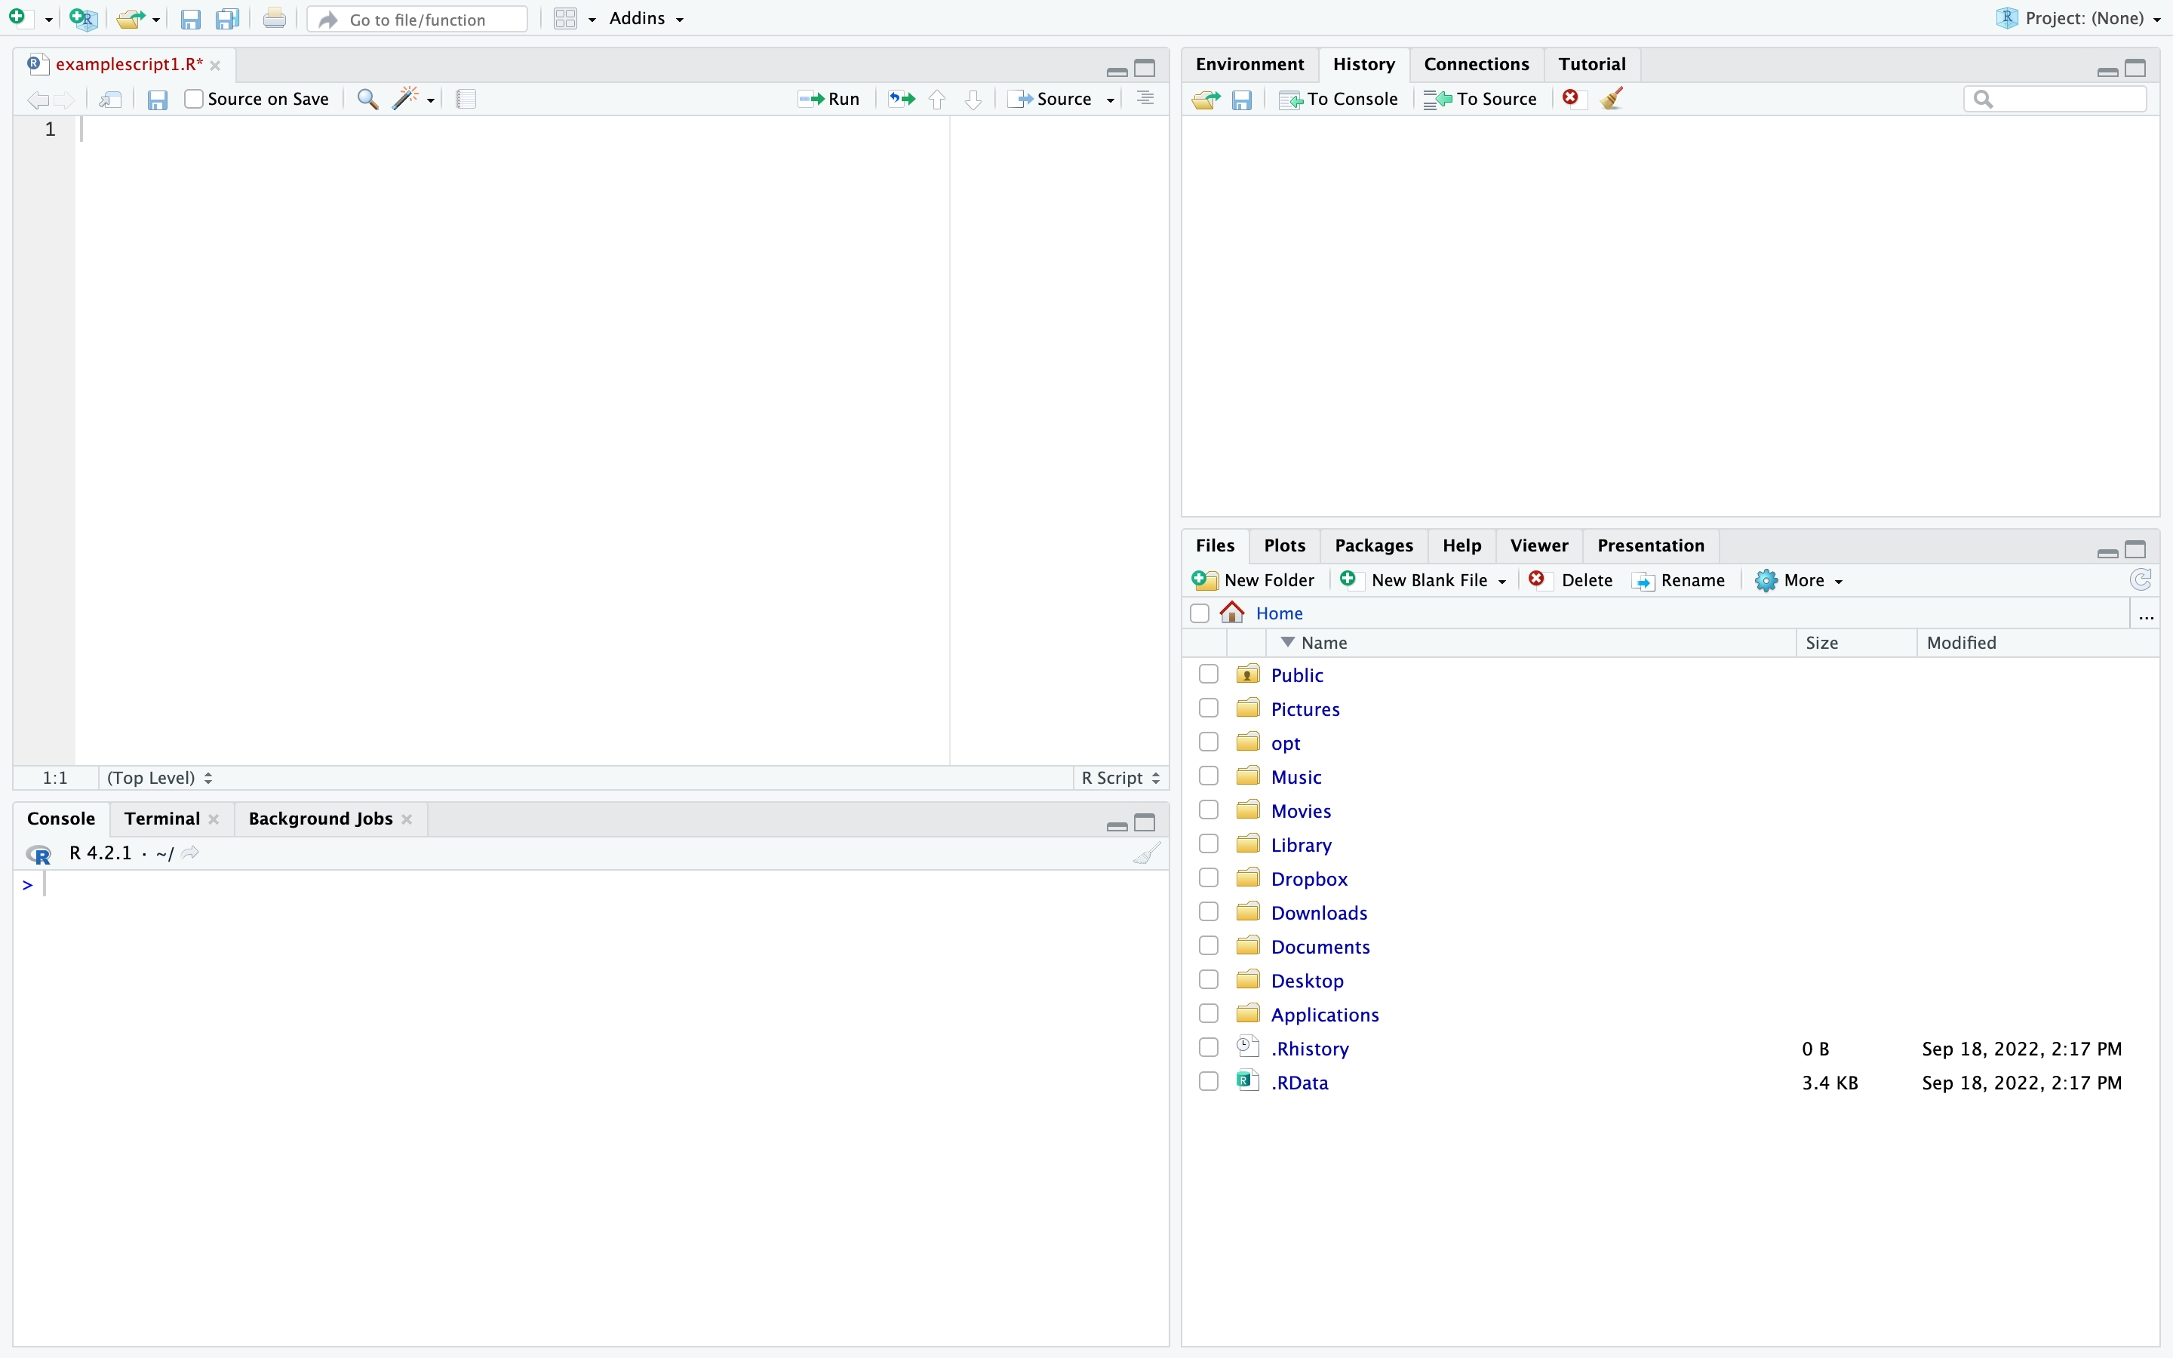
Different Ways to Run R: R Studio
Source
Environment/History
Console
Files/Plots/Packages/Help

Slide 5
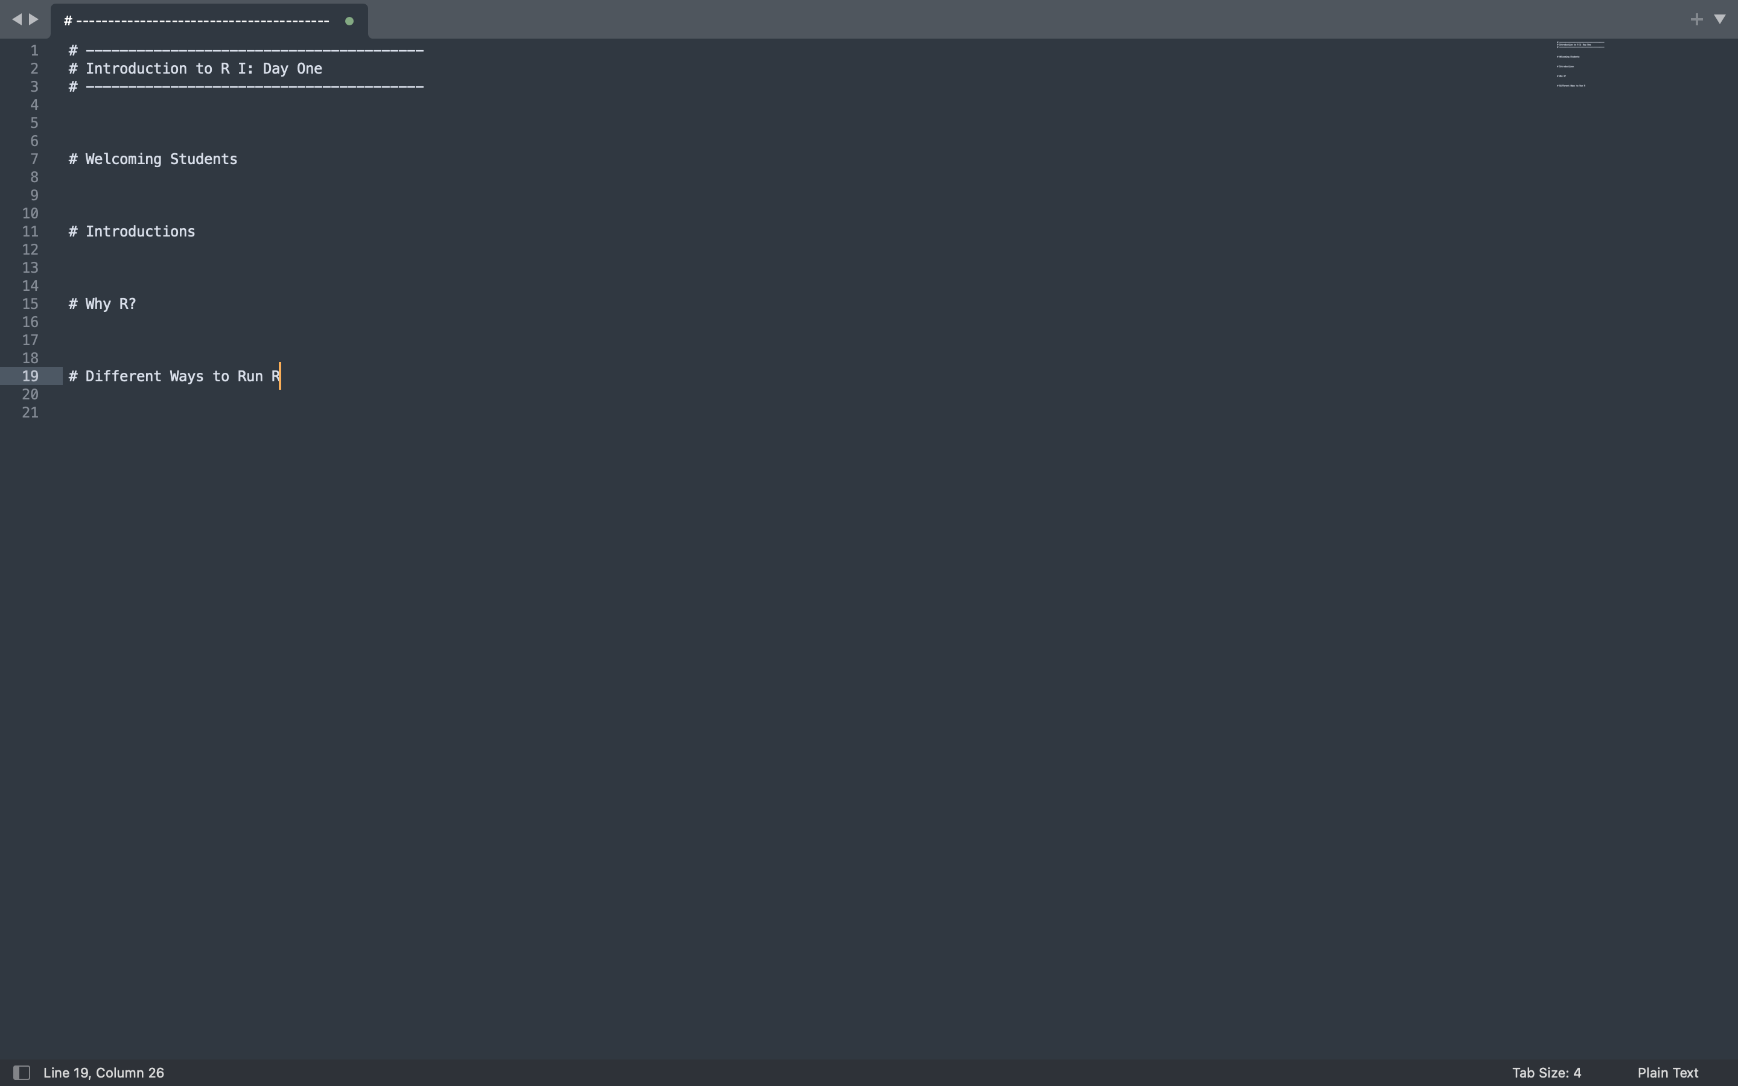
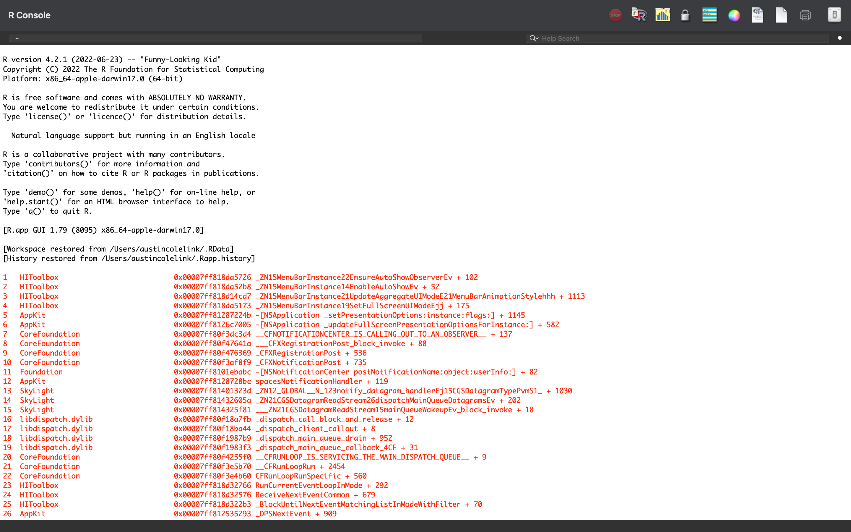
Different Ways to Run R: Text Editor + Console

Slide 6
Different Ways to Run R: Just the Console!

Slide 7
The Point:
Explore the different methods and find what is comfortable for you!
There is no one “correct” way to do things, do what helps you work the most efficiently!

Slide 8
Getting Help:
Coding can be difficult at times
Often many solutions to a single problem
Be creative!!
STEM work/careers often require a lot of creativity to address problems
Coding is art!
Some Resources:
>?function or help(function) This will make sense later
Google!
Forums/Reddit/Community

