Slide 1

Python data visualization Tutorial
This Photo by Unknown author is licensed under CC BY-SA-NC.

Slide 2

Lecture 1: Topics
Introduction to data visualization
What is Numpy?
Installing and importing Numpy
Basics of Numpy
Pandas
What are pandas Dataframes`?
Fundamental Dataframe operations.

Slide 3

What is Numpy?
Numpy is the core library for scientific and numerical computing in python.
It provides high-performance multidimensional array object and tools for working with arrays.
Numpy main object is the multidimensional array.
It is a table of elements, all of the same type and indexed by a positive integers.
In Numpy, dimensions are called axes.

Slide 4
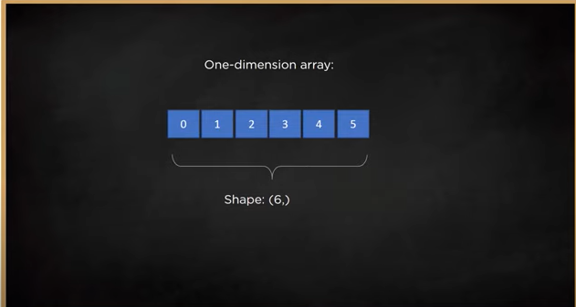

Slide 5
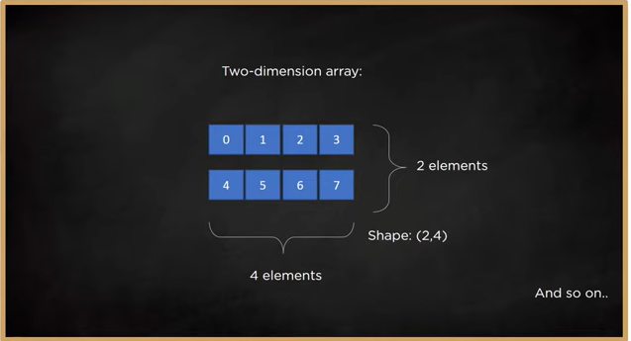

Slide 6

What is Pandas?
Pandas is a Python package for data analysis which provides flexible and powerful data structures for data storing and manipulation.
It is useful for data wrangling and data manipulation

Slide 7
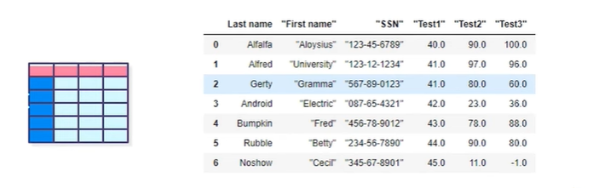
What are Pandas Dataframes?
Pandas dataframe store data in the form of rectangular grids consisting of rows and columns. Each column is used to store similar type of data while each row is an instance of a value.

Slide 8
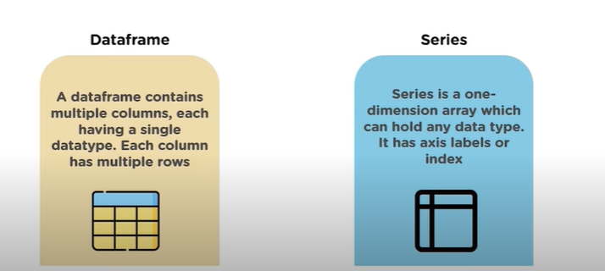
Types of Pandas Dataframes

Slide 9

Fundamental Dataframe Operations

Slide 10
Topics:
Types of Libraries
Types of plots
Plotting graphs and sub graphs
Adding graph inside a graph
Graph parameters-title, label, legend

Slide 11
Types of libraries:
Matplotlib
Seaborn
Plotnine (ggplot)
Plotly
Folium
Geoplotlib

Slide 12

Matplotlib
It is an opensource drawing library which supports rich drawing types.
It is used to draw 2D and 3D Graphics.
We can understand the data easily by visualizing it with the help of matplotlib.
We can generate plots, histogram, bar charts and many other charts with just a few lines of code.

Slide 13
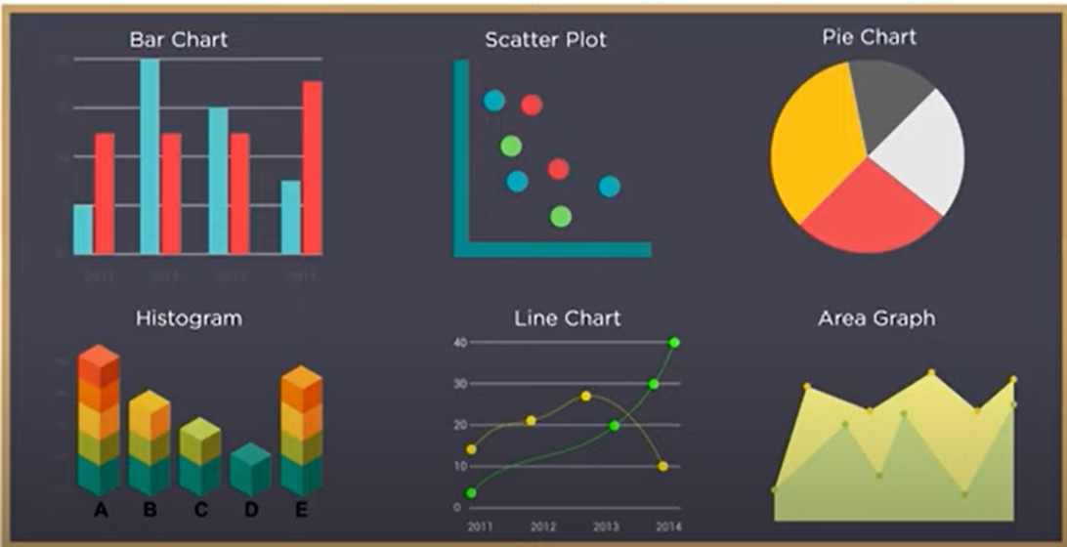
Types of Plots

Slide 14

Let's start Plotting them..

Slide 15

Thank You

