Slide 1


Image and Video Analysis in R
Code workshop
Eli Bridge (ebridge@ou.edu)
Associate Professor
University of Oklahoma
Oklahoma Biological Survey
Assistants: Meelyn Pandit (meelyn.pandit@ou.edu)
and Alva Strand (alvastrand@ou.edu)

Slide 2
Course outline
Image and Video Analysis in R
Open Science Framework location:
https://osf.io/k93zv/
Part 1: Basics of images
Part 2: Working with images in R
Part3: Working with video in R

Slide 3
Participant Requirements
Image and Video Analysis in R
A computer running the latest versions of R and R Studio with the following packages installed.
Rvision (requires several steps to install)

Slide 4
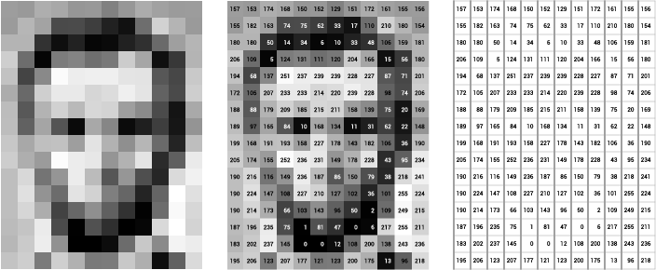
Intro to images
Digital images are a grid of numbers (usually bytes ranging from 0 to 255).
In a grayscale image the numbers represent intensity of brightness (0 = black and 255 = white)

Slide 5
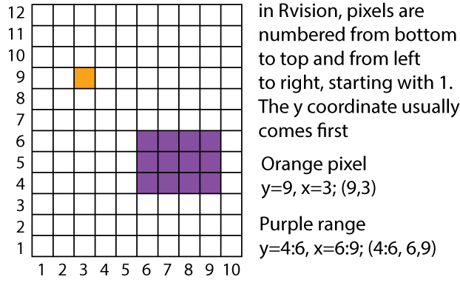
Intro to images

Slide 6
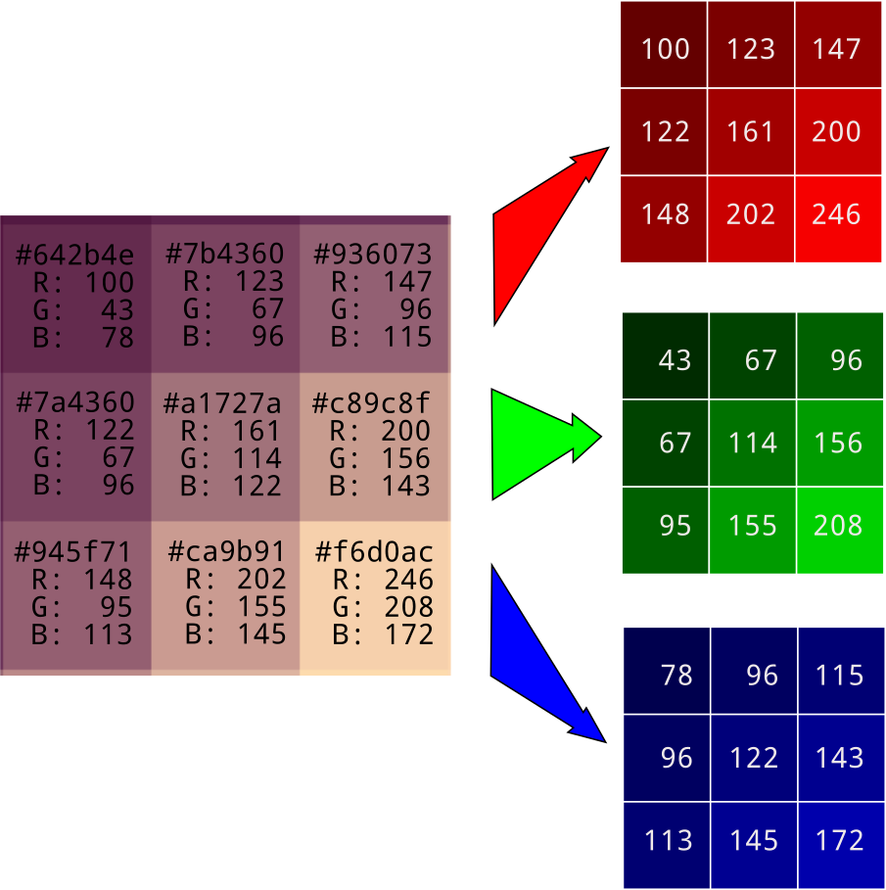
Intro to images
A color image has three layers that are combined (stacked) to generate virtually any color humans can discern
Often the layers represent Red, Green, and Blue, which gives us an RGB image.
Black = R:0, G:0, B:0
White = R:255, G:255, B:255

Slide 7
Intro to images
Color Image layers can also be represented as brightness (grayscale), relative blueness, and relative redness (green is extrapolated). This method gives us a YCrCb image.

Slide 8

Intro to images
100 x100 pixel grayscale image = 10,000 pixels.
But when stored as a jpeg it only takes up about 5kB of memory or ~5000 bytes.
How is this possible?

Slide 9
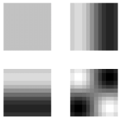
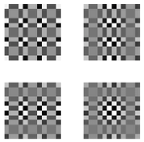
Intro to images
IMAGE COMPRESSION!!!
Jpegs are compressed in 3 ways:
Chrominance Subsampling (color images only) – converts to YCrCb and reduces resolution of color information.
Discrete Cosine Transformation – Represents each 8x8 panel of pixels as cosine frequency coefficients that can represent any possible luminance or chromatic pattern.
Delta Compression – saves space by recoding repeated numbers and sequences
(e.g. 4 4 4 5 5 5 5 3 3 3 3 3 3 -> 4 3 5 4 3 6
Unwraveling the JPEG
https://parametric.press/issue-01/unraveling-the-jpeg/
←Low freq cosine patterns
Hi freq cosine patterns →
(can often be ignored)

Slide 10
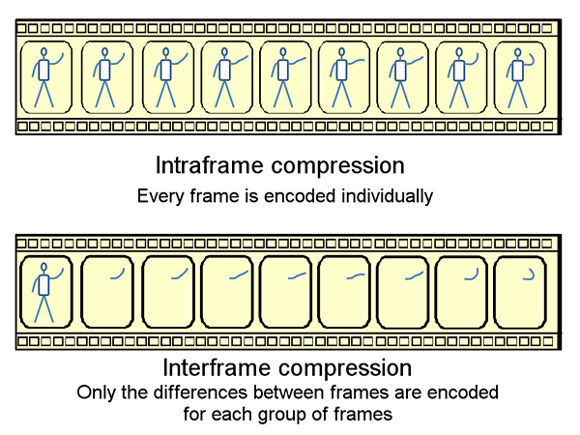
Intro to Video
Video is just a sequence of individual images (frames).
Video frames can be compressed in the same way single images can be compressed.
Video can also be compressed through time. In particular, If the background of an image is static, those pixels only need to be encoded once every few frames.
Keyframes are reference frames where all pixels are updated.
Codecs are the different compression and decompression schemes for video

