Slide 1
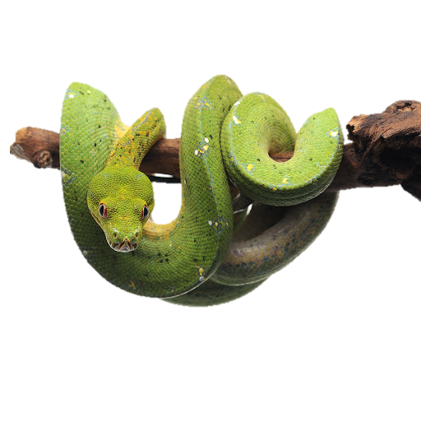

Introduction to Python (Part 1)
Instructor: Angie Rosellini-Labombarde
Teaching Assistant: Sanjana Mudduluru

Slide 2

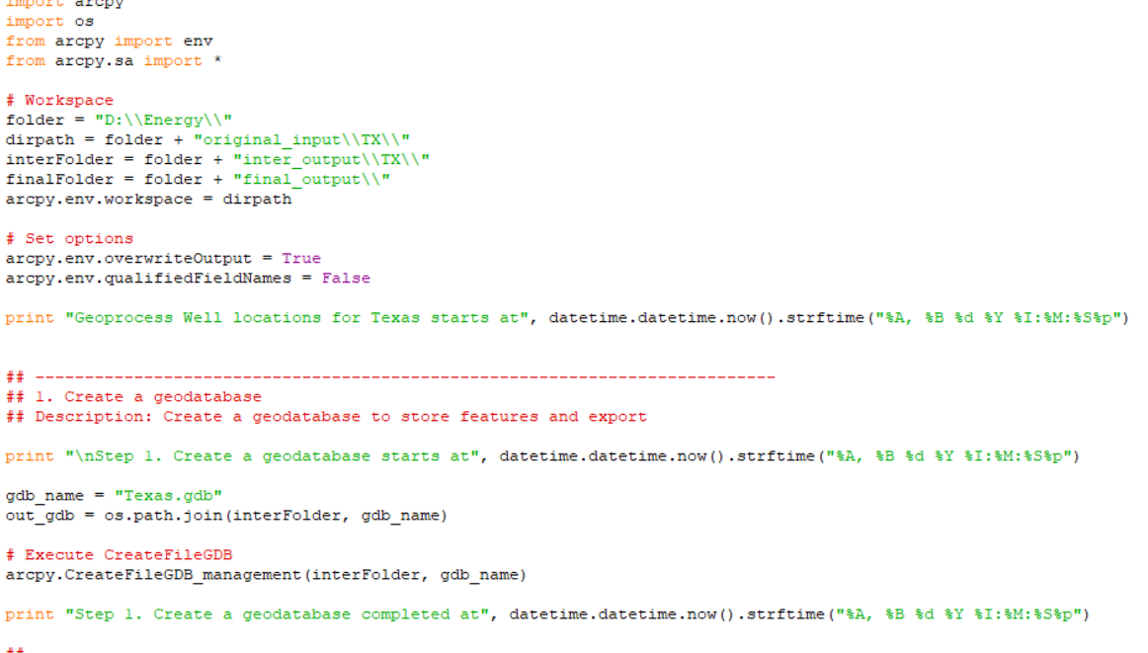
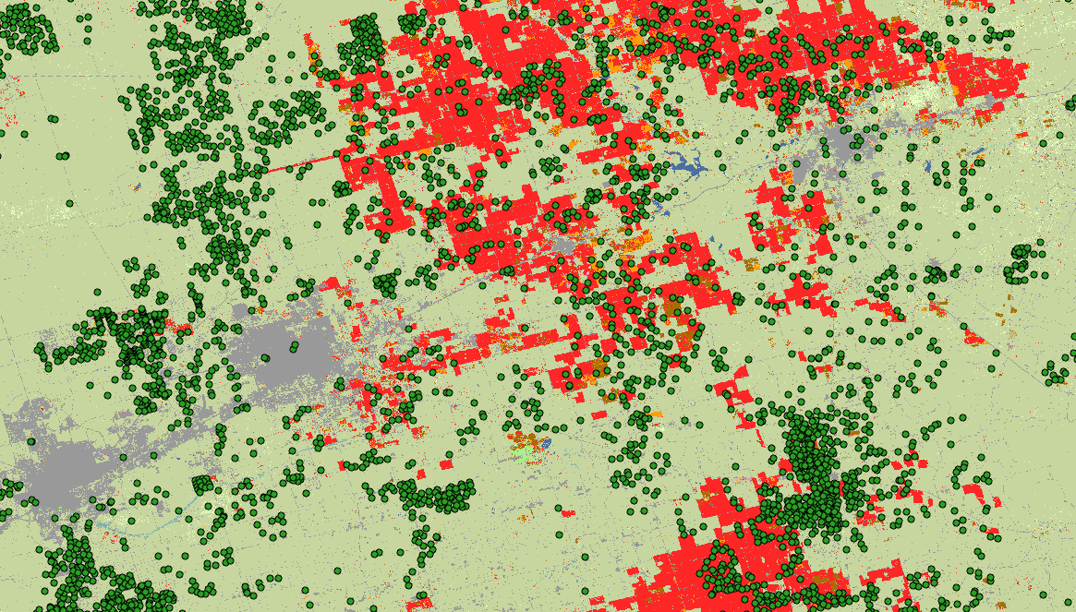
Angie Rosellini-Labombarde
B.S. Environmental Sustainability, minor in GIS (OU 2021)
M.S. student in Geography & Environmental Sustainability (2023)
Graduate teaching assistant
2 years Python experience
Current research: Spatial analysis of the relationship between unconventional oil and gas development, agricultural water usage, and drought conditions in the Permian Basin

Slide 3


Teaching Assistant
Sanjana Mudduluru
B.S. in Computer Science
M.S. in Data Science and Analytics (OU, 2016 - 2018)
PhD candidate in the School of Computer Science (OU, 2018 - )
Graduate teaching assistant

Slide 4
Introduction
Course Objectives
Give scientists comfort and confidence with computation
Learn and practice computational skills for your future or current research
Basic Python programming
Learn how to use IDLE to execute Python commands
Learn the basics of Python syntax
Explore Python data types, create and manipulate variables, and use loops and conditionals in a Python program

Slide 5
Introduction
This course is a formal introduction to computer science
This course is not a substitute for understanding how the statistics/programs/analyses you use work

Slide 6
Introduction
What you need to succeed:
A logical and organized way of thinking (or at least organized notes for your future self!)
Determination
Practice, practice, practice
What you don’t need:
A math background
Previous programming experience

Slide 7
Introduction
Am I cut out for programming?
Programming Skills
Logical thinking
Detail-oriented
Able to solve problems based on incorrect results
Scientists are natural programmers!

Slide 8
Schedule
Day 1
Install Python and open IDLE
Interactive and batch mode
Docstrings and comments
Learn the basics of Python syntax
Variables
Data types
Strings
Day 2
Review the basics of Python syntax
Gene sequence exercise
Lists
Conditional statements
Loops
You don’t need to know what any of these mean yet!

Slide 9

Let’s get started!!

Slide 10
What is Programming?
Providing a set of instructions for a computer to execute
A way to automate tasks, perform difficult data analysis, document the process, and save time
There are many programming languages and applications
Python
Java
R
Perl

Slide 11
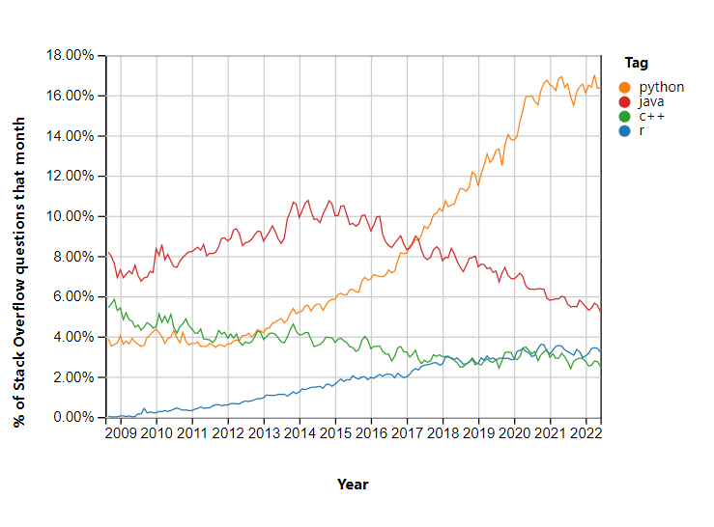
Why Python?
Easy to learn
Popular
Free and open-source
Interchangeable between Windows, Linux, and iOS
High-level and object-oriented
Many applications use Python

Slide 12
What is a Program(Script)?
A detailed set of instructions for how to do something
Definitions/symbols:
pi = 3.1416
Actions
Area = pi x radius^2
Loops
Repeat 2 times
Repeat until…
Conditional
If (something) do (something)
Results (Output)

Slide 13
What is a Program(Script)?
Computers are like very hard working but very stupid lab helpers
Instructions must be exact- computers will gladly do the wrong thing over and over
All possible alternatives must be covered. When undefined situations occur computers either:
Do the wrong thing
Stop and wait
Fail catastrophically

Slide 14
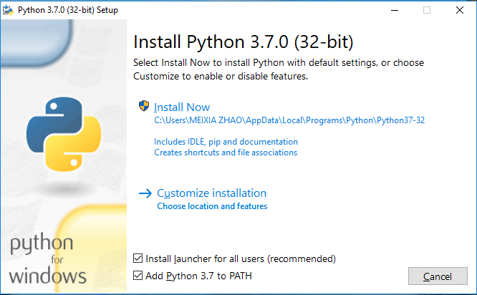
Install Python
https://www.python.org/downloads/
Must be version 3

Slide 15
IDLE (Integrated Development and Learning Environment)
IDLE is a program used to write and execute Python code
For windows:
Navigate to the Start Menu at the bottom left corner of the screen
Type ‘IDLE’ in the search bar and click on the application
For Mac:
Open the Finder and type ‘IDLE’ in the search menu
You can also open the Applications folder in the Finder and find the IDLE program

Slide 16
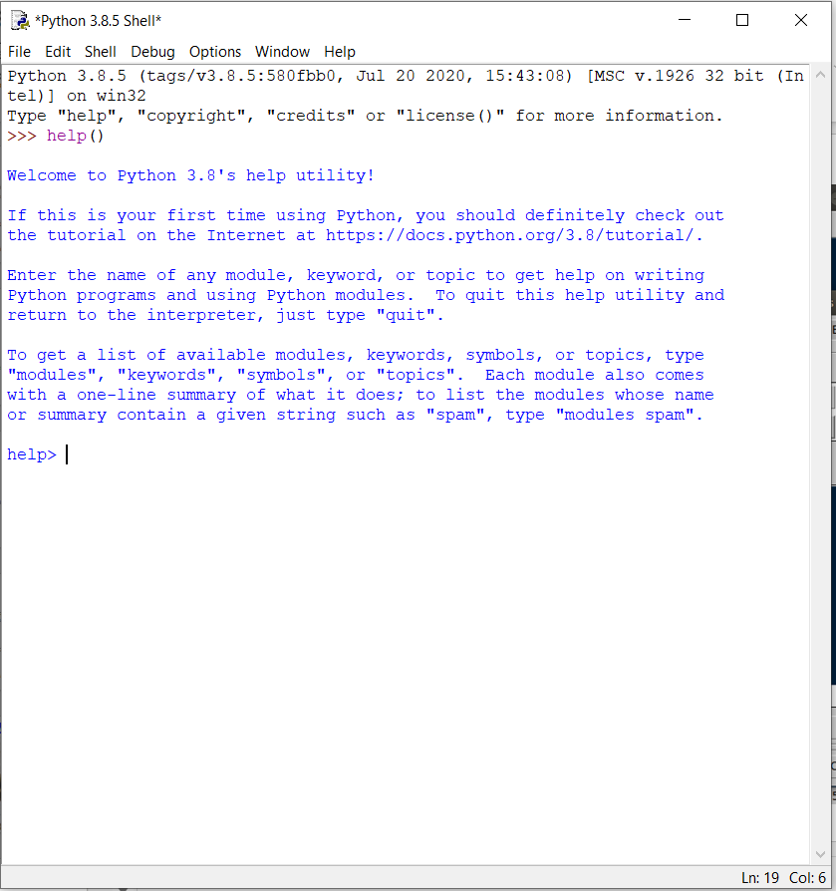
Check that you are using version 3!
IDLE to execute Python commands

Slide 17
Python Programming / Interactive Mode
Two Basic Python Modes:
Interactive mode (front-end)
Batch mode (a script)

Slide 18
Python Programming / Interactive Mode
Two Basic Python Modes:
Interactive mode (front-end)
Interactive mode is a command line shell which gives immediate feedback for each statement
Executing code in the interactive window happens in 3 steps:
1. Python reads the code entered at the prompt (>>>)
2. Python evaluates the code
3. Python prints the result and waits for more input (>>>)
>>>print(“Hello, world!”)
Hello, world!
>>> 1 + 1
2

Slide 19
Python print( ) function
A Python function is a code that performs a task and can be invoked by a name. For example: print( ); sum( ); len( )
The print( ) function prints the given object to the standard output device (screen)
You need the print( ) function to see variable values, results, list contents, etc. ** Especially important in batch mode
By default, it prints all inputs separated with a whitespace, but you can change the separator with a parameter named ‘sep’
>>>print(“Hello”, “World”, sep = “-”)
Hello-World!

Slide 20
Python Programming/Batch Mode
Two Basic Python Modes
Batch Mode (script)
The Python Shell (interactive mode) is convenient for executing a few simple commands. If you need to give the computer more complex instructions, it is a good idea to write a script. A script is a set of instructions you can easily edit and run.
When a program is executed from such a text file, rather than line-by-line in an interactive interpreter, it is called batch mode.
1. Go to File >>> New File to create a new script
2. In your script, write: print(“Hello!”)
3. Go to File >>> Save As… to save your script. Choose a location and a name. Be sure it saves as a .py file extension
4. Go to Run >>> Run Module to run your script. The Python shell will reopen and display: “Hello!”

Slide 21
Python Programming/Batch Mode
Two Basic Python Modes
Some programmers prefer using software programs like Wing 101, PyCharm, or Jupyter Notebook to create their Python scripts.
The choice to use IDLE or another application is entirely up to the individual programmer.
Many find environments other than IDLE to be more user-friendly or better for more complex scripts.

Slide 22
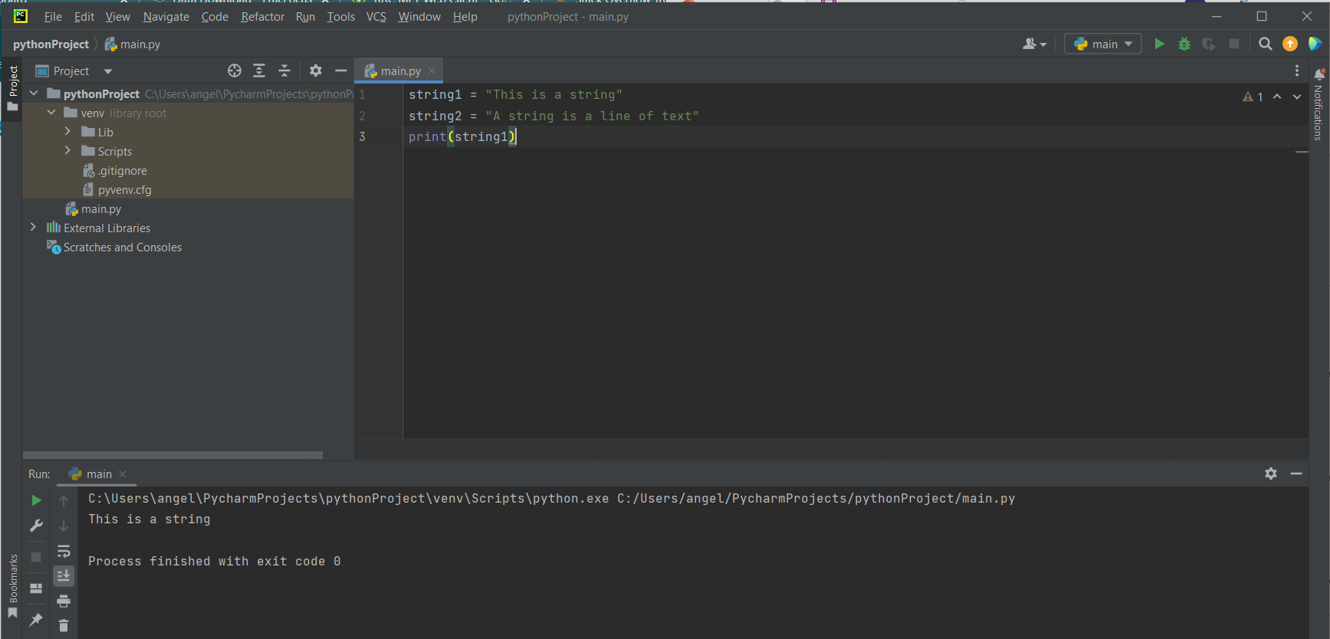
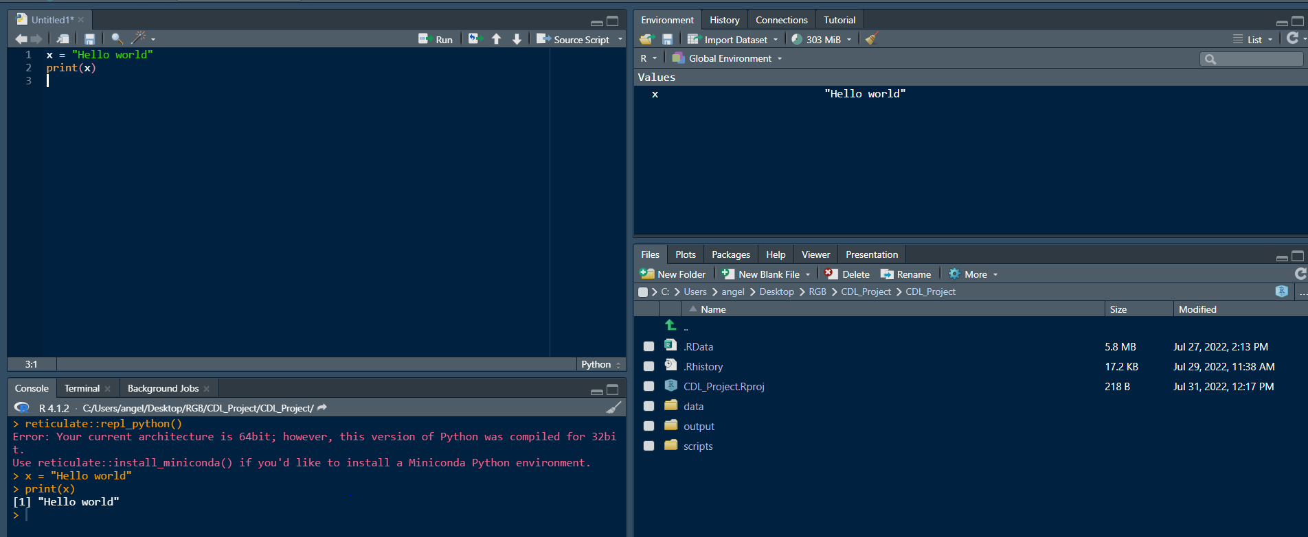
RStudio
PyCharm
Environment/History
File Explorer
Script
Script
Console
Plots/Files/
Packages/Help
Console

Slide 23
Comments and Docstrings
Programming Best Practices: Commenting and Clarity
The top priority is making your program easy to understand
Makes it possible to verify correct outputs
Simplifies modifying and updating
Promotes reuse and sharing
Requirements
Docstrings: Block quotes with triple quotation marks are called docstrings. They are used in the interpreter to provide help.
Comments: Introduced by using the # symbol. Use comments to describe the steps in your program, helpful notes or clarification, and titles.

Slide 24
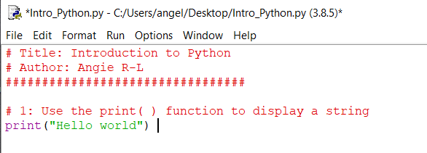
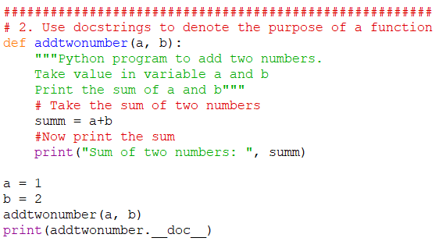
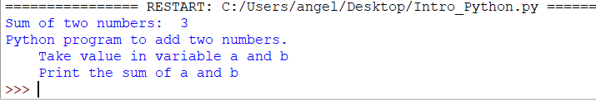
Comments and Docstrings
Comments
Docstrings

Slide 25
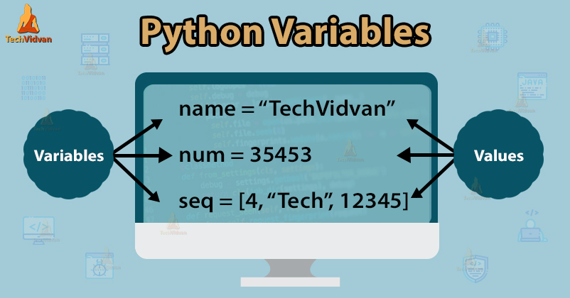
Variables

Slide 26
Variables
A variable is a value you can change and access throughout your script (variables are just names)
Variable names can only contain these characters:
Lowercase letters
Uppercase letters
Digits (0 through 9)
Underscore(_)
Names cannot begin with a digit
1
1a
1_

Slide 27
Variables: Assign a Variable
The assignment operator is the equal sign ( = )
Pick variable names that are distinct and memorable
course = “Python 101”
num_students = 30
greeting = “Hello world”
Variables are case sensitive (greeting ≠ Greeting)
Mixed case:
numStudents = 30
introPythonCourse = “This course is a formal introduction to Python”
listOfNames = [“Angie”, “Sanjana”]
Lower case with underscores*:
name_of_class = “Introduction to Python”

Slide 28
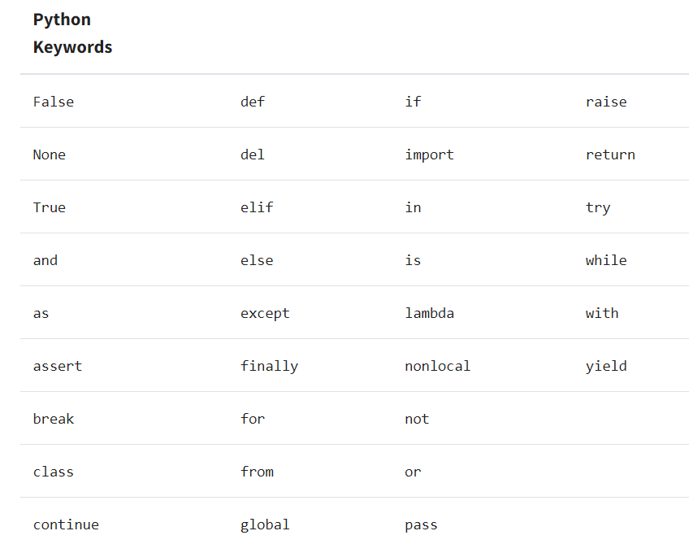
Variables: Assign a Variable
Python has a set of reserved words that cannot be used as variable names

Slide 29
Variable Names
Which of the following is a good variable name for a variable holding a value for “meters per second”?
m/s = 35
meters_per_second = 35
metersPerSecond = 35
m = 35
speed = 35

Slide 30

Basic Variable Types
Numbers
Integer numbers
A whole number (not a decimal)
Examples:
100
-7
1
1863210897465
Floating point numbers
Numbers that contain a decimal
Examples:
3.1416
0.7851
1.0

Slide 31
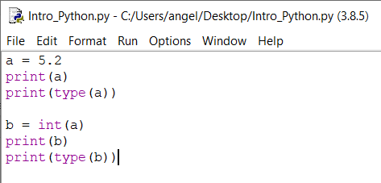
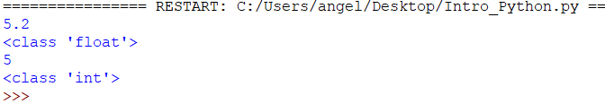
Basic Variable Types
Numbers
You can check the variable type using the function type( )
You can change the variable type (with certain exceptions) by using the variable type as a function
Convert to integer: int( )
Convert to float: float( )

Slide 32
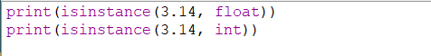
Basic Variable Types
Boolean
True
False
Some functions only return a True or False
Example: isinstance(object, type)

Slide 33
Basic Variable Types
Strings
A sequence of zero or more characters that are enclosed within a pair of quotation marks.
Single quotes, double quotes, triple single quotes, triple double quotes
Strings are immutable (‘read-only’)
A string can contain letters, digits, punctuation, white spaces, and other characters.
my_string = “Hello world! 123 True”

Slide 34
Basic Variable Types
Typecasting between variable types
From | To | Function | Possible?
Integer | Float | float( ) | Yes
Integer | String | str( ) | Yes
Integer | Boolean | bool( ) | Yes, but…
Float | Integer | int( ) | Yes
Float | String | str( ) | Yes
Float | Boolean | bool( ) | Yes, but…
String | Integer | int( ) | Yes, if…
String | Float | float( ) | Yes, if…
String | Boolean | bool( ) | Yes, but…
Boolean | Integer | int( ) | Yes - binary
Boolean | Float | float( ) | Yes – binary
Boolean | String | str( ) | Yes

Slide 35
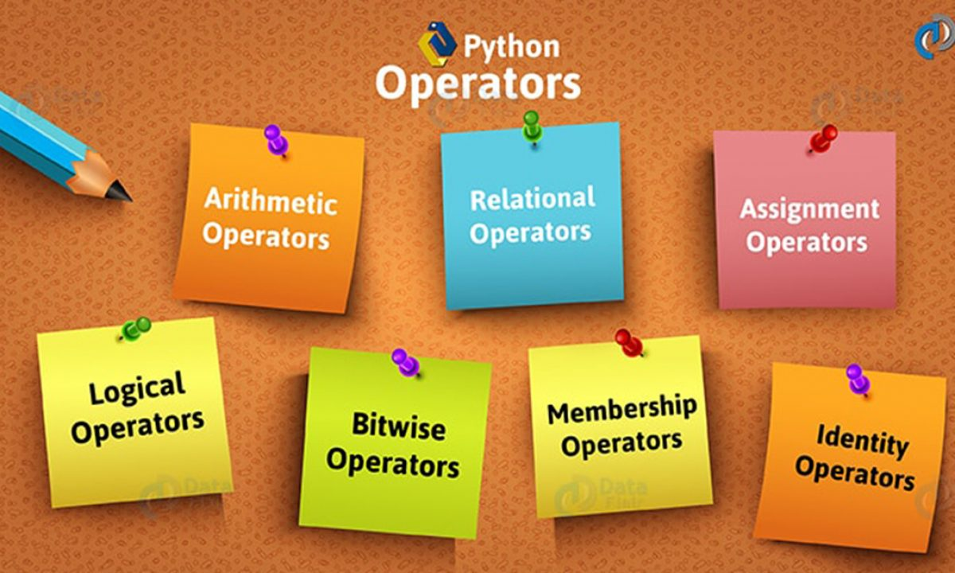
Operators

Slide 36
Operators
An operator is a symbol that indicates a calculation using one or more operands
Operator | Description | Example
+ Addition | Adds values on either side of the operator | >>> 5 + 2 7
- Subtraction | Subtracts right hand operand from left hand operand | >>> 5 – 2 3
* Multiplication | Multiplies values on either side of the operator | >>> 5 * 2 10
/ Division | Divides left hand operand by right hand operand | >>> 5 / 2 2.5
// Integer Division | The whole number smaller than the floating point result | >>> 5 // 2 2
% Modulus | Integer remainder after b/a | >>> 5 % 2 1
** Exponent | Performs exponential (power) calculation on operators | >>> 5 ** 2 25

Slide 37
Operators
Operator | Description | Example
= | Assigns values from right side expression to left side operand | c = a + b assigns c the values of a + b
+= Add AND | It adds right operand to the left operand and assign the result to left operand | c += a is equivalent to c = c + a c += 1 is equivalent to c = c + 1
-= Subtract AND | It subtracts right operand to the left operand and assign the result to left operand | c -= a is equivalent to c = c - a
*= Subtract AND | It multiplies right operand to the left operand and assign the result to left operand | c *= a is equivalent to c = c * a
/= Divide AND | It divides left operand to the right operand and assign the result to left operand | c /= a is equivalent to c = c / a
//= Integer Division AND | It performs floor division on operators and assign value to the left operand | c //= a is equivalent to c = c // a
%= Modulus AND | It takes modulus using two operands and assign the result to left operand | c %= a is equivalent to c = c % a
** Exponent | Performs exponential (power) calculation on operators and assign value to the left operand | c **= a is equivalent to c = c ** a

Slide 38
Operators
Box Model
Beginner programmers are often puzzled by syntax such as:
b = 2
b = 4 + b
print(b)
Before you run this, what do you think the answer is?

Slide 39
Operators
Box Model
Thank of variables as boxes
A box is a location in the computer’s memory
The variable name is a label on the box, or the box’s name
Assigning b = 2 copies a value from a temporary location into the box
tmp
tmp
2
2
b = 2
b
b
2

Slide 40
Operators
Box Model
b = 2
b = 4 + b
4 is loaded in a temporary space
b is added to 2 in the temporary space
The result is copied back into b
tmp
tmp
4
2 + 4
6
4 +b
b = 4 + b
b
2
b
2
b
6
tmp = 4 +b
b = tmp

Slide 41
Operators
Box Model
The box model is conceptual
You can check where the variable is stored using the id( ) function
Try this:
>>>n = 6 >>>n = n + 4
>>>id(n) >>>id(n)
1349663056 1349663120
The memory address changes when the value of n is changed

Slide 42
Strings (again)
Strings are a collection of characters enclosed by quotation marks
Strings are immutable, meaning they cannot be changed after they are created
You can use string methods to return a new value for the string (but it does not alter the original string)
It is important to know how characters are indexed in Python
alphabet_string = “ABCDEFG”
Python indexing starts at 0
String Character | A | B | C | D | E | F | G
Position | 0 | 1 | 2 | 3 | 4 | 5 | 6

Slide 43
String Indexing
You can extract a character using [ ]
The index will return the character at a given index point
Look at the following examples:
dna_seq = “ANTGCTG”
dna_seq[0]
dna_seq[5]
Before running this code, what do you think the results will be?

Slide 44
String Slicing
Slicing extracts a series of characters from a string
The character positions of a slice are specified by two or three integers inside square brackets, separated by a colon
dna_seq = “ANTGCTG”
dna_seq[1:4]
Indicates the position of the first character to be extracted
Indicates where the slice ends. This character will not be included in the slice

Slide 45
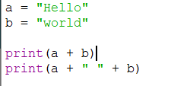

String Concatenation
String concatenation puts two or more strings together
Can be combined with the input( ) function to create personalized strings

Slide 46
String Functions
A function is a piece of code written to carry out a specified task and is called by a name.
The following are built-in functions: print( ); input( ); len( )
len( ) returns the length of a string:
dna_seq = “ANTGCTG”
len(dna_seq)
* Note: using the len( ) function in batch mode will not return a value without adding a print( ) statement

Slide 47
String Methods
str.count( )
Count how many times a particular substring occurs in a string
print(dna_seq.count(“A”))
str.replace(old, new, count)
Replace a particular substring within a string
print(dna_seq.replace(“N”, “G”))
str.lower( )
Returns a copy of the string with all lowercase letters
print(dna_seq.lower())

Slide 48
In-Class Exercise
dnaseq = ATgTCtCATTcAAAGCANNNNNATGCGAGTTATGA”
Write a simple Python script to:
Replace “N” into “G” in the variable dnaseq, and print the sequence
Capitalize all the lowercase letters in the variable dnaseq and print the sequence
Get the length of dnaseq and print the length
Calculate the number of “G” in dnaseq and print the number
Hints:
Write comments as necessary
Use string methods and functions

Slide 49
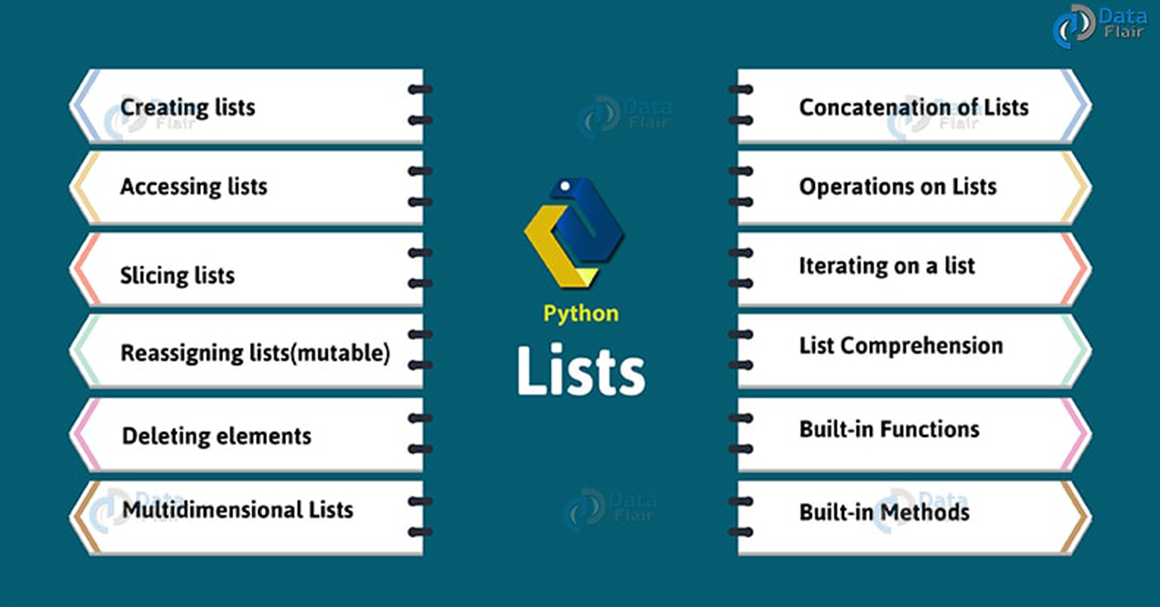
Lists

Slide 50
Lists
What is a list?
A list is a collection of characters made from zero or more items, separated by commas, and surrounded by square brackets.
Examples:
empty_list = [ ]
weekdays = [“Monday”, “Tuesday”, “Wednesday”, “Thursday”, “Friday”]
birds = [‘emu’, ‘ostrich’, ‘cassowary’]
Items can be of any data type
my_list = [123, ‘John’, ‘Terry’, 1.45, True]

Slide 51
Lists
How to access list elements or items:
As with strings, you can extract a single value from a list by indexing.
>>>sequences = [“AAA”, “TTT”, “GGG”]
>>>sequences[0]
‘AAA’
>>>sequences[1]
‘TTT’

Slide 52
Changing a List / Changing a String
Lists
Lists are mutable
>>>sequences = [“AAA”, “TTT”, “GGG”]
>>>sequences[2] = “CCC”
>>>print(sequences)
[‘AAA’, ‘TTT’, ‘CCC’]
Strings
Strings are immutable
DNAseq = “ANTGCTG”
DNAseq[1] = “G”
Returns a type error

