Slide 1

Introduction to Python: Part II
Section 2
August 10–11, 2022
12:30pm–3pm CDT

Slide 2

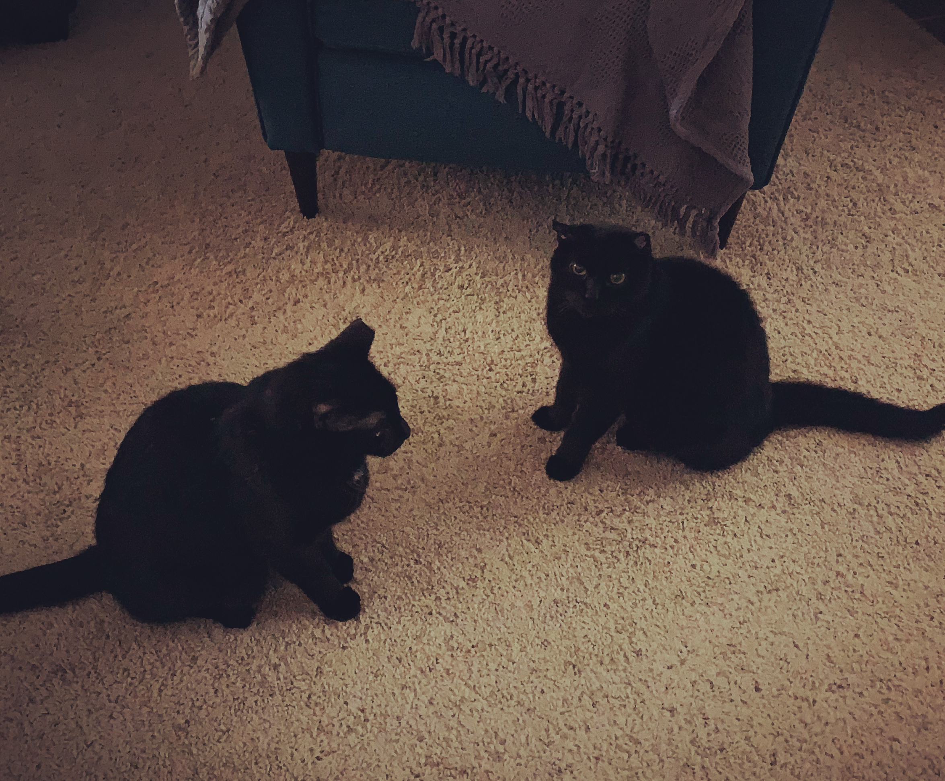







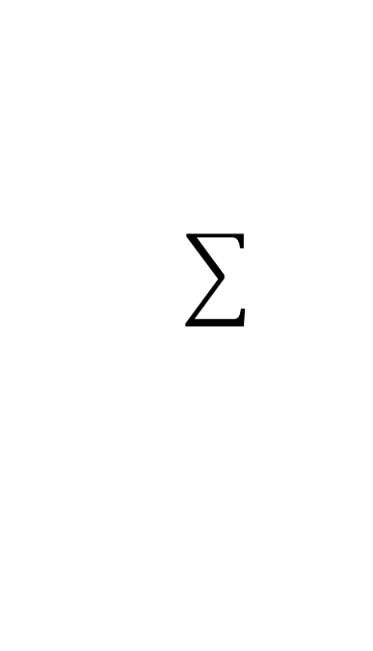

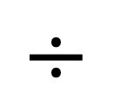
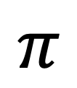
Hello, world!
$$π$$
$$≈$$
Dr. Amanda Kis (“Amanda”)
$$÷$$

Slide 3
Documentation & tutorials
Many of the definitions used in this workshop are taken from the official Python documentation on Python.org
  Check out their tutorial for a comprehensive but informal overview
Other great tutorials, courses, and overviews
  LearnPython.org interactive python tutorial
  freeCodeCamp.org Learn Python full course (YouTube video)
  Real Python tutorials (my favorite!)
  Codeacademy Learn Python 2 course

Slide 4
Sequences
Groups of objects that are ordered based on their position
Capable of iteration: returning their items one at a time
Strings and lists are examples of sequences in Python
motto = ‘Cats rock!’ # string
my_list = [‘This’, ‘is’, ‘a’, ‘Python’, ‘class’] # list

Slide 5
Lists
Group of comma-separated items, surrounded by square brackets
Items usually are homogeneous (of same type)
Items can be nonhomogeous (of different types)
Lists can be empty
>>> my_list = [‘This’, ‘is’, ‘a’, ‘Python’, ‘class’]
All items are strings
>>> different_list = [10, ‘Oklahoma’, -5.6, True]
Items are a mix of integer, string, float, and Boolean types
>>> empty_list =[]

Slide 6
Indexing
Access an individual item of a sequence based on its position
Zero-based: First (left-most) item has index 0, indices increment by 1 to the right to the end of the sequence
0 1 2 3 4 5 6 7 8 9
motto = ‘Cats rock!’
0
1
2
3
4
my_list = [‘This’, ‘is’, ‘a’, ‘Python’, ‘class’]

Slide 7
Indexing
Access an individual item of a sequence based on its position
Zero-based: First (left-most) item has index 0, indices increment by 1 to the right to the end of the sequence
0 1 2 3 4 5 6 7 8 9
>>> motto = ‘Cats rock!’
>>> motto[0]
‘C’
>>> motto[5]
‘r’

Slide 8
Indexing
Access an individual item of a sequence based on its position
Zero-based: First (left-most) item has index 0, indices increment by 1 to the right to the end of the sequence
0
1
2
3
4
>>> my_list = [‘This’, ‘is’, ‘a’, ‘Python’, ‘class’]
>>> my_list[0]
‘This’
>>> my_list[3]
‘Python’

Slide 9
Indexing
The largest index, for the last (right-most) item, is one less than the length of the sequence
0 1 2 3 4 5 6 7 8 9
0
1
2
3
4
>>> motto = ‘Cats rock!’
>>> my_list = [‘This’, ‘is’, ‘a’, ‘Python’, ‘class’]
>>> len(motto)
10
>>> motto[9]
‘!’
>>> motto[10]
IndexError: string index out of range
>>> len(my_list)
5
>>> my_list[4]
‘Python’
>>> my_list[5]
IndexError: list index out of range

Slide 10
Indexing
The largest index, for the last (right-most) item, is one less than the length of the sequence
0 1 2 3 4 5 6 7 8 9
0
1
2
3
4
>>> motto = ‘Cats rock!’
>>> my_list = [‘This’, ‘is’, ‘a’, ‘Python’, ‘class’]
len( ) function
built-in function that returns the number of items in an iterable object
>>> len(motto)
10
>>> motto[9]
‘!’
>>> motto[10]
IndexError: string index out of range
>>> len(my_list)
5
>>> my_list[4]
‘Python’
>>> my_list[5]
IndexError: list index out of range

Slide 11
Indexing
Negative indices start at -1 for the right-most item and increment by
-1 to the left to the start of the sequence
-10 -9 -8 -7 -6 -5 -4 -3 -2 -1
-5
-4
-3
-2
-1
>>> motto = ‘Cats rock!’
>>> my_list = [‘This’, ‘is’, ‘a’, ‘Python’, ‘class’]
>>> motto[-1]
‘!’
>>> motto[-10]
‘C’
>>> motto[-11]
IndexError: string index out of range
>>> my_list[-1]
‘class’
>>> my_list[-5]
‘This’
>>> my_list[-6]
IndexError: list index out of range

Slide 12
Slicing
Access a subsequence (range of items) in a sequence
Builds on indexing: [start:stop:step]
  start is included in the subsequence
  stop is excluded from the subsequence
  step gives the increment between each index
0 1 2 3 4 5 6 7 8 9
>>> motto = ‘Cats rock!’
>>> motto[1:6:1]
‘ats r’
>>> motto[3:9:2]
‘src’

Slide 13
Slicing
Access a subsequence (range of items) in a sequence
Builds on indexing: [start:stop:step]
  start is included in the subsequence
  stop is excluded from the subsequence
  step gives the increment between each index
half-open interval [start, stop)
0 1 2 3 4 5 6 7 8 9
>>> motto = ‘Cats rock!’
>>> motto[1:6:1]
‘ats r’
>>> motto[3:9:2]
‘src’

Slide 14
Slicing
[start:stop:step]
  If start is omitted, the subsequence begins with the first item of the sequence
  If stop is omitted, the subsequence proceeds through the last item of the sequence
  If step is omitted, an increment of 1 is used
0 1 2 3 4 5 6 7 8 9
>>> motto = ‘Cats rock!’
>>> motto[:4] # start from index 0 with step = 1
‘Cats’
>>> motto[5:] # start from index 5, proceed to end of sequence, with step = 1
‘rock!’
>>> motto[5::2] # start from index 5, proceed to end of sequence, with step = 2
‘rc!’
>>> motto[::2] # start from index 0, proceed to end of sequence every other item is returned
‘Ct ok’

Slide 15
Control flow
The order in which pieces of a computer program are executed
Control flow in Python is determined by:
  Indentation
  Conditional execution
    if statements
  Loops
    for loops
    while loops
  Functions

Slide 16
Indentation
Leading whitespace produced by either spaces or tabs (use one or the other—
do not mix!)
Used to group statements
Code at smaller indentation level given higher priority
Code blocks: Pieces of code executed as a unit
Indentation defines multi-line code blocks
  Indentation starts a multi-line code block
  Dedentation ends a multi-line code block
Code block 1
Code block 2
Code block 3
Code block 3
Code block 3
Code block 4
Code block 4
Code block 4
Code block 5

Slide 17
Indentation
Code block 1
number = 1
Code block 2
while True:
Code block 3
if number < 10:
Code block 3
print(‘Still in single digits’)
Code block 3
number += 1
Code block 4
else:
Code block 4
print(‘Double digits entered’)
Code block 4
break
Code block 5
print(number)

Slide 18
Indentation
run first
number = 1
run second
while True:
if number < 10:
print(‘Still in single digits’)
number += 1
else:
print(‘Double digits entered’)
break
print(number)

Slide 19
Indentation
number = 1
while True:
checked first
if number < 10:
print(‘Still in single digits’)
number += 1
else:
print(‘Double digits entered’)
break
print(number)

Slide 20
Indentation
number = 1
while True:
checked first
if number < 10:
print(‘Still in single digits’)
number += 1
checked only if condition is false
else:
print(‘Double digits entered’)
break
print(number)

Slide 21
Indentation
number = 1
while True:
if number < 10:
Lowest priority: will only be run if the expression at next-higher priority is true
print(‘Still in single digits’)
number += 1
else:
Lowest priority: will only be run if the expression is false and the else clause is used, otherwise will be skipped entirely
print(‘Double digits entered’)
break
print(number)

Slide 22
if statements
Start
if keyword creates statement for conditional execution
If the condition is true, the code block beneath it (“suite”) is executed
If the condition is false, the suite is not executed
True
if CONDITION
False
if suite
Proceed

Slide 23
if statements
if statement
if CONDITION:
statement
statement
…
if keyword creates statement for conditional execution
If the condition is true, the code block beneath it (“suite”) is executed
If the condition is false, the suite is not executed
header
suite
clause

Slide 24
if statements
if keyword creates statement for conditional execution
If the condition is true, the code block beneath it (“suite”) is executed
If the condition is false, the suite is not executed
>>> x = 10
>>> y = 5
>>> if x > y:
. . . print(‘x greater than y’)
x greater than y
>>> if x < y:
. . . print(‘x less than y’)
>>>

Slide 25
if statements
Start
Becomes more powerful with else continuation clause
Suite below else clause is executed only if condition is false; otherwise, it is ignored
True
if CONDITION
False
if suite
else suite
Proceed

Slide 26
if statements
if statement
Becomes more powerful with else continuation clause
Suite below else clause is executed only if condition is false; otherwise, it is ignored
if CONDITION:
statement
statement
…
else:
statement
statement
…
header
suite
clause
header
suite
clause

Slide 27
if statements
if statement
Becomes more powerful with else continuation clause
Suite below else clause is executed only if condition is false; otherwise, it is ignored
if CONDITION:
statement
statement
…
else:
statement
statement
…
header
suite
clause
header
suite
clause
Clause headers are at the same indentation level, so they are given the same priority

Slide 28
if statements
if statement
Becomes more powerful with else continuation clause
Suite below else clause is executed only if condition is false; otherwise, it is ignored
if CONDITION:
statement
statement
…
else:
statement
statement
…
header
suite
clause
header
suite
clause
Clause headers are at the same indentation level, so they are given the same priority
Suites are at a larger indentation level, so they are given lower priority, and one is executed only if its header is used

Slide 29
if statements
Becomes more powerful with else continuation clause
Suite below else clause is executed only if condition is false; otherwise, it is ignored
>>> x = 5
>>> y = 10
>>> if x > y:
. . . print(‘x greater than y’)
. . . else:
. . . print(‘x less than or equal to y’)
x less than or equal to y

Slide 30
if statements
Becomes more powerful with else continuation clause
Suite below else clause is executed only if condition is false; otherwise, it is ignored
Example 1
>>> x = 10
>>> y = 5
>>> if x > y:
. . . print(‘x greater than y’)
. . . else:
. . . print(‘x less than or equal to y’)
x greater than y
Example 2
>>> x = 5
>>> y = 10
>>> if x > y:
. . . print(‘x greater than y’)
. . . else:
. . . print(‘x less than or equal to y’)
x less than or equal to y

Slide 31
if statements
Start
True
if suite
if CONDITION
Becomes even more powerful with elif continuation clause(s)
0 or more elif clauses can be used
No limit to the number of elif clauses!
Conditions are evaluated one-by-one in order until a true condition is found; then the corresponding suite is executed, and no other part of the if statement is evaluated or executed
If all conditions are false, the else suite is executed
False
True
elif suite
elif CONDITION
False
True
elif suite
elif CONDITION
False
else suite
Proceed

Slide 32
if statements
if statement
if CONDITION:
statement
statement
…
elif CONDITION:
statement
statement
…
elif CONDITION:
statement
statement
…
…
else:
statement
statement
…
header
suite
clause
Becomes even more powerful with elif continuation clause(s)
0 or more elif clauses can be used
No limit to the number of elif clauses!
Conditions are evaluated one-by-one in order until a true condition is found; then the corresponding suite is executed, and no other part of the if statement is evaluated or executed
If all conditions are false, the else suite is executed
header
suite
clause
header
suite
clause
header
suite
clause

Slide 33
if statements
Becomes even more powerful with elif continuation clause(s)
0 or more elif clauses can be used
No limit to the number of elif clauses!
Conditions are evaluated one-by-one in order until a true condition is found; then the corresponding suite is executed, and no other part of the if statement is evaluated or executed
If all conditions are false, the else suite is executed
>>> x = 5
>>> y = 10
>>> if x > y:
. . . print(‘x greater than y’)
. . . elif x == y:
. . . print(‘x equals y’)
. . . else:
. . . print(‘x less than y’)
x less than y

Slide 34
if statements
Becomes even more powerful with elif continuation claus’(s)
Example 1
>>> x = 3
>>> y = 3
>>> if x > y:
. . . print(‘x greater than y’)
. . . elif x == y:
. . . print(‘x equals y’)
. . . else:
. . . print(‘x less than y’)
x equals y
Example 2
>>> x = 5
>>> y = 10
>>> if x > y:
. . . print(‘x greater than y’)
. . . elif x == y:
. . . print(‘x equals y’)
. . . else:
. . . print(‘x less than y’)
x less than y

Slide 35
if statements
Conditions are evaluated one-by-one
Only the suite beneath the first true condition is executed
All further clauses and suites ignored after a true condition is found
Example 1
>>> x = 3
>>> y = 3
>>> if x > y:
. . . print(‘x greater than y’)
. . . elif x == y:
. . . print(‘x equals y’)
. . . else:
. . . print(‘x less than y’)
x equals y
checked first, false, continues to next condition

Slide 36
if statements
Conditions are evaluated one-by-one
Only the suite beneath the first true condition is executed
All further clauses and suites ignored after a true condition is found
Example 1
>>> x = 3
>>> y = 3
>>> if x > y:
. . . print(‘x greater than y’)
. . . elif x == y:
. . . print(‘x equals y’)
. . . else:
. . . print(‘x less than y’)
x equals y
checked first, false, continues to next condition
checked second, true, suite executed, rest of statement ignored

Slide 37
if statements
Conditions are evaluated one-by-one
Only the suite beneath the first true condition is executed
All further clauses and suites ignored after a true condition is found
Example 2
>>> x = 5
>>> y = 10
>>> if x > y:
. . . print(‘x greater than y’)
. . . elif x == y:
. . . print(‘x equals y’)
. . . else:
. . . print(‘x less than y’)
x less than y
checked first, false, continues to next condition

Slide 38
if statements
Conditions are evaluated one-by-one
Only the suite beneath the first true condition is executed
All further clauses and suites ignored after a true condition is found
Example 2
>>> x = 5
>>> y = 10
>>> if x > y:
. . . print(‘x greater than y’)
. . . elif x == y:
. . . print(‘x equals y’)
. . . else:
. . . print(‘x less than y’)
x less than y
checked first, false, continues to next condition
checked second, false, program continues

Slide 39
if statements
If all if and elif conditions are false, the suite beneath the else clause is executed
Example 2
>>> x = 5
>>> y = 10
>>> if x > y:
. . . print(‘x greater than y’)
. . . elif x == y:
. . . print(‘x equals y’)
. . . else:
. . . print(‘x less than y’)
x less than y
checked first, false, continues to next condition
checked second, false, program continues
suite beneath else clause executed

Slide 40
if statements
Conditions are evaluated one-by-one
Only the suite beneath the first true condition is executed
All further clauses and suites ignored after a true condition is found
Example 3
>>> x = 8
>>> y = 3
>>> if x > y:
. . . print(‘x greater than y’)
. . . elif x == y:
. . . print(‘x equals y’)
. . . else:
. . . print(‘x less than y’)
x greater than y
checked first, true, suite executed, statement stops

Slide 41
Loops
Code is executed repeatedly
for loop: suite of statement(s) executed for each item in an iterable object (which includes sequences)
while loop: suite of statement(s) executed as long as a condition is true
for statement
for ITEM in ITERABLE:
statement
statement
…
header
suite
clause
while statement
while CONDITION:
statement
statement
…
header
suite
clause

Slide 42
for loops
Start
yes
for keyword creates statement for repeated execution for each item of an iterable object
Suite beneath the for statement is executed for each item of an iterable object
Loop terminates once all items are exhausted
for
for suite
More items left?
no
Proceed

Slide 43
for loops
for statement
for keyword creates statement for repeated execution for each item of an iterable object
Suite beneath the for statement is executed for each item of an iterable object
Loop terminates once all items are exhausted
for ITEM in ITERABLE:
statement
statement
…
header
suite
clause

Slide 44
for loops
for keyword creates statement for repeated execution for each item of an iterable object
Suite beneath the for statement is executed for each item of an iterable object
Loop terminates once all items are exhausted
>>> my_list = [1, 2, 3, 4]
>>> for number in my_list:
. . . print(‘Square of ’ + str(number) + ‘is:’)
. . . print(number**2)
Square of 1 is:
1
Square of 2 is:
4
Square of 3 is:
9
Square of 4 is:
16
>>>

Slide 45
while loops
Start
while keyword creates statement for repeated execution as long as a condition is true
Suite beneath the while statement is executed as long as the condition remains true
Loop terminates when the condition becomes false
True
while CONDITION
while suite
False
Proceed

Slide 46
while loops
while keyword creates statement for repeated execution as long as a condition is true
Suite beneath the while statement is executed as long as the condition remains true
Loop terminates when the condition becomes false
while statement
while CONDITION:
statement
statement
…
header
suite
clause

Slide 47
while loops
while keyword creates statement for repeated execution as long as a condition is true
Suite beneath the while statement is executed as long as the condition remains true
Loop terminates when the condition becomes false
>>> counter = 1
>>> while counter < 5:
. . . print(counter)
. . . counter += 1
1
2
3
4
>>>

Slide 48
while loops
while keyword creates statement for repeated execution as long as a condition is true
Suite beneath the while statement is executed as long as the condition remains true
Loop terminates when the condition becomes false
>>> counter = 1
>>> while counter < 5:
. . . print(counter)
. . . counter += 1
1
2
3
4
>>>
augmented assignment
changes a number and re-assigns it to the original variable
counter = counter + 1
or
counter += 1

Slide 49
break statement
>>> multiples_of_three = [3, 6, 9, 12, 15]
>>> for multiple in multiples_of_three:
. . . print(multiple)
. . . if multiple > 10:
. . . print(‘Breaking out of loop.’)
. . . break
. . . print(‘Moving onto next multiple.’)
3
Moving onto next multiple.
6
Moving onto next multiple.
9
Moving onto next multiple.
12
Breaking out of loop.
>>>
Used to terminate a (for or while) loop

Slide 50
break statement
Used to terminate a (for or while) loop
>>> counter = 1
>>> while counter < 5:
. . . if counter >= 3:
. . . print(‘Breaking out of loop.’)
. . . break
. . . print(counter)
. . . counter += 1
1
2
Breaking out of loop.
>>>

Slide 51
continue statement
Used to skip the rest of the suite inside a (for or while) loop for the current iteration only
Loop continues with next iteration
>>> my_list = [1, 2, 3, 4, 5, 6]
>>> for num in my_list:
. . . if num % 2 == 0: # check if even
. . . continue
. . . print(num)
1
3
5
>>>

Slide 52
continue statement
Used to skip the rest of the suite inside a (for or while) loop for the current iteration only
Loop continues with next iteration
>>> my_list = [1, 2, 3, 4, 5, 6]
>>> for num in my_list:
. . . if num % 2 == 0: # check if even
. . . continue
. . . print(num)
1
3
5
>>>
modulo operator %
returns the remainder of the division of the first term by the second term
great for checking if a number is even or odd!

Slide 53
continue statement
Used to skip the rest of the suite inside a (for or while) loop for the current iteration only
Loop continues with next iteration
>>> counter = 1
>>> while counter < 5:
. . . if counter <= 3:
. . . print(counter)
. . . counter += 1
. . . continue
. . . print(‘Done counting.’)
. . . break
1
2
3
Done counting.
>>>

Slide 54
Functions
Used to accomplish specific tasks
Call to execute
  Form of function call: function_name(arg1, arg2, …)
    Any given function may require 0 or more values in place of arguments arg1, arg2, …
    Read a function’s documentation to determine which (if any) arguments must be supplied and which (if any) are optional
Exit by returning (passing back) value(s) to the user
  Value(s) can be assigned to variable(s) for later use

Slide 55
Built-in functions
Useful functions that always are available and are commonly used by programmers in all fields and applications
Function | Description
abs(x) | returns absolute value of number x
len(o) | returns number of items in iterable object o
list(o) | returns list constructed from items in iterable object o
max(o) | returns largest item in iterable object o
min(o) | returns smallest item in iterable object o
print(o) | displays representation of object o to screen (or other standard output device)
round(x, n) | returns x rounded to n digits precision after the decimal point
str(o) | returns string representation of object o
sum(o) | returns sum of items in iterable object o

Slide 56
Methods
Functions associated with (“belonging to”) a particular type of object
Special call format: object.method_name(arg1, arg2, …)
Examples of list methods
  list.append(x) # append item x to end of list
  list.insert(i, x) # insert item x at index i
  list.pop(i) # remove item at index i
  list.count(x) # return the number of times item x appears in the list
  list.sort() # sort the items of the list in-place
  list.reverse() # reverse the items of the list in-place

Slide 57
User-defined functions
We can define our own functions and then call them to carry out specific tasks!
Users define their own functions to follow the DRY principle
  “Don’t Repeat Yourself”
  Don’t repeat code: Write reusable code instead!

Slide 58
User-defined functions
Function definition
  Header: def keyword followed by function name and 0 or more parameters in parentheses followed by colon
  Function body (suite) indented
Body usually includes a return statement
  Returns None if no explicit return statement included, or if no value(s) provided after the return keyword
Execution of the function stops when a return statement is run, and no code after it within the body is executed
def function_name(param1, param2, …):
statement
statement
…
return value(s)

Slide 59
User-defined functions
Function definition
  Header: def keyword followed by function name and 0 or more parameters in parentheses followed by colon
  Function body (suite) indented
Body usually includes a return statement
  Returns None if no explicit return statement included, or if no value(s) provided after the return keyword
Execution of the function stops when a return statement is run, and no code after it within the body is executed
>>> def simple_func(x):
. . . print(‘Squaring in progress.’)
. . . return x**2
>>> simple_func(6)
Squaring in progress.
36
>>> simple_func(-4)
Squaring in progress.
16

Slide 60
User-defined functions
Function definition
  Header: def keyword followed by function name and 0 or more parameters in parentheses followed by colon
  Function body (suite) indented
Body usually includes a return statement
  Returns None if no explicit return statement included, or if no value(s) provided after the return keyword
Execution of the function stops when a return statement is run, and no code after it within the body is executed
>>> def testing(x):
. . . print(‘Printing for the first time.’)
. . . return x
. . . x += 1
. . . print(‘Printing for the second time.’)
. . . return x
>>> testing(2)
Printing for the first time.
2
>>> testing(7)
Printing for the first time.
7

Slide 61
User-defined functions
Returned value(s) can be assigned to variables for later use
>>> def simple_func(x):
. . . return x**2
>>> my_square = simple_func(6)
>>> my_square
36
>>> my_square = simple_func(-4)
>>> my_square
16

Slide 62
User-defined functions
Default parameter values allow arguments to be omitted from a call
>>> def simple_func(x):
. . . return x**2
>>> simple_func(5)
25
>>> simple_func()
TypeError: simple_func() missing 1 required positional argument: 'x'

Slide 63
User-defined functions
Default parameter values allow arguments to be omitted from a call
>>> def simple_func(x=2):
. . . return x**2
>>> simple_func(5)
25
>>> simple_func()
4

Slide 64
Scope
Global variables are those created outside functions
  They can be read by everything inside your program!
  They can be read inside functions without being passed in as arguments
>>> x = 3.5
>>> def simple_func():
. . . return x
>>> simple_func()
3.5

Slide 65
Scope
Global variables are those created outside functions
  They can be read by everything inside your program!
  They can be read inside functions without being passed in as arguments
  But they cannot be modified inside functions…
>>> x = 3.5
>>> def simple_func():
. . . x += 2 # add 2 to x and reassign it
. . . return x
>>> simple_func()
UnboundLocalError: local variable ‘x’ referenced before assignment

Slide 66
Scope
Global variables are those created outside functions
  They can be read by everything inside your program!
  They can be read inside functions without being passed in as arguments
  But they cannot be modified inside functions…unless they are passed in as arguments and the modified value is returned
>>> x = 3.5
>>> def simple_func(x):
. . . x += 2 # add 2 to x and reassign it
. . . return x
>>> simple_func(x)
5.5

Slide 67
Scope
Global variables are those created outside functions
  They can be read by everything inside your program!
  They can be read inside functions without being passed in as arguments
  But they cannot be modified inside functions…unless they are passed in as arguments and the modified value is returned
  For the new value to “stick,” the returned value must be assigned to the variable
>>> x = 3.5
>>> def simple_func(x):
. . . x += 2 # add 2 to x and reassign it
. . . return x
>>> simple_func(x)
5.5
>>> x
3.5

Slide 68
Scope
Global variables are those created outside functions
  They can be read by everything inside your program!
  They can be read inside functions without being passed in as arguments
  But they cannot be modified inside functions…unless they are passed in as arguments and the modified value is returned
  For the new value to “stick,” the returned value must be assigned to the variable
>>> x = 3.5
>>> def simple_func(x):
. . . x += 2 # add 2 to x and reassign it
. . . return x
>>> simple_func(x)
5.5
>>> x
3.5
>>> x = simple_func(x)
>>> x
5.5

Slide 69
Scope
Local variables are those created inside functions when the functions are called
  They can be read and modified only inside the function within which they are created
>>> x = ‘global’
>>> def simple_func():
. . . x = ‘local’
. . . y = ‘another local’
. . . print(x)
>>> simple_func()
local
>>> print(x)
global
>>> y
NameError: name ‘y’ is not defined

Slide 70
Scope
Local variables are those created inside functions when the functions are called
  They can be read and modified only inside the function within which they are created
  Their value must be returned in order to access it outside the function
>>> x = ‘global’
>>> def simple_func():
. . . x = ‘local’
. . . return x
>>> simple_func()
‘local’
>>> x
‘global’

Slide 71
Scope
Local variables are those created inside functions when the functions are called
  They can be read and modified only inside the function within which they are created
  Their value must be returned in order to access it outside the function
  Their returned value can be assigned to a variable, making it global in scope
>>> x = ‘global’
>>> def simple_func():
. . . x = ‘local’
. . . return x
>>> simple_func()
‘local’
>>> x
‘global’
>>> x = simple_func()
>>> x
‘local’

Slide 72
Structured programming
Use control flow to produce optimal code
  Readable
  Reusable
  Efficient
  Easier and quicker to develop
  Easier and quicker to modify
Guided by principles of
  Sequence—order of execution
  Selection—conditional execution
  Iteration—repeated execution

Slide 73
Structured programming
Use control flow to produce optimal code
  Readable
  Reusable
  Efficient
  Easier and quicker to develop
  Easier and quicker to modify
Guided by principles of
  Sequence—order of execution
  Selection—conditional execution
  Iteration—repeated execution
order of statements and function calls
if statements
for and while loops

Slide 74
Guess-A-Word game
A player solves a 5-letter word by guessing one letter at a time
Correct answers are added to the word
The player is allowed up to 5 wrong guesses
If the player guesses the word without making 5 wrong guesses, they win!
H
E

Slide 75
Guess-A-Word game
What are the steps in the game?
What are actions that must be taken for the game to proceed?

