Slide 1

Computer Science in Modern Biology: Introduction to
Part 1
August 2022

Slide 2
Introductions
Instructor
TA’s
Notes:
Will have time for practice problems both days!

Slide 3
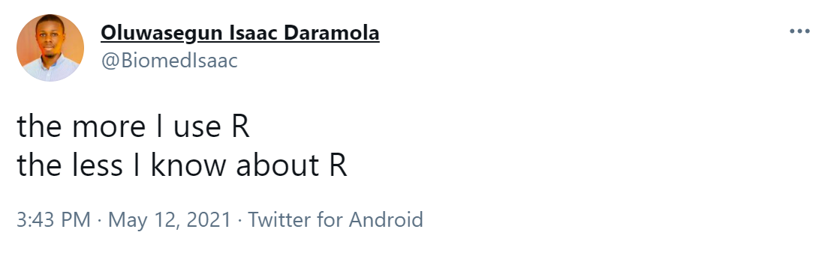
Intro to R Part 1: Schedule
Day 1:
Introduction to R
Coding Basics
Working with data
Day 2:
Packages
Manipulating Data
Notes:
Will have time for practice problems both days!

Slide 4
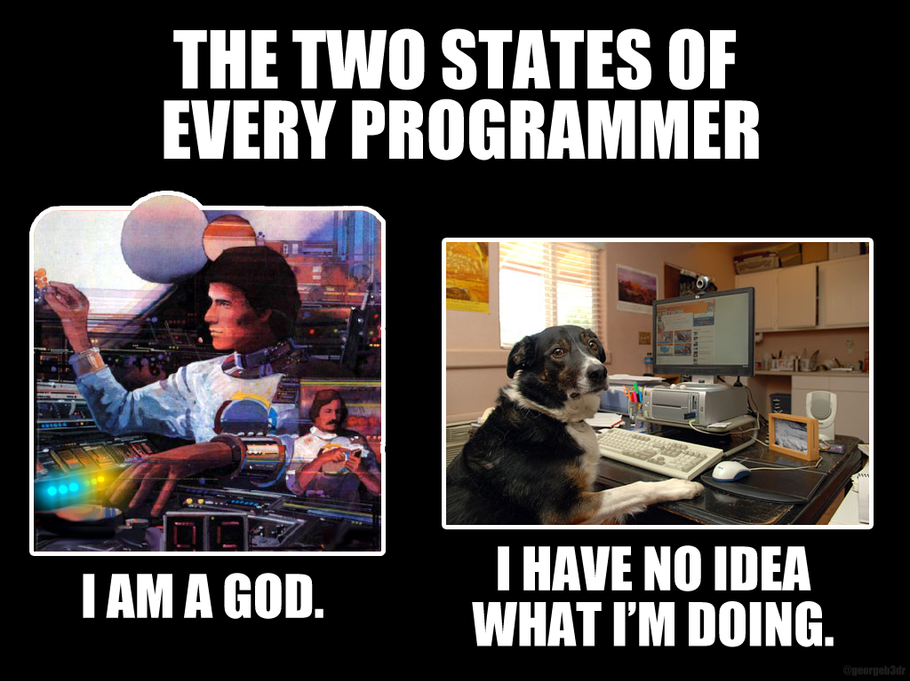
Intro to R Part 1: Schedule
Day 1:
Introduction to R
Coding Basics
Working with data
Day 2:
Packages
Manipulating Data
Notes:
Will have time for practice problems both days!
ONE OF THE MOST IMPORTANT LESSONS YOU CAN LEARN IS THAT THE MORE YOU CODE, THE BETTER YOU WILL GET!

Slide 5
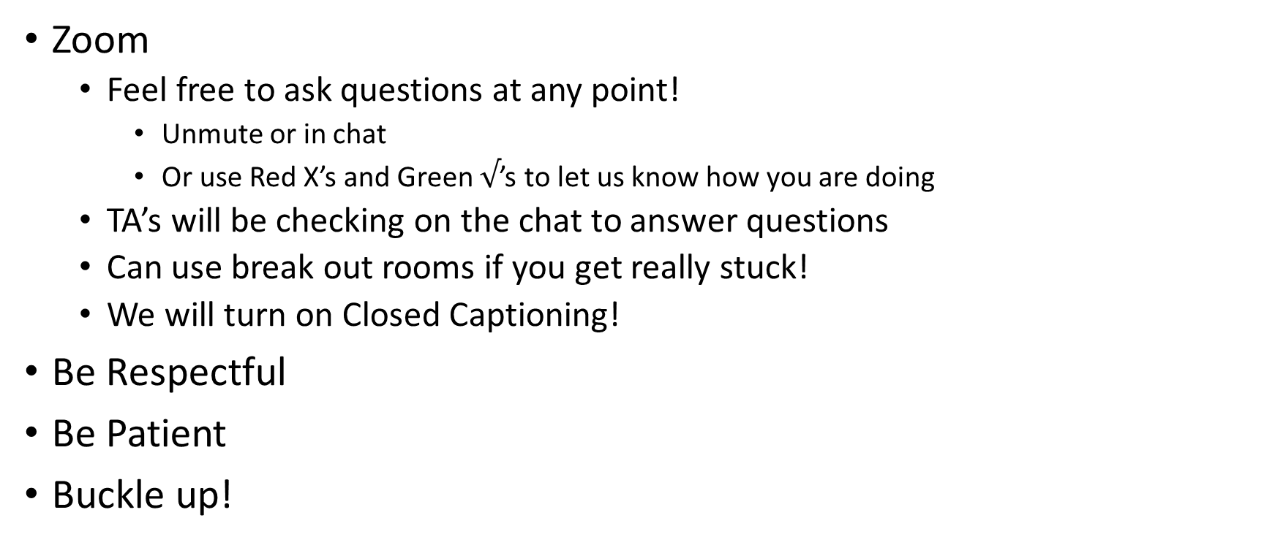
Logistics
Zoom
Feel free to ask questions at any point!
Unmute or in chat
Or use Red X’s and Green $√$’s to let us know how you are doing
TA’s will be checking on the chat to answer questions
Can use break out rooms if you get really stuck!
We will turn on Closed Captioning!
Be Respectful
Be Patient
Buckle up!

Slide 6
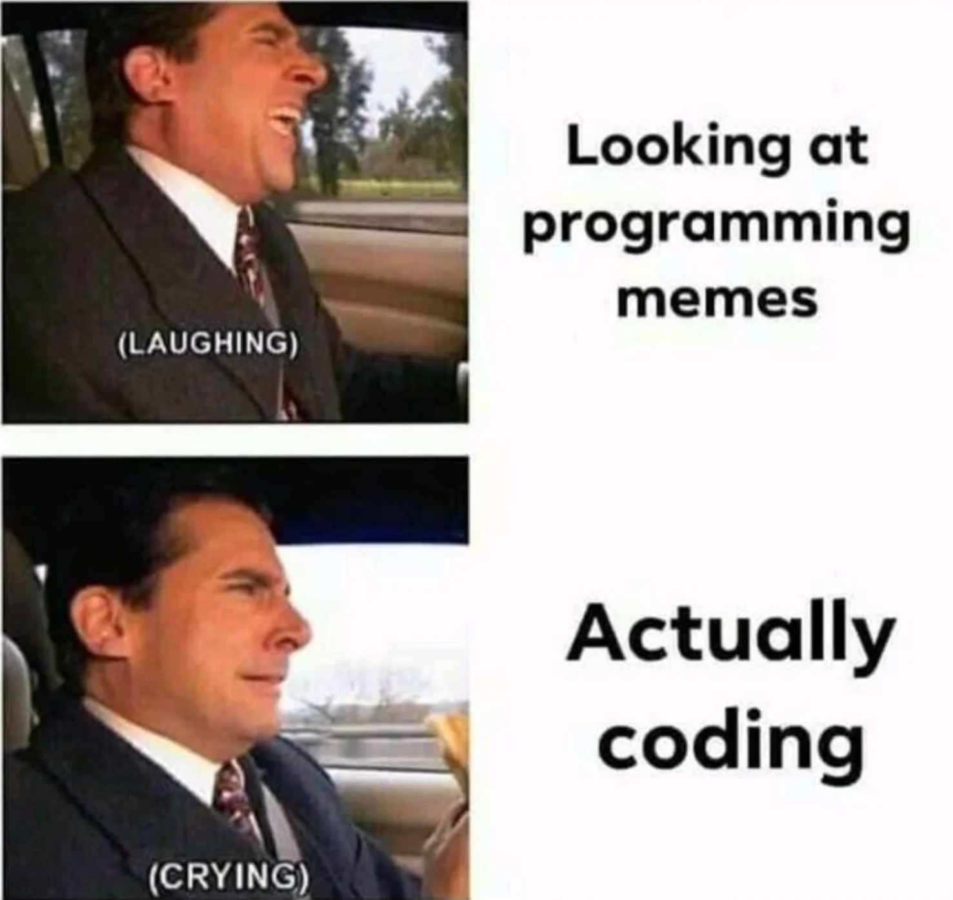
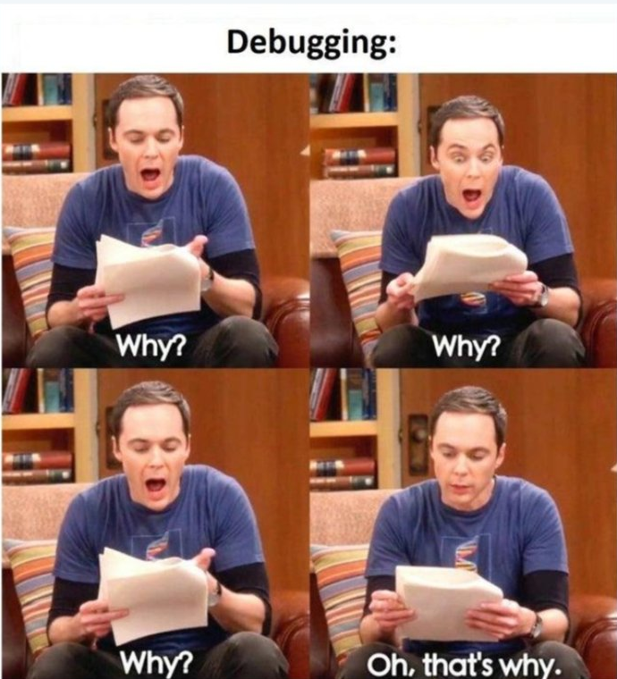
What is ???
Free and Open statistical / computational program
EVERYONE STRUGGLES!

Slide 7
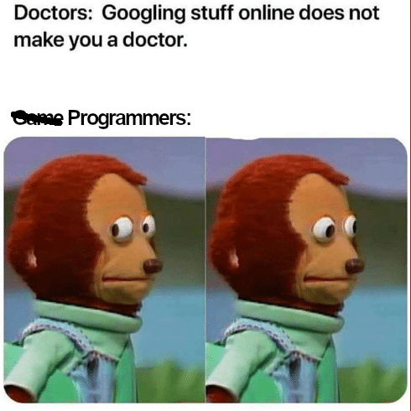
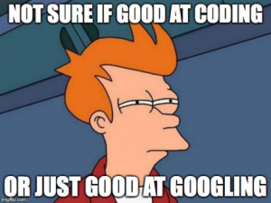
What is ???
Widely used, popularity growing rapidly
Large, online community!
Many people to help!

Slide 8
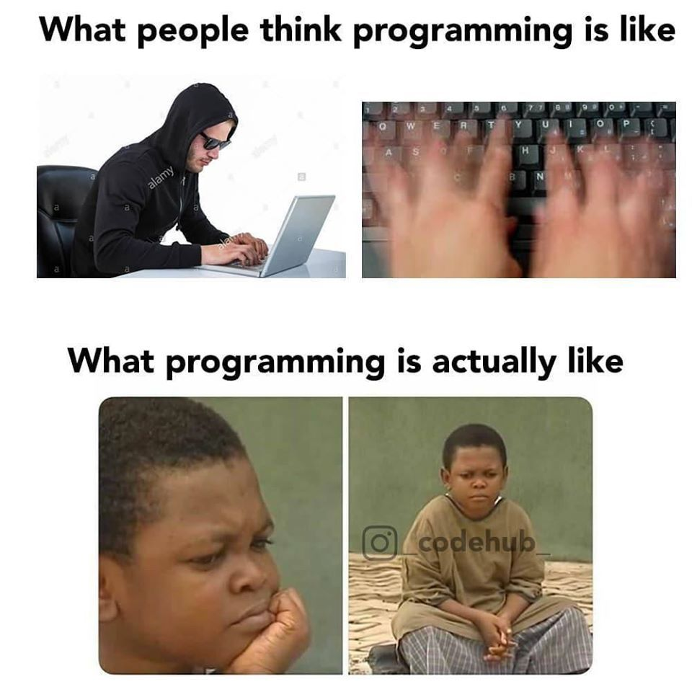
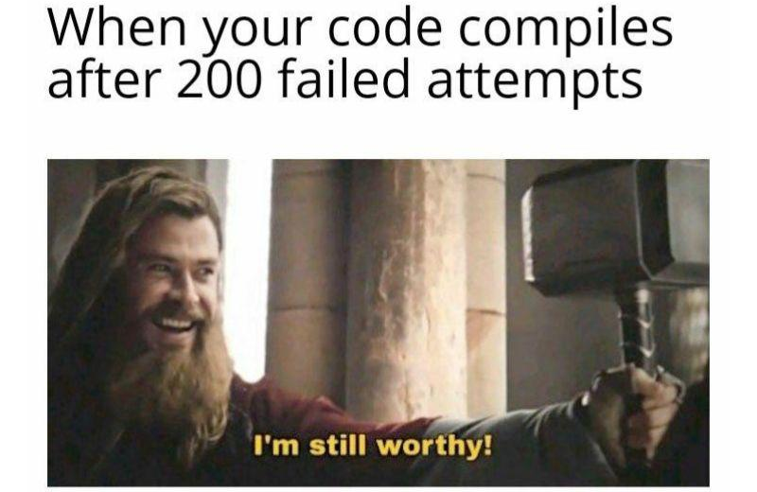
What is ???
Practice, Practice, Practice!

Slide 9
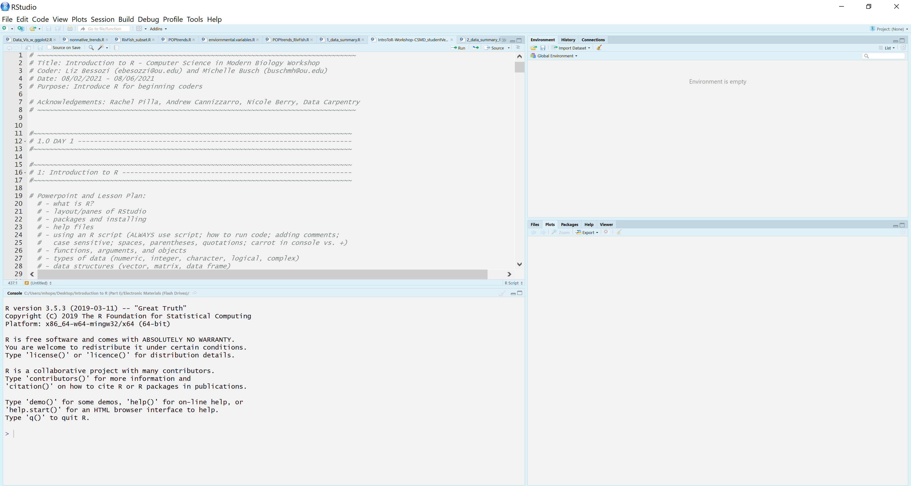
How does it work?
Notes:
R vs R studio!
R studio more user friendly

Slide 10
How does it work?
SCRIPT!/
SOURCE!
Notes:
Where you write and edit your code

Slide 11
How does it work?
SCRIPT!/
SOURCE!
CONSOLE!
Notes:
Where commands are run, where results appear

Slide 12
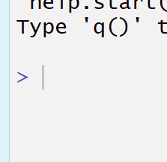
How does it work?
SCRIPT!/
SOURCE!
CONSOLE!
Notes:
This symbol means the code is ready to run!
If a plus sign, the code didn’t finish running, line not completed

Slide 13
How does it work?
SCRIPT!/
SOURCE!
ENVIRONMENT!
CONSOLE!
Notes:
What you have, type of object
Other tabs –
History: can see code that has already run through the console
Connection: can allow you to connect with other data sources

Slide 14
How does it work?
SCRIPT!/
SOURCE!
ENVIRONMENT!
PLOTS!
PACKAGES!
HELP!
CONSOLE!
Notes:
What’s in your folder
Plots will appear here
What packages you have
R Help

Slide 15
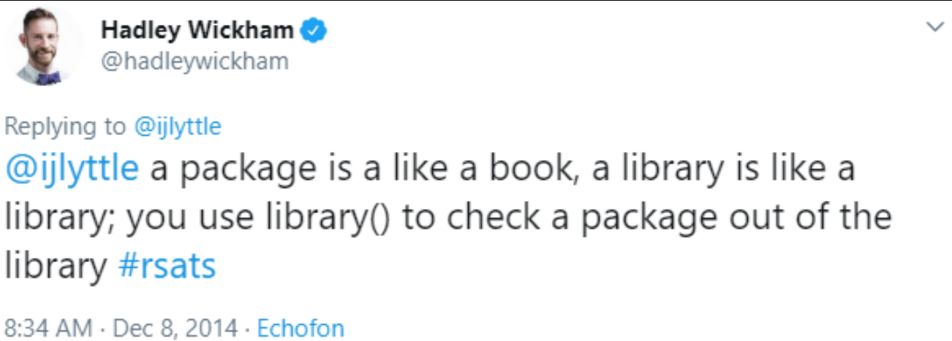
R Packages
Bundles of tools / functions that have been developed
Many to choose from! For data manipulation, spatial data, text data, etc. etc.
We will go through installing these tomorrow…

