Slide 1
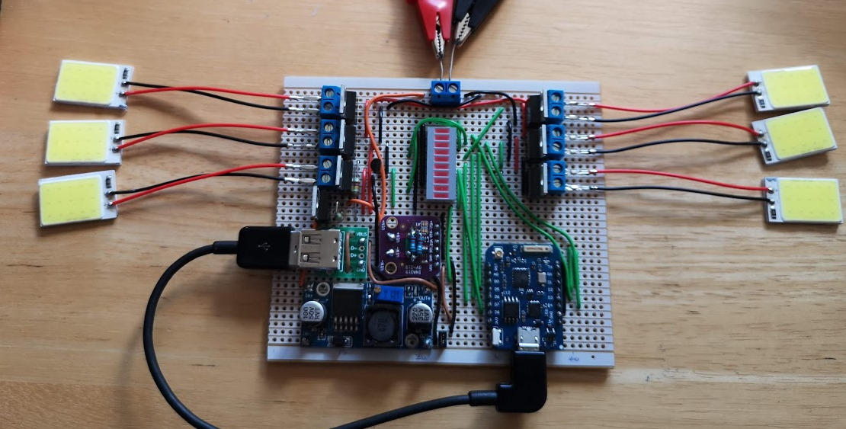
LED House Lights
Smart lighting using 30x 2W COB LED panels
Notes:
Home lighting system
Use in loft and under eaves for outside lighting
Loft: several – maybe 10 or so?
Outside: 2 or 3 per wall – so maybe 12?
Total: about 20 or so…

Slide 2

LEDs for lighting
LEDs are very efficient compared to other forms of lighting
Notes:
Candle, incandescent, compact fluorescent lamp. LED
Approx: Incandescent 2%, CFL 8%, LED up to 25% (theoretically 40%?)
LEDs are the way to go

Slide 3
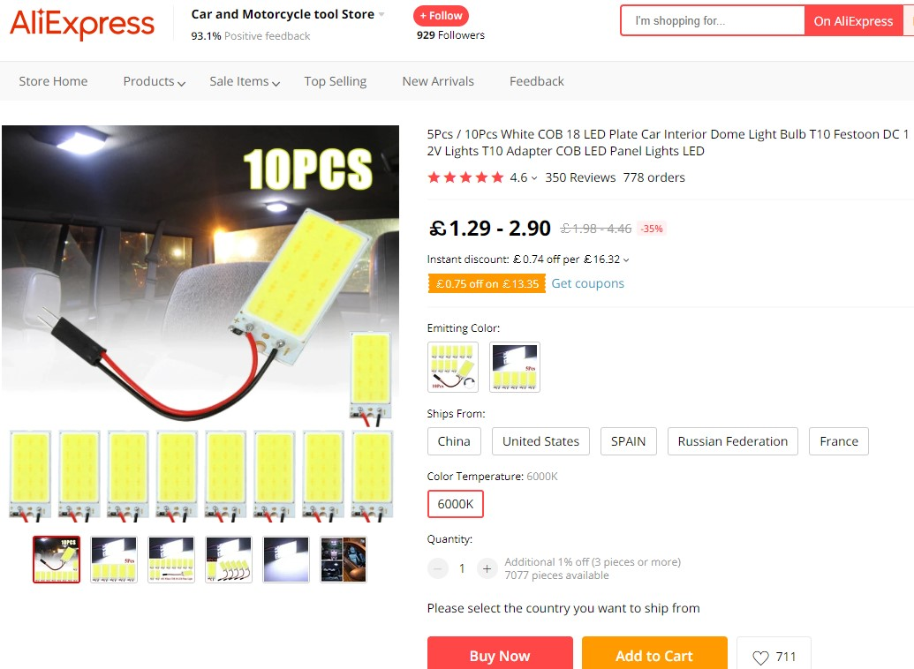
COB LED panels
Very bright and inexpensive
Notes:
Saw these on Aliexpress – advertised as suitable for interior light in car, 12V supply
Ordered, received.
Very bright, very inexpensive, COBs maybe future of lighting? Until something else comes along...
Worked from 8V to 12V. OK @ 10V. Car voltage is 14V...
Use blue LEDs with phosphor coating – convert to white light
15 LEDs, 5 parallel sets of 3 in series
Single series resistor to limit current – cuts efficiency down by 75%
25% becomes about 18%
Get hot @ 12V: about 100degC

Slide 4
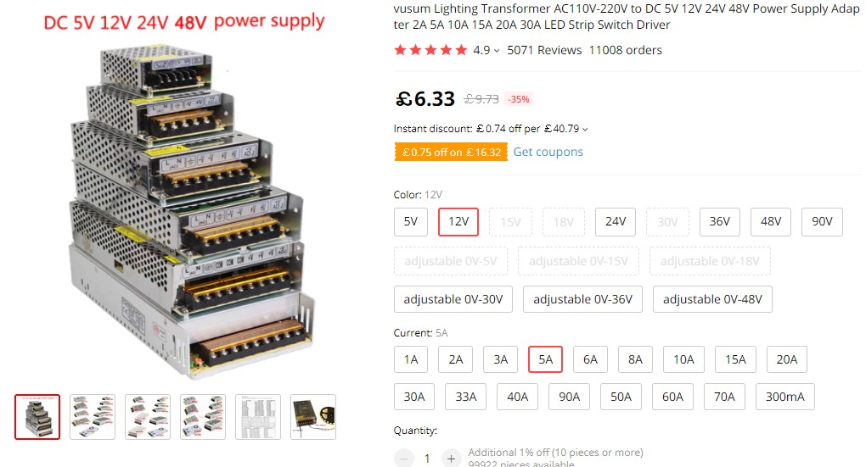
12V Power Supply
5A about £6, 10A about £10
Notes:
Needed 12V supply – so looked on Aliexpress
12V 5A – about £6
12V 10A – about £10
Got one of each

Slide 5
Controller Board
Turn on/off via home network (i.e. wifi)
Control brightness using PWM
Several different circuits
Notes:
Smart control
Safety

Slide 6
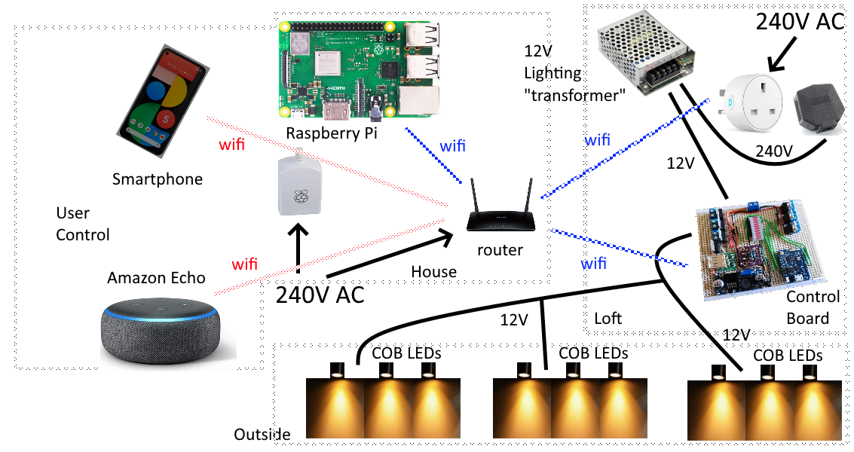
Top Level Hardware Design
Notes:
Most important part: lights
Then: controller board. Powered by 12V
Smart plug is for safety – last resort: power down
Raspberry Pi talks to controller board via REST API
Raspberry Pi does the clever stuff – lights on when it gets dark etc.
Raspberry Pi Nginx, VueJS, Python API.

Slide 7
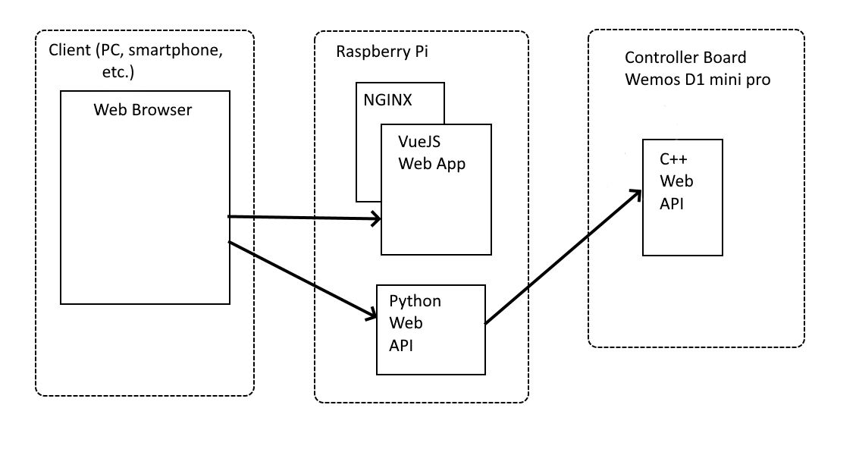
Top Level Software Design
Notes:
Multicast DNS (mDNS)
Python API so that:
a) We can have better security e.g. Google login
b) mDNS doesn’t work on Android

Slide 8
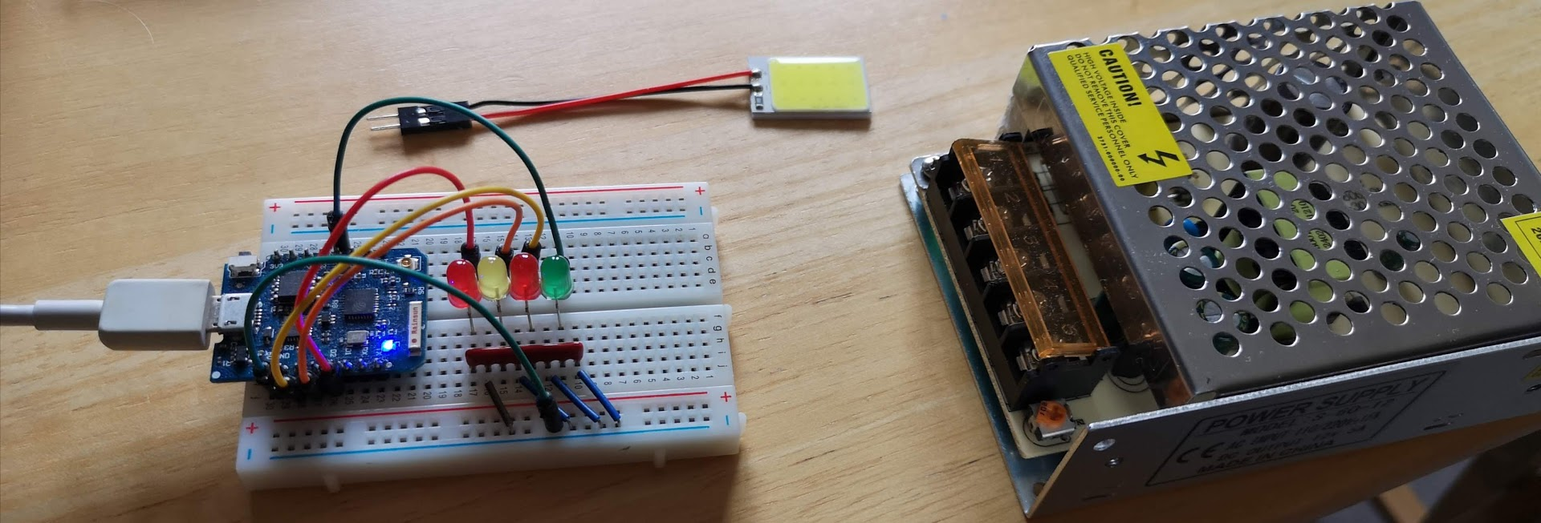
Prototype 1
Wemos D1 with API
Notes:
First prototype
Not connected to COB LEDs or 12V supply
Just testing wifi and API
Had a Wemos D1 mini pro in my box of bits - ESP8266
Basic authentication over a secure TLS connection
Request takes just under a second on ESP8266 board
Code based on Arduino examples
Raspberry Pi to provide web interface and then pass commands onto Wemos API

Slide 9
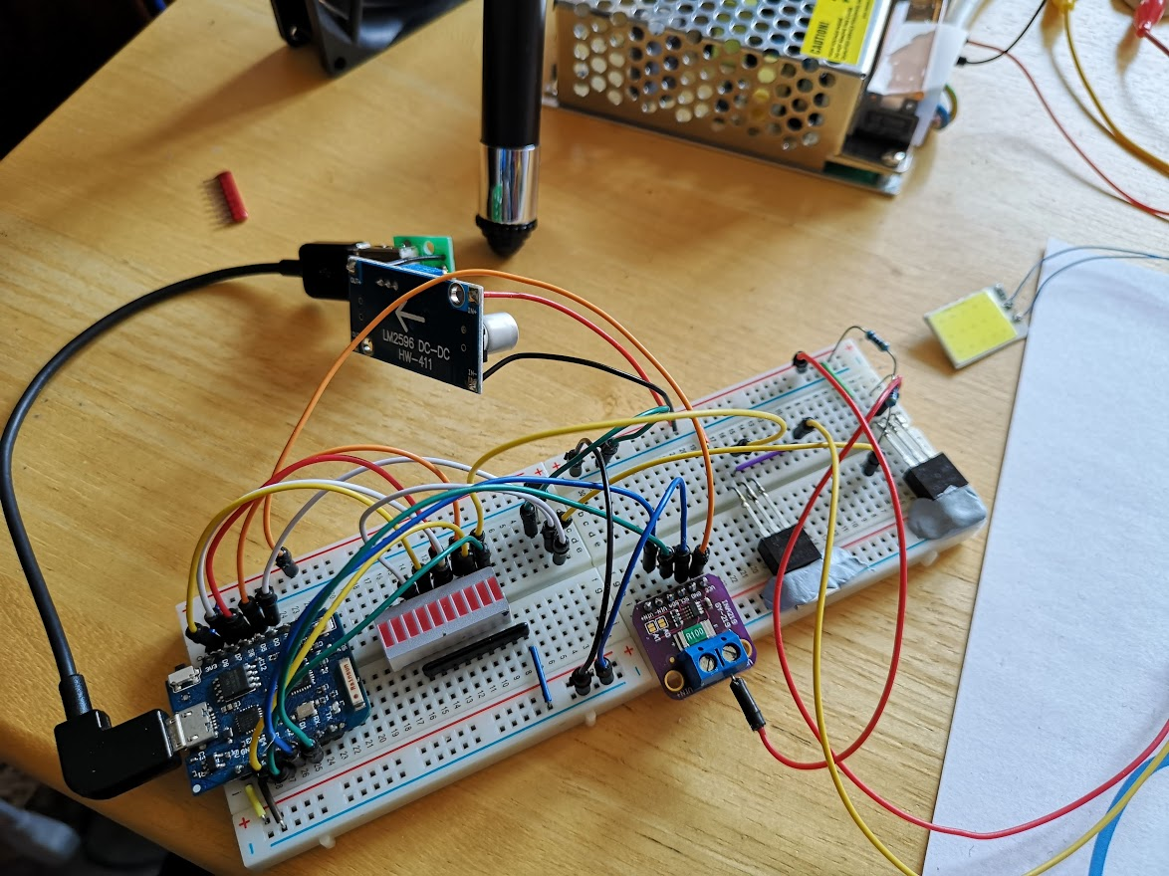
Prototype 2
N channel MOSFET, DC to DC converter
Notes:
Hooked up 12V supply
First thought was 7805 regulator to drop 12V to 5V – but tried this and regulator got hot even though D1 board was only using about 80mA
So used DC to DC converter – about 85% efficient
N channel MOSFET between LED and ground – allows on/off and PWM
Realised 12V on one side of LEDs even when LEDs off – thought this was ok until I accidentally shorted the 12V line to earth and wire started to melt!
Then added P channel MOSFET to 12V side, and current sensing board – INA219 – modified to allow 5.4A reading rather than 3.2A

Slide 10
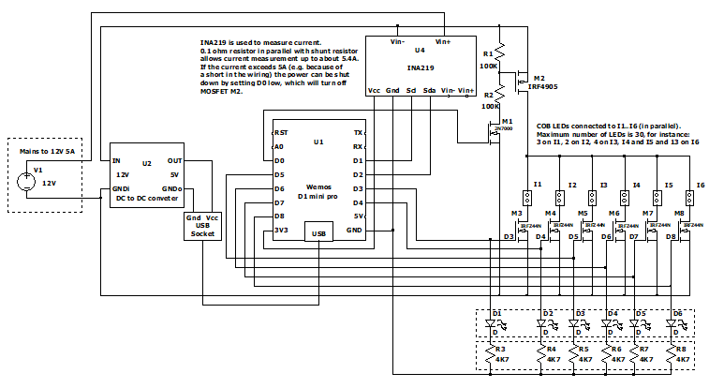
Schematic
Using LTSpice
Notes:
Created in LTSpice – had to create custom packages for Wemos D1, DC to DC converter and INA219
LTSpice usage outside scope of talk
Quite high resistance on indicator LEDs because I didn’t want to affect the high output of the Wemos
N channel MOSFET gate voltage min: 2V, max: 4V
ESP8266 high output measured at 3.3V
With hindsight: could have used P channel MOSFETs rather than N type, but driver circuit more complicated and also this way I can isolate both sides of LEDs

Slide 11
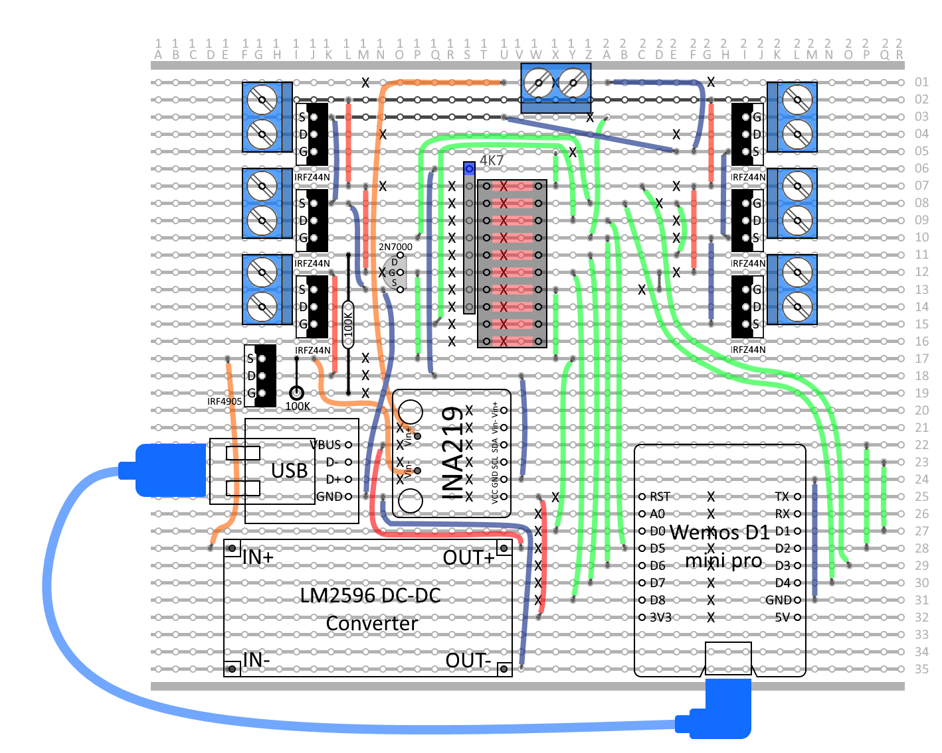
Vero board Layout
Using Paint.Net (which is like photoshop)
Notes:
Decided to make on veroboard rather than PCB
Created with Paint.Net which is like photoshop
Multiple layers – components, tracks, wires, track cuts

Slide 12
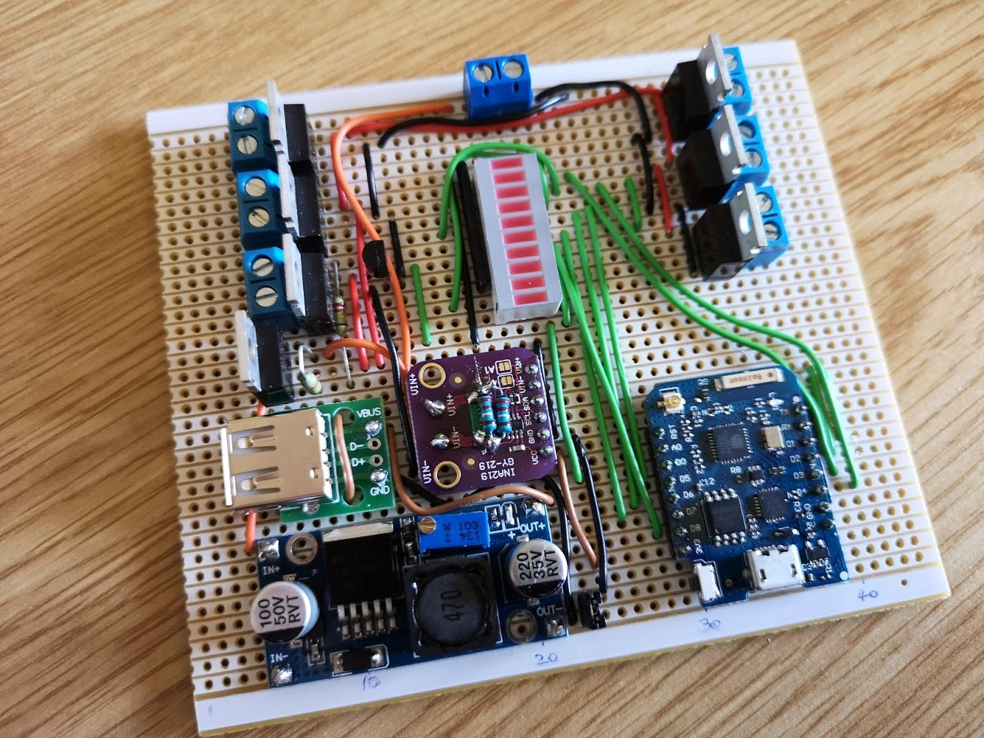
Finished Board
Tested before it was plugged in!
Notes:
Nothing worse than plugging it in and something burning out – so tested it first.
Visual check
Resistance check
Some tracks connected when they shouldn’t be.
Supply connected to ground
Couple of Wemos outputs shorted to ground

Slide 13
Test setup
Measured current and voltage
Notes:
Plugged in Wemos board to PC first
Then plugged in 12V supply
Checked all LEDs could be turned on and off
Wire missing to one of MOSFETs
One it was all working: measured voltages and currents at various points.

Slide 14
Test Results

Slide 15
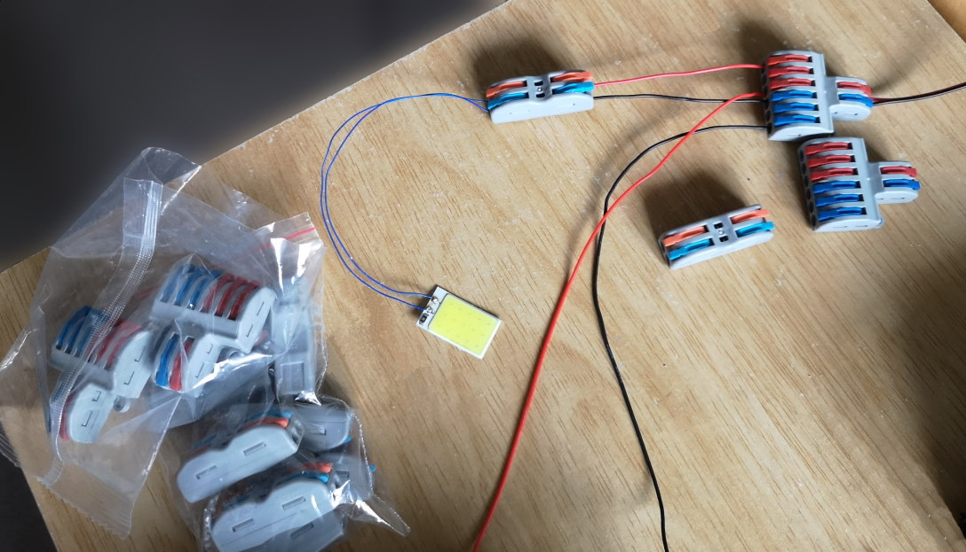
Cable Connectors
Notes:
Better than normal terminal blocks because they have clips rather than screws
Less stress on wire
Lots of different types – here 1 to 1 and 1 to 3
Search for “cable connector”

Slide 16
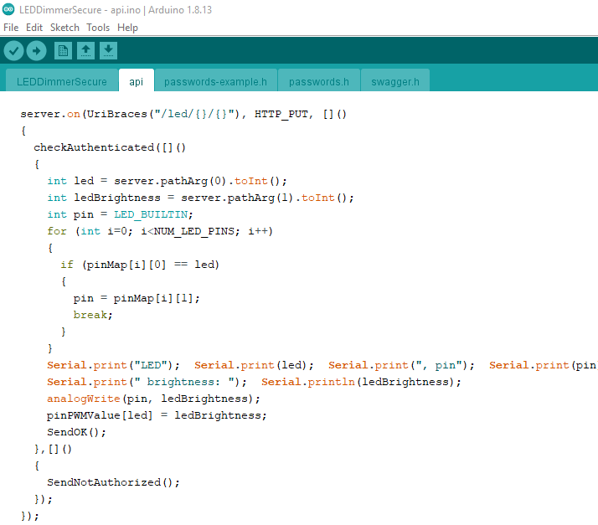
Arduino Software (ESP8266)
Notes:
Used Arduino IDE
Modified existing example

Slide 17
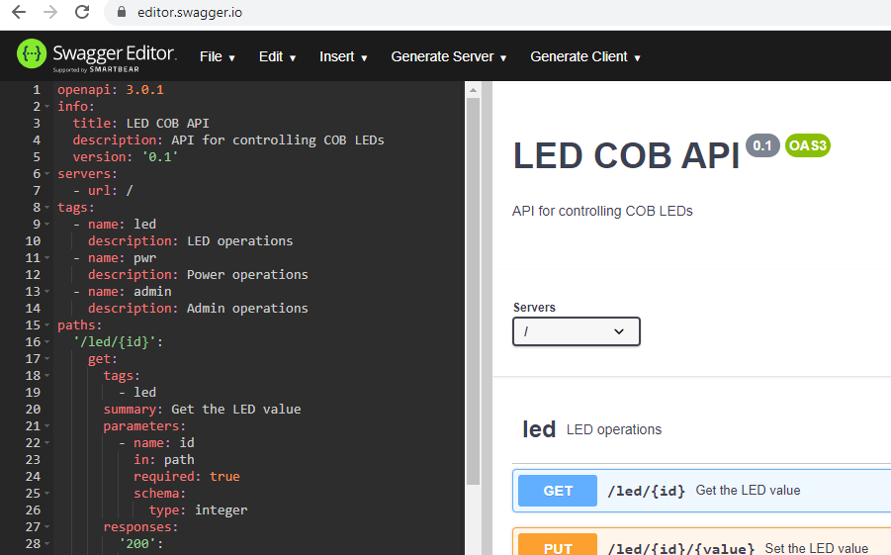
OpenAPI (aka Swagger)
Notes:
Swagger editor to create API definition
Useful as:
Documentation
Testing API

Slide 18
SwaggerUI
<!DOCTYPE html>
<html lang="en">
<head>
<meta charset="UTF-8">
<meta name="viewport" content="width=device-width, initial-scale=1.0">
<meta http-equiv="X-UA-Compatible" content="ie=edge">
<script src="//unpkg.com/swagger-ui-dist@3/swagger-ui-standalone-preset.js"></script>
<script src="//unpkg.com/swagger-ui-dist@3/swagger-ui-bundle.js"></script>
<link rel="stylesheet" href="//unpkg.com/swagger-ui-dist@3/swagger-ui.css" />
<title>Swagger</title>
</head>
<body>
<div id="swagger-ui"></div>
<script>
window.onload = function() {
SwaggerUIBundle({
url: "/swagger.yaml",
validatorUrl: null,
dom_id: '#swagger-ui',
presets: [
SwaggerUIBundle.presets.apis,
SwaggerUIStandalonePreset
],
layout: "StandaloneLayout"
})
}
</script>
</body>
</html>
Notes:
Implementation:
HTML web page
Uses CDN

Slide 19
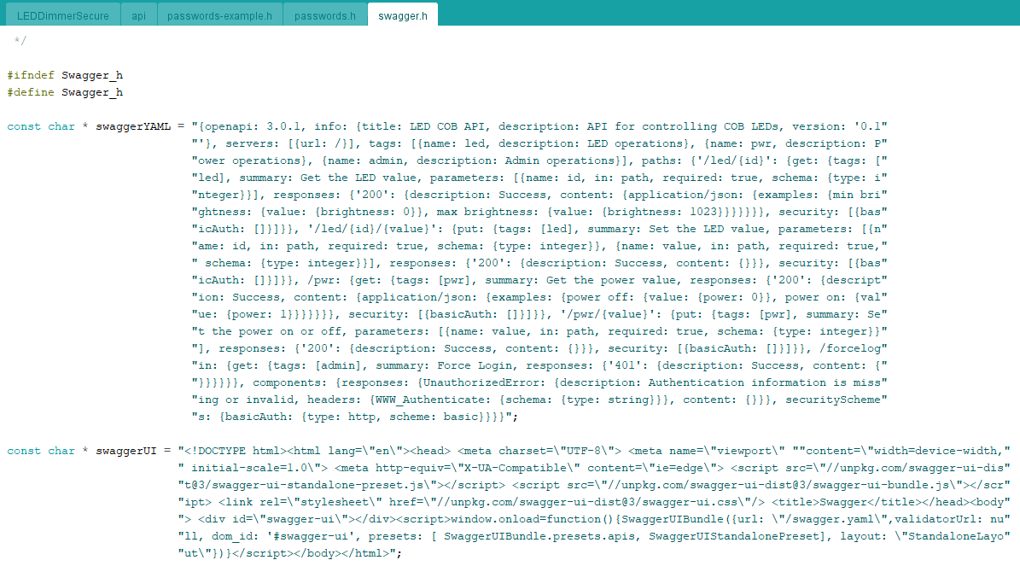
Arduino Code (part 1)
Notes:
Paste into strings in code

Slide 20
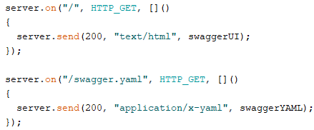
Arduino Code (part 2)
Notes:
Connect requests to strings we just defined

Slide 21
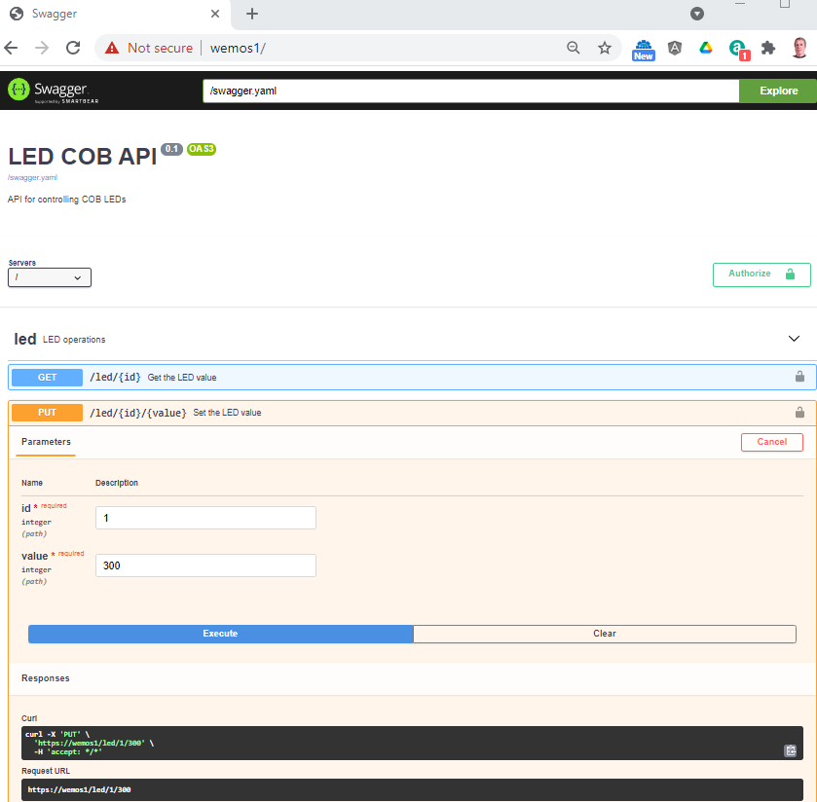
OpenAPI testing
Notes:
Upload to board
Open home page in browser

Slide 22
Raspberry Pi Code

Slide 23
Thoughts for Version 2
ESP32 board
Create a tunnel for Alexa (localhost.run?)
Temperature sensor for P channel MOSFET
Notes:
Tunnel: ngrok not free, so localhost.run or just use public DNS to subdomain

Slide 24
Any Questions?
Code available on Github:
https://github.com/codewrite/COBHouseLights

