Slide 1
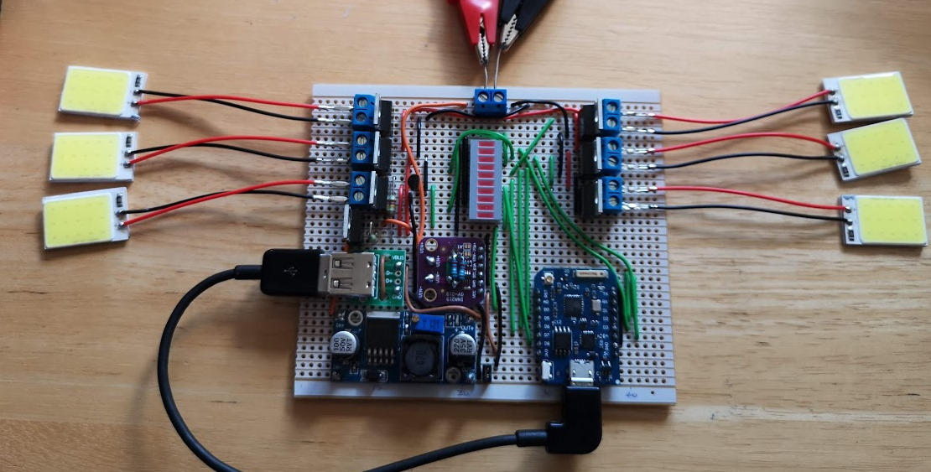
LED House Lights
Smart lighting using 30x 2W COB LED panels
Notes:
Home lighting system
Use in loft and under eaves for outside lighting
Loft: several – maybe 10 or so?
Outside: 2 or 3 per wall – so maybe 12?
Total: about 20 or so…

Slide 2

LEDs for lighting
LEDs are very efficient compared to other forms of lighting
Notes:
Candle, incandescent, compact fluorescent lamp. LED
Approx: Incandescent 2%, CFL 8%, LED up to 25% (theoretically 40%?)
LEDs are the way to go

Slide 3
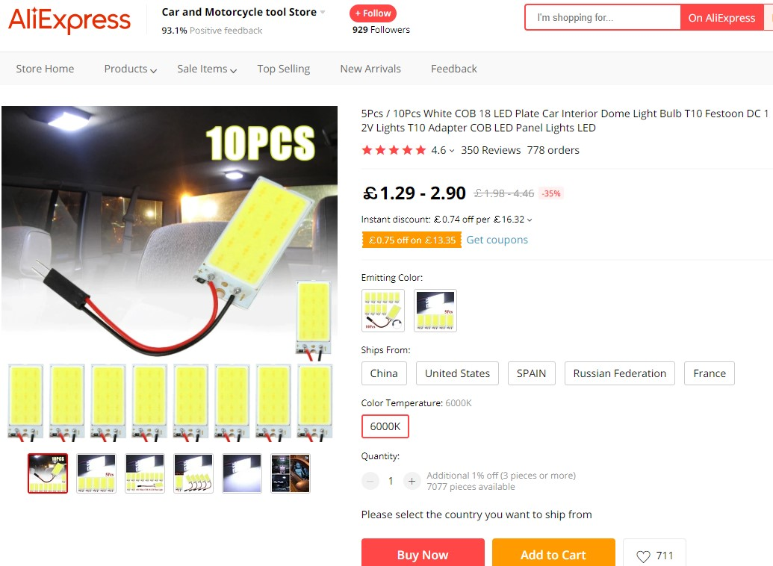
COB LED panels
Very bright and inexpensive
Notes:
Saw these on Aliexpress – advertised as suitable for interior light in car
Very inexpensive => Ordered
Tested from 8V to 12V. OK @ 10V. Car voltage is 14V (not tried)...
Very bright
Get hot @ 12V: about 100degC
Use blue LEDs with phosphor coating – convert to white light
15 LEDs, 5 parallel sets of 3 in series
Single series resistor to limit current – cuts efficiency down by 75%
25% becomes about 18%

Slide 4
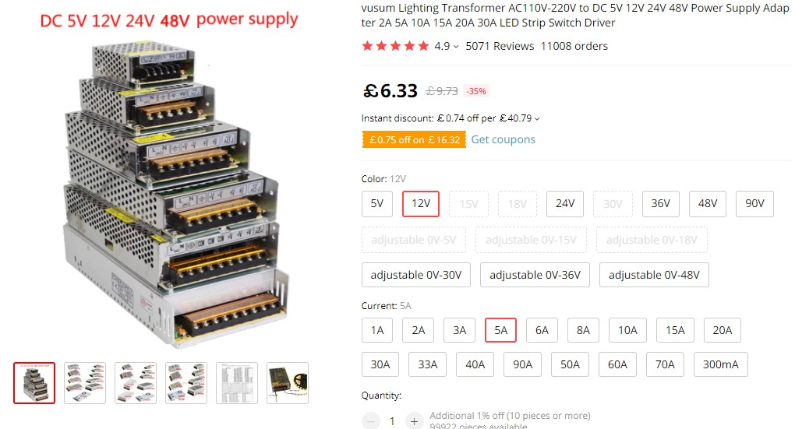
12V Power Supply
5A about £6, 10A about £10
Notes:
Needed 12V supply – so looked on Aliexpress
12V 5A – about £6
12V 10A – about £10
Got one of each

Slide 5
Controller Board
Turn on/off via home network (i.e. wifi)
MOSFETs to turn LEDs on and off
Control brightness using PWM
Several different circuits
Fail safe
Secure

Slide 6
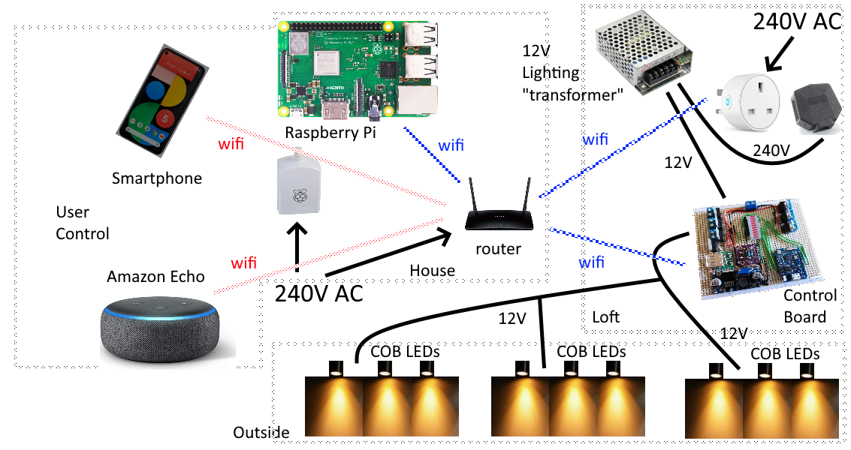
Top Level Hardware Design
Notes:
Most important part: lights
Then: controller board. Powered by 12V
Smart plug is for safety – last resort: power down
Raspberry Pi talks to controller board via REST API
Raspberry Pi does the clever stuff – lights on when it gets dark etc.
Raspberry Pi Nginx, VueJS, Python API.

Slide 7
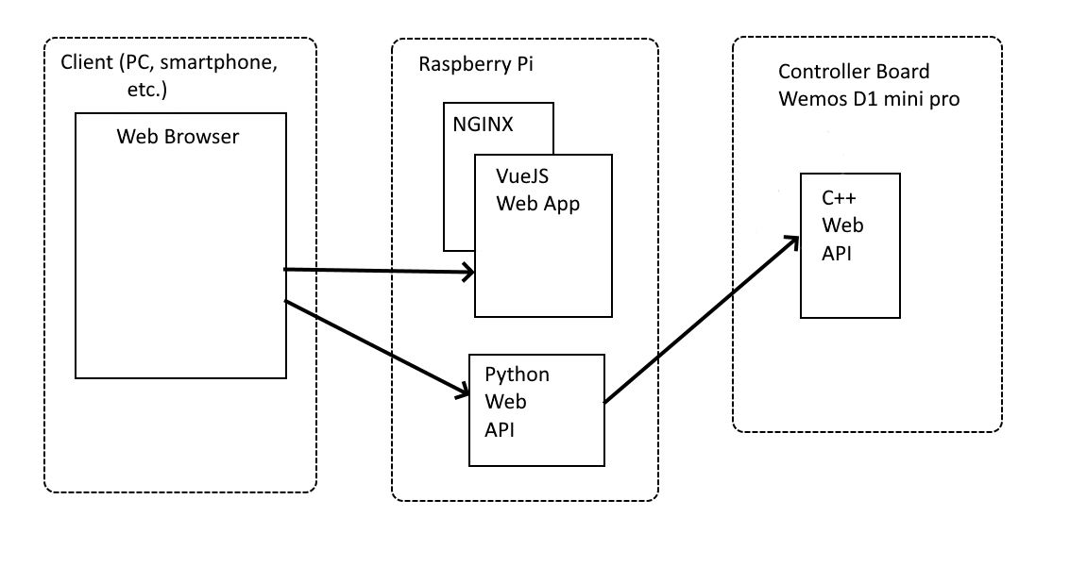
Top Level Software Design
Notes:
Multicast DNS (mDNS)
Python API so that:
a) We can have better security e.g. Google login
b) mDNS doesn’t work on Android

Slide 8
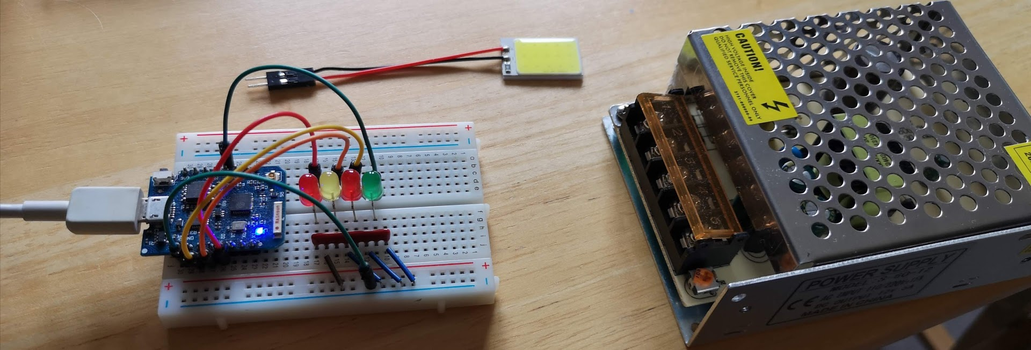
Prototype 1
Wemos D1 with API
Notes:
First prototype
Not connected to COB LEDs or 12V supply
Just testing wifi and API
Had a Wemos D1 mini pro in my box of bits - ESP8266
Modified Arduino examples
Basic authentication over a secure TLS connection
Request takes just under a second on ESP8266 (crypto in ssoftware not hharware like esp32)

Slide 9
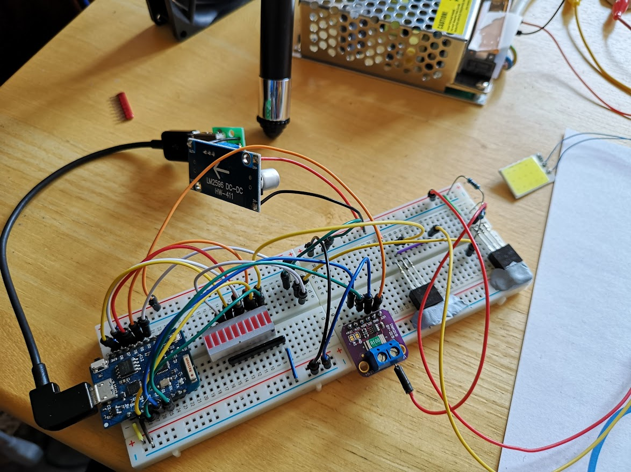
Prototype 2
N channel MOSFET, DC to DC converter
Notes:
Hooked up 12V supply
To drop 12V to 5V: First thought was 7805 regulator – but tried this and regulator got hot even though D1 board was only using about 80mA
So used DC to DC converter – about 85% efficient
N channel MOSFET between LED and ground – allows on/off and brightness via PWM
Realised 12V on one side of LEDs even when LEDs off – thought this was ok until I accidentally shorted the 12V line to earth and wire started to melt!
Then added P channel MOSFET to 12V side, and current sensing board – INA219 – modified to allow 5.4A reading rather than 3.2A

Slide 10
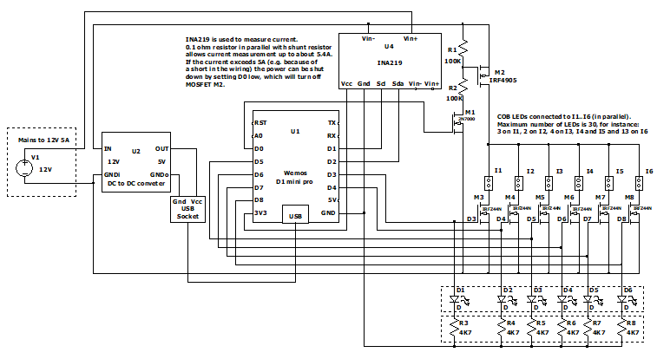
Schematic
Using LTSpice
Notes:
Created in LTSpice – had to create custom packages for Wemos D1, DC to DC converter and INA219
LTSpice usage outside scope of talk
N channel MOSFET gate voltage min: 2V, max: 4V
ESP8266 high output measured at 3.3V
With hindsight: could have used P channel MOSFETs rather than N type, but driver circuit more complicated and also this way I can isolate both sides of LEDs

Slide 11
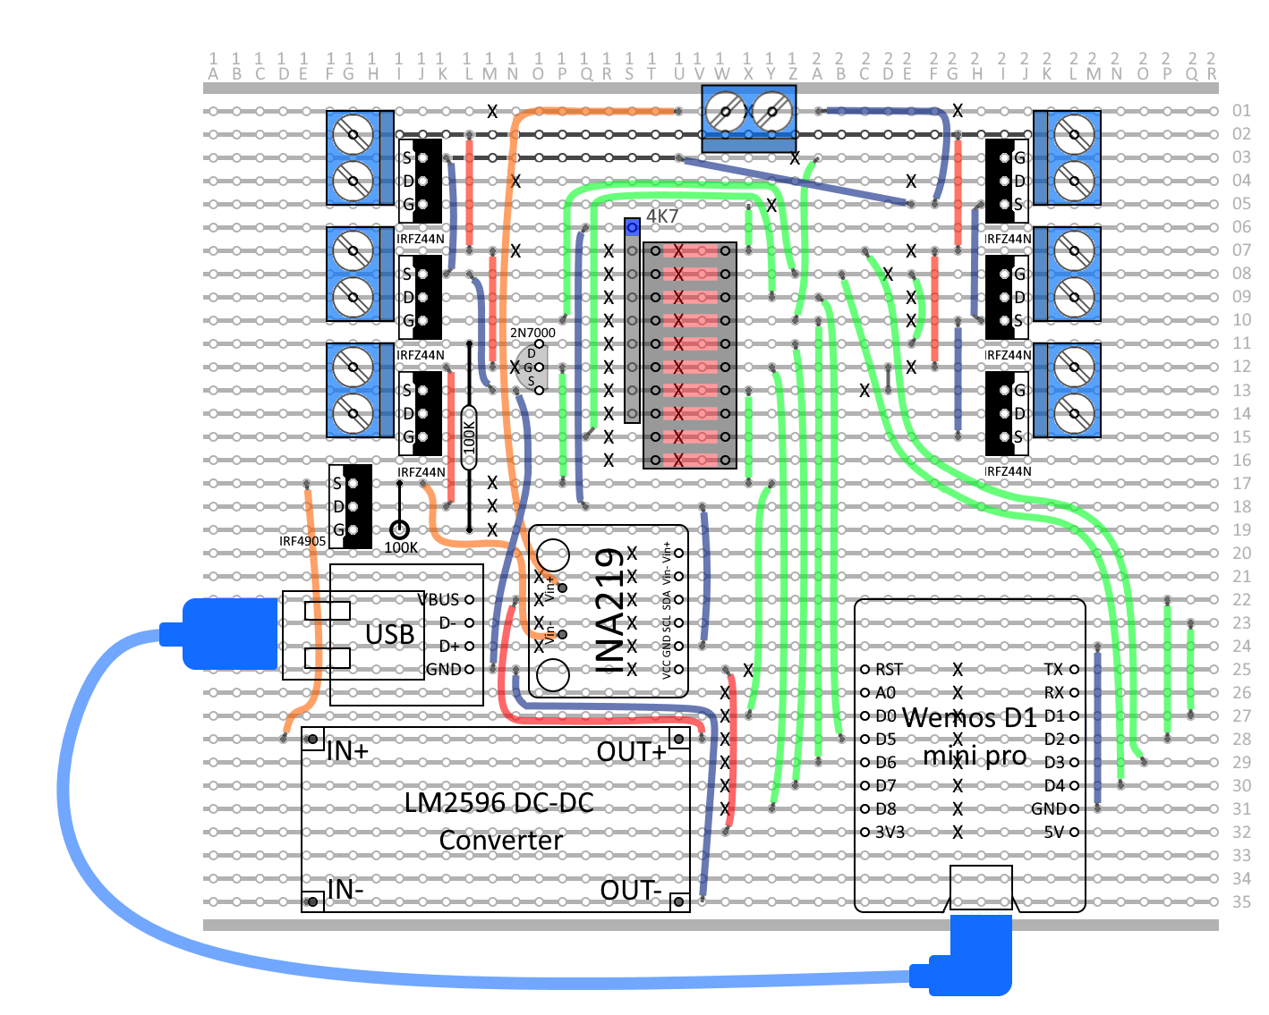
Vero board Layout
Using Paint.Net (which is like photoshop)
Notes:
Decided to make on veroboard rather than PCB
Created with Paint.Net which is like photoshop
Multiple layers – components, tracks, wires, track cuts

Slide 12
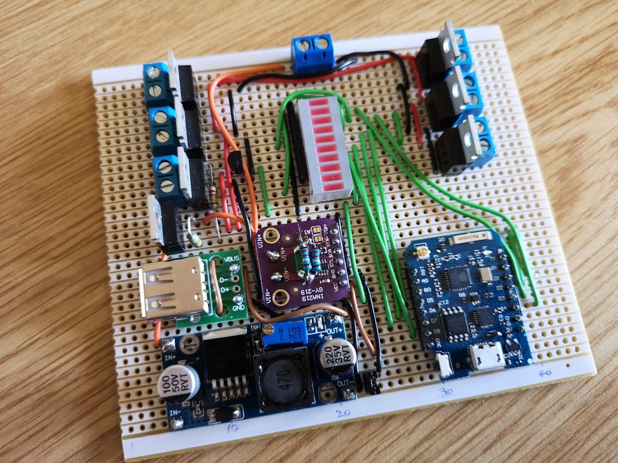
Finished Board
Tested before it was plugged in!
Notes:
Nothing worse than plugging it in and something burning out – so tested it first.
Visual check
Resistance check
Some tracks connected when they shouldn’t be.
Supply connected to ground
Couple of Wemos outputs shorted to ground

Slide 13
Test setup
Measured current and voltage
Notes:
Plugged in Wemos board to PC first
Then plugged in 12V supply
Checked all LEDs could be turned on and off
Wire missing to one of MOSFETs
One it was all working: measured voltages and currents at various points.

Slide 14
Test Results 1
Prototype board 2
Current 1 LED panel ~ 120mA. Input voltage 12.1V. Voltage across LED panel 10.3V
Voltage across MOSFETs when ON: ~ 7mV => MOSFET on resistance ~ 60mΩ
13mV across INA219
10.9V on breadboard (source pins of MOSFETs)
1800mV loss – only 27mV accounted for in component voltage drops – rest is substandard wires and breadboard
For more information about RDS(on) see:
https://www.allaboutcircuits.com/technical-articles/understanding-mosfet-on-state-drain-to-source-resistance/
P channel MOSFET @ 3A => 0.5W, 58°C, @ 5A => 1.5W, 120°C (at 25°C ambient)
Notes:
Tests on breadboard
Big voltage drop between supply and LEDs
Voltage drop across MOSFETs
RDS should be about 20 m ohm => measured @ 60
RDS dependant on gate voltage and temperature
Tempted to use heatsink, or could limit current to 3A

Slide 15
Test Results 2
Using Veroboard version
Six LED panels plus 4.7Ω resistor
Total current consumption 3.3A
11.8V on board, 11.3V across LED panel
204mV across INA219
222mV across P channel MOSFET => 67mΩ (measured on veroboard as close as possible to MOSFET)
N channel MOSFETs => between 31mΩ and 34mΩ
P channel MOSFET => 58°C, added heatsink => 38°C (both 3.3A).
Noticed that LEDs flash on power up or reset
Notes:
Veroboard tests
Wanted to test with high currents
Show flashing LEDs video

Slide 16
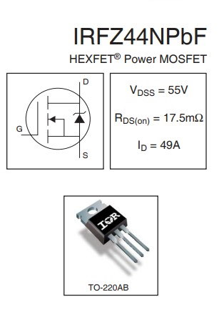
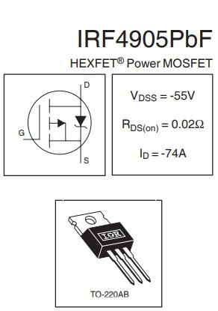
MOSFETs
Notes:
MOSFETs I’m using
Bit disappointed in the on resistance
N channel ok at 30 milli ohms – low gate voltage
P channel 67 milli ohms seems too high – might have to do some experiments – see if I can get better performance
Show LTSpice

Slide 17
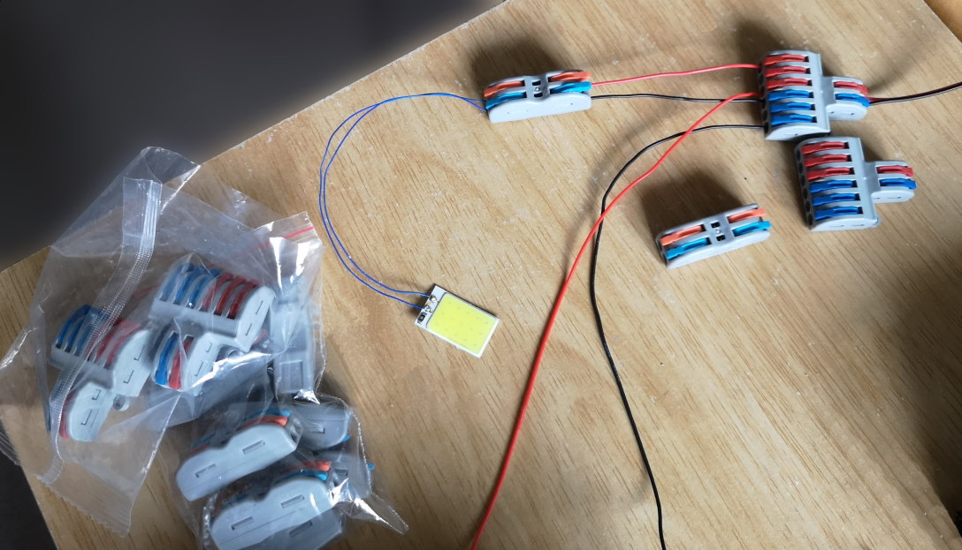
Cable Connectors
Notes:
Spring loaded clips, lift up, insert wire, put clip down
Better than normal terminal blocks because they don’t have screws
Less stress on wire
Lots of different types – here 1 to 1 and 1 to 3
Search for “cable connector”

Slide 18
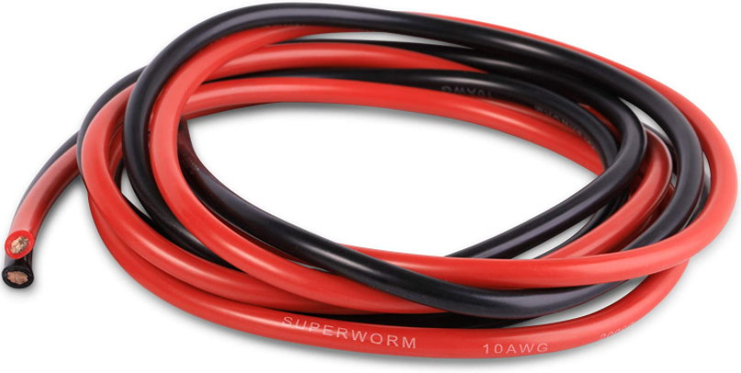

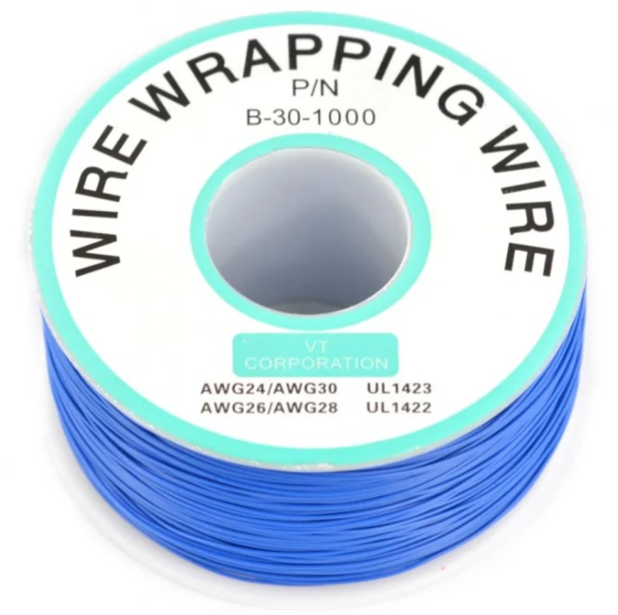
Wires
30 AWG => 450mΩ per metre (max 500mA)
24 AWG => 123mΩ per metre (max ~2A)
30AWG 5m (10m in total) 0.8V drop @ 180mA
24AWG => 5m x2 = 1.2V drop @ 1A
10AWG => 4mΩ per metre (max ~20A)
Notes:
Show video
Wires => you get what you pay for
Could get expensive to wire it all up with 10 gauge wire
10m 30 gauge wire shorted across 12V => current 2.6A

Slide 19
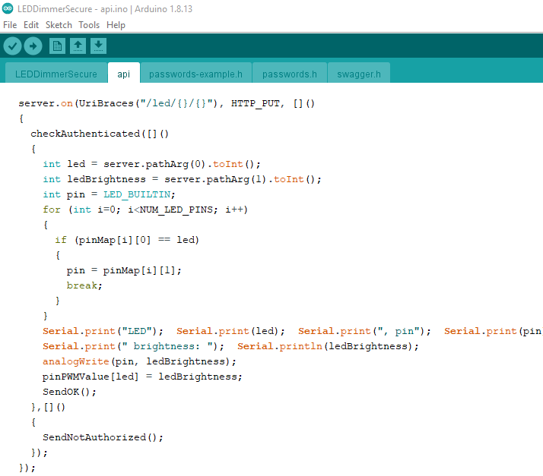
Arduino Software (ESP8266)
Notes:
Used Arduino IDE – could have used platfomio and VS code – but sometimes think it’s just as easy to use Arduino IDE
Modified existing examples

Slide 20
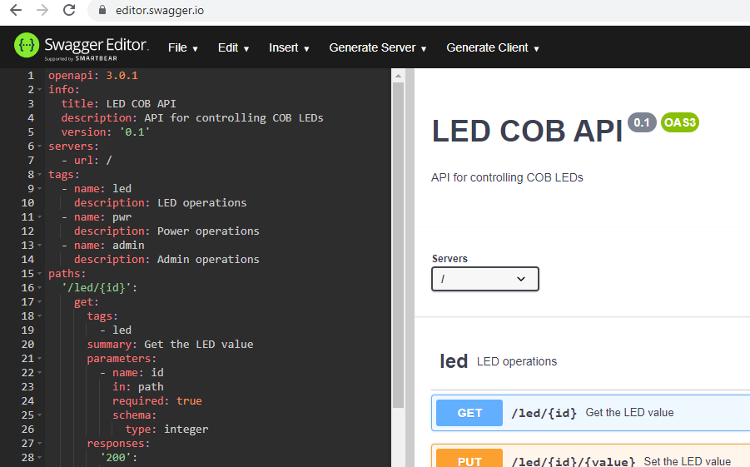
OpenAPI (aka Swagger)
Notes:
Swagger editor to create API definition
Useful as:
Documentation
Testing API

Slide 21
SwaggerUI
<!DOCTYPE html>
<html lang="en">
<head>
<meta charset="UTF-8">
<meta name="viewport" content="width=device-width, initial-scale=1.0">
<meta http-equiv="X-UA-Compatible" content="ie=edge">
<script src="//unpkg.com/swagger-ui-dist@3/swagger-ui-standalone-preset.js"></script>
<script src="//unpkg.com/swagger-ui-dist@3/swagger-ui-bundle.js"></script>
<link rel="stylesheet" href="//unpkg.com/swagger-ui-dist@3/swagger-ui.css" />
<title>Swagger</title>
</head>
<body>
<div id="swagger-ui"></div>
<script>
window.onload = function() {
SwaggerUIBundle({
url: "/swagger.yaml",
validatorUrl: null,
dom_id: '#swagger-ui',
presets: [
SwaggerUIBundle.presets.apis,
SwaggerUIStandalonePreset
],
layout: "StandaloneLayout"
})
}
</script>
</body>
</html>
Notes:
Implementation:
HTML web page
Uses CDN

Slide 22
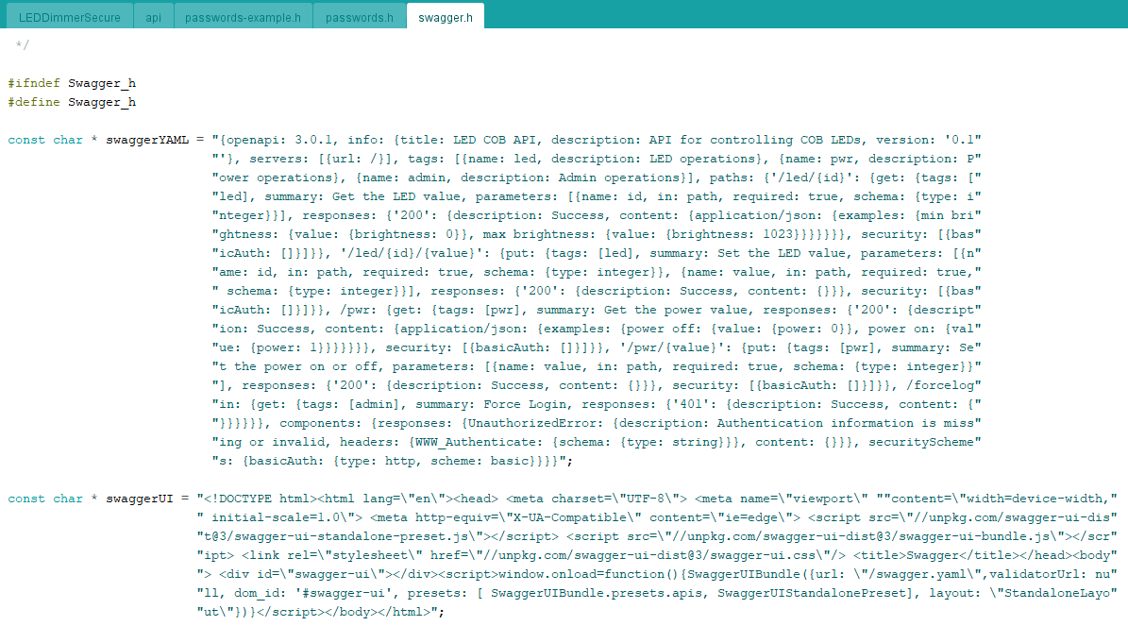
Arduino Code (part 1)
Notes:
Paste into strings in code

Slide 23
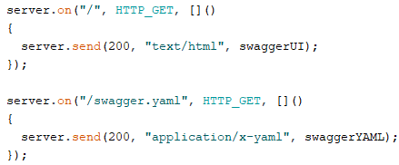
Arduino Code (part 2)
Notes:
Connect requests to strings we just defined

Slide 24
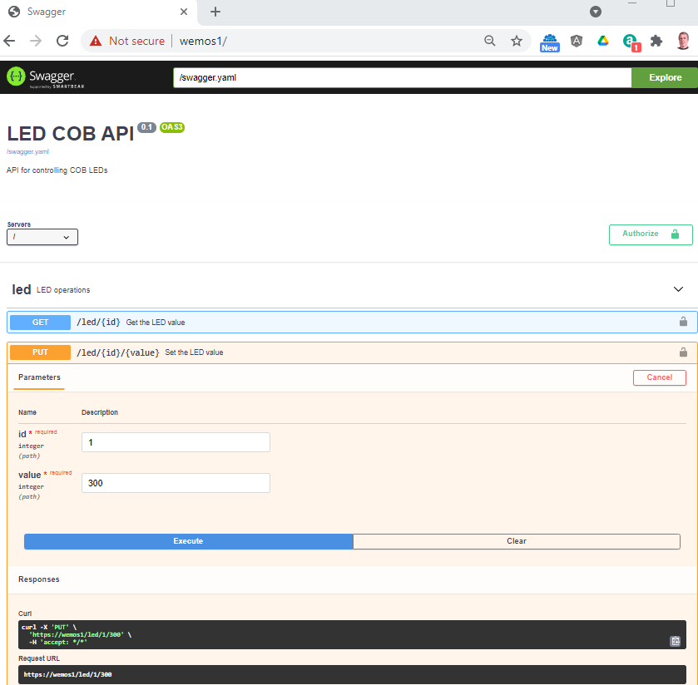
OpenAPI testing
Notes:
Upload to board
Open home page in browser
Show Demo

Slide 25
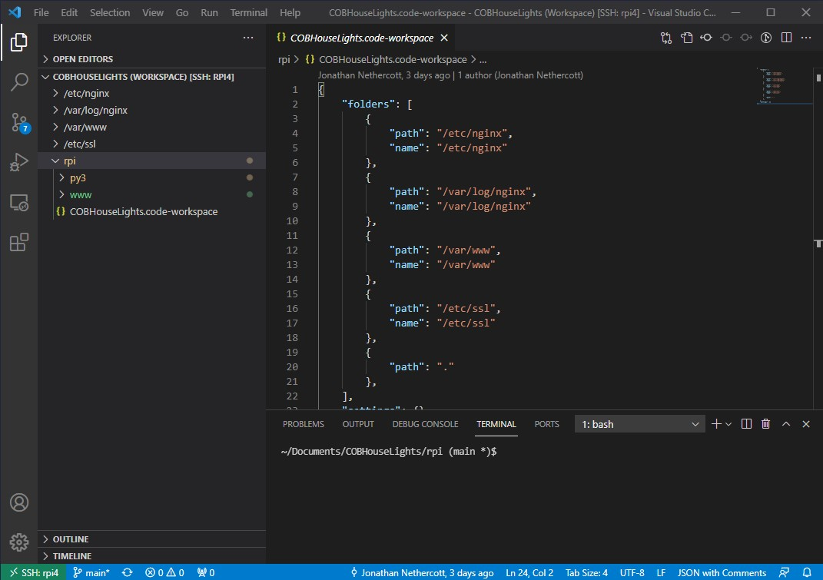
Raspberry Pi Code
Notes:
Install nginx (google how to)
Add workspace to include nginx folders
Show code

Slide 26
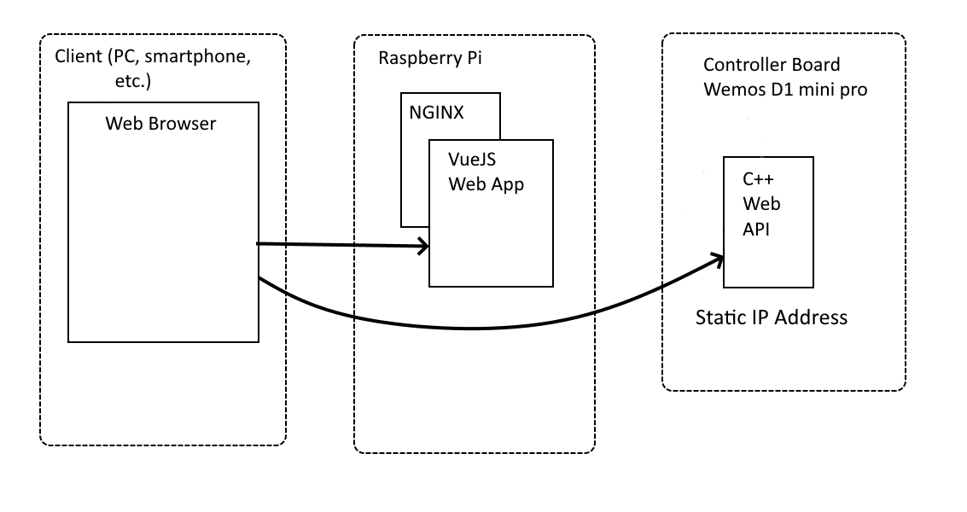
Modified Architecture
Notes:
For Android: Used static IP addresses

Slide 27
Thoughts for Version 2
Raspberry Pi API and Google (OAuth) authentication (federated login)
ESP32 board
Create a tunnel for Alexa (localhost.run?)
Current monitoring
Temperature sensor for P channel MOSFET
PIR (and other) sensors
Notes:
1. Google sign in would make logging in really easy. Hard coded list of allowed email addresses
3. Tunnel: ngrok not free, so localhost.run or just use public DNS to subdomain
4. Like safety checks in cars and car engines – can be a pain – but can prevent catastrophic failure
5. Sensors can be anywhere on network

Slide 28
Any Questions?
Code available on Github:
https://github.com/codewrite/COBHouseLights

