Slide 1
Interacting With Memory
Embedded Software Essentials
C2M1V4

Slide 2
Microcontroller Memory [S1]
Memory is used during every single instruction
Generalized ARM CPU
General Purpose Registers
Stack pointer
Microcontroller
Flash
Program Counter
CPU
Instruction
SRAM
Arithmetic Logical
Unit (ALU)
Special Function
Registers
Peripherals
PSR
Mask Registers
Control
Result

Slide 3
Embedded Memory [S2]
Memories of an Embedded Systems
Code Memory (Flash)
Data Memory (SRAM)
Register Memory
The CPU and peripherals contain register memory
CPU Registers
General Purpose
Special Purpose
General Peripheral Registers
Microcontroller
Code Memory
(Flash)
CPU
Registers
Data Memory
(SRAM)
Peripherals
GPIO
Registers
Registers

Slide 4
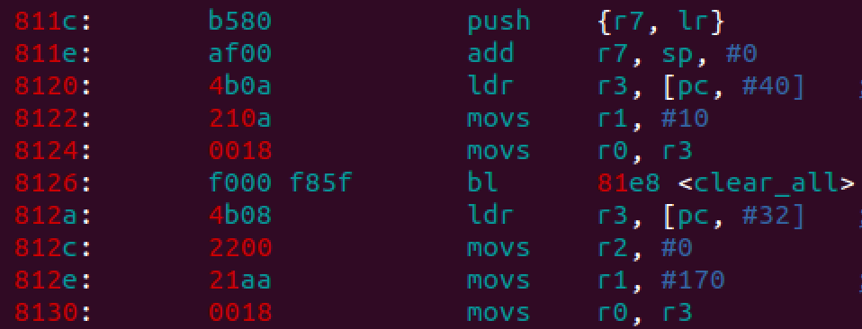
Core CPU Registers [S3]
SRAM
Load into
R4
CPU Registers have unique identifiers
r0-r15, sp, pc, lr
apsr, ipsr, epsr
primask, faultmask, control, etc
CPU
Bus Interface
Store from
R10
Example Assembly Code

Slide 5
Load-Store Architecture [S4]
Instruction Fetch
Data Load/Store
CPU Register memory is small
16 Registers (R0-R12, SP, PC, LR)
5 Special Function Registers
All processing occurs in CPU
CPU Register data constantly changes
Data is loaded in from memory
Results are stored back to memory
General Purpose Registers
Instruction
Stack pointer
Program Counter
Arithmetic Logical
Unit (ALU)
Result
CPU
SRAM
Flash

Slide 6
Read-Modify-Write [S5]
SRAM
Load into
R4
Read: Data is loaded into CPU
Modify: Data is Operated on
Write: Result is stored back
Compiler tries to reduce number of loads and stores for execution efficiency
CPU
Bus Interface
Optimization
Store from
R10
Notes:
http://infocenter.arm.com/help/index.jsp?topic=/com.arm.doc.dui0497a/CHDBIBGJ.html

Slide 7
Peripheral Registers [S6]
Peripheral register require some contents (bit-fields) to be preserved
Use bit manipulation to change certain bits of a register (not all contents)
Microcontroller
CPU
Code Memory
Registers
Data Memory
Peripherals
Registers
uint8_t * ptr = (uint8_t *) 0x1000;
Set 4th bit without changing other bits:
Clear 4th bit without changing other bits:
*ptr |= 0x10;
*ptr &= ~(0x10);

Slide 8
Bit-Banded Regions [S7a]
Bit-Banded Regions allow programmer to perform bit-level loads and stores
Bit-Banded operations are atomic
Handled in hardware
No CPU Load/Store
Memory Map
System
Microcontroller
Peripherals
Flash
CPU
Data
SRAM
Code
Peripherals
Reduces Read-Modify-Write overhead!

Slide 9
Bit-Banded Regions [S7b]
Bit-Banded Regions allow programmer to perform bit-level loads and stores
Bit-Banded operations are atomic
Handled in hardware
No CPU Load/Store
Memory Map
System
Data Region
(Unused)
0x2FFFFFFF
Peripherals
Bit-Banded Region
0x23FFFFFF
Data
0x22000000
Code
(Unused)
SRAM
0x20100000
Reduces Read-Modify-Write overhead!
0x20000000

Slide 10
Data/Instructions Busses [S8a]
Microcontroller
Flash
CPU
Registers
Simplistic model shows only 1 bus interface to all components of the microcontroller
SRAM
Peripherals
GPIO
Registers
Registers

Slide 11
Microcontroller Busses [S8b]
Debugger
Microcontroller
PPB (Internal)
PPB (External)
High-Speed Peripheral
High-Speed Peripheral
Cortex-M
AHB System Bus
SRAM Memory
Internal Private Peripherals
APB
Peripheral
Bus
AHB Flash I-code Bus
AHB Flash
D-code Bus
Peripherals
Bridge
Peripherals
Peripherals
High-Speed Peripheral
Flash
Controller
Flash Memory
High-Speed Peripheral
High-Speed Peripheral

Slide 12
Private Bus Interfaces [S9]
AMBA High-Performance Bus (AHB)
Fast/High-Bandwidth Interfaces
Private Cortex-M4 Busses
Internal Private Peripherals Bus (PPB)
NVIC, SCS, MPU
External Private Peripherals Bus (PPB)
External Debugging
Debugger
Microcontroller
PPB (Internal)
PPB (External)
Internal Private Peripherals
Cortex-M
AHB System
Bus
SRAM Memory
APB
Peripheral
Bus
AHB Flash
D-code Bus
Peripherals
AHB Flash I-code Bus
Peripherals
Bridge
Peripherals
Flash
Controller
Flash Memory
High-Speed Peripheral

Slide 13
Code and Data Busses [S10]
AHB External Core AHB busses
System Bus (AHB-Lite)
SRAM
High Speed Peripherals
Peripheral Bridge
Flash Bus
I-Code Bus
D-Code Bus
Debugger
Microcontroller
PPB (Internal)
PPB (External)
Internal Private Peripherals
Cortex-M
AHB System
Bus
SRAM Memory
APB
Peripheral
Bus
AHB Flash
D-code Bus
Peripherals
AHB Flash I-code Bus
Peripherals
Bridge
Peripherals
Flash
Controller
Flash Memory
High-Speed Peripheral
Flash Busses allow for fetching of Code and Flash Data simultaneously

Slide 14
Peripheral Bus [S11]
Advanced Peripheral Bus (APB)
Low Bandwidth Bus
Connected to CPU via Bridge to System Bus
Interfaces with Low Bandwidth
Communications
UART
SPI
I2C
Timers
ADC
Debugger
Microcontroller
PPB (Internal)
PPB (External)
Internal Private Peripherals
Cortex-M
AHB System
Bus
SRAM Memory
APB
Peripheral
Bus
AHB Flash
D-code Bus
Peripherals
AHB Flash I-code Bus
Peripherals
Bridge
Peripherals
Flash
Controller
Flash Memory
High-Speed Peripheral

