Slide 1
Endianness
Embedded Software Essentials
C2M1V6

Slide 2
Memory [S1]
Memory storage interacting with the CPU
Code Memory
Data Memory
Registers (Peripherals)
Memory interfaces to CPU through Busses
Load-Store architecture requires operations to occur in CPU
Data get loaded into CPU
Data is operated on
Data is stored back to memory
Microcontroller
Flash
CPU
Registers
SRAM
Peripherals
GPIO
Registers
Registers

Slide 3
Data Order [S2]
Each address stores 1 Byte
Half-Words store 2 Bytes
Words store 4 Bytes
Memory
byte
0x100
0x101
0x102
0x103
0x104
half-word
0x105
0x106
Which location stores the MSB?
Which location stores the LSB?
0x107
0x108
0x109
word
0x110
0x111

Slide 4
Endianness [S3]
Endianness = How data is represented
Byte-order in memory!
Can express data order in two different ways
Little Endian
Big Endian
4-Bytes
uint32_t var = 0xABCD1234;
MSB
LSB
Endianness only relevant for multi-byte data!

Slide 5
Endianness [S4]
Endianness = How data is represented
Byte-order in memory!
uint32_t var = 0xABCD1234;
Memory
0x100
AB
0x101
CD
0x102
12
0x103
34
Big Endian:
Store MSB at smallest address

Slide 6
Endianness [S5]
Endianness = How data is represented
Byte-order in memory!
uint32_t var = 0xABCD1234;
Memory
Memory
0x100
AB
0x100
34
0x101
CD
0x101
12
0x102
12
0x102
CD
0x103
34
0x103
AB
Big Endian:
Store MSB at smallest address
Little Endian:
Store LSB at smallest address

Slide 7
Types and Endianness [S6]
Endianness does not affect order of elements Arrays or Structures
Little Endian Memory
0x34
0x100
array[0]
0x101
0x12
0x67
0x102
array[1]
0x103
2-Bytes
0x45
0xAB
0x104
array[2]
0x105
0x89
0xEF
0x106
array[3]
0x107
uint16_t array[4] = { 0x1234,
0x4567,
0x89AB,
0xCDEF };
0xCD
0x108
0x109
0x110
0x111

Slide 8
Endianness Configuration [S7]
Boring Slide. This would be good just to do text
Endianness is Configurable on many modern platforms
ARM Cortex-M allows for configuration of Data Memory Endianness
Code Memory is set to little endian

Slide 9
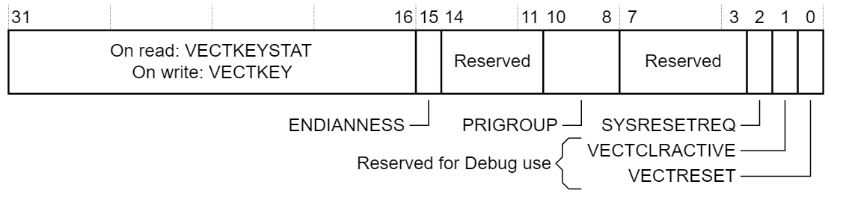
Endianness Configuration [S8]
Application Interrupt and Reset Control Register (AIRCR)
Allows for reconfiguration of Data Memory Endianness
Bit 15 of AIRCR Register
0 = Little Endian
1 = Big Endian
AIRCR Register Bit Fields
Changing Endianness requires a reset
Notes:
http://infocenter.arm.com/help/index.jsp?topic=/com.arm.doc.dui0553a/Cihehdge.html

Slide 10
Endianness Trouble [S9]
Endianness must be accounted for
Supporting Multiple platforms/Architectures with the same code base
Connecting multiple systems together
Platform 1, Architecture 1
Platform 2, Architecture 2
Same code, different endianness, may transmit byte order opposite
Microcontroller
Microcontroller
Flash
Flash
CPU-1
CPU-2
SRAM
SRAM
Peripheral
GPIO
UART
UART
GPIO
Peripheral

Slide 11
Byte-Swapping [S10a]
/* Switches endianness of variable pointed by ptr */
void byte_swap32(uint32_t * ptr){
uint8_t i, temp_byte;
for (i = 0; i < 2; i++){
temp_byte = *((uint8_t*)ptr + (3-i));
*((uint8_t*)ptr + (3-i)) = *((uint8_t*)ptr + i)
*((uint8_t*)ptr + i) = temp_byte;
}
}
/* Assume little endian */
void main(){
uint32_t var = 0xABCD1234;
uint32_t * ptr = &var;
byte_swap32(ptr);
while (1);
}
Memory
Memory
0x00
AB
0x00
0x01
CD
0x01
0x02
12
0x02
0x03
34
0x03
Before
After

Slide 12
Byte-Swapping [S10b]
/* Switches endianness of variable pointed by ptr */
void byte_swap32(uint32_t * ptr){
uint8_t i, temp_byte;
for (i = 0; i < 2; i++){
temp_byte = *((uint8_t*)ptr + (3-i));
*((uint8_t*)ptr + (3-i)) = *((uint8_t*)ptr + i)
*((uint8_t*)ptr + i) = temp_byte;
}
}
/* Assume little endian */
void main(){
uint32_t var = 0xABCD1234;
uint32_t * ptr = &var;
byte_swap32(ptr);
while (1);
}
Memory
Memory
0x00
AB
0x00
34
0x01
CD
0x01
12
0x02
12
0x02
CD
0x03
34
0x03
AB
Before
After

Slide 13
Unused Slides

Slide 14
Portability with Endianness [S9a]
0x2412
/* Program depends on LE architecture. */
void main(){
uint16_t array[] = {0xF924, 0x120C, 0};
uint16_t * ptr = (uint16_t*) ((array[0] & 0xFF00) | (array[1] & 0xFF));
array[2] = *ptr;
// Rest of code...
}
0x2413
Invalid
section
0x2414
0x2415
...
0x4000
24
0x4001
F9
Dereference at valid address
0x4002
0C
array
0x4003
12
0x4000
33
In little endian architecture...
0x4001
07
...
0xF90C
33
ptr
0xF90D
07

Slide 15
Portability with Endianness [S9b]
0x2412
ptr
/* Program depends on LE architecture. */
void main(){
uint16_t array[] = {0xF924, 0x120C, 0};
uint16_t * ptr = (uint32_t) ((array[0] & 0xFF00) | (array[1] & 0xFF));
array[2] = *ptr;
// Rest of code...
}
0x2413
Invalid
section
0x2414
0x2415
...
0x4000
F9
0x4001
24
Dereferenced at invalid address!
0x4002
12
array
0x4003
0C
0x4000
07
In big endian architecture...
0x4001
33
...
0xF90C
07
0xF90D
33

