Slide 1
Attributes and Pragmas
Embedded Software Essentials
C2 M1 V7

Slide 2
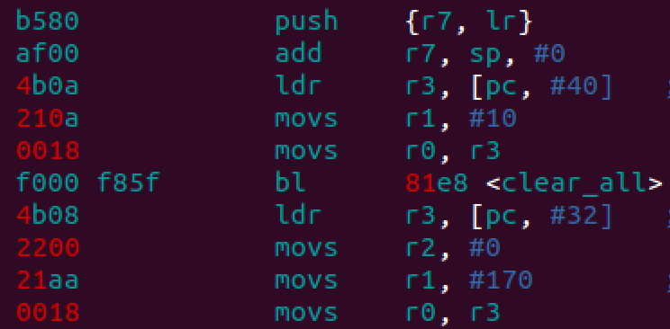
Optimizations [S1]
Optimizations will alter the implementation of code
Build System
Linker File
*.c
Compiler & Linker
Executable
*.c
SRCS
*.c
*.c
libs
Compile and Link with Optimizations
Machine Code
Assembly Code
$ gcc main.c –o main.o –O2

Slide 3
Compiler Attributes [S2]
Attributes can give specific details on how to compile code for
Variables
Structures & Structure Members
Functions
struct struct_name {
int8_t var1;
int32_t var2;
int8_t var3;
} __attribute__ ((packed));
Attributes are NOT part of the C-standard
Not Portable Across Compilers

Slide 4
Alignment Attributes [S3]
Alignment attributes specify memory alignment for data
Power of two: 2, 4, 8, 16
Memory
Memory
Memory
0x100
0x100
int8_t foo;
Placed at Word aligned addresses
0x101
0x102
0x103
0x104
0x104
0x105
Can be placed at any address
0x106
0x107
0x108
0x108
0x109
0x10A
int8_t foo __attribute__ ((aligned(4)));
0x10B

Slide 5
Alignment on a Structure [S4]
Structures and structure members can be aligned
typedef struct {
int8_t var1;
int32_t var2;
int8_t var3;
} str1;
At a minimum, structure requires 6 Bytes
typedef struct {
int8_t var1 __attribute__ ((aligned(4)));
int32_t var2 __attribute__ ((aligned(4)));
int8_t var3 __attribute__ ((aligned(4)));
} str2;
sizeof( str2 ) → 12 Bytes

Slide 6
Alignment on a Structure [S5]
Structure is aligned, all members aligned
Memory
0x00
typedef struct {
int8_t var1;
int32_t var2;
int8_t var3;
} str3 __attribute__ ((aligned));
padding
0x04
0x08
sizeof( str3 ) → 16 Bytes
0x0C
padding
Aligned structure members size would require 12 bytes, Not a power of 2!

Slide 7
Alignment on a Structure [S6]
Structure is packed, alignment ignored
typedef struct {
int8_t var1;
int32_t var2;
int8_t var3;
} str4 __attribute__ ((packed));
Memory
0x00
0x01
packed
sizeof( str4 ) → 6 Bytes
0x05
When structure is packed, members will be unaligned!!!

Slide 8
Function Attributes [S7]
Compiler Attributes can apply to Functions
Inline – Skips calling convention, copies function body into calling code
Compiler will
NOT ignore this
Compiler might
ignore this
__attribute__ ((always_inline)) inline int32_t add( int32_t x, int32_t y ) {
return (x + y);
}
Inline keyword is a c99 Feature → Not supported in c89
always_inline is a GCC attribute → Not supported on other compilers

Slide 9
Function Pragmas [S8]
Pragmas provide special instructions to the compiler
Push/Pop – Add extra option for compilation
Optimize – Specify a certain level of optimization block of code
#pragma GCC push
#pragma GCC optimize (“O0”)
int32_t add( int32_t x, int32_t y )
{
return (x + y);
}
#pragma GCC pop
Only this code will have Zero Optimizations applied

Slide 10
GNUC Support [S9]
Embedded teams can support multiple chipset platforms and multiple architectures
Different architecture may require different compiler
#ifndef (__GNUC__)
#define __attribute__ (x)
#endif
__attribute__(x) is only a GCC compiler keyword,
Throws errors for other compilers
Define as nothing for Non-GNU C compilers

Slide 11
Ignore all slides after this
Unused slide material

Slide 12
Introduction [S1.3.6.a]
Attributes and pragmas are compiler directives (i.e. not part of C)
Can use them on functions and variables to convey special information to compiler.
/* Use #pragma to specify compiler directives */
#pragma Otime /* Optimize for execution time */
/* Using attributes on functions */
void Mandelbrot16(uint16_t n, uint16_t c); __attribute__ ((noreturn));
__attribute__ ((always_inline));
#pragma Ospace /* Optimize for code space */
struct __attribute__ ((packed)) PackedStruct { /* sizeof(PackedStruct) = 5 bytes */
uint8_t varx __attribute__ ((mode (__pointer__)));
uint32_t vary __attribute__ ((aligned (16))); /* allocate ’vary’ on 16-bit boundary */
};

Slide 13
Compiler Specific [S1.3.6.b]
Function attributes and pragmas are compiler-dependent, though some common ones may be shared between them.
/* Only valid for MIPS */
void __attribute__ ((interrupt, use_shadow_register_set)) v1 ();
/* Gives error unless using GCC Solaris compiler */
#pragma fini (fnc1, fnc2, fnc3, fnc4);
/* Works for GCC ARM compiler */
#pragma thumb
void __attribute__ ((interrupt, use_shadow_register_set)) v1 ();
static int max(int x, int y) __attribute__((always_inline));

Slide 14
Attributes at Compile Time [S1.3.6.c]
Attributes can be turned on/off using compile time switches
/* If compiler is not GNU C, then omit ‘__attribute__’ */
#ifndef __GNUC__
#define __attribute_(x) /* Nothing */
#endif
/* Can also use pragmas to enable/disable optimization at certain parts */
#pragma GCC push_options
#pragma GCC optimize (“O0”)
// code section here
#pragma GCC pop_options

Slide 15
Aligned [S1.3.6.d]
By default, strongly declared symbols have definitions.
Symbols declared weak don’t need definitions – i.e. can have multiple definitions.
/*************************************************************************
* Forces compiler to ensure ‘S’ or ‘some_int_var’
* will be allocated and aligned at least on a 8-bit boundary.
*************************************************************************/
struct S {short f[3]; } __attribute__ ((aligned (8)));
typedef int some_int_var __attribute__ ((aligned (8)));

Slide 16
Packed [S1.3.6.e]
Using the packed attribute on a struct or union makes each its members also packed.
/* Members of packed_struct are packed, but internal layout of ustruct is not packed. The unpacked_struct must be packed separately. */
struct unpacked_struct{
uint8_t c1;
uint32_t c2;
};
struct __attribute__ ((__packed__)) packed_struct {
uint8_t d1;
uint32_t d2;
struct unpacked_struct ustruct;
};

Slide 17
Target [S1.3.6.f]
Target attribute allows user to specify target-specific compilation options.
/* Equivalent to compiling somefunc with ‘–march=core2’ and ‘-sse4a’ target options. */
uint32_t somefunc (void) __attribute__ ((__target__ (“march=core2", "sse4a")));

Slide 18
Pragma Optimizations [S1.3.6.g]
Use pragma to specify optimization levels and types
#pragma Otime
void function1(){ … } /* Optimize function1 for execution time */
#pragma push /* Save current pragma state */
#pragma O2 /* Optimize at level 3 */
uint32_t function2(){ … } /* Optimize function2 at O3*/
#pragma Ospace
uint8_t function3(){ … } /* Optimize function3 for code size */
#pragma pop /* Restores previously saved pragma state */

