Slide 1
Registers
Embedded Software Essentials
C2M1V8

Slide 2
Embedded System Memories [S1]
Memories of an Embedded Systems
Code Memory (Flash)
Data Memory (SRAM)
Register Memory (internal to chip)
External Memory (if applicable)
Compilation tracks and maps memory from a program into segments
Microcontroller
Flash
CPU
Registers
SRAM
Peripherals
GPIO
Specified in the Linker File
Registers
Registers

Slide 3
Registers [S1a]
Registers store temporary data
Can Be Read/Write or Read-Only
Typically divided into multiple bit fields
Bit 7
Bit 6
Bit 5
Bit 4
Bit 3
Bit 2
Bit 1
Bit 0
(MSB)
8-bit Register
(LSB)

Slide 4
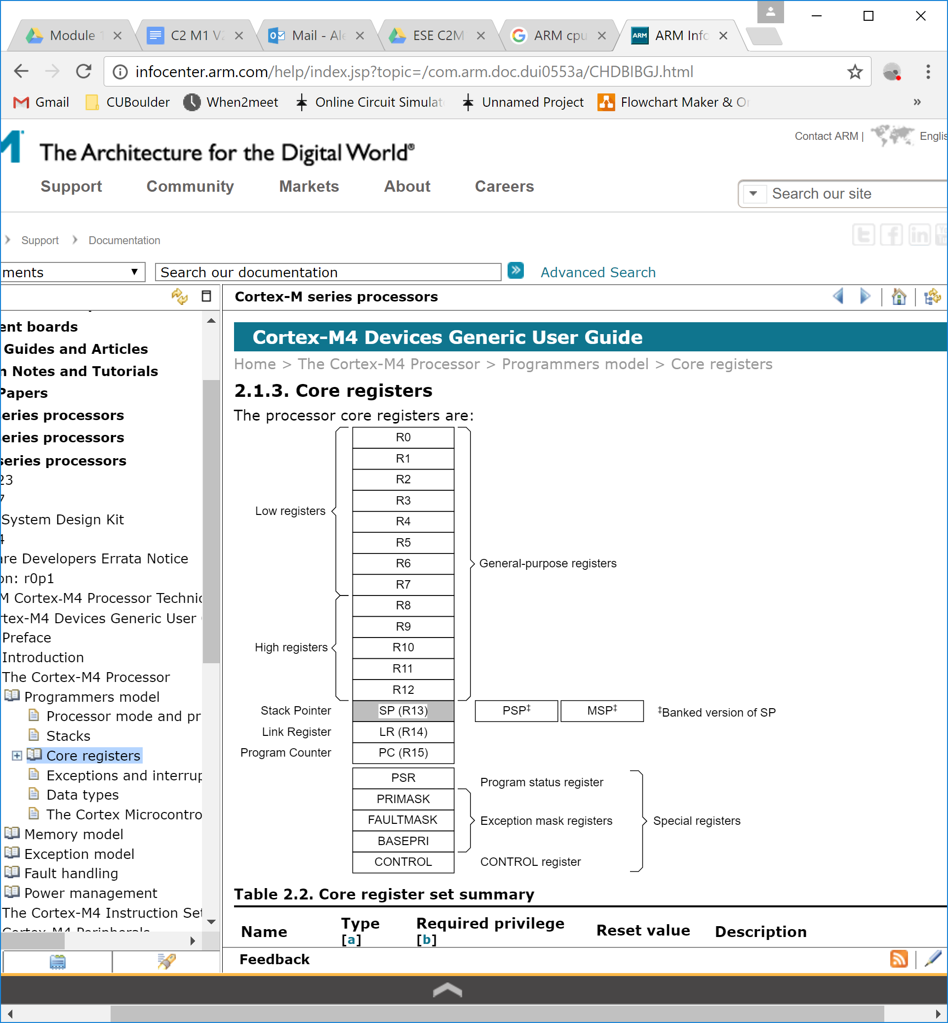
Registers [S1b]
Bit 7
Bit 6
Bit 5
Bit 4
Bit 3
Bit 2
Bit 1
Bit 0
Registers store temporary data
Can Be Read/Write or Read-Only
Typically divided into multiple bit fields
(MSB)
8-bit Register
(LSB)
Core CPU Registers
Memory Map
Microcontroller
Code
0x00000000
Flash
CPU
Data
SRAM
Peripherals
Addresses
Peripherals
GPIO
Device
System
0xFFFFFFFF

Slide 5
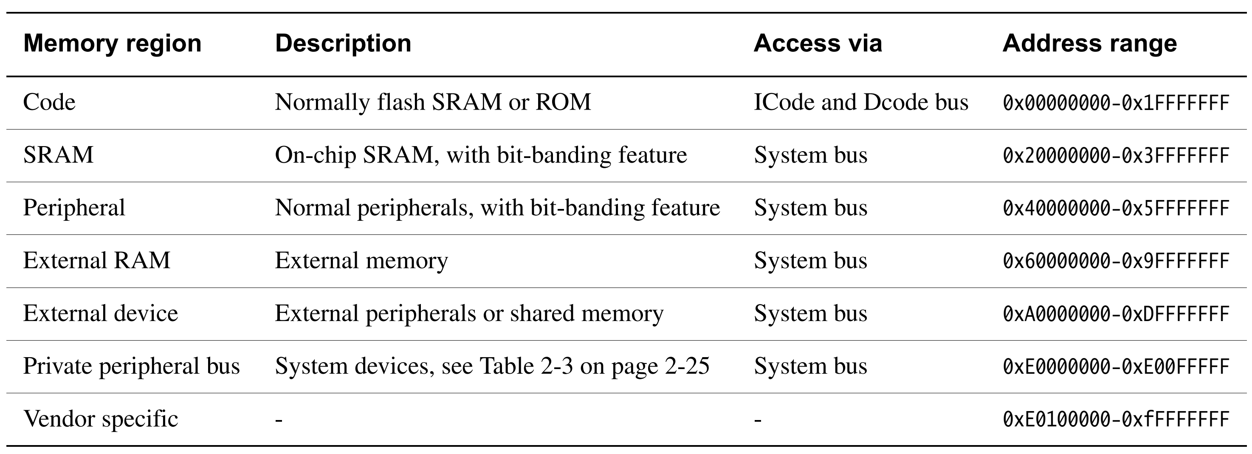
Memory Map [S2]
Memory Map: Provides a memory address to physical device mapping within an address space for use in programming
Mapped Components (Memory, Peripherals, System Config, etc.)
Address Space (Ranges for each device)
Notes:
http://infocenter.arm.com/help/topic/com.arm.doc.dui0203h/DUI0203H_rvct_developer_guide.pdf

Slide 6
Embedded Memory [S3]
Compilation tracks and maps memory from program code and program data into segments
Code Segment (Flash)
Data Segment (SRAM)
Memory allocation is application dependent
Exact address allocation changes at every compile
Microcontroller
Flash
CPU
SRAM
Specified in the Linker File
Peripherals
GPIO
MEMORY
{
MAIN (RX) : origin = 0x00000000, length = 0x00040000
DATA (RW) : origin = 0x20000000, length = 0x00010000
}

Slide 7
Register Memory [S4a]
Registers from Peripherals, System and Vendor specific regions have immutable addresses
Typical Register Memories
Internal Core CPU
Internal Private Peripherals
External Private Peripherals
General Peripheral Memory
Microcontroller
Flash
CPU
Registers
SRAM
Peripherals
GPIO
Registers
Registers
Examples:
CPU Core Register Identifiers: r0-r16
Timer A0 Control Register Address: 0x40000000

Slide 8
Core CPU Registers [S4b]
Core CPU Registers
Cortex-M CPU Core registers
r0-r15 General Purpose
r13-r15 Special Role (lr, sp, pc)
Program Status Registers
Exception Mask Registers
Control Register
General Purpose Registers
Used on every clock cycle
Always updating
Notes:
http://infocenter.arm.com/help/index.jsp?topic=/com.arm.doc.dui0497a/CHDBIBGJ.html

Slide 9
Core CPU Registers [S5]
Cortex-M CPU Special Function Registers
Program Status Registers
APSR
IPSR
EPSR
Exception Mask Registers
PRIMASK
FAULTMASK
BASEPRI
Control Register
Not part of the memory map. Needs special instructions to read/write
MRS r1, BASEPRI
MSR FAULTMASK, r0
Notes:
http://infocenter.arm.com/help/index.jsp?topic=/com.arm.doc.dui0497a/CHDBIBGJ.html

Slide 10
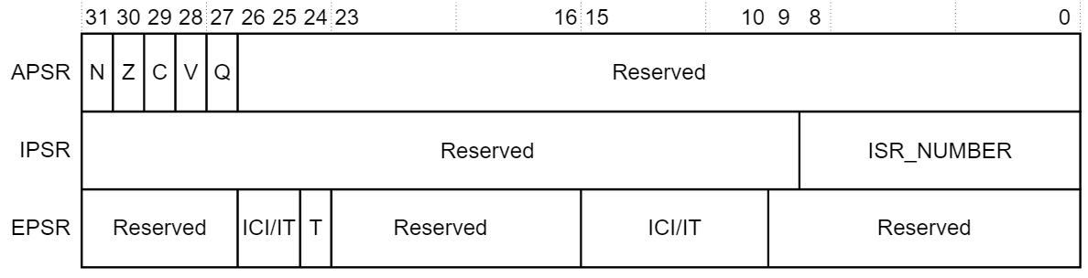
Cortex-M4 Program Status Registers [S6a]
PSR
The Program Status Register (PSR) captures the current CPU and program application state.

Slide 11
Cortex-M4 Program Status Registers [S6b]
PSR
The Program Status Register (PSR) captures the current CPU and program application state.
APSR
EPSR
IPSR
The PSR combines the APSR, EPSR, IPSR
These status registers are mutually exclusive bit fields in the 32-bit PSR.
Notes:
http://infocenter.arm.com/help/index.jsp?topic=/com.arm.doc.dui0553a/CHDBIBGJ.html

Slide 12
Cortex-M4 Program Status Registers [S7]
PSR
The Application Program Status Register (APSR) contains current state of condition flags from previous instruction execution
APSR
EPSR
IPSR
31
30
29
28
27
26:0
N
Z
C
V
Q
Reserved
Status Flags
N = Negative Flag
Z = Zero Flag
C = Carry Flag
V = Overflow Flag
Q = Saturation Flag
Was last result negative?
Was last result zero?
Did last result have a carry?
Did last result have an overflow?
Did last result saturate?

Slide 13
Cortex-M4 Program Status Registers [S8]
PSR
The Interrupt Program Status Register (IPSR) contains the exception type number of the current ISR.
APSR
EPSR
IPSR
31:9
8:0
Exception Numbers:
0 = Reset
1 = Non-Maskable Interrupt (NMI)
2 = Hard Fault
3 = Memory Management Fault
…
16 = IRQ0
17 = IRQ1
…
N+15 = IRQ(n-1)
Reserved
Exception_NUM
Reserved
Number of Current Exception

Slide 14
Exception Mask Registers [S9a]
PRIMASK
Prevents activation of all exceptions with configurable priority (If set to 1)
FAULTMASK
Prevents activation of all exceptions with configurable priority EXCEPT the Non-Maskable Interrupt (NMI) (If set to 1)
BASEPRI
Defines minimum priority for exception processing
31:1
0
Reserved
PRIMASK
31:1
0
Reserved
FAULTMASK
31:8
7:0
Reserved
BASEPRI

Slide 15
Control Register [S9b]
FPCA – Floating Point State Active
0 = No Floating Point Context Active
1 = Floating Point Context Active
SPSEL – Selects Current Stack Pointer
0 = MSP – Main Stack Pointer
1 = PSP – Process Stack Pointer
nPRIV – Defines Privilege Level
0 = Privileged
1 = Unprivileged
31:3
2
1
0
Reserved
FPCA
nPRIV
SPSEL
Notes:
http://infocenter.arm.com/help/index.jsp?topic=/com.arm.doc.dui0553a/CHDBIBGJ.html

Slide 16
Private Peripherals [S10]
Processor Debug Control
0xFFFFFFFF
System Specific
System Control Block (SCB)
0xE0000000
Reserved
0xDFFFFFFF
(unused)
System Control Space (SCS)
FPU
0x60000000
0x5FFFFFFF
Peripherals
Reserved
MPU
0x40000000
FPB
NVIC
0x3FFFFFFF
SRAM
DWT
Reserved
0x20000000
ITM (ETM)
SysTick Timer
0x1FFFFFFF
Code
Misc system control registers
0x00000000
Memory Map
Notes:
http://infocenter.arm.com/help/index.jsp?topic=/com.arm.doc.dui0553a/CHDBIBGJ.html

Slide 17
General Peripherals [S11a]
Peripheral Zone Memory Map
Reserved
0xFFFFFFFF
System Specific
Peripheral Bit-Band Alias Region
0xE0000000
512 KB
0xDFFFFFFF
(unused)
Reserved
0x60000000
Peripheral Region
0x5FFFFFFF
Peripherals
0x40000000
(Reserved)
0x3FFFFFFF
SRAM
SRAM Bit Band Alias Region
0x20000000
0x1FFFFFFF
Code
(Reserved)
0x00000000
SRAM
Memory Map
Sram Zone Memory Map
Notes:
http://infocenter.arm.com/help/index.jsp?topic=/com.arm.doc.dui0553a/CHDBIBGJ.html

Slide 18
General Peripherals [S11b]
Peripheral Zone Memory Map
ADC14
Reserved
Reserved
0xFFFFFFFF
System Specific
Peripheral Bit-Band Alias Region
Timer32
0xE0000000
Port
0xDFFFFFFF
(unused)
Reserved
WDT_A
0x60000000
Peripheral Region
RTC_C
CRC32
4KB
0x5FFFFFFF
Peripherals
AES256
0x40000000
(Reserved)
COMP_E0-E1
0x3FFFFFFF
SRAM
REF_A
SRAM Bit Band Alias Region
0x20000000
eUSCI_B0-B3
0x1FFFFFFF
Code
(Reserved)
eUSCI_A0-A3
Timer_A0-A3
0x00000000
SRAM
Peripheral Devices
Memory Map
SRAM Zone Memory Map
Notes:
http://infocenter.arm.com/help/index.jsp?topic=/com.arm.doc.dui0553a/CHDBIBGJ.html

Slide 19
Timer A0 Peripheral [S12]
4KB
ADC14
Timer_A0 Expansion 0
0x40000020
Reserved
Timer_A0 Interrupt Vector
0x4000002E
Timer_A0 CAPCOM 4
0x4000001A
Timer32
Timer_A0 CAPCOM 3
0x40000018
Port
Timer_A0 CAPCOM 2
0x40000016
Timer_A0 CAPCOM 1
0x40000014
WDT_A
Reserved
Timer_A0 CAPCOM 0
0x40000012
RTC_C
0x40000010
CRC32
Timer_A0 Counter
Peripheral Bit-Band Alias Region
0x4000000A
AES256
Timer_A0 CAPCOM Control 4
Timer_A0 CAPCOM Control 3
0x40000008
Reserved
COMP_E0-E1
0x40000006
Timer_A0 CAPCOM Control 2
REF_A
Timer_A0 CAPCOM Control 1
0x40000004
Peripheral Region
eUSCI_B0-B3
0x40000002
Timer_A0 CAPCOM Control 0
eUSCI_A0-A3
Timer_A0 Control
0x40000000
Peripheral Zone
Memory Map
Timer_A0-A3
Timer_A0 Registers
Peripheral Devices
Notes:
http://infocenter.arm.com/help/index.jsp?topic=/com.arm.doc.dui0553a/CHDBIBGJ.html

Slide 20
Timer A0 Control Register [S13a]
Timer_A0 Control Register
15:10
9
8
7
6
5
4
3
2
1
0
Reserved
TASSEL
ID
MC
Reserved
TACLR
TAIE
TAIFG
Bit fields are variables with predefined widths (i.e. non-standard sizes) within the register
Notes:
http://infocenter.arm.com/help/index.jsp?topic=/com.arm.doc.dui0553a/CHDBIBGJ.html

Slide 21
Timer A0 Control Register [S13b]
Timer_A0 Control Register
15:10
9
8
7
6
5
4
3
2
1
0
Reserved
TASSEL
ID
MC
Reserved
TACLR
TAIE
TAIFG
Bit fields are variables with predefined widths (i.e. non-standard sizes) within the register
Bit fields of Timer_A0 Control Register
TASSEL
ID
MC
TACLR
TAIE
TAIFG
= Select input clock source for Timer_A0
= Select input clock divider for Timer_A0
= Select count-mode for Timer_A0
= Resets Timer_A0
= Enable Timer_A0 interrupt
= Timer_A0 interrupt flag
Bit Fields help represent operations/status/configurations.
Notes:
http://infocenter.arm.com/help/index.jsp?topic=/com.arm.doc.dui0553a/CHDBIBGJ.html

Slide 22
Timer A0 Control Register [S13c]
Timer_A0 Control Register
15:10
9
8
7
6
5
4
3
2
1
0
Reserved
TASSEL
ID
MC
Reserved
TACLR
TAIE
TAIFG
Bits 15:10 and 3 are reserved
Bit fields of Timer_A0 Control Register
TASSEL
ID
MC
TACLR
TAIE
TAIFG
= Select input clock source for Timer_A0
= Select input clock divider for Timer_A0
= Select count-mode for Timer_A0
= Resets Timer_A0
= Enable Timer_A0 interrupt
= Timer_A0 interrupt flag
Reserved bits can be:
Unused
Reserved for advanced sub-family models
For internal use only
Notes:
http://infocenter.arm.com/help/index.jsp?topic=/com.arm.doc.dui0553a/CHDBIBGJ.html

Slide 23
Timer A0 Control Pointer [S14]
Timer_A0 Control Register
15:10
9
8
7
6
5
4
3
2
1
0
Reserved
TASSEL
ID
MC
Reserved
TACLR
TAIE
TAIFG
0b10
0b1
16-Bit Register (Address = 0x40000000)
Configure for:
TASSEL = 2 = 0b10
TAIE = 1 = 0b1
volatile uint16_t * ta0_ctrl = (uint16_t*)0x40000000;
*ta0_ctrl = 0x0202;
Notes:
http://infocenter.arm.com/help/index.jsp?topic=/com.arm.doc.dui0553a/CHDBIBGJ.html

Slide 24
Unused Slides

Slide 25
Memory Map [S1.3.5.a]
Memory
0xFFFFFFFF
General Purpose and Special Registers
Process of dividing the Address Space into logical sections
0xE0100000
0xE00FFFFF
Interrupt Vector Table
0xD0000000
Reserved
0x3EFFFFFF
Peripherals
0x30000000
0x20000000
SRAM
0x20000000
Reserved
Code
0x00000000

Slide 26
Memory Map [S1.3.5.b]
Memory
0xFFFFFFFF
General Purpose and Special Registers
Process of dividing the Address Space into logical sections
0xE0100000
Address ranges are mapped to particular functions
0xE00FFFFF
Interrupt Vector Table
e.g. 0x00000000-0x09FFFFFF range mapped to flash
0xD0000000
Reserved
0x3EFFFFFF
Peripherals
0x30000000
System Memory
0x1E0FFFFF
0x20000000
SRAM
0x0A000000
0x20000000
Flash
0x09FFFFFF
Reserved
Code
0x00000000
0x00000000

Slide 27
Memory Map [S1.3.5.c]
Memory
0xFFFFFFFF
General Purpose and Special Registers
Process of dividing the Address Space into logical sections
0xE0100000
Address ranges are mapped to particular functions
0xE00FFFFF
Interrupt Vector Table
e.g. 0x00000000-0x09FFFFFF range mapped to flash
0xD0000000
Reserved
Addresses act as a physical/virtual access of a memory location
0x3EFFFFFF
Peripherals
0x30000000
System Memory
0x1E0FFFFF
0x20000000
SRAM
0x0A000000
0x20000000
Flash
0x09FFFFFF
Reserved
Code
0x00000000
0x00000000

Slide 28
Memory Map [S1.3.5.d]
Memory
0xFFFFFFFF
General Purpose and Special Registers
Process of dividing the Address Space into logical sections
0xE0100000
Address ranges are mapped to particular functions
0xE00FFFFF
Interrupt Vector Table
e.g. 0x00000000-0x09FFFFFF range mapped to flash
0xD0000000
Reserved
Addresses act as a physical/virtual access of a memory location
Typically includes: Flash, SRAM, Peripherals, Debug,
General Purpose and Special Registers
0x3EFFFFFF
Peripherals
0x30000000
System Memory
0x1E0FFFFF
0x20000000
SRAM
0x0A000000
0x20000000
Flash
0x09FFFFFF
Reserved
Code
0x00000000
0x00000000
Notes:
@Alex Do memory maps only refer to peripherals? Can memory maps refer to actual raw memory?

Slide 29
Types of Registers [S1.3.6.b]
CPU Registers
Peripherals
R0-R12
General-Purpose Registers
Peripheral n
Data Register
Peripheral n
Control Register
R13-R15
CPU-Special Registers
Stack Pointer (SP)
Link Register (LR)
Program Counter (PC)
Special Registers
SCB
System Control Block
NVIC
Nested Vector Interrupt Controller
xPSR
Program Status Registers
CONTROL
Processor’s control
Notes:
Expand to 3 slides, with brief explanations for each

Slide 30
Address Space [S1.3.5.3]
The address space is the range of valid addresses in memory that a program/process can access.
Address space 1
0xFFFFF
0xFFFFF
Process 1
0x00000
Process 2
Peripherals located (i.e. mapped) to address space of physical memory (memory space) are called
Memory Mapped Peripherals
(or more commonly memory mapped I/O).
Address space 2
0xFFFFF
Process 3
0x00000
Address space 3
0xFFFFF
Code
0x00000
0x00000
Physical Address Space
Virtual Address Spaces
Easy for programmer to interface address space due to bus decision making.
However, different address spaces require different read/write mechanisms.
Notes:
Transition for Address Space Figure?

Slide 31
I/O Blocks and Peripheral Limitations [S1.3.5.4]
Typical size of address spaces are 4kB, though can be larger.
Peripheral 1
Data Register
0x000000FF
Peripheral 1
Control Register
Because of memory mapped I/O, peripherals are therefore limited by size of address space.
Peripheral 2
Data Register
Peripheral 2
Control Register
0x00000000
4 kB Address Space for
Memory Mapped I/O
Notes:
I wanted to talk more about ARM memory, but not sure what to cover on it. Already talked about memory maps and address spaces; and as for registers, that should be talked about in next section?

Slide 32
Types of Memory [S1.3.3.1a]
Memory
Loses data
without power
Volatile
memory
Non-volatile
memory
Keeps data without power
Read/write speed fast
RAM
Flash
Read/write speed slow
Holds data & programs
Stores bootloader
Reading/writing to memory:
Expensive, Takes Time,
Architecture designed for memory cache hits

Slide 33
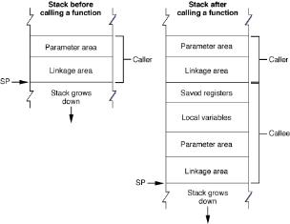
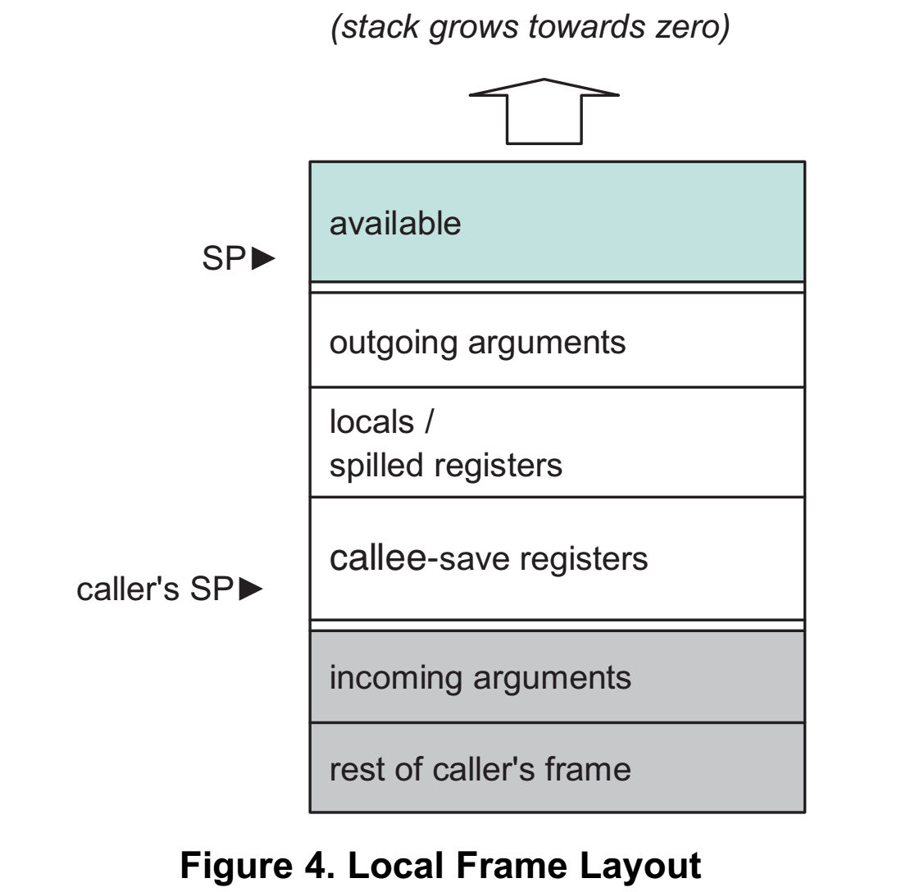
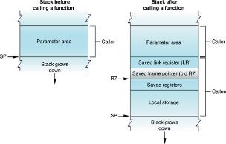
Stack Implementation [S4]
Show the different types of things that get put on stack (general)
Two types of routines

Slide 34
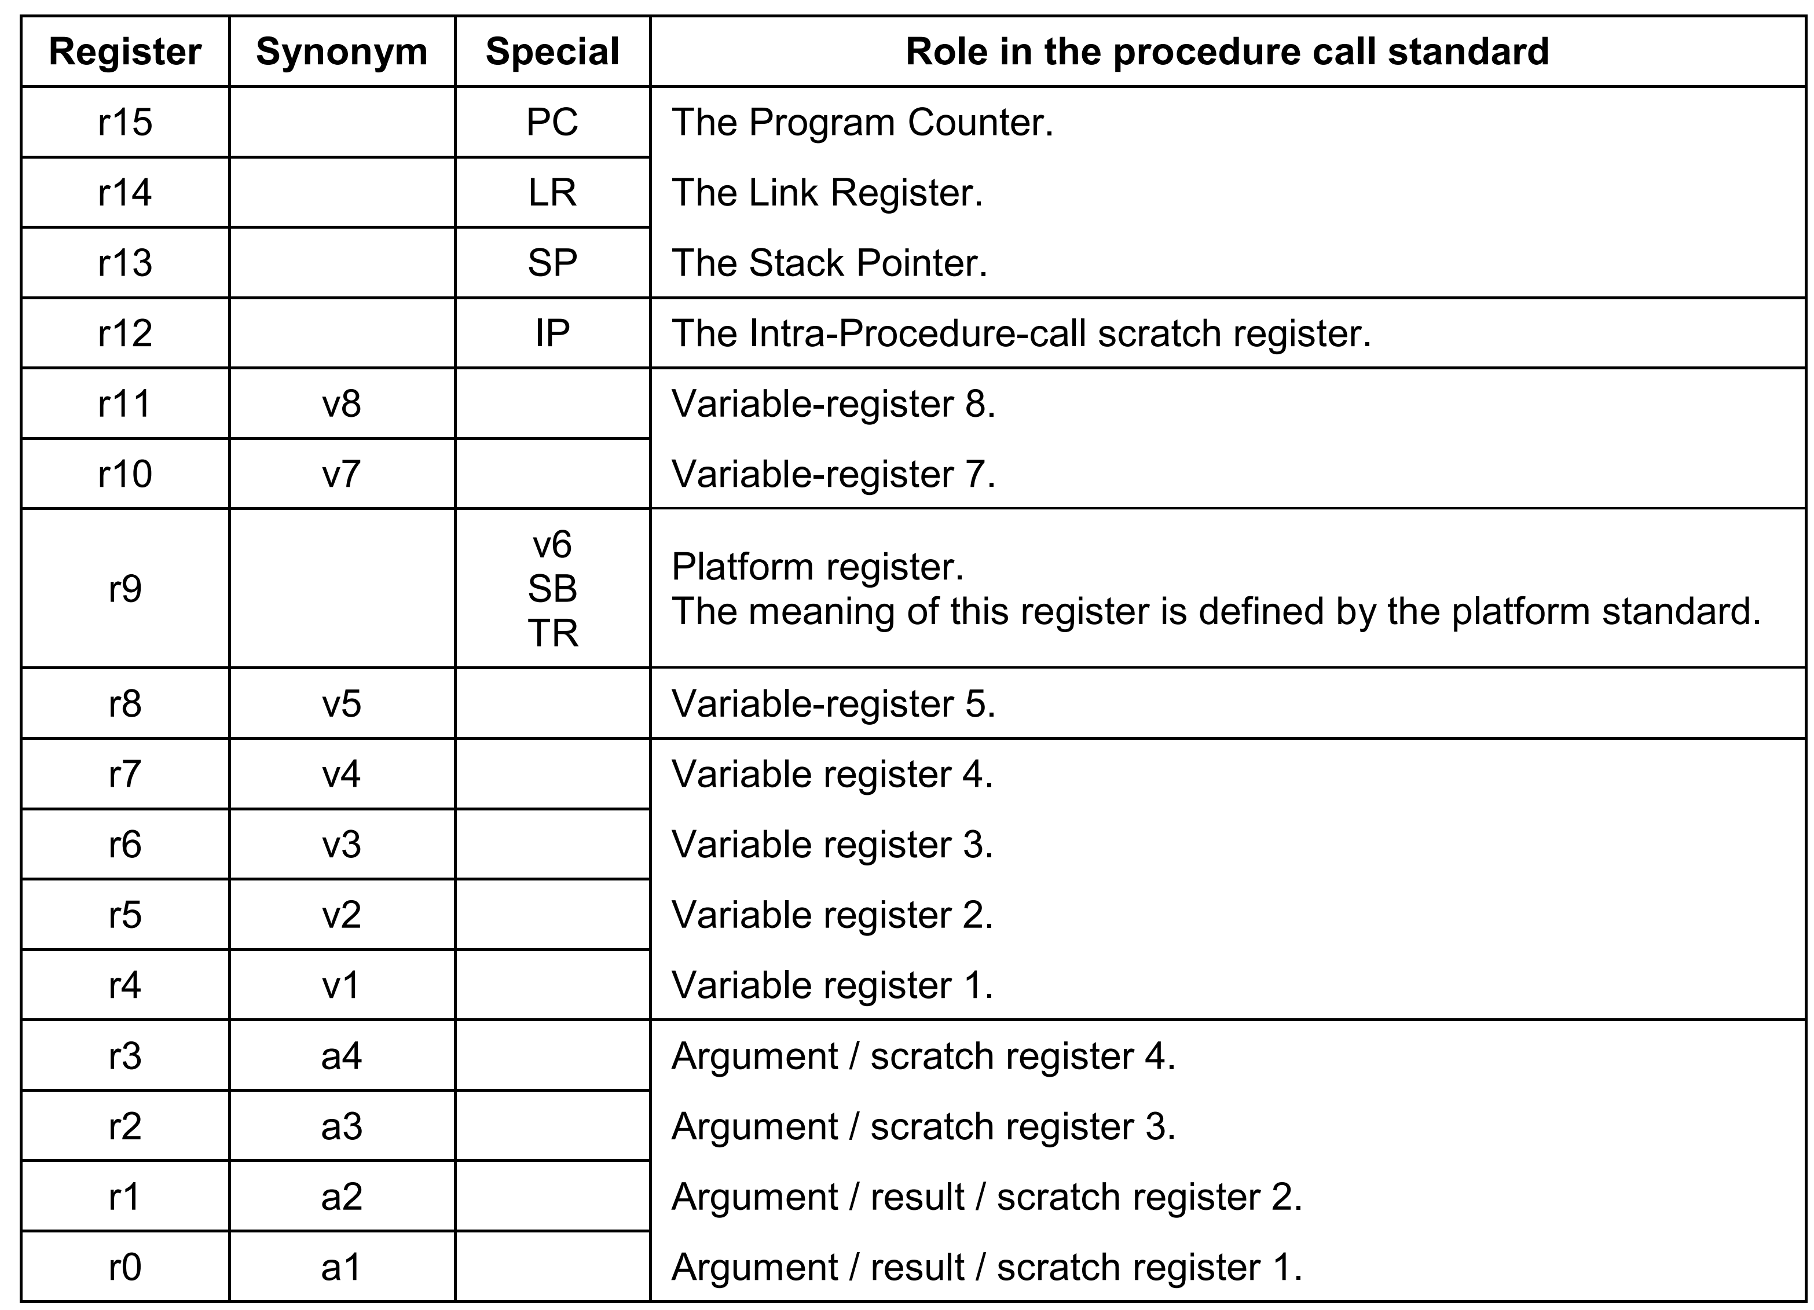
CPU Registers [S6]

Slide 35
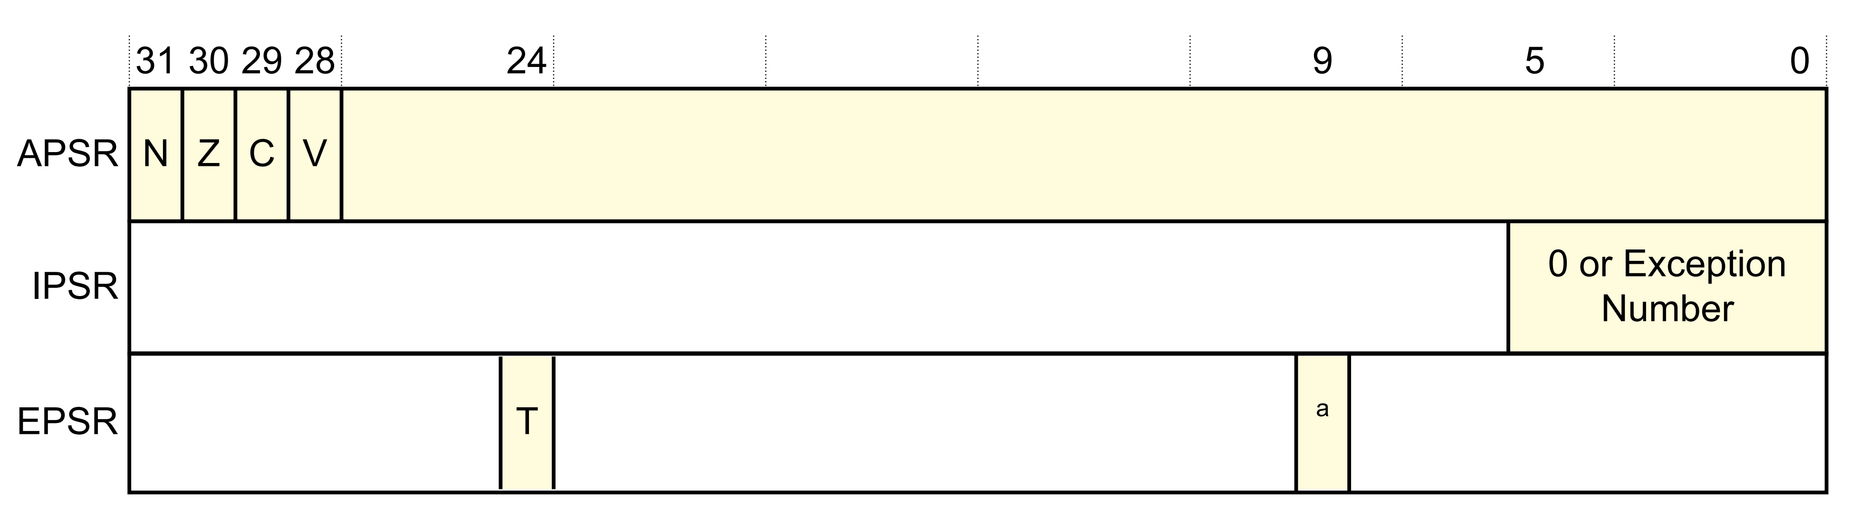

Special Purpose Registers
APSR – Application Program Status Register
NZCV = Flags that evaluate conditional execution
IPSR – Interrupt Program Status Register
EPSR – Execution Program Status Register
35
Notes:
http://infocenter.arm.com/help/index.jsp?topic=/com.arm.doc.dui0552a/CHDBIBGJ.html

Slide 36
ARM Stack Calling Conventions
High Address
In ARM, the stack is a Full Descending Stack
Starts at a High Address, and grows toward low addresses
LIFO – Last-in-First-Out
Used
Stack
Space
Stack
Pointer
Unused
Stack
Space
Grows from high to low
Addresses
Low Address

Slide 37
Architecture Independence [S2]
Put a picture in of application code on top of hardware features or hardware specific code
Freedom Freescale – KL25z
Control_Lib
LED_Lib
Nordic_Lib
UART_Lib
SPI_Lib
SPI FW KL25z
UART FW KL25z
I/O
SPI Peripheral Module
UART Peripheral Module
GPIO HW

Slide 38
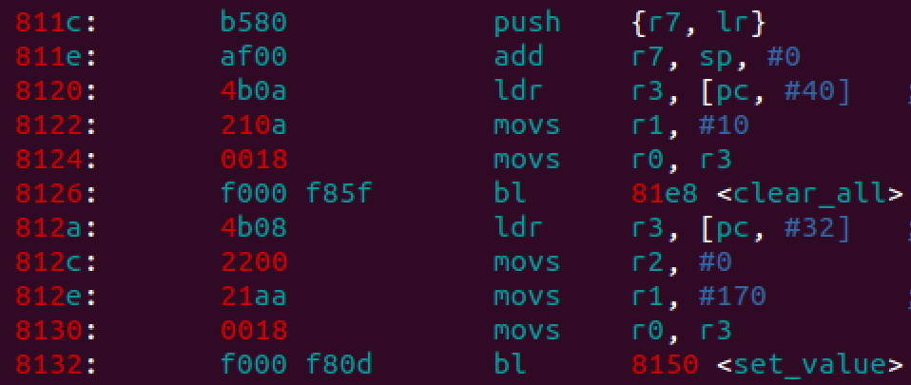
Applications
Libs
Middleware
Operating System
Drivers
Bootloader
Hardware

