Slide 1
Creating Software Interfaces for Hardware
Embedded Software Essentials

Slide 2
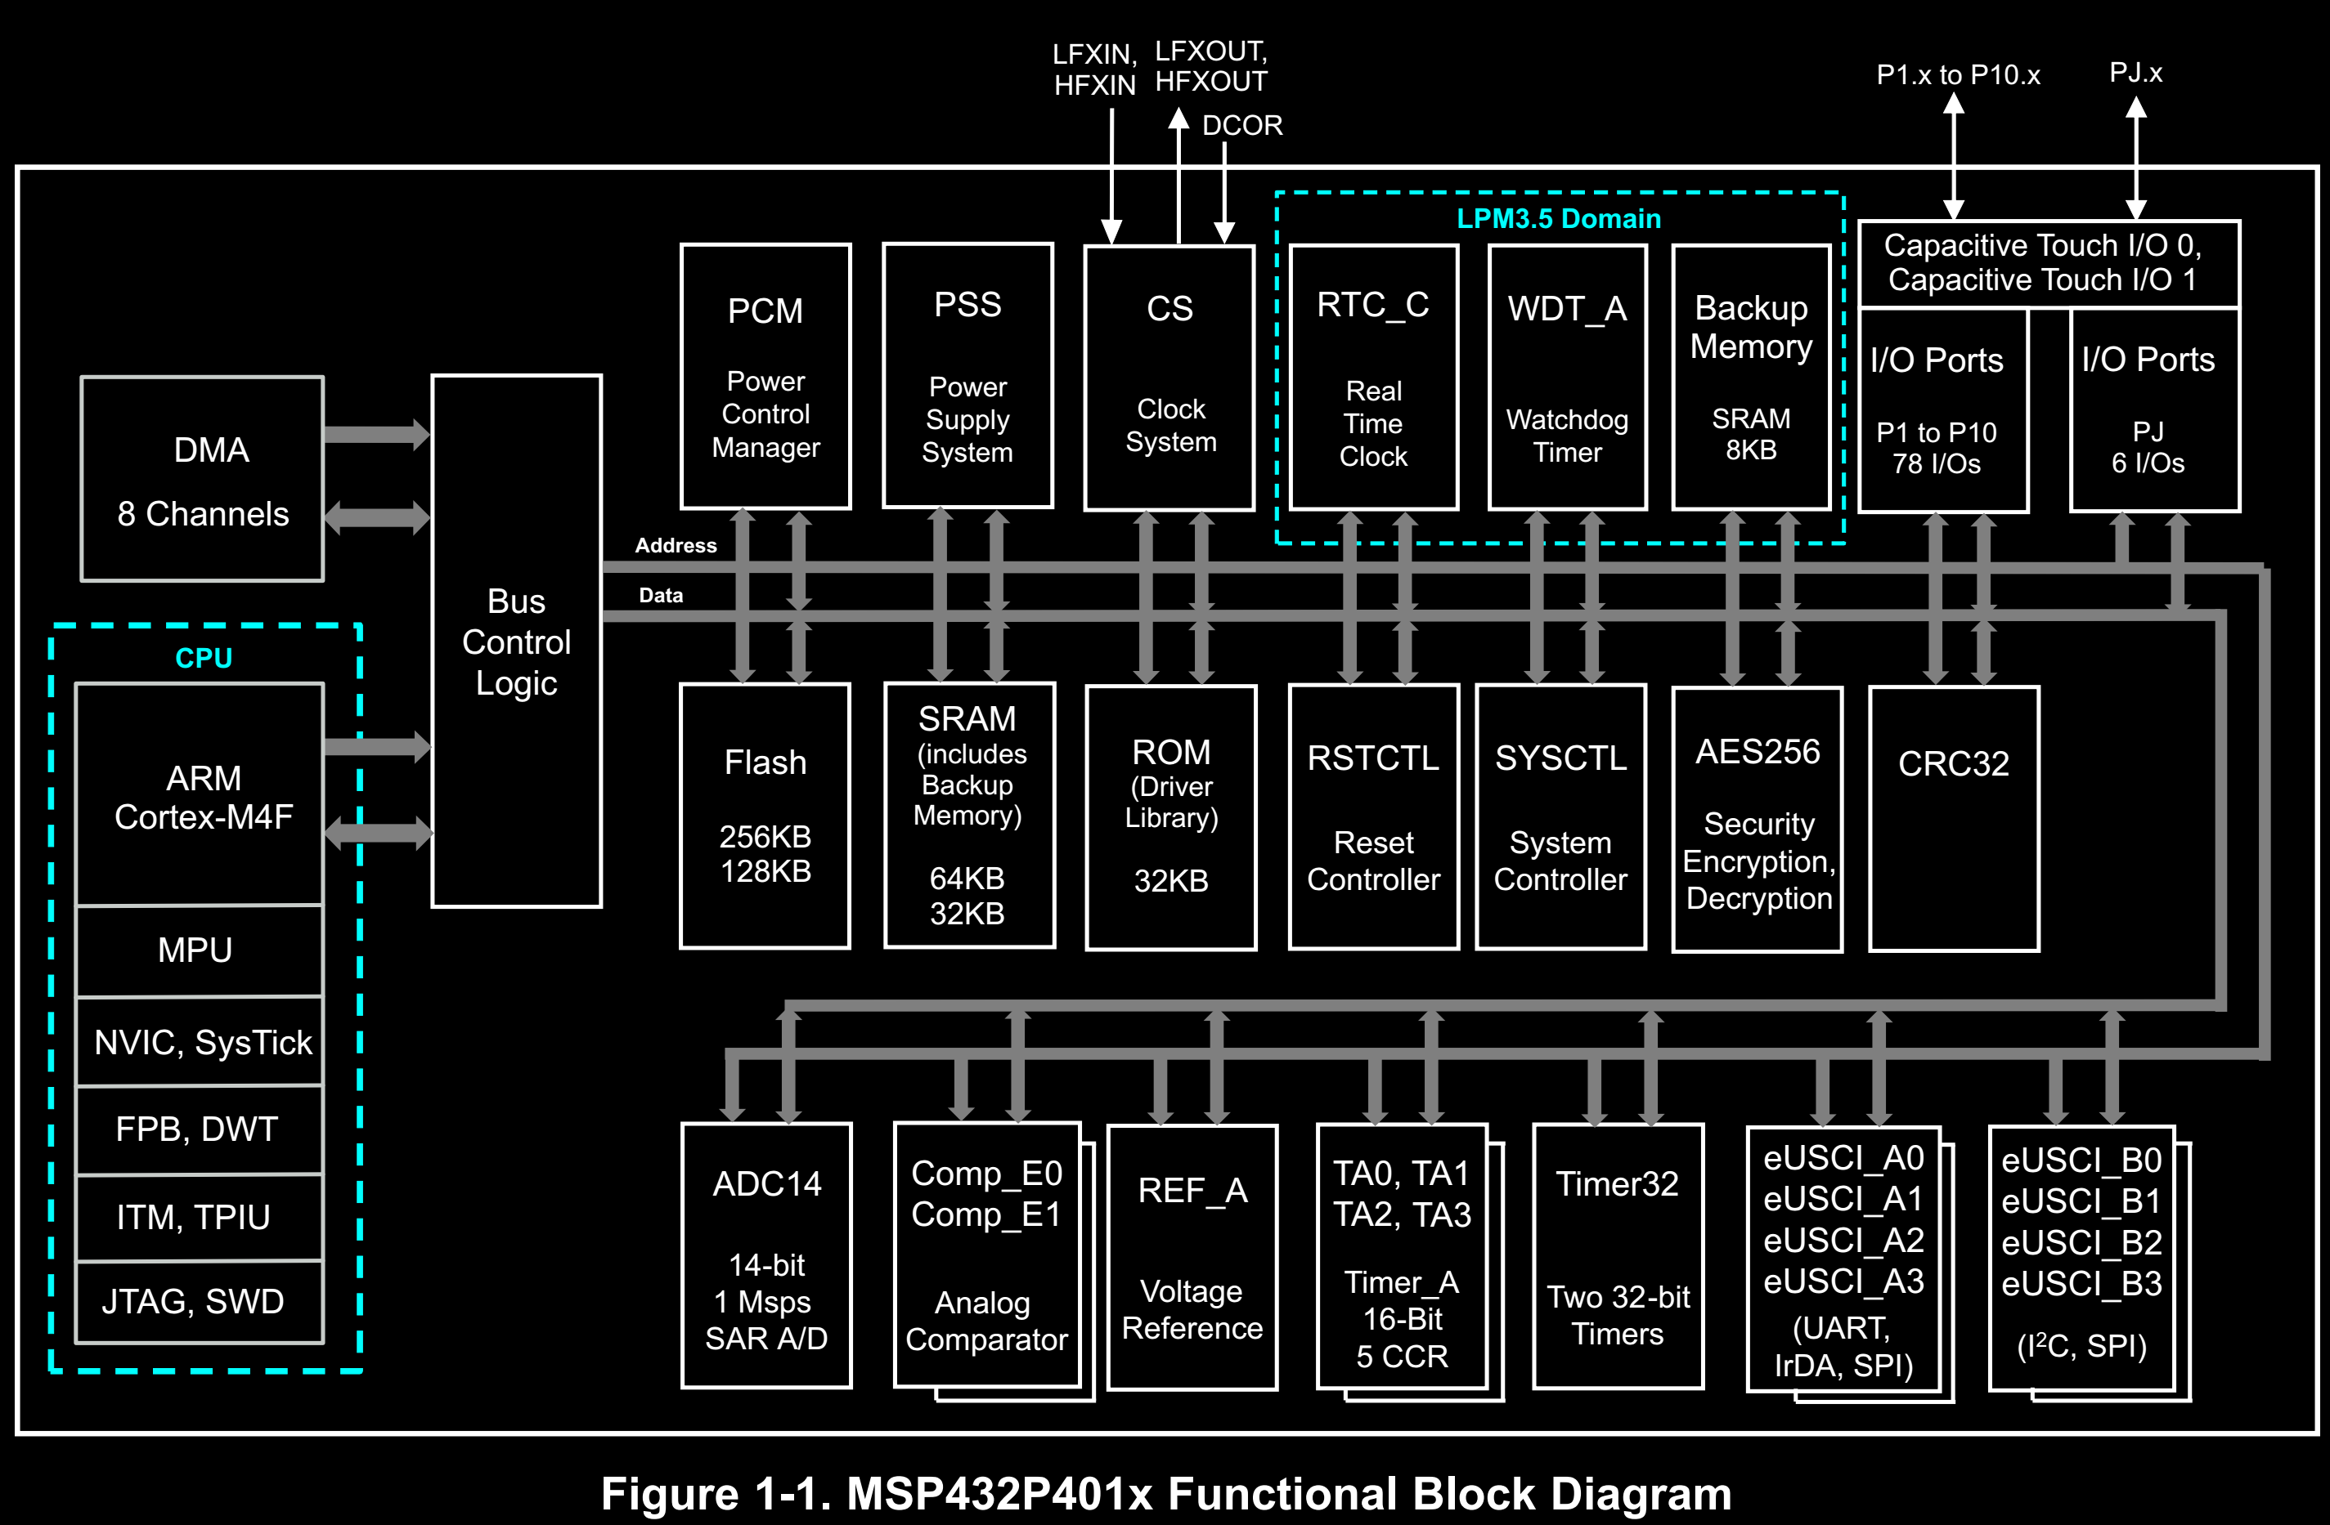
Platform Independence [S1a]
Microcontrollers have a variety of
Peripherals
Registers
Memories
Software Architecture: structured organization of a software project
Design software to be independent of architecture and platform¹
May have 1000+ peripheral registers.
¹Impossible to remove all hardware dependencies
Notes:
http://www.ti.com/lit/ds/symlink/msp432p401m.pdf

Slide 3
Platform Independence [S1b]
MSP432 Platform
Microcontrollers have a variety of
Peripherals
Registers
Memories
Software Architecture: structured organization of a software project
Design software to be independent of architecture and platform¹
Executable Program
Application
Executable stored in Flash
Abstraction Layer
Bare Metal Firmware

Slide 4
Abstraction Layers [S2a]
Firmware layer needs to be efficient and bug-free
Make higher level software independent of low level firmware
Example: application software
Application
Specific
MSP432
Application
platform_msp432.c
Firmware
port.c
spi.c
msp432p401r.h
SPI Peripheral
Hardware
Layer
GPIO Hardware
$ make all PLATFORM=MSP432

Slide 5
Abstraction Layers [S2b]
KL25z
Same Application, Different Firmware and Platform code
MSP432
Application
Application
platform_kl25z.c
platform_msp432.c
port.c
spi.c
port.c
spi.c
MKL25Z.h
Register Definition Files
msp432p401r.h
SPI Peripheral
SPI Peripheral
Hardware
Layers
GPIO Hardware
GPIO Hardware
$ make all PLATFORM=KL25Z

Slide 6
Abstraction Layers [S2c]
KL25z
Same Application, Different Firmware and Platform code
Application
platform_kl25z.c
Interface methods for hardware
Register Definition Files
Macro Functions
Specialized C-Functions
port.c
spi.c
MKL25Z.h
Register Definition Files
SPI Peripheral
Hardware
Layers
GPIO Hardware
$ make all PLATFORM=KL25Z

Slide 7
Embedded Hardware Interface [S4a]
Interface methods for hardware
Register Definition Files
Macro Functions
Specialized C-Functions
MSP432
Application
CMSIS
platform_msp432.c
port.c
spi.c
msp432p401r.h
ARM Core
SPI Peripheral
GPIO Hardware
Notes:
https://www.arm.com/products/processors/cortex-m/cortex-microcontroller-software-interface-standard.php

Slide 8
Embedded Hardware Interface [S4b]
Interface methods for hardware
Register Definition Files
Macro Functions
Specialized C-Functions
Create Hardware Abstraction Layer (HAL) to simplify application level programming
Acts like an API (Application Programming Interface)
MSP432
Application
CMSIS
platform_msp432.c
port.c
spi.c
msp432p401r.h
ARM Core
SPI Peripheral
GPIO Hardware
Notes:
https://www.arm.com/products/processors/cortex-m/cortex-microcontroller-software-interface-standard.php

Slide 9
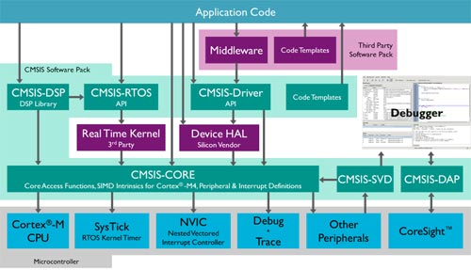
Embedded Hardware Interface [S4c]
Create Hardware Abstraction Layer (HAL) to simplify application level programming
MSP432
Application
CMSIS
platform_msp432.c
port.c
spi.c
msp432p401r.h
ARM Core
SPI Peripheral
GPIO Hardware
ARM Core Microcontroller Software Interface Standard (CMSIS) Diagram
Notes:
https://www.arm.com/products/processors/cortex-m/cortex-microcontroller-software-interface-standard.php

Slide 10
Register Definition Files [S5a]
Platform File that provides interface to peripheral memory by specifying
Address List for Peripherals
Access Methods
Defines for Bit Fields and Bit Masks
Private
Peripherals
General
Peripherals
Processor Debug Control
ADC14
Reserved
SCB
Timer32
FPU
Port
WDT_A
MPU
RTC_C
CRC32
NVIC
AES256
Reserved
COMP_E0-E1
SysTick Timer
REF_A
eUSCI_B0-B3
Misc system control registers
eUSCI_A0-A3
Timer_A0-A3
Could Contain 1000’s of Registers!

Slide 11
Register Definition Files [S5b]
Platform File that provides interface to peripheral memory by specifying
Address List for Peripherals
Access Methods
Defines for Bit Fields and Bit Masks
Peripheral Access Methods used to read/write data
Preprocessor Macros
Direct Dereferencing of Memory
Structure Overlays
MSP432
Application
CMSIS
msp432p401r.h
ARM Core
SPI Peripheral
GPIO Hardware

Slide 12
Register Definition Files [S5c]
Platform File that provides interface to peripheral memory by specifying
Address List for Peripherals
Access Methods
Defines for Bit Fields and Bit Masks
Peripheral Access Methods used to read/write data
Preprocessor Macros
Direct Dereferencing of Memory
Structure Overlays
MSP432
Application
CMSIS
msp432p401r.h
ARM Core
SPI Peripheral
GPIO Hardware
Platform and architecture software interface

Slide 13
Register Definition Files [S5d]
Platform File that provides interface to peripheral memory by specifying
Address List for Peripherals
Access Methods
Defines for Bit Fields and Bit Masks
Peripheral Access Methods used to read/write data
Preprocessor Macros
Direct Dereferencing of Memory
Structure Overlays
MSP432
Application
CMSIS
msp432p401r.h
ARM Core
SPI Peripheral
GPIO Hardware
Direct Application dependency on platform and core architecture

Slide 14
Embedded Hardware Interface [S6a]
Interface methods for hardware
Register Definition Files
Macro Functions
Specialized C-Functions

Slide 15
Embedded Hardware Interface [S6b]
Interface methods for hardware
Register Definition Files
Macro Functions
Specialized C-Functions
Regularly used in firmware abstraction

Slide 16
Embedded Hardware Interface [S6c]
Interface methods for hardware
Register Definition Files
Macro Functions
Specialized C-Functions
Regularly used in firmware abstraction
/* Macro Function to Read Memory */
#define HWREG16(x) (*((volatile uint16_t *)(x)))
Platform Dependency

Slide 17
Embedded Hardware Interface [S6d]
Interface methods for hardware
Register Definition Files
Macro Functions
Specialized C-Functions
Regularly used in firmware abstraction
/* Macro Function to Read Memory */
#define HWREG16(x) (*((volatile uint16_t *)(x)))
Platform Dependency
/* Specialized CMSIS Function to Enable Interrupts */
__attribute__( ( always_inline ) ) __STATIC_INLINE void __enable_irq(void)
{
__ASM volatile ("cpsie i" : : : "memory");
}
Architecture Dependency

Slide 18
Macro Functions [S7a]
Direct Substitution in code
#define TA0CTL_ADDR (0x40000000)
/ * 16 Bit Register Access Macros */
#define HWREG16(x) (*((volatile uint16_t *)(x)))

Slide 19
Macro Functions [S7b]
Direct Substitution in code
#define TA0CTL_ADDR (0x40000000)
/ * 16 Bit Register Access Macros */
#define HWREG16(x) (*((volatile uint16_t *)(x)))
Not an actual function call, no calling convention overhead!

Slide 20
Macro Functions [S7c]
Direct Substitution in code
Example use of access method:
#define TA0CTL_ADDR (0x40000000)
/ * 16 Bit Register Access Macros */
#define HWREG16(x) (*((volatile uint16_t *)(x)))
HWREG16(TA0CTL_ADDR) = 0x0202;
(*((volatile uint16_t *)(0x40000000))) = 0x0202;

Slide 21
Macro Functions [S7d]
/ * 8, 16, & 32 Bit Register Access Macros */
#define HWREG8(x) (*((volatile uint8_t *)(x)))
#define HWREG16(x) (*((volatile uint16_t *)(x)))
#define HWREG32(x) (*((volatile uint32_t *)(x)))
#define TA0CTL (HWREG16(0x40000000))
Example Use of Access Macro:
volatile uint16_t * ta0_ctrl = (uint16_t*)0x40000000;
*ta0_ctrl = 0x0202;
TA0CTL = 0x0202;
Same

Slide 22
Macro Functions [S7e]
/ * 8, 16, & 32 Bit Register Access Macros */
#define HWREG8(x) (*((volatile uint8_t *)(x)))
#define HWREG16(x) (*((volatile uint16_t *)(x)))
#define HWREG32(x) (*((volatile uint32_t *)(x)))
#define TA0CTL (HWREG16(0x40000000))
Pass in any address to access a register
Example Use of Access Macro:
volatile uint16_t * ta0_ctrl = (uint16_t*)0x40000000;
*ta0_ctrl = 0x0202;
TA0CTL = 0x0202;
Same

Slide 23
Port Macros [S8a]
Generic memory access macro for different sized registers
8, 16, 32 Bit Registers
/ * 8, 16, & 32 Bit Register Access Macros */
#define HWREG8(x) (*((volatile uint8_t *)(x)))
#define HWREG16(x) (*((volatile uint16_t *)(x)))
#define HWREG32(x) (*((volatile uint32_t *)(x)))
/ * Port 1 Register Access Macros */
#define P1IN (HWREG8(0x40004C00))
#define P1OUT (HWREG8(0x40004C02))
#define P1DIR (HWREG8(0x40004C04))
#define P1SEL0 (HWREG8(0x40004C0A))
#define P1SEL1 (HWREG8(0x40004C0C))
#define P1IES (HWREG8(0x40004C18))
#define P1IE (HWREG8(0x40004C1A))

Slide 24
Port Macros [S8b]
Generic memory access macro for different sized registers
8, 16, 32 Bit Registers
Port registers use the generalized access macros
/ * 8, 16, & 32 Bit Register Access Macros */
#define HWREG8(x) (*((volatile uint8_t *)(x)))
#define HWREG16(x) (*((volatile uint16_t *)(x)))
#define HWREG32(x) (*((volatile uint32_t *)(x)))
/ * Port 1 Register Access Macros */
#define P1IN (HWREG8(0x40004C00))
#define P1OUT (HWREG8(0x40004C02))
#define P1DIR (HWREG8(0x40004C04))
#define P1SEL0 (HWREG8(0x40004C0A))
#define P1SEL1 (HWREG8(0x40004C0C))
#define P1IES (HWREG8(0x40004C18))
#define P1IE (HWREG8(0x40004C1A))
/ * Set P1.0 to Output Direction */
P1DIR |= 0x01;

Slide 25
Port Macros [S8c]
#define SET_PORT_PIN_DIR (port, pin) ( (port)->DIR) |= (1 << pin) )
/* Set bit P1.0 to be output Direction */
SET_PORT_PIN_DIR( P1, PIN0 );

Slide 26
Port Macros [S8c]
#define SET_PORT_PIN_DIR (port, pin) ( (port)->DIR) |= (1 << pin) )
/* Set bit P1.0 to be output Direction */
SET_PORT_PIN_DIR( P1, PIN0 );

Slide 27
Port Macros [S8d]
Port Structure Overlay
typedef struct {
__I uint8_t IN;
uint8_t RESERVED0;
__IO uint8_t OUT;
uint8_t RESERVED1;
__IO uint8_t DIR;
uint8_t RESERVED2;
__IO uint8_t REN;
uint8_t RESERVED3;
… /* More Registers */
} DIO_PORT_TYPE;
#define SET_PORT_PIN_DIR (port, pin) ( (port)->DIR) |= (1 << pin) )
/* Set bit P1.0 to be output Direction */
SET_PORT_PIN_DIR( P1, PIN0 );
/* Define the PORT Constants and Types*/
#define PIN0 (0x0)
#define DIO_PORT1_ADDR ((uint32_t) 0x40004C00)
#define P1 ( (DIO_PORT_Type*)(DIO_PORT1_ADDR) )

Slide 28
Port Macros [S8e]
Port Structure Overlay
typedef struct {
__I uint8_t IN;
uint8_t RESERVED0;
__IO uint8_t OUT;
uint8_t RESERVED1;
__IO uint8_t DIR;
uint8_t RESERVED2;
__IO uint8_t REN;
uint8_t RESERVED3;
… /* More Registers */
} DIO_PORT_TYPE;
#define SET_PORT_PIN_DIR (port, pin) ( (port)->DIR) |= (1 << pin) )
/* Set bit P1.0 to be output Direction */
SET_PORT_PIN_DIR( P1, PIN0 );
/* Define the PORT Constants and Types*/
#define PIN0 (0x0)
#define DIO_PORT1_ADDR ((uint32_t) 0x40004C00)
#define P1 ( (DIO_PORT_Type*)(DIO_PORT1_ADDR) )

Slide 29
Bit Band Macros [S9b]
Bit Band Region allows for atomic reads/writes of single bits for first 1MB of SRAM and Peripheral Memory
Not all of the SRAM & Peripheral Memory has a bit-band alias
Memory Map
Reserved
0xFFFFFFFF
Peripheral Bit-Band Alias Region
System Specific
0xE0000000
Reserved
0xDFFFFFFF
(unused)
Peripheral Region
0x60000000
0x5FFFFFFF
Peripherals
0x40000000
Reserved
0x3FFFFFFF
SRAM
Peripheral Bit-Band Alias Region
0x20000000
0x1FFFFFFF
Code
Reserved
Peripheral Region
0x00000000

Slide 30
Bit Band Macros [S9b]
#define TA0CTL_ADDR (0x40000000)
/* Bit Band Region is offset from Peripheral/SRAM */
#define BB_OFFSET (0x02000000)
/* Macro Function to Read Memory */
#define HWREG32(addr) (*((volatile uint32_t *)(addr)))
/* Bit Band Alias Offset Address */
#define BITBAND_ADDR(addr, bit) ( (addr & 0xF0000000) + BB_OFFSET + \
((addr & 0xFFFFF) << 5) + (bit << 2) )
/* Set bit 1 of TA0CTL Register */
HWREG32( BITBAND_ADDR(TA0CTL_ADDR, 1) );

Slide 31
Bit Band Macros [S9c]
#define TA0CTL_ADDR (0x40000000)
/* Bit Band Region is offset from Peripheral/SRAM */
#define BB_OFFSET (0x02000000)
/* Macro Function to Read Memory */
#define HWREG32(addr) (*((volatile uint32_t *)(addr)))
/* Bit Band Alias Offset Address */
#define BITBAND_ADDR(addr, bit) ( (addr & 0xF0000000) + BB_OFFSET + \
((addr & 0xFFFFF) << 5) + (bit << 2) )
/* Set bit 1 of TA0CTL Register */
HWREG32( BITBAND_ADDR(TA0CTL_ADDR, 1) );

Slide 32
Macro Problems [S10a]
Numerous Issues with Macro Functions
No Type Checking
Bug Introduction
Complex / Confusing Layers of Macros Calling Macros
Code Size and Duplication

Slide 33
Macro Problems [S10b]
Numerous Issues with Macro Functions
No Type Checking
Bug Introduction
Complex / Confusing Layers of Macros Calling Macros
Code Size and Duplication
#define PERIPH_BASE ((uint32_t) 0x40000000)
#define DIO_BASE (PERIPH_BASE + 0x00004C00)
#define P1_BASE (DIO_BASE + 0x0000)
#define P1DIR_ADDR (P1BASE + 0x0004)
Must specify type explicitly
Before Preprocessing
#define SQUARE(x) ((x)*(x))
uint32_t y = 2;
uint32_t Y_sqrd = ;
Y_sqrd = SQUARE(y++);
After Preprocessing
uint32_t y = 2;
uint32_t Y_sqrd = ;
Y_sqrd = ((y++)*(y++));
Undefined Operation

Slide 34
Macro Problems [S10c]
Numerous Issues with Macro Functions
No Type Checking
Bug Introduction
Complex / Confusing Layers of Macros Calling Macros
Code Size and Duplication
#define PERIPH_BASE ((uint32_t) 0x40000000)
#define DIO_BASE (PERIPH_BASE + 0x00004C00)
#define P1_BASE (DIO_BASE + 0x0000)
#define P1DIR_ADDR (P1BASE + 0x0004)
#define HWREG8(x) (*((volatile uint8_t *)(x)))
#define P1DIR (HWREG8(P1DIR_ADDR))

Slide 35
Macro Problems [S10d]
Numerous Issues with Macro Functions
No Type Checking
Bug Introduction
Complex / Confusing Layers of Macros Calling Macros
Code Size and Duplication
The preprocess will search and replace any used macro!

Slide 36
Specialized C Functions [S11]
Functions are excellent for encapsulating a specialized operation
Calling a traditional C-function can decrease performance due to calling convention overhead

Slide 37
Specialized C Functions [S11b]
Functions are excellent for encapsulating a specialized operation
Calling a traditional C-function can decrease performance due to calling convention overhead
Saving data to stack
Creating local variables
Branching
Need to reduce performance hit
__attribute__( ( always_inline ) ) static inline void __enable_irq(void)
{
__ASM volatile ("cpsie i" : : : "memory");
}

Slide 38
Specialized C Functions [S11c]
Functions are excellent for encapsulating a specialized operation
Calling a traditional C-function can decrease performance due to calling convention overhead
Saving data to stack
Creating local variables
Branching
Need to reduce performance hit
__attribute__( ( always_inline ) ) static inline void __enable_irq(void)
{
__ASM volatile ("cpsie i" : : : "memory");
}

Slide 39
Inline Keyword [S12a]
Compiler Attributes can apply to functions
Inline – Skips calling convention, copies function body into calling code
__attribute__ ((always_inline)) inline int32_t add( int32_t x, int32_t y ) {
return (x + y);
}
Inline keyword is a c99 Feature → Not supported in c89
always_inline is a GCC attribute → Not supported in other compilers

Slide 40
Inline Keyword [S12b]
Compiler Attributes can apply to functions
Inline – Skips calling convention, copies function body into calling code
Compiler will
NOT ignore this
Compiler might
ignore this
__attribute__ ((always_inline)) inline int32_t add( int32_t x, int32_t y ) {
return (x + y);
}
Inline keyword is a c99 Feature → Not supported in c89
always_inline is a GCC attribute → Not supported on other compilers

Slide 41
Inline Keyword [S12c]
Compiler Attributes can apply to functions
Inline – Skips calling convention, copies function body into calling code
Compiler will
NOT ignore this
Compiler might
ignore this
__attribute__ ((always_inline)) inline int32_t add( int32_t x, int32_t y ) {
return (x + y);
}
Good for
Small functions
Bad for / Will not work for
Recursive functions
Variadic functions
Long functions

Slide 42
Static Keyword [S13a]
Static Keyword can apply to functions to create private access

Slide 43
Static Keyword [S13b]
Static Keyword can apply to functions to create private access
Function/Variable only visible to current file
core_cm4.h
__attribute__( ( always_inline ) ) static inline void __enable_irq(void)
{
__ASM volatile ("cpsie i" : : : "memory");
}

Slide 44
Static Keyword [S13c]
Static Keyword can apply to functions to create private access
Function/Variable only visible to current file
Combine Static and Inline to prevent integrating all code into calling function
Linkage is internal to file
core_cm4.h
__attribute__( ( always_inline ) ) static inline void __enable_irq(void)
{
__ASM volatile ("cpsie i" : : : "memory");
}

Slide 45
Interface Library for GPIO [S14a]
High Level Software – blink_LEDs.c
Application
Bare-Metal
Firmware
IO.c
IO_Configure()
IO_Write()
IO_Read()
Peripheral & Hardware Layer
GPIO Hardware
External Hardware
LED
LED
LED
LED

Slide 46
Interface Library for GPIO [S14b]
IO_MSP432.h
#include <stdio.h>
#include “msp.h”
__attribute__( ( always_inline ) ) static inline void IO_Read(DIO_PORT_Type * port,
uint8_t pin)
{
return ( ((port)->IN) & (1 << pin) );
}
__attribute__( ( always_inline ) ) static inline void IO_Write(DIO_PORT_Type * port,
uint8_t pin,
uint8_t value)
{
value ? ( ((port)->OUT) |= (1 << pin) ) : ( ((port)->OUT) &= ~(1 << pin) ) ;
}

Slide 47
Interface Library for GPIO [S14c]
KL25z
MSP432
blink_LEDs.c
blink_LEDs.c
platform.c/.h
platform.c/.h
IO_KL25Z.h
IO_MSP432.h
MKL25Z.h
msp432p401r.h
#include <stdio.h>
#include “msp.h”
__attribute__( ( always_inline ) ) static inline void IO_Read(DIO_PORT_Type * port,
uint8_t pin)
{
return ( ((port)->IN) & (1 << pin) );
}
__attribute__( ( always_inline ) ) static inline void IO_Write(DIO_PORT_Type * port,
uint8_t pin,
uint8_t value)
{
value ? ( ((port)->OUT) |= (1 << pin) ) : ( ((port)->OUT) &= ~(1 << pin) ) ;
}
GPIO Hardware
GPIO Hardware
IO_MSP432.h

Slide 48
Interface Library for GPIO [S14c]
KL25z
MSP432
blink_LEDs.c
blink_LEDs.c
platform.c/.h
platform.c/.h
IO_KL25Z.h
IO_MSP432.h
#if defined (KL25Z ) && ! defined (MSP432)
#include “IO_KL25Z.h”
#elif defined (MSP432) && ! defined (KL25Z)
#include “IO_MSP432.h”
#else
#error “Platform not properly specified”
#endif
MKL25Z.h
msp432p401r.h
GPIO Hardware
GPIO Hardware
Platform.h
$ make all PLATFORM=MSP432

