Slide 1
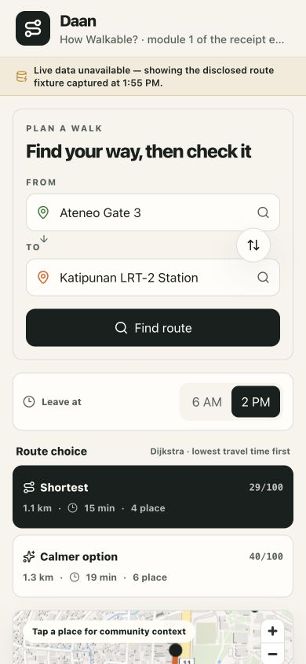
Project Daan
Website Structure
CURRENT STATE · MODULAR DECK
Current product + module map
Team alignment · July 18, 2026

Slide 2
The site can be read as six reusable modules
01 | Product promise
02 | Responsive page map
03 | User and data flow
04 | Component contract
05 | Current gaps
06 | Decisions and next action

Slide 3
Desktop centers the route map
Current composition
Left: place search, departure time and route alternatives.
Center: MapLibre route map and selected-place context.
Right + below: score, coverage, receipt and a route-bound community write path.

Slide 4
The user flow moves from choice to proof
1 · Search places
Combobox suggestions resolve origin and destination to local place nodes.
2 · Compare routes
Shortest and calmer alternatives expose score, time and place count.
3 · Inspect context
The MapLibre canvas links route geometry to selectable place reviews.
4 · Verify evidence
Receipt projections, answers, votes and replies stay scoped to one route.

Slide 5
Mobile preserves the same hierarchy
Responsive composition
The stack keeps its order: search → alternatives → map → place context → score → receipt → community.
At 390 px, no primary surface disappears or changes meaning.

Slide 6
Three boundaries keep the richer surface honest
What the UI proves
The site now supports place search, route alternatives, a live MapLibre canvas and route-bound answers, votes and replies. Route planning and evidence still come from local graph and fixture contracts; community writes stay browser-local.
Deterministic route
Dijkstra plans the local graph; 33 route and community tests pass.
Map is context
Live tiles show where; the scored receipt still owns why.
Community is scoped
URL state and projections bind every report, vote and reply to route context.

Slide 7
One RoutePlan coordinates four surface zones
Shared contract
App owns route selection while RoutePlan carries path, receipt and thread data. Community URL state scopes route, segment, thread, report and reply; the repository owns browser persistence.
Surfaces stay separate; route truth stays shared.
Control
RouteSearch + RouteAlternativePanel
Map
MapCanvas + NodePanel
Receipt
Score + coverage + path + segment receipt
Community
CommunityPanel + repository + URL state

Slide 8
The surface is broader; live evidence adapters remain the gap
Current state versus next integration
The website now demonstrates search, alternative routing, a live map, a scored receipt and a complete browser-local community loop. Production readiness still depends on replacing local planning, evidence and persistence adapters without breaking those boundaries.
WORKING NOW
Search, MapLibre, reports, replies, votes, karma, URL state and receipt projections.
NOT IN THIS SCAFFOLD
External geocoder, live route/evidence API, server persistence, identity or rewards.
Lint + build pass
33 tests pass
Fallbacks remain visible
Live collectors
Moderation + privacy gates
Map bundle hardening

Slide 9
Team alignment protects the receipt spine
Keep the four surface zones stable while live adapters mature.
Decision boundary
Treat search → map → receipt → community as the contract test. Map tiles provide navigation context; score claims still come from route evidence. Browser persistence proves the interaction model, not production trust.
If time compresses, preserve the receipt spine first.
Keep one receipt engine
Replace local planning behind planRoute
Treat map tiles as context, not evidence
Keep fallback disclosure
Promote local writes only behind trust gates

Slide 10
Integrate in three controlled steps
Freeze the surface
Lock search, map, receipt, community, URL and failure-state contracts.
Replace adapters
Wire geocoding, routing, evidence and persistence behind stable contracts.
Promote write paths
Move local reports to authenticated storage after moderation, privacy and proof gates.
NOW
NEXT
THEN

Slide 11
Change the source,
keep the receipt
PROJECT DAAN · CURRENT STRUCTURE
TEAM ALIGNMENT · JULY 18

