Slide 1
gpp_graphs.sql
File created on: 11/30/24 10:10:25 PM CST

Slide 2
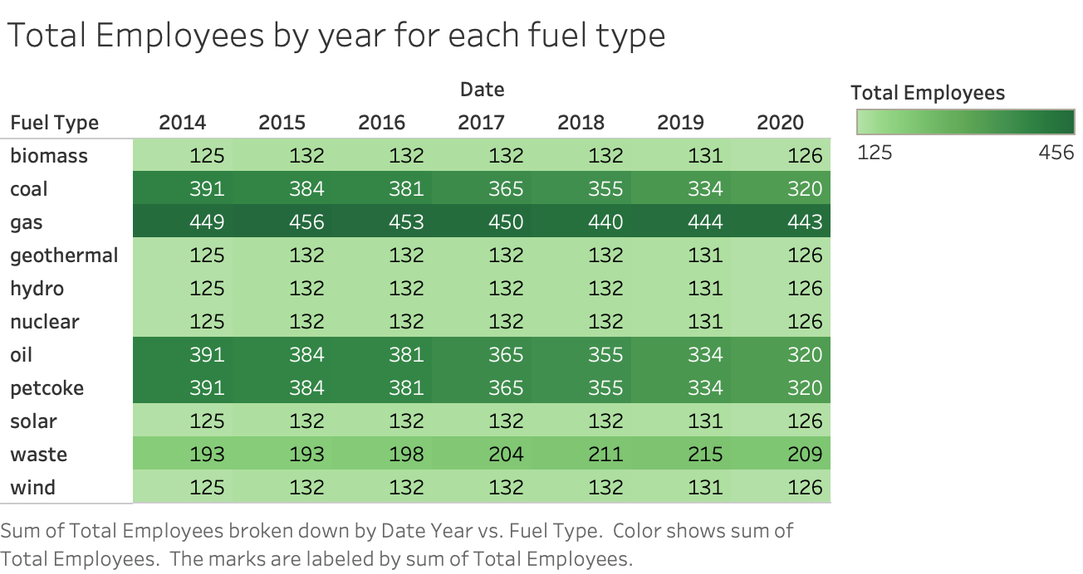

Slide 3
